Slide 1
PROGRESS REPORT OF THE PRESIDENTIAL TASK TEAM (PTT) ON MILITARY VETERANS 1 December 2021 PCODMV

Slide 2
PRESENTATION LAYOUT
Purpose
Introduction
8 Work-Streams and their Purpose
Progress made to date on issues raised by military veterans and the Consensus Document

Slide 3
PURPOSE
To provide an update and progress made in redressing the challenges faced by military veterans and those who marched to in November 2020

Slide 4
INTRODUCTION
The PTT on military veterans has committed to continuous engagements with military veterans in a bid to resolve issues raised during various interactions with military veterans since November 2020.
The PTT committed to work with all spheres of governments in accelerating the much needed service delivery to military veterans.
Subsequently, the PTT has started provincial visits in fulfilling the commitments.
Since the start of the engagements with different Military Veterans Associations, the PTT employed the Technical Task Team to establish Work-streams for the implementation of the issues contained in the consensus document.
A lot of work has been done and this report entails the progress thereof.

Slide 5
8 WORK-STREAMS AND THEIR PURPOSE
# | WORK STREAM | PURPOSE
 | Legislative Review and Governance | To develop implementation plans aimed at addressing the policy and legislative issues raised by the Military Veterans.
 | ii. Organization Redesign | To align the DMV structure to its legislative mandate, strategy and business processes.
 | iii. Socio Economic Support | To facilitate meaningful interaction with the social cluster and facilitate the identification of short to medium and long term programmes of government to benefit MV’s.
 | iv. Database Verification, cleansing, enhancement and ICT | To implement a project plan for an accelerated completion of the verification process. The DMV to accelerate the implementation of the Integrated Database Management System.
 | v. Heritage and memorialization | To facilitate collaborative research of best practices with relevant countries around matters of heritage and memorialization of liberation veterans.
 | vi. Pension and Benefits | To finalise the Pension policy, review and update the pension actuarial enquiry undertaken by the DMV in 2014 in order to determine the appropriate Military Veterans quantum in line with inflation.
 | vii. Communications | To ensure that communication and engagement are harnessed effectively throughout the period of the Presidential Task Team.
 | viii. Land and Agriculture (PTT must approve and appoint this workstream) | To work with the Department of Agriculture, Forestry and Fisheries and the Department of Rural Development & Land Reform for the provision of Land and Agriculture interventions to the Military Veterans.

Slide 6
# | ISSUES RAISED BY MILITARY VETERANS AND THE CONSENSUS DOCUMENT | RESPONSE BY THE WORK-STREAM | DMV PROGRESS TO DATE | TIMEFRAME
LEGISLATIVE REVIEW AND GOVERNANCE WORK STREAM | LEGISLATIVE REVIEW Review the definition of the Military Veteran Policy shift towards NSF members Provision of the Healthcare benefit to the dependents of Military Veterans Means test Inclusion of dependents and widows as beneficiaries in the housing benefit Inclusion of dependents and widows in the burial benefit | Amend the Military Veterans Act | Draft Bill is in place waiting to be consulted with the Ministry, PTT, government clusters, Gazette for public comments, Cabinet and Parliament The Draft Bill was submitted to the Minister | May 2022

Slide 7
# | ISSUES RAISED BY MILITARY VETERANS AND THE CONSENSUS DOCUMENT | RESPONSE BY THE WORK-STREAM | DMV PROGRESS TO DATE | TIMEFRAME
LEGISLATIVE REVIEW AND GOVERNANCE WORK STREAM | GOVERNANCE Conference of SANMVA | Transitional model for accessing funds to be developed Registration of Military Veterans member association Develop Guidelines for Recognition of membership by the Executive Authority | DMV has developed the transitional model for funding for military veterans associations. Freedom Park was identified as an institution to assist until the end of the financial year. SANMVA conference to take place to give way for the new elected leadership Draft guidleines for the registration of member association have been developed and still to be consulted with the Ministry Guidelines were gazzetted in 2015 | Finalized in October 2021

Slide 8
# | ISSUES RAISED BY MILITARY VETERANS AND THE CONSENSUS DOCUMENT | RESPONSE BY THE WORK-STREAM | DMV PROGRESS TO DATE | TIMEFRAME
ORGANISATIONAL REDESIGN WORK STREAM | Establishment of the separate Ministry Position the Department in the Presidency National, Provincial and Regional footprint | It was suggested that the DMV should align the department to its Mandate | The DMV has its own: budget vote, Vote 26, Strategic Plan 2020-2025 and its own Annual Performance Plan Service Delivery Model finalized. Draft functional structure developed, awaiting the finalization of the amendment of the Bill to ensure that the final structure responds to the mandate Draft functional structure has been developed, awaiting to be confirmed once the amendment of the Bill is finalized in order to align with the new mandate GTAC has been appointed to assist the department to confirm the proposed structure and to cost the implications of implementing the proposed structure | May 2022
 |  | The Department has established provincial offices – fully capacitated and adequately staffed. | Department currently has 169 approved posts in the 2010 approved establishment - 19% (SMS). Department had 90 contract workers as at 31 March 2021, mostly below level 9. The DMV has partially addressed capacitating provinces by appointing provincial coordinators. 6 Provincial coordinators have been appointed at the Deputy Director level. 3 posts are vacant (NC, WC, KZN). The intention is to elevate these posts to Director level with the reviewed structure. | May 2022

Slide 9
# | ISSUES RAISED BY MILITARY VETERANS AND THE CONSENSUS DOCUMENT | RESPONSE BY THE WORK-STREAM | DMV PROGRESS TO DATE | TIMEFRAME
ORGANISATIONAL REDESIGN WORK STREAM | The role of the provinces in supporting the military veterans | Suggested that the DMV work should find itself in Offices of the Premiers for support from all provincial departments | The efforts of institutionalizing the relationship between the DMV and the three spheres of government including state-owned entities is on-going Protocol agreements are being signed with Provincial departments (2 already in place – GP and EC with Offices of the Premiers) Protocol Agreements to be tabled at the Presidential Coordinating Council – The framework has been finalized and ready for presentation to the PTT. | 2022/23 – 2025/26 (MTEF)

Slide 10
Some of the issues raised in the consensus document that require noting and further discussions
Best positioning of the Department in the Presidency

Slide 11
# | ISSUES RAISED BY MILITARY VETERANS AND THE CONSENSUS DOCUMENT | RESPONSE BY THE WORK-STREAM | DMV PROGRESS TO DATE | TIMEFRAME
SOCIO-ECONOMIC SUPPORT WORK STREAM | Social Relief of Distress Immediate payment of the COVID-19 Unemployment Top up grant for Military Veterans | The DMV must take into consideration the means test when implementing SRD SRD payment requires Social Worker assessments. DMV must increase capacity to speed up assessments DMV must speed up the top-up payment. | Challenges with Social worker assessments – DMV has no capacity in this regard DMV wrote a letter to DSD regarding 20 000 food parcel for Military Veterans The payment of the R850 to up grant continues for the approved beneficiaries of the SASSA R350 beneficiaries The grant was first approved to be provided for a period of 6 months, but was subsequently extended for a further 3 months in 2020/21 financial year. In February 2021, the President of SA, promulgated another 3 months extension of the R350 grant. The extension meant that each military veterans who met the criteria, should receive the benefit for 12 months which amounts to a total of R10 200.00 each. To date 1058 Military Veterans have been provided with the benefit. A total amount of R8,9 million has been paid to military veterans since inception of the top-up benefit. | Ongoing

Slide 12
Some of the challenges that require noting and further discussions
Challenges with Social worker assessments – DMV has no capacity in this regard
Recommendation is that DMV prepares a Ministerial directive to replace the Social Worker assessments with means test
Way forward: DMV working with DSD on an alternative mechanism of distributing the cash benefit to beneficiaries using DSD infrastructure

Slide 13
# | ISSUES RAISED BY MILITARY VETERANS AND THE CONSENSUS DOCUMENT | RESPONSE BY THE WORK-STREAM | DMV PROGRESS TO DATE | TIMEFRAME
SOCIO-ECONOMIC SUPPORT WORK STREAM | Decent Houses | Amendment of the Act will deal with the Inclusion of dependants and widows as beneficiaries in the housing benefit 80sqm proposal for the houses of Military Veterans must be implemented upon the Amendment of the Bill The Minister of Human Settlements set up a task team to study the feasibility of the the 80 sm Causes conflict amongst communities. Therefore the DMV should align with the policy of human settlement. Resolve the challenges of illegal occupation and quality of houses in places such as Rama City, Aloe Ridge and Belhar | Background: The Department of Human Settlements and its related agencies are responsible for providing housing for Military Veterans. This provision is delivered within the framework of Section 14 of the Regulations to the Act the Memorandum of Understanding (MOU) signed between the Department of Human Settlements (DHS National as well as SLA’s signed between the DMV and the nine provincial Departments of the DHS in 2014. The specifications to the type of house which is 50 m2 have constituted the basis for the implementation of the programme Furthermore, the top up to a house for those who befitted from RDP/BNG houses are yet to be addressed The mortgage/bond rescue stands at R188 000 threshold which the DMV and the DHS are in the process of reviewing | Ongoing

Slide 14
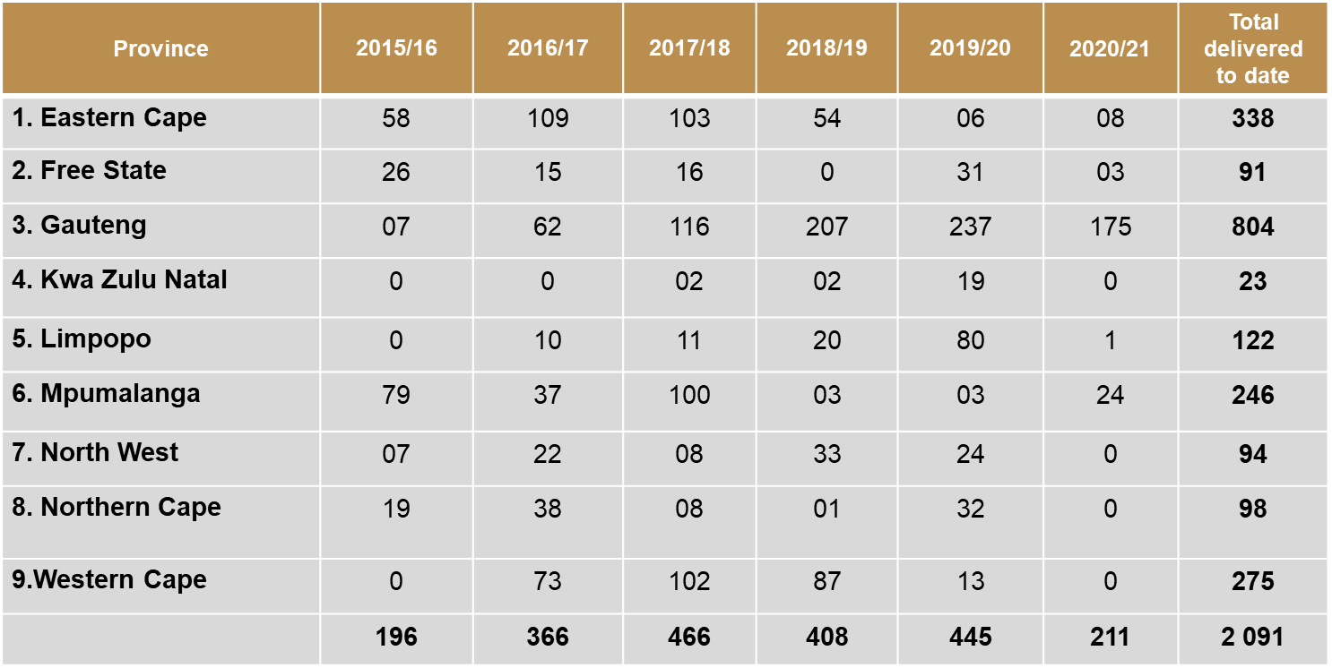
# | ISSUES RAISED BY MILITARY VETERANS AND THE CONSENSUS DOCUMENT | DMV PROGRESS TO DATE
SOCIO-ECONOMIC SUPPORT WORK STREAM | Decent Houses | 2 091 Military Veterans have been provided with houses during the period 2015/16 – 2020/21. Gauteng province accounts for 38% and Eastern Cape is at 16% of total provided houses. KZN is the worst performing province at 1% of total housing provision. Houses provided to Military Veterans from 2015/16 – 2020/21 per province as follows:-

Slide 15
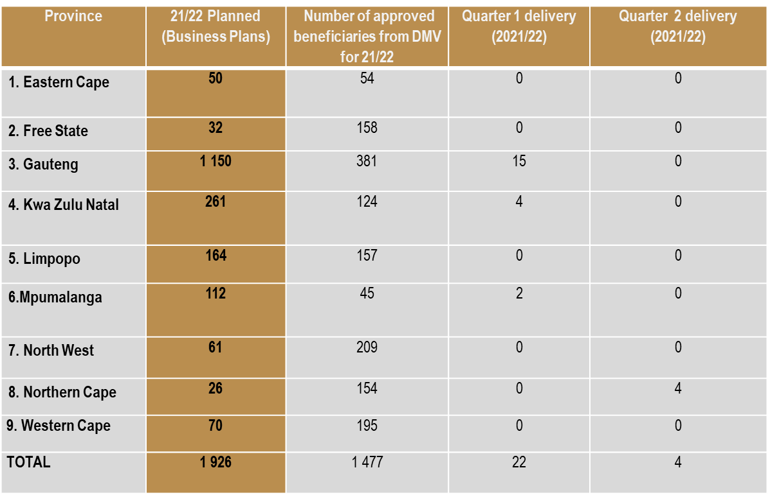
# | ISSUES RAISED BY MILITARY VETERANS AND THE CONSENSUS DOCUMENT | DMV PROGRESS TO DATE
SOCIO-ECONOMIC SUPPORT WORK STREAM | Decent Houses | 2021/2022 planned delivery and approved beneficiaries per province as follows:-

Slide 16
# | ISSUES RAISED BY MILITARY VETERANS AND THE CONSENSUS DOCUMENT | RESPONSE BY THE WORK-STREAM | DMV PROGRESS TO DATE | TIMEFRAME
SOCIO-ECONOMIC SUPPORT WORK STREAM | Decent Houses – Bond rescue |  | Delivery of MVs housing and rescue of distressed mortgages is on-going under the current legislative and regulatory provisions. The DMV has noted in dealing with mortgage bonds above the department threshold. The issue is addressed in the draft amendment Bill. Bond paid is as follows for the past 3 years: EC – 2 FS – 1 Gauteng – 23 KZN – 1 Limpopo – 1 North West – 1 Northern Cape – 1 Western Cape - 24 | Ongoing

Slide 17
# | ISSUES RAISED BY MILITARY VETERANS AND THE CONSENSUS DOCUMENT | REASONS FOR SLOW DELIVERY IN Q1 - Q2 & WORK IN PROGRESS
SOCIO-ECONOMIC SUPPORT WORK STREAM | Decent Houses | Challenges in delivering the 2021/2022 planned houses are as follows: Some of the provinces experience delays in procurement process due to constraints imposed by Covid-19 related lock down working arrangements. There are units currently at various levels of construction in KwaZulu Natal, Free State, Northern Cape and Eastern Cape Provinces. Invasions remains a major challenge – A strategy was proposed to identify the owners before the houses are built to mitigate the invasions

Slide 18
# | ISSUES RAISED BY MILITARY VETERANS AND THE CONSENSUS DOCUMENT | RESPONSE BY THE WORK-STREAM | DMV PROGRESS TO DATE | TIMEFRAME
SOCIO ECONOMIC SUPPORT WORK STREAM | Education Support | A decision was taken to uplift the moratorium on new applications for education support Payment of fees for Military Veterans and Dependents with immediate effect | Letters of Commitments have been issued to approved applicants. The bursary threshold for Basic Education for 2022/2023 financial year will be reviewed to R42 500, as benchmarked with the Department of Education. The involvement and the support of the Provincial Government has been identified a critical success factor. Some provincial department have already started to assist with bulk collection of invoices of learners supported by DMV. GP has lead the way as DMV support more learner from this province. | Ongoing

Slide 19
# | ISSUES RAISED BY MILITARY VETERANS AND THE CONSENSUS DOCUMENT | RESPONSE BY THE WORK-STREAM | DMV PROGRESS TO DATE | TIMEFRAME
SOCIO ECONOMIC SUPPORT WORK STREAM | Provision of Healthcare to dependants | The provision of Healthcare to dependents is awaiting the review of the legislation and the related funding . This implementation is linked to the amendment of the Act and Regulations. Access to other state facilities across all provinces is being investigated | 18 867 Military Veterans have been approved for access to Healthcare since the inception of the benefit,R510M has been paid for healthcare services from 2014 to 2020 Comparative study will be done with Defense for the provision of medical cover similar to that provided to the Former statutory forces from SADF and their families to ensure that provision of healthcare is aligned, preferably support to be given to the Department to source a medical aid cover To date, more than 6300 military veterans have accessed the counselling services since 2013, some through group and individual therapy interventions. Compensation benefit has been implemented since 2015 . 2114 applications have been received to date, however 1084 (51%) did not qualify for assessment. Of the 1030 military veterans who qualified for assessment ,503, qualified for payment after medical assessments were done.427(40%) have been paid, 76 (7%) are still in the payment process. | Ongoing

Slide 20
# | ISSUES RAISED BY MILITARY VETERANS AND THE CONSENSUS DOCUMENT | RESPONSE BY THE WORK-STREAM | DMV PROGRESS TO DATE | TIMEFRAME
SOCIO ECONOMIC SUPPORT WORK STREAM | Provision of Healthcare to dependants | The provision of Healthcare to dependents is awaiting the review of the legislation and the related funding . This implementation is linked to the amendment of the Act and Regulations. | Intervention required from PTT The PTT to advocate for budget review to allow for provision of Comprehensive Medical Aid which will improve access for military veterans (and their dependants). Advantages: Managed healthcare services including preventative care, Seamless claims payments, Case management of high risk patients and referrals and Reduction of interprovincial travelling Review of regulations on compensation payment since the DMV compensation is a once off lump sum payment that has no provision for medical reviews to allow for continuous payment until recovery | Ongoing

Slide 21
# | ISSUES RAISED BY MILITARY VETERANS AND THE CONSENSUS DOCUMENT | RESPONSE BY THE WORK-STREAM | DMV PROGRESS TO DATE | TIMEFRAME
SOCIO ECONOMIC SUPPORT WORK STREAM | Land for farming and human settlement | The DMV must leverage on the recent Department of Agriculture, Rural Development and Land Reform Bill published in a gazette No. 42939 | The DMV will handle the issue of land in the proposed amendments Bill PTT must approve and appoint this workstream | May 2022
 | Subsidisied Public Transport |  | Draft Transport Policy has been developed | Ongoing

Slide 22
# | ISSUES RAISED BY MILITARY VETERANS AND THE CONSENSUS DOCUMENT | RESPONSE BY THE WORK-STREAM | DMV PROGRESS TO DATE | TIMEFRAME
PENSION WORK STREAM | Military Pension should be paid separately from the Special and Gratuity (RM4) Review the Special Pension Act (Act 69 of 1996) | Once off amount of R4m to each Military Veteran was found not to be affordable for Government Pension benefit as prescribed in the Military Veterans Act of 2011 must be implemented as soon as possible | The content of the Pension policy has been finalised by the work stream on a monthly payment High level budget implications has been done Proposal of R6 615 for 2021/22 financial year – linked to Old Age Grant 12 536 Non Statutory Forces members and 9 827 not receiving any Special Pension Preliminary analysis shows a maximum of R66 million per month should all 9 827 qualify for the Pension The DMV to request budget from National Treasury Further budget request analysis and costing is being done by DMV. National Treasury has offered to assist | April 2022

Slide 23
# | ISSUES RAISED BY MILITARY VETERANS AND THE CONSENSUS DOCUMENT | RESPONSE BY THE WORK-STREAM | DMV PROGRESS TO DATE | TIMEFRAME
DATABASE VERIFICATION, CLEANSING, ENHANCEMENT AND ICT WORK STREAM | Database Include with speed Provide benefits Use of force numbers | Process must be representative of military veterans from all formations 2 additional personnel proposed to the verification panel as at end of September 2021 to increase capacity The challenges regarding the payment of verification panel members has been partly resolved as at end of September 2021 The equipment to assist the panel with recording is in the process of being procured | A panel of verification has been established chaired by Major-General (ret) Mashoala. Total number of processed applications as at 8 October 2021 – 2 277 No of Applicants who were invited but never appeared – 327 No of applications re-routed to DMV due to application not meeting the requirements for verification - 2 Application whose verdicts had to be withheld due to panel making further investigation – 29 | Ongoing

Slide 24
# | ISSUES RAISED BY MILITARY VETERANS AND THE CONSENSUS DOCUMENT | RESPONSE BY THE WORK-STREAM | DMV PROGRESS TO DATE | TIMEFRAME
DATABASE VERIFICATION, CLEANSING, ENHANCEMENT AND ICT WORK STREAM | Database Include with speed Provide benefits Use of force numbers |  | No of Applicants not recommended (119 are SDUs and 172 are declined) – 291 No of recommended Applicants (Internal Operatives and Ex-Political Prisoners) – 59 Prospective Applicants, reported to be unreachable – either contact details provided have changed or they are deceased – DMV made contact – 377 Total No of Untraceable Applicants – With no contact details – 1192 | Ongoing
 | ICT | Development of the IDMS | The IDMS proposal has been approved. The registration module of the IDMS is on testing phase and will be implemented in Q3. The system will incorporate the registration to the Military Veterans database and registration to all the 11 benefits. | Ongoing

Slide 25
Some of the challenges that require noting and further discussions
Reimbursements of S&T related money used by panel members – The department is still looking at the best process to implement such. The DMV will advise in due course
Remuneration of Mr Moopeloa – Mr Moopeloa was appointed as a panel member by a Ministerial directive of November 2020. His remuneration was determined at the level at which he was appointed using National Treasury regulations. He is not satisfied with the payment at such a level and requires a higher payment. The DMV is still exploring how to best manage this permissible prescripts.

Slide 26
# | ISSUES RAISED BY MILITARY VETERANS AND THE CONSENSUS DOCUMENT | RESPONSE BY THE WORK-STREAM | DMV PROGRESS TO DATE | TIMEFRAME
SKILLS DEVELOPMENT AND EMPOWERMENT WORK STREAM | Socio-Economic Integration Military veterans must participate in socio economic activities | Ensure that MV participate in all government Programs that can create jobs, business and Entrepreneurship opportunities. | DMV has priorities the infrastructure programme amongst others. The DMV has purchased 90 pothole machines that are meant to support the road maintenance programme. Each province will be receiving 10 that will be used as part of on the job training. DMV will be signing an MOU with DoD for military veterans to pilot the maintenance of roads in the Defense Force Complexes. Partnerships: LGSETA- MOU signed SANRAL Draft MOU finalized to be signed once ratified by SANRAL BOARD Road Traffic Management Corporation (RTMC) – under consultation. COGTA finalized aligned with DDM. SASSETA- MOU consultation in progress. SANPARKS- MOU under consultation. Agriculture: Joint programme with DOD on agriculture Food for hunger home garden programme at a planning stage and oceans economy is at consultation stage. Department of Small Business Cooperatives Training Climate Change consultation document on waste management and space shuttle interventions finalized. | Arrived on the 14th October

Slide 27
# | ISSUES RAISED BY MILITARY VETERANS AND THE CONSENSUS DOCUMENT | RESPONSE BY THE WORK-STREAM | DMV PROGRESS TO DATE | TIMEFRAME
SKILLS DEVELOPMENT AND EMPOWERMENT WORK STREAM | Socio-Economic Integration | Empowerment and skilling of Military Veterans The DMV seek strategic partners to ensure the empowerment and skilling of military veterans | The DMV will be seeking to meet the private sector companies in mining, and motor industry terms of the participation of military veterans in 30% set aside for previously disadvantaged groups. Partnership with SITA and the National Electronic Media Institute of South Africa (NEMISA) to provide Digital Literacy to the 5000 military veterans’ youth. The programme will focus on computer literacy, technical ICT skills, graphic design, radio, film and television etc. The rollout plan will be provided and the MV database will be used for selection purposes. All provinces will be catered for. Post training, the MV youth will be provided with opportunities for business and employment at the DMV, SITA and their partners. | Ongoing

Slide 28
# | ISSUES RAISED BY MILITARY VETERANS AND THE CONSENSUS DOCUMENT | RESPONSE BY THE WORK-STREAM | DMV PROGRESS TO DATE | TIMEFRAME
SKILLS DEVELOPMENT AND EMPOWERMENT WORK STREAM | Socio-Economic Integration | Empowerment and skilling of Military Veterans The DMV seek strategic partners to ensure the empowerment and skilling of military veterans | A letter for partnership has been written to the services SETA to excess their Business Entrepreneurship training for Military Veterans In this partnership DMV has requested provision of containers for Military Veterans to start up their business. It may businesses like Internet Café’s, Spaza shops, Tyre fitment Centres, Bed and breakfast, Hair salons, Bakeries, Appliances workshops, cellular accessories shops DMV has also agreed with the Department of Social Development on a Food Parcel Programme and a Comprehensive programme that will focus on short term, medium term and long term development programme | Ongoing

Slide 29
# | ISSUES RAISED BY MILITARY VETERANS AND THE CONSENSUS DOCUMENT | RESPONSE BY THE WORK-STREAM | DMV PROGRESS TO DATE | TIMEFRAME
HERITAGE AND MEMORIALISATION WORK STREAM | Heritage Repatriation of remains Erection of monuments in host countries Memorialization of fallen heroes | DMV in partnership with the Department of Sport, Arts and Culture and other relevant institutions Repatriation Policy Discussion of Implementation Plan in circulation Repatriation of the remains of fallen heroes | On-going engagements are being held with the Departments of Arts and Culture and its agencies such as SAHRA, NHC, and Freedom Park. An MOU will be put in place between the two departments DMV to establish a committee headed by the office of the DM Consultation process with the DMV, Families, Reps from formations, Department of sport arts and culture, the relevant ambassadors and other interested parties. | Ongoing
 | Unity and Diversity | DMV to partner with the DASC in order to be integrated to Moral Regeneration, Nation Building Programmes | DMV and DOD, Arts and culture to develop a strategy and implementation plan. DMV to align its strategy with the national strategy on Moral Regeneration | 2022

Slide 30
# | ISSUES RAISED BY MILITARY VETERANS AND THE CONSENSUS DOCUMENT | RESPONSE BY THE WORK-STREAM | DMV PROGRESS TO DATE | TIMEFRAME
PRESIDENTIAL PARDONS AND EXPUNGEMENTS | Presidential Pardons and expungements of political and criminal records | Department of Justice and Constitutional Development are the custodians of presidential pardon and expungement | The DMV is awaiting guidance from the Department of Justice and Constitutional Development. | Ongoing

Slide 31
COMMUNICATIONS AND PROVINCIAL ENGAGEMENTS
The DMV is currently utilizing the following tools to communicate with Military Veterans:
Social Media: WhatsApp, Facebook
DMV website
Booklets, Military Veterans Benefits flyers
Regarding provincial engagement
3 Provinces (EC, GAUTENG, LIMPOPO) have been visited by the work stream – (2 virtual and 1 physical)

Slide 32
Thank You

