Slide 1
^{when the sun rises}
^{we work hard to deliver}
RESPONSES TO NATIONAL COUNCIL OF PROVINCES ON PROGRESS REPORT INTERVENTIONS IN TERMS OF S106 OF THE LOCAL GOVERNMENT MUNICIPAL SYSTEMS ACT, 2000, IN DR PIXLEY KA ISAKA SEME, GOVAN MBEKI, LEKWA AND DR JS MOROKA LOCAL MUNICIPALITIES

Slide 2
PURPOSE
To respond to the National Council of Provinces comments on the progress reports on interventions in Lekwa, Dr Pixley Ka Isaka Seme, Govan Mbeki, and Dr JS Moroka, local municipalities, in terms of S106(1)(b) of the Local Government : Municipal Systems Act, 2000.

Slide 3
BACKGROUND AND INTRODUCTION
The findings of the S106 (1)(b) (1)(b) of the Local Government : Municipal Systems Act, 2000 will be implemented in short term, medium term and long term.
Dr Pixley Ka Isaka Seme LM has made significant progress implementing the recommendations, followed by findings Govan Mbeki.
The process has been slow in Lekwa and Dr JS Moroka LM. The Administrator in Lekwa has committed to prioritizing the implementation of the report.
The matters of slow implementation of the investigation reports will also be raised with the TROIKAs of the new councils In Lekwa and Dr JS Moroka municipalities.
What have municipalities done after receiving the reports.
All the affected municipalities developed action plans to respond to the findings. These action plans were tabled and approved by the respective councils.
The department guided the municipalities on the development of the action plans. The department monitors the implementation of the action plans quarterly .

Slide 4
BACKGROUND AND INTRODUCTION
Resolved Matters
When a matter is resolved it means according to the remedial action the municipality has indicated on the action plan, the activity has been accomplished.
In progress Matters
These are matters that according to the remedial action the municipality has indicated on the action plan, the activity is still work in progress. The department monitors progress on these on a quarterly basis.
Unresolved Matters
These are matters that according to the remedial action the municipality has indicated on the action plan, there is no or very little progress that has been made in resolving them. There are matters that the department engages with the municipality to get them addressed.

Slide 5
EXAMPLE OF RESOLVED MATTERS: DR PIXLEY KA ISAKA SEME LOCAL MUNICIPALITY
NO | ALLEGATIONS | FINDINGS | REMIEDIAL ACTION BY MUNICIPALITY | PROGRESS AS SUBMITTED BY MUNICIPALITY | COMMENTS BY DEPARTMENT
01 | Acts of maladministration levelled against the Office Bearers and Employees. (Interference by the Executive Mayor in the Administration of the Municipality.) | The Executive Mayor and some Councillors do interfere in the administration of the municipal council. The Executive Mayor did instruct Mjali Zimema attorneys to act on behalf of the Municipality. The instruction by the Executive Mayor was unlawful and the payment to Mjali Zimema Attorney’s was therefore irregular. As a result of the unlawful instruction and the irregular payment, the municipality incurred a loss of R194, 828.50 in legal fees | Training to be provided to councillors and municipal staff on roles and powers In relation to the R194 828.50 the municipal council to discuss this matter and take the necessary action to reprimand the Executive Mayor for him not to commit similar conduct in future. | That the training of the office bearers/ all Councillors on Roles and Responsibilities of Councillors. Training took place on the 04/03/2021. The council committee established to investigate the matter has exonerated the Executive Mayor. It found that the Executive Mayor acted lawfully when he instructed the attorneys to act on behalf of the municipality as per his delegations | The municipality has resolved this finding. (Resolved) The municipality has resolved this finding. (Resolved)

Slide 6
EXAMPLE OF RESOLVED MATTERS :DR PIXLEY KA ISAKA SEME LOCAL MUNICIPALITY
NO | ALLEGATIONS | FINDINGS | REMIEDIAL ACTION BY MUNICIPALITY | PROGRESS AS SUBMITTED BY MUNICIPALITY | COMMENTS BY DEPARTMENT
03 | Non-implementation of Municipal Council Resolutions/wrong resolutions are passed | Council resolutions are not implemented, some are partly implemented and in some instances resolutions are taken without following correct procedures. | Council to establish a Special Committee to monitor the resolution register. | Mayoral Committee and oversight committees of Council are briefed on the implementation of the Council Resolutions monthly The MM and the Manager: Legal attend all Council meetings and are given opportunity to advise council | The municipality has resolved this finding. (Resolved)

Slide 7
EXAMPLE OF MATTERS IN PROGRESS :DR PIXLEY KA ISAKA SEME LOCAL MUNICIPALITY
NO | ALLEGATIONS | FINDINGS | REMIEDIAL ACTION BY MUNICIPALITY | PROGRESS AS SUBMITTED BY MUNICIPALITY | COMMENTS BY DEPARTMENT
02 | Irregular Payments of Overtime | The allegation is substantiated. In some instances people work more hours per day in excess of what the law and the policy stipulates. The municipality must adhere to the overtime policy and applicable legislation | Municipality must adhere to overtime policy and applicable legislation | Managers to report on all overtime monthly. The Top Management monitors the implementation of the policy. | The municipality has made progress in addressing this finding. (In progress)
 |  | Vacant positions b filled as a matter of urgency | Vacant posts must be filled as the high vacancy rate led to the abuse of overtime. | Prioritization of the filling of posts is dependent on the financial position at the time, for the Municipality Fill all vacant funded posts | The municipality has made progress in addressing the finding. (In progress)

Slide 8
EXAMPLE OF MATTERS IN PROGRESS :DR PIXLEY KA ISAKA SEME LOCAL MUNICIPALITY
NO | ALLEGATIONS | FINDINGS | REMIEDIAL ACTION BY MUNICIPALITY | PROGRESS AS SUBMITTED BY MUNICIPALITY | COMMENTS BY DEPARTMENT
04 | Underspending of MIG funds | The resolution of the municipality to implement the MIG funded projects internally resulted in Mr Mpangeva, the PMU Manager registering on the system as the contractor and the consultant. Mr Mpangeva was a referee and a player at the same time and this led to the flouting of procurement policies (DPKISLM 7). This he did in contravention of the key principles of MIG Policy Framework, For example; Mr Mpangeva in one of his reports reported that the MIG was utilised 100% and which was not true. The National Treasury picked this up, when the Municipality requested a rollover of R4.1 Million that was not spent. | That council reconsiders its resolution to implement the MIG funded projects internally. The role of the PMU Manager in all the MIG funded projects where he was involved as a contractor and consultant be investigated That disciplinary action be taken against Mr Mpangeva for reporting that 100% of the MIG fund had been spevt when in fact it was not. | Consultants appointed for one year, and the contractors were appointed for the 2020 / 2021 financial year. The Acting MM, Mr. N Mokako appointed to investigate as per the disciplinary code. At a special council sitting on 20 April 2021 the Acting MM was appointed to investigate this matter. On 02 June 2021 Mr Mpangeva was suspended. On 03 August 2021council referred the matter to the Disciplinary Board. The matter is still under the consideration of the Disciplinary Board. | The municipality is making progress in addressing the finding. The municipality has indicated that they are still conducting investigations on the matters. (In progress) The municipality is making progress in addressing the finding. (In progress)

Slide 9
EXAMPLE OF MATTERSIN PROGRESS: DR PIXLEY KA ISAKA SEME LOCAL MUNICIPALITY
NO | ALLEGATIONS | FINDINGS | REMIEDIAL ACTION BY MUNICIPALITY | PROGRESS AS SUBMITTED BY MUNICIPALITY | COMMENTS BY DEPARTMENT
04 | Underspending of MIG funds | The resolution of the municipality to THAT the role of the Municipal Manager in requesting and signing off the letter for the roll-over be investigated. | That the role of the Municipal Manager in requesting and signing off the letter for Roll over be investigated. | The municipality appointed an investigation team to investigate the matter. The report was submitted to council on 20 April 2021. The MM was subsequently suspended and disciplinary processes are currently underway. On 03 August 2021council referred the matter to the Disciplinary Board. The matter is still under the consideration . of the Disciplinary Board. | On 03 August 2021council referred the matter to the Disciplinary Board. The matter is still under the consideration . of the Disciplinary Board. (In progress)

Slide 10
OVERARCHING ISSUES
EXAMPLE OF MATTERS NOT RESOLVED : OVERARCHING ISSUES
NO | ALLEGATIONS | FINDINGS | REMEDIAL ACTION | PROGRESS AS SUBMITTED BY MUNICIPALITY | COMMENTS BY DEPARTMENT
13 | There is total collapse in the Human Settlements Departments particularly with regards to the allocation of stands. | The provincial department of Human settlements conduct a verification process to check if the people living in the houses are the correct beneficiaries | MEC COGTA to engage the MEC for Human Settlement to address the human settlement challenges in the municipality | COGTA has submitted the matter to the Department of Human Settlements and no response has been received. | The matter has not been addressed( not resolved)
 |  | That a meeting between the MECs for COGTA and DCSSL be held to address the conduct of SAPS members in Volkrust in investigating some of the unlawful evections done by Cllrs, municipal officials and SAPS | MEC COGTA to engage the MEC for DCSSL to address the conduct of SAPS in Volkrust | COGTA has submitted the matter to the DCSSL and no response has been received. | The matter has not been addressed. (not resolved)

Slide 11
CONCLUSION
The department has established A Project Steering Committee to monitor the implementation of the S106 investigation reports.
The committee comprises of the following stakeholders:
(i) Provincial COGTA
(ii) National Department of COGTA
(iii) Office of the Premier ( Integrity Management Unit)
(iv) Provincial Treasury
(v) Provincial Department of Community, Safety, Security and Liaison
(vi) Mpumalanga Provincial Protector
(vii) SAPS ( Directorate of Priority Crime Investigations.)
The process of ensuring that all members of the Project Steering Committee are vetted has delayed the functionality of the committee.
All progress reports are presented to the Executive Council for them to note progress and give guidance.

Slide 12
CONCLUSION
Municipalities are submitting quarterly progress reports.
Department will visit municipalities quarterly to verify progress reported by municipalities in addressing the findings of the S106 investigation reports.
The investigation reports will be tabled to the new councils for them to be informed and also monitor their implementation.
The new councils will be expected to give time frames on addressing all findings that have not been addressed.
The department will continue to monitor the implementation of the recommendations of the investigation reports and if such are not being implemented will not hesitate to explore any legal remedies available to it.
Through the legal unit in the department, municipalities will be supported to pursue civil cases against all individuals/ service providers where money must be recouped.
All forensic reports will be handed over to law enforcement agents to pursue further action.

Slide 13
ANNEXURE A : ANALYSIS PER MUNICIPALITY

Slide 14
ANALYSIS: DR PIXLEY KA ISAKA SEME LOCAL MUNICIPALITY
The municipality has made progress in addressing the findings of the S106 investigation report. A number of short term solutions have been addressed.
The municipality has instituted consequence management against officials currently in the employ of the municipality who have been implicated in allegations of wrong doing. The MM has been suspended and is undergoing disciplinary processes and the PMU manager is also on suspension and undergoing disciplinary processes.
The following cases will be reported to Law Enforcement Agents:
The conduct of the PMU manager (Mr Mpangeva) in the awarding of MIG projects
The conduct of the supply chain official ( Mr Hadebe) and the the PMU manager (Mr Mpangeva) in the abuse and non compliance of supply chain management processes, including fictitious quotations and supplies
The selling of RDP houses and empty Stands by Cllr T A Mazibuko

Slide 15
ANALYSIS: GOVAN MBEKI LOCAL MUNICIPALITY
The municipality has made progress in addressing some of the findings. There are still some findings that the municipality has not made any progress on.
Only two findings have been resolved( one by the resignation of the CFO), six are in progress and two have not been addressed.
The municipality has initiated disciplinary processes against the following implicated officials.
Adv TM Gininda
M H Ramoleta
Mr S Rasmeni
Mr TI Phungwayo
Mr E Mkhompe
Mr S Mokoena
The municipality must also take action against former officials and councillors who are implicated in wrong doing but have left the institution.
The action being taken against service providers implicated in wrong doing is very lacklustre
The municipality has reported cases of fraud and corruption to the HAWKS and these are being investigated.

Slide 16
ANALYSIS: GOVAN MBEKI LOCAL MUNICIPALITY
The following cases have been reported to Law Enforcement Agents by the Municipality:
Corrupt relationship between councillors, officials and service providers.
Non compliance to supply chain processes leading to irregular appointment of service providers, illegal extension of contracts etc.
Abuse of and non-compliance to supply chain management processes. There are findings of deviations on projects and irregular expenditure.

Slide 17
ANALYSIS: LEKWA LOCAL MUNICIPALITY
The municipality has made progress in addressing some of the findings, however there are some findings that municipality has not addressed. 04 of the findings have been resolved by the municipality, 05 are in progress and they have not processed 02 of the findings.
The administrator has committed himself to ensuring the implementation of the S106 investigation report.
Law enforcement agents are investigating the allegations of impropriety in the municipality.
The following cases will be reported to Law Enforcement Agents:
Irregular appointment of service provider for the compilation of the General valuation roll and the extension of the existing General Valuation Roll
Non compliance to SCM processes and irregular appointment of service providers PMU manager and the former MM
Irregular appointment of Thaphiwe Logistics and Calandra Trading 621 PTY LTD JV
Non compliance to the Municipal Supply Chain Management Regulation 32 on appointments done using this regulation i.e. The appointment of Nako Liso Consulting, Tarcron PTY LTD,

Slide 18
ANALYSIS: DR JS MOROKA
The municipality has not addressed any of the findings of the S106 investigation report. The municipality has shown poor commitment to address the findings of the S106 investigation report.
There are no civil/ criminal proceedings that have been instituted against individuals implicated in impropriety to recover lost funds.

Slide 19
ANALYSIS: DR JS MOROKA
The following cases will be reported to Law Enforcement Agents:
Acts of nepotism in the Irregular employment of Ms K Sekwala the daughter of Cllr M Sekwala; appointment of Ms S Nkoana and Ms G Ntuli wives of Cllr Madonsela and the appointment of Ms M Maja wife of Cllr Ntlailane
Abuse and Non compliance to the Municipal Supply Chain Management Regulation 32 on appointment of service providers resulting in fictitious invoices being submitted without services being rendered.
Irregular extension of contracts. Matapunuka Trading CC’s contract was extended irregularly and there were acts of fraud as the extension letter was backdated
Irregular appointment of internal audit service provider
Irregular appointment of two security companies : Sidas and Matimpule Security Services
The R40 million spent on the construction of a fresh produce market that was never completed
R18 million spent for boreholes on drought relief projects with some boreholes being drilled in homes of councillors and officials if the municipality

Slide 20
ANALYSIS: DR JS MOROKA
The following cases will be reported to Law Enforcement Agents:
Abuse of municipal petrol cards / fleet by officials
Irregular awarding of bursaries to Ms P Riba and Ms M Bhoshomane

Slide 21
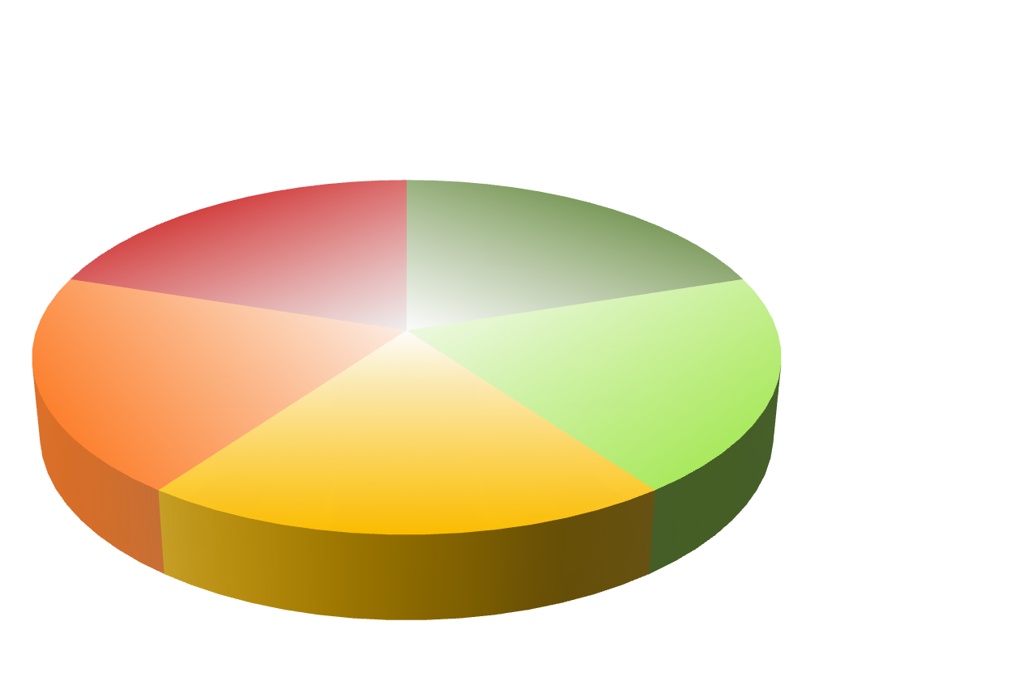
Thank You

