Slide 1
PROGRESS UPDATE ON THE IMPLEMENTATION OF BROADCASTING DIGITAL MIGRATION TO PORTFOLIO COMMITTEE ON COMMUNICATIONS
18 November 2021

Slide 2
Contextual Background – Revised Delivery Model
On 29 September 2021 Cabinet approved the revised integrated Analogue Switch off (ASO) implementation plan to be achieved through the four key principles; namely:
  Principle 1: Adoption of an expedited analogue switch-off approach at national level over a period not exceeding 31 January 2022
    simultaneously terminating analogues transmission services in all provinces.
  Principle 2: Adopt a Managed Integrated Model (MiM) with all media players contributing towards connecting households during analogue switch-off.
  Principle 3: That all households registered by the 15th of October 2021 will be connected during analogue Switch-Off process, and households registered thereafter will be connected within 3 to 6 months period.
  Principle 4: Allocate devices distribution and installation to Broadcasters and platform operators based on confirmed capacity,
    and where STB Installations from one entity lacks behind, households will be re-allocated through statistical allocation approach.

Slide 3
Contextual Background – Enabling Delivery (Governance and Accountability)
Following the Cabinet approval, the Minister of Communications and Digital Technologies had subsequently:
  Established a Project Steering Committee to oversee the implementation of the Digital Migration comprised of.
    Parties that are involved in the implementation of the programme
    Parties to be affected by the Analogue Switch Off process.
  Mandated department, entities and stakeholders to align plans to the analogue switch off plan.
  The project implementation is underway in line with the four principles of the implementation plan.

Slide 4
ASO Model
3

Slide 5
Awareness Campaigns
    The Steering committee approved Communications and Awareness strategy during October.
    Currently running national messaging on analogue receiving televisions
    Minister’s media briefing on the 5th of October 2021
    Minister’s live engagements on Morning Live, and 10 radio engagements.
    Live reads on 106 community radio stations across the country.
    Script translated to all 11 official languages
    Live reads on all African language stations on SABC ,PSA on S 1,2,3 and Social media activation
    Minister’s awareness campaigns in the Eastern Cape, Free-State, North-West and Limpopo
2

Slide 6
STB Registrations and Data Management System
Following the previous cabinet meeting, the Minister made a national call for STB registrations to improve number of eligible households.
STB registrations are improving nationally, as at the end of October we recorded 48,453 new registrations bringing the total number of registrations to 1,228,879.
For the first two weeks of November, over 30 000 new applications were recorded.
2

Slide 7
STB Installations
STB Installations are underway in the 4 provinces of the Northern Cape, North-West, Limpopo and Mpumalanga. Installers are still active in the Free-State province to conclude new registrations.
Sentech’s is ramping up installer capacity for the remaining provinces, and National Treasury has recently approved the use of Broadcasters and Telkom in line with PFMA: Supply Chain Management Regulations
We have Installed STBs in Northern Cape to enable provincial switch-off
2

Slide 8
Analogue Switch Off
The project has managed to conclude analogue Switch-off in the Free-State province at the end of October in accordance with the plan without TV black-outs.
Project has reached the required Installation threshold to conclude analogue Switch-off in the Northern Cape Province.
The project is also on track to switch-off North West in line with the approved Plan.
To date, 113 analogue transmitters have been switched off compared too 105 when Cabinet approved the revised Plan.
2

Slide 9
Summary of Analogue Services Switched Off
 | NATIONAL HIGH LEVEL ASO SUMMARY as at November 2021
 | PROVINCE | SABC ASO STATUS |  |  | ETV REMAINING
 |  | ASO | REMAINING | TOTAL
 | FS (1*) | 22 | 0 | 22 | 8
 | NC (15*) | 46 | 2 | 48 | 1
 | NW | 21 | 6 | 27 | 6
 | MP | 10 | 13 | 23 | 9
 | LP | 14 | 21 | 35 | 4
 | EC | 0 | 51 | 51 | 13
 | KZN | 0 | 43 | 43 | 18
 | WC | 0 | 53 | 53 | 20
 | GP | 0 | 12 | 12 | 12
 | TOTALS | 113 | 202 | 314 | 91
 | * indicates ASO pre March 2021

Slide 10
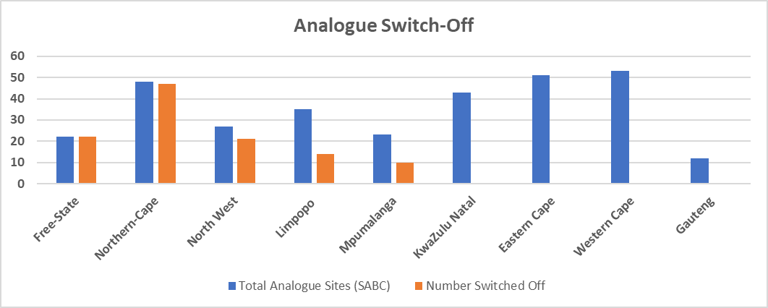
Analogue Switch Off
FS province has been completed
NC last site switch off approved. Switch-off event planned for 26 Nov 21.
STB registration and installations commenced in Limpopo and Mpumalanga.
Household registrations continuing and ramping up installer capacity
2

Slide 11
Analogue Switch Off Plan – Towards successful migration
In line with 29 September 2021 Cabinet Decision, analogue switch off is targeted to be achieved as follows:

Slide 12
After Market Support
The aftermarket support plan has been approved by the BDM steering committee on the 22nd October 2021.
The objective of the plan is ensure that registered households are supported in all languages during and after STB installation process.
  The existing Call Centre within Sentech is being transitioned to the After-Market Support Centre and engagements are ongoing with SABC.
The call centre is operational with a call and whatsapp contact numbers.
2

Slide 13
Plans for November 2021
  Drive Households registrations
    In collaboration with provincial governments, district and local municipalities
    Accelerated Awareness and Communications campaign
  Finalize the Master-SLA with all the Stakeholders
    To ensure project governance and accountability
  Elevate Communication & Awareness Campaign Implementation
  Finalize the allocation delivery & funding model with Broadcasters
    To commence with the distribution to qualifying registered households
  Finalize the engagements with National Treasury for deviations to be authorized

Slide 14
Critical Success Factors
Timeous approval of deviation by National Treasury to ensure effective governance.
Timeous conclusion of SLAs / MOUs with entities to ensure accountability.
Timeous decoder availability accompanied by efficient distribution and installations by the newly formed collaboration with broadcasters
Impactful communications and media engagement interventions.
Full collaboration of provincial governments, district and local municipalities

Slide 15


