Slide 1
CRL Rights Commission
Presentation to the
Portfolio Committee on Cooperative Governance and Traditional Affairs – CRL Rights Commission Annual Report 2020/2021
23 November 2021

Slide 2
Presentation Outline
Audit Outcomes
Part A: CRL Rights Commission 2020/2021 Performance on Predetermined Targets
Overview: Strategy Plan 2020/2021 Outcomes and Outcome Indicators
Impact Statement
Our Vision, Mission and Values
MTSF Priorities
Performance on the 2020/21 Outcomes, Outcome Indicators. Outputs, Output Indicators and Targets per programme
Part B CRL Rights Commission Financial Performance
2020/2021 Appropriation Statement per programme and Economic Classification
Reasons for underspending
Irregular Expenditure Audit Outcomes
Part C District Development Model and Human resources related matters
1. District Development Plan
2. Capacity and Capability Review Project Update

Slide 3
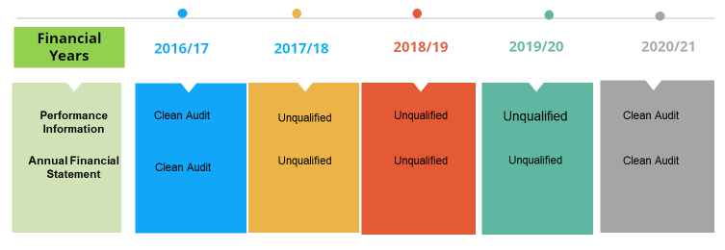
Audit Outcomes 2016/17-2020/21

Slide 4
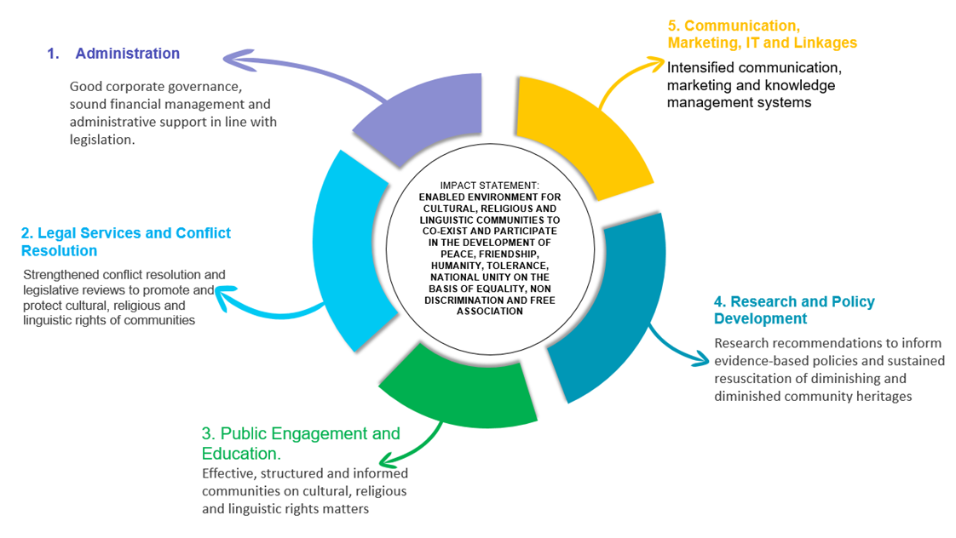
Strategy Plan 2020/2021 Impact Statement, Programmes and Outcomes

Slide 5
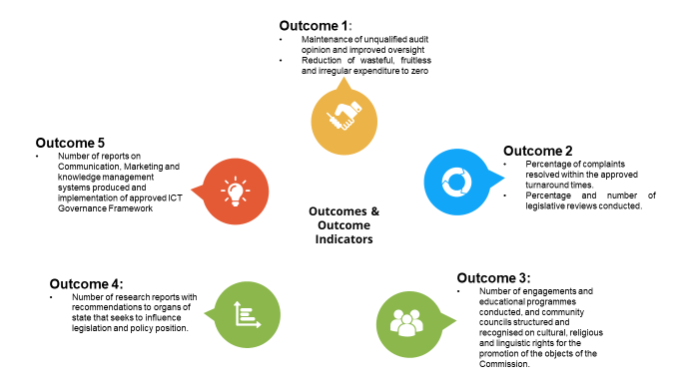
Overview Strategy Plan 2020/2021 Outcomes and Outcome Indicators

Slide 6
Our Vision, Mission and Values
VALUES | DEFINITION
Transparency | Committed in being open and honest in conduct at all times when embarking in organizational operations
Professionalism | Committed to uphold high standard in self-conduct, self-presentation and adherence to the workplace policies and procedures
Responsiveness | Committed to understand the organizational, contextual and job demands to ensure the provision of appropriate service, rendered on time in order to uphold the organizational mandate
Accountability | Committed to take full responsibility of decisions, conduct and actions in the workplace, and ensure to support and assist colleagues to uphold the same
Integrity | Committed to and firm adherence to the code of conduct and ethics as prescribed by the organizational policies and procedures
Impartiality | Committed to unbiased, fair play and conduct in all the dealings with colleagues, partners and other stakeholders in the workplace
Respect | Committed to actions of treating colleagues, partners and other stakeholders with appreciation and dignity at all times
Mutual Respect amongst diverse cultural, religious and linguistic communities
Mission
To foster rights of cultural, religious and linguistic communities to freely observe and practise their culture, religion and language

Slide 7
MTSF Priorities
The Commission Subscribe to the following Medium Term Strategic Framework (MTSF)
Social Cohesion and Safe Communities
Better Africa and the World
A capable, Ethical and Developmental State

Slide 8
PART A:Progress towards the achievement of institutional impacts and Outcomes
Impact Statement | Enabled environment for cultural, religious and linguistic communities to co-exist and participate in the development, peace, friendship, humanity, tolerance, national unity on the basis of equality, non discrimination and free association
MTSF Priorities | Social cohesion and safe communities, Better Africa and the world and A capable, ethical and developmental state
Outcomes | Outcome Indicator | Baseline | Five Year Targets | Progress
1 | Maintenance of unqualified audit opinion and improved oversight | Unqualified audit opinion for 2019/20 | Unqualified audit opinion for each year until 2024/25 | Clean audit in the 1st year
 | Reduction of wasteful, fruitless and irregular expenditure to zero | No irregular expenditure | Zero fruitless, Irregular and wasteful expenditure | In progress
2 | Percentage of complaints resolved within the approved turnaround timeframes | New | 80% of complaints handled annually | 33% ( which is reported performance for 2020/21 financial period).
 | Percentage and number of legislative reviews conducted | New | 100% of reviewed Bills before Parliament Number of Municipal By-Laws reviewed | 0% 15 Metropolitan By-Laws reviewed
3 | Number of engagements and educational programmes conducted and community councils structured and recognised on CRL rights for the promotion of objectives of the Commission | New | 250 engagements and educational programmes conducted with cultural religious and linguistic communities | 44 engagements and educational campaigns conducted with cultural, religious and linguistic communities
4 | Number of research reports with recommendations to organs of state that seeks to influence legislation and policy position | 4 research reports produced per annum | 20 research reports with recommendations produced. | 5 research reports with recommendations were produced
5 | Number of reports on Communications, Marketing and Knowledge Management systems produced and implementation of approved ICT Governance framework | 4 reports on communications, marketing and knowledge Management systems | 20 reports on communications, marketing and knowledge management systems | 4 reports on communication and marketing and knowledge Management systems

Slide 9
Summary of Performance on the 2020/21 Annual Targets per programme
Programmes | Total No of targets | No. of targets fully achieve | No. of targets partially achieved | No. of targets not met | Achievement in percentages
Programme 1: Administration | 8 | 6 | 2 | 0 | 75%
Programme 2: Legal Services and Conflict Resolution (LS&CR) | 4 | 1 | 2 | 1 | 25%
Programme 3: Public Engagement and Education (PEE) | 3 | 3 | 0 | 0 | 100%
Programme 4: Research and Policy Development (RPD) | 4 | 5 | 0 | 0 | 125%
Programme 5: Communication, Marketing and IT and Linkages (CMIL) | 3 | 3 | 0 | 0 | 100%
TOTALS | 22 | 18 | 4 | 1 | 81.81%

Slide 10
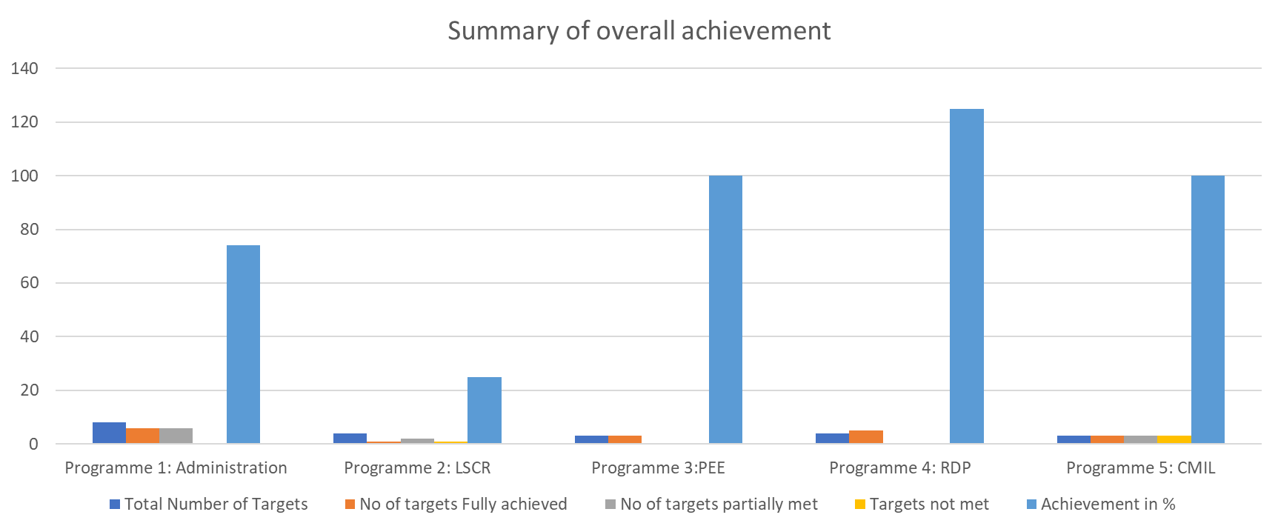
Summary of Overall Achievement: Graphical presentation- raw figures

Slide 11
Organisational Overall Achievement

Slide 12
Performance on the 2020/21 Annual Targets per Programme

Slide 13
Programme 1: Administration
Outcomes | Outputs | Output Indicators | Audited Actual Performance 2018/19 | Audited Actual Performance 2019/20 | Planned Annual Targets 2020/21 | Actual Achievement 2020/21 | Deviation from planned target to actual achievement | Reasons for deviations
Good corporate governance, sound financial management and administrative support in line with legislation | Reports and minutes for increased oversight, reporting and evaluation and coordination | Number of Plenary and oversight Committee meetings held per annum | 5 plenary and 4 section 22 meetings conducted | 4 Plenary and 4 Oversight Committee meetings per annum | 4 Plenary and 4 oversight Committee meetings held per annum | 4 Plenary and 4 oversight Committee meetings held per annum | Target met | No deviation
 |  | Number of quarterly performance reports reviewed per annum | 4 approved business reports consolidated and compiled | 4 quarterly reports were reviewed by the CEO within 30 days after the start of the new quarter | 4 reviewed quarterly performance reports per annum | 4 reviewed quarterly performance reports per annum | Target met | No deviation
 |  | Number of quarterly financial statements reviewed per annum | 4 sets of quarterly financial statements produced | Unqualified audit reports on Financial Statements. | 4 quarterly financial statement reviewed per annum | 4 quarterly financial statements reviewed per annum | Target met | No deviation
 |  | Number of quarterly internal audit reports per annum | New Target | 4 quarterly internal audit reports reviewed by the Audit Committee per annum | 4 quarterly internal audit reports per annum | 4 quarterly internal audit reports per annum | Target met | No deviation

Slide 14
Programme 1: Administration …continues
Outcomes | Outputs | Output Indicators | Audited Actual Performance 2018/19 | Audited Actual Performance 2019/20 | Planned Annual Targets 2020/21 | Actual Achievement 2020/21 | Deviation from planned target to actual achievement | Reasons for deviations
Good corporate governance, sound financial management and administrative support in line with legislation | Reports and minutes for increased oversight, reporting and evaluation and coordination | Percentage of approved performance agreements aligned to the strategy and the structure annually | New target | 31 performance agreements submitted on time. | 100% approved annual performance agreements aligned to the strategy and the structure annually | 100% approved Annual performance agreements aligned to the strategy and the structure annually | Target met | No deviation
 |  | Percentage of workplace skills development plan implemented per annum | Implemented training and education programme as per personal growth plans per annum | 37.1% of workplace skills development plan has been implemented | 100% of Workplace skills development plan implemented per annum | 45 % of Workplace skills development plan implemented per annum | Target partially met | Due to Covid – 19 pandemic and lockdown, training service providers were unable to carry out the required services virtually and as a result, turnaround time for the planned target was prolonged

Slide 15
Programme 1: Administration …continues
Outcomes | Outputs | Output Indicators | Audited Actual Performance 2018/19 | Audited Actual Performance 2019/20 | Planned Annual Targets 2020/21 | Actual Achievement 2020/21 | Deviation from planned target to actual achievement | Reasons for deviations
Good corporate governance, sound financial management and administrative support in line with legislation | Reports and minutes for increased oversight, reporting and evaluation and coordination | Percentage of queries on internal and external audit findings resolved annually | 100% of audit queries resolved and findings register updated | External and Internal audit findings register has been updated and all audit findings resolved | 100% of all queries on internal and external audit findings resolved annually | 85.33 % of all queries on internal and external audit findings resolved annually | Target partially met | Remaining queries are under investigation and report will be updated as soon as the matters are concluded.
 |  | Number of reports on implemented risk management strategy per annum | 1 risk workshop conducted per annum | Risk Management Workshop conducted, and risk register updated annually | 4 reports on implemented risk management strategies per annum | 4 reports on implemented risk management strategies per annum | Target met | No deviation

Slide 16
Graphic Presentation of Administration Achievements

Slide 17
Programme 2: Legal Services and Conflict Resolution (LSCR)
Outcomes | Outputs | Output Indicators | Audited Actual Performance 2018/19 | Audited Actual Performance 2019/20 | Planned Annual Targets 2020/21 | Actual Achievement 2020/21 | Deviation from planned target to actual achievement | Reasons for deviations
Strengthened conflict resolution and legislative reviews to promote and protect cultural, religious and linguistic rights of communities | Register of complaints/requests handled. | Percentage of complaints/ requests handled per annum | 100% of complaints and disputes received processed in line with Complaints Handling Manual | 32% of Cases were processed in line with Complaints Handling Manual | 80% of complaints (new and carried over) handled annually | 33 % of complaints handled annually. 50% of complaints received in the year under review and 16% of complaints carried over from 2019/20 financial year were handled. | Target partially met | New and carried over complaints needed deeper and further investigations and mediation which could not be fully accomplished due to Covid-19 pandemic and lockdown.
 | Register of legal advice and opinions to the Commission and to the public on cultural, religious and linguistic rights | Percentage of Legal opinions and/or drafts in responses to all requests per annum | 100% response to all requests | 100% response to all requests: 36 Legal opinions and/ or drafts have been produced. | 100% response to all legal advice/ opinion requests annually | 100% response to all legal advice/ opinion requests annually | Target met | No deviation

Slide 18
Programme 2: Legal Services and Conflict Resolution (LSCR) …continues
Outcomes | Outputs | Output Indicators | Audited Actual Performance 2018/19 | Audited Actual Performance 2019/20 | Planned Annual Targets 2020/21 | Actual Achievement 2020/21 | Deviation from planned target to actual achievement | Reasons for deviations
Strengthened conflict resolution and legislative reviews to promote and protect cultural, religious and linguistic rights of communities | Report on reviewed Bills before Parliament and report on reviewed legislation that impacts cultural, religious and linguistic rights of communities as guided by received complaints | Number of reviewed Bills before Parliament and on reviewed legislation that impacts cultural, religious and linguistic rights of communities as guided by received complaints per annum | New Target | One report on Bills before Parliament: • Recognition of Customary Marriages Bill; • Comments on Issue Paper on Single Marriage Statute; • Hearings on the use of languages | Review 100% of Bills before Parliament that impacts on the mandate of the CRL Rights Commission annually | 0% of Bills before Parliament that impacts on the mandate of the CRL Rights Commission reviewed annually | Target not met | Management went into the Parliament website and found that there were no Bills that impacts on the cultural, religious and linguistic rights of communities
 |  |  |  | New Target | 16 Reviewed municipal metropolitan By-Laws: 8 on fireworks and 8 on cemeteries that impact cultural, religious and linguistic rights of communities per annum | 15 Municipal metropolitan By-Laws: 7 on fireworks and 8 on cemeteries that impact cultural, religious and linguistic rights of communities have been reviewed per annum | Target partially met | One metropolitan municipality (Buffalo Municipality) did not have By-laws on fireworks

Slide 19
Graphic Presentation of Legal Services and Conflict Resolution Achievements

Slide 20
Programme 3: Public Engagement and Education (PEE)
Outcomes | Outputs | Output Indicators | Audited Actual Performance 2018/19 | Audited Actual Performance 2019/20 | Planned Annual Targets 2020/21 | Actual Achievement 2020/21 | Deviation from planned target to actual achievement | Reasons for deviations
Effective, structured and informed communities on cultural, religious and linguistic rights matters | Reports on engagements with communities on cultural, religious and linguistic rights of communities conducted | Number of engagements with communities on cultural, religious and linguistic communities conducted per annum | 7 nation building dialogues conducted | 4 engagements with PEE stakeholders on C-R-L matters have been conducted | 24 engagements with communities on cultural, religious and linguistic rights of communities per annum | 24 engagements with communities on cultural, religious and linguistics rights of communities were conducted per annum | Target met | No deviation
 | Reports on public educational campaigns on cultural, religious and linguistic rights of communities conducted | Number of public educational campaigns on cultural, religious and linguistic rights of communities conducted per annum | 26 awareness campaigns | 10 educational programmes have been conducted on CRL matters | 20 public educational campaigns on cultural, religious and linguistic rights of communities conducted per annum | 20 public educational campaigns on cultural, religious and linguistic rights of communities conducted per annum | Target met | No deviation
 | Established and maintained database of cultural, religious and linguistic community organisations and institutions | Updated, established and maintained database of community organisations and institutions per annum | New indicator | Community Council Policy has been reviewed by March 2020 | 1 updated maintained database of community organisations and institutions per annum | Updated maintained database of community organisations and institutions per annum | Target met | No deviation

Slide 21
Graphic Presentation of Public Engagement and Education Achievements

Slide 22
Programme 4: Research and Policy Development (RPD)
Outcomes | Outputs | Output Indicators | Audited Actual Performance 2018/19 | Audited Actual Performance 2019/20 | Planned Annual Targets 2020/21 | Actual Achievement 2020/21 | Deviation from planned target to actual achievement | Reasons for deviations
Research recommendations to inform evidence-based policies and sustained resuscitation of diminishing and diminished community heritages | Research reports on cultural, religious and linguistic rights produced | Number of research reports on cultural, religious and linguistic rights produced per annum | 4 research reports per annum produced | 1 Research report on a topic approved by the research committee has been produced | 4 research reports on cultural, religious and linguistic rights produced per annum | 5 research reports on cultural, religious and linguistic rights produced per annum | Target exceeded | An urgent request was made to conduct research on a particular topic which needed the position of the Commission, hence the variation

Slide 23
Graphic Presentation of Public Research and Policy Development (RPD) achievements

Slide 24
Programme 5: Communication, Marketing, IT and Linkages (CMIL)
Outcomes | Outputs | Output Indicators | Audited Actual Performance 2018/19 | Audited Actual Performance 2019/20 | Planned Annual Targets 2020/21 | Actual Achievement 2020/21 | Deviation from planned target to actual achievement | Reasons for deviations
Intensified communication, marketing and knowledge management systems | Reports on the implemented internal and external communication and marketing strategy | Number of reports on Implemented internal and external communication strategy per annum | 4 checklists of implemented and integrated communication and marketing strategy per annum | External and Internal Communication Strategy has been approved | 4 reports on Implemented internal and external communication strategy per annum | 4 reports on Implemented internal and external communication strategy per annum | Target met | No deviation
 | Stable and secure ICT environment that meets all functional needs of the Commission and its strategy | Number of reports on maintained and upgraded infrastructure And implemented ICT Governance Framework per annum | 4 checklists of implemented IT Framework and IT strategy per annum | IT Governance Framework has been reviewed | 4 reports on maintained and upgraded infrastructure and implemented ICT Governance Framework per annum | 4 reports on maintained and upgraded infrastructure and implemented ICT Governance Framework per annum | Target met | No deviation
 | Report on monitored activities on social media platforms | Number of reports of activities on social media platform per annum | New target | Report on active social media platforms and posts produced per annum | 4 reports on activities on social media platforms per annum | 4 reports On activities on social media platform per annum | Target met | No deviation

Slide 25
Summary of Targets not achieved and strategies to deal with them
PPI | Performance Indicator | Planned Annual Target | Annual Achievement | Reason for variance and correct measure
1.6 | Percentage of workplace Skills Development Plan implemented per annum | 100% | 52% | Due to Covid–19 and lockdown it was difficult for some training service providers to carry out services virtually. The Commission will identify skills internally that can be used to provide training as well as to identify suppliers that have capacity to provide training virtually
1.7 | Percentage of queries on internal and external audit findings resolved annually | 100% | 85.33% | Remaining queries are under investigation and report will be updated as soon as the matters are concluded.
1.9 | Percentage of complaints/requests handled per annum | 80% | 33% of complaints received in the year under review. 50% are new cases and 16% is for carried over cases were handled. | New and carried over complaints needed deeper and further investigations and mediation which could not be fully accomplished due to Covid-19 pandemic and lockdown
1.10 | Number of reviewed Bills before Parliament and on reviewed legislation that impacts cultural, religious and linguistic rights of communities as guided by received complaints per annum | Review 100% of Bills before Parliament that impacts on the mandate of the CRL Rights Commission annually | 0% of Bills before Parliament that impacts on the mandate of the CRL Rights Commission reviewed annually | Management went into the Parliament website and found there were no Bills that impacts on the cultural, religious and linguistic rights of communities. Management will continue monitoring Parliament’s website to ascertain that there are no Bills that impacts on the cultural, religious and linguistic rights of communities

Slide 26
Graphic Presentation of Communication, Marketing, IT and Linkages Achievements

Slide 27
PART B
FINANCIAL PERFORMANCE

Slide 28
Allocation and Economic Classification
Economic Classification | Final Allocation R’000 | Actual Expenditure R’000 | Variance R’000 | Expenditure % of Final Allocation
Current Payment Compensation of employees Goods and Services | 27 097 19 177 | 25 005 16 956 | 2 092 2 221 | 92.28 88.7
Payment of Capital assets | 0 | 0 | 0 | 0
Total | 46 274 | 41 961 | 4 313 | 90.68

Slide 29
Reasons for Underspending
The operational expenditure of the CRL Rights Commission was mainly impacted by the travel restrictions due to the lockdown regulations relating to the Covid-19 pandemic at the beginning of the 202/2021 financial year, and which is still affecting travel arrangements.
The saving in respect of employee cost relate to the cost of living adjustment that was not implemented during the 2020/2021 financial year due to the decision of National Treasury not to implement the customary cost of living adjustment due to the financial position of Government.
The CRL Rights Commission achieved all its set targets through alternative interventions and the use of technology.

Slide 30
Report on the 2020/21 Irregular Expenditure
There were two cases of irregular expenditure during the year under review.
The first case relate to the contract for internal audit services that was terminated during the year under review due to it being found irregular by the AG in the 2019/2020 annual audit.
The second case relate to the renewal of the contract for the supply of hygiene products at the head office that was not renewed procedurally.

Slide 31
Report on 2020/2021 Fruitless and Wasteful Expenditure
Five cases of fruitless and wasteful expenditure were reported during the year under review.
Penalties and interest was raised by SARS due to late payment of PAYE to the amount of R 49 403.28.
The other four cases relates to price inflation that was detected to the values of R 144 597, R 195 290, R 253 272 and R 234 267 respectively.
Two of the cases in respect of price inflation relates to the procurement of promotional material, and two relates to the printing of reports.

Slide 32
PART C
District Development Model
&
Human Resources Related Matters

Slide 33
District Development Model
The Portfolio Committee advised that the Commission considers District Development Model in its planning
Workshops: Management & Commissioners
The Commission established collaboration with Cogta Gauteng Province.
MOU – being drafted
Cogta Gauteng - Sedibeng Municipality project

Slide 34
Human Resources Related Matters
Resignations
-One senior Manager resigned in the year under review
Capacity and Capability
-The project is almost complete.
-Job Evaluation stage

Slide 35
Thank you

