Slide 1
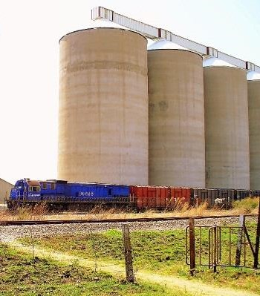
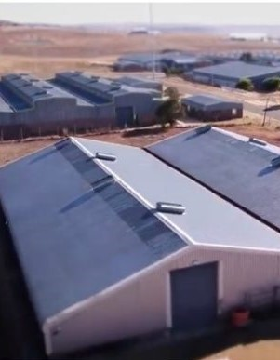
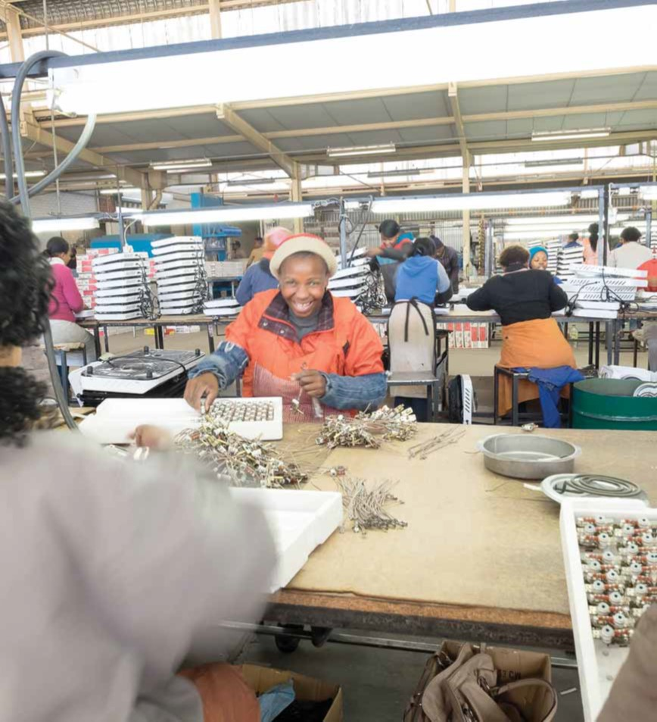
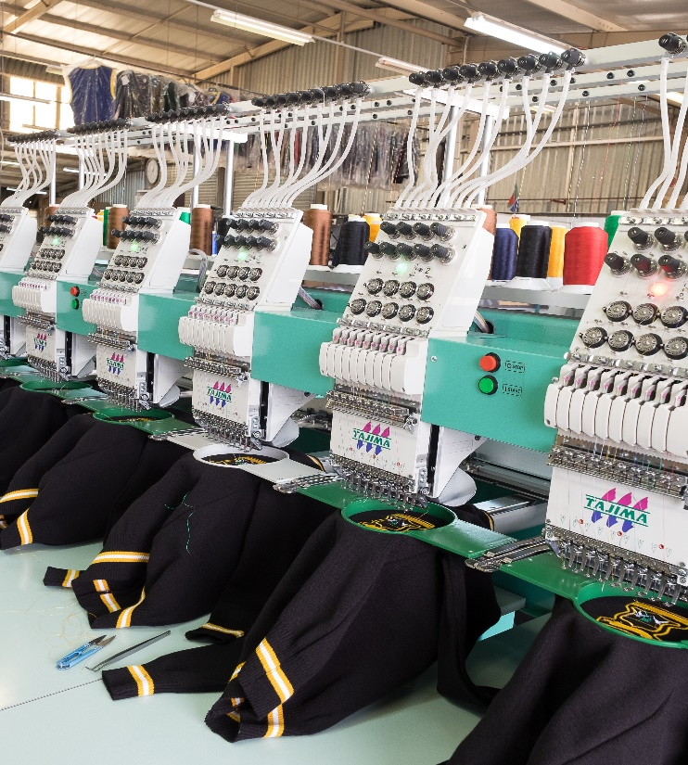

FDC PRESENTATION TO PARLIAMENT
23 NOVEMBER 2021

Slide 2
PRESENTATION LAYOUT
Purpose of the Presentation
Role of the FDC
FDC Structure and Governance
FDC Developmental Mandate
Overview of the FDC Industrial Parks
Incentives Provided
Initiatives to Maintain Current Jobs & Create New Jobs
Major Infrastructure Projects
FDC Operational Statistics
PRESENTATION TO PARLIAMENT SELECT COMMITTEE – 23 NOVEMBER 2021

Slide 3
PURPOSE
The purpose of this presentation is to brief the Select Committee on Trade and Industry, Economic Development, Small Business Development, Tourism, Employment and Labour on the turn around strategy on boosting the economic growth, attracting investments and boosting job creation in the Free State Province.
PRESENTATION TO PARLIAMENT SELECT COMMITTEE – 23 NOVEMBER 2021

Slide 4
ROLE OF THE FDC
DEVELOPMENTAL
Initiate economic empowerment projects that would benefit the Free State
Assist Free State based small, medium and micro enterprises in financial distress
FINANCIAL
Provide funding to Free State based small, medium and micro enterprises
Initiate economic empowerment projects that would benefit the Free State
PROMOTIONAL
Identify, analyse, develop, package & publicize investment opportunities
Promotion and development of small, medium and micro enterprises
PRESENTATION TO PARLIAMENT SELECT COMMITTEE – 23 NOVEMBER 2021

Slide 5
FDC STRUCTURE & GOVERNANCE
Free State Legislature Committees that facilitate its oversight role over the FDC:
The FDC is a public business enterprise established in terms of Free State Development Corporation Act No.6 of 1995.
It is listed as a Schedule 3D in terms of the Public Finance Management Act No.1 of 1999 (PFMA)
The Board of Directors is the accounting authority in terms Section 55 of the PFMA, has governance responsibilities and must account to the Provincial Member of the Executive Council for Economic, Small Business Development, Tourism and Environment Affairs.
In terms of section 63 to 65 of the PFMA, the MEC is the Executive Authority
Portfolio Committee on Public Accounts, (PROPAC) (Financial responsibilities)
Portfolio Committee on Agriculture and Rural Development, Economic, Small Business Development
and Sports, Arts and Culture (Non-financial responsibilities)
PRESENTATION TO PARLIAMENT SELECT COMMITTEE – 23 NOVEMBER 2021

Slide 6
FDC DEVELOPMENTAL MANDATE
PROPERTY LEASES
Commercial Properties
Reduced rental rates per square meter (R10,00/sq.m instead of R40,00/sq.m)
MUNICIPAL SERVICES
Utilities (Water only)
No mark-up on utility bills
SUPPORT SERVICES
Financial & Non-Financial Support
We undertake investment promotions and facilitation at our cost.
FDC out of the electricity sale and cost recovery business. Municipalities supply directly to the FDC tenants in its industrial parks and other commercial properties.
We provide SMME financing who ordinarily would not get funding from the bank with generous payment terms.
We provide bridging finance to SMMEs based on the government orders and we sign cessions with departments and municipalities
Work with tenants in financial distress instead of outright eviction when they default on rent and utilities. This is part of our mandate in terms of the FDC Act but its unfunded.
The Corporation’s Developmental Approach to Promoting SMMEs, Creating Jobs and Growing the Provincial Economy
PRESENTATION TO PARLIAMENT SELECT COMMITTEE – 23 NOVEMBER 2021

Slide 7
INDUSTRIAL PARKS OVERVIEW
Free State Development Corporation (FDC) has three Industrial Parks and one Special Economic Zone in Harrismth – Maluti A Phofung in the province.
The Industrial Parks consist of small (50-499 sqm) and large units(+500 sqm).
Phuthaditjhaba Industrial Park is strategically located in the Eastern Free State and 40km away from N5 and N3 highway. The Park falls along the border between Gauteng and Kwazulu-Natal Province.
The Botshabelo Industrial Area is situated approximately 53 Km from Bloemfontein on the N8 towards Lesotho. The Botshabelo Industrial Area is one of the main drivers of the economy of the Mangaung Metropolitan Municipality.
Our tenants profile consists of the following various sectors; Textile , Plastic Products, Poly Propylene Bags, Poultry, Food and snacks, Packaging, Paraffin Stoves/Hot plates, Plastic packaging, electrical transformer manufacturing. Etc.
PRESENTATION TO PARLIAMENT SELECT COMMITTEE – 23 NOVEMBER 2021

Slide 8
SUPPORT PROVIDED BY THE DTIC
Botshabelo Revitalization phase 1 - Completed
  Security fencing
  High mask lights
  Roller shutter doors
  Boom gates
  Value of the project R21,9m
Botshabelo Revitalization phase 2 – Almost Complete
  CCTV cameras
  ICT hub
  Refurbishing of roofs
  Refurbishing of seven (7) factories
  Electrical upgrades
  Upgrade of entrance / façade
  Value of the project R40,4m
PRESENTATION TO PARLIAMENT SELECT COMMITTEE – 23 NOVEMBER 2021

Slide 9
SUPPORT PROVIDED BY THE DTIC
Ø Phuthaditjhaba Revitalization phase 1 – Completed
Phuthaditjhaba Industrial Park was approved for phase 1 Revitalisation at an amount of R32,3 million.
installation of parameter fencing
CCTV Cameras,
Installation of gates
guard rooms.
Ø Phuthaditjhaba Revitalization phase 2 – DBSA on site 17 November 2021 scoping the project
Ø Application submitted to DTIC;
- Address occupational compliance for 16 factories including roofing, plumbing and electrical upgrades
3 substations Upgrade.
MAP TVET College in partnership with SEDA is housing the digital hub which is in the FDC factory.
PRESENTATION TO PARLIAMENT SELECT COMMITTEE – 23 NOVEMBER 2021

Slide 10
SUPPORT PROVIDED BY THE DTIC
PRESENTATION TO PARLIAMENT SELECT COMMITTEE – 23 NOVEMBER 2021

Slide 11
INCENTIVES PROVIDED
The property department aims to utilize property space in order to facilitate commercial and industrial activity, while assisting new investors who are seeking suitable rental premises.
The following incentives are provided:
Subsidized rental rates
Rental holidays of up to three months,
Other special Incentives – e.g. amortising tenant capital investment over the lease term.
Strategic Objectives :
Increase Rental Revenue
Increase Rental Occupancy
Increase the number of private sector partnerships to utilize vacant/vandalized properties to facilitate job creation. Private sector has funding and expertise to
PRESENTATION TO PARLIAMENT SELECT COMMITTEE – 23 NOVEMBER 2021

Slide 12
INITIATIVES
Revitalization of three (3) Industrial Parks i.e. Botshabelo, Thaba Nchu, and Phuthaditjhaba parks
Revive AgiParks partnership with the Department of Rural Development (Phuthas, Tshiame, and Thaba Nchu)
ICT Digital Hub – In partnership with MAP TVET and SEDA in progress;
Collective training for Industrial sectors in the park on Textile manufacturing skills.
Student Accommodation in Phuthaditjhaba Industrial Park.
Revitalization of Shopping Centers with Private Partnerships.
Partnership with Maluti Tvet College and SEDA in establishing Centre for Entrepreneurial Rapid Incubator in the Phuthaditjhaba Industrial Park.
Phase three roads reticulation upgrades within Botshabelo and Phuthaditjhaba industrial parks assisted by the DTiC through the DBSA as an implementing agent.
PRESENTATION TO PARLIAMENT SELECT COMMITTEE – 23 NOVEMBER 2021

Slide 13
MAJOR INFRASTRUCTURE PROJECTS
Steel Smelter Projects – R300m ( ThabaNchu)
Development of the N8/Mahungra Node (project in planning stage)
Revitalisation of the Bloem Industria with the Mangaung Metro (project in planning stage)
PRESENTATION TO PARLIAMENT SELECT COMMITTEE – 23 NOVEMBER 2021

Slide 14
... FDC PERFORMANCE REPORT
STATISTICAL INFORMATION OF FDC INDUSTRIAL PARKS
72% Occupancy
60% Occupancy
83,91% Occupancy
50% Occupancy
5 486
Jobs
119
Jobs
8 500
Jobs
1 845
Jobs
PRESENTATION TO PARLIAMENT SELECT COMMITTEE – 23 NOVEMBER 2021

Slide 15
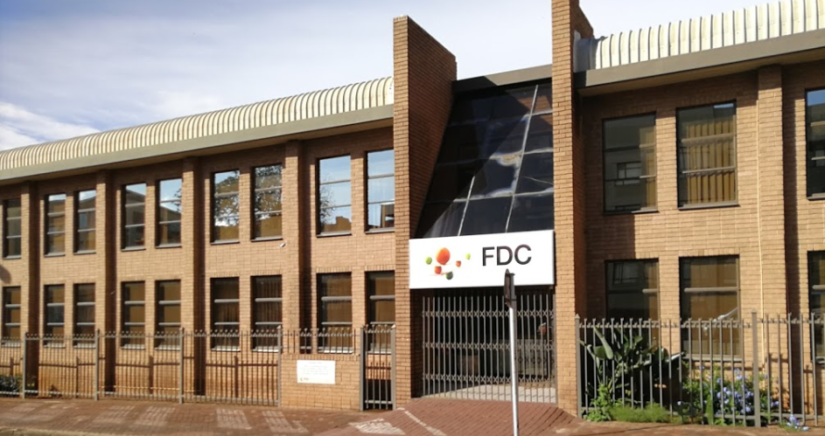
WE THANK YOU
PRESENTATION TO PARLIAMENT SELECT COMMITTEE – 23 NOVEMBER 2021

