Slide 1
DSD Annual Performance Report 2020-21
(1 April 2020 to 31 March 2021)
Presentation to the Select Committee on Health and Social Services
23 November 2021

Slide 2
PURPOSE
To inform the Select Committee on Health and Social Services of the Department’s programme performance against its pre-determined objectives and expenditure during the 2020/21 financial year

Slide 3
CONTEXTUAL ANALYSIS 1
The 2020/2021 was one of the most difficult financial years as a result of the COVID-19 pandemic, and our DSD Portfolio presentations give account on the implementation of the 2020/21 commitments within this context;
Whilst the outbreak of COVID-19 in March 2020 disrupted the DSD’s service delivery environment, we were able to achieve 81% (2020/2021 (*4=88%) of our set targets which shows a significant improvement in achievement of targets as compared to 49% in the 2019/2020 F/Y. The last time DSD was at this level was in the 2016/17 F/Y 81% and this year’s performance under the current circumstances is an indication that we are starting to turn the corner and getting back to good performance;
We have adopted a Results Based Approach in order to demonstrate the impact of our interventions and our targets are directly aligned to the MTSF priorities of Government more so, priority 4 (Consolidating the Social Wage) as well as the NDP;
In line with the revised APP (+ reprioritized budgets), DSD achieved 48 (52) out of 59 set targets with only 11 targets not met; this was subsequently tabled and adopted by the Committee;
Key to the revisions was to enable us to respond to the heightened demands for our services such as responding to food security needs especially for the most vulnerable in society, the provision of psychosocial support services, provision of sheltering services, the provision of income support to the millions of the 18-59 year olds who lost their jobs as a result of the pandemic, as well as adapting to the new normal which would see us digitising and automating several of our services within COVID-19 confines;
Notes:
- Principle of concluding targets within specific timeframes…
- Technical definition of the indicator…

Slide 4
CONTEXTUAL ANALYSIS 2
While in most areas the DSD was able to deliver as planned, in other areas, the commitments were not fully realized, given the context of the pandemic which has forced us to operate in new ways – notwithstanding the numerous challenges we faced which included; (turned these into lessons learnt and built our capacities from these);
  While we were able to move swiftly to provide a wide range of social protection services at the outbreak of COVID-19 and the subsequent rise in social ills and demand for our services, the new norm presented serious challenges for us to deliver maximally given the nature of our systems that to a large extent are face-to-face contact services and not necessarily automated;
  An increase of social ills that include gender-based violence, substance abuse, abuse of children, and many others which were compounded by the outbreak of COVID-19 pandemic;
  The persistent and stubborn challenges of high levels of poverty, unemployment and inequality that continue to overstretch the demand for our services, especially with regards to the provision of psychosocial support given the trauma that the pandemic has had on the general public;
  The testing of our agility/speed to swiftly respond to shocks and rising need for social services;

Slide 5
CONTEXUAL ANALYSIS 3
While 11 annual targets were not achieved during 2020/2021, only 8 (with the remaining 3 were achieved days after the end of the reporting period) of these were carried over to 2021/22 APP, to ensure continuity of critical policies and legislation to enable enhanced service delivery; These include among others:
  Information Management Systems and Technology (IMST): (x2)
    Development of the Substance Abuse System into Social Development Integrated Case Management System;
    Integration of Victim Empowerment Programme and Gender Based Violence systems;
  Social Assistance
    Monthly payment of social grant beneficiaries as administered and paid by SASSA on behalf of DSD;
  Professional Social Services (x2)
    Submitting the Social Service Practitioners Bill to Cabinet;
    Amendment of the Older Persons Amendment Bill amended;
  Population and Development
    Research Report on Youth perception survey on Socio-economic, health, and gender on Impact of COVID-19;
  Services to Persons with Disabilities (x2)
    Submission of the Policy on Social Development Services to Persons with Disabilities to Cabinet for approval;
    Submission of the Guidelines on Respite care services for Families of children and Persons with disabilities for approval and implementation;
5

Slide 6
ACHIEVEMENT OF TARGETS PER PROGRAMME
Programme | Total Targets | No. of Targets Achieved | No. of targets not achieved | % of targets achieved
Programme 1 | 8 | 6 | 2 | 75%
Programme 2 | 1 | 0 | 1 | 0%
Programme 3 | 7 | 6 | 1 | 86%
Programme 4 | 26 | 20 | 6 | 77%
Programme 5 | 17 | 16 | 1 | 94%
Total Targets | 59 | 48 | 11 | 81%
6

Slide 7
Summary of DSD Programme Performance 2018-19 to 2020-21
Notes:
- Due to corrective measures we have applied have assisted us in surpassing the prior years.

Slide 8
Where are we now on the 8 Unmet Targets? Performance Overview 1
Substantial progress has been reported on those targets which were carried over into the new APP. The overview below provides the current status/progress on implementation:
Information Management Systems and Technology:
  Analysis of the requirements for the Integration of GBV and VEP systems was not achieved due to complexity of the processes which requires due diligence, proper mapping and clear definition of functional requirements specification; (not clear terms of reference);
  Development of the Substance Abuse System was also not achieved. The tender was cancelled as a result of major variance in the bid price between different service providers that required a review of the terms of reference and the job specification. This subsequently negatively impacted implementation time frames.
  Analysis of the requirements for the integration of GBV and VEP systems have now been completed. The service provider has now been appointed and the development of systems is now underway and will be reported upon within the 2021/22 targets accordingly.
Social Assistance
  The target of Monthly transfers of funds to SASSA was not achieved, since the DSD does not “transfer” the funds, but the funds are provided in monthly “allocations” to SASSA to pay social grants. The Auditor-General has advised that the use of the word “transfer” is inaccurate, which means the target will never be achieved if maintained. DSD has since revised the indicator to “allocation” in its 2021/22 APP to address the ambiguity.

Slide 9
Where are we now on the 8 Unmet Targets? Performance Overview 2
Professional Social Services
  Pre-Certification of the Draft Social Service Practitioners Bill could not be achieved due to the following reasons, amongst others; dependency on the availability of Legal Services for technical support on redrafting of the Bill, which led to the redrafting process being delayed. The redrafting of the draft bill was finalized and submitted and submitted to OCLSA which has since been received with comments being submitted back to OCSLA for FINAL Certification. We have also received a SEIAS certificate from the DPME on the Draft Bill which will both us to go to Cabinet in the current quarter.
  The Older Persons Amendment Bill was not finalized at the end of the financial year. The Bill has now been processed through various structures and was tabled and approved in Cabinet in August and is now being introduced to Parliament. The Committee should consider prioritizing this Bill within its processes.
Population and Development
  The annual target of Research report on Youth perception survey on Socio-economic, health, & gender on Impact of COVID-19 was not achieved. The appointment of a Research Institution to conduct this study required approval from National Treasury, which took 4 months to be approved by National Treasury i.e. October 2020. The remaining time was not sufficient to complete the final study reports as planned. The report for the first survey has been completed and finalized. The second survey is also completed and a final report being compiled. The third survey is also currently underway.

Slide 10
Where are we now on the 8 Unmet Targets? Performance Overview 3
Services to Persons with Disabilities
  The Policy on Social Development Services to Persons with Disabilities was not finalized and was therefore not submitted to Cabinet at the end of the fourth quarter. The delays to submit the policy to Cabinet was due to additional edits that needed to be concluded as well as to ensure its re-alignment to the White Paper on the Rights of Persons with Disabilities before tabling to Cabinet. The editorial work on the Policy has been finalised and the document is being processed through relevant structures for finalization.
  Guidelines on Respite care services to Families and Persons with disabilities was not finalized. Efforts to source for the service provider with relevant expertise on Persons with Disabilities and their families, taking into consideration the need to address the COVID-19 social issues of children and persons with disabilities and their families had an adverse delay on the appointment of a service provider.
  The appointment of the service provider has now been concluded and the guidelines are being processed for finalization and approval which will pave the way for implementation.

Slide 11
The following targets, while not achieved at the end of the financial year, were not carried over into the new APP as they were achieved within the first month of the new F/Y.
Monitoring and Evaluation:
  The three Rapid Assessment Studies on the socio economic impacts of COVID-19 on the Social sector were not completed at the end of the financial year.
  All these studies continued in the new financial year and are now completed.
  Social Security:
  The Regulations to the Social Assistance Amendment Act could not be finalised by 31 March 2021.
  The Regulations are now finalised, approved and ready for publication.
  ORC/Children, Legislation, Monitoring and Reporting:
  The Annual Report on the implementation of the National Plan of Action for Children was not finalised at the end of the fourth quarter.
  The report has now been completed in the first quarter, finalised and processed accordingly.
11
Notes:
Analysis:
You will note that most of the unmet targets are Legislation or Policy related targets - and we may have underestimated the processes involved in processing legislation but also these were really and truly due to the impact of COVID-19;
We are also taking on a different posture to setting targets in that we are being more cognoscente in taking RISKS and MITIGATING measures into consideration coupled with using the SMART principles. (so we are trying to MANAGE RISK better);
We are also taking dependencies into consideration;
The targets as set out in the APP may not give a complete reflection of what we are actually doing on the ground – some of the work we do is imbedded in our Operational plans and has had a significant impact of creating a better life for many people (whether it be through substance abuse, through our care and protection measures for children, or even reaching out to millions of vulnerable households to assist with food security needs etc. our work is improving the well being of South Africans.
What we also want to do better is align our targets to budgets.

Slide 12
AGSA’s AUDIT OUTCOME ON DSD
Overall, DSD received unqualified audit outcome with no findings also referred to as “clean audit opinion”;
Although the department has received the unqualified audit outcome with no findings, AGSA highlighted the serious concerns around management of the following areas:
Assets management processes, mainly disclosure and completeness of the assets register;
Quality of Financial Statements although not material, have findings such as aid assistant revenue in kind, aid assistant expenditure, employee benefit and completeness of contract register;
Supply Chain Management (SCM) processes;
Performance Information outcome, although remained unchanged from prior years, however, findings were raised in which an indicator was materially adjusted after submission of the performance report.
Information Technology systems;
We have since implored all staff to attend compulsory Ethics Management Courses to build an ethically mature environment,
Management has since developed a clear strategy endorsed by the Audit Committee to address findings raised by AGSA during 2020/21 financial year to ensure that we address the root causes and instil strong preventative controls whilst also repeat findings;
Part of the corrective measures is to ensure that adequate consequence management is implemented accordingly;
With regards to performance information, for the 9th consecutive financial year (2020/2021), the Department retained its unqualified audit outcome on performance information;
12
Notes:
- We now also have functional Risk and Ethics Management Committee

Slide 13
Reporting against the originally tabled APP 2020-2021 and the revised (re-tabled APP)
  The National Treasury Guideline on preparation of the 2020-2021 Annual Reports required Departments to account on both the Original APP (tabled in March 2020) and the Revised APP (tabled in July 2020).
  While only one report (First Quarter of 2020-2021) was compiled on the Original APP, a full annual report was also accordingly submitted;
  Clarity was sought from DPME and NT and it was confirmed that the annual report (on the original APP) must only include performance until the time of re-tabling the APP. The DSD re-tabled its 2020-2021 APP in July 2020.
  The annual report against the originally tabled APP include only targets which were impacted by the revision of the APP, i.e. Those removed or revised during the re-tabling
  The annual report against the revised APP include those targets which were not revised and new targets added during the revision of the APP in July 2020
  Therefore, the 2020-2021 DSD Annual Report, which include both reports (against the originally tabled APP and against the revised APP), was tabled in Parliament on 30 September 2021.
  The Department thus complied with the tabling timelines and procedures.
Notes:
The fact that we re-tabled did not override the first quarter.

Slide 14
GOVERNANCE AND INSTITUTIONAL DEVELOPMENT
  Maintaining sound organisational and business practice is an integral part of promoting accountability and efficiency in the Department.
  DSD continues to implement a number of initiatives towards maintaining the highest standards of governance in the management of public finances and resources. Some of these initiatives includes the following:
    Audits: Audits were conducted in accordance with the standards and requirements of the Institute of Internal Auditors and the Department’s Audit Charter. The audit reports and action plans to respond to audit findings are discussed by the Audit Committee and the Department’s top management, who takes necessary corrective action to address identified deficiencies.
    Risk and Ethics Management: DSD has a functional Risk and Ethics Management Committee (REMC), which meets on a quarterly basis to review the progress that the Department is making in addressing its risks.
    Programme Performance Reporting and Performance Reviews: The management of programme performance information has been institutionalised and performance reports are discussed by Senior Management Structures. DSD has also institutionalized Programme Performance Reviews, which provides early warning system and identify barriers towards the achievement of set targets. The reviews allow managers to identify and implement measures to ensure that the DSD achieves all set targets.

Slide 15
GOVERNANCE AND INSTITUTIONAL DEVELOPMENT
  Standard Operating Procedures for all departmental support functions: DSD is developing and reviewing all existing Standard Operating Procedures (SOPs) for support services functions to improve service delivery. The SOPs provide details on the requirements and turn-around timelines for procurement of services as well as development and submission of compliance reports. Improved compliance will result in improved performance.
  Alignment of individual performance agreements to institutional plans: The Performance Agreements of all Senior Managers are being intrinsically linked to the specific targets in the APP and Operational Plans of the DSD. This alignment will improve the management of performance at institutional and individual level.
  Directive on implementation of preventative controls: DSD issued a directive to all its Senior Managers to implement Preventative Control Guides (PCG). These are guides developed by the Auditor-General of South Africa advising management on how to enhance the current financial management systems to utilise public resources effectively, efficiently and economically, and consequently receive positive audit outcome.
  Planning: During development of its plans, particularly the APP, the indicators and targets are subjected to SMART (Specific, Measurable, Attainable, Realistic, Time bound) principles to ensure that all commitments in the APP are achievable. We have also institutionalized planning across the DSD Portfolio for the first time against a common mantra supported by a Sector APP.

Slide 16
Social Assistance
OUTCOME (OBJECT OF CHANGE): Social grants for eligible individuals
TARGET/INTERVENTION What did we develop/implement/reach? | ACHIEVEMENT What did we do?
R200 629 475 000 allocated for Social Grants | A total of R223 436 557 000 was transferred to SASSA between April 2020 and March 2021
IMPACT OF THE INTERVENTION: DSD continued to oversee the management and administration of social grants by SASSA, and remained accountable for the over R220 billion received for the payment of social grants. Social grants continue to be Government’s most effective measure for combating poverty and reducing inequalities, reaching over 18.4 million vulnerable South Africans. In addition to the Social Grants, DSD provided an additional R50 billion Social Relief Package, consisting of the following: Caregiver Grant of R500 per month to each Child Support Grant (CSG) caregiver from June to October 2020 inclusive; COVID-19 Social Relief of Distress Grant of R350 per month to adults aged 18-59 with no income from May 2020 to April 2021. Top up of existing grants - The Old Age Grant, Disability Grant, Care Dependency Grant and Foster Child Grant were each topped up by R250 per month from May to October 2020 inclusive. The CSG was topped up by R300 per child in May 2020 only. Social grants proved to be the most effective mechanism available to government to cushion millions of the most vulnerable individuals and households from the dire socio-economic impact of COVID-19
16

Slide 17
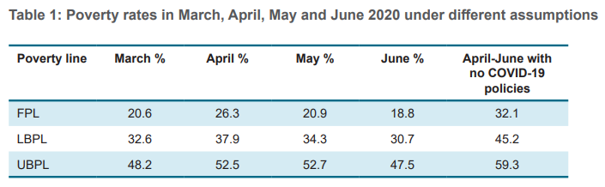
Social Assistance
  A study was conducted on the implementation and utilization of the R350 Special COVID-19 SRD Grant.
  The study found that the SRD Grant provided protection from severe poverty and contributed immensely to the reduction in inequality.
  Massive protection against poverty
    The 6 months relief package contributed to the largest reduction of poverty during this period of all the relief measures implemented (NC)
      In particular, the CSG Caregivers grant and the SRD R350 grant together played the most significant role
    COVID-19 relief measures played a huge role in preventing the worsening of poverty and even resulted in reduction of poverty at the Food Poverty Line (ST)

Slide 18
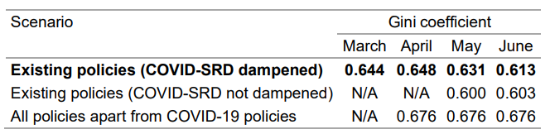
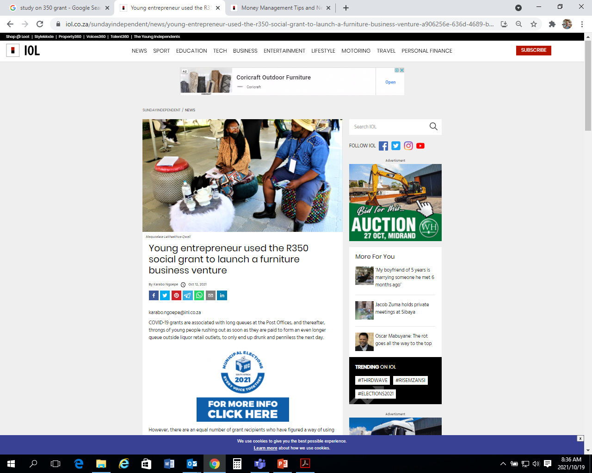
Social Assistance
  Reduction in inequality
    Without the Covid-19 Relief intervention our Gini would have increased from 0.64 to 0.67, but instead it decreased to 0.61 (ST)

Slide 19
High Level Achievement – Comprehensive Social Security
  Social Grants and COVID-19 Relief Packages:
    DSD continued to oversee the management and administration of social grants by SASSA, and remained accountable for the over R220 billion received for the payment of social grants.
    Social grants continue to be the Government’s most effective measure for combating poverty and inequality, reaching over 18.4 million vulnerable South Africans.
    In addition to the Social Grants, the Department provided an additional R50 billion Social Relief Package, consisting of the following:
    Caregiver Grant of R500 per month to each Child Support Grant (CSG) caregiver from June to October 2020 inclusive;
    COVID-19 Social Relief of Distress Grant of R350 per month to adults aged 18-59 with no income from May 2020 to April 2021.
    Top up of existing grants - The Old Age Grant, Disability Grant, Care Dependency Grant and Foster Child Grant were each topped up by R250 per month from May to October 2020 inclusive. The CSG was topped up by R300 per child in May 2020 only.
  Comprehensive Social Security Reforms:
    The DSD continued to formulate policies and legislative proposals for contributory income support aimed at protecting households against life cycle risks.
    These policy reforms are intended to create a social security system that covers everyone in the country, ensuring that those who are unable to support themselves are provided with social grants, while those in both formal and informal employment are provided with an institutional platform to make mandatory and voluntary contributions to cover themselves and their families against these life cycle risks.

Slide 20
High Level Achievements – Comprehensive Social Security
  Comprehensive Social Security Reforms (cont.):
  In pursuit of these reforms, the Department developed the following policies:
    A draft policy proposal for the Basic Income Grant. The policy proposal focusses primarily on the provision of income support to unemployed working age individuals between 18 and 59 years, who currently do not have access to social assistance.
    Two inter-related policy reports, one on Maternal Benefits and the other on Policy Options for the Linking of Child Support Grant Beneficiaries to other government services were costed.
    The Maternal Benefits Policy work is motivated by a recognition of the importance of the first 1000 days in a child’s life, and the role that poverty and deprivation in the antenatal period plays in the early development of the child from birth onwards.
    The Policy on Linking Children Grants Beneficiaries will integrate social welfare services, education, and health within the cash transfer context, through improved access and cooperation, alongside economic support.
    The Green Paper on Comprehensive Social Security Reforms, which makes proposals for the introduction of a National Social Security Fund and significant overhaul of the current institutional framework for social security.
    The reforms will create a social security system that covers everyone in the country, ensuring that those who are unable to support themselves are provided with social grants, while those in both formal and informal employment are provided with an institutional platform to make mandatory and voluntary contributions to cover themselves and their families in the event of their retirement, death or disability.

Slide 21
High Level Achievements – Comprehensive Social Security
  In addition, the following legislation were processed
  Social Assistance Amendment Act:
    The Bill was passed by Parliament in October 2020 and assented to by the President in December 2020. The Bill paves the way for the introduction of the Extended Child Support Grant (CSG) top-up policy whereby Orphans living with family members will receive a top up on their CSG.
    The Bill also removed the reconsideration process within SASSA. Once regulations are in place, applicants and beneficiaries will be able to appeal directly to the Independent Tribunal for Social Assistance Appeals, which allows for quicker access to appeals, and thus will improve access to administrative justice for thousands of applicant and/or beneficiaries.
    The President proclaimed Chapter 4 of the Bill, which establishes an Inspectorate for Social Assistance, to act as a robust institution to protect the integrity of the social assistance system.
    The Inspectorate will put measures in place to ensure that SASSA develops and implements appropriate systems and programmes to prevent and combat fraud so that only deserving applicants receive social grants, and this is done in the most effective and efficient way.
  Fund Raising Amendment Bill:
    The Bill was tabled in Parliament. The amendments are intended to address the fragmentation and inefficiency that currently exists in the processes of responding to disasters in the country.
    This will contribute to improving the capacity of the state, by promoting greater efficiency and coherence in the management and use of disaster relief, while also promoting adherence to the PFMA.`

Slide 22
High Level Achievement – Welfare Services
  Introduction and roll-out of the ECD-Presidential Stimulus Relief Fund;
    DSD received the Presidential ECD Stimulus Relief Fund of R496 million, towards supplementing the income generated by the ECD services through subsidising the cost of employment, help restoring the provision of ECD services, support continued operation and reduce the risk of permanent closure.
    The programme is aimed at providing income support to the ECD workforce by paying a once off payment of R4 100 per ECD practitioner/workforce in all ECD programmes affected by the pandemic in order to ensure that ECD services remain operational.
    At the end of the reporting period, over R100 million was dispersed to all ECD services that have been found eligible for this programme.
    A total of 28 283 applications from ECD services were received with 126 283 workforce for this programme. More applications were received from female ECD operators, with majority of them being African.
  The launch of the Vangasali Campaign aimed at “Finding every ECD”.
    During the reporting period the Department launched the Vangasali Campaign which contributes towards the NDP target of providing universal access to ECD services
    The campaign promotes the registration of ECD centre and ensuring that children in these centers are supported and provided with quality programmes.
    Through this campaign, a total 52 000 ECD services were registered on the Vangasali databases.

Slide 23
High Level Achievement – Welfare Services
  National Plan of Action for Children and the 2020 Annual Child Rights Status Report;
    In October 2020, Cabinet approved the National Plan of Action for Children (NPAC).
    The NPAC provides a holistic framework for the integration of all policies and plans developed by government departments and civil society to promote the well-being of children.
    The Department also conducted a review of the status of children in the country, and a draft annual child rights status report was produced.
    The report is aligned to the fourth National Plan of Action for Children (NPAC 2019 – 2024) and it summarizes the 2020 year trends with regard to children’s rights and well-being.
  Improved access to Substance Abuse Treatment Services;
    In order to increase access to substance abuse treatment services, the Department built public treatment centres in Eastern Cape, Northern Cape, Free State and North West;
    The JB Marks Public Treatment Centre in the North West was operationalised and officially opened in December 2020. Prior to the operationalisation of the JB Marks Public Treatment Centre, the North West province used to refer Service Users to other provinces and private treatment centres for help.
    Similarly, the Free State Public Treatment Centre is completed and ready to take in Service Users from across the province.
  The launched National Drug Master Plan (2019-2024)
    In commemoration of the International Day Against Drug Abuse and Illicit Trafficking, the Department launched the National Drug Master Plan 2019-2024
    Through this launch a total of seven provincial Substance Abuse Forums in EC, FS, GP, KZN, MP, NW and WC were capacitated on the National Drug Master Plan 2019 – 2024.

Slide 24
High Level Achievement – Welfare Services
  The relocation and re-launch of the Gender Based Violence Command Centre
    The Department secured a state-owned facility for the Gender-Based Violence Command Centre (GBVCC), through partnership with the Department of Public Works and Infrastructure.
    The new premises are spacious and can accommodate a total of 30 officials at the same time, an increase from 15 officials at the old facilities.
    The centre is therefore able to reach out to an additional number of beneficiaries as the number of Social Work agents can be increased in each shift.
    The (GBVCC) was re-launched during the 2020 16 Days of Activism Campaign.
    The relocation has also reduced costs of delivery of services as the new building is owned by the Department of Social Development.
  Victim Support Services Bill
    During the reporting period, the Victim Support Services Bill was gazetted for public comments
    This Bill contribute to the policy reforms within the Gender-Based Violence and Femicide space.
    It also forms part of the implementation of the Pillar 2 of the National Strategic Plan on Gender-Based Violence and Femicide.

Slide 25
High Level Achievement – Welfare Services
  Adoption Policy Framework and Strategy, and Register of Adoptable Children and Prospective Adoptive Parents (RACAP)
    Section 232 of the Children’s Act, 2005 (Act No. 38 of 2005) requires the Director–General to keep and maintain a Register on Adoptable Children and Prospective Adoptive Parents (RACAP) for the purpose of keeping a record of adoptable children and a record of fit and proper adoptive parents.
    In this regard, a total of 432 Social Workers in eight provinces, except Mpumalanga were capacitated on both the Framework and the Strategy.
    The trained Social Workers were empowered and will be able to provide adoption services as required by the Legislation.
    Similarly, a total 849 adoptions were registered, which includes 799 national adoptions and 50 intercountry adoptions. Furthermore, a total of 166 adoption service providers were accredited, which includes 128 Child Protection Organisations and 38 Social Workers in private practice.
    RACAP was managed with 264 children and 80 parents registered respectively
  Construction of Community Care Centers;
    The DSD received funding to the value of €9m (9 million pounds) for the construction of 17 Community Care Centres (CCCs) in NW, KZN and LP.
    Until 2019, a total of 11 of the 17 CCCs were completed with 6 in KZN, 3 in NW and 2 in LP.
    During 2020/201, the Department was able to complete an additional 3 CCCs in NW, bringing the total to 14 CCCs.

Slide 26
Social Crime Prevention and Victim Empowerment
OUTCOME (OBJECT OF CHANGE): Reduced levels of poverty, inequality, Vulnerability and social ills
TARGET/INTERVENTION What did we develop/implement/reach? | ACHIEVEMENT What did we do?
Monitor implementation of Anti-Gangsterism Strategy in six (6) provinces | Implementation of Anti-Gangsterism Strategy was monitored in six (6) provinces, namely; KZN, EC, WC, MP, GP and LP
IMPACT OF THE INTERVENTION: The Anti-Gangsterism Strategy aims to prevent Gangsterism in Child and Youth Care Centres (CYCC) and promotes welfare and safety of children from any child/ children who come with Gangsterism influences. Monitoring covers the profiling of children from admission of their affiliation into gangs and their needs that make them join gangs are assessed as part of interventions rendered. This is also aimed at protecting other children under DSD’s care who are not into Gangsterism from the positively profiled children not to recruit them
26

Slide 27
High Level Achievement – Welfare Services
  DSD Anti-Gangsterism Strategy
    The Strategy that aim to prevent Gangsterism in Child and Youth Care Centres (CYCC) and promotes welfare and safety of children from any child/ children who come with Gangsterism influences
    The Department monitored the implementation of the DSD Anti-Gangsterism Strategy in six provinces namely Eastern Cape, Limpopo, KwaZulu-Natal, Western Cape, Gauteng and Mpumalanga.
    The key areas monitored included all facilities that are to put in place systems and techniques to prevent gangsterism
  HIV and AIDS
    As part of implementing Psychosocial Support Guidelines, the Department trained 204 Social Service Practitioners in Gauteng, KwaZulu-Natal and Mpumalanga provinces. The Guidelines ensure early identification of Orphans, Vulnerable Children and Youth (OVCY) at higher risk of contracting HIV.
    The interventions provided by trained SSPs also contributes to the national Cheka Impilo Wellness Campaign and the UNAIDS 95-95-95 strategy, which encourages 95% of people with HIV to test, of those tested, 95% to be on treatment, and 95% of those on treatment to be virally suppressed.
    We further implemented our Social and Behaviour Change (SBC) Compendium interventions to reach young people and influence positive social and behaviour change. In this regard, we launched the YOLO (You Only Live Once) and ChommY programmes in KwaZulu-Natal and Gauteng.
    The Sector, together with the Parliament and the South African National Aids Council (SANAC), hosted the National Men’s Parliament, attended by men and boys from all provinces.
    The National Men’s Parliament continues to organise men and boys to champion change in the prevention of new HIV infections, gender-based violence, toxic masculinity, substance abuse and many other social ills.

Slide 28
Special Projects and Innovation
OUTCOME (OBJECT OF CHANGE): EPWP work opportunities created through DSD Programmes
TARGET/INTERVENTION What did we develop/implement/reach? | ACHIEVEMENT What did we do?
17 400 EPWP work opportunities created through DSD Programmes | A total of 39 437 EPWP Work Opportunities were created through DSD Programmes
IMPACT OF THE INTERVENTION: The DSD continued to lead the coordination of the EPWP for the Social Sector, which comprises of the departments of Health, Education, Social Development, Community Safety, and Sports and Recreation in South Africa. The programme focuses on skills development and providing work opportunities by giving unemployed people access to temporary work. Helping unemployed people through skills programmes and work experience and ensuring that unemployed people receive a stipend for any work they have completed as part of the EPWP. The sector focuses on increasing the quality of home-based care and early childhood development programmes, both of which require large amounts of dedication. The Department through the Social Sector created 179 204 Work Opportunities. Of these work opportunities, 39 437 were created through DSD programmes. The Presidential Economic Stimulus allocation to provinces has also contributed to the achievement of targets in the sector.
28

Slide 29
High Level Achievement – Community Development
  Job Creation
    The DSD continued to lead the coordination of the EPWP for the Social Sector, which comprises of the departments of Health, Education, Social Development, Community Safety, and Sports and Recreation in South Africa.
    The Department through the Social Sector created 179 204 Work Opportunities. Of these work opportunities, 39 437 were created through DSD programmes.
    The Presidential Economic Stimulus allocation to provinces has also contributed to the achievement of targets in the sector.
  National Community Development Policy
    The National Community Development Policy was finalised.
    The Policy aims to provide policy leadership and guidance on the implementation of community development in the country (including by other government departments).
    The policy also intends to give guidance on the coordination and integration of community development interventions at community level by multiple role-players involved in community development
  DSD Youth Development Policy
    The DSD Youth Development Policy was finalised and costed.
    The policy was developed in alignment with the National Youth Policy developed by the Department of Women, Youth and Persons with Disabilities (DWYPD).
    The DSD Youth Policy focuses on the enhancement of capabilities and development of aspirations for youth in a way that enables them to participate in socio-economic opportunities within communities.

Slide 30
High Level Achievement – Community Development
  Community Mobilisation and Empowerment Framework
    The Framework focuses on the community mobilisation processes to be followed when conducting community dialogues, household and community profiling.
    The development of the framework is part of government effort of building an active citizenry.
  NPO Amendment Bill
    The NPO Amendment Bill and the SEIAS report were finalized. The Bill was presented and endorsed by FOSAD.
    The Bill will be presented to Cabinet Committees and introduced to Parliament.
  Draft NPO Policy Framework
    The NPO Policy Framework, which outline the challenges faced by the sector and how to ensure greater accountability from the sector, was developed.
    The Framework emphasizes how the different NPO regulators can coordinate and work harmoniously to supervise and monitor the sector.
  Non-Profit Organisations
    The Department continued with Registration and Compliance Monitoring of the NPOs in line with the NPO Act.
    The NPO web-based application system was strengthened and oth processing of new applications and scrutinizing of compliance reports has been automated.
    A total of 22 685 applications for NPO registration were received, 13 621 were processed and 12 551 (55%) of those were processed within two months.

Slide 31
Poverty Alleviation, Sustainable Livelihoods and Food Security
OUTCOME (OBJECT OF CHANGE): Functional, efficient and integrated sector
TARGET/INTERVENTION What did we develop/implement/reach? | ACHIEVEMENT What did we do?
Develop Framework on Programme to Link Social Protection Beneficiaries to Sustainable Livelihood Opportunities | Framework on Programme to Link Social Protection Beneficiaries to Sustainable Livelihood Opportunities was developed and ready for external consultations
IMPACT OF THE INTERVENTION: The Department developed a Framework on Linking Social Protection Beneficiaries to Sustainable Livelihood Opportunities. The Framework seeks to respond to the ever-increasing number of beneficiaries of social protection, especially social grants beneficiaries which may not be sustainable even though it significantly contributes towards poverty alleviation. It is intended to protect the poor, vulnerable individuals and households, but also to ensure that those who graduated out of poverty are in a position to survive with limited support from government as well as to deal with the shocks and stresses that may emerge in future.
31

Slide 32
Poverty Alleviation, Sustainable Livelihoods and Food Security
OUTCOME (OBJECT OF CHANGE): Nutritious food provided to poor, vulnerable and marginalised (pvm) people
TARGET/INTERVENTION What did we develop/implement/reach? | ACHIEVEMENT What did we do?
3 300 000 individuals accessing nutritious foods through DSD Food Programmes | 10 006 423 individuals accessed nutritious foods through DSD Food Programmes
IMPACT OF THE INTERVENTION: The programme contributes to the goal of improving access to diverse and affordable food. Due to COVID-19 outbreak and the subsequent nationwide lockdown, there was an increased demand for food by vulnerable households The Department had to continue with the provision of food parcels to poor and vulnerable individuals and households as a response to the COVID-19 pandemic, even during the hard lockdown levels. A total of 10 006 423 people and 2 348 848 households accessed food through DSD programmes. About R66 million worth of food donations were distributed to the provinces during the lock-down period, through organisations such as the Church of Jesus Christ of the Latter Days Saints, The Solidarity Fund, Old Mutual, The Spar Group, Khula Mulling, South African Sugar Association and many others, who donated food, and food vouchers to support humanity during this time
32

Slide 33
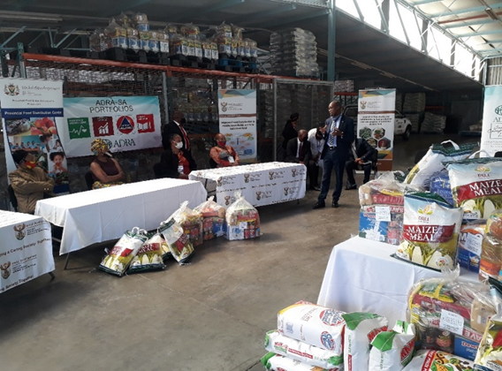
Poverty Alleviation, Sustainable Livelihoods and Food Security
33

Slide 34
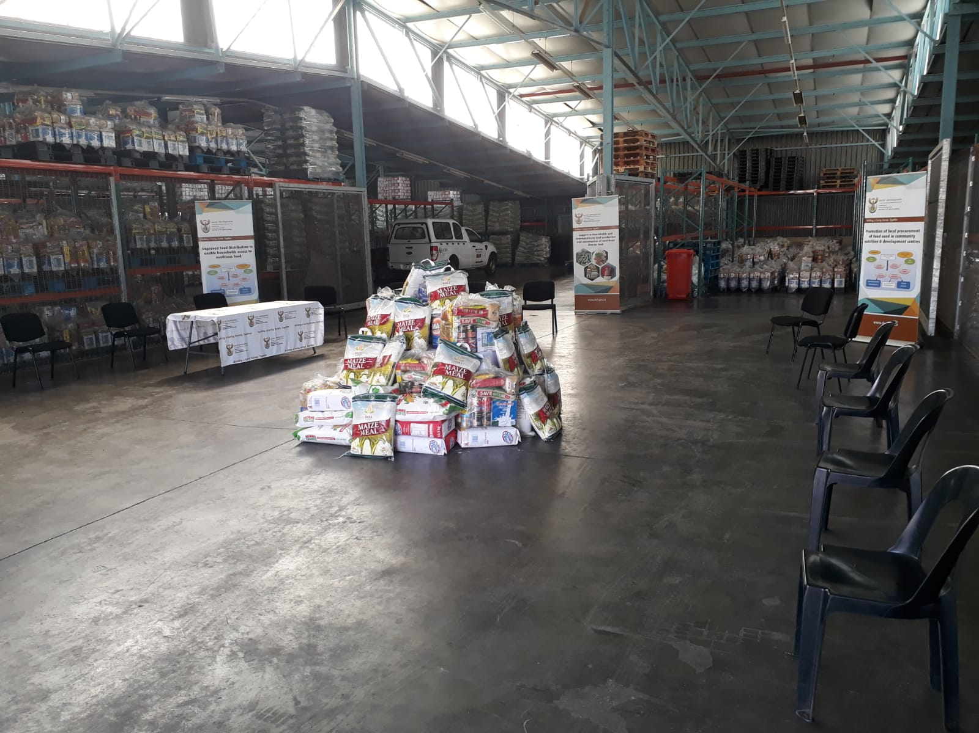
Poverty Alleviation, Sustainable Livelihoods and Food Security
34

Slide 35
High Level Achievement – Community Development
  Framework on Linking Social Protection Beneficiaries to Sustainable Livelihoods Opportunities
    The Department developed a Framework on Linking Social Protection Beneficiaries to Sustainable Livelihood Opportunities.
    The Framework seeks to respond to the ever-increasing number of beneficiaries of social protection, especially social grants beneficiaries which may not be sustainable even though it significantly contributes towards poverty alleviation.
    It is intended to protect the poor, vulnerable individuals and households, but also to ensure that those who graduated out of poverty are in a position to survive with limited support from government as well as to deal with the shocks and stresses that may emerge in future.
  Provision of food to poor and vulnerable people and those affected by COVID-19 pandemic
    Due to COVID-19 outbreak and the subsequent nationwide lockdown, there was an increased demand for food by vulnerable households
    The Department had to continue with the provision of food parcels to poor and vulnerable individuals and households as a response to the COVID-19 pandemic, even during the hard lockdown levels.
    A total of 10 006 423 people and 2 348 848 households accessed food through DSD programmes.
    About R66 million worth of food donations were distributed to the provinces during the lock-down period, through organisations such as the Church of Jesus Christ of the Latter Days Saints, The Solidarity Fund, Old Mutual, The Spar Group, Khula Mulling, South African Sugar Association and many others, who donated food, and food vouchers to support humanity during this time

Slide 36
Part B: Annual Financial Statements

Slide 37
AUDITED ACTUAL EXPENDITURE – 2020/21
99%
Spending
The audited actual expenditure of the Department for the 2020/21 financial year reflects a 99% spending. This mainly relate under Programme 2: Social Assistance, due to higher than expected payments to beneficiaries for the special COVID-19 Social Relief of Distress grant since May 2020.
37

Slide 38
AUDITED ACTUAL SUMMARY EXPENDITURE
Programme | Final Approp | Audited Outcome
 |  | Expenditure | Deviation | % Spending
 |  | R’000 | R’000 | R’000
P1 :Administration | 426 560 | 391 451 | 35 109 | 91.77%
P2: Social assistance | 220 606 557 | 218 945 760 | 1 660 797 | 99.25%
P3: Social Security Policy And Administration | 7 585 831 | 7 548 537 | 37 294 | 99.51%
P4: Welfare Services Policy Development And Implementation Support | 1 842 277 | 1 718 632 | 123 645 | 93.29%
P5: Social Policy And Integrated Service Delivery | 346 073 | 318 322 | 27 751 | 91.98%
TOTAL | 230 807 298 | 228 922 702 | 1 884 596 | 99.18%

Slide 39
AUDITED ACTUAL SUMMARY EXPENDITURE
Economic Classification | Final Approp | Audited Outcome
 |  | Expenditure | Deviation | % Spending
 |  | R’000 | R’000 | R’000
Current Payments | 999 528 | 786 705 | 212 823 | 78.71%
Compensation of Employees | 630 793 | 528 853 | 101 940 | 83.84%
Goods and Services | 368 735 | 257 852 | 110 883 | 69.93%
Transfers and Subsidies | 229 795 843 | 228 127 910 | 1 667 933 | 99.27%
Provinces and municipalities | 1 411 399 | 1 411 399 | 0 | 100.00%
Departmental agencies and accounts | 7 705 022 | 7 705 021 | 1 | 100.00%
Foreign governments and international organisations | 7 318 | 3 817 | 3 501 | 52.16%
Non-profit institutions | 42 620 | 38 774 | 3 846 | 90.98%
Households | 220 629 484 | 218 968 899 | 1 660 585 | 99.25%
Payments of Capital Assets | 11 927 | 8 087 | 3 840 | 67.80%
Payments of Financial Assets | 0 | 0 | 0
TOTAL | 230 807 298 | 228 922 702 | 1 884 596 | 99.18%
39

Slide 40
REASONS FOR UNDER SPENDING PER PROGRAMME
P1: Administration – 91%
  Low spending on operational expenditure was a result of lockdown restrictions which reduced travelling costs significantly.
P2: Social Assistance – 99%
- The underspending relate mostly to the R350 SRD grant in terms of backpays and appeals cases.
P3: Social Security Policy and Administration – 99.5% Inspectorate
    The low spending mainly relate in the processing of the Social Assistance Amendment Bill, 2018 in Parliament coupled with the moratorium on filling of posts has hampered the full operationalization of the Inspectorate.
  Appeals Tribunal
    The underspending on consultants mainly relate to the drafting of regulations that will support the implementation of the Social Assistance legislation and lesser litigation costs.
40

Slide 41
REASONS FOR UNDER SPENDING PER PROGRAMME
P4: Welfare Services Policy Development and Implementation Support – 93.4%
  Compensation of Employees
    Lower than expected spending as a result of the additional allocations received (R124 million) in the adjusted budget for the extension of the 1809 social worker contracts and the employment of the 500 ECD registration support officers.
  Goods and Services
    Lower than expected spending on travel, venue and advertising which relate to the extended lockdown restrictions. This also influenced and limited community interactions.
P5: Social Policy and Integrated Service Delivery – 92%
  Compensation of Employees
    The low spending relate to the number of current vacancies in this programme. Currently, 9 vacant posts have been recorded of which 4 posts relate to Senior Management Services.
  Goods and Services –
    Low spending relate to the Covid-19 lockdown restrictions which had a direct impact on traveling and outreach programmes.
41

Slide 42
CONCLUSION
DSD recorded a very significant improvement in performance during 2020-2021, where a total of 81% of its set targets were achieved, as compared to 49% achievement of targets in the 2019-2020.
The improvement in performance may be attributed to, among others, Strengthened Governance and Compliance Culture, institutionalised Quarterly Performance Review Sessions. Several Review session were held during 2020-2021 to identify the root causes and agree on corrective actions to ensure that targets are fully achieved.
DSD has also improved greatly on its planning and monitoring processes. During development of its plans, particularly the APP, the indicators and targets are subjected to SMART (Specific, Measurable, Attainable, Realistic, Time bound) principles to ensure that all commitments in the APP are achievable. Risks as well as mitigation strategies are identified for all measurable outputs to ensure that if such risks arise, the impact on the delivery of services is minimal. Strict controls are also in place and early warning systems to detect possible risks of non achievements. We have also institutionalized planning across the DSD Portfolio for the first time against a common mantra supported by a Sector APP.
For the first time during 2020-2021, we also developed a Support Services APP (SSAPP). The SSAPP elaborate how support services functions within the Department enable and enhance the internal operational environment for improved efficiencies. The SSAPP brings core and support services closer together and ensures a collective focus on service delivery – this, like the complete core APP are linked to managers performance agreements.
These efforts towards improved planning were demonstrated through an improved APP for the 2021-22 which shows how we want to operate differently (SMARTER) in the new F/Y, having made a number of significant shifts towards improving performance.
We continue to implement our interventions in a Portfolio Approach in order to consolidate and strengthen our efforts of improving the quality of life of our people.
We continue take the lessons learnt and find innovative ways to be much more agile and more responsive to the high demand our services.
We remain committed to improving the wellbeing of every South African Citizen through our support measures, many of which we view as investments towards unlocking the potential of citizens to make them self sufficient.

Slide 43


