Slide 1


Building on the past to shape the future
Presentation to the Portfolio Committee on Higher Education, Science and Innovation
19 November 2021
1

Slide 2


Presentation overview
Mandate
HSRC’s COVID response
Performance overview
HSRC’s achievements in 2020/21
Important areas of work
Human Resources
Financial overview
Going forward and acknowledgements

Slide 3









Mandate
The Human Sciences Research Council Act, 2008 (Act No. 17 of 2008) (HSRC Act).
The Act outlines the mandate of the HSRC as follows:
Research in human sciences relevant to South Africa, Africa and worldwide projects linked to public sector collaborative programmes
Inform policy, monitor policy and evaluate implemented policy
Encourage debate through effective circulation and distribution of research
Build research capacity and infrastructure in South Africa and Africa
Support and build research collaboration with the people and government
Researching and analysing development problems
Develop and make publicly available new data sets to support research, development and public discussion
Develop new and improved methodologies for use

Slide 4
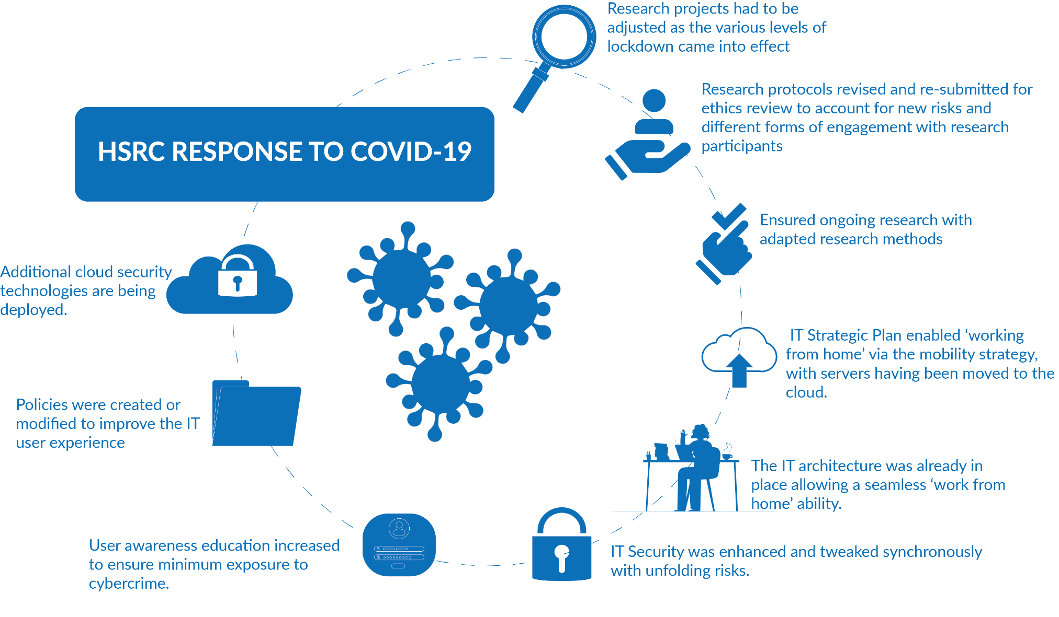
HSRC’s response to the COVID-19 pandemic
4
Notes:
Many research projects had to be adjusted as the various levels of lockdown came into effect, with research protocols revised and re-submitted for ethics review to account for new risks and different forms of engagement with research participants. Through adaptation and implementation of new research methods the HSRC was able to ensure that ongoing research studies proceeded and structures were set in place to respond to new opportunities necessitated by the need for evidence-based responses to the impacts of COVID-19.
The IT Department’s Strategic Plan was tested during the pandemic. In its third year of existence, the IT Strategic Plan enabled ‘working from home’ via the mobility strategy, with servers having been moved to the cloud. Thus during the pandemic, the architecture was already in place allowing a seamless ‘work from home’ ability. Security was enhanced and tweaked synchronously with unfolding risks. User awareness education increased to ensure minimum exposure to cybercrime. Policies were created or modified to improve the IT user experience when working from home and additional cloud security technologies are being deployed.

Slide 5
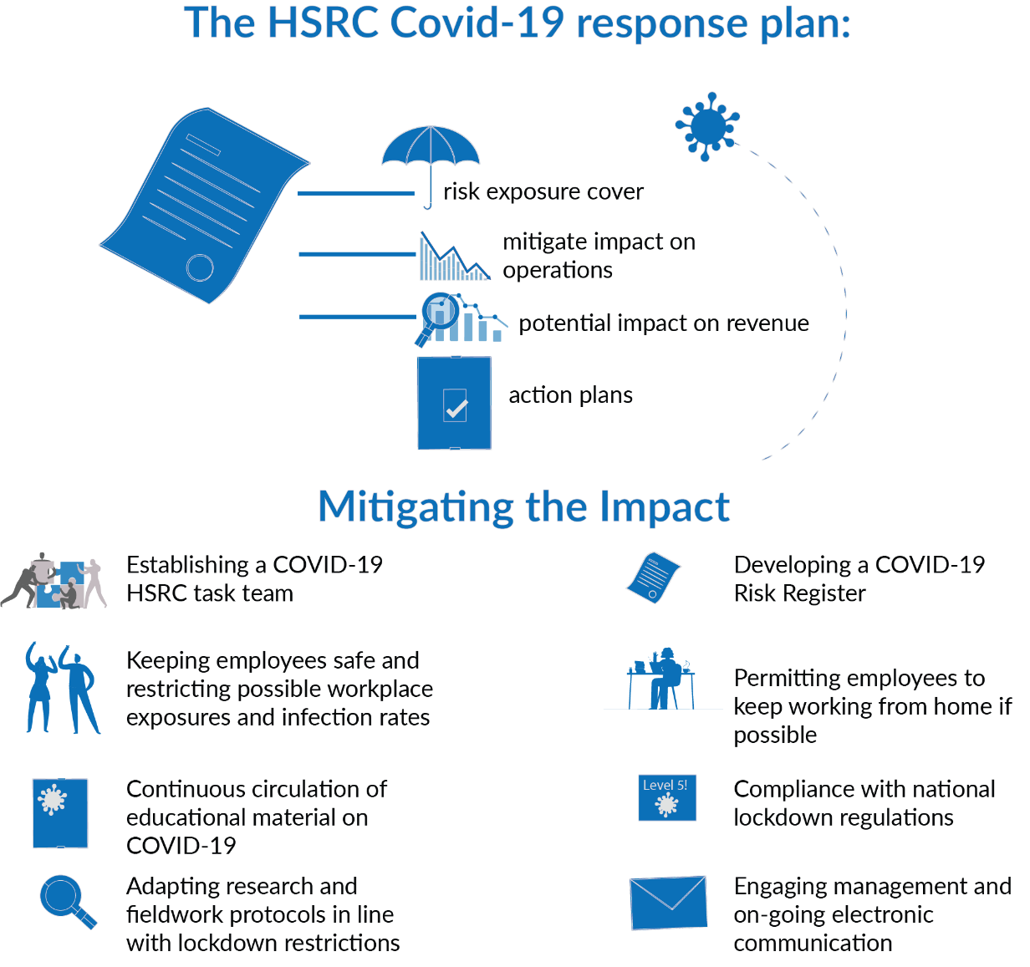
HSRC’s response to the COVID-19 pandemic
5
Notes:
In line with the COVID-19 regulations, the HSRC was faced with severe restrictions but complied with lockdown regulations to prevent loss of life and maintain the well-being of staff, while at the same time maintaining business continuity in critical organisational areas.
The HSRC developed a COVID-19 response plan that covers risk exposure, impact on operations, safety measures, action plans and potential impact on revenue. This document was also informed by directives from the Presidency and the DSI.
The HSRC approach to mitigating the impact of the COVID-19 pandemic included:
Establishing a COVID-19 HSRC task team;
Developing a COVID-19 Risk Register;
Keeping employees safe and restricting possible workplace exposures and infection rates;
Permitting employees to keep working from home as far as possible;
Continuous circulation of educational material on COVID-19;
Compliance with national lockdown regulations;
Adapting research and fieldwork protocols in line with national lockdown restrictions; and
Engaging management and on-going electronic communication.

Slide 6
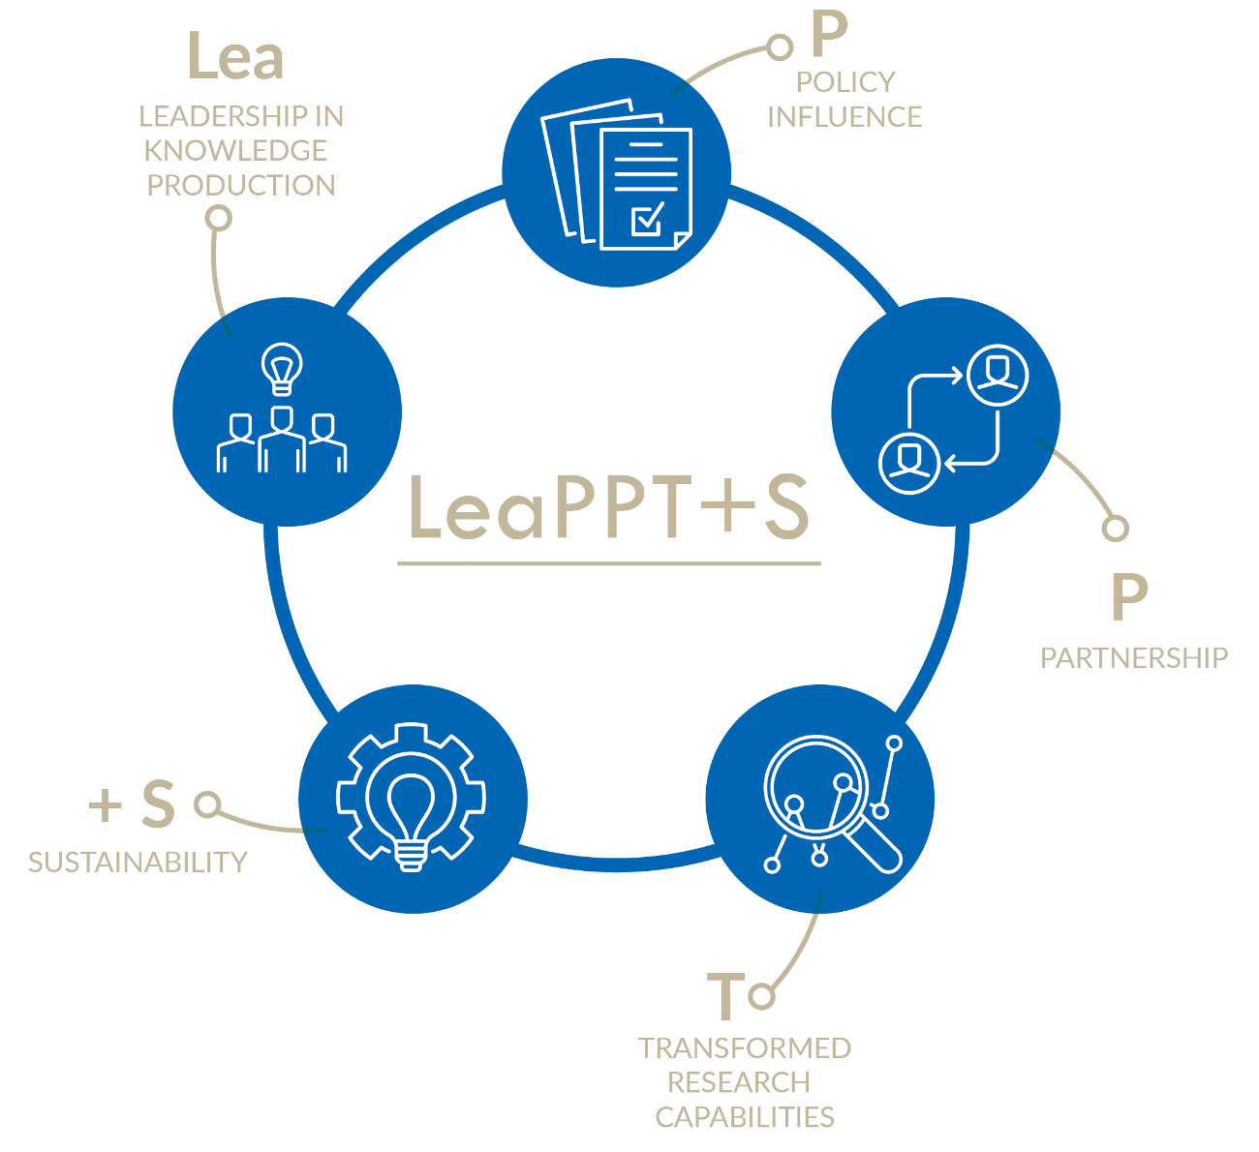
Performance Overview
6
Notes:
Effective from 1 April 2020, the HSRC implemented an organisational realignment with a more streamlined structure of research divisions, better reflecting the areas of ongoing and future focus of the HSRC.
This was part of the implementation plan envisioned in the Strategic Plan 2020–2025. The new five-year strategy necessitated a realignment of the organisational structure to ensure that resources were allocated optimally to achieve the outcomes envisaged in the strategy.

Slide 7

Performance Overview
HSRC’s overall performance for 2020/21
90%
7

Slide 8
Performance Overview
LeaPPT+S
Lea - Leadership in knowledge production
100%
7/7
P – Policy influence
100%
2/2
P – Partnerships
100%
5/5
T – Transformed research capabilities
80%
5/4
S – Sustainability
50%
2/1
8
Notes:
Out of 7 annual indicators, 7 targets were met (i.e., achieved or exceeded). Five of the quarterly targets (for Q4) were met.
Out of 2 annual indicators, 2 targets were met.
Two quarterly targets were met.
Out of 5 annual indicators, 5 targets were met.
Four quarterly targets were met.
Out of 5 annual indicators, 4 targets were met.
Three quarterly targets were met.
Out of 2 annual indicators, 1 target was met.
One quarterly target was met.

Slide 9

The HSRC’s achievements – 2020/21
THE CONTEXT FOR THE HSRC’S PERFORMANCE IN A COVID-19 YEAR
When the global COVID-19 pandemic reached South Africa in March 2020, the HSRC, and its entire workforce had to rapidly adapt to a remote and virtual working environment. Several physical engagements, including training events, workshops or contributions at international conferences had to be cancelled, impacting on planned performance in some instances. Many research projects had to be adjusted, with research protocols revised and re-submitted for ethics review to account for new risks and different forms of engagement with research participants.
As the Ministry of Higher Education, Science and Innovation mobilised the National System of Innovation for a coordinated response to COVID-19, the HSRC added to these efforts by gathering, assimilating and sharing information to assist government in understanding the social aspects of the pandemic.
Despite national COVID-19 safety protocols and risk mitigation strategies work continued. Amongst a range of surveys indicated hereunder, the HSRC worked with DSI to host the 2020 Science Forum and continued with its flagship survey, the South African Democracy Expert Survey.
The HSRC continued to host its thought provoking seminars, albeit on digital platforms. In the year under review, 48 seminars were held.
Informing awareness and public debate around the social and human dimensions of COVID-19 restrictions
Processing responses to gazetted amendments to the Disaster Management Act Regulations
Science engagement: COVID-19 Africa Rapid Grant
COVID-19 comic for distribution to communities
Special edition HSRC Review, April 2020, with a focus on COVID-19
9

Slide 10
The HSRC’s achievements – 2020/21
Surveys to understand attitudes, perceptions and behaviours in relation to COVID-19
The HSRC conducted a number of surveys aimed at informing government planning and messaging for coordinated and effective COVID-19 responses. The nature of the pandemic and the COVID-19 safety protocols necessitated an agility and innovation in how the HSRC conducted its research. Much of the work conducted by the HSRC took place using online platforms, primarily the biNu Moya messaging platform which is also data free. This helped the HSRC to reach its intended audiences in a more targeted way.
The Lockdown Survey conducted by the HSRC
The UJ/HSRC COVID-19 Democracy Survey
HSRC and UKZN’s School of Medicine release results of Health Workers Survey
National COVID-19 Antibody Survey
Key contributions to work led by the National Education Collaboration Trust
The impact of COVID-19 on R&D and innovation in South African businesses
Death without Dignity? COVID and custom in rural South Africa
Home delivery and monitoring of ART during COVID-19
Schooling and post-schooling during the COVID-19 pandemic in South Africa
Contributing to the quest for equitable education in South Africa
Presidential Youth Employment Intervention Project
The SA National Survey on Health, Life
Experiences and Family Relations
State of the Nation Volume 2021: Ethics, Politics, Inequality: New directions
National Survey on Persons with
Disabilities in COVID Times
10

Slide 11
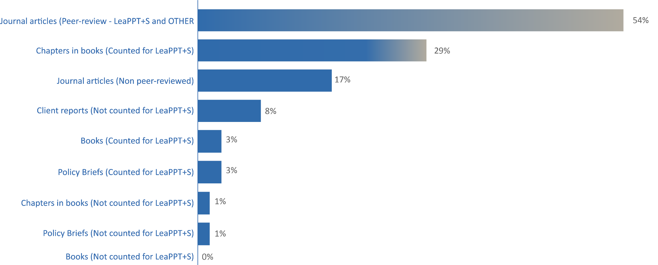
The HSRC’s achievements – 2020/21
RESEARCH OUTPUTS PRODUCED
LeaPPT+S per research output type
Most (54%) of the research outputs produced in 2020/21 were journal articles, of which 69% were DHET accredited or peer-reviewed and 31% non-peer-reviewed. The journal articles were closely followed by chapters (29%) published in scholarly peer-reviewed books.
11

Slide 12
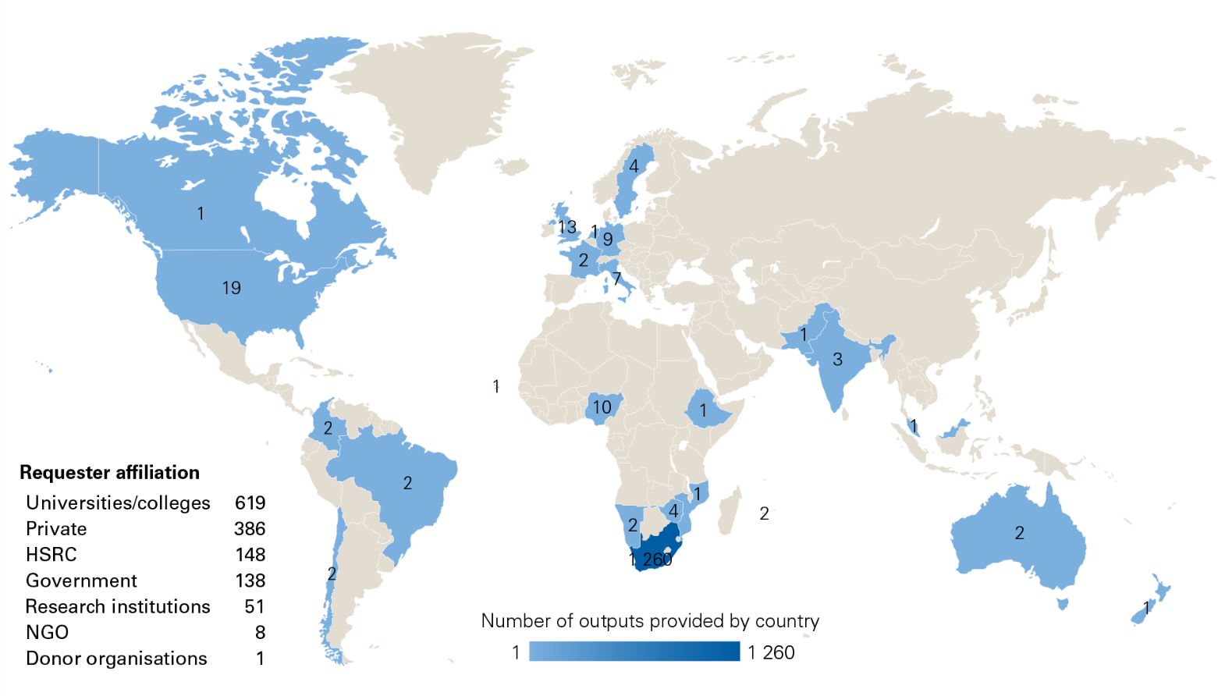
The HSRC’s achievements – 2020/21
RESEARCH OUTPUTS PRODUCED
Requests for HSRC research outputs
1 351 requests for HSRC research outputs were delivered during the year under review. Requests for research outputs mostly originated from South Africa (93%), United States of America (1%) and the United Kingdom (1%).
The individuals who enquired about research outputs mainly hailed from higher education institutions (46%) or requested the outputs in their private capacity (29%). HSRC staff contributed to 11% of the total requests, while the majority of the requests were received from non-HSRC individuals (89%).
12

Slide 13
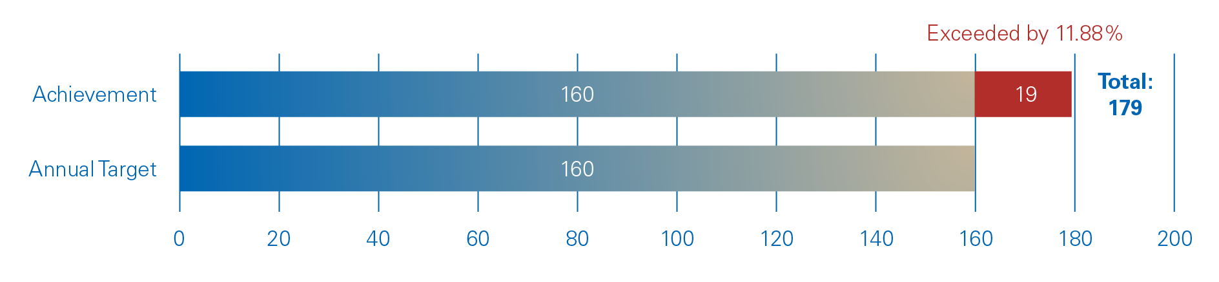
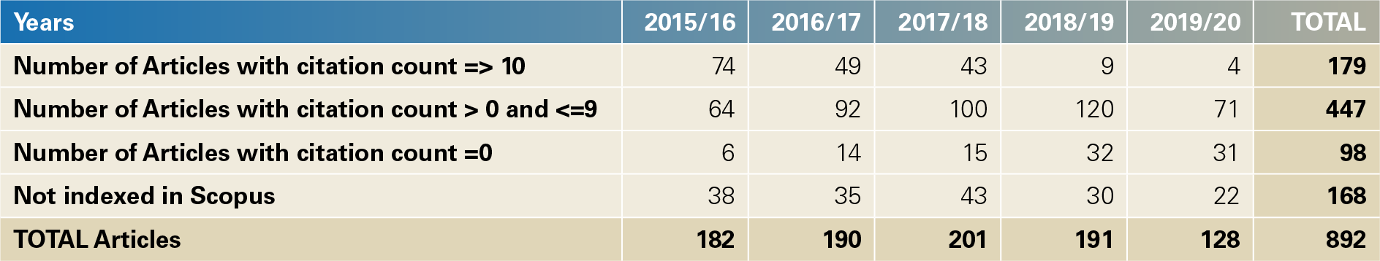
The HSRC’s achievements – 2020/21
RESEARCH OUTPUTS PRODUCED
HSRC research academic impact for 2020/21
By conducting citation analysis through credible databases, it is possible to determine the citation count of all published journal articles authored by HSRC staff.
An abstract and citation analysis tool called Scopus was used to track citations for the 892 accredited journal articles retrieved from the Research Management System (RMS). It was found that 81.17% of these articles were primarily indexed in Scopus.
The target that was set for 2020/2021 was 160 journal articles that had a citation count of 10 or more. The investigation revealed that 179 of the 892 articles (20.07%) had a citation count of 10 or more, measured over the five-year period. This achievement is 11.88 % above the annual target.
Comparison between the achievement and target for articles with a citation count >=10
Number of articles with citation count levels
13

Slide 14
The HSRC’s achievements – 2020/21
ONGOING AND LONG-TERM WORK
Food Security and Nutrition Survey in South Africa (DALRRD)
Research & Development Survey (DSI)
The Sixth South African National HIV Prevalence, Incidence, Behaviour, and Communication Survey, 2021 (SABSSM VI - PEPFAR/CDC)
2020 South African Social Attitudes Survey (Multiple funders)
The Trends in International Mathematics and Science Study (TIMSS)(DBE)
The Imprint of Education (TIE) study (MasterCard Foundation)
Strengthening the Capacities of Science Granting Councils in Gender and Inclusivity (IDRC)
AI ethics and human rights in Africa (Facebook Foundation)
School’s Out Engaging civil society in rolling out Sexual and Reproductive Health and Rights (SRHR) education across Eastern and Southern Africa (Amplify Change)
District Development model pilot study (HSRC)
Assessment of the National Development Agency (NDA)
14

Slide 15
Human Resource Management
EMPLOYMENT AND VACANCIES
The table below captures the details of all permanent employees and those on long-term contracts, i.e. 12 months or longer, including those whose salaries are recovered from project funding.
Programme | 2019 / 20 No. of Employees | 2020/21 Approved Posts | 2020/21 No. of Employees | 2020/21 Vacancies | % of Vacancies
Programme 1 | 171 | 222 | 201 | 21 | 9%
Programme 2 | 297 | 235 | 220 | 15 | 6%
Total | 468 | 457 | 421 | 36 | 7%
The table below specifically captures the details of Top and Senior Management levels as these are the only two levels which do not have project funded staff which would impact on the vacancy factor.
Occupation Level | 2019 / 20 No. of Employees | 2020/21 Approved Posts | 2020/21 No. of Employees | 2020/21 Vacancies | % of Vacancies
Top Management | 14 | 15 | 14 | 1 | 7%
Senior Management | 23 | 30 | 22 | 8 | 26%
Total | 37 | 45 | 36 | 9 | 27%
15

Slide 16
Human Resource Management
EQUITY TARGET AND EMPLOYMENT EQUITY STATUS
HSRC Employees by race
HSRC Employees by gender
16
Notes:
The Employment Equity Act requires that designated employers must report on all employees, including those on short-term contracts. The tables below thus also incorporate employees on short-term contracts as at 31 March 2021.
HSRC also employed 4 disabled staff members, 2 male and 2 female during the year. (0.95% of staff)

Slide 17

Financial Overview
Audit report
Annual Financial Statements overview
17

Slide 18
Audit report
  Unqualified opinion with findings on compliance with legislation;
  No material misstatements were identified on the annual financial statements
  No material findings were identified in terms of the annual performance information
18
Notes:
Procurement and contract management
20. Some of the goods and services of a transaction value above R500 000 were procured without inviting competitive bids as
required by Treasury Regulation 16A6.1 and paragraph 3.4.1 of Practice Note 8 of 2007/2008.
Internal Control Deficiencies
Management did not adequately monitor controls to ensure compliance with laws and regulations. Review and monitoring
processes were not sufficient to ensure that the appropriate authority approved deviations from normal competitive bidding
resulting in irregular expenditure.

Slide 19
Irregular expenditure
19
Notes:
Procurement and contract management
20. Some of the goods and services of a transaction value above R500 000 were procured without inviting competitive bids as
required by Treasury Regulation 16A6.1 and paragraph 3.4.1 of Practice Note 8 of 2007/2008.
Both the current and prior period irregular expenditure identified, are due to non-compliance under paragraph 8.5 of SCM Instruction note 3 of 2016/2017 originates from the incorrect interpretation of "sole supplier" versus "single source supplier". Sole supplier deviations are approved in terms of the entity’s delegation of authority, but all single source suppliers must be pre-approved by National Treasury.
Five (5) donor funded sub-contractor appointments to the amount of R3,064 million
Twelve (12) donor funded sub-contractor appointments to the amount of R12,835 million

Slide 20
Irregular expenditure
Further determination 2016/17 to 2018/2019 will be concluded by management and reported.
Improvement plan:
          National Treasury / AGSA
          SCM Policy update
          Procurement Framework
          Training
Consequence management
20
Notes:
Further determination to identify facts and amounts related to transactions for 2016/17 to 2018/2019 will be concluded by management and reported accordingly.
HSRC met with National Treasury in September 2021.
The appointment of sub-contractors/partners in terms of proposals is categorised under “single source suppliers” and requires pre-approval from National Treasury before appointment or issuing of a purchase order or signing of the contract.
Procedure for approval in place since September 2021.
National Treasury has agreed to a turnaround time of 5 working days for a response on this nature of preapprovals.

Slide 21

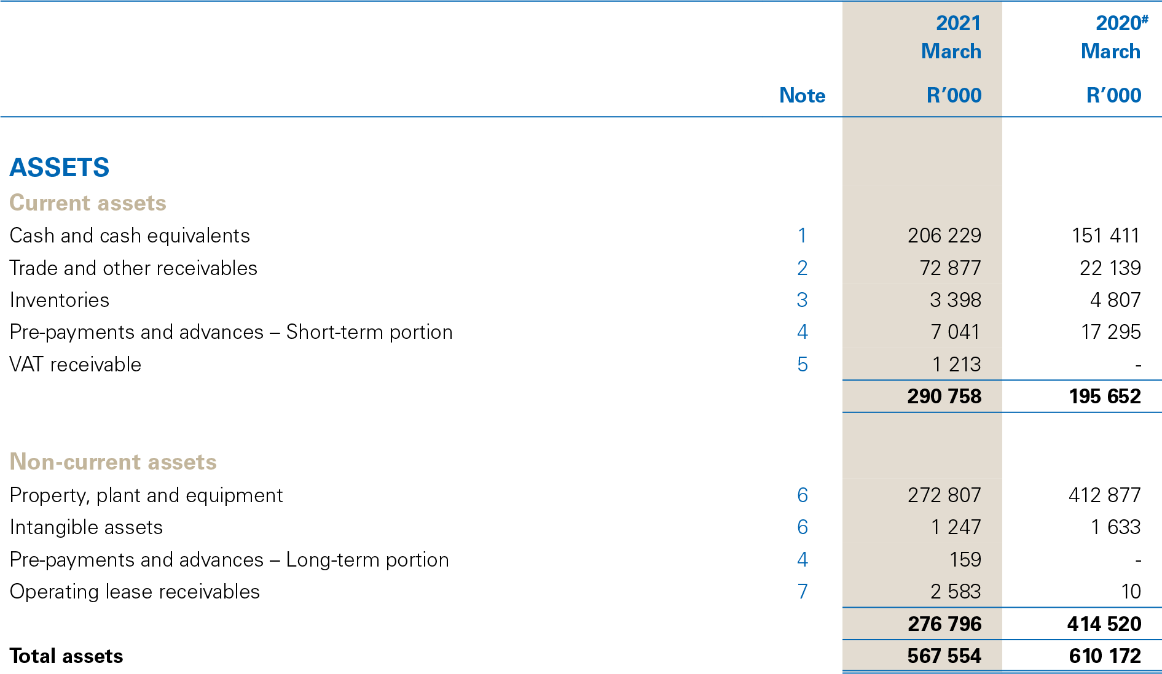
Statement of Financial Position
21
Notes:
Page 133
Note 1 page 143. Increase of 36.2% in cash from R151,4 million to R206,2 million. The significant increase, is primarily due to large amount of income received in advanced (project funds) that are held in short-term investment accounts during the financial year. Also refer to note 9.
Note 2 page 143/144. Increase of 252% in Trade and other payables for 2020 to 2021. The increase due to invoices raised the last two months of 2021. Decrease in WIP from R8,2 million in the previous year to R6,8 million in the current financial year. The provision for impairment remained the same.
Note 4 page 145. Decrease in prepayments is primarily due to the prepayment of R13 million made to the Amplify Change partners in the final quarter of 2020.
Note 6 page 145. Decrease of 34% in PPE due to the revaluation of the Pretoria Building.
Note 7 page 145. Decrease of 23.6 % in Intangible assets.

Slide 22
Assets
22
Notes:
Page 133

Slide 23
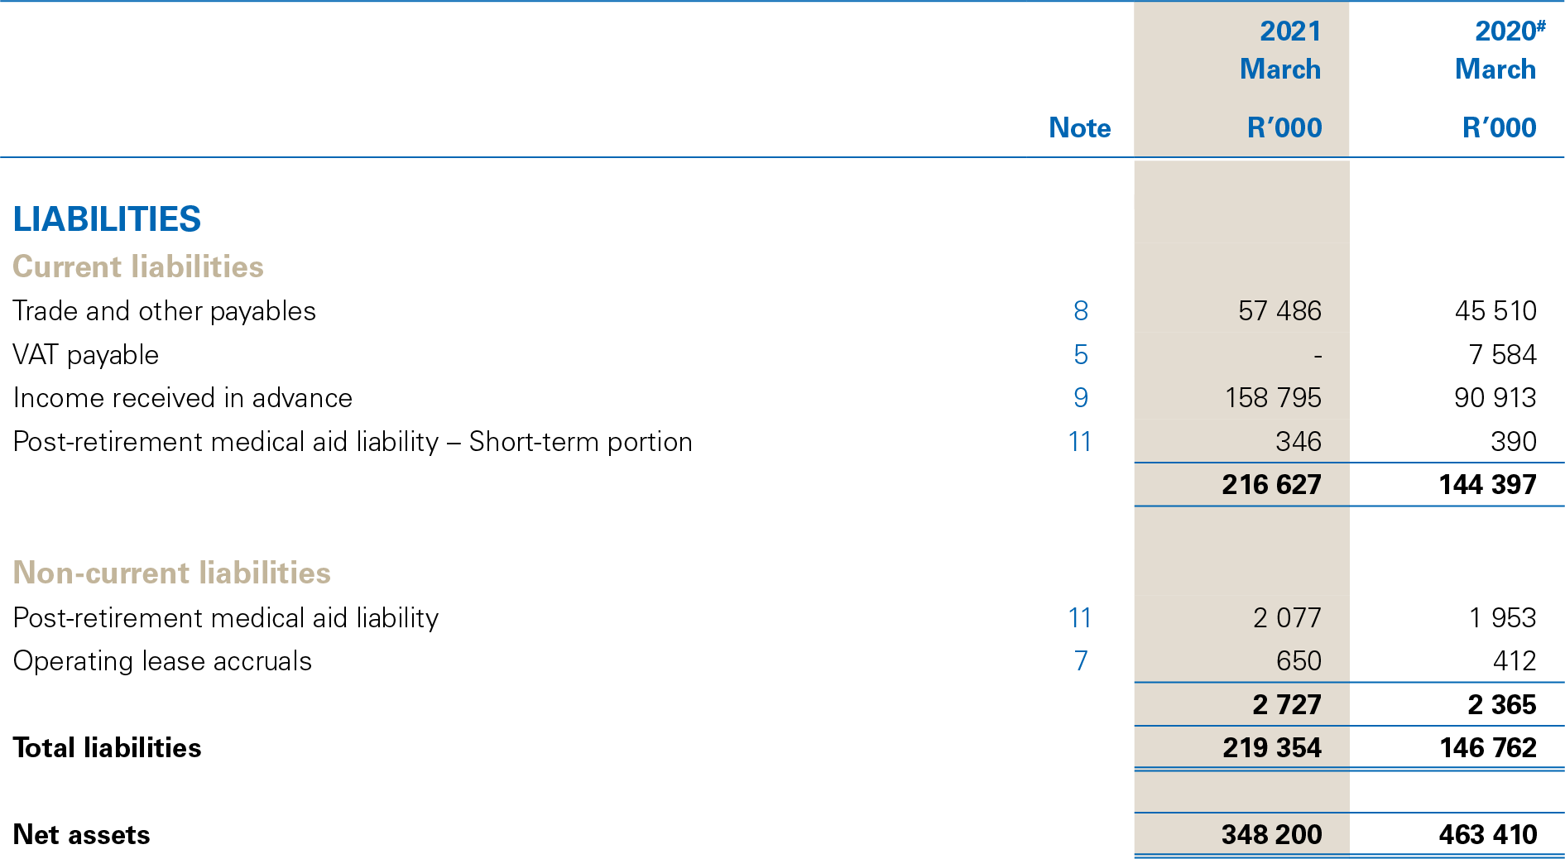
Statement of Financial Position
23
Notes:
Page 133
Note 8 page 154 Trade payables increased with 26% mainly due to an increase of accruals at year end to the amount of R 11,3 million.
Note 9 page 154 Income received in advance increased by R67,9 million or 75%. The significant increase is primarily due to large amount of advanced project funds that are held in short-term investment accounts during the financial year.

Slide 24
Liabilities
24
Notes:
Page 133

Slide 25
Assets – Liabilities + Net Assets
25
Notes:
Page 134 – Revaluation reserve

Slide 26
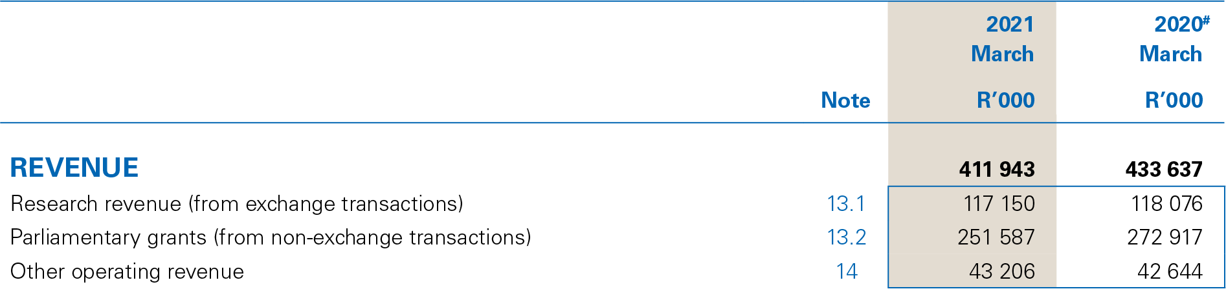
Statement of Financial Performance
26
Notes:
Page 134
Note 13 page 159
Revenue declined by 5% or 21,7 million
Decline of R1 million in research income (note 13 page 158)
Decline in national and provincial funding of R24,4 million or 41%
Increase in international funding agencies of R10,3 million or 21%
Decline in private sector of R2,6 million or 47%
Increase in universities of R15,8 million or 496%
Reduction of R 21,3 million in Parliamentary grants
Increase of R562 000 or 1% (note 14 page 159)
rental income and recoveries, interest received.

Slide 27
Revenue
27

Slide 28
Revenue
28
Notes:
Page 136 and note 29 page 169/170
Research revenue underachieved by 51% or R120 million
Absence of flagship projects in 2019/2020. Most completed in 2017/2018.
Secured multi-year big projects which commenced in 2020/2021
Other operating revenue overachieved by 16% or R6,1 million
Interest earned on unspent funds
Cafeteria closed

Slide 29
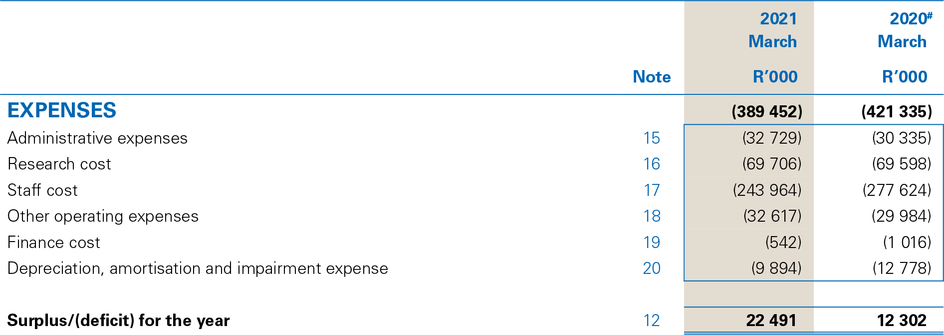
Statement of Financial Performance
29
Notes:
Page 134
Expenses declined by R33,8 million or 7,6%
Administration Increased R2,4 million or 7,9%
Research costs Remained the same. Increase of R108 000
Staff costs Declined R33,7 million or 12%
Other operating expenses Increased R2,6 million or 8,9%
Depreciation and amortisation Declined R2,9 million or 22,6%

Slide 30
Expenditure - Annual Report
30
Notes:
Page 134
Service delivery organisation 66% Personnel

Slide 31
Expenditure - National Treasury
31

Slide 32
Expenditure
MILLIONS
32
Notes:
Page 136
Administrative 42% underachieved or 23,4million
Research cost 58% underachieved or 76,5 million
Staff cost A COVID-19 budget cut was made in June 2020. As staff cost is the main cost driver of the organisation, the salary budget was limited by the Parliamentary grant amount of R251,5 million. Salaries was 3 % or R7,6 million underachieved
Other operating expenses 42% underachieved or R24,3 million
Depreciation 32% overachieved or R4,6 million

Slide 33
Revenue Analysis
33
Notes:
Page 122
Salaries was usually covered by the Parliamentary grant in 2010, 2011, 2012, 2015, 2016
Not covered by the Parliamentary grant from 2017 - 2019
Enforced in 2020 and 2021.

Slide 34

Going forward
The pandemic has shown us that we can do credible, authoritative work that can inform policy makers and society at large. As we go forward, we will bring some of these lessons to the work we do, to ensure we can make timely interventions that can support the country’s political and socio-economic agenda.
We have realised the capacity of our people to innovate and adapt. This will also be encouraged going forward as we look to bring more innovation and agility to the way in which the HSRC serves the social sciences and humanities and the country’s objectives.
While adequate budgets will always be desired, the HSRC will use the lessons and capacities developed in the last two years to deliver on its mandate more creatively.
Management is committed to resolving the issue identified during the audit regarding compliance with laws and regulations.
34

Slide 35
Acknowledgements
The HSRC Board
The Department of Science & Innovation
HSRC Management and staff
35

