Slide 1
DEPARTMENT OF EMPLOYMENT AND LABOUR
SUPPORTED EMPLOYMENT ENTERPRISES
AUDITED ANNUAL PERFORMANCE REPORT 2020/21
EMPLOYMENT AND LABOUR PORTFOLIO COMMITTEE
10 November 2021

Slide 2
TABLE OF CONTENTS
03
INTRODUCTION
04
LEGEND
05
QUARTER 1 - QUARTER 4 2020/21 ACHIEVEMENTS
06
ANNUAL PERFORMANCE REPORT 2020/2021
Highlights
07
SEE FINANCIAL STATEMENTS
08
AUDIT OPINION
09
CONCLUSION
Chief Directorate Communication | 2011.00.00

Slide 3
INTRODUCTION: SEE MANDATE
SEE STRATEGIC IMPERATIVES.
Increase revenue to 40% by 2025 – Entity projected 10% increase in revenue for FY2021/2022.
Increase SEE market share – Entity projected 7 Memorandum of Understanding (MOUs) by the end of March 2022.
To employ 400 new additional persons with disabilities by 2025 – projected 25 additional PWD to be employed by 31 March 2022.
STATUTORY OBLIGATIONS FOR SUPPORTED EMPLOYMENT ENTERPRISES
Facilitate supported employment
Provide work opportunities for people with disabilities
Develop and implement programmes that promote the employability of people with disabilities, including people with permanent disablement as defined in the Compensation for Occupational Injuries and disease Act No 30 of 1993
May perform any other act that may be required by the Minister

Slide 4
LEGEND
Implication: ACHIEVED
Performance Indicator is on track or reflects complete implementation. Target achieved
100% + Complete
Implication: NOT ACHIEVED
Performance Indicator behind schedule. Target not achieved
0% - 99% Complete

Slide 5
QUARTER 1 OVERALL PERFORMANCE
OVERALL ACHIEVEMENTS PER STRATEGIC OBJECTIVE DURING QUARTER 1
(APRIL TO JUNE 2020/21 )
PRIORITY 2: ECONOMIC TRANSFORMATION AND JOB CREATION
PURPOSE | ANNUAL PLANNED INDICATORS | INDICATORS WITH TARGETS REPORTING IN QUARTER 1 | ACHIEVED | NOT ACHIEVED | OVERALL ACHIEVEMENT %
PROVIDE WORK OPPORTUNITIES FOR PEOPLE WITH DISABILITIES | 3 | 2 | 0 | 2
TOTAL NUMBER OF INDICATORS | 3 | 2 | 0 | 2
OVERALL PERFORMANCE |  |  |  |  | 0%

Slide 6
QUARTER 2 OVERALL PERFORMANCE
OVERALL ACHIEVEMENTS PER STRATEGIC OBJECTIVE DURING QUARTER 2
(JULY TO SEPT 2020/21)
PRIORITY 2: ECONOMIC TRANSFORMATION AND JOB CREATION
PURPOSE | ANNUAL PLANNED INDICATORS | INDICATORS WITH TARGETS REPORTING IN QUARTER 1 | ACHIEVED | NOT ACHIEVED | OVERALL ACHIEVEMENT %
PROVIDE WORK OPPORTUNITIES FOR PEOPLE WITH DISABILITIES | 3 | 2 | 0 | 2
TOTAL NUMBER OF INDICATORS | 3 | 2 | 0 | 2
OVERALL PERFORMANCE |  |  |  |  | 0%

Slide 7
QUARTER 3 OVERALL PERFORMANCE
OVERALL ACHIEVEMENTS PER STRATEGIC OBJECTIVE DURING QUARTER 3
(OCTOBER TO DEC 2020/21)
PRIORITY 2: ECONOMIC TRANSFORMATION AND JOB CREATION
PURPOSE | ANNUAL PLANNED INDICATORS | INDICATORS WITH TARGETS REPORTING IN QUARTER 3 | ACHIEVED | NOT ACHIEVED | OVERALL ACHIEVEMENT %
PROVIDE WORK OPPORTUNITIES FOR PEOPLE WITH DISABILITIES | 3 | 3 | 3 | 0
TOTAL NUMBER OF INDICATORS | 3 | 3 | 3 | 0
OVERALL PERFORMANCE |  |  |  |  | 100%

Slide 8
QUARTER 4 OVERALL PERFORMANCE
OVERALL ACHIEVEMENTS PER STRATEGIC OBJECTIVE DURING QUARTER 4
(JAN TO MARCH 2020/21)

Slide 9
ANNUAL PERFORMANCE REPORT 2020/21
ANNUAL REPORT 2020/21
01 APRIL 2020 – 31 MARCH 2021
PROGRESS AND MAJOR PERFORMANCE CHALLENGES ENCOUNTERED DURING REPORTING PERIOD

Slide 10
ANNUAL PERFORMANCE REPORT
OUTCOME | OUTPUT INDICATOR | 2020/21 PLANNED TARGET | ACTUAL ACHIEVEMENT | DEVIATION FROM PLANNED TARGET TO ACTUAL ACHIEVEMENT 2020/2021 | STRATEGY TO OVERCOME UNDER PERFORMANCE | REASON FOR VARIANCE
Provide additional job opportunities for People with Disabilities | Number of additional persons with disabilities employed in the SEE factories by the end of March | 25 additional persons with disabilities employed in the SEE factories by the end of March 2021 | Achieved 25 additional persons with disabilities employed in the SEE factories by the end of March 2021 | None | N/A | N/A

Slide 11
ANNUAL PERFORMANCE REPORT
OUTCOME | OUTPUT INDICATOR | 2020/21 PLANNED TARGET | ACTUAL ACHIEVEMENT | DEVIATION FROM PLANNED TARGET TO ACTUAL ACHIEVEMENT 2020/2021 | STRATEGY TO OVERCOME UNDER PERFORMANCE | REASON FOR VARIANCE
Increase sales revenue | % annual increase of sales revenue from goods and services by the end of March | 5% annual increase of sales revenue from goods and services by the end of March 2021 | Not achieved -67% Actual sales R41 865 234 against last year’s sales of R128 122 846 | -62% | Implement aggressive marketing strategy | Insufficient orders received from government Departments due to reprioritization of expenditure areas by government Departments as a result of Covid-19

Slide 12
ANNUAL PERFORMANCE REPORT
OUTCOME | OUTPUT INDICATOR | 2020/21 PLANNED TARGET | ACTUAL ACHIEVEMENT | DEVIATION FROM PLANNED TARGET TO ACTUAL ACHIEVEMENT 2020/2021 | STRATEGY TO OVERCOME UNDER PERFORMANCE | REASON FOR VARIANCE
Increase SEE’s market share | Number of customer agreements entered into annually | 3 customer agreements entered into by the end of March 2021 | Not achieved 2 customer agreements entered into by the end of March 2021 | 1 Customer agreement | Undertake roadshows to visit provincial districts of health and education to persuade participation into the national MoUs | Insufficient commitment by Provincial parties to conclude agreements during Covid-19 uncertain times after the decentralization of procurement from national to provincial Departments.

Slide 13
SEE AUDITED AFS 2020/2021
OVERVIEW OF THE FINANCIAL RESULTS OF THE SEE
REVENUE
SEE budget comprises of a Grant from the National Treasury and additional income generated from sale of goods manufactured across all factories.
The entity was bailed out by R25m for payment of Salaries and R17,5m for the enhancement of ICT Infrustructure.
Footprint expansion plans to Mpumulanga shelved until recapitalisation budget funding is secured.
EXPENDITURE
Although expenditure SEE has high expenditure costs due to high manufacturing costs and Salary Bill
Programme expenditure incurred is less than budgeted expenditure
THE ENTITY INCURRED A DEFICIT FOR THE 2020/2021.

Slide 14
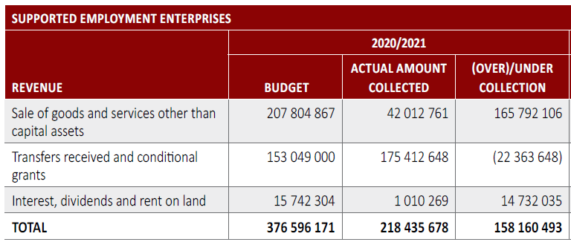
SEE AUDITED AFS 2020/2021
OVERVIEW OF THE FINANCIAL RESULTS OF THE SEE Cont…
VARIANCE EXPLANATAION:
Less sales orders due Covid-19 and minimal orders received.
Over Collection on Grants received from National Treasury due to additional funds for Bail out.
Minimal interest received due to less cash reserves in the bank.

Slide 15
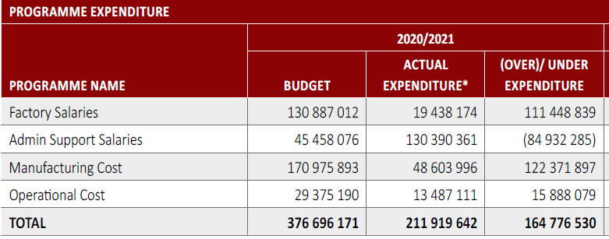
SEE AUDITED AFS 2020/2021
OVERVIEW OF THE FINANCIAL RESULTS OF THE SEE Cont…
VARIANCE EXPLANATAION:
Factory salaries were under spent due to reduced target for additional employment for persons with disabilities and;
The cost of factory salary accounted for under Admin due to less production in factories.
Admin Support Salaries reflect overspending due to factory salaries accounted for under Admin per GRAP requirements - The overall salary budget was not overspent
Manufacturing costs were underspent as less orders received than anticipated impactingon manufacturing costs.
Operational Costs were under spend due to financial constrains in 2020/2021 financial year.

Slide 16
AUDIT OPINION 2020/2021
The entity received a Qualified Audit Opinion for 2020/2021 Annual Financial Statements.
Areas of repeat findings resulted in basis for qualified opinion:
Inventory
Cost of Sales
Assets
Services in kind
Areas of improvement from 2019/2020 Annual Financial Statements:
Cash Flow Statement
Performance Information

Slide 17
AUDIT ACTION PLAN - 2020/2021
Audit report was concluded on 15 September 2021.
Summary of audit progress as at 15 October 2021
Status of Audit Action plan Audit Findings

Slide 18
Thank You…

