Slide 1

Seda 2020-21 Annual Report
Portfolio Committee
17 November 2021
N Mbatha: CEO (Acting)

Slide 2
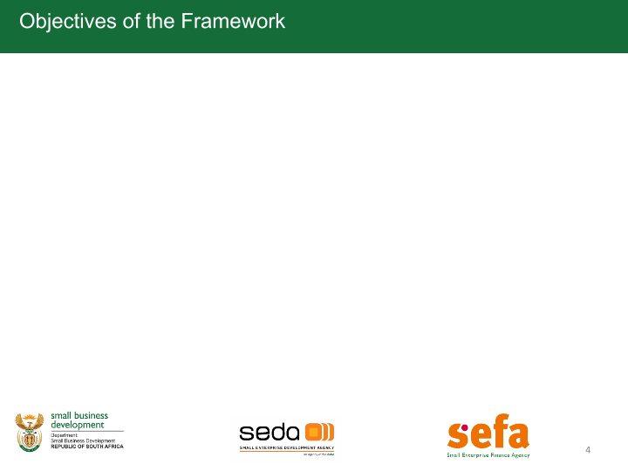
SEDA PRESENTATION OUTLINE
1 | Organisational Overview
2 | Seda Performance 2020 -21 FY
2. 1 | Programme 1 :EDD
2.2 | Programme 2 :STP
2.3 | Programme 3 :Administration
3 | Human Resources Report
4 | Financial Information
5 | Governance & Compliance
6 | Audit Outcomes
7 | Success Stories

Slide 3
1. Organisational Overview

Slide 4
Organisational overview
Seda’s performance information is presented in accordance to the approved Annual Performance Plan 2020-21
In the year under review Seda measured its performance on 23 indicators at output level
The organisation achieved and exceeded the set targets on 12 indicators, this performance reflect an achievement of 52% on set indicators.
One (1) indicator was underachieved between 80% to 99%, three (3) indicators were underachieved between 50% to 79% and seven (7) indicators were achieved below 50% category.
A total of 52 139 SMMEs and Cooperatives were supported in the 2020-21 financial year.
Seda supported 14 657 SMMEs and Cooperatives who are based in Township and Rural areas through the Township and Rural Entrepreneurship Programme.

Slide 5
Organisational overview
Core | Statement
Mission | To promote entrepreneurship and facilitate the development of small enterprises by providing customized business support services that result in business growth and sustainability in collaboration with other role players in the ecosystem
Vision | To make a difference in SMME’s life everyday
Values | Nurture Innovation Customer Centricity Responsible Conduct

Slide 6
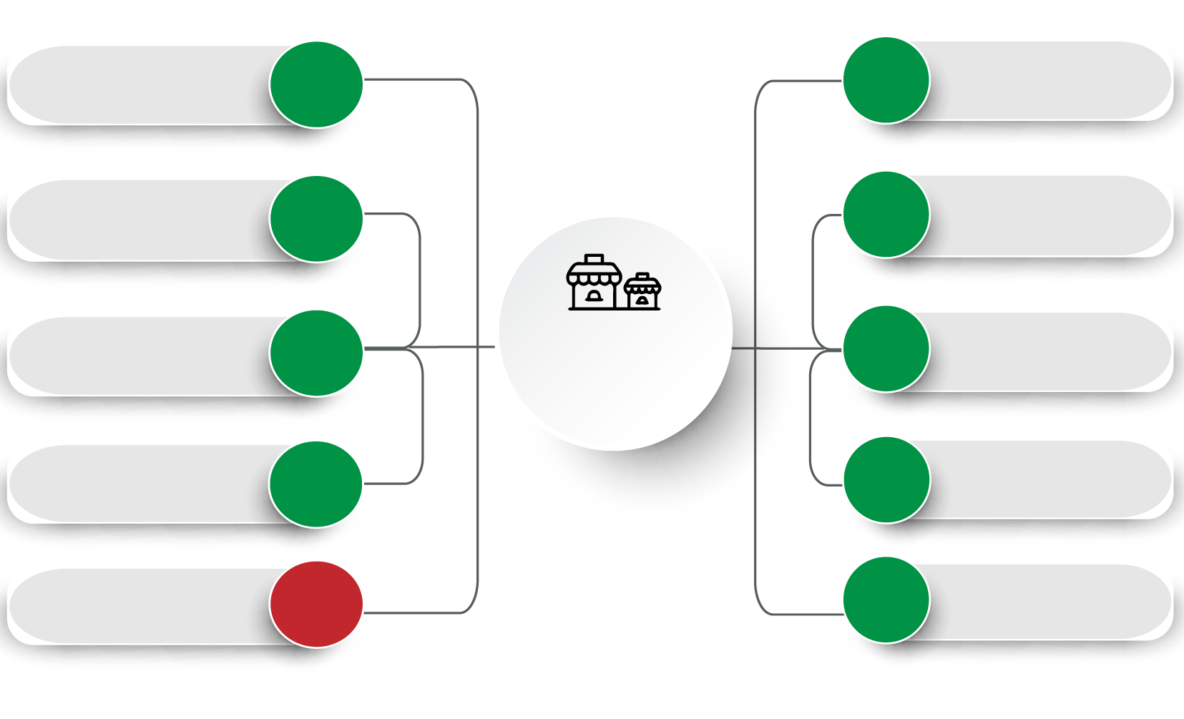
Performance dashboard
Business Development
Support
23 123
4 694
Export
Development
Cooperatives
Supported
1 222
1 336
Tech start-ups
Supported
Spaz shops
supported
5 703
Total SMMEs &
Cooperatives
Supported
52 139
826
Idea Pitching
Support through
Information Centre
8 576
4 232
Access to Finance
Technology
Transfer Assistance
3 557
Conformity
Assessments
206

Slide 7

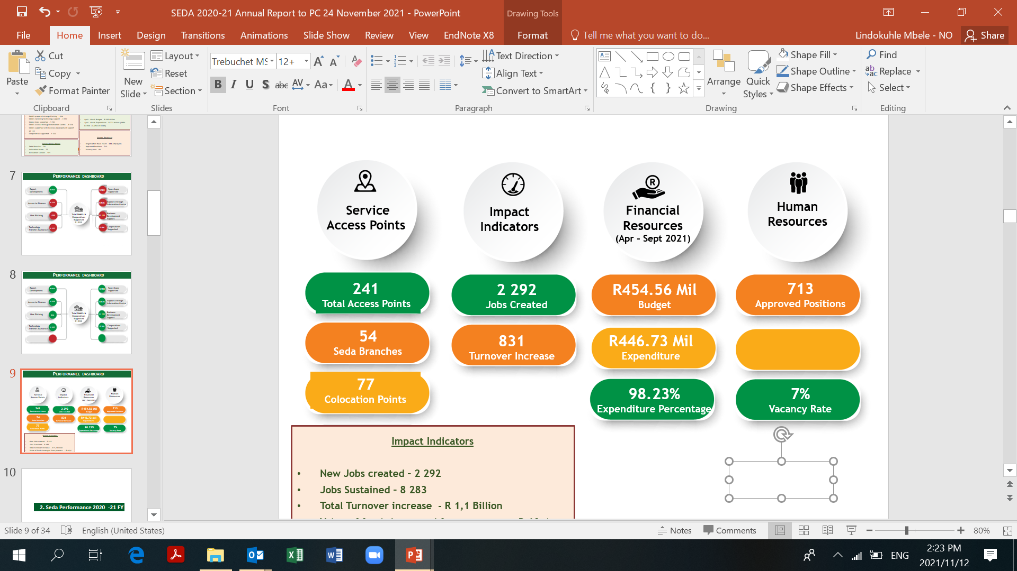
Performance dashboard
Service
Access Points
Impact
Indicators
Financial
Resources
(Apr – Mar 2021)
Human
Resources
232
Total Access Points
2 292
Jobs Created
R990 Mil
Budget
713
Approved Positions
54
Seda Branches
8283
Jobs Sustained
R773 Mil
Expenditure
646
Filled Positions
77
Colocation Points
R 1.1 Billion Turnover increase
78%
Expenditure Percentage
9%
Vacancy Rate
101
Incubation Centers
101
Incubation Centers

Slide 8
2. Seda Performance 2020 -21 FY

Slide 9
2.1 Programme 1 :EDD

Slide 10
2.1 Programme 1 :EDD
No. | Performance Measure | Target | Achievement
1. | Number of Districts where the Facilitation Model Implemented | 15 | 8
2. | Number of spaza shop supported | 16 666 | 5 703
3. | Percentage of BDS Standards developed and implemented | 50% | 100%
4. | Number of SMMEs participating in Export Development | 2 487 | 4 694
5. | Number of Co-location Points Supported | 66 | 77

Slide 11
2.1 Programme 1 :EDD
No. | Performance Measure | Target | Achievement
6. | Number of SMMEs assisted with Access to Finance | 4 973 | 4 232
7. | Percentage of SMMEs which accessed finance successfully | 40% | 61%
8. | Number of SMMEs Assisted through the Information Centre | 14 666 | 8 576
9. | Number of BDS Providers & Practitioners capacitated to provide Sector Specific Support | 198 | 345
10. | Number of cooperatives supported through ecosystem partners | 2 600 | 1 222
11. | Number of SMMEs accessing Business Development Support (min 40% women, 30% youth & 7% disabled persons) | 55 667 | 23 123

Slide 12
2.2 Programme 2 : STP

Slide 13
2.2 Programme 2 :STP
No. | Performance Measure | Target | Achievement
1. | Percentage of Incubation & Acceleration Eco-system Facilitation Model Developed & Implemented | 25% | 25%
2. | Percentage of Incubation & Acceleration Standards Completed | 100% | 100%
3. | Number of Investment Ready SMMEs prepared to Access Finance through Pitching | 300 | 826
4. | Number of Tech Start-Up Enterprises Supported | 700 | 1 336
5. | Number of Incubation Centers, CFERIs & Digital Hubs Supported (prioritising township & rural areas) | 96 | 101
6. | Number of SMMEs Receiving Technology Transfer & Technical Assistance | 5 000 | 3 557
7. | Number of SMMEs Supported with Conformity assessments | 500 | 206

Slide 14
2.3 Programme 3 : Administration

Slide 15
2.3 Programme 3 : Administration
No. | Performance Measure | Target | Achievement
1. | Value of Support Leveraged from Partners | R 20 Million | R 60,4 Million
2. | Number of SMMEs Accessing Procurement Opportunities in Government & Corporates (30% government set asides & ESD) | 800 | 35
3. | Turnover increase in supported Enterprises through Eco-system Partnership | R 666 million | R 1,1 Billion
4. | New Jobs Created & Reported by Eco-system Partners Supported | 6 300 | 2 292
5. | Number of Jobs Sustained by Eco-system supported | 18 666 | 8 283

Slide 16
3. Human Resource Report

Slide 17
Staff Compliment
Programme | 2019/2020 No. of Employees | 2019/2020 Approved Posts | 2020/2021 No. of Employees | 2020/2021 Vacancies | % of vacancies
Programme 1: EDD | 524 | 548 | 504 | 44 | 8%
Programme 2: STP | 30 | 28 | 23 | 5 | 18%
Programme 3: Administration | 123 | 137 | 119 | 18 | 13%
Total | 677 | 713 | 646 | 67 | 9%

Slide 18
Labour Relations
Reason | Number | % of total no. of staff leaving
Resignation | 62 | 9%
Dismissal | 1 | 0%
Retirement | 4 | 1%
Ill health | 2 | 0%
Expiry of contract | 14 | 2%
Other | 2 | 0%
Total | 85 | 9%

Slide 19
4. Financial Information

Slide 20
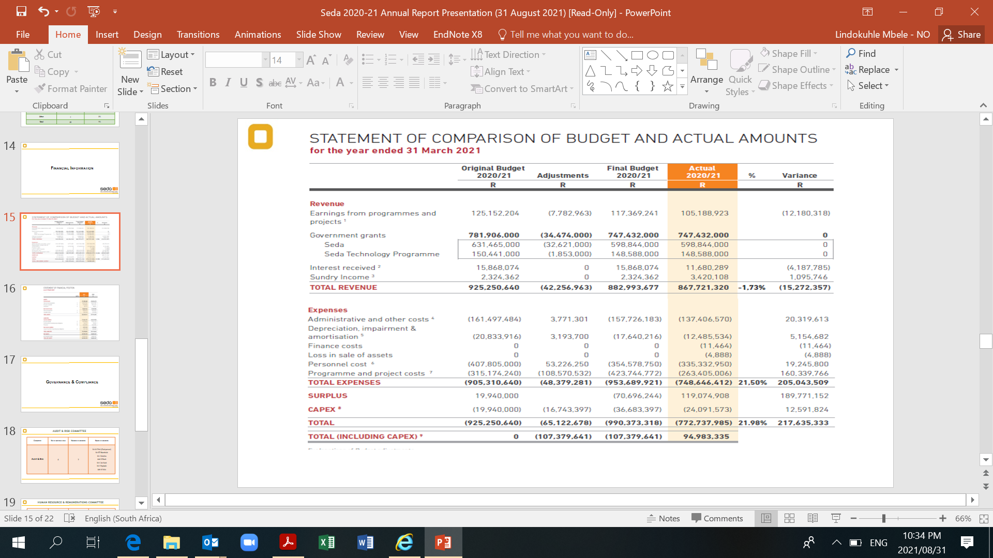

Slide 21
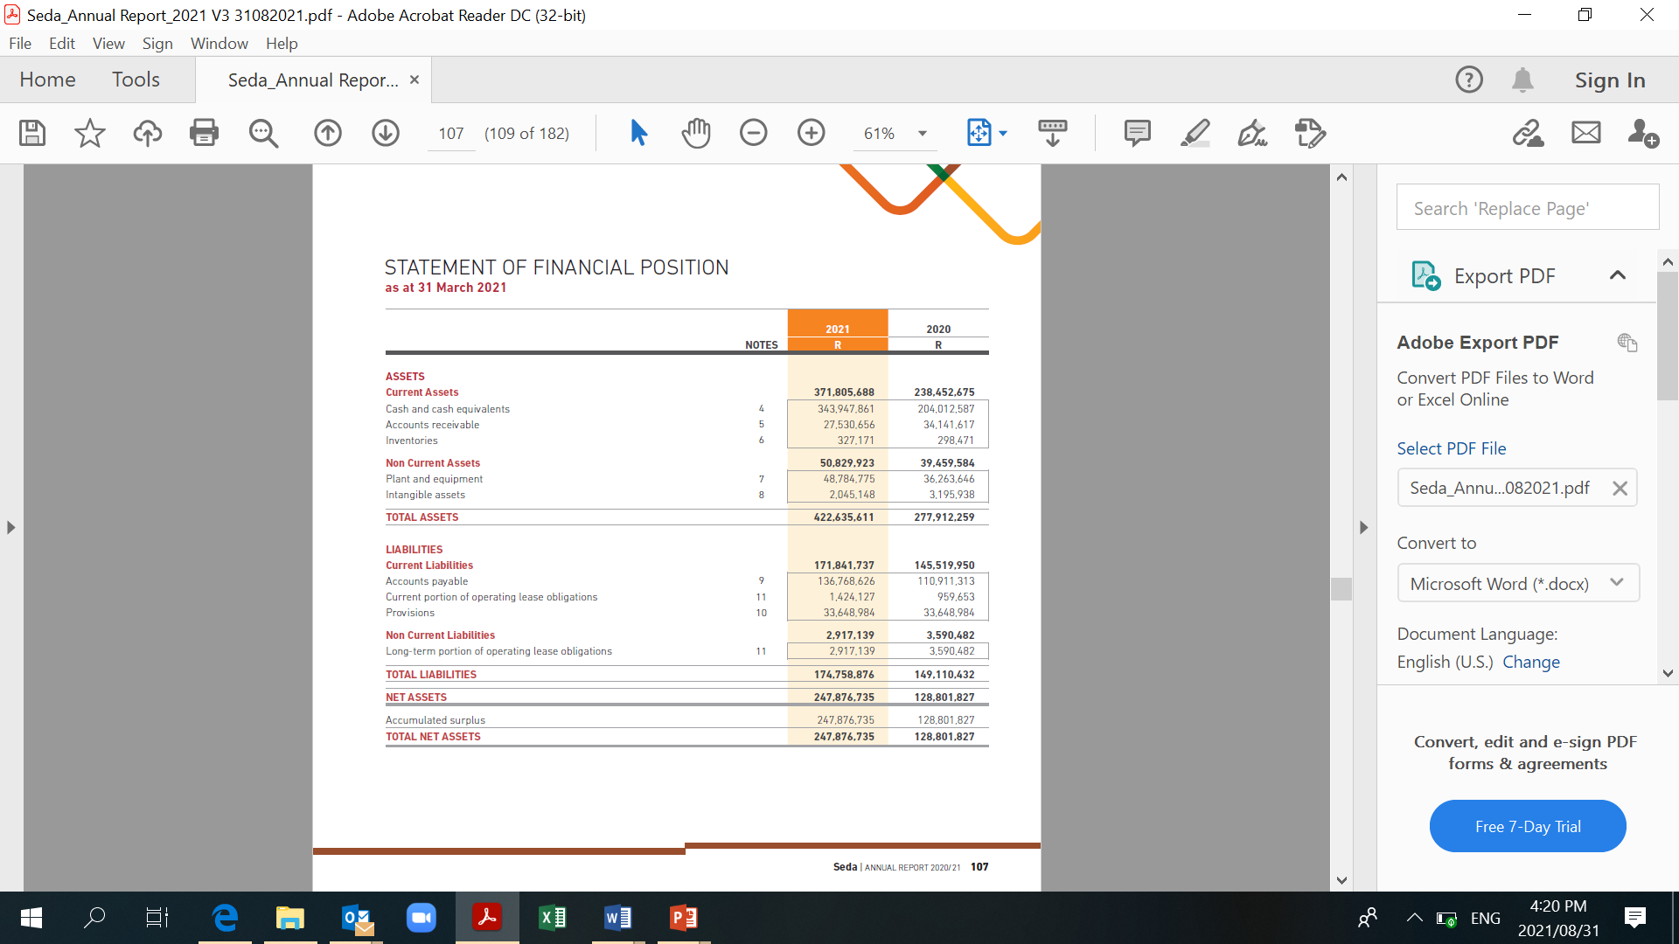

Slide 22
5. GOVERNANCE & COMPLIANCE

Slide 23
Audit & Risk Committee
Committee | No of meetings held | Number of members | Names of members
Audit & Risk | 6 | 7 | Ms M Phiri (Chairperson) Ms BT Nkambule Mr J Matsho Adv D Block Mr C de Kock Ms S Nyakale Adv M Xulu

Slide 24
Human Resource & Remuneration Committee
Committee | No of meetings held | Number of members | Names of members
Human Resource & Remunerations Committee | 7 | 5 | Mr J Matsho (Chairperson) Mr M Sibeko Adv D Block Ms N Kana Dr M Ndlovu Ms N Majola (ACEO)

Slide 25
Social Ethics Committee
Committee | No of meetings held | Number of members | Names of members
Social Ethics Committee | 3 | 6 | Dr S Bvuma (Chairperson) Mr J Matsho Adv. D Block Ms N Kana Mr M Sibeko Ms N Majola(ACEO)

Slide 26
Strategy and Organisational Performance Committee
Committee | No of meetings held | Number of members | Names of members
Strategy And Organisational Performance Committee | 9 | 9 | Ms B Nkambule(Chairperson) Mr C de Kock Dr S Bvuma Adv. M Xulu Ms S Nyakale Ms N Kana Mr M Maki Mr M Sibeko Ms N Majola(ACEO)

Slide 27
6. Audit Outcomes

Slide 28
AUDIT OF 2020/21 FINANCIAL YEAR
The audit of Seda began on the 12 April 2021 as per the audit strategy. While at the planning stage of audit, the organisation suffered a Cyber-attack on 23 April 2021, which was followed by another one on 29 April 2021. The Cyber-attack affected all operating systems. The cyber attack was reported to various institutions including State Security, National Treasury, AGSA amongst others.
After the internal assessment of the ICT environment, Management appointed the service provider to conduct the forensic investigations, rebuild and restored the systems.
As a result of the above, Management requested the auditors to keep the audit on hold in order to minimise the audit costs as the systems were not accessible. This caused the audit to fall behind schedule.
The Disaster Recovery (DR) site was activated from 10 May 2021. Seda Finance team operated from the DR site in order to finalise the draft Annual Financial Statements which were due on 31 May 2021. The tight deadlines meant that the Internal audit review had to be limited to 24 hours in order to meet the statutory deadline of 31 May 2021. This had an impact on the quality of information submitted.
The systems were recovered on 17 June 2021.

Slide 29
OVERVIEW OF AUDIT FINDINGS
Finding | Explanation and Progress
Quality and review of the Draft Annual Financial Statements | Due to the cyber attack, the Draft AFS was prepared while operating at the DR site, file servers were not fully accessible and as a result the preparation period of Draft AFS was shortened. Annually the Internal audit unit reviews the Draft AFS prior to submission to AGSA, this was limited to 24 hours in order to meet the statutory deadline of 31 May.
Review of the Performance Information | Due to non-availability of file servers where the documents are stored, the information was not timeously available. The auditors did not travel to Branches to audit the Performance Information due to Covid-19 cases. The new reporting system for Performance Information Management has been procured to address the audit findings.
Two Irregular expenditures were reported | Lease of office space in the KZN for R182 358 (four months) expired April 2020, an amount of R182 358 was paid for four months. The move to the new office was delayed by the Lockdown. Internal process and consequence management was effected, NT supported the condonation. Another for R84 281 relates to the RFQ awarded to supplier who did not score the highest points. Seda client chose the supplier and paid the excess. The finding was due to fact that the RFQ did not state upfront that the bid may not be awarded to the bidder with the highest bid as required by the PPPFA section 2 (1) (f). In order to avoid similar findings in the near future, Seda has resolved that the bidder with a highest points will be assigned to Clients thus the Clients will not be selecting the Service Providers post the adjudication. Seda did not suffer any financial losses on both cases.

Slide 30
OVERVIEW OF AUDIT FINDINGS
Finding | Explanation and Progress
Provision for Bonus error on the notes to AFS | The finding relate to the unused performance bonus of 2019/20 financial year that was inserted on the incorrect line on one page of the AFS, the finance system information was correct. The said amount of R33 million was provided for in 2019/20, prior to the Covid-19 breakout and DPSA moratorium on remuneration. An error on the single page of AFS was mainly due to the time limitation that was available to review the AFS. Going forward more time will be allocated to prepare and review the AFS.
Revenue not collected | The amounts totalling R151 000 relates to three former employees’ debts whereby their contractual obligations were not met by the time they resigned. The Legal Unit has been implementing various debt recovery strategies to recover the outstanding balances. However, the Auditors were of the view that a provision should have been made as the amounts were deemed irrecoverable given that the debt is older than three years. To resolve this audit finding a provision will be raised in the current financial year.
Vacancies of Executives | During 2020/21 financial year, Seda could not fill the vacant positions of Executives (CEO, CFO, CSIO, Executive Corporate Services and Executive Seda Technology Programme) due to the proposed merger. Currently, Senior Managers are acting in these vacant Executive positions. The Minister has since approved the filling of these vacancies on a 12 months contract with a view to ensure stability within Seda.
ICT Controls and Cyber attack | In response to the Cyber-attack, Seda sourced a Service Provider that specialises in Cyber-attack to provide security solutions. Due to lack of internal Capacity and Technical Skills in the ICT unit, the organisation has embarked in a process of acquiring the services of an independent ICT Service Provider to provide High skilled personnel to maintain and safeguard the Security control already implemented in order to avoid similar incidents in the near future. In addition to the above, the ICT Governance project started in July 2021.

Slide 31
AUDIT OPINION
Seda obtained the Unqualified Audit Opinion
The occurrence of the cyber-attack meant that alternative procedures had to be performed and the audit scope was increased, as a result, the audit period was also extended beyond 31 July 2021. The alternative procedures included 100% reconciliation of all the transactions against the bank statements.
After the Auditors were satisfied with the financial information and supporting documents, Seda received an Unqualified audit opinion.

Slide 32
7. Success Stories

Slide 33
Barui Driehoek Cooperative Ltd (North West)
Impact | Annual sales have increased by 7% increase 10 jobs have been sustained
Business Challenges | Need to protect commercial value and improve competitive edge, having identified export business opportunity during participation in China International Import Expo Unbranded packaging material for international market
Seda Intervention | Conducted an export readiness assessment Identified the need for branded packaging and protection of intellectual property. Assistance was provided with a logo, barcoding, packaging material design and printing. It was also helped to register its intellectual property rights.

Slide 34
Gimbo Bricks and Sand (Limpopo)
Impact | Revenue increased by 57% and 17 new jobs were created. STP approved R432 057 grant to buy brickmaking machinery.
Business Challenges | No marketing or promotional material nor plan and strategy to compete in its highly competitive business sector Lack of access to finance, financial management and recordkeeping Assistance needed with product testing and certification
Seda Intervention | Seda supported the clients with developing a business plan used to apply for finance to procure equipment and machinery, The client was assisted with the design, print and installation of marketing materials. An accounting system was developed and implemented to create and maintain proper financial records and Seda recommended that Gimbo submit its bricks to SABS for testing and certification.

Slide 35
Rally Business Consulting (Pty) Ltd (Mpumalanga)
Impact | The business turnover increased by 75.35% and 78 new jobs were created The business has an efficient payroll system, HR policies and procedures to ensure compliance with labour regulations.
Business Challenges | Lack of machinery and equipment for the business to execute the SAFCOL contract No business plan to guide the day-to-day operations of the business. No formal systems and processes in place to adequately manage and address the finance, payroll and human resources functions of the business.
Seda Intervention | A business plan was developed to assist the owner to competently manage daily operations. Access to finance was facilitated and two mentorship projects commissioned to provide the owner and finance and human resources staff with formal systems, policies and procedures for effective and efficient management of the business. Covid-19 support was provided during lockdown, including facilitation of a workshop

Slide 36


Slide 37
