Slide 1
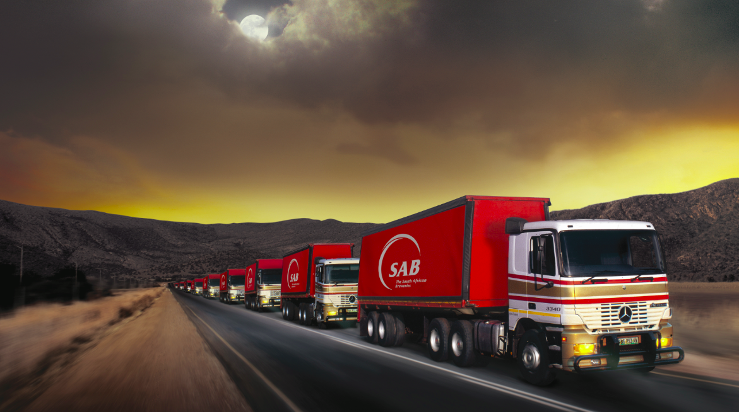
SABs oral submission to the 2021 Revised Fiscal Framework and Revenue Proposals

Slide 2
Introduction
As SAB the emphasis that the Minister has made in his maiden MTBPS, the extensiveness of South Africa’s long-standing macroeconomic issues of poverty and unemployment and the prioritisation of the national budget to dealing with these issues in a substantial manner.
We commend the Minster for highlighting that business remains constrained by persistent obstacles such as electricity shortages, inadequate broadband spectrum and red tape. The lack of progress in implementing reforms, including increasing the competition in electricity supply that has constrained business growth.
Over the medium-term the government has signalled its intention to shift expenditure away from consumption and crisis response towards growth-enhancing investment. The public sector can indeed lay the foundation for this to happen, in partnership with the private-sector that has the ability to foster investment and increase job creation.

Slide 3
Macro-Fiscal position of South Africa
The 2021 Medium Term Budget Policy Statement (MTBPS) charts a course that will enable South Africa to continue the difficult task set out in the 2020 MTBPS, of economic recovery. Government’s central policy goals over the next three years are to position the economy for faster, broad-based economic growth, and to return the public finances to a sustainable position.
As deliberations take place on the medium-term budget, our ask is simple especially during a time when the entire economy has suffered, and the beer industry has been particularly hard hit. Minister excise policy certainty is critical to our business. When you decide to keep excise adjustments at or below inflation in line with policy, the beer value chain can start to grow again, business by business, allowing green shoots to spread throughout the economy. When we rebuild our beer value chain business by business, we can continue to contribute to the fiscus through taxes.
National Treasury has repeatedly stated that excise policy is only implemented as a policy guideline, meaning that the beer industry has no transparency or certainty to plan its business costs or future investments with regards to excise.

Slide 4
Medium-term outlook and specific excise duties related matters
We would like to raise two key issues:
1.All major tax categories have grown above 2019/20 levels, except for specific excise duties. The fact that excise duties have not recovered Minster, is a direct reflection of the reality that the beer industry is still reeling from the effects of the pandemic and have not yet entered the path of economic recovery.
2. The tax base for increases in specific excise duties has changed from consumer price inflation (CPI) to the growth in household consumption. This may decrease the ability of the alcohol industry to plan excise costs as household consumption growth is far more volatile (see figure 1 below) and also forecasts are not easily available to the industry, unlike CPI. Also, household consumption has tended to grow faster than CPI, which would create greater cost pressures for the beer industry.
What we would like to know from National Treasury is:
a) If the beer industry will be given a chance to recover via targeted economic and tax relief in the medium-term budget so that we can once again contribute through taxes to the fiscus;
b) The rationale behind the re-basing of specific excise duty taxes away from CPI to household consumption growth.

Slide 5
Economic Recovery in the context of the Medium-term budget: Implications for the beer industry
MTBPS: Government’s efforts to manage the COVID-19 pandemic and support vulnerable households and firms has required increased spending in the current year. Further increases will be elaborated in the 2022 Budget.
SAB Position:
The beer industry is still grappling with the economic impact of the COVID-19 pandemic that had led to 161 of days of no trade and multiple restrictions.
Despite the challenging business environment that we have been faced with, SAB is still determined to be part of the economic recovery story of South Africa, via the growth of the beer value chain and the overall improvement in the job and investment landscape of the country. Earlier in the year SAB announced that it has allocated a R2 billion capital investment for its South African operations earmarked for 2022.
The beer industry has not received specific economic and tax relief from the government in order to continue to sustain our businesses through the length of the pandemic. We therefore request that National Treasury grant in the medium term a below or no inflation increase in excise to allow for our sector to recover.

Slide 6
Conclusion
SAB has been an active participant in the parliamentary process related to the amendment of the fiscal framework and the money bills in general. We have also made several submissions to National Treasury as a means of addressing the shortcomings and gaps in the current excise tax policy. In particular, we continue to seek platforms that allow for fruitful engagement with government around the excise tax framework. To that end we look forward to the release of the discussion paper around the excise policy review by Treasury and the related stakeholder engagement process.
We are concerned that there may be limited engagement with National Treasury prior to the 2022 Budget, because of timelines in the budget cycle having been pushed back, however we would like to request that Pre-Budget 2022 engagements be prioritised by Treasury.
We continue to seek both economic and excise tax relief from the government that allows us to get back to a place where we can once again be a significant driver of investment and job growth. We are currently at the stage in our business where we are putting together plans as to where we want to place our future investments and assessing whether South Africa has the business enabling environment for us to do this.

Slide 7
End

