Slide 1
BRIEFING TO THE PORTFOLIO COMMITTEE ON HEALTH
17 NOVEMBER 2021

Slide 2
CHAIRPERSON’S REMARKS
Dr. EM Kenoshi

Slide 3
DELEGATION
BOARD
Dr EM Kenoshi
Chairperson
Ms OA Montshiwa
Deputy Chairperson
Dr Adv M Peenze
Board Member
Mr AK Hoosain
Board Member
Ms R Msibi
Board Member
Dr M Sengwana
Board Member
Prof KC Househam
Board Member
Prof K Mfenyana
Board Member
Prof MN Chetty
Board Member
Prof U Chikte
Board Member
Dr L Simelane
Board Member
3

Slide 4
DELEGATION
EXECUTIVE & SENIOR MANAGEMENT
EXECUTIVE MANAGEMENT | SENIOR MANAGEMENT
Dr. S Mndaweni Chief Executive Officer Mr. J Mapatha Executive Manager: Corporate Services and CFO Ms. W Moleko Executive Manager: Health Standards Design, Analysis and Support Dr. D Jacobs Executive Manager: Complaints Management Ms. D Tsukudu Executive Manager: Compliance Inspectorate | Mrs. K Padayachee Director: Governance, Board Secretariat and Legal Services Adv. M Makgopa-Madisa Director: Certification and Enforcement Mr. R Mahlakanya Director: Communication and Stakeholder Relations Mr. M Govuzela Director: Planning, Monitoring and Evaluation
4

Slide 5
CHIEF EXECUTIVE OFFICER’S
OVERVIEW
Dr. S Mndaweni

Slide 6
OUTLINE
The Mandate
Annual Performance Information Report 2020/21
Audited Financial Information 2020/21
6

Slide 7
ORGANISATIONAL STRUCTURE
Minister of Health
Ombud
Board
Chief Executive Officer
Office of the CEO
Communication & Stakeholder Relations
Governance, Board Secretariat & Legal Services
Planning, Monitoring & Evaluation
Complaints Management
Health Standards Design, Analysis & Support
Corporate Services & Chief Financial Officer
Compliance Inspectorate
Certification & Enforcement

Slide 8
INTRODUCTION
The OHSC was established in terms of the National Health Act, 2003 (Act No. 61 of 2003) as a juristic person under the oversight control and leadership of a Board appointed by the Minister of Health.
The entity is further governed through the Public Finance Management Act, 1999 (PFMA) and is listed under Schedule 3A as a public entity.

Slide 9
THE MANDATE
The main objects of the OHSC as outlined in the National Health Act are: to protect and promote the health and safety of users of health services by:
Monitoring and enforcing compliance by health establishments with norms and standards prescribed by the Minister in relation to the national health system; and
Ensuring consideration, investigation and disposal of complaints relating to non-compliance with prescribed norms and standards in a procedurally fair, economical and expeditious manner.

Slide 10
THE MANDATE (Cont…)
The mandate contributes to two distinct but interdependent regulatory outcomes:
Reduction in avoidable mortality, morbidity and harm within health establishments through reliable and safe health services; and
Improvements in the availability, responsiveness and acceptability of health services for users.

Slide 11
THE MANDATE (Cont…)
Constitutional Mandate:
Section 27
Section 28
Policy and Legislative Mandate:
NHA, 2003
NHI Bill, 2019
National Policy on Quality 2007
National Development Plan, Medium Term Strategic Framework, Sustainable Development Goal
Norms and Standards Regulations applicable to different categories of Health Establishments (2018)
Procedural Regulations pertaining to the functions of OHSC (2016)
Policies and Strategies (Presidential Health Summit Compact of July 2019)
Relevant Court Rulings

Slide 12
IMPLICATIONS OF THE OHSC MANDATE
Our Mandate implies that we shall:
Act as the champion of the public and of healthcare users to restore credibility and trust;
Respect healthcare users and their families as well as healthcare personnel;
Push for effectiveness in achieving health system change and social impact;
Strive for excellence, innovation and efficiency in our operations;
Be truthful, fair and committed to intellectual honesty;
Practice transparency, but respect confidentiality;
Achieve the highest standards of ethical behaviour, teamwork and collaboration; and
Promote professionalism, compassion, diversity and social responsibility.

Slide 13
LINK TO NATIONAL HEALTH INSURANCE
OHSC
Monitoring of risk
NHI
Fund
Services to be provided
Service provision
Certification
Contracting
Compliance with norms & standards regulations
Strategic purchasing of health services

Slide 14
STRATEGIC FOCUS
Our vision
Our mission
Our values
Consistent, safe and quality
healthcare for all
We monitor and enforce healthcare
safety and quality standards in health establishments independently, impartially, fairly, and fearlessly on behalf of healthcare users.
The OHSC’s corporate values are
shaped by ethical considerations and constitute guiding principles that govern the actions of all employees. OHSC staff members are required to maintain the highest standards of integrity at all times and our values ensure there is no doubt of what is required of them

Slide 15
OUR VALUES
Human dignity | Accountability | Transparency
We have respect for human individuality and treat each individual as a unique human being. | We take responsibility for our results and outcomes. | We operate in a way that creates openness between managers and employees.
Quality healthcare | Safety | Integrity
Quality healthcare means doing the right thing, at the right time, in the right way, for the right person – and having the best possible results. | We maintain a safe and healthy workplace for all employees in compliance with all applicable laws and regulations, and promote a positive attitude towards safety. | We conduct ourselves with openness, honesty and respect for all stakeholders.

Slide 16
PERFORMANCE INFORMATION
Programme 1:
Administration
Programme 1:
Administration
Programme 2:
Compliance Inspectorate
Programme 3:
Complaints Management and Office of the Ombud
Programme 4:
Health Standards Design, Analysis and Support
Programme 5:
Certification and Enforcement
16

Slide 17
STRATEGIC OUTCOMES
Outcome 1
Outcome 2
Compliance with norms and standards is effectively monitored
Outcome 3
Improved quality of health care services rendered to the users in the Health Establishments
Outcome 5
Compliance with norms and standards increased
A fully functional OHSC
Outcome 4
Facilitate achievement of compliance with the norms and standards regulations for different categories of Health Establishments
17

Slide 18
OVERVIEW OF OHSC 2020/21 PERFORMANCE
(pp. 23-40)
Twenty-one (21) output indicators tracked and reported in the 2020/21 Annual Report.
Fourteen (14) or 67% of outputs indicators were either achieved or partially achieved.
Seven (7) or 33% of output indicators were not achieved.
The OHSC achieved unqualified audit opinion.
Negative impact of COVID-19 on the operational environment.
18

Slide 19
PROGRAMME 1: ADMINISTRATION
OUTCOME:
A fully functional OHSC.
PROGRAMME PURPOSE:
To provide the leadership and administrative support necessary for the OHSC to deliver on its mandate and comply with all relevant legislative requirements.
19

Slide 20
PROGRAMME 1: ADMINISTRATION
Sub-Programme: Human Resources
Output Indicator: Percentage of vacancies filled within four months of the vacancy existing
Actual Achievement 2018/19
New Indicator
Actual Achievement 2019/20
New Indicator
Planned Target
2020/21
90%
Actual Achievement 2020/21
41.7%
The target was not met with a deviation of -48.3% due to recruitment being negatively affected by the National State of Disaster. This includes difficulty in finding suitable candidates for some senior management posts. As at 31 March 2021, 119 (94%) of 127 funded posts were filled.
20

Slide 21
PROGRAMME 1: ADMINISTRATION
Sub-Programme: Human Resources
Output Indicator: Percentage of certified inspectors after completion of training
Actual Achievement 2018/19
New Indicator
Actual Achievement 2019/20
New Indicator
Planned Target
2020/21
95%
Actual Achievement 2020/21
80%
A total of 49 certified inspectors were in the employment of the OHSC at the end of the 2020/21 financial year. Training of newly appointed inspectors was adversely affected during lockdown.
21

Slide 22
PROGRAMME 1: ADMINISTRATION
Sub-Programme: Finance and Supply Chain Management
Output Indicator: Unqualified audit opinion achieved by the OHSC
Actual Achievement 2018/19
Unqualified audit opinion
Actual Achievement 2019/20
Unqualified audit opinion
Planned Target
2020/21
Unqualified audit opinion
Actual Achievement 2020/21
Unqualified audit opinion
The OHSC achieved an unqualified audit opinion from the Auditor General South Africa
22

Slide 23
PROGRAMME 1: ADMINISTRATION
Sub-Programme: Information and Communication Technology
Performance Indicator: Percentage of ICT availability for core OHSC services
Actual Achievement 2018/19
New Indicator
Actual Achievement 2019/20
New Indicator
Planned Target
2020/21
95%
Actual Achievement 2020/21
99.84%
The IT systems operated efficiently due to close monitoring of systems, contracts with service providers and implementation of automation.
23

Slide 24
PROGRAMME 1: ADMINISTRATION
Sub-Programme: Information and Communication Technology
Performance Indicator: Percentage of ICT availability for OHSC support services
Actual Achievement 2018/19
New Indicator
Actual Achievement 2019/20
New Indicator
Planned Target
2020/21
95%
Actual Achievement 2020/21
98.22%
The IT systems operated efficiently due to close monitoring of systems, contracts with service providers and implementation of automation.
24

Slide 25
PROGRAMME 1: ADMINISTRATION
Sub-Programme: Communication and Stakeholder Relations
Output Indicator: Number of community stakeholder engagements to raise public awareness on the role and powers of the OHSC and Health Ombud
Actual Achievement 2018/19
New Indicator
Actual Achievement 2019/20
New Indicator
Planned Target
2020/21
12
Actual Achievement 2020/21
6
Legal restrictions on travel and gatherings introduced to combat the spread of COVID-19 constrained stakeholder engagement. Towards the end of the year, as restrictions eased, some public awareness activities were conducted at health establishments and in communities in rural areas of the North West.
25

Slide 26
PROGRAMME 1: ADMINISTRATION
Sub-Programme: Communication and Stakeholder Relations
Output Indicator: Number of private sector engagements to raise awareness on the role and powers of the OHSC and Health Ombud
Actual Achievement 2018/19
New Indicator
Actual Achievement 2019/20
New Indicator
Planned Target
2020/21
8
Actual Achievement 2020/21
3
While webinars were held with health services in the mining sector, general medical practitioners and emergency medical services the number was limited by factors related to the COVID-19 pandemic.
26

Slide 27
PROGRAMME 2: COMPLIANCE INSPECTORATE
OUTCOME:
Compliance with Norms and Standards is effectively monitored
PROGRAMME PURPOSE:
The purpose of the Compliance Inspectorate is to inspect health establishments against prescribed norms and standards.
27

Slide 28
PROGRAMME 2: COMPLIANCE INSPECTORATE
COMPLIANCE INSPECTORATE
Output Indicator: Percentage of public health establishments inspected for compliance with the norms and standards
Actual Achievement 2018/19
19.13%
(730/3816)
Actual Achievement 2019/20
16.95%
(647/3816)
Planned Target
2020/21
10%
(382 of 3 816)
Actual Achievement 2020/21
10.14 %
(387 of 3 816)
Eight Early Warning System (EWS) inspections were conducted as a result of media reports – KwaZulu-Natal (1), Gauteng (2), North West (2), Eastern Cape (2) and Limpopo (1) A total of 23 COVID-19 rapid inspections were conducted, covering all provinces except Limpopo.
28

Slide 29
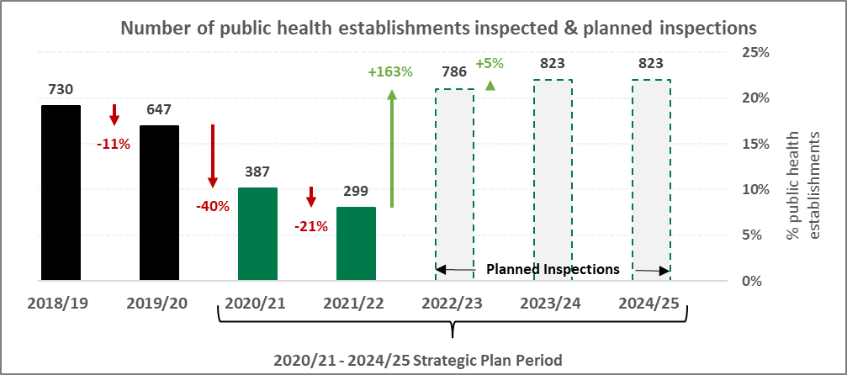
PUBLIC HEs INSPECTED FOR COMPLIANCE WITH THE NORMS AND STANDARDS
29

Slide 30
PROGRAMME 2: COMPLIANCE INSPECTORATE
COMPLIANCE INSPECTORATE
Output Indicator: Percentage of private health establishments inspected for compliance with the norms and standards
Actual Achievement 2018/19
New Indicator
Actual Achievement 2019/20
New Indicator
Planned Target
2020/21
6%
(16 of 393)
Actual Achievement 2020/21
0%
30

Slide 31
PRIVATE HEs INSPECTED FOR COMPLIANCE WITH THE NORMS AND STANDARDS
Compliance inspections in the private sector has not started.
Consultations on the development of inspection tools for the private sector were conducted.
Private sector compliance inspections will commence in the 2022/23 financial year.
31

Slide 32
PROGRAMME 2: COMPLIANCE INSPECTORATE
COMPLIANCE INSPECTORATE
Output Indicator: Percentage of additional inspections conducted at health establishments where non-compliance was identified
Actual Achievement 2018/19
New Indicator
Actual Achievement 2019/20
New Indicator
Planned Target
2020/21
100%
Actual Achievement 2020/21
0%
There were no re-inspections during the reporting period because the re-inspection strategy was being finalised.
32

Slide 33
PROGRAMME 2: COMPLIANCE INSPECTORATE
COMPLIANCE INSPECTORATE
Output Indicator: Publish bi-annual consolidated reports on health establishments’ performance against norms and standards
Actual Achievement 2018/19
New Indicator
Actual Achievement 2019/20
New Indicator
Planned Target
2020/21
2
Actual Achievement 2020/21
1
There were no inspections in Q1 and Q2 of the financial year due to the COVID-19 pandemic. Since inspections only commenced in Q3, the timelines for communicating 2020/21 reports to health establishments and finalising them fell into the next financial year. However, a report relating to 2019/20 inspections was tabled in the current reporting period.
33

Slide 34
PROGRAMME 3:
COMPLAINTS MANAGEMENT AND OMBUD
OUTCOME:
Improved Quality Of Healthcare Services rendered to users of Health Establishments
PROGRAMME PURPOSE:
To consider, investigate and dispose of complaints relating to noncompliance with prescribed norms and standards in a procedurally fair, economical, and expeditious manner.
34

Slide 35
PROGRAMME 3: COMPLAINTS MANAGEMENT AND OMBUD
COMPLAINTS MANAGEMENT AND OMBUD
Output Indicator: Percentage of low-risk complaints resolved within 25 working days of being lodged with the call centre
Actual Achievement 2018/19
77.84%
(1 082/1 390)
Actual Achievement 2019/20
95.58%
(1 580/1 651)
Planned Target
2020/21
65%
Actual Achievement 2020/21
91.81%
(2 108/2 296)
Good performance was sustained through referral of low-risk complaints to relevant health establishments and continuous, active engagement of both complainant and health establishment
35

Slide 36
PROGRAMME 3: COMPLAINTS MANAGEMENT AND OMBUD
COMPLAINTS MANAGEMENT AND OMBUD
Output Indicator: Percentage of user complaints resolved through assessment within 30 working days of receipt of response from complainant and/or health establishment
Actual Achievement 2018/19
49.42%
(43/87)
Actual Achievement 2019/20
7.3%
(9/24)
Planned Target
2020/21
45%
Actual Achievement 2020/21
2.46%
(5/203)
The historic backlog due to human resource challenges inflates the denominator.
36

Slide 37
PROGRAMME 3: COMPLAINTS MANAGEMENT AND OMBUD
COMPLAINTS MANAGEMENT AND OMBUD
Output Indicator: Percentage of complaints resolved within six months through investigation
Actual Achievement 2018/19
New indicator
Actual Achievement 2019/20
10.00%
(2/20)
Planned Target
2020/21
10%
Actual Achievement 2020/21
11.11%
(1/9)
The unit has developed strategies to address historic backlog in the resolution of complaints
37

Slide 38
PROGRAMME 3: COMPLAINTS MANAGEMENT AND OMBUD
COMPLAINTS MANAGEMENT AND OMBUD
Output Indicator: Percentage of complaints resolved within 12 months through investigation
Actual Achievement 2018/19
New indicator
Actual Achievement 2019/20
New indicator
Planned Target
2020/21
20%
Actual Achievement 2020/21
0%
Due to COVID-19, the on-site investigation was only conducted in Q4 and a preliminary report was completed within the financial year
38

Slide 39
PROGRAMME 3: COMPLAINTS MANAGEMENT AND OMBUD
COMPLAINTS MANAGEMENT AND OMBUD
Output Indicator: Percentage of complaints resolved within 18 months through investigation
Actual Achievement 2018/19
New indicator
Actual Achievement 2019/20
New indicator
Planned Target
2020/21
20%
Actual Achievement 2020/21
0%
There were no cases falling within this category in 2020/21.
39

Slide 40
PROGRAMME 4: HEALTH STANDARDS, DESIGN, ANALYSIS, AND SUPPORT (HSDAS)
OUTCOME
Facilitate achievement of Compliance with the Norms and Standards Regulations for different categories of Health Establishments.
PROGRAMME PURPOSE
The purpose of the Health Standards Design, Analysis and Support programme is to provide high-level technical support to the Office through research, health systems analysis, development of data collection tools, training in the use of these tools, and analysis and interpretation of the data collected.
40

Slide 41
PROGRAMME 4: HEALTH STANDARDS, DESIGN, ANALYSIS, AND SUPPORT
HSDAS
Output Indicator: Number of recommendations for improvement in the healthcare sector implemented by relevant authorities
Actual Achievement 2018/19
New Indicator
Actual Achievement 2019/20
New Indicator
Planned Target
2020/21
3
Actual Achievement 2020/21
3
41

Slide 42
PROGRAMME 4: HEALTH STANDARDS, DESIGN, ANALYSIS, AND SUPPORT
HSDAS
Output Indicator: Number of guidance visits to facilitate implementation of norms and standards regulations
Actual Achievement 2018/19
New Indicator
Actual Achievement 2019/20
New Indicator
Planned Target
2020/21
24
Actual Achievement 2020/21
18
No workshops were conducted in Q1 due to COVID-19 lockdown. Some workshops were postponed due to private hospital groups requesting extensions for inputs on inspection tools.
42

Slide 43
PROGRAMME 5: CERTIFICATION AND ENFORCEMENT
OUTCOME
Compliance with Norms and Standards is Increased
PROGRAMME PURPOSE
The purpose of the Certification and Enforcement programme is to certify compliant health establishments and take enforcement action against non-compliant health establishments.
43

Slide 44
PROGRAMME 5: CERTIFICATION AND ENFORCEMENT
CERTIFICATION AND ENFORCEMENT
Output Indicator: Percentage of health establishments issued with a certificate of compliance within 15 days of the date of the final inspection report
Actual Achievement 2018/19
New Indicator
Actual Achievement 2019/20
New Indicator
Planned Target
2020/21
100%
Actual Achievement 2020/21
100%
Certification of health establishments depends on the production of final inspection reports. Due to backlogs in the finalisation of reports, the 33 certificates issued in 2020/21 related to inspections undertaken in 2019/20.
44

Slide 45
PROGRAMME 5: CERTIFICATION AND ENFORCEMENT
CERTIFICATION AND ENFORCEMENT
Output Indicator: Percentage of health establishments against which enforcement action has been initiated within 10 days of the date of the final additional inspection report
Actual Achievement 2018/19
New Indicator
Actual Achievement 2019/20
New Indicator
Planned Target
2020/21
100%
Actual Achievement 2020/21
0%
Although all non-compliant establishments were issued with compliance notices, enforcement only occurs after the finalisation of an additional inspection report that confirms persistent non-compliance. In 2020/21 reinspection of non-compliant facilities did not take place as a result of the disruptive impact of the COVID-19 pandemic and this
45

Slide 46
PROGRAMME 5: CERTIFICATION AND ENFORCEMENT
CERTIFICATION AND ENFORCEMENT
Output Indicator: Number of health establishment compliance status reports published every six months
Actual Achievement 2018/19
New Indicator
Actual Achievement 2019/20
New Indicator
Planned Target
2020/21
2
Actual Achievement 2020/21
1
One report was published – the first since commencement of certification and enforcement processes. Internal processes require strengthening to ensure that all statutory reports are compiled, approved and published within the prescribed time frames.

Slide 47
OVERVIEW OF OHSC COVID-19 RESPONSE

Slide 48
OHSC’S COVID-19 RESPONSE (p. 41)
Rapid inspections were conducted at 23 newly established field hospitals, isolation and quarantine facilities
Responded to COVID-19 related complaints
Reviewed rapid inspection reports and investigations triggered by the early warning system
48

Slide 49
OHSC’S COVID-19 RESPONSE (p. 41)
Rapid inspections were conducted at 23 newly established field hospitals, isolation and quarantine facilities
Responded to COVID-19 related complaints
Reviewed rapid inspection reports and investigations triggered by the early warning system
49

Slide 50
OVERALL CHALLENGES FOR THE OHSC

Slide 51
CHALLENGES
With the growth of the organisation, inadequate funding for the fulfilment of its mandate remains a major challenge for the OHSC.
Financial constraints impact especially on the ability of OHSC inspectors to conduct the targeted number of inspections of health establishments. The number of inspections completed is proportional to available funding.
Financial constraints have also led to HR constraints in the Complaints investigation unit (50% vacancy rate), which impacts on the resolution of backlog cases.
51

Slide 52
CHALLENGES
The adverse impact of COVID-19 was felt particularly in relation to additional inspections of health establishments that had been found non-compliant with norms and standards during earlier inspection.
The COVID-induced national lockdown had a significant impact on the Complaints Investigation Unit’s activities, particularly the conduct of on-site investigations.
52

Slide 53
WAY FORWARD
OHSC working on a model for charging fees on inspections, as well as provision of guidance and support
National fiscus will continue to be main source of revenue
For purposes of increasing inspection coverage, OHSC is working on a decentralisation model
The 2021/22 year is being used to address the key challenges faced by the OHSC
53

Slide 54
AUDITED FINANCIAL INFORMATION
2020/21
CHIEF FINANCIAL OFFICE
Mr. J Mapatha

Slide 55
Financial
PERFORMANCE (pp. 59-90)
55

Slide 56
COMMENTS ON FINANCIAL PERFORMANCE
AUDIT OUTOMES
Clean audit achieved
REVENUE
1% increase in allocation from the National Treasury, due to OHSC allocation being reduced, as a result of COVID-19 impact
Decrease in interest on short term investment with the OHSC bankers, as a result of reduced interest rates by the SARB
EXPENDITURE
No salary increases were implemented as a result of moratorium on salary increases
Decrease in board costs - reduced travelling as a result of COVID-19
Decrease in inspection costs – reduced travelling as a result of COVID-19
Increase in asset base of the OHSC
56

Slide 57
SURPLUS
Main contributors to surplus:
Limited travelling i.r.o. inspections and other activities (COVID-19)
No re-inspections conducted in 2020/21
No private sector inspections in 2020/21
Moratorium on salary increases in 2020/21
Physical stakeholder engagements held virtually (COVID-19)
Additional revenue from investment interest
57

Slide 58
SURPLUS
National Treasury approval to retain the 2020/21 surplus for:
Supplementing human resource capacity in complaints management, monitoring & evaluation, legal services, and expert panel
Additional budget for inspections and re-inspections, and certification and enforcement
Replacement of old computer equipment/tools of trade (recapitalization)
Development and/or enhancement of core systems – inspection, early warning system, certification and enforcement
58

Slide 59
TOTAL EXPENDITURE PER DIVISION
59

Slide 60
% SHARE OF EXPENDITURE PER DIVISION
60

Slide 61
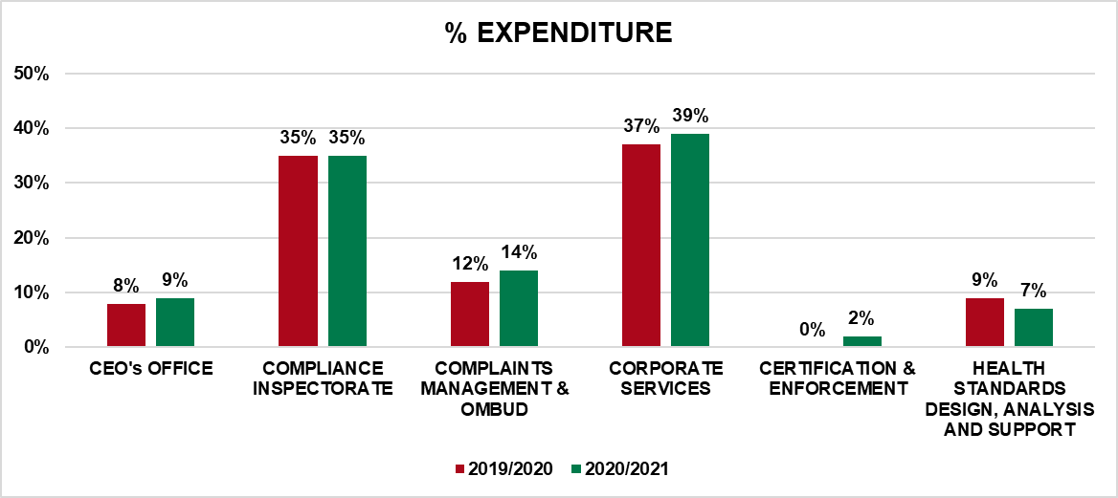
% SHARE OF EXPENDITURE PER DIVISION
61

Slide 62
COMPENSATION COSTS BY EMPLOYEE LEVEL
62

Slide 63
STAFF COMPLEMENT
63

Slide 64
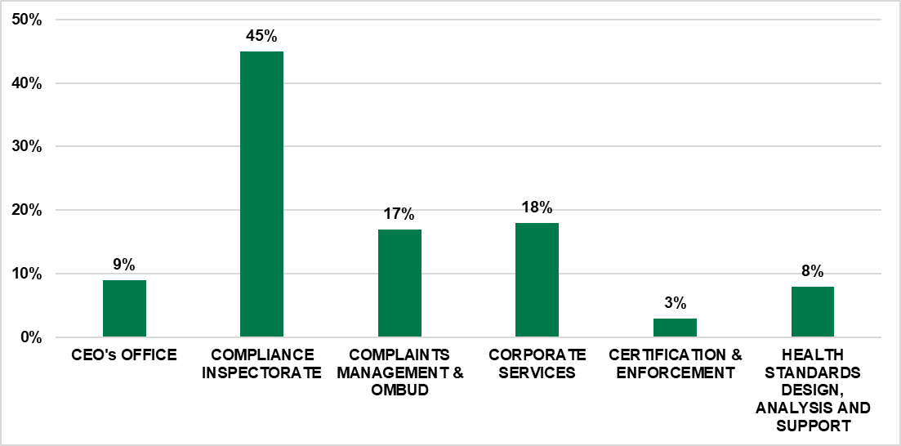
% SHARE - STAFF COMPLEMENT
64

Slide 65
Thank you

