Slide 1
Nedlac Annual Report 2020/21 Presentation to DeL Portfolio Committee 10 November 2021

Slide 2
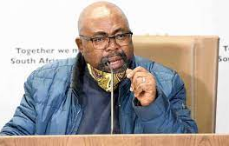
Introduction
“Nedlac has been central in co-ordinating the response of the social partners in addressing the Covid-19 pandemic and the economic recovery and reconstruction of our country”
Minister of DeL, TW Nxesi
2020/21 was an unprecedented year for Nedlac, as it was for the country
Our role shifted drastically to respond to the Covid19 pandemic and the subsequent need to recover and reconstruct the economy
The Annual Report reflects our progress in these areas as well as the ongoing work in promoting social dialogue and inputting into policy and legislation

Slide 3
Plan (ERAP). A summary of the Annual Performance Indicators is displayed in the table below:
2020/21 KPIs achieved
Programme | Annual Planned Indicators | Planned Targets Achieved in 2020/21 | Not Achieved | Overall Achievement (%)
Administration | 4 | 4 | 0 | 100%
Core Operations | 9 | 8 | 1 | 89%
Constituency Capacity Building Funds | 1 | 1 | 0 | 100%
Summary | 14 | 13 | 1 | 93%
Quote from Annual Report

Slide 4
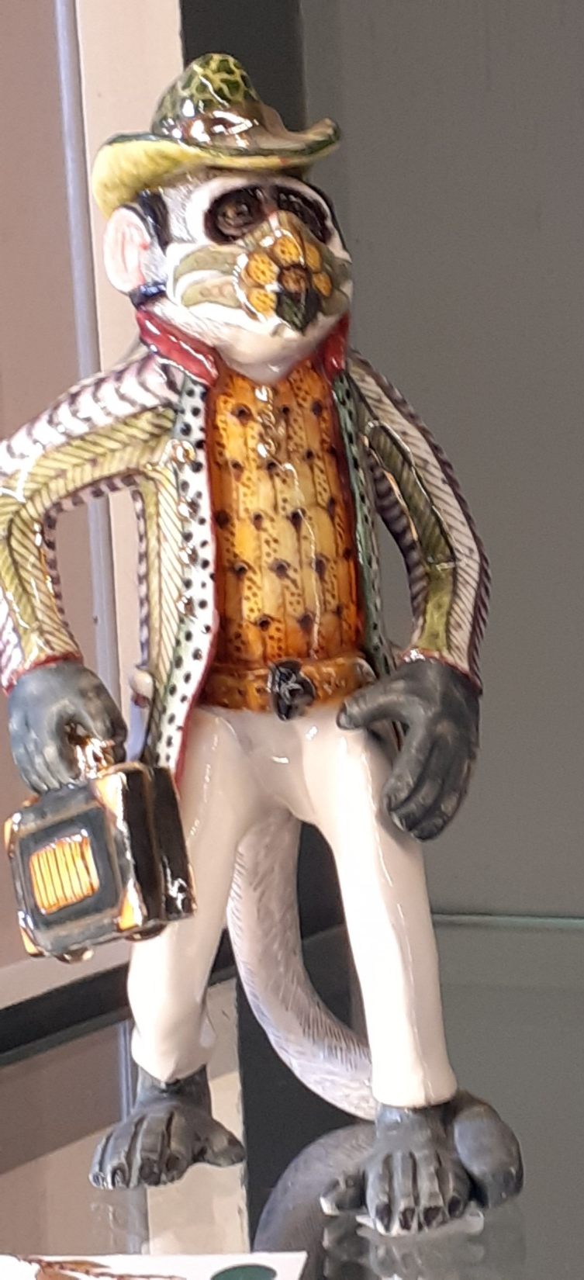
Programme 1: Administration

Slide 5
Programme 1: Administration
Achievements
Nedlac 25th Annual Summit: Was convened on 8 December 2020, under the theme “Social compacting for economic recovery in the time of Covid-19: pointers to the future
Executive Council: Five Exco meetings engaged on the Covid-19 pandemic, the MTEF and the budget. Two meetings were special consultations between the social partners and the President
Monitoring reports: Two reports were produced on the progress of consideration of Nedlac Reports once they have been concluded at Nedlac and submitted to the relevant Ministers and Parliamentary Portfolio Committees.
Revised polices: Performance Management, Human Resources and Asset Management policies were reviewed.
Challenges
Managing the shift to working from home
Ensuring data for constituencies to attend online meetings
Slow SCM processes

Slide 6
Strategic planning and restructuring
During 2020/21, the Nedlac secretariat:
Reviewed the five year strategic plan
Embarked on a process to restructure the secretariat
The new Strategic Plan focus the organisation around three areas of work:
Building an effective and accountable organisation
Achieving significant collaboration between the social partners on relevant and important socio-economic issues
Enhancing the capacity of social partners
The new restructuring process sought to:
Organise the core operations of Nedlac around two units, one focusing on economic issues and the other on labour and development issues. Each unit will be led by a senior manager
Introduce a new post of Senior Manager: Corporate Services
Separate out the planning, budgeting, monitoring and reporting from the core operations and situates it n the office of the executive director
Re-evaluate all jobs and benchmarked Nedlac salaries to public entities of a similar size and scope of work.

Slide 7
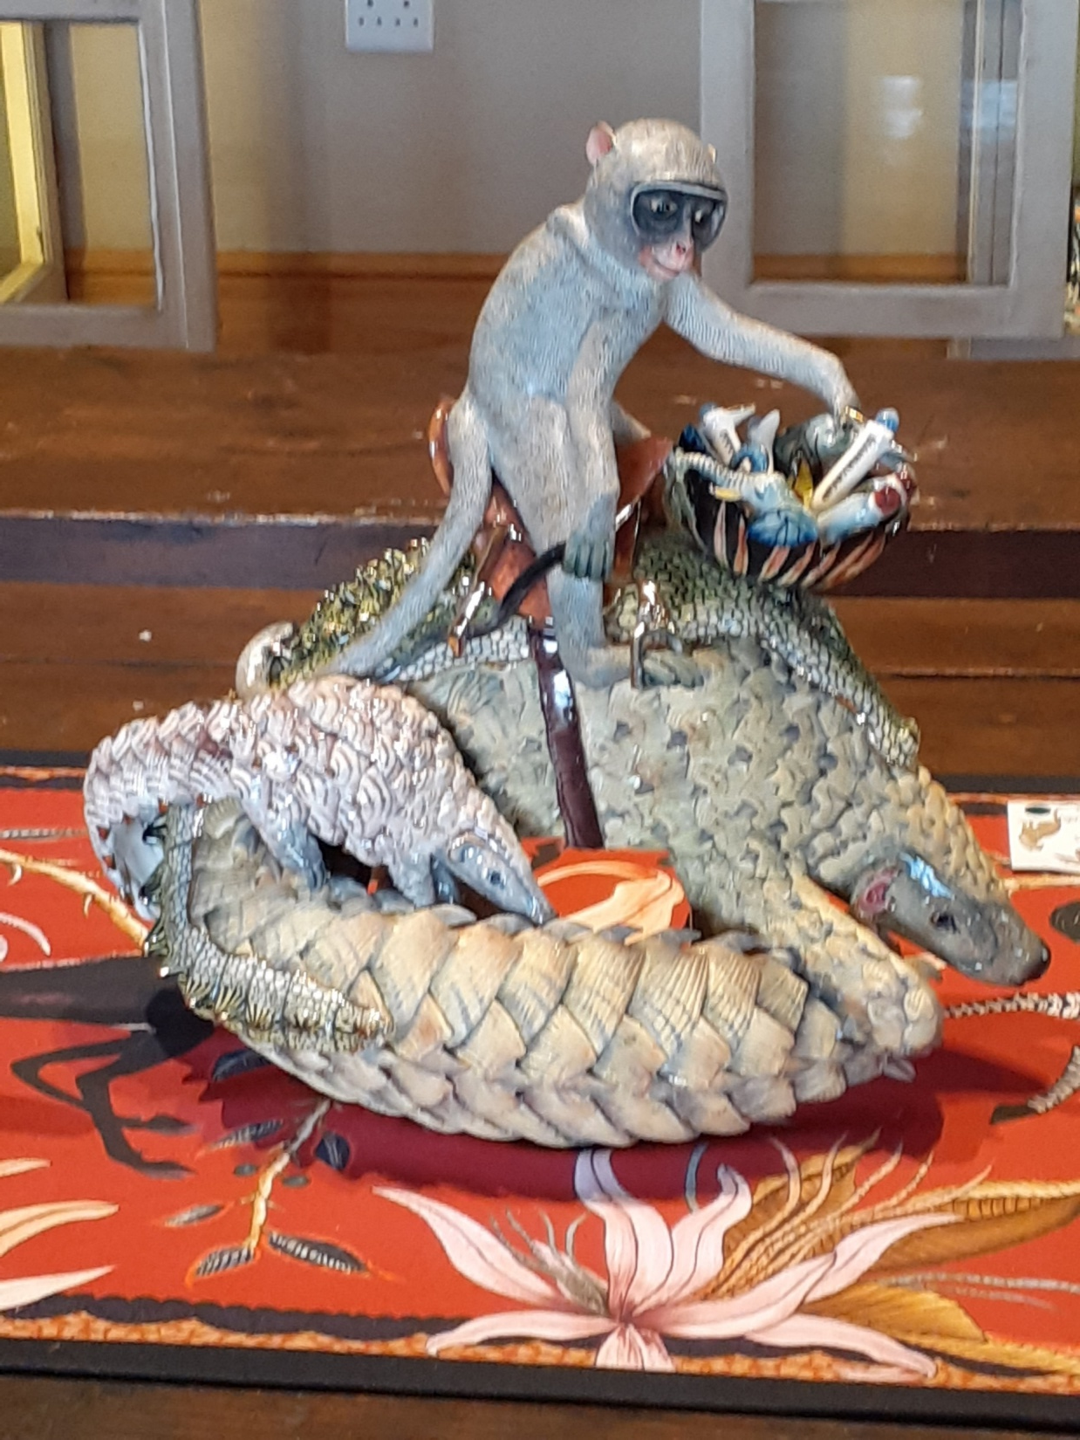
Programme 2
Operations

Slide 8
Programme 2: Operations
Achievements
Challenges
Consideration of Climate Change Bill took slightly longer than required six months
Delays in the completion of the work of the Comprehensive Social Security Task Team due to longer than anticipated time to sign off the research
Non achievement of Job Summit report indicator due to the transition to economic recovery
Engagements to respond to the Covid-19 pandemic through the Nedlac Rapid Response Task Team
Development of social partner’s Economic Recovery Action Plan and the subsequent establishment of processes to track and collaborate on the implementation of the Economic Recovery and Reconstruction Plan (ERRP)
Commissioning of research by the Governance Task team on how Nedlac can become fit for purpose
Conclusion of two Section 77 notices
Details on next slides

Slide 9
Responding to Covid-19
A Nedlac Rapid Response Task Team has worked actively and intensively to mitigate the impact of Covid19 pandemic and the lockdown and enabling the economy to open up safely including in areas of:
Relief for employees, unemployed, vulnerable citizens
Workplace health and safety
Vaccinations
Safe travel
Liquor restrictions
Local production of PPEs and medical supplies
Since December 2020, the social partners met regularly with a work stream of Nat Joints to give and get feedback on government measures and escalate issues.
“Without a shadow of doubt, Nedlac played a pivotal role in shaping a collective country response to Covid-19 in saving the lives and livelihoods of many people”
Thulani Tshefuta, Community Constituency Convenor
Details of achievements and progress on next slides

Slide 10
Covid-19 Rapid Response Task Team (1)
Covid-19 TERS
Support for workers, informal workers and unemployed and distressed companies
Inputs into the wording of the Direction(s) to extend rights and improve functionality
Joint consideration of actuarial assessments on sustainability of UI funds,
Engaging for extensions
Significant support and monitoring of UI to ensure operational and communication challenges resolved including for foreign nationals
Motivating for additional technical support of GTAC for the UI Fund.
Engagement with banks, medical aid companies, short term lenders and pension and provident fund administrators for contribution holidays
Engagement with Social Development on the extension of social grants and support for delivery
Engagement with SALGA and COGTA to protect informal traders – do no harm directive
Engagement with DSBD on the assistance provided by this Department to small businesses
Significant engagement on the Credit Guarantee Scheme to increase its coverage – still ongoing in respect of DFI’s and non-bank lenders

Slide 11
Covid-19 Rapid Response Task Team (2)
Health and Safety and Vaccination
Opening up the economy: Sectors
Engagement with the retail sector to ensure improved safety for workers and customers
Negotiation of a liquor social compact to balance:
Negative health impact of alcohol use and
Job and income loss through restrictions on the sale of alcohol
Engagement on the opening up of local and international travel to support tourism recovery
Input and drafting support to Health and Safety Direction (three revisions)
Input into and promotion of workplace surveillance
Distribution and promotion of behavioural change communication materials
Engagement and input into the government’s vaccination programme

Slide 12
Covid-19 Rapid Response Task Team (3)
Protective Personal Equipment
Transport
Attempts to secure a Safe Travel Direction including promoting ‘peak spreading – not successful
Engagement on the safe numbers of commuters in public transport – “100% capacity issue” – unsuccessful and led to organised labour socio-economic protest on 7 Oct 2020
Engagement with Metrorail on safe travel and opening up of rail
Engagement on relief for taxi drivers, e-hailing, bus and taxi operators – unsuccessful
Monitoring of security of supply of PPE in early days of epidemic
Initiated the governance structure in DTIC to promote and enable local production of PPE’s
Engagement to ensure that government entities are compelled to procure from local producers – unsuccessful

Slide 13
Economic Recovery (1)
On 13 August the President called a Forum for Economic Recovery where all social partners presented their plans and it was agreed that senior leadership would draw up a set of priority actions for economic reconstruction and the institutional arrangements to support these actions
On 15 September, a Social Partner’s Economic Recovery Action Plan was presented to the President which set out collective and individual commitments in a focused number of areas
On 15 October 2020, the President at a Joint Sitting of Parliament announced the government’s Economic Recovery and Reconstruction Strategy which incorporated the social partner’s plan.
Nedlac subsequently set up processes and structures to track implementation of commitments and collaborate in identified areas
The Presidential Job Summit commitments were integrated into ERRP commitments.
Good and excellent plans were crafted at Nedlac which were broadly accepted by many and gave hope that if all were executed, they would positively change our situation. The commitment made by the government of ensuring the participation by the President and some key Ministers gave confidence to social dialogue and commitment to find lasting solutions” Bheki Ntshalintshali, Labour Overall Convenor

Slide 14
Economic Recovery (2)
Structures
Areas of focus (works streams)
Economic Recovery Leadership Team (made up of 7-a-side including Cabinet Ministers from government)
Three-a-side leadership team to deal with escalations
Work streams to focus on identified areas
Process Committee to process and manage the tracking of implementation and areas of collaboration
Unlocking blockages in freight and improving public transport
Implementation of the social compact to support Eskom and steps to improve energy security
Identifying and delivering on targets for localisation in public and private sector
Improving the eco-system for small business including reducing unnecessary and excessively stringent licence and permit requirements especially for workers and enterprises in the informal economy

Slide 15
Presidential Job Summit
As the implications of Covid-19 and the lockdown on the economy emerged, social partners realised that the Job Summit needed to be refocused while retaining the social compact that was created through the signing of the Job Summit Framework Agreement
The Annual Report includes an annexure recording the work done on implementing the job summit commitments including whether the commitment:
Has been achieved
Institutionalised within government
Is Integrated in the ERRP
Is continuing in an appropriate forum
Key areas of achievement:
Signing of the social compact to support Eskom
Establishment of the Temporary Employee Employer Relief Scheme (TERS)
Capitalisation with UI funds of the Productivity SA Business Turnaround Solution
Boosting and monitoring localisation including through tender monitoring
Prioritising industrial financing including in Special Economic Zones
Introducing a blended finance model for emerging farmers
Promoting master plans especially in clothing, textile, footware, auto and furniture
Escalating jobs in business processing
Establishment of the Presidential Climate Change Commission
Supporting regulatory certainty on evisas, unabridged birth certificates and critical skills
Supporting the development of pathway management

Slide 16
Social dialogues: Special sessions, webinars etc
Engagement with Minister of Finance and his team before and after the Supplementary Budget and the MTBPS (Feb, June, Aug, Oct 2020)
Fourth Industrial Revolution diagnostic report (21 May 2020)
Addressing Unclaimed Benefits (28 May 2020)
Infrastructure Investment Plan (19 June 2020)
Dispute resolution with the CCMA (25 June 2020)
Expanded Public Works Programmes (16 October 2020)
FinScope Research 2019 (2 November 2020)
Quarterly Labour Force Survey with Statistics SA (19 November 2020)
Six Future of Work webinars (November 2020)
Essential Services Commission (1 December 2020)
National Student Financial Aid Scheme financial crisis (30 March 2021)
Unctad report on economy and Covid19
There were four special meetings chaired by the President, Cyril Ramaphosa:
Two special Excos discuss the Covid 19 pandemic (17 April and 15 May 2020)
Two Economic Recovery Forums to discuss plans for economic recovery

Slide 17
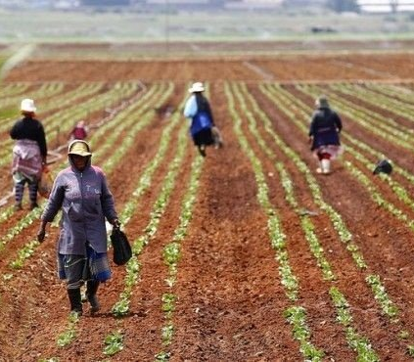
Completed reports on policy and legislation
Policy:
National Policy on Comprehensive Produce Development support (for sustainable agriculture)
National Freshwater (Inland) Wild Capture Fisheries Policy
Conservation of Agriculture Policy
Legislation
Climate Change Bill
Upgrading of Land Tenure Rights Amendment (ULTRA) Bill
Basic Education Laws Amendment Bill
Expropriation Bill

Slide 18
Other ongoing work or work in progress
Comprehensive Social Security and Retirement Forums Task Team
Other
The following research reports were concluded and considered:
National social security fund
Financial feasibility of a basic income grant
Actuarial sustainability of a national social security fund
Economies of scale in respect or retirement funds
Whether should be a default fund for self employed workers
Extending UI to atypical workers
Improving the functioning of Technical Infrastructure Agencies
Improving the stability of SARS
Oversight of ILO Decent Work Country Programme
Ongoing work of the Demarcation Standing Committee addressing CCMA demarcation awards

Slide 19
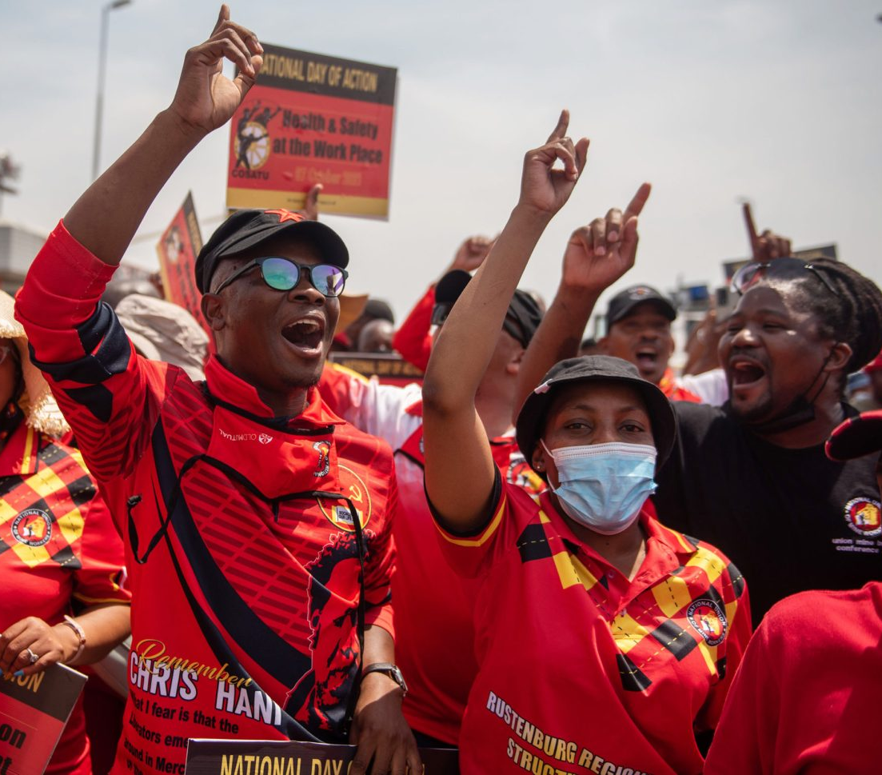
LRA Section 77 processes
Concluded applications:
COSATU: Economic crisis
Public transport challenges filed by COSATU, Fedusa & Nactu (7 Oct 2020)
Applications in progress:
Violent Crimes in the Western Cape
SAFTU: Defence and promotion of socio-economic interests of workers and working class in general

Slide 20
Annual Financial Statements

Slide 21
Statement of financial performance
 | 2021 | 2020
Revenue
Revenue from exchange transactions | 1 241 134 | 1 596 307
Revenue from non-exchange transactions | 58 303 497 | 45 912 254
Total revenue | 59 544 631 | 45 912 254
Expenditure
Personnel expenses | (29 272 595) | (24 827 931)
Depreciation and amortisation expenses | (1 804 056) | (1 782 485)
Reversal of impairments | - | 98 480
Finance costs | (404) | (205 179)
Lease rentals on operating lease | (120 139) | (27 483)
Profit on sale of assets | - | (100)
Miscellaneous expenses | (15 403 772) | (18 405 777)
 | (45 600 966) | (45 347 234)
Surplus for the year | 13 943 665 | 565 019

Slide 22
Auditor General report
Nedlac received an unqualified audit with findings
Key findings related to:
Irregular expenditure of R3.7. million for 2020/21 was recorded relating to the non-advertising of the awards of tenders as per NT guidelines
Wasteful and fruitless expenditure of R192 771 for 2020/21 was recorded relating to interest due to late payments to SARS.
Remedial action has been taken
Nedlac has asked NT to condone irregular expenditure from prior years
No findings were received in respect of performance information.

Slide 23
Conclusion
The Nedlac secretariat would like to extend its appreciation to the social partners and Department of Employment and Labour for their support and partnership, in strengthening social dialogue and partnership during 2020/21

