Slide 1
2020/2021 ANNUAL REPORT “ADAPT, WITHSTAND, OVERCOME”
Portfolio Committee on CoGTA
16 November 2021

Slide 2
PRESENTATION OUTLINE
INTRODUCTION & 2017-2022 STRATEGIC FOCUS
COMPLIANCE WITH COVID-19 REGULATIONS
2020 – 2021 AUDIT OUTCOME
IMPACT OF LOCAL GOVERNMENT TRANSITION
2020-2021 NON-FINANCIAL PERFORMANCE
SALGA’s RESPONSE
2020-2021 FINANCIAL PERFORMANCE
RECOMMENDATIONS

Slide 3
A TRIBUTE
SALGA pays tribute to the frontline workers and over 240 local and municipal government colleagues and friends who fought bravely but lost their battle against COVID-19. We honour their contributions and accomplishments and will always cherish the time spent with them. May they rest in peace, never erased from memory.
And to those among our colleagues and friends who lost loved ones and have had to come to terms with such devastating loss, we offer our sincere condolences. You remain in our thoughts.

Slide 4
SALGA STRATEGY 2017 – 2022: STRATEGIC OUTCOMES

Slide 5
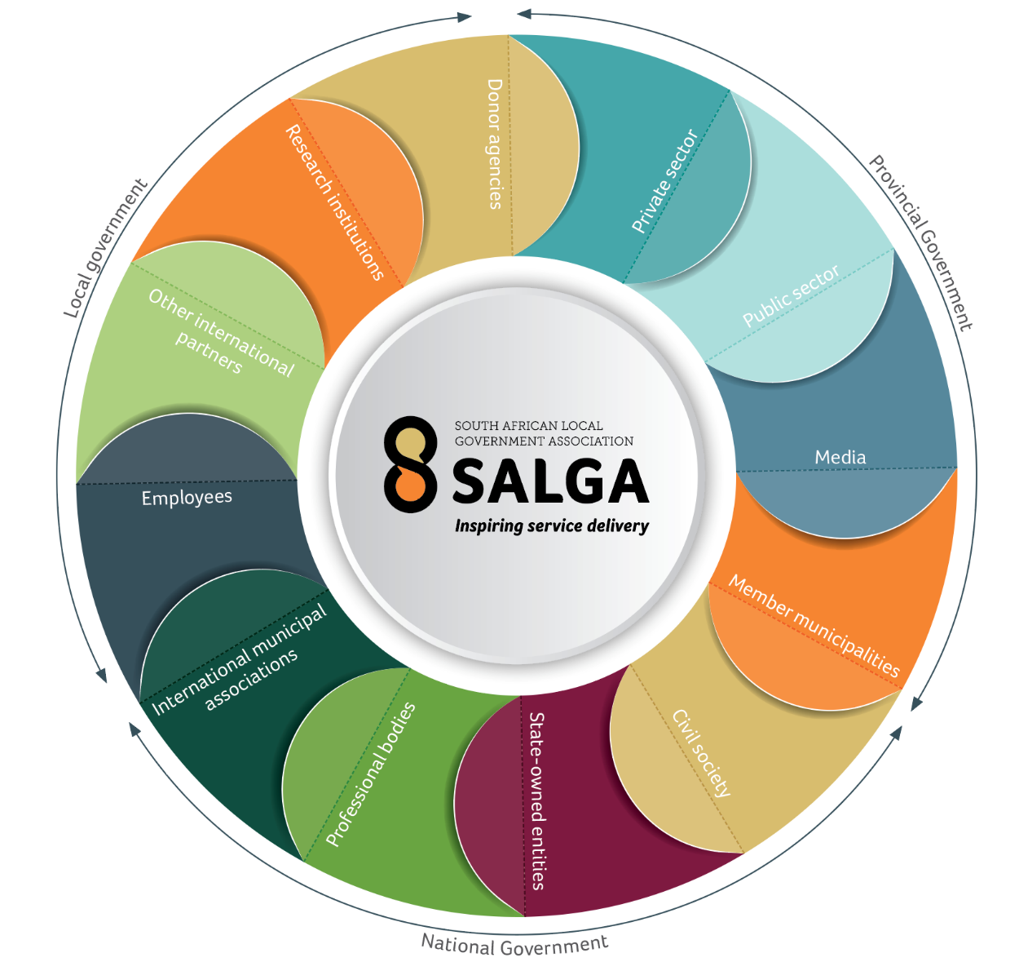
STAKEHOLDERS AND PARTNERS
Stakeholder and partner support is integral to SALGA’s ability to fulfil its mandate of promoting and protecting the interests of local government and enabling its resource capacity.
SALGA is keenly aware of the value of stakeholder contributions and partner collaboration to meet member needs.
Effective and efficient stakeholder management is critical to aligning stakeholders and partners with a broader process of representing, supporting and servicing members.

Slide 6
Auditor-general of south Africa Audit Outcome

Slide 7
AUDIT OUTCOME (NON-FINANCIAL)
Audited Performance of the Predetermined Objectives

Slide 8
AUDIT OUTCOME (FINANCIAL)
“We call on leadership to embrace their responsibility to drive change if we are to make a difference.”
Tsakani Maluleke, Auditor-General of South Africa, 30 June 2021
12 consecutive unqualified audits – 9 clean audits
SALGA’S commitment to ethical business conduct remains steadfast & determined to continue leading by example to be the difference called for by the Auditor-General.
SALGA will continue to assist municipalities to raise the bar on consequence management and ethical business practices.

Slide 9
NON-FINANCIAL PERFORMANCE

Slide 10
NON-FINANCIAL PERFORMANCE
Performance for the first four years
of its five-year Strategic Plan 2017-2021
OUTCOME 1: Municipalities with sustainable inclusive economic growth underpinned by spatial transformation
1
15/16
30/31
22/23
31/36
?
2
OUTCOME 2: Good governance and resilient municipal institutions
21/23
14/14
11/11
44/55
?
3
OUTCOME 3: FINANCIAL SUSTAINABILITY OF LOCAL GOVERNMENT AND GREATER FISCAL EQUITY
5/5
3/3
3/3
7/9
?
4
OUTCOME 4: EFFECTIVE AND EFFICIENT ADMINISTRATION
17/17
7/7
2/2
35/37
?

Slide 11
NON-FINANCIAL PERFORMANCE

Slide 12
NON-FINANCIAL PERFORMANCE: STRATEGIC OUTCOMES

Slide 13
NON-FINANCIAL PERFORMANCE: SALGA MANDATES

Slide 14
Summarised Reasons for Achieving 85%
Limitations introduced by COVID-19;
capacity constraints;
delays in the appointment of external support (service providers);
Inability to exhaust the internal governance approval processes (SALGA Mandating process);
Duplication with COGTA impacted the ability of SALGA to execute a similar target;
Work commenced but could not be finalised to satisfy the requirements of achieved targets.

Slide 15
OUTCOME 1
Municipalities with sustainable inclusive economic growth underpinned by spatial transformation
Purpose: Foster integrated and sustainable urban development and management, as well as regional economic growth that includes rural development and brings about social cohesion.

Slide 16
OUTCOME 1: MUNICIPALITIES WITH SUSTAINABLE, INCLUSIVE ECONOMIC GROWTH UNDERPINNED BY SPATIAL TRANSFORMATION
SPATIAL PLANNING AND LAND-USE MANAGEMENT
Lobbied the Department of Agriculture, Land Reform and Rural Development (DALRRD) for the 24-month no-penalty extension of land-use scheme (LUS) adoption until 1 July 2022.
IMPACT
No penalty for non-compliant municipalities;
Needs-based and financial resources support to municipalities to comply timeously;
Ninety-one municipalities reviewed their LUS, others will conclude reviews during 2021/22.
LAND ACQUISITION AND RELEASE
Developed a generic municipal land acquisition and disposal policy;
Policy is adaptable to specific municipal needs and advocates for a programmatic approach and alignment between land acquisition and disposal to support strategic priorities.
IMPACT
Municipalities are able to respond expeditiously to service delivery demands.

Slide 17
OUTCOME 1: MUNICIPALITIES WITH SUSTAINABLE, INCLUSIVE ECONOMIC GROWTH UNDERPINNED BY SPATIAL TRANSFORMATION
MUNICIPAL NON-REVENUE WATER
Non-revenue water costs municipalities up to 41% in revenue loss (similar loss in Japan 10%). Secured R5 million from the Budget Infrastructure Facility to design a national Municipal Non-Revenue Water Programme to reduce revenue loss. The Japan International Cooperation Agency (JICA) and Department of Water and Sanitation (DWS) to support programme implementation.
Key achievements
JICA trained three municipalities online in bulk metering, reticulation, operations and maintenance, zone configuration, logging, step test and billing.
Inter-municipal networking through trainee/municipal facilitator interaction.
Simulated training at a new non-revenue water training yard enhanced management skills and capabilities.
IMPACT
Improved capabilities at trained municipalities to manage non-revenue water usage.
R25 000 monthly saving at the uMgungundlovu municipality and a recognisable decrease in revenue loss at the other two municipalities.

Slide 18
OUTCOME 1: MUNICIPALITIES WITH SUSTAINABLE, INCLUSIVE ECONOMIC GROWTH UNDERPINNED BY SPATIAL TRANSFORMATION
WATER SECTOR TECHNOLOGY AND INNOVATION
SALGA/water Research Commission (WRC) launched seven integrated, web-based technology and innovation classification platforms with proven water and sanitation services solutions.
DHS, DWS and CoGTA pledged to use the web-based classifications.
DWS Technology Knowledge Centre, launched during 2020’21, is an example of using innovations with municipal and stakeholder support.
Key achievements
First time single-point access for municipalities to seven platforms with sector-specific innovative technology solutions.
City of Cape Town is developing city-specific guide to apply the solutions.
Stakeholder request to National Treasury for a procurement dispensation for using the innovative solutions.
IMPACT
Municipalities can use the platforms to make appropriate technological choices based on sound support and advice.

Slide 19
OUTCOME 1: MUNICIPALITIES WITH SUSTAINABLE, INCLUSIVE ECONOMIC GROWTH UNDERPINNED BY SPATIAL TRANSFORMATION
PROCUREMENT OF SPECIALISED WASTE MANAGEMENT EQUIPMENT
Amendment to the Municipal Infrastructure Grant (MIG) framework for municipalities to secure specialised waste management vehicles.
Support to municipalities with MIG compliance, funding applications and procurement.
Thirty-three municipalities across eight provinces applied to CoGTA for MIG funding for specialised waste management vehicles.
IMPACT
Dramatic improvement in municipal waste management services.
WASTE MANAGEMENT
SALGA supported 13 municipalities to draft waste management bylaws currently awaiting approval from various councils.
IMPACT
Improved local regulation for waste management
Municipalities will benefit from the updated bylaws

Slide 20
OUTCOME 1: MUNICIPALITIES WITH SUSTAINABLE, INCLUSIVE ECONOMIC GROWTH UNDERPINNED BY SPATIAL TRANSFORMATION
TRANSPORTATION
Developed Practical guide for municipalities to adopt a consistent approach to planning, managing and delivering standardised multimodal public transport facilities.
Guide provides municipalities with:
Design principles and guidelines, management prerequisites, municipal regulatory instruments to standardise operations and facilities
Information on safety, security and management structures, stakeholder accountability, accounting and paying for services and maintenance.
IMPACT
Improved public and user appeal, ease, comfort and safety.
Municipal accountability for assets ownership, management and maintenance.
Municipal benefit from inclusive stakeholder engagement and coordinated planning, standardised management principles, structures and systems of accountability and compliance measures to sustain standards and key institutional dependencies.

Slide 21
OUTCOME 1: MUNICIPALITIES WITH SUSTAINABLE, INCLUSIVE ECONOMIC GROWTH UNDERPINNED BY SPATIAL TRANSFORMATION
ELECTRICITY: NEW GENERATION CAPACITY REGULATIONS
Key achievements
Submitted consolidated input on the Draft Regulations Amending the Electricity Regulations on New Generation Capacity.
Developed implementation guidelines for municipal renewable energy projects aligned with the amended legislation.
IMPACT
Municipalities can procure new generation capacity from independent power producers (IPPs).
Guidelines enable municipalities to implement renewable energy projects more effectively.

Slide 22
OUTCOME 1: MUNICIPALITIES WITH SUSTAINABLE, INCLUSIVE ECONOMIC GROWTH UNDERPINNED BY SPATIAL TRANSFORMATION
SERVICE DELIVERY AGREEMENT ON BULK ELECTRICITY RETICULATION AND DISTRIBUTION
Key achievements
Developed Service Delivery Agreement (SDA) terms of reference, identified legal risks and complied draft Legal and Regulatory Risks Report.
Submitted an alternative to Eskom’s active partnering proposal for indebted municipalities
Compiled a draft SDA framework, aligned with the Municipal Systems Act, 32 of 2000, to negotiate Eskom’s active partnering proposal.
IMPACT
Invalidated some risks Eskom raised to signing the SDA to fast-track finalisation
Eskom accepted the alternative to its active partnering proposal, which expedited the signing of the SDA.
Eskom reneged on signing the SDA and complying with the 2018 Cabinet-approved Inter-Ministerial Task Team (IMTT) Advisory Panel recommendations.

Slide 23
OUTCOME 1: MUNICIPALITIES WITH SUSTAINABLE, INCLUSIVE ECONOMIC GROWTH UNDERPINNED BY SPATIAL TRANSFORMATION
SMALL-SCALE EMBEDDED GENERATION
SALGA/GIZ/Department of Mineral Resources and Energy (DMRE) technical support to municipalities accommodate safe and financially secure Small-Scale Embedded Generation (SSEG).
Training webinars to inform decisions about integration and identify SSEG impact on municipal revenues and tariff settings.
IMPACT
43 municipalities benefitted from SSEG training.
Municipal processes to accommodate SSEG in distribution networks and develop sensible SSEG tariffs.

Slide 24
OUTCOME 1: MUNICIPALITIES WITH SUSTAINABLE, INCLUSIVE ECONOMIC GROWTH UNDERPINNED BY SPATIAL TRANSFORMATION
CLIMATE CHANGE
During the past five years, SALGA reviewed and supported the integration of climate change into municipal infrastructure planning and development.
Key achievements
Climate change support programme focused on climate change concepts and response integration in municipal planning and operations.
Developed a climate integration results matrix for the water, roads, transport, storm water and waste management sectors.
IMPACT
Municipal engagement technically in climate change challenges.
Climate change response plans for all district municipalities.

Slide 25
OUTCOME 1: MUNICIPALITIES WITH SUSTAINABLE, INCLUSIVE ECONOMIC GROWTH UNDERPINNED BY SPATIAL TRANSFORMATION
LOCAL ECONOMIC DEVELOPMENT
Local government was the hardest hit by COVID-19 given its reliance on property rates and taxes as a primary income source and rate payers unable to fulfil payment and tax obligations.
The 2020’21 revenue shortfall that affected most municipalities could worsen in the short- to medium-term.
Key achievements
Developed a local government recovery plan to support the projected municipal revenue shortfalls and other COVID-19-related collateral damage.
Obtained a National Treasury opinion on the legislative requirement for joint procurement between two or more municipalities.
IMPACT
Municipalities are better equipped to use local procurement as a lever to ignite the local economy.
Municipalities are better placed to make informed decisions about joint procurement.

Slide 26
OUTCOME 1: MUNICIPALITIES WITH SUSTAINABLE, INCLUSIVE ECONOMIC GROWTH UNDERPINNED BY SPATIAL TRANSFORMATION
MAINSTREAMING OF VULNERABLE GROUPS
Mainstreaming vulnerable groups in municipal policies, plans and processes is fundamental to ensuring the inclusion of women, youth, children, the elderly and persons with disabilities in service delivery and developmental programmes.
Key achievements
Four webinars on mainstreaming of vulnerable groups to stimulate peer learning and knowledge sharing among municipalities.
Identified practical actions to include women and the youth in local economies and persons with disabilities in government structures.
Addressed appropriate action to manage gender-based violence and femicide (GBVF) within local government.
IMPACT
Municipal capacity and peer insight strengthened to mainstream vulnerable groups.

Slide 27
OUTCOME 1: MUNICIPALITIES WITH SUSTAINABLE, INCLUSIVE ECONOMIC GROWTH UNDERPINNED BY SPATIAL TRANSFORMATION
POST-COVID ECONOMIC RECOVERY PLANS AND TRANSFORMATION
South Africa’s economic recovery depends on a capable local government with a functioning IGR and integrated planning and implementation across all spheres of government.
Key achievement
Thirty municipalities attended a two-day dialogue on economic reconstruction and municipal recovery to prepare sound and credible economic recovery plans.
IMPACT
Municipal capacity strengthened to prepare the Municipal Economic Recovery Plans.

Slide 28
OUTCOME 2
Good governance and resilient municipal entities
Purpose: Invest in good governance and the modernisation of governmental approaches and strengthen community interface mechanisms, sound labour relations and professionalisation.

Slide 29
OUTCOME 2: Good governance & resilient municipal institutions
PARLIAMENT AND INTERGOVERNMENTAL RELATIONS
IMPACT of achievements
Industry responsibility for own-product disposal and recycling provides municipal waste management relief.
Systems Amendment Bill supports professionalisation and greater stability within local government.
Multi-Disciplinary Revenue Committee improves municipal revenue management and provides a holistic approach to addressing municipal debts.
SALGA recognised for contribution as the voice of local government.

Slide 30
OUTCOME 2: Good governance & resilient municipal institutions
MUNICIPAL SUPPORT, MONITORING AND INTERVENTIONS
Key achievements
Section 139 interventions database periodically updated with new provincial information.
Case studies of Section 139 municipalities, including the Emfuleni Local Municipality, Mangaung Metro and Tshwane Metro municipalities, informed a critical analysis of intervention application, successes and challenges to develop integrated self-correcting early warning municipal support system.
Findings were presented to the NEC and CoGTA Portfolio and Select Committees.
IMPACT
The Section 139 municipal case study analysis enabled SALGA to highlight intervention challenges and successes.
Identified a link between mergers/amalgamations and Section 139 interventions, which indicates the need for further engagement with other stakeholders on future demarcations.

Slide 31
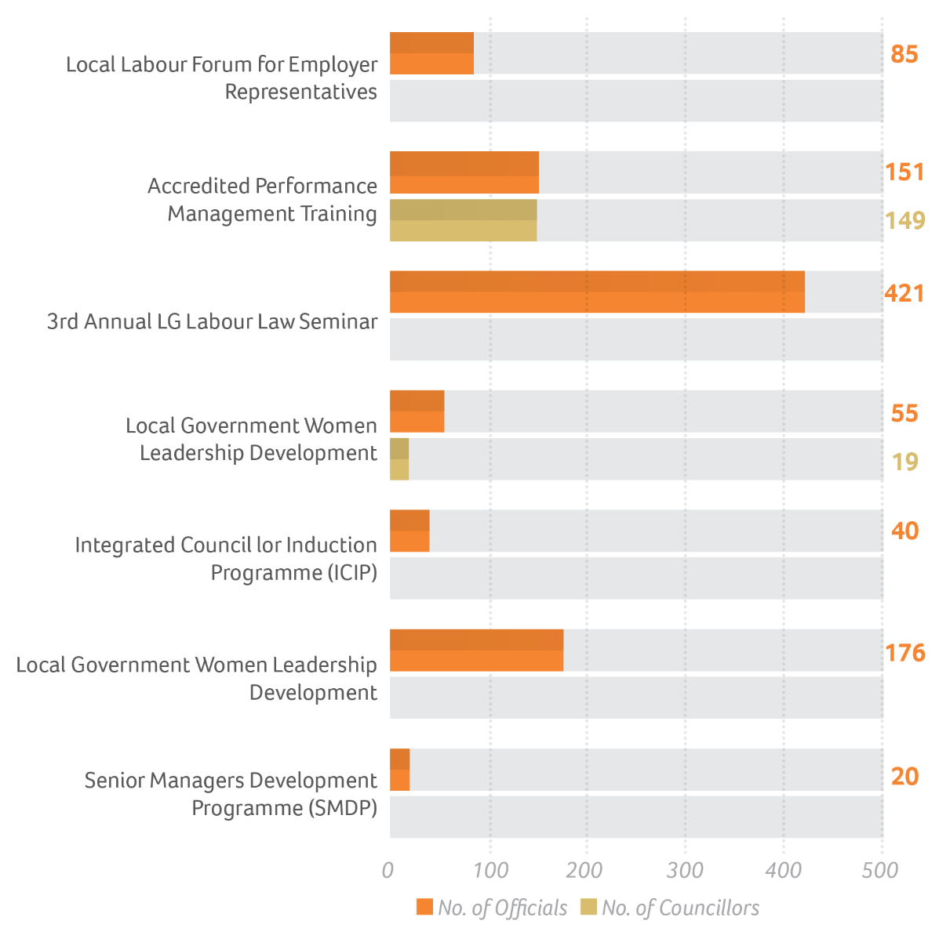
OUTCOME 2: Good governance & resilient municipal institutions
SALARY AND WAGE COLLECTIVE AGREEMENT
The 2018-2021 Salary and Wage Collective Agreement lapsed on 30 June 2021 with an imperative on local government to implement the expected cost-of-living adjustments across all municipalities by 1 July 2020.
Key achievements
SALGA developed a Collective Bargaining Strategy to prepare its negotiating team to lead a structured negotiation process.
The multi-year 2018/2021 Salary and Wage Collective Agreement included an “exemption” option to mitigate unforeseen economic hardships for municipalities.
The NEC approved the Collective Bargaining Strategy and bargaining team on 26 February 2021.
IMPACT
Peaceful and stable local labour relations

Slide 32
OUTCOME 2: Good governance & resilient municipal institutions
COMPLIANCE WITH SALARY AND WAGE AGREEMENT
Key achievements
A circular to municipalities on 4 March 2020 confirmed the NEC decision to align salary increases with the municipal budgetary process and a 6.25% salary increase for the 2020/21 financial year.
According to Section 71 of the Municipal Systems Act, 32 of 2000, municipalities must comply with Bargaining Council Collective Agreements.
Failure to do so is unlawful, attracts audit queries and damages municipal/union management relations.
Due to the devastating effect of COVID-19 on municipal finances, some could not honour their financial obligations, including salary increases on 1 July 2020.
Due to the impact of the pandemic on the economy, the state did not implement the provisions of the final year of the Salary and Wage Collective Agreement.
The trade unions are litigating the decision.
IMPACT
Peaceful and stable local labour relations

Slide 33
OUTCOME 2: Good governance & resilient municipal institutions
ACCOUNTABILITY AND CONSEQUENCE MANAGEMENT PROTOCOL (ACMP)
SALGA resolved to develop an Accountability and Consequences Management Protocol (ACMP) to support municipalities in their daily decision-making processes.
Key achievements
MPAC readiness survey conducted to determine MPACs readiness to carry out their oversight mandate.
ACMP launch plan finalised, engagements completed within SALGA and intergovernmental structures and key stakeholders consulted during February 2021.
IMPACT
Municipal readiness established
ETHICS, INTEGRITY MANAGEMENT AND CODE OF CONDUCT
The municipal audit outcomes report by the Auditor-General of South Africa (AGSA) again highlighted the challenges of leadership, integrity and ethics in municipalities.
Key initiatives
Supported and capacitated 74 municipalities in matters of ethics, integrity management and a Code of Conduct for Councillors and officials
Supported municipalities to implement the Municipal Audit Support Programme (MASP).
IMPACT
Improved Municipal Audit Outcomes

Slide 34
OUTCOME 2: Good governance & resilient municipal institutions
ENHANCE PUBLIC PARTICIPATION
Key initiatives
Facilitated four provincial dialogues on public participation in 4IR and times of COVID-19 to promote inclusive governance.
Developed and presented a concept paper to guide the dialogues to the Mpumalanga Provincial Public Participation Forum on 2 March 2021.
Consulted and engaged key stakeholders (IGR partners), including CoGTA, DPSA, DTA, UNDP and the Moepi Setona Innovative NGO on 11 November 2020.
IMPACT
Enhanced public participation processes for municipalities

Slide 35
OUTCOME 2: Good governance & resilient municipal institutions
GOVERNANCE-RELATED AUDIT FINDINGS
“Disciplined financial and performance management is key to achieving improved audit outcomes and service delivery. Ethical and accountable leadership should drive the required change.” - Auditor-General Tsakani Maluleke, 30 June 2021
2019/20 AGSA Municipal Audit Report:
Emphasised the lack of progressive and sustainable improvements in local government to prevent or deal with accountability failures.
Confirmed a regression in clean audits from 30 in 2018/19 to 27 in 2019/20.
Key initiatives
Facilitated municipal summits nationally (82 participants) on governance, accountability and consequence management with a focus on managing municipal audit findings.
Worked with the MASP team on a concept paper analysis of the 2019/20 AGSA Municipal Audit Report.
Assisted selected municipalities to manage their governance-related audit findings.
Engaged key stakeholders to support selected municipalities.
Report on Local Government Audit Outcomes 2019/20 released on 30 June 2021
IMPACT
Improved Municipal Governance and ultimately improved audit outcomes

Slide 36
OUTCOME 2: Good governance & resilient municipal institutions
HUMAN RESOURCE AND ORGANISATION DEVELOPMENT SUPPORT
COVID-19 movement restrictions and a 10 170 (to date) infected municipal employees required municipal officials capacitated to work from home and rotational talent deployment.
Key initiatives
SALGA NEC approved a local Work-from-Home in National Emergency Conditions policy framework on 10 April 2020.
Circulars issued to municipalities to guide policy implementation and respond to ministerial directives about managing COVID-19 in the workplace.
IMPACT
Improved Municipal performance

Slide 37
OUTCOME 2: Good governance & resilient municipal institutions
SERVICE STANDARDS FOR SELECTED MUNICIPAL PORTFOLIOS
Collaboration between the South African Human Rights Commission, selected sector departments, SALGA and municipal experts and executives identified 33 standards (benchmarked locally and globally) to manage performance and improve service delivery in local government.
The framework differentiates between performance and material standards.
Performance standards define behaviour by officials in planning, implementing and monitoring performance against service delivery indicators.
Material standards describe service quality in delivering, among others, potable water, energy, refuse collection and monitoring building standards compliance.
The standards are aligned with municipal powers and functions and the applicable statutory and non-statutory norms and regulations.
IMPACT
The framework will provide a better understanding of the municipal powers and functions.

Slide 38
OUTCOME 2: Good governance & resilient municipal institutions
ORGANISATIONAL STRUCTURES AND HUMAN RESOURCES MATURITY LEVEL
Key achievements
Concluded and formalised municipal structure guidelines with CoGTA.
Applied the guidelines to organisational structure reviews for the Enoch Mgijima, Sol Plaatje and Kai! Garib municipalities.
The majority of municipalities received poor audit outcomes and scored low on HR maturity levels.
A total of 56 municipalities were supported to improve their HR maturity level during the 2020/2021 financial year.
IMPACT
Improved Municipal HR maturity levels.

Slide 39
OUTCOME 3
Financial sustainability of Local Government and Greater Fiscal Equity
Purpose: Improve the financial health of municipalities through a revised Local Government fiscal framework, effective revenue management and enhancement, access to alternative/innovative funding sources and sound financial management.

Slide 40
OUTCOME 3: Financial sustainability of local government & greater fiscal equity
MUNICIPAL FINANCIAL VIABILITY AND LONG-TERM SUSTAINABILITY
Key achievements
SALGA represented local government and lobbies for equitable fiscal allocations in platforms such as the Budget Forums.
IMPACT
Improved equitable allocation
NATIONAL REVENUE MANAGEMENT PROGRAMME DEVELOPED AND IMPLEMENTED
Key achievements
SALGA established a National Local Government Finance Committee as a platform to share resources and knowledge to improve support to municipalities.
IMPACT
The platform allows all stakeholders to access practical solutions to enhance revenue streams, including:
Improving capacity for revenue collection within an acceptable timeframe
Consolidating stakeholder perspectives from revenue practitioners, municipal executives/leaders, revenue associations, finance interns and industry experts
Creating a platform for finance interns to gather and share knowledge and experiences while developing practical financial management tools and processes.

Slide 41
OUTCOME 3: Financial sustainability of local government & greater fiscal equity
LOCAL PROCUREMENT QUOTA OF NON-SPECIALISED GOODS AND SERVICES
The inability of rate payers to fulfil their tax obligations due to the effect of COVID-19 on income has affected municipal revenue negatively. SALGA supported municipalities to increase their local procurement quota of non-specialised goods and services.
Key achievements
Facilitated a symposium on using local procurement to ignite local economic development
SALGA secured a National Treasury opinion on the legislative requirements for joint procurement between two or more municipalities.
IMPACT
Municipalities are better equipped to use local procurement to ignite the local economy.
Municipalities are better placed to make informed decisions about joint procurement.

Slide 42
OUTCOME 3: Financial sustainability of local government & greater fiscal equity
INCREASE LOCAL PROCUREMENT QUOTA OF NON-SPECIALISED GOODS AND SERVICES
Key achievements
SALGA facilitated a knowledge sharing summit for women and youth.
The summit identified key opportunities for women and the youth in strategy and policy, budgeting, capacity and skills, information and communications and establishing and strengthening structures for women and youth.
IMPACT
The information and tools shared at the summit will assist municipalities to formulate economic development strategies with a strong bias towards women and youth empowerment.
MUNICIPAL GUIDELINES ON THE INVESTMENT ATTRACTION AND PROMOTION
Key achievements
SALGA developed a Municipal Investment Guide in collaboration with Growth Map Infonomics to promote municipal spaces as investment destinations, attract investors, formulate and review municipal investment strategies and create an environment conducive to business activity.
IMPACT
There will be potential of economic benefit for all municipalities.

Slide 43
OUTCOME 3: Financial sustainability of local government & greater fiscal equity
MUNICIPAL AUDIT SUPPORT PROGRAMME [MASP]
SALGA continued to emphasise the importance of accountability and the need for action against ill-discipline.
Key achievements
Lobbied National Treasury for an extension to the MFMA reporting and auditing deadlines due to COVID-19 disruptions.
Developed a MASP Phase 1 online support portal.
Developed a Municipal Finance Good Practice Guide.
Disseminated letters about accountability and consequence management to Accounting Officers in affected municipalities.
Disseminated a Records Management Toolkit.
Finalised an Asset Management Guide/Toolkit.
Completed the process to appoint a panel of experts.
IMPACT
Improved municipal performance and audit outcomes

Slide 44
OUTCOME 3: Financial sustainability of local government & greater fiscal equity
REGULATORY FRAMEWORK INCEPTION REPORT REVIEW TO INCLUDE SUSTAINABLE MUNICIPAL TARIFFS
Key achievements
An Energy Reform Commission appointed to review the municipal tariff structure and existing reforms, define a sustainable structure and implement the changes.
IMPACT
The study will assess/identify:
municipal tariffs and NERSA’s Municipal Tariff Guidelines for the past 10 years, with key findings
inclining block tariffs on municipal revenues and sustainability - challenges to designing an effective block tariff
current tariff sufficiency or overall need for tariff increase/decrease to cover costs (done in selected municipalities)
the efficacy of NERSA’s regulatory frameworks for Eskom and municipal tariff increases and recommend corrections to tariff deficiencies
evaluate the performance of existing subsidies (based on the underlying error of inclusion/exclusion).

Slide 45
OUTCOME 3: Financial sustainability of local government & greater fiscal equity
ELECTRICITY DISTRIBUTION IMPACT ON MUNICIPAL FINANCIAL VIABILITY
Electricity distribution is a municipal function in terms of the Constitution - biggest revenue contributor. Where Eskom supplies electricity directly to about 50% of consumers, including to major energy consumers, local government loose billions annually in revenue.
Concerns from a municipal perspective
Inability to use electricity cut-off as credit control - impacting on collection of other revenue streams;
Payment levels for services in areas where municipalities supply electricity typically exceed 80%.
Similar payment levels in areas where Eskom supplies electricity are as low as 20%.
Key achievements
Conducted research to improve municipal PPP uptake.
Provided institutional investors with a rationale for more investments.
Developed a framework for credible project pipelines.
Decision to seek declaratory order on executive authority for the function.
IMPACT
Certainty to the municipal vs ESKOM role in electricity distribution

Slide 46
OUTCOME 4
Effective and Efficient Administration
Purpose: Provide SALGA with an effective and efficient administration support service to deliver its programmes.

Slide 47
OUTCOME 4: An effective and efficient administration support service for SALGA programme delivery
RESEARCH
Key achievements
Public Procurement Bill (2020) research with North West University - partnered with the North West University in a study on Public Procurement to:
assess the challenges to implementing the current Supply Chain Management (SCM) policy and legal framework, and
improve laws and policies to respond better to socio-economic objectives that informed public procurement reform in post-1994 South Africa.
Public-Private Partnerships Research:
study evaluated the extent to which municipalities are using PPPs as a financing instrument.
addressed a regulatory framework for PPPs in South Africa, previous and current PPP projects (including current municipal projects), challenges in implementing PPPs.
Land Administration: SALGA collaborated with the Programme for Land and Agrarian Studies and Public Affairs Research Institute to facilitate research into integrated land administration.
IMPACT
Informed local government decision making processes

Slide 48
OUTCOME 4: An effective and efficient administration support service for SALGA programme delivery
KNOWLEDGE PRODUCTS
Key achievements
SALGA collaborated with business units and partners to develop a series of knowledge products:
SALGA National Members Assembly Publication
SALGA Municipal Support and Intervention Framework
SALGA Municipal Support and Intervention Model
SALGA Virtual Meetings Guide
2nd Annual Local Government Talent Management Seminar Publication
3rd Annual Local Government Performance Management Seminar Publication
SALGA Devolution Framework
SALGA Study on the Review of Public-Private Partnerships Uptake by SA Municipalities
Study on Public Procurement in Local Government
Good Practice Guide on Municipal Financial Management
SALGA Mobil APP Posters
Lessons Learned Publication on the district development model pilot municipalities of eThekwini Metro, Waterberg and OR Tambo district municipalities.
IMPACT
Informed local government

Slide 49
OUTCOME 4: An effective and efficient administration support service for SALGA programme delivery
PROFILING SALGA AND LOCAL GOVERNMENT
The devastating impact of the COVID-19 pandemic changed the media landscape significantly. Media consumption shifted to digital platforms and SALGA and local government partnered with media houses to tell the local government story.
Key achievements
Created public awareness about the transformative and innovative work of municipalities.
Educated South Africans about municipal challenges and policies that impede effective service delivery through publications, media interaction and events.
Received a wide range of media coverage on various issues, including the Auditor-General’s report on municipal performance, waste management, environmental health, 2021 local government elections and by-elections and municipal electricity debt owed to Eskom.
IMPACT
Public awareness created about the transformative and innovative work of municipalities.

Slide 50
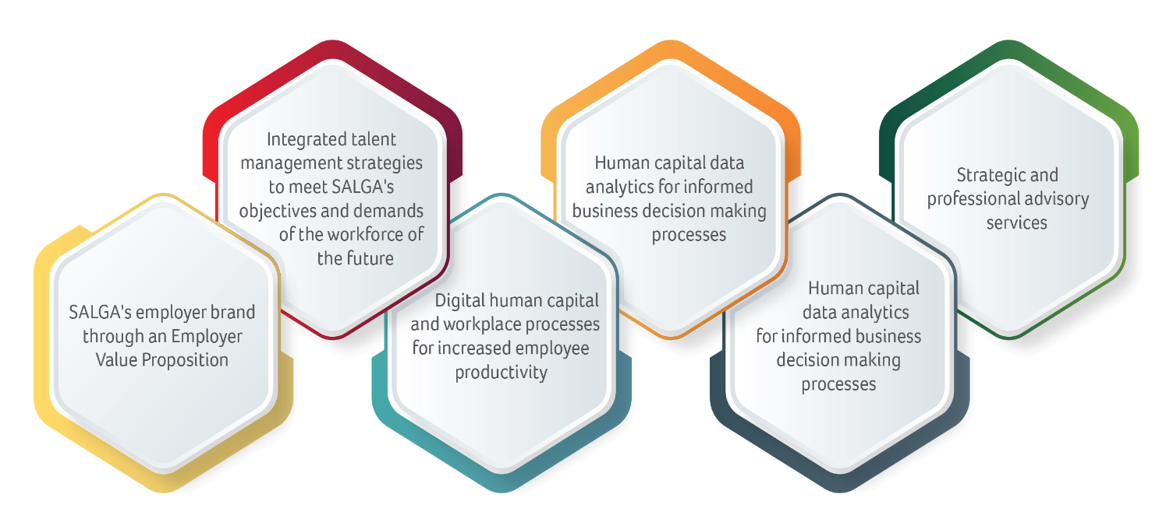
OUTCOME 4: An effective and efficient administration support service for SALGA programme delivery
MANAGING HUMAN CAPITAL
SALGA regards human capital management
as an enabler that leverages every aspect in the
pursuit of its mandates.
Focus areas 2020-2021
Developing a human capital strategy and
employee value proposition (EVP) to support
SALGA as a leading employer brand and reposition the human capital unit as customer-centric.
Embedding a business environment with progressive, digital and effective human resource practices, aligned with the SALGA vision, mission and values that encourage and inspire competent and professional business conduct.
IMPACT
Improved working environment

Slide 51
OUTCOME 4: An effective and efficient administration support service for SALGA programme delivery
EMPLOYEE VALUE PROPOSITION (EVP)
SALGA introduced a compelling employee value proposition to create a psychological and emotional connection with employees. The six EVP pillars reflect employee feedback about what they value the most about working for SALGA.
The SALGA vision, mission and values guide its business conduct and characterise its business offering. The EVP enables SALGA to:
remain relevant within the changing expectations of its workforce
align its human capital strategy with real employee experiences, business objectives and employee expectations
enable employees and potential employees to connect, collaborate and partner with SALGA to fulfil its mandate.
“Our Promise” is SALGA’s commitment to giving employees the opportunity to grow their careers through experiences and connections that inspire them to make a difference.
IMPACT
Improved working environment

Slide 52
OUTCOME 4: An effective and efficient administration support service for SALGA programme delivery
EMPLOYEE CONTRIBUTIONS TO THE SOLIDARITY FUND
In April 2020, the SALGA NEC invited councillors, municipal officials and employees to respond to the President’s call for a financial contribution towards dealing with the COVID-19 pandemic.
SALGA employees contributed a gross amount of R1 594 592.97.
Contributors agreed that the funds be used to support municipalities in their responses to COVID-19.
funds used to procure personal protective equipment (PPE) for front-line workers through bulk procurement at national level.
The equipment included unisex two-piece poly cotton suits, reusable white coats/lab coats, heavy duty gloves and surgical gloves.
Seventeen municipalities received a first batch in January 2021 and the second batch was ready by April 2021.
IMPACT
SALGA officials provided with an opportunity to make and impact in the society.

Slide 53
FINANCIAL PERFORMANCE

Slide 54
FINANCIAL PERFORMANCE
STATEMENT OF FINANCIAL PERFORMANCE

Slide 55
FINANCIAL PERFORMANCE
STATEMENT OF FINANCIAL POSITION

Slide 56
Compliance with covid-19 regulations

Slide 57
COVID-19 MITIGATION ACTION
Standard operating procedures (SOP) for employees and work permits for essential workers.
Employee induction training, training for cleaners on COVID-19 protocols and for SHE representatives as the COVID-19 implementation group.
Employee awareness about safety protocols via posters, social distancing stickers, weekly COVID-19 response team meetings and risk assessments to create a low-risk business environment.
Return-to-work plan, mitigation implementation plan and updates to SOP in line with new regulations and lockdown alert levels.
Compulsory employee temperature screening at all office entry points in all provinces to monitor wearing of face masks/face shields, sanitising hands, recording temperatures and other symptoms, signing attendance registers and signing a return-to-work declaration form.
PPEs issued to national and provincial offices consisting of thermometers, facial masks, foot and mounted sanitisers, reception screens, social distancing stickers and COVID-19 posters.
Back-to-work updates and regular feedback on COVID-19 employee engagement survey.
Regular communique about dealing with stress and anxiety during the lockdown and taking care of mental health issues.

Slide 58
CHALLENGES BROUGHT BY COVID-19
INSTITUTIONAL RESPONSE TO THE COVID-19 PANDEMIC
SALGA responded expeditiously to government’s directive to businesses to manage and contain the spread of the disease at business premises and among employees.
Workplace measures introduced were compliant with the Organisational Health and Safety Act, 85 of 1993.
2020/21 COVID-19 cases
During the past financial year, 34 confirmed COVID-19 positive cases were reported across all 10 SALGA offices.
Offices were closed for decontamination and deepcleaning after every reported case.

Slide 59
IMPACT OF LOCAL GOVERNMENT TRANSITION

Slide 60
LOCAL GOVERNMENT TRANSITION: 2016-2021 TO 2021 - 2026
PRE-ELECTIONS
Voter Registration
Proclamation of Election Date
DURING ELECTIONS
Ward & PR Elections
Declaration of Election Results
POST-ELECTIONS
Inaugural Council Meetings (Metros & Local)
Nomination of Candidates
Inaugural Council Meetings (Districts) (Election of Office Bearers)
2016 – 21 TERM OF OFFICE
2021- 26 TERM OF OFFICE

Slide 61
SALGA PREPARATIONS FOR THE LG TRANSITION
6 Oct ‘21
Council of Speakers – workshop on critical Role of Speakers during the Transition
20 Oct ‘21 Municipal Managers & Senior Managers - workshop on critical Role of Senior Managers during the Transition
27 Oct ‘21 All Councillors – preparation for exit focusing on councillor welfare and support
18, 25 & 29 Oct ‘21 - Transition Guidance Circulars
15 – 16 May ‘21
Special National Members Assembly – adopted Framework & Guidelines for the Transition
2 Nov ‘21 – Approval and Release of SALGA Coalition Government Framework

Slide 62
KEY TRANSITION CONCERNS
Low voter Turnout:
26 million Registered
12 million votes
Increased number of Hung Councils:
from 27 (2016) to 66 (2021)
Calibre of Councillors 2021 - 2026

Slide 63
Low Voter Turnout: A SALGA Response
Initiate all encompassing structured response including focus on increased awareness of the role & mandate of municipalities;
profiling the municipal IDPs, budgets and related status of implementation;
facilitate improved public participation and regular feedback and consultation engagements between councillors and communities.
Initiate multi-disciplinary Programme of Support to municipalities with Coalition Governments/Minority governments.

Slide 64
Coalition Governments since 2000 Elections
PROVINCES | 2000 | 2006 | 2011 | 2016 | 2021
EC – 33 | 1 | 1 | - | 1 | 3
FS – 19 | - | - | - | 1 | 4
GP – 9 | 2 | - | - | 4 | 8
LP – 21 | - | - | - | 2 | 2
KZN - 44 | 10 | 9 | 20 | 7 | 19
MP – 19 | - | - | - | - | 3
NC – 25 | 2 | - | 5 | 3 | 10
NW – 18 | - | - | - | 1 | 3
WC - 25 | 14 | 21 | 12 | 8 | 15
Totals | 29 | 31 | 37 | 27 | 67

Slide 65
Problem Statement with Coalition Governments
coalition governments have not become institutionalised ;
there are no rules in the Constitution or in legislation that define the principles, rules, procedures or sanctions that will apply to the political parties (and independent councillors) that attempt to govern together;
There are no guidelines to follow when they enter coalition talks to establish a coalition government; and
Coalition agreements -
are often vague;
often do not translate into a programme for the incoming government;
are usually not tailored to the needs of that municipality and its community;
are often subsequently undermined by coalition parties in practice; and
are not public.

Slide 66
Coalition Governments: A SALGA Response
There is a need for a framework that can guide political parties and independent councillors on the formation and sustainability of coalitions;
Key focus of a coalitions framework is to:-
Resolve challenges of instability; and
Encourage cooperation in coalitions.
SALGA developed a guiding Framework for tabling to political parties. The Guidelines deal with two crucial stages of coalition governments:-
Coalition formation stage - What happens after a council is declared hung?
Coalition governance stage - What is needed to promote stability during the life-cycle of the coalition?
NOTE: Coalition Framework to be applicable to hung councils after a general election, a by-election or where an existing coalition collapses.

Slide 67
PROCESSING COALITIONS FRAMEWORK
Voluntary Adoption of Framework
Reviewing Section 12 Establishment Notices of Municipalities
Regulatory Framework

Slide 68
CALIBRE OF COUNCILLORS: 2021 NEWLY ELECTED COUNCILLORS
Post the 2021 LGE, a total of 9473 new councillors elected as gazette by the IEC as follows:
BREAKDOWN OF 2021 NEWLY ELECTED COUNCILLORS (PR, Ward & Independents)
PR Cllrs | Ward Cllrs | Independents
5006 | 4416 | 51

Slide 69
CALIBRE OF COUNCILLORS: AGE PROFILE
Age Band | Councillors Count | %
20-29 | 398 | 4.20%
30-39 | 2571 | 27.14%
40-49 | 3273 | 34.55%
50-59 | 2223 | 23.47%
60-69 | 883 | 9.32%
70-79 | 121 | 1.28%
80+ | 4 | 0.04%
Total | 9473 | 100%

Slide 70
SALGA’S RESPONSE: COUNCILLOR INDUCTION
As a multi-stakeholder driven capacity building programme, the Integrated Councillor Induction Programme (ICIP) appreciates the journey of councillor induction as a first step in a series of learning interventions which is best expressed via the Inductive Learning Pathway diagram. The Inductive Learning Phase of this learning pathway is the foundational level for the Macro Learning pathway and has a 3-tier approach for inducting a councillor as outlined below:
Induction by the municipality (upon Councils being constituted)
Generic Induction
Portfolio Based Induction

Slide 71
RECOMMENDATIONS

Slide 72
RECOMMENDATIONS
It is recommended for the PC COGTA to:
Note the SALGA Annual Report for the year ended 31 March 2021.
Note the SALGA’s Annual Performance Plans up to the end of the strategic term 31 March 2022
Note the Local Government Transition and related key concerns with the SALGA responses.

