Slide 1
2020/21 Annual Report
Presentation to the Portfolio Committee on Agriculture, Land Reform and Rural Development
12 November 2021

Slide 2
Executive Summary
2020/2021 Financial Year
OBP realised R238 million gross sales against a budget of R170 million.
Budget exceeded by R68 million.
The overall rate for organisational performance is 50%, which is an improvement compared to 43% that was achieved in the 2019/2020 financial year.
Auditor-General report of the financial statements
Unqualified audit opinion
Achieved reduction in irregular expenditure from R44 mill to R9 mill.
Process of condonation under way
Unqualified audit on performance information (all 5 strategic goals)
The company passes the going-concern evaluation

Slide 3
01
02
03
CONTENTS
ABOUT
OBP
GOVERNANCE
PERFORMANCE PROGRAMMES
04
05
06
FINANCIALS
STRATEGIC RISKS
WAY FORWARD

Slide 4
1
ABOUT OBP

Slide 5
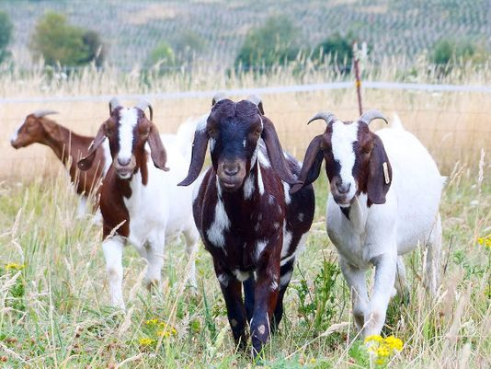
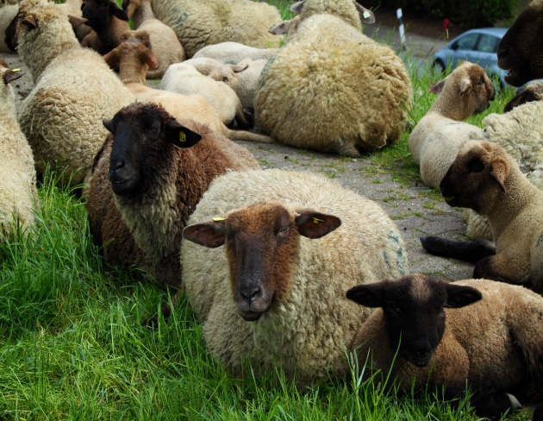
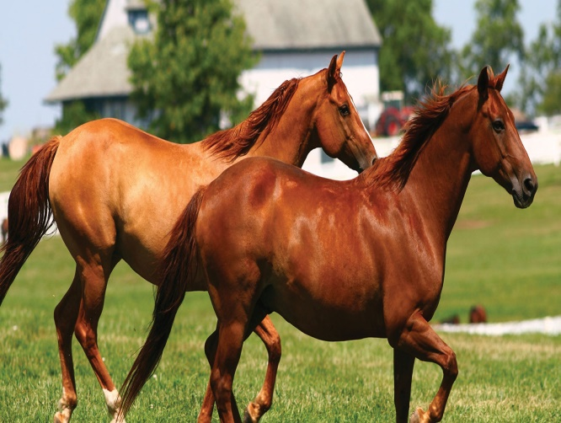
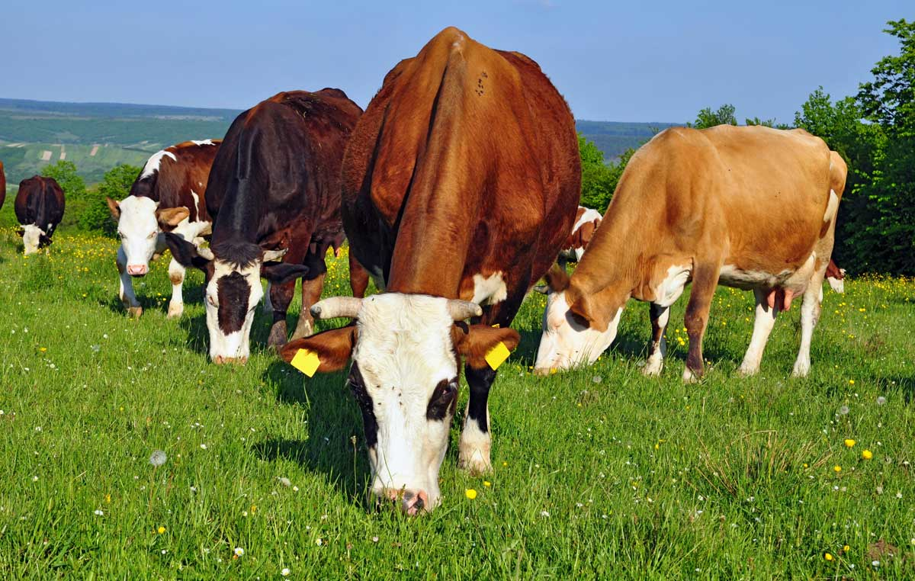
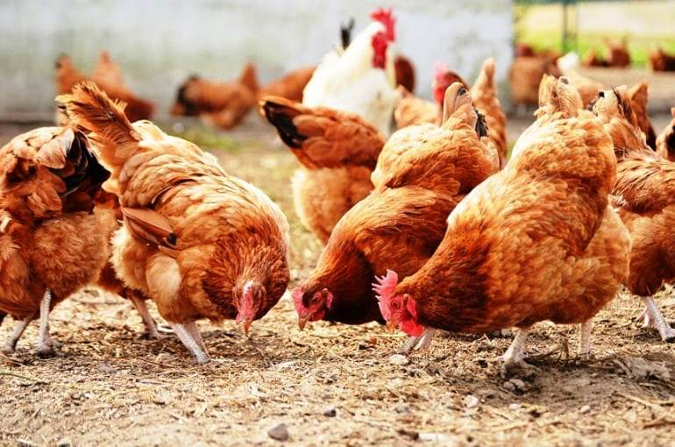
Our Product Range
6 diagnostics reagents
Autogenous vaccines
Therapeutic sera
28 Bacterial Vaccines
14 Viral Vaccines
4 Parasitic Vaccines
More than 150 m doses annually
5 | Onderstepoort Biological Products © | November 3, 2021

Slide 6
One OBP Strategy
OUR VISION
To be the first choice in animal health solutions
OUR PURPOSE
OUR BUSINESS MODEL
To provide innovative and disruptive solutions
for animal health
ONE GOAL 3-5-1
ONE SET OF VALUES - PRIDE
People first
Respect
Integrity (incl. accountability)
Dedication
Excellence (includes innovation)
Smart digital solutions for
Animal Health
Develop and Produce
Biological
Solutions
Managed
Distribution
Services
Triple (3X) EBITDA in 5 years by:
Being a great place to work at
Providing exceptional customer service
Delivering leading “return on investment”
OUR SET OF STRATEGIC OUTCOMES
CURRENT STRATEGIC RISKS
Fraud and corruption
Insufficient research and development output
Lack of market share growth/ loss of market share
Production inefficiencies
Threat to financial sustainability
Inadequate HR Capacity
ICT system inefficiencies/inadequate functionality/underutilization
Financial growth and sustainability
Optimized business processes
Improved customer services
Capable, ethical and developmental organisation
SOCIETAL IMPACT
ANIMAL HEALTH
SKILLS DEVELOPMENT
ECONOMIC TRANSFORMATION
FOOD SECURITY

Slide 7
Workforce Profile
OCCUPATIONAL LEVELS Top management | MALE |  |  |  | FEMALE |  |  |  | FOREIGN NATIONALS |  | TOTAL
 | A | C | I | W | A | C | I | W | MALE | FEMALE
 | 1 | 0 | 0 | 0 | 0 | 0 | 0 | 0 | 0 | 0 | 1
Executive management | 2 | 0 | 0 | 0 | 0 | 0 | 0 | 1 | 0 | 1 | 4
Management | 6 | 2 | 0 | 5 | 9 | 0 | 0 | 1 | 1 | 0 | 24
Skilled employees | 31 | 1 | 1 | 2 | 37 | 0 | 1 | 5 | 0 | 3 | 81
Semi-skilled employees | 33 | 0 | 0 | 5 | 20 | 0 | 0 | 4 | 0 | 0 | 62
Basic – skilled employees | 18 | 0 | 0 | 0 | 15 | 0 | 0 | 0 | 0 | 0 | 33
TOTAL PERMANENT | 91 | 3 | 1 | 12 | 81 | 0 | 1 | 11 | 1 | 4 | 205
Temporary employees | 5 | 0 | 1 | 0 | 6 | 0 | 0 | 0 | 0 | 0 | 12
GRAND TOTAL | 96 | 3 | 2 | 12 | 87 | 0 | 1 | 11 | 1 | 4 | 217

Slide 8
02
GOVERNANCE
8 | Onderstepoort Biological Products © | November 3, 2021

Slide 9
Board of Directors
Governance Structure
AUDIT, RISK AND IT COMMITTEE (AR&IT) (consists of three independent non-executive directors) | Roles and responsibilities Assists the Board in fulfilling its oversight responsibilities for: financial reporting, the system of internal controls, Assurance, Risk management ICT, and, compliance with laws and regulations as they relate to financial reporting.
REMUNERATION, HUMAN RESOURCES, SOCIAL & ETHICS COMMITTEE (consists of four independent non-executive directors) | Roles and responsibilities Ensures that the management of human resources and statutory reporting are in line with all applicable legislations Makes recommendations on human resources strategy and policies, succession planning, remuneration, training, governance of ethics, and performance management. Social and Ethics
RESEARCH AND DEVELOPMENT COMMITTEE (consists of five independent non-executive directors) | Roles and responsibilities Oversees the development of the research agenda for the institution, ensuring that all intellectual property is managed in accordance with the Intellectual Property Policy. etc.
OPERATIONS, SALES AND MARKETINGCOMMITTEE (consists of four independent non-executive directors) | Roles and responsibilities Oversees the establishment of processes for the support of the core mandate of the organisation.
(Members of the Board
from top left to right)
Ms Rene Kenosi
(Chairperson)
Ms Nona Sonjani
Mr Lufuno Motsherane
Prof Khathutshelo Nephawe
Ms Kribashni Naidoo
Mr Luvuyo Mabombo
Dr Boitshoko Ntshabele
(Shareholder’s Representative and acting CEO
9 | Onderstepoort Biological Products © | November 3, 2021

Slide 10
Organisational Structure
Board of Directors
Company Secretary & Legal Advisor
Internal Audit
Chief Executive Officer
Personal Assistant
Chief Scientific Officer
Chief Operations Officer
Business Development Officer
Chief Financial Officer
ANNUAL REPORT 2020 2021
9

Slide 11
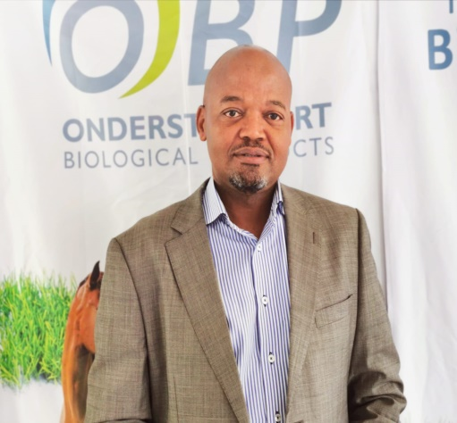
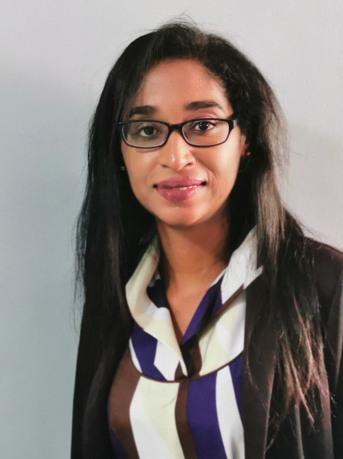
Executive Management Team
Dr Boitshoko Ntshabele
Acting Chief Executive Officer
(Acting CEO)
VACANT
Ms Elspeth Govender
Chief Financial Officer
(CFO)
Dr Jacob Modumo
Business Development Officer
(BDO)
Chief Operations Officer
(COO)
Dr Bethuel Nthangeni
Chief Scientific Officer
(CSO)
11 | Onderstepoort Biological Products © | November 3, 2021

Slide 12
ORGANISATIONAL PERFORMANCE
03
12 | Onderstepoort Biological Products © | November 3, 2021

Slide 13
2020/2021 Financial Year SG1: FINANCIAL SUSTAINABILITY To increase company profitability and position OBP as a top five in the market
Outcome | Outcome | Output Indicator | Annual Targets | Actual YTD Performance | Variance | Reason for Variance | Action Plan
 |  |  |  |  |  | New markets
Improve income and profitability | Income | Sales Revenue (R) | R170m | R238m | +R68m Over- achieved | Increased sales of FMD High demand for vaccine due to vaccination campaigns workshops on disease management Increase in operating expenses | Strive to continue to grow the markets
 | Increased profitability | Percentage (%) operating profit | 8% of Gross revenue | -10% of gross revenue | -18% |  | Management needs to implement robust cost efficiency processes / practices

Slide 14
2020/2021 Financial Year SG2: PRODUCT DEVELOPMENT To accelerate the development of market driven and innovative products and technological offerings for the market
Outcome | Outcome | Output Indicator | Annual Targets | Actual YTD Performance | Variance | Reason for Variance | Action Plan
Expand product portfolio and access to new markets | New and improved products and technologies | Number (#) of new and improved product registration dossiers submitted to regulatory authorities | 3 | 1 | -2 Not achieved | Limited availability of compliant animal facilities for clinical trials | Expedite outstanding product development research
 |  | Number (#) of products improved | 2 | 3 | +1 Over- achieved |  | Continue with product improvement and introduction of other new technologies to be relevant in the market
 |  | Number (#) of new technologies introduced | 2 | 3 | +1 Over- achieved | All techniques under development succeeded
 | GMP facility | (%) project phases completed | 100% Completion of Phase 1 / 50% of Phase 2 | 0 | 0 Not achieved | Lockdown restrictions Dispute raised with supplier | Dispute referred to legal, once resolved construction activities will resume
 | Vector proof facility | Approved facility | Completed building | 0 | 0 Not achieved | Delay in tender process | Re-start tender process and appoint service provider in Q2 FY2021/22

Slide 15
2020/2021 Financial Year SG3: SALES AND MARKETING To build a high-performance organisation driven by service excellence and internal collaboration
Outcome | Outcome | Output Indicator | Annual Targets | Actual YTD Performance | Variance | Reason for Variance | Action Plan
Supplier of choice Optimised business processes | Satisfied customers | Percentage (%) of customer complaints resolved | 80% | 54.7% | -25.3% Not achieved | Quarter 4 complaints were received in March (2nd week) and majority were pending resolution. | This indicator will be carried over to 2021/22
 | New Partnerships | Number (#) of partnership agreements signed | 3 | 3 | Achieved |  | This indicator is discontinued
 | Trained farmers on OBP products | Number (#) of trained farmers | 250 | 646 | +396 Over- achieved | High demand for training in Provinces due to outbreaks | This indicator will be carried over to 2021/22
 | Registered Distributors | Number (#) of newly registered distributors | 2 | 4 | +2 Over- achieved | Growing demand for OBP products in Provinces | This indicator will be carried over to 2021/22

Slide 16
2020/2021 Financial Year
SG4: OPERATIONS AND PRODUCTION
To constantly drive a culture of accountability to our customers, stakeholders and the shareholders
Outcome | Outcome | Output Indicator | Annual Targets | Actual YTD Performance | Variance | Reason for Variance | Action Plan
 | Improved production | Percentage (%) success rate | 85% | 74.8% | -10.2% Not achieved | Improved planning functions | Continue with planning on time
Improved product availability | Improved efficiency | Production efficiency index | 7.9 | 9.7 | +1.8 Over- achieved | Outstanding stock transferred to distribution | Planning to accommodate commissioning of equipment Improve on process flow and equipment maintenance
 |  |  |  |  |  |  | This indicator will be carried over to 2021/22

Slide 17
2020/2021 Financial Year SG5: HUMAN RESOURCE MANAGEMENT AND DEVELOPMENT To attract, develop and retain the best talent through fourth-industrial revolution-inspired human resource strategy
Outcome | Outcome | Output Indicator | Annual Targets | Actual YTD Performance | Variance | Reason for Variance | Action Plan
Inspired staff striving excellence Preferred employer | Approved policy documents | Number of reviewed policies | 10 | 3 | -7 Not achieved | 3 Policies were developed/ reviewed for presenting to EXCO. Poor focus on policy review process | The policies will be submitted to the Board for approval in 2021/22
 | Effective performance management system | Percentage (%) Staff performance reviewed | 100% | 45% | 55% Not achieved | The instability of leadership in the HR department | Appoint HR Manager for continuity and productivity in the department and organisation HR Manager was due to commence on 2 May 2021
 | Trained/skilled staff | Percentage (%) WSP successfully achieved | 25% | 6% | 19% Not achieved

Slide 18
04
FINANCIALS
18 | Onderstepoort Biological Products © | November 3, 2021

Slide 19
Highlights Of Financial Performance
Revenue increased by 35%
Largest contributor being the increase in demand from foreign countries.
Improved from a net loss position in the prior year to a net profit position
Cash generated from operating activities improved from a negative balance to a positive balance. The company had a closing cash balance of R274 million.

Slide 20
Income Statement
Figures in Rand | Note(s) | 2021 | 2020 Restated
Revenue | 16 | 214 771 906 | 158 743 996
Cost of sales |  | (68 544 206) | (47 109 372)
Gross profit |  | 146 227 700 | 111 634 624
Other income | 17 | 13 489 560 | 24 705 240
Operating expenses |  | (165 355 488) | (140 937 628)
Administrative expenses |  | (18 339 676) | (33 711 407)
Operating (loss) profit |  | (23 977 904) | (38 309 171)
Investment revenue Appreciation of deferred government grants | 20 | 10 028 366 11 812 062 | 19 068 782 10 411 540
(Loss) profit before taxation |  | (2 137 476) | (8 828 849)
Taxation | 21 | 3 590 223 | 7 645 165
Profit (loss) for the year | 28 | 1 452 747 | (1 183 684)
Total comprehensive income (loss) for the year |  | 1 452 747 | (1 183 684)

Slide 21
Balance Sheet
Figures in Rand | Note(s) | 2021 | 2020 Restated
Assets
Non-Current Assets
Property, plant and equipment | 3 | 338 161 996 | 332 842 543
Intangible assets | 4 | 243 074 | 915 625
Deferred tax | 5 | 13 321 483 | 9 731 260
 |  | 351 726 553 | 343 489 428
Current Assets
Inventories | 6 | 53 686 775 | 80 389 342
Trade and other receivables | 7 | 68 242 961 | 38 769 703
Tax prepayment | 24 | 29 260 416 | 25 394 239
Cash and cash equivalents | 8 | 274 289 110 | 286 237 789
 |  | 425 479 262 | 430 791 073
Total Assets |  | 777 205 816 | 774 280 501
Equity and Liabilities
Equity
Share capital | 9 | 1 000 | 1 000
Retained income |  | 273 922 573 | 272 469 826
 |  | 273 923 573 | 272 470 826
Liabilities
Non-Current Liabilities
Finance lease liabilities | 10 | 131 954 | 270 581
Deferred Recapitalisation Grant | 11 | 436 247 920 | 444 291 521
Deferred government grant – Small-Animal Facility | 12 | 20 493 | 306 025
Deferred government grant – Corporatisation of OBP | 13 | 6 973 034 | 9 224 909
Deferred Research and Development Grant | 14 | 25 403 575 | 24 645 636
 |  | 468 776 976 | 478 738 672
Current Liabilities
Finance lease liabilities | 10 | 157 876 | 157 876
Trade and other payables | 15 | 23 612 331 | 12 501 587
Deferred Recapitalisation Grant | 11 | 7 280 634 | 6 517 669
Deferred government grant – Small-Animal Facility | 12 | 285 532 | 285 532
Deferred government grant – Corporatisation of OBP | 13 | 2 251 875 | 2 251 875
Deferred Research and Development Grant | 14 | 917 019 | 1 356 464
 |  | 34 505 267 | 23 071 003
Total Liabilities |  | 503 282 243 | 501 809 675
Total Equity and Liabilities |  | 777 205 816 | 774 280 501
21 | Onderstepoort Biological Products © | November 3, 2021

Slide 22
Cash Flow Position
Figures in Rand | Note(s) | 2021 | 2020 Restated
Cash flows from operating activities Cash receipts from customers Cash paid to suppliers and employees |  | 170 944 891 (170 414 112) | 169 132 170 (193 691 809)
Cash generated from operations Interest income Tax paid | 23 24 | 530 779 10 028 366 (3 866 176) | (24 559 639) 19 068 782 (5 970 709)
Net cash from operating activities |  | 6 692 969 | (11 461 566)
Cash flows from investing activities Purchase of property, plant and equipment 3 |  | (18 469 168) | (94 285 876)
Cash flows from financing activities
Finance lease payments |  | (138 627) | 428 457
Finance costs |  | (33 853) | -
Net cash from financing activities |  | (172 480) | 428 457
Total cash movement for the year |  | (11 948 679) | (105 318 985)
Cash at the beginning of the year |  | 286 237 789 | 394 553 266
Effect of prior period adjustments on cash balances |  | - | (2 995 251)
Total cash at end of the year 8 |  | 274 289 110 | 286 239 030

Slide 23
Key Strategic Risks
Outcomes | Key Risks | Risk Mitigation
Financial growth and sustainability | Fraud and corruption Ineffective sales and marketing model Inadequate costing model Noncompliance to SCM and other key legislation. Operational Expenses surpassing sales generated. Discounts Inadequate expertise and funding to improve and fast-track product development and product range | Investigate and Report all fraud and corruption to the authorities. Review current sales model/develop and implement an effective model. Review the current model/improve the costing model with the use of ICT. Continuous Training and monitoring of legislation updates. Cost management strategy. Review Discount models. Collaborate with institutions to acquire technologies or licenses.
Continuous improvement of business processes | Production inefficiencies. Inadequate ICT infrastructure. ICT Technical failures and electronic threats Supplier and customer concentration risk Unreliable equipment. Aging/un-maintained infrastructure | Introduction of cGMP and improvement of processes. Organisation wide enterprise architecture and plan roll out.to address ICT gaps. Fair SCM processes to rotate suppliers were applicable. Increase of customer base across within South Africa and internationally Strengthen engineering and maintenance capacity to establish and implement preventative maintenance. Replace/repair infrastructure and equipment.
Improved customer service | Unavailable products Reputational risk | Explore investment into new (external supplier) product dossier.
Capable, ethical and development leadership | Inadequate HR capacity / poor policy and governance framework / poor internal controls | Ensure skills transfer. Align training to skills development within current job profile / Develop and implement policies / monitor internal controls

Slide 24
06
WAY FORWARD
24 | Onderstepoort Biological Products © | November 3, 2021

Slide 25
Areas For Improvement For Next Financial Year
Increase the accessibility of OBP products to rural and emerging markets.
Adhere to the GMP roadmap.
Continue with the GMP facility upgrade to acquire certification
Finalise the full registration dossiers for existing vaccines
Maintain and improve customer support levels.
Revitalise the OBP brand back to global recognition
Increase or develop the number of popular new combination vaccines
Build partnerships with private and or provincial governments to gain access to rural farmers and support rural development programs
Have the right people doing the right job – employees should match the requirement of a job description according to culture, policy and strategy.
Training and mentoring of staff for continuous improvement and to build a sustainable future
Collaboration with other institutions and commercial entities to gain access to new products and technology to build capacity
Maintain and gain market share through broadening our product range (introduction to recombinant technology to produce combination vaccines) creating an effective pricing strategy, focusing market efforts, relationship building of end user customers and effective distribution nodes
25 | Onderstepoort Biological Products © | November 3, 2021

Slide 26
Thank you

