Slide 1
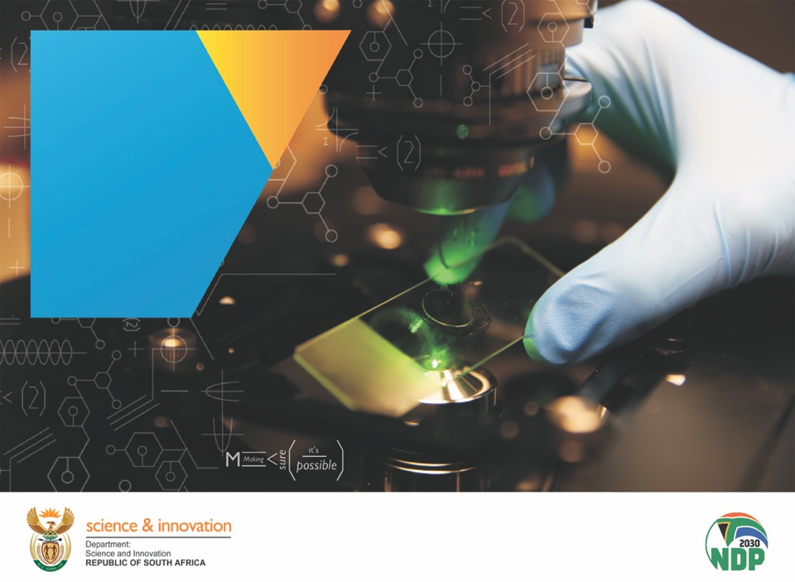
Contents
DSI Annual Report for 2020/2021
(Portfolio Committee)
Dr Phil Mjwara
Director-General
12 November 2021
Chapter 01
Chapter 01
Chapter 01
Chapter 01
Chapter 01
Chapter 01
Chapter 01

Slide 2
Presentation Outline
DSI’s Outcome Goals
Key achievements per DSI Outcome Goals
DSI Performance highlights
DSI’s Overall Performance
Financial Performance
Conclusion

Slide 3
DSI’s OUTCOME GOALS
A transformed, inclusive, responsive coordinated and efficient NSI.
Knowledge utilisation for economic development.
Knowledge utilisation for inclusive development.
Human capabilities and skills for the economy and for development.
Innovation in support of a capable and developmental state
Increased knowledge generation and innovation outputs.

Slide 4

DSI PERFORMANCE HIGHLIGHTS

Slide 5
2020/21 DSI Annual overall performance
Approved 2020/21 Annual Performance Plan (APP)
total number of output targets n=52
[achieved: 45 (87%)] and [7 (13%) not achieved]

Slide 6
A TRANSFORMED, INCLUSIVE, RESPONSIVE COORDINATED AND EFFICIENT NSI
Decadal Plan approved by Cabinet in March 2021 & pronounced as a masterplan of government.
Cabinet endorsed Inter-departmental consultations on the Decadal Plan to discuss cross cutting NSI.
In-principle agreement by National Treasury that a Public STI Budget Coordination Mechanism be integrated into the annual Medium-Term Expenditure Committee (MTEC) processes to improve the allocation of funding to STI across government.
Higher Education, Science, Technology and Innovation Institutional Landscape (HESTIIL) Review report finalized and presented to the Minister in September 2020.

Slide 7
HUMAN RESOURCES AND SKILLS FOR
ECONOMIC DEVELOPMENT (1)
DSI Human capital development (HCD) targeted interventions:
The NDP envisaged HCD as central in addressing South Africa’s unemployment, poverty and inequality challenges.
Postgraduate Bursaries and Internships awarded through NRF and other agencies
Current transformation Interventions;
Task team established within the DSI to;
  co-create a robust and evidence-based transformation agenda for the next 10 years and
  identify reforms and actions to be implemented over the 2020-2025 cycle by DSI and its entities to enhance transformation outcomes.
 | Total Beneficiaries | Black | Women | Black Women | People with Disabilities | South Africans
BTech/Honours and master’s students | 8 610 | 7 151 | 5 346 | 4 525 | 18 | 8 309
Doctoral students | 2 961 | 1 882 | 1 653 | 1 148 | 29 | 2 442
Total no of students funded | 11 571 | 9 033 | 6 999 | 5 673 | 47 | 10 751
Interns | 1 085 | 982 | 700 | 557 | 5 | 1085

Slide 8
HUMAN RESOURCES AND SKILLS FOR
ECONOMIC DEVELOPMENT (2)
Increased the development of technical and vocational skills for the economy:
50 Artisans and/or technicians trained in the energy and agriculture sectors, e.g.
6 – week Hydrogen Fuel Cell Training conducted through the Bambili Energy Group in partnership with the University of Pretoria. In support of DSI’s implementation of the Cabinet approved Hydrogen South Africa (HySA) Strategy through the 15-year HySA Programme. 17 graduates (15 unemployed TVET graduates with minimum N4 Chemical and Electrical Engineering)

Slide 9
INCREASED KNOWLEDGE GENERATION
AND INNOVATION OUTPUTS (1)
Maintained/ increased the relative contribution of South African researchers to global scientific and innovation output:
8150 research articles were published by DSI-NRF-funded researchers and cited in the Web of Science Citation Database.
Research Grants
Awarded 3000 research grants through DSI-NRF-managed programmes, 49% (1445) black and 46% (674) black women.
30 research infrastructure grants awarded through the DSI, the NRF and the South African Research Infrastructure Roadmap (SARIR)

Slide 10
INCREASED KNOWLEDGE GENERATION
AND INNOVATION OUTPUTS (2)
NIPMO made investments toward the identification of the potential intellectual property (IP) and the protection of the developed IP:
Supported six new Office of Technology Transfer (OTTs) from three different provinces (19 new and existing technology transfer jobs/positions exist through this fund).
Funding provided to Sefako Makgatho Health Sciences University, to establish an OTT to ensure that publicly financed health research outputs are identified and find application in society.
Refunded 50% (just under R21 million) of all eligible IP rights protection and maintenance costs following submissions to NIPMO by 23 higher education institutions and science councils.
NIPMO IP Wise™ sessions to Technical and Vocational Education and Training (TVET) colleges around the country extended & the IP awareness campaign to continue going forward
In total 346 trainees upskilled in IP management and technology transfer.
Conducted a National Survey of IP and TT at Publicly Funded Research Institutions (results next slides)

Slide 11
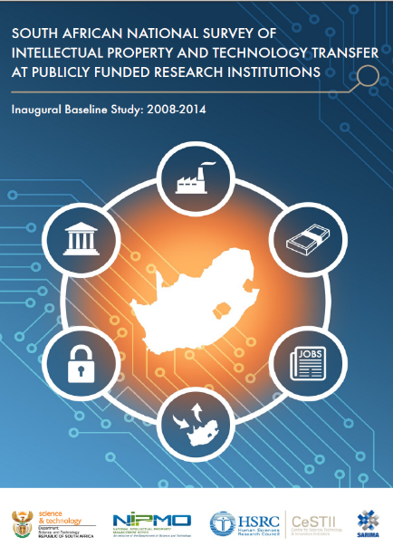

National Survey of IP and TT
at Publicly Funded Research Institutions
Inaugural baseline survey conducted for the period
2008 to 2014 – published April 2017
33 publicly funded R&D institutions governed by the IPR Act:
23 Higher Education Institutions (HEIs)
10 Schedule 1 institutions or Science Councils (SCs)
73% response rate
Second national survey conducted for the period
2014 to 2018 – published June 2021
37 publicly funded R&D institutions governed by the IPR Act:
26 Higher Education Institutions (HEIs)
11 Schedule 1 institutions or Science Councils (SCs)
100% response rate

Slide 12
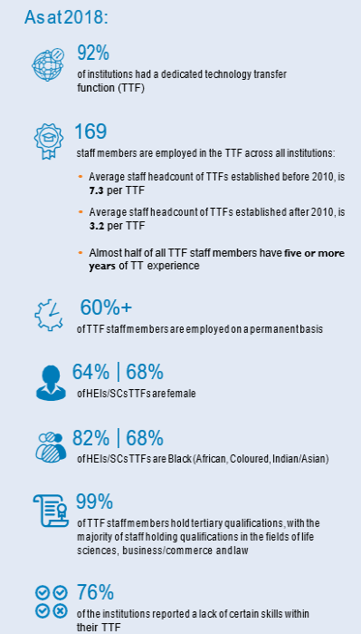

High-level findings:
Technology transfer capacity
Technology Transfer (TT) is the process of translating research outputs into new products, services and processes
“female representation within the TTF has remained dominant, increasing slightly from 2014 to 2018 in both HEIs and SCs”
“the number of black individuals has increased substantially from the baseline survey.
In HEIs the increase is 16.7 percentage points to 81.9% and in SCs it is 11.7 percentage points to 68%”

Slide 13
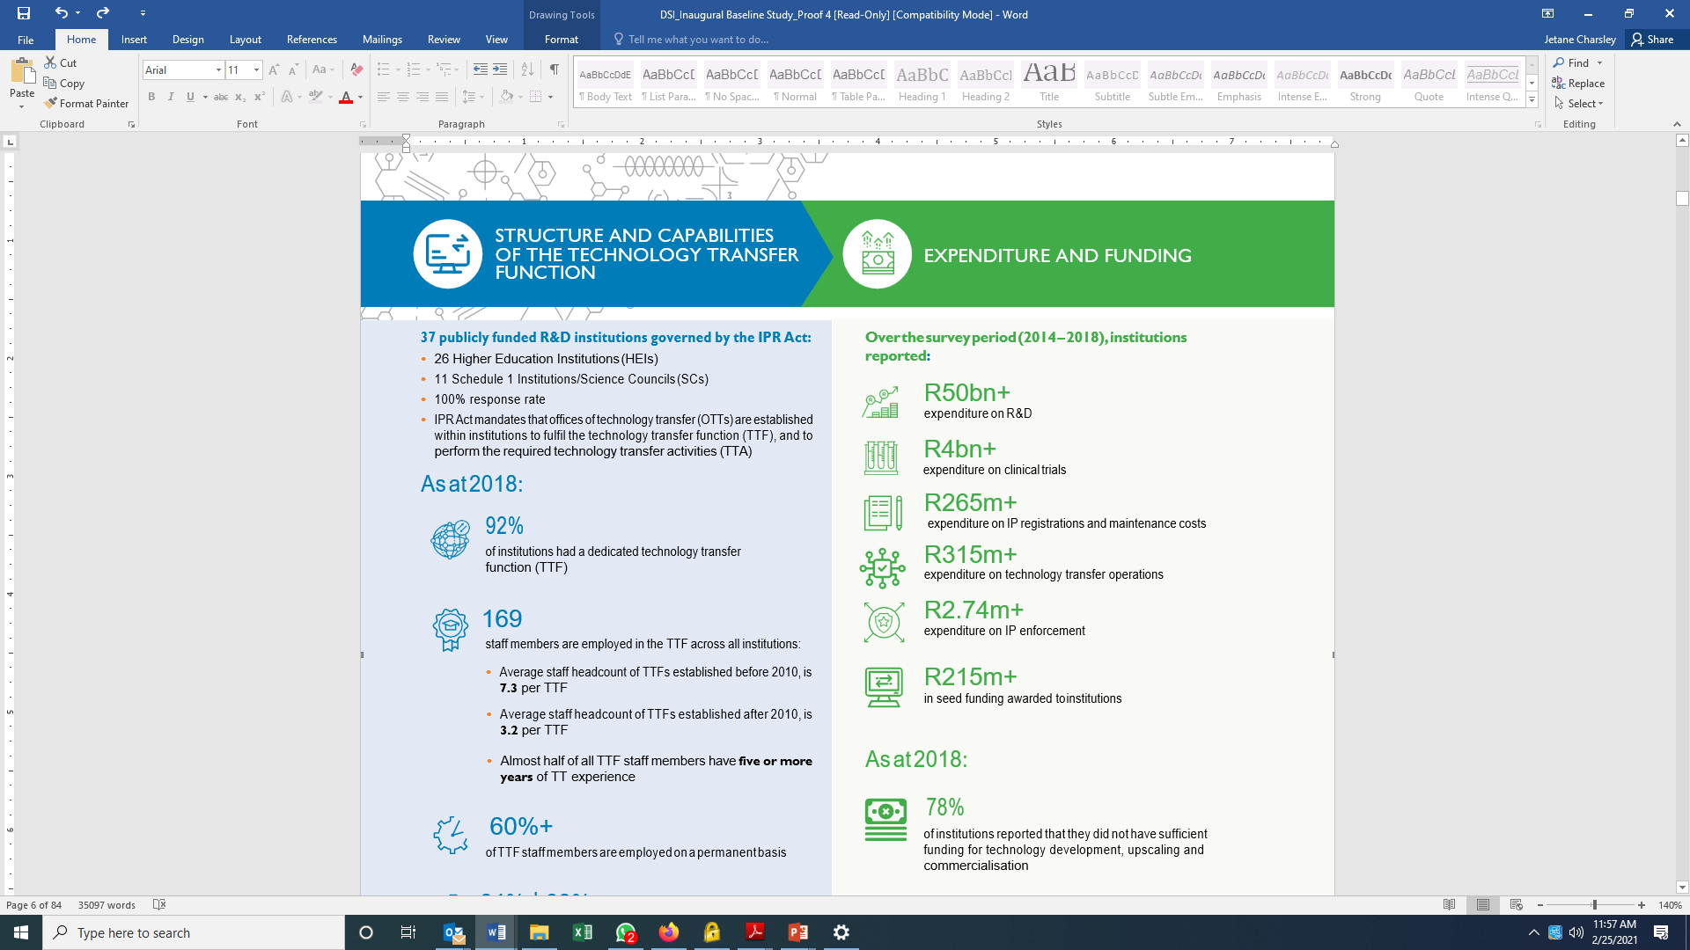

High-level findings:
Expenditure and Funding
        Funding vs associated returns
      Economic value added (MVA) extends far beyond just the number of licenses concluded and revenue earned.
      Includes impact which has not necessarily been quantified or reported on.
Societal benefits* | Best captured through evidence–based case studies. In addition to IP and technology–based outcomes, generated through gaining new knowledge – eg impact on new products or process, impact on policy; healthcare interventions etc.
Economic Benefits* | The broader economic benefits are challenging to capture - require externally commissioned experts …studies which may demonstrate Economic Value Added (EVA) and job creation within a region or country can be powerful. They should be undertaken on an occasional basis.
*Source: EU Knowledge Transfer Metrics

Slide 14
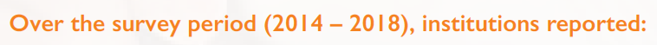
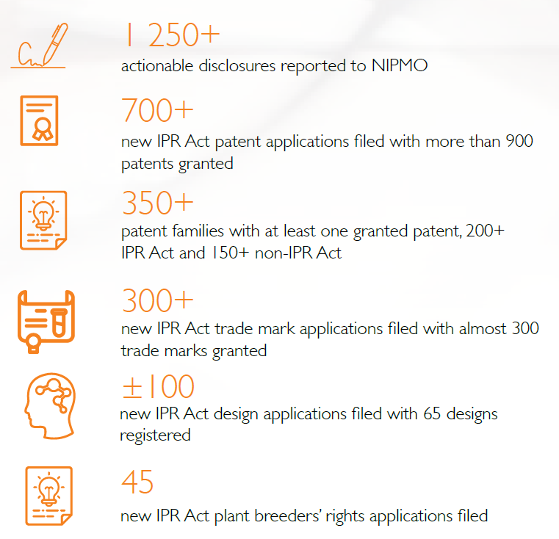
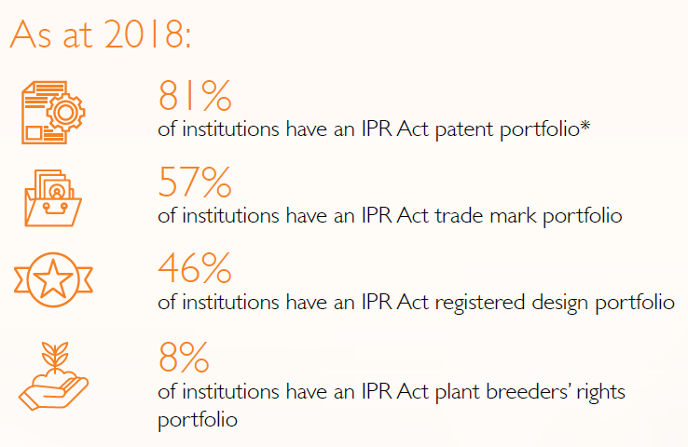
High-level findings:
Intellectual Property Portfolio
“there is a 23.7% increase in reported new actionable disclosures over the survey period. The total number of actionable disclosures managed by TTFs more than
doubled over the survey period.”

Slide 15
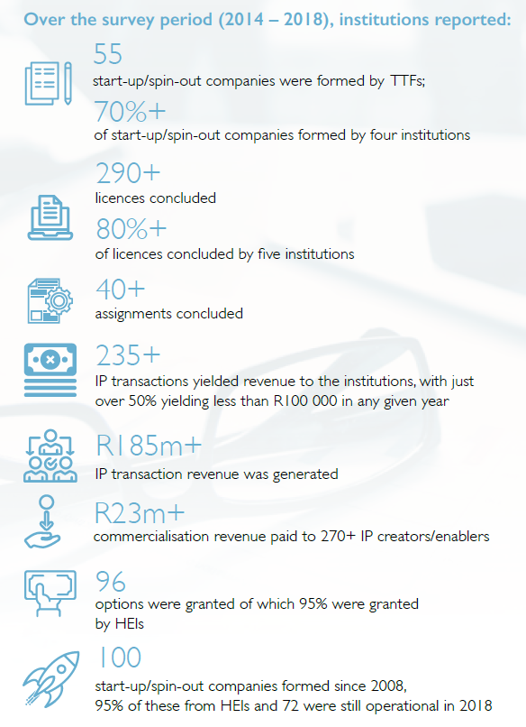
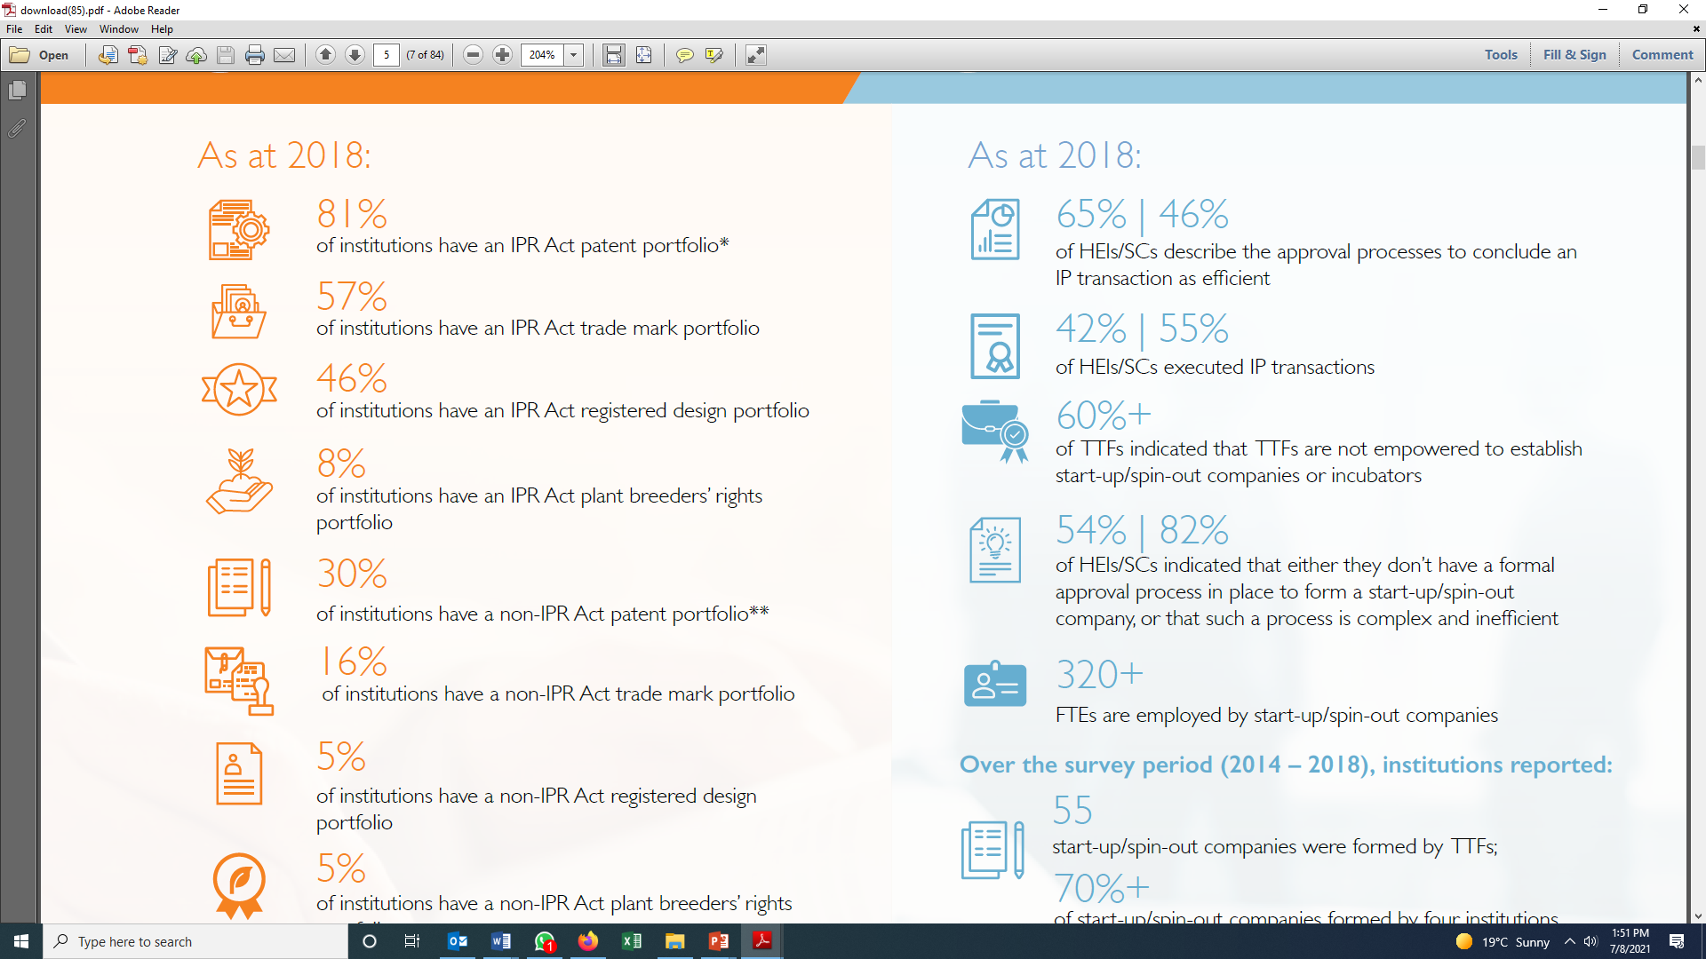
High-level findings:
IP Transactions & Start-Up/ Spin-Out Companies

Slide 16
INCREASED KNOWLEDGE GENERATION
AND INNOVATION OUTPUTS (3)
Potential patents filling: North West University: Covid-19 Covid screening and data storage tool:
A digital Covid screening and data storage tool for a special needs school in North-West was developed by Professor Leenta Grobler and Dr Henri Marais. Product awarded a UNECA innovation award and confirmed as national finalist for South Africa by the World Summit Awards 2020 in the Covid Screening category. Also nominated by the North-West department of Education for a CPSI (Centre for Public Service Innovation ) Award.
A team of engineers led by Prof Grobler developed a remote monitoring system, which will enable experienced nurses and clinicians to remotely monitor a large fleet of ventilators, of different makes and models, on a single centralised monitoring screen.
International patents are in the process of being filed from this work.

Slide 17


DSI COVID-19 INTERVENTIONS (1)
Through knowledge generation and innovation outputs, the DSI and its partners contributed to government efforts to contain the spread of Covid-19 pandemic through;
Genomic surveillance tool:
Genomic surveillance is a critical component of the epidemic response.
We detected a new variant with multiple spike mutations that affected some vaccine response.
Plasma collected from people infected with 501Y.V2 has good neutralizing activity and also against ‘first wave’ viruses and potentially other variants of concern.
People infected have immunity against the variant and other lineages.
South Africa has the scientific tools to evaluate new variants and effects on neutralization and vaccines.

Slide 18



DSI COVID-19 INTERVENTIONS (2)
Media brief that highlight new scientific results on 501Y.V2
Update of NGS-SA and variants in SA.
Effect of 501Y.V2 in neutralization of first wave virus and vaccines.
Effect of 501Y.V2 on neutralizing itself and other variants.

Slide 19
National Policy Data Observatory (NPDO)
The NPDO is a government-led, national policy data observatory currently incubated at the Council for Scientific and Industrial Research’s (CSIR). The Data and Decision Support Centre, which is housed in a secure facility at the CSIR, provides data collection and storage services, analytics, trends and dashboards on various socio-economic indicators. The data and insights generated by the Data Centre are already a significant input for NATJOINTS, Inter-Ministerial Committee (IMC) on Vaccination and other departments such as Department of Planning Monitoring and Evaluation (DPME) and Government Communication and Information System (GCIS).
Data Insights on COVID-19
COVID-19 provincial, districts, national data including trends, analytics, models and strategies, rolling averages, mortality, and hospitalization surveillance including global monitoring of the pandemic, vaccinations and variants
Data Insights and Projections
Use available data to research and evaluate surge across different areas (districts and provinces), and this includes assessing impact of “waves” across different districts and countries. forecasting of the next hotspots or problematic areas using movement data and geospatial case data, and other sources of data
District Profiles
Demographics, households, service delivery, water, electricity education, district financial status, and many more insights .
Others include individual surveillance episodes in rural districts from SAPRIN considered as well.
Use Community Surveys on Socio-Economic Matters
by Anchor knowledge institutions such as HSRC, NIHSS, SAPRIN, SANSA , and others including citizen engagements (GovChat)
Mobility Patterns
Understand the mobility citizens across all levels (national, district, municipality, and wards) to understand lock-down compliance (e.g. monitoring curfews, restrictions etc) and possible super-spreaders
IMC Workstream 4 on Research, Oversight and Monitoring
Support the IMC on vaccine-rollout including conducting research on various aspects and data collection, monitoring of indicators, modelling, and forecasting
Social Sentimental Analysis
collecting daily social medial data to measure national sentiment analysis around various topics including measuring the pandemic fatigue, misinformation, and unrests
Global Trends
Research and monitoring of global trends on various socio-economic interventions such as vaccinations, COVID-19, and many other topics as required
National Government Online Data Portal (National Treasury)
Linking directly to up to date data sources on government budgets and interventions including infrastructure projects at different government levels (e.g. national, departmental, districts and so on)
Other Research Data Sources
Collates myriad of R&D reports including data for different types of analysis and decision-making

Slide 20
National Policy Data Observatory (NPDO)
DSI COVID-19 INTERVENTIONS (4)
Active Contributions (to date)
  Weekly Data Analytics & Reports
  Research and Monitoring
  Technical Data Advisory
  Global Data Trends and Analysis
  Forecasting, Projections and Modelling
  Collaborate with other Natjoints work streams such as threat and risk assessments, travel, law enforcement with data and analysis
  Resurgence tracking and monitoring
  Research via Anchor Institutions
  Data collection and analysis on various vaccination indicators
  Tracking and monitoring of data indicators
  Data analysis and trends on vaccination
  Modelling, forecasting, and projections of the vaccination indicators
  Technical Data Advisory
  Misinformation Data Collection and Sharing
  Strategies for Curbing Misinformation Online
  Research and Models Development

Slide 21
National Policy Data Observatory (NPDO)
DSI COVID-19 INTERVENTIONS (5)
No | Nature of Report | Institution/s | Date expected
1. | Cultural Religious Research Organisations Report on work on counselling and food security | National Institute for the Humanities and Social Sciences (NIHSS) | May 2021
2. | New waive of the surveys on Attitudes towards vaccination | HSRC | August 2021
3. | 2nd Sero Surveillance Survey | HSRC | August 2021
4. | National HIV Survey included Covid-19 and questions on vaccination | HSRC | June/July
5. | Thought pieces on several issues including impact on work and schooling | HSRC/SAPRIN | June 2021
6. | Completed Household Impact Study | South African Population Research Infrastructure | June/September 2021
7. | Poverty, Malnutrition and Food Security | Centre of Excellence for Food Security | July 2021
8. | Vulnerability Index | StatsSA | June 2021
9. | Demographics on Covid-19 | StatsSA | July 2021
10. | Barometer on Resource Utilisation | CHPC | Ongoing basis

Slide 22
KNOWLEDGE UTILISATION FOR ECONOMIC DEVELOPMENT (1)
Improved the sustainability and competitiveness of traditional sectors of the economy and initiate/continue research and development in emerging technology areas that could enable the creation of non-traditional South African economic sectors:
Focused on the stimulation and intensification of technological innovation in order to improve economic growth.
In partnership with other government departments and economic actors, spearheading focused efforts that exploit knowledge capabilities for economic benefit i.e.
  the development of advanced technologies and industries,
  improved government service delivery,
  improved productivity and competitiveness, and
  technology transfer and support to SMMEs and manufacturing firms in the supply chains of large-scale public procurement programmes.

Slide 23
KNOWLEDGE UTILISATION FOR ECONOMIC DEVELOPMENT (2)
Funded a number of instruments in support of increased localisation, competitiveness and R&D- led industry development in aerospace, advanced manufacturing, chemicals, mining, advanced metals, and ICTs, Industry Innovation Programme and the sector innovation fund.
Example: Revitalisation of the Mining Sector:
The South African Mining Extraction, Research, Development and Innovation (SAMERDI) programme developed and launched the mining equipment and Technology Availability Readiness Atlas (TARA https://miningtara.co.za).
The vision of the SAMERDI strategy is “to maximise the sustainable returns of South Africa’s mineral wealth through collaborative research, development, innovation & implementation of mining technologies in a socially, environmentally and financially sustainable manner that is rooted in the local community and national economy.”
Implementation programme comprises the following five programmes:
-Longevity of Current Mines, -Mechanised Mining Systems, -Successful Application of Technologies Centred Around People, -Real Time Information Management Systems, -Advanced Orebody Knowledge
These programmes contribute (collectively and individually) to the following criteria of:
  Increasing the competitiveness of the industry;
  Creating new industries; and
  Allowing for technology localisation.

Slide 24
KNOWLEDGE UTILISATION FOR
ECONOMIC DEVELOPMENT (3)
Revitalisation of the Agricultural Sector:
The Agricultural Bio-economy Innovation Partnership Programme (ABIPP) supported a number of initiatives in support of the economic recovery.
Agro-processing and value chain:
DSI through the SIIP Programme, granted a patent for novel xylanase enzyme formulation with commercial application in the animal feed additive industry
An anti-Taq polymerase fragmented antibody technology aimed at improving the performance of polymerase chain reaction as a diagnostic tool was developed and demonstrated (TRL6).
Innovation support in agro-processing and value chain yielded 2 potential IP products in citrus research during the reporting period.
A bilateral research programme with Malawi was supported: new pro-active interventions for diagnostic, surveillance, monitoring and early warning systems (Aquaculture Health and Feed Programme).

Slide 25
Knowledge utilisation for inclusive development (1)
Health innovation initiatives:
Indigenous Knowledge - Based Covid-19 Research Team made progress in the investigation of herbal medicines against Covid-19.
The University of Free State working in collaboration with Farmers and the United States Food and Drug Administration (US-FDA) at a approved clinical trial facility. Worl also being conducted in collaboration with the Beijing University of Chinese Medicines as an international collaborating research partner.
The PHELA clinical trial protocol was developed and sent to two international regulators, i.e., Learn and Confirm in Canada and the US-FDA experts in the US, for comments prior to submission to the South African Health Products Authority (SAHPRA) for approval.

Slide 26
Knowledge utilisation for inclusive development (2)
Health innovation initiatives:
The Indigenous Knowledge-Based Bio-Innovation Consortium has supported 6 platforms in African medicines, cosmeceuticals, nutraceuticals, health infusions, technology transfer (incubation) and commercialisation (enterprise development).
Over 20 products and prototypes were further supported through these 6 platforms. Six SMMEs on African medicines were graduated from the CSIR and BioPark Incubator with standard operating procedures for manufacturing.
Six medical cannabis prototypes on cancer, diabetes, neurodegenerative conditions, pain and brain performance were developed as were Medi-Weed range of capsules, ointments, oils, parches, etc. Nine SMMEs with agri-businesses were supported (I-Brand, Honeybush and Setsong) in Limpopo, North West, Eastern Cape and Northern Cape.
Two Cosmeceuticals projects with two enterprise development arms were supported in Mpumalanga, Gauteng and Eastern Cape. The mainstreaming of IKS work received a major boost with the approval of the establishment of an IK-Based Platform in African Medicines at the University of Free State under the Technology Innovation Agency.

Slide 27
Innovation in support of a capable and developmental state (1)
Provision of STI decision support tools:
The DSI has developed decision support tools and information management systems to provide policy and decision makers with relevant space derived spatial information and tools to support evidence-based decision making in their efforts to deliver services and better the lives of all South Africans.
DSI together with SANSA provided services to the National Disaster Management Centre (NDMC), Department of Small Business Development (DSBD) and National Department of Human Settlements (NDHS).
DSI and Department of Environment, Forest and Fisheries supported the CSIR and SANSA in their development of the National Oceans and Coast Information Management System and acquisition of Synthetic Aperture Radar dataset for the maritime domain awareness (Oceans Economy).

Slide 28
Innovation in support of a capable and developmental state (2)
The District Development Model (DDM): Initiatives contributed towards
STI to strengthen capacity at local municipality level, thereby contributing to local economic development;
Data observatory: engaging lead departments for an observatory to enable real-time access to DDM information (This is critical for evidence-informed decision-making);
Harness solutions developed from DSI entities for the DDM; and
DSI DDM project information submitted to COGTA for planning purposes.

Slide 29
Innovation in support of a capable and developmental state (3)
The DDM Implementation - Progress:
Analysed the DDM profiles across the DM;
Developed DDM project selection criteria, projects most responsive to profiles; early emerging ideas towards the Draft DSI DDM Plan (outlines the DSI’s approach in supporting the DDM);
Identified 129 initiatives that meets the criteria and are responsive to the DDM profiles;
Established the DSI Entities DDM Committee coordinated by ASSAF; Several meetings held with entities to identify responsive projects from entities;
Submitted the DDM list of projects from the DSI and entities to DCOG; and
DSI team is working with CSIR to develop DDM Impact Simulator.

Slide 30
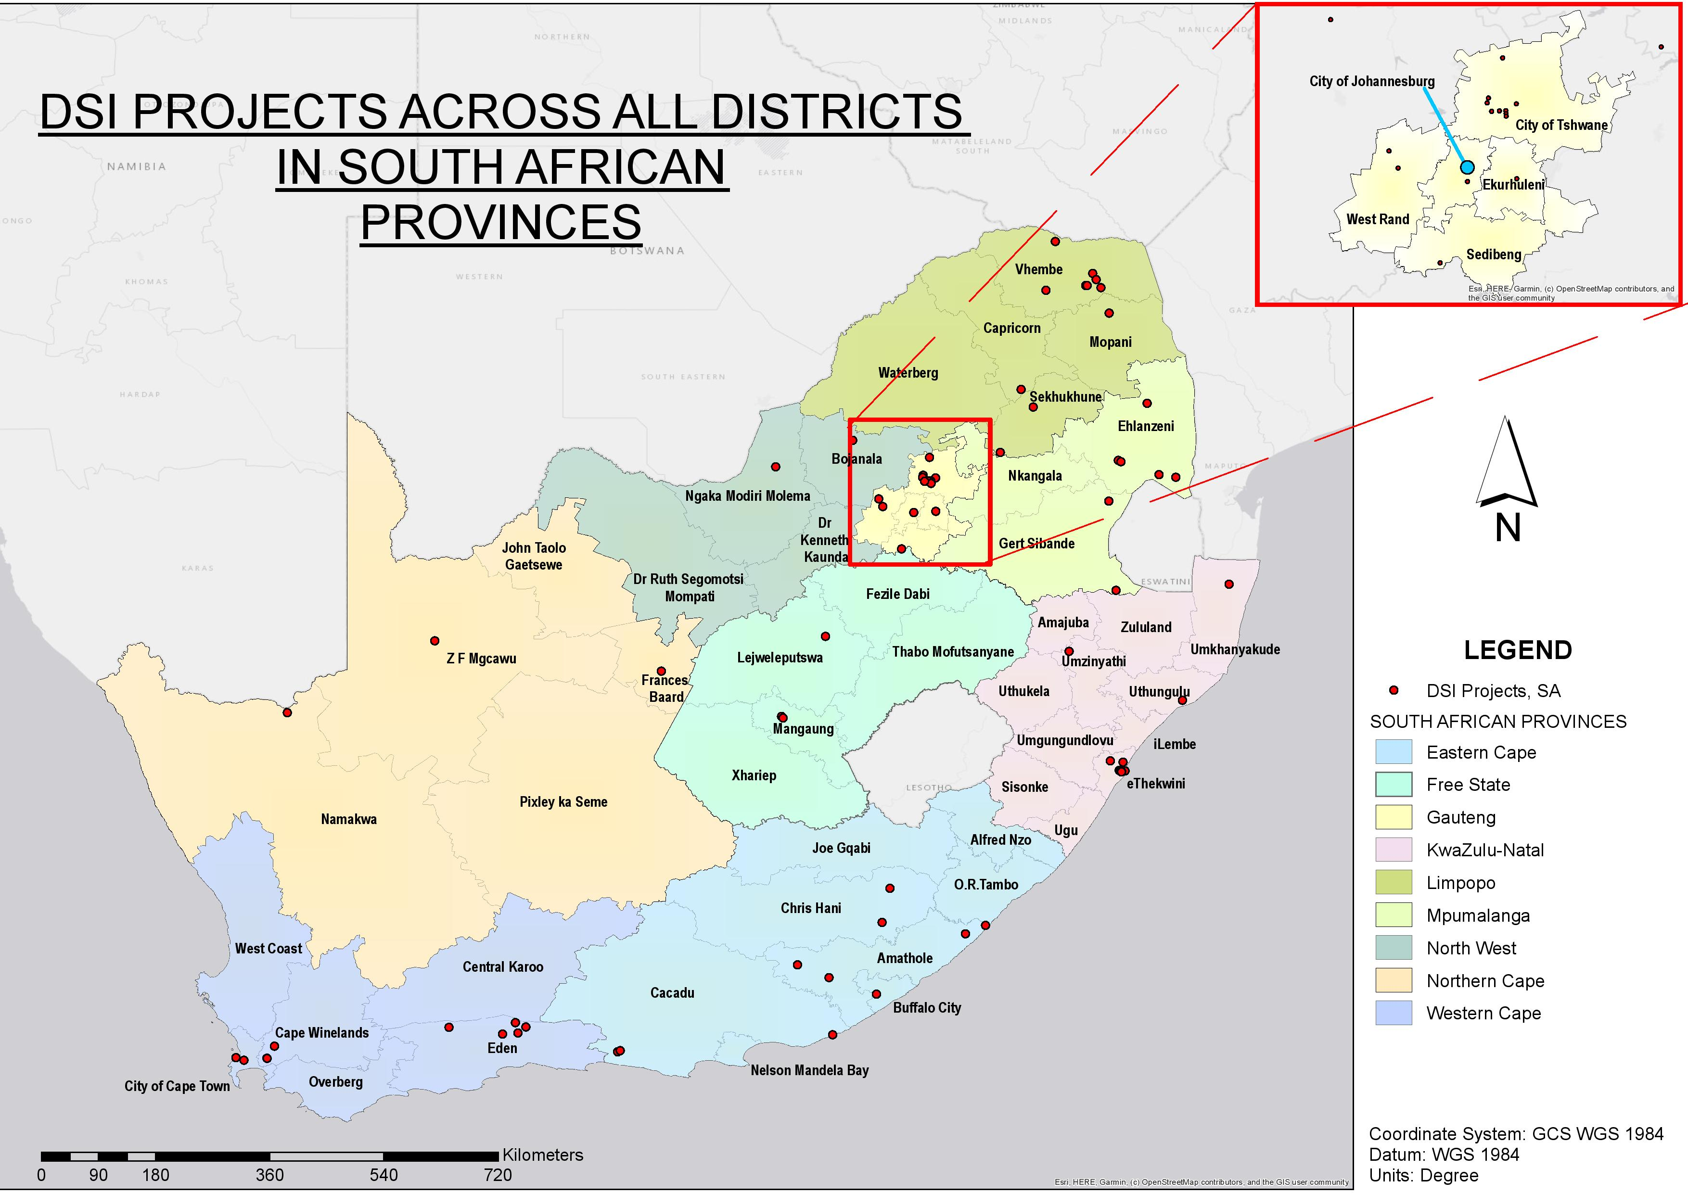
DSI DDM projects

Slide 31
International cooperation and resources (1)
DSI participated in a diverse portfolio of international partnerships initiatives, i.e.
Took part in global research programmes with partners such as the European Union (EU), Japan and BRICS (Brazil, Russia, India, China and South Africa).
Promoted South Africa as a preferred partner for excellence in science cooperation,
Nominated to serve on the UNESCO Open Science Advisory Committee and the International Institute for Applied Systems Analysis Governing Council.
Most engagements took place in programmes linked to strategic priorities areas with a strong support of the policy intents of the White Paper on STI.
Enabled the attraction of significant funding, from the European Union, for innovation in support of a capable state and HCD initiatives.
South Africa benefited from 426 international human capital development opportunities, including for postgraduate qualifications and technical exchanges (17 targeting historically disadvantaged institutions), to be addressed as a priority 2022/23.
Eight projects supported were in relation to the implementation of the Sustainable Development Goals.

Slide 32
International cooperation and resources (2)
In further Pan-African cooperation:
The Minister launched the OR Tambo Africa Research Chairs Initiative, which aims to contribute to the improvement of African global research competitiveness while responding to the continent’s socio-economic needs.
DSI supported 18 projects related to the African Union’s Agenda 2063. Projects range from;
  the Africa Open Science Consultation Forum,
  advancing entrepreneurial universities in Africa, and
  strengthening Africa’s medicine manufacturing capacity.
17 initiatives supported in response to the Southern African Development Community (SADC) Regional Indicative Strategic Development Plan.

Slide 33
Performance Overview for All DSI Entities (1)
Entities Annual Reports are drafted in line with the National Treasury Guidelines and declared information as required by King IV Report.
The DSI has analysed the Annual Reports and made the following observations:
  Some entities’ performance was affected by the COVID 19 pandemic.
  Lockdown and restrictions to travelling and hosting of events led to savings in funds. Savings made was used in other activities for improved performance.
  The DSI entities played a key role in terms of contributing to COVID 19 solutions.
  Transformation targets remain a concern, not achieved by many entities.
  Generally, the DSI was satisfied with the Annual Reports and were approved by the Minister for tabling in Parliament on 30 September 2021.

Slide 34
Performance Overview for All DSI Entities (2)
Entity | KPI Targets | % | Audit Status
CSIR | Achieved 24 of the 31 | 80% | Unqualified Audit
NRF | Achieved 5 of the 7 | 71% | Unqualified Audit
HSRC | Achieved 19 of the 21 | 69,6% | Clean audit opinion and irregular and fruitless expenditure incurred
SANSA | Achieved 14 of the 17 | 82% | Unqualified Audit with findings on compliance matters
TIA | Achieved 10 of the 11 | 91% | Unqualified Audit and irregular expenditure of R868 000
NACI | Achieved 5 of the 8 | 62,5% | NACI reported a deficit of R2,9 million as a result of fixed term contracts and unadjusted deliverables
SACNASP | Achieved 4 of the 7 | 57% | Spent 94,8% of its total revenue

Slide 35
2020/21 UNDERPERFORMANCE
UNACHIEVED ANNUAL TARGETS

Slide 36
Classification of reasons for variances due to non/under achievement
Process delays – refers to under/non-achievement due to factors which are not within the control of the DSI and therefore the achievement of such targets is mainly dependent on outside stakeholders (Such targets require the department to better manage the inter-dependent nature of the deliverables which, in turn, affect the DSI deliverables).
Ineffectiveness of implementers – refers to non-achievement due to deficiencies during the implementation phase (Such targets require the department to better manage the planning of its targets to be aligned to the entities’ targets to ensure that they are working towards achieving a common goal)
Target formulation deficiencies – refers to under/non-achievement due to variables which were not foreseen during the target formulation phase (These gaps can be addressed during the strategic planning processes of the following financial year as part of the lessons learnt)

Slide 37
DSI’s Underperformance Overview
Annual targets not achieved
Annual Target | Annual Progress | Reasons for non-achievement | Status | Variance Classification
Flight model delivered and ready for launching by 31 December 2020 | Flight model delivered but not launched by 31 December 2020 | Launched delayed due to effects of COVID-19 on Global space value chain | Not Achieved | Process delays
200 black emerging farmers (subsistence, small-scale, and potential commercial farmers) benefiting from technology/ innovation support programmes by 31 Mar. 2021 | 71 black emerging farmers (subsistence, small-scale, and potential commercial farmers) benefiting from technology/ innovation support programmes by 31 Mar. 2021 | Support to enough black emerging farmers were reported in signed reports to meet the target, however, only 71 could be verified as the necessary documentation could not be sourced in time. The documentation will be improved in the next financial year | Not Achieved | Target formulation deficiencies

Slide 38
DSI’s Underperformance Overview
Annual targets not achieved
Annual Target | Annual Progress | Reasons for non-achievement | Status | Variance Classification
32 capacity building initiatives for international cooperation specifically targeting historically disadvantaged institutions and individuals by 31 March 2021 | 17 capacity building initiatives for international cooperation specifically targeting historically disadvantaged institutions and individuals by 31 March 2021 | Due to COVID restrictions engagement opportunities with HDIs were limited as a result of connectivity in rural areas. | Not Achieved | Process delays
Regulations for the IK Act approved by the Minister by 31 March 2021 | The Minister could not approve the IK Act Regulations due to internal delays in finalising the regulations for consultations to take place. On 10 March 2021, EXCO | Due to internal delays in finalising the IK Act Regulations, the outputs were not achieved | Not Achieved | Ineffectiveness of Implementers
12 strategic and technical engagements with NRF, SACNASP and ASSAf to ensure alignment to national priorities by 31 March 2021 | 9 strategic and technical engagements with NRF, SACNASP and ASSAf to ensure alignment to national priorities by 31 March 2021 | Some institutions could not hold meetings in quarter one and quarter two | Not Achieved | Process delays
Quarter 4 targets which were not achieved

Slide 39
DSI’s Underperformance Overview
Annual targets not achieved
Annual Target | Annual Progress | Reasons for non-achievement | Status | Variance Classification
Preapproval decisions provided within 90 days from date of receipt for 80% of applications for the R&D tax incentive received between 1 January 2020 and 31 December 2020 | Preapproval decisions provided within 90 days from date of receipt for 20.2% (or 23) of the 114 of applications for the R&D tax incentive received between 1 January 2020 and 31 December 2020 | Capacity within the R&D Tax Incentive unit, no online system, delays caused by requests for additional information from applicants as well as adherence to the PAJA process, general delays with processing applications. | Not Achieved | Process delays
1 700 PYEI beneficiaries by 31 March 2021 | 641 PYEI beneficiaries by 31 March 2021 | A new indicator introduced after the start of the financial year, that is, in July 2021 to accommodate performance requirements associated with the Presidential Employment Stimulus. The initiative initially encountered delays to the funding allocation only being finalised in September. The available funding was not sufficient to continue with the initiative and savings needed to be generated to cover the shortfall. This only happened by December | Not Achieved | Process delays

Slide 40
FINANCIAL PERFORMANCE

Slide 41
Financial Statements: Sources of Revenue and Spending
Appropriation Statement
The Appropriation Statement provides an indication of the Department’s spending against the final Appropriated funds.
In summary the position is as follows: R’000
Final Appropriation, including donor funds: R7, 350, 080
Voted Funds: R7, 278, 287
Donor Funds: R69, 552
Departmental receipts R2, 241
Actual Expenditure: (R7, 234, 396)
Voted Funds: (R7, 165, 265)
Donor Funds: (69, 131)
Variance (Underspending): R113, 442 (2.2%)
Voted funds: R113 022 (1.6%)
Donor funds: R420 (0.6)
Detailed Information per Programme and Economic Classification is presented in the Appropriation section of the Annual Report

Slide 42
2020/21 Adjustment Budget Split
Economic classification | Adjusted Budget R’000
Compensation of employees | 361,993
Goods and services | 119,369
Transfers and subsidies | 6,789,431
Payments for capital assets | 6,994
Payments for financial assets | 500
Total | 7,278,287

Slide 43
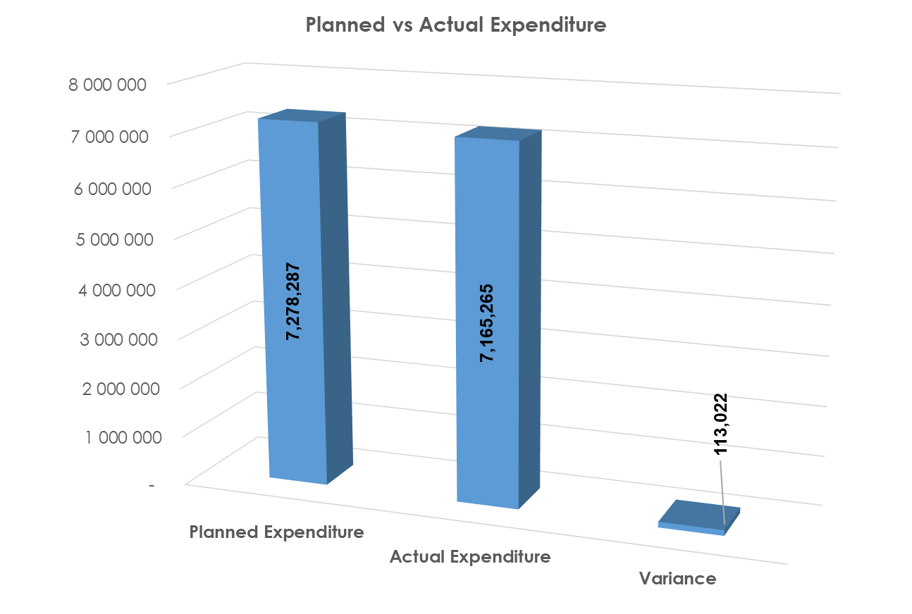
Overall Financial Performance
The department planned to spend R7,278 billion by end of the financial year.
The actual spending for the period amounted to R7,165 billion (98,4% of the total adjusted budget of R7,278 billion).
This translates to a variance of R113 million or 1,6% of planned expenditure.

Slide 44
Financial Statements: Financial Performance Per Programme
Appropriation Statement
The underspending per programme was a follows:
Programmes | Appropriated amount R’000 | Actual expenditure R’000 | Variance R’000 | % Variance
Administration | R294, 416 | R262, 240 | R32, 176 | 10.9%
Technology Innovation | R1, 397, 065 | R1, 379, 841 | R17, 224 | 1.2%
International Cooperation and Resources | R119, 302 | R114, 229 | R5, 073 | 4.3%
Research, Development and Support | R3, 735, 718 | R3, 730, 976 | R4, 742 | 0.1%
Socio-Economic Innovation Partnerships | R1, 731, 786 | R1, 677, 979 | R53, 807 | 3.1%
Total | R7, 278, 287 | R7, 165, 265 | R113, 022 | 1.6%

Slide 45
Financial Statements: Financial Performance Per Programme

Slide 46

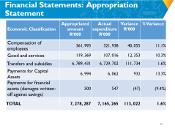
Financial Statements: Appropriation Statement
Economic Classification | Appropriated amount R’000 | Actual expenditure R’000 | Variance R’000 | % Variance
Compensation of employees | 361, 993 | 321, 938 | 40, 055 | 11.1%
Good and services | 119, 369 | 107, 016 | 12, 353 | 10.3%
Transfers and subsidies | 6, 789, 431 | 6, 729, 702 | 111, 734 | 1.6%
Payments for Capital Assets | 6, 994 | 6, 062 | 932 | 13.3%
Payments for financial assets (damages written-off against savings) | 500 | 547 | (47) | (9.4%)
TOTAL | 7, 278, 287 | 7, 165, 265 | 113, 022 | 1.6%

Slide 47
Financial Performance Per Classification

Slide 48
Reasons For Variances and Proposed Remedies
Expenditure Category | Reasons for variance | Remedies
Compensation of employees | Nationwide lockdown delayed the filling of prioritised positions. The budget cuts effected on the compensation of employees budget affected the filling of positions for the current financial year. The DSI can only feel critical positions that are affordable for the 2021 MTEF period. | Three phases of prioritised positions have been approved by EXCO and the department is accelerating the process of filling vacancies.
Goods and services | Most services under this item were not rendered as planned, including the Budget Vote, which were held virtually, and three public participation programmes, which were cancelled. Expenditure incurred was mainly for communication (data and airtime), operating leases, property payments, and consumable supplies related to COVID-19 (sanitisers, sanitiser dispensers, masks, etc.) | R53.4 million was cut from the budget due to COVID19. In addition to the cut, a virement of R20 million has been effected within and to other items to cover shortfalls on some initiatives.

Slide 49
Reasons For Variances and Proposed Remedies
Expenditure Category | Reasons for variance | Remedies
Transfers and subsidies | The variance is due to the following: Delays in finalising contracts for Presidential employment stimulus package due to the funding only being made available in October. It took longer for the DSI to identify funding to top up shortfalls on Presidential employment stimulus package | The department requested a roll-over from the National Treasury however it was not approved. Presidential Employment Stimulus Package was funded through reprioritisation.

Slide 50
Budget and Expenditure For COVID19
Item | Budget R’000 | Expenditure R’000 | Comments
Transfers and subsidies | 189,863 | 147,080 | The money was paid through Strategic Health Innovation Partnerships (SHIP) for different initiatives focusing on diagnostics, prevention and treatment, sequencing/surveillance. Implementation of social science outreach, communication, dissemination and impact Programme for Africa. Electricity to support temporary and existing facilities where COVID-19 patients will be receiving treatment.
Goods and services | 5,222 | 1,873 | The money was spent on decontamination of the DSI building, personal protective equipment, foot petals and digital communication services to share information through social media platforms during the lockdown.
Total | 195,085 | 148,953

Slide 51
Financial Statements: Highest spending goods and services items, note 5
Items | 2020/21 R’000 | 2019/20 R’000 | % variance | Reason for variance
Communication | R12, 793 | R7, 204 | 43.6% | Due to COVID 19 and a need to work from home, most officials had to use voice and data as a result spending on the item increased.
Computer services | R25, 577 | R13, 090 | 48.8% | The increase was due to the procurement of systems required for officials to be able to work from home .
Agency outsourced services | R10, 242 | R9, 149 | 10.7% | The increase was due to use of temporary employment services.

Slide 52
Financial Statements: Reasons for slow spending on goods and services
  Due to COVID 19 pandemic the department experienced slow spending on most of their items due to the following reasons:
  There was no travel during the lockdown. When the lockdown was eased little travel took place.
  There were no meetings as a result there was little spending on catering and venues and facilities.
  There was little maintenance of the building due to lockdown.
  There was no training that took place during lockdown and when training resumed few took place.
  Due to lockdown lot of activities did not take place resulting in slow spending under goods and services.

Slide 53
Financial Statements: Spending on Transfers and Subsidies (High Spending line item(s)
Item | 2020/21 R’000
Parliamentary grants | 2 63 7236
Academy of Science of South Africa | 24 840
Council for Scientific and Industrial Research | 893 581
Human Science Research Council | 289 325
National Research Foundation | 859 469
South African National Space Agency | 161 196
Technology Innovation Agency | 408 825
High spending line items | 2 440 951
Human Resource Development | 831,109
Research and Development Infrastructure | 587,679
Square Kilometre Array | 477,655
South African Research Chairs Initiative | 544,508
Total | 5 078 187

Slide 54
Financial Statements: Impact on Operations
The impact of the underspending to the department:
  There won’t be any financial impact to the department as a result of underspending under compensation item. However the delays in the filling of positions will have an impact on the existing personnel due to added responsibilities.
  For the underspending in transfers and subsidies for the Presidential Employment Stimulus package, the department requested a roll-over from the National Treasury for this funds but it was declined. The department reprioritised funding from slow spending programmes for this project.
  The projects that were not finalised;
    in goods and services will be financed through shifting of funds in the subsequent financial year
    in capital assets will be financed through shifting of funds in the subsequent financial year

Slide 55
2020/2021: Spending on Procurement
  The Total procurement expenditure on goods and services from 1 April 2020 to 31 March 2021 amounted to R47 643 764.
  The procurement expenditure on SMMEs, Black, Women and Youth Owned Companies is depicted below as follows:
TOTAL PROCUREMENT EXPENDITURE | TOTAL EXPENDITURE ON SMME COMPANIES | TOTAL EXPENDITURE ON BLACK COMPANIES | TOTAL EXPENDITURE ON WOMAN OWNED COMPANIES | TOTAL EXPENDITURE ON YOUTH OWNED COMPANIES
R47 643 764 | R18 960 682 | R31 925 822 | R15 072 225 | R6 762 090
% EXPENDITURE ON SMME COMPANIES | % EXPENDITURE ON BLACK OWNED COMPANIES | % EXPENDITURE ON WOMEN OWNED COMPANIES | % EXPENDITURE ON YOUTH OWNED COMPANIES
39,8% | 67,0% | 31,6% | 14,2%

Slide 56
2020/21 Spending on COVID-19 Procurement
  The total COVID-19 procurement expenditure on goods and services from 1 April 2020 to 31 March 2021 amounted to R1 873 051.
  The procurement expenditure on SMMEs, Black, Women and Youth Owned Companies is depicted below as follows:
TOTAL PROCUREMENT EXPENDITURE | TOTAL EXPENDITURE ON SMME COMPANIES | TOTAL EXPENDITURE ON BLACK COMPANIES | TOTAL EXPENDITURE ON WOMAN OWNED COMPANIES | TOTAL EXPENDITURE ON YOUTH OWNED COMPANIES
R1 873 051 | R1 748 595 | R1 368 039 | R304 960 | R1 122 035
% EXPENDITURE ON SMME COMPANIES | % EXPENDITURE ON BLACK OWNED COMPANIES | % EXPENDITURE ON WOMEN OWNED COMPANIES | % EXPENDITURE ON YOUTH OWNED COMPANIES
93,4% | 73,0% | 16,3% | 59,9%

Slide 57
Average Payment Days of Invoices Per Month For 2019/20 And 2020/21 Financial Years
Month | Average payment days
 | 2020/21 | 2019/20
April | 12 | 11
May | 8 | 9
June | 12 | 9
July | 11 | 8
August | 10 | 8
September | 9 | 7
October | 8 | 8
November | 11 | 8
December | 7 | 9
January | 6 | 11
February | 11 | 8
March | 7 | 7
Total average number of days | 9 | 9

Slide 58
Percentage Of Invoice Paid Within 30 Days Per Month For 2019/20 and 2020/21 Financial Years
Month | Average payment days |  | Comments
 | 2020/21 | 2019/20
April | 100% | 100%
May | 100% | 100%
June | 100% | 100%
July | 100% | 100%
August | 92.57% | 100% | The department could not process all invoices due to the closure of the building and self-isolation of finance staff as a result of COVID 19 cases.
September | 94.97% | 100% | Few invoices could not be processes because the service provider’s tax matters were not in order and this was only pick-up during the processing of invoices.
October | 100% | 100%
November | 98.87% | 100% | The invoice was incorrectly captured and not verified by responsible official.
December | 100% | 100%
January | 100% | 100%
February | 100% | 100%
March | 100% | 99.51%
Average percentage | 98.86% | 99.96%

Slide 59
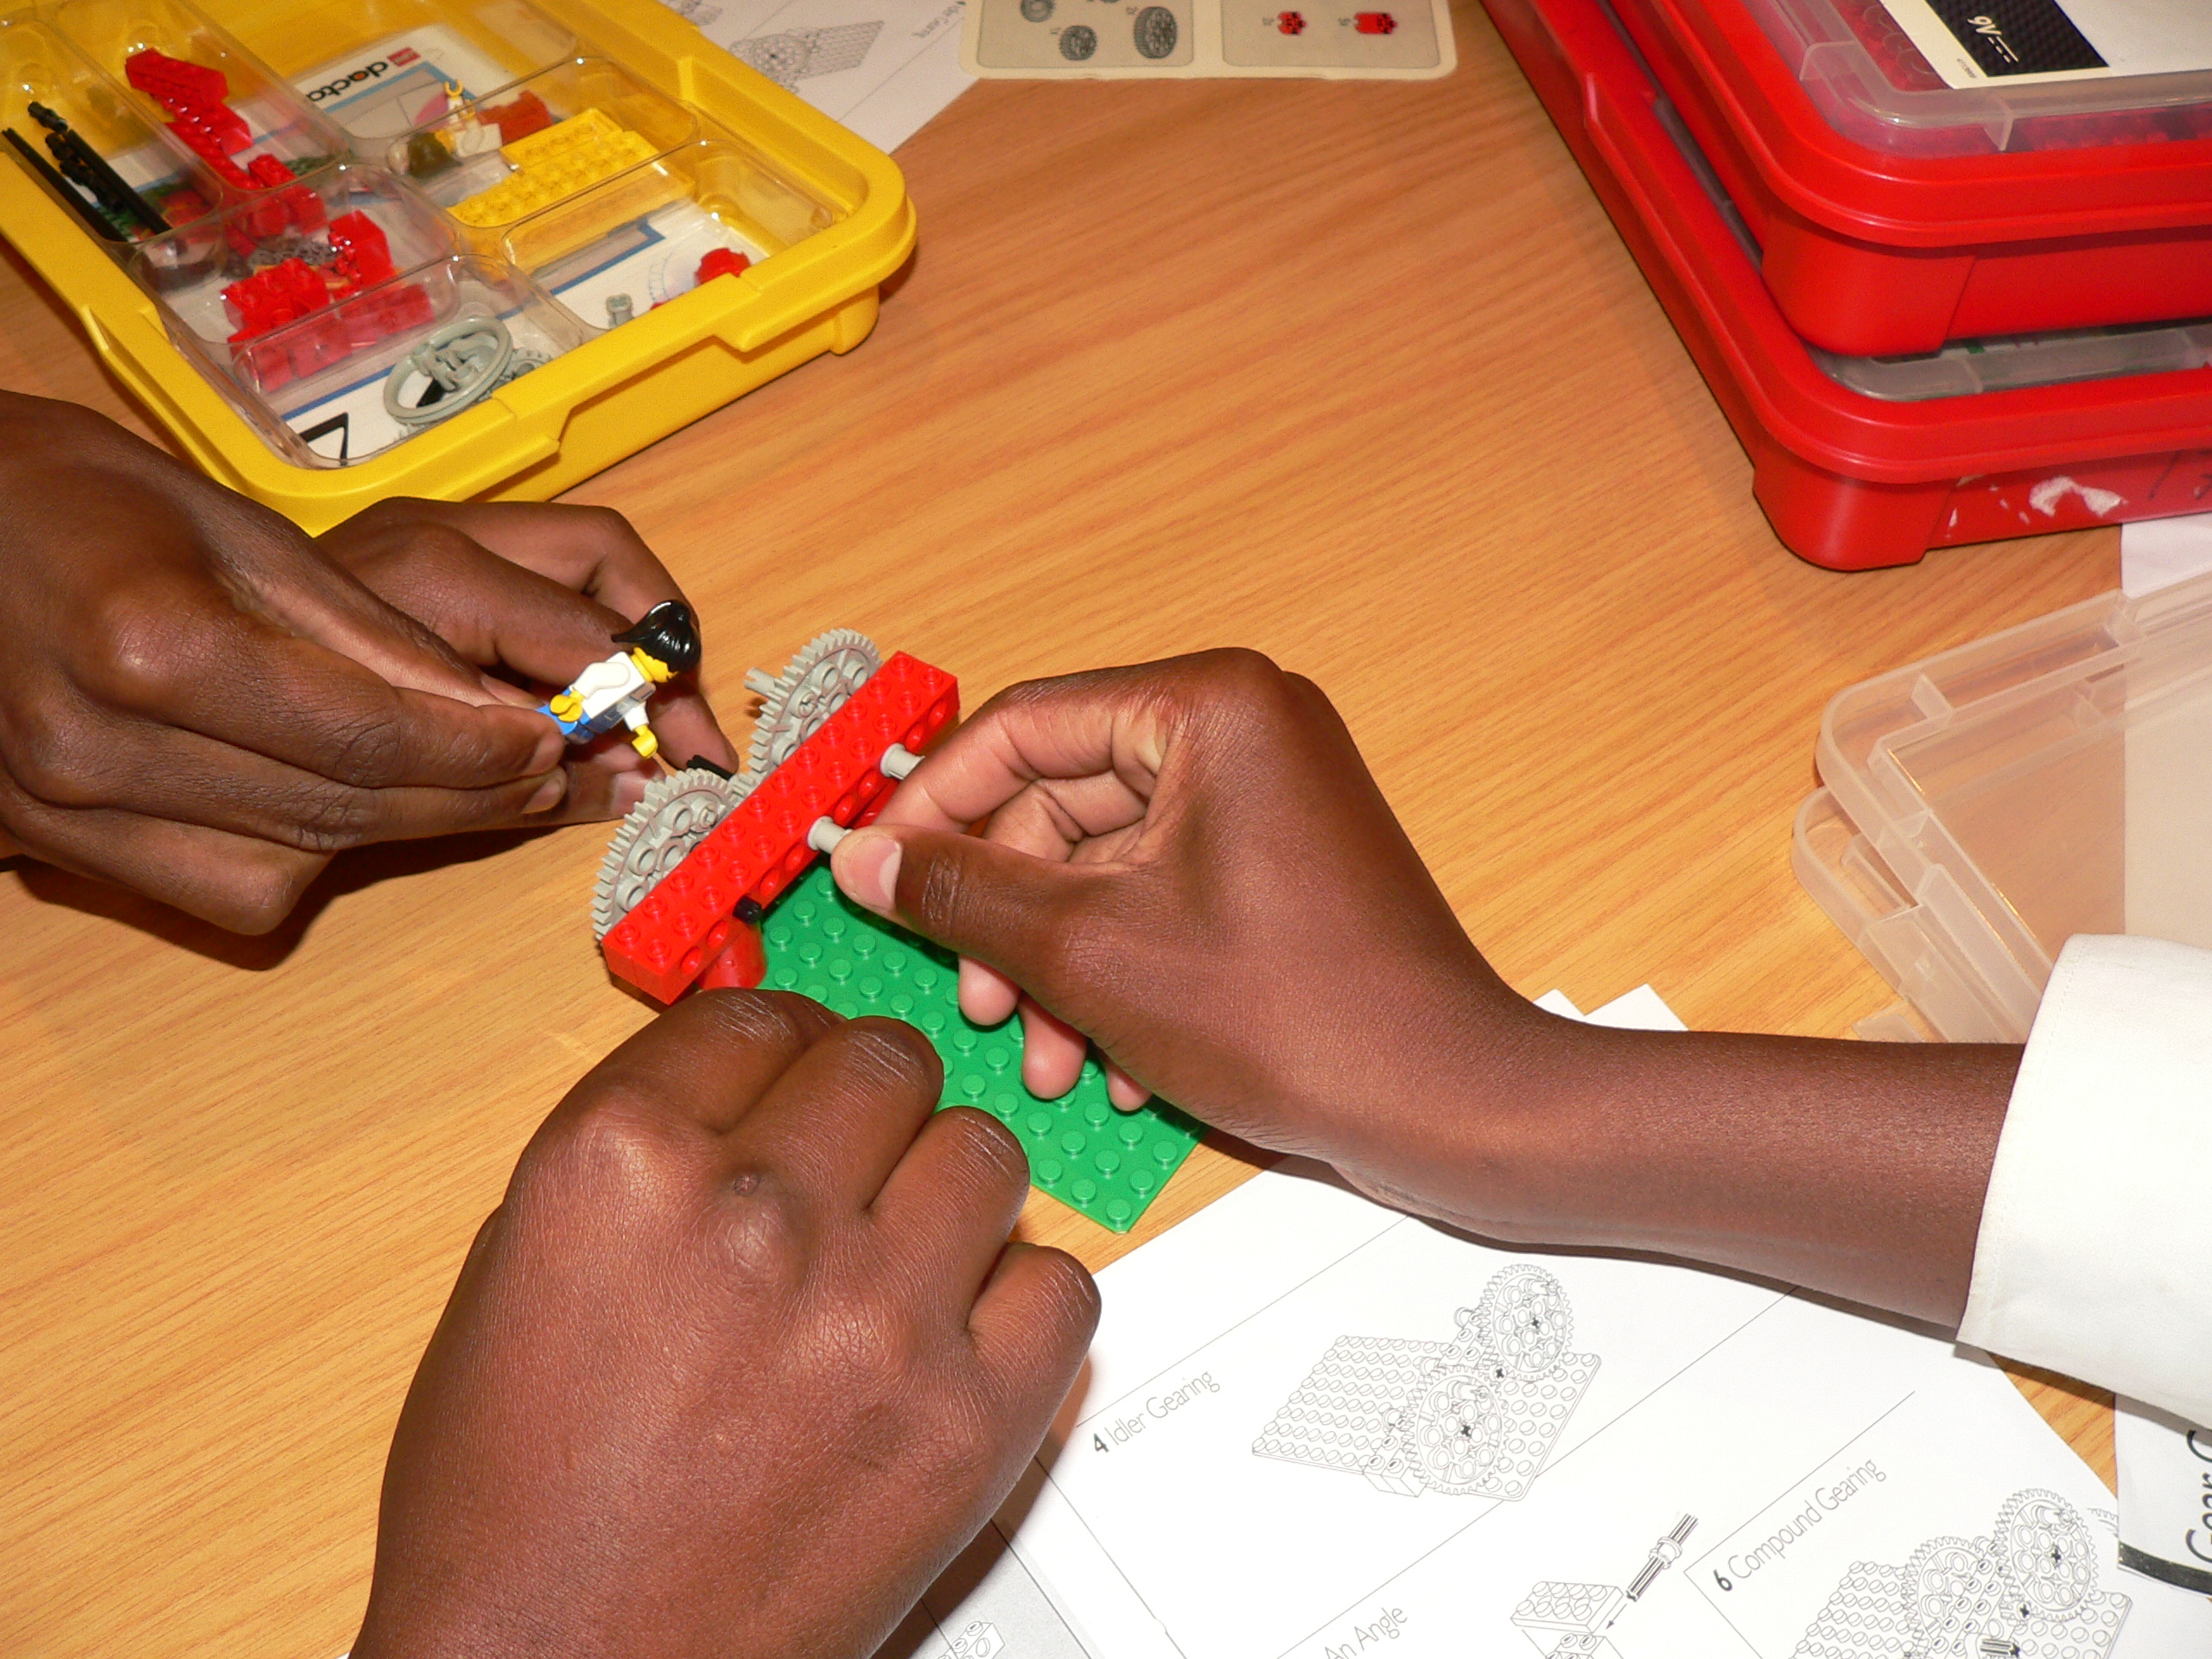
Dankie
Enkosi
Ha khensa
Re a leboga
Ro livhuwa
Siyabonga
Siyathokoza
Thank you

