Slide 1
RSR 2020/21 ANNUAL REPORT

Slide 2
RSR ACHIEVEMENTS !!!!
AGSA
CLEAN AUDIT!
100%
ANNUAL PERFORMANCE

Slide 3
TABLE OF CONTENT
1
Strategic focus
3
2020/21 Performance Highlights
4
RSR Contribution to government priorities
5
2
Strategic drivers
Human Resource
Finance
6

Slide 4
RSR STRATEGIC FOCUS
VISION
Safe, reliable and sustainable railway operations, recognised globally
MISSION
To oversee and promote safe railway operations through appropriate support, monitoring and enforcement, guided by an enabling regulatory framework
VALUES
Integrity
Transparency
Fairness
Innovation
Timely & accountable delivery
Mutual respect
Excellence

Slide 5
RSR STRATEGIC DRIVERS
Risk Based Approach To Safety | The enhancements to the regulatory framework are all aimed at understanding the safety risks within the environment and ensuring that adequate mitigations are put in place to reduce the risk to “as low as reasonably practicable”.
Good governance and clean administration | The organisation is committed to excellence and to practicing the highest standards of ethical and accountable behaviour at all levels within the organisation.
Financial Sustainability | The management of the RSR in a fiscally prudent and sustainable manner is an important cornerstone in carrying out its mandate.
Stakeholder engagement | Ensuring safe railway operations is a collaborate effort that requires all stakeholders to play their part in a consistent and meaningful manner linked to their mandate.

Slide 6
RSR STRATEGIC RISKS
Outcome | Risk Statement | Mitigations
Good governance and clean administration | Cyber security vulnerability Hackers may gain access to RSR systems and corrupt data or share inappropriate operators’ information | Firewall, Antivirus and OS penetration test and vulnerability assessment Evaluation of Mobile Device Management tools Source a service provider to conduct a cyber security awareness
Railways are safer | Inaccurate & Incomplete Safety Information NIMS may have design faults, be inaccessible or data inputted on NIMS by operators may be incomplete or inaccurate resulting in non- compliance with the requirements of the RSR Act. | Monthly and Quarterly data verification of operator data Manually request additional safety information from operators during permit assessments

Slide 7
Outcome | Risk Statement | Mitigations
Railways are safer | Inadequate Regulatory Framework and Competencies The RSR may be implementing an incomplete, inconsistent, or incoherent mix of regulations, determinations, standards or protocols. | Stakeholder engagement and lobbing SMS audits and inspection when dealing with transportation of dangerous goods Forming the industry working groups when developing regulatory tools
Railways are safer | Lack of independence The RSR may fail to fully utilise its regulatory instruments and authority due to internal inefficiencies, political interference, or an inadequate independence from or familiarity with operators. | Enforcement and monitoring of operator compliance to RSR directives and special conditions of permit RSR not part of committees linked to operator matters Aligning Board and Audit Committee composition to requirements of King Code
Good governance and clean administration | Loss of key skilled personnel The RSR may struggle to effectively execute its mandate due to departure of key personnel | Industry benchmarked and aligned salary packages for RSR Staff Effective performance management and incentive process Initiatives around building an excellent organisation

Slide 8
Outcome | Risk Statement | Mitigations
Good governance and clean administration | Financial Sustainability The financial position may deteriorate to the extent that the RSR is unable to continue as a going concern, unable to render regulatory services or unable to pay salaries and creditors. | Cost of employment targeted at 60 per cent (or lower) of fixed revenues All accruals and commitments funded at year end RSR Budget adjustment for revenue shortfalls
Railways are safer | Inadequate Stakeholder Buy-in & Support (RSR initiatives) RSR initiatives may experience poor attendance, repeated objections or receive a lack of public comments thereby diminishing their value or delaying their implementation | RSR involvement in SARA in order to maintain relations with regional operators RSR involvement in various National Department of Transport committees that bring together rail industry stakeholders MOU’s with partner national government departments, public entities, and relevant institutions OCOO quarterly meetings with major operators Permit application guide shared with all operators to clarify the permit and ASIP assessment requirements

Slide 9
2020/21 PERFORMANCE HIGHLIGHTS

Slide 10
PERFORMANCE TREND

Slide 11
RSR CONTRIBUTION TO
GOVERNMENT PRIORITIES

Slide 12
OUTCOME 1: RAILWAYS ARE SAFER
APEX PRIORITY CONTRIBUTIONS | Output Indicator
Advance national-building and social cohesion and a safe South Africa | Occurrence reporting categories published; Industry-wide hazard log; Railway Management Maturity Model; Verbal Safety Communication Determination developed Interface Agreements Framework; and National Rail Communicators Forum Research was conducted on level crossings as well as on personal safety on trains.

Slide 13
OUTCOME 2: GOOD GOVERNANCE AND CLEAN ADMINISTRATION
APEX PRIORITY CONTRIBUTIONS | Output Indicator
Transforming the economy to serve all South Africans and create jobs | The RSR spent a total amount of R35.7 million of which 93 per cent which equates to R33.4 million was spent on B-BBEE compliant suppliers, 18 per cent which equates to R6.3 million was spent on women-owned companies 8.71 per cent of which equates to R2.9 million was spent on youth owned companies Out of the total 242 companies utilised, 166 (69 %) were EMEs, 37 (15 %) were QSEs and the remaining 39 (16per cent) were large companies.

Slide 14
OUTCOME 2: GOOD GOVERNANCE AND CLEAN ADMINISTRATION
APEX PRIORITY CONTRIBUTIONS | Output Indicator
Investing in the capabilities of all the people, through an education and skills revolution | A total of 12 students were awarded bursaries to the value of R1 million covering tuition, accommodation, and incidental expenses. The RSR appointed 10 interns for a period of one year as from 1 March 2021 The RSR also entered into a secondment agreement with the African Rail Industry Association (ARIA) to regulate the terms and conditions of the secondment of two interns to the Regulator.

Slide 15
OUTCOME 3: IMPROVED STAKEHOLDER SERVICE
APEX PRIORITY CONTRIBUTIONS | Output Indicator
Tackling the persistence of apartheid spatial development to build sustainable and safe human settlements, towns and rural areas, and effective local government Build a better Africa and world | The RSR conducted several meetings with SALGA during the period under review. Key matters of undertaken included the collaboration of the RSR, PRASA and Transnet to address issues of mutual interest, particularly on rail compliance by municipalities. RSR’s contribution: The RSR is a member of the SARA, an association that aims to promote the harmonisation of the railway safety regime in the SADC railway operations.

Slide 16
HUMAN RESOURCES

Slide 17
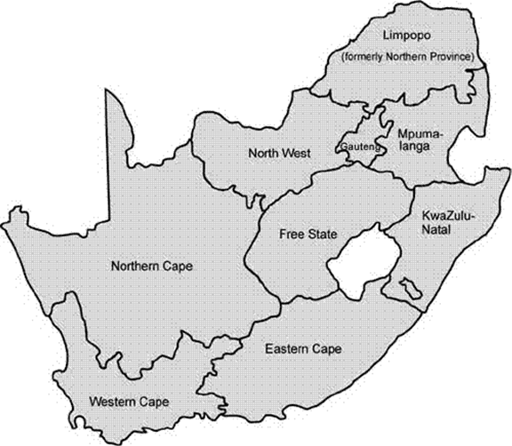
HR OVERVIEW
140
150
12
13
10
14
No. of Employees - 162 No. of positions - 177

Slide 18
EMPLOYMENT EQUITY

Slide 19
EMPLOYMENT EQUITY

Slide 20
FINANCE

Slide 21
AUDITOR GENERAL OPINION
Clean Audit achieved

Slide 22
AUDIT OUTCOME
FINANCIAL YEAR | OUTCOME | NUMBER OF FINDINGS | NUMBER OF RECURRING FINDINGS
2016/17 | Unqualified Opinion | 11 | 1
2017/18 | Unqualified Opinion | 16 | 4
2018/19 | Unqualified Opinion | 15 | 1
2019/20 | Unqualified Opinion | 14 | 3
2020/21 | Unqualified Opinion | 5 | 0
Nature of findings Procurement and contract management Financial statement disclosure B-BBEE Act and Regulations

Slide 23
REVENUE (R’000)

Slide 24
FINANCIAL HEALTH
2020/21 Revenue of R259 845 498
2020/21 Accounting surplus of R2 613 294
2020/21 Cash surplus of R121 067 656

Slide 25
THANK YOU

