Slide 1
Annual Report of the Council on Higher Education (CHE) for the Year 2020/21
Presentation to the Parliamentary Portfolio Committee on Higher Education, Science and Innovation
10 November 2021

Slide 2
Part 1
Vision, Mission Mandate and Strategy
Professor Themba Mosia
Chairperson of the Council on Higher Education

Slide 3
Mandate conferred by the Higher Education Act No. 101 of 1997
Advising the Minister on HE matters, at the request of the Minister, and proactively.
Arrange and coordinate conferences.
Through the HEQC, to promote QA in HE, audit the QA mechanisms of HEIs, and accredit programmes of HE.
Publish information on HE including reports on the state of HE.
Promote access of students to higher education institutions
Perform any other functions designated to it by the HE Act, the NQF Act or by the Minister through notice in the Gazette.

Slide 4
Mandate conferred by the National Qualifications Framework Act No. 67 of 2008
Developing and managing the HEQSF.
Developing and implementing policies and criteria for advancement the HEQSF.
Sets up the CHE as the Quality Council for higher education as provided for in the HE Act, with responsibility for the HEQSF.
Recommending higher education qualifications to SAQA for registration on the NQF.
Maintaining a database of learners 'achievements and submitting the data for recording on the NLRD.
Take responsibility for quality assurance in relation to the HEQSF
Conducting or commissioning and publishing research of importance for the further development of the HEQSF.
Advising the Minister on matters relating to the HEQSF.
Informing the public about the HEQSF.

Slide 5
Strategic Plan 2020-2025
Vision | Innovative, quality higher education responsive to the needs of society.
Mission | The CHE is an independent, statutory, quality assurance and advisory body for South African higher education, which transforms lives in pursuit of an equitable, prosperous, and innovative society. In fulfilment of its role, the CHE: Leads and manages external quality assurance. Regulates qualifications through the HEQSF. Is an intellectual hub for higher education research, monitoring, policy, and critical discourse. Advises the Minister on all higher education matters.
Values | In pursuit of its vision and mission the CHE is committed to, and guided by the following values: Innovation Integrity Equity Respect Accountability

Slide 6
Strategic Outcomes 2020-2025
Outcome 1 | CHE as an effective custodian of the HEQSF
To manage the development and implementation of the HEQSF policies, qualification standards and data in order to meet the goals of the NQF, NPPSET and the National Development Plan (NDP). | To manage the development and implementation of the HEQSF policies, qualification standards and data in order to meet the goals of the NQF, NPPSET and the National Development Plan (NDP).
Outcome 2 | Comprehensive and coherent quality assurance system for the higher education sector
To develop and implement a new Quality Assurance Framework for effective and efficient internal quality assurance (IQA) and external quality assurance (EQA) for the sector. | To develop and implement a new Quality Assurance Framework for effective and efficient internal quality assurance (IQA) and external quality assurance (EQA) for the sector.
Outcome 3 | A reputable centre of intellectual discourse, knowledge generation and advice on higher education
To revitalise and strengthen the research, monitoring, evaluation and advice capabilities of the CHE. | To revitalise and strengthen the research, monitoring, evaluation and advice capabilities of the CHE.
Outcome 4 | Governance, compliance and risk management
To set the broad strategic direction, policy and tone for good governance, statutory compliance and risk management of the organisation to support the discharge of the core functions of the CHE. | To set the broad strategic direction, policy and tone for good governance, statutory compliance and risk management of the organisation to support the discharge of the core functions of the CHE.
Outcome 5 | Sustainable, responsive and dynamic organisation
To design and implement an organisational architecture, business processes, capabilities and infrastructure to realise the strategy of the CHE. | To design and implement an organisational architecture, business processes, capabilities and infrastructure to realise the strategy of the CHE.

Slide 7
Implementation Programmes
The realisation of the 5 strategic outcomes are being pursued through 4 implementation programmes. These are:
Programme 1: Management of the HEQSF and Quality Promotion (Outcome 1)
Programme 2: Quality Assurance (Outcome 2)
Programme 3: Research, Monitoring & Advice (Outcome 3)
Programme 4: Corporate Services (Outcomes 4 and 5)
Each programme has several functions/subprogrammes.
The relationship between the strategic outcomes, programmes & functions or sub-programmes follows.

Slide 8
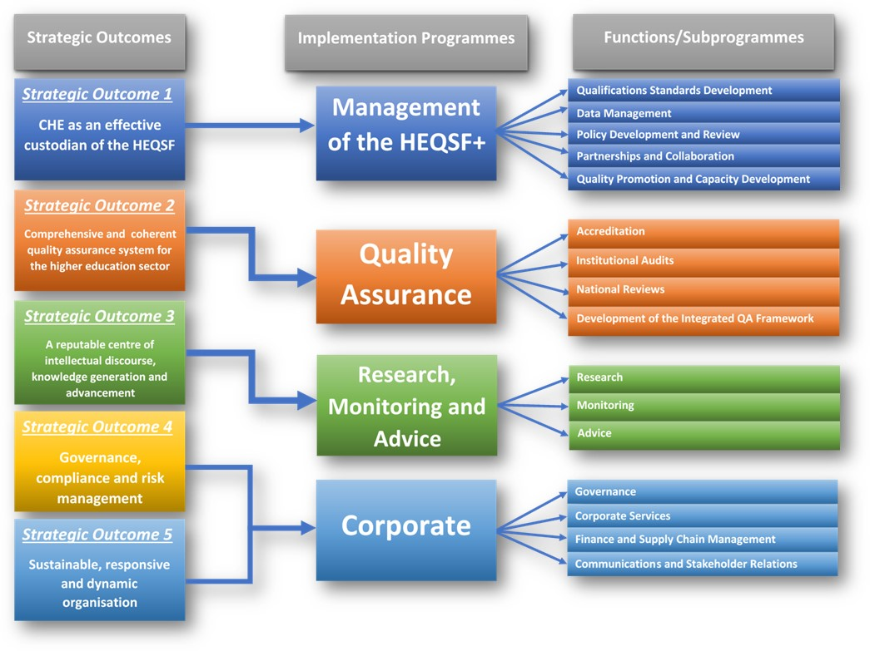

Slide 9
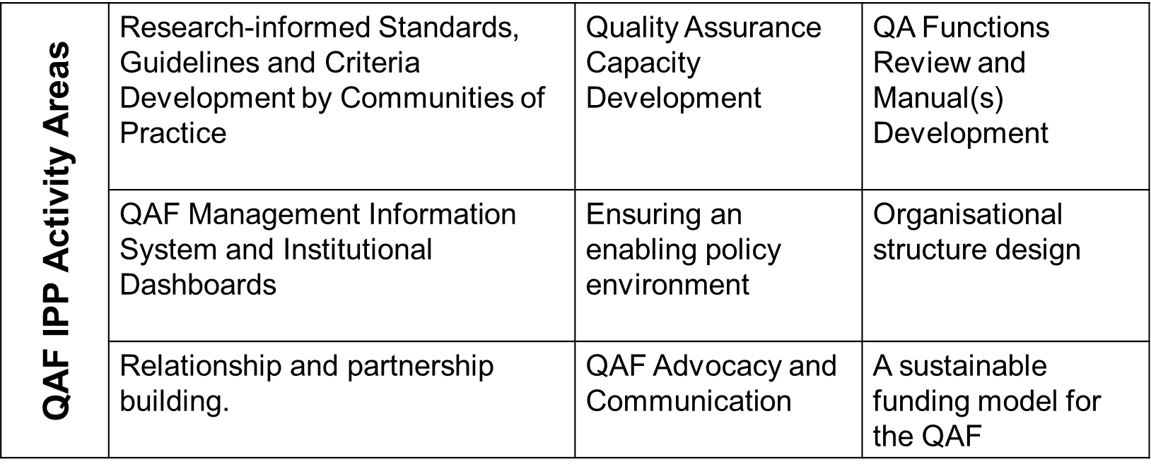
Development to note: Approval of a new Quality Assurance Framework and progress towards its implementation
Approved by Council in September 2020.
A re-imagined strategic framework for how Quality Assurance will work in higher education.
To be fully implemented from 2024, although implementation steps already being taken.
A 3 year Implementation Preparation Project (IPP) is being implemented – preparing the sector and the CHE for the QAF.

Slide 10
Progress Update: Inquiry into the Remuneration of Vice-Chancellors and Senior Executives
Study conceptualised and led by a Council Task Team.
Mixed methods: Review of national and international literature, online questionnaire, populated spreadsheet, revie of university policy documents and Council minutes, interviews.
Relevant expertise recruited to assist with the analysis.
Draft report has been completed, reviewed by two external reviewers, 1 international and 1 local.
Reviewer feedback currently being taken into account, report being finalized.
Next step, language editing, layout and formatting
Plan to submit the report to the Minister of Higher Education, Science and Innovation by the end of November/early December.

Slide 11
Progress Update: Research on Strategies to Address Articulation Challenges
The Research Project was undertaken at the request of the Portfolio Committee and it covered the following areas:
Why is articulation necessary?
The Post-School Education and Training (PSET) landscape in South Africa.
Education and Training silos.
Summary of barriers between TVET and HEIs from local studies.
Key lessons from international articulation studies .
Recommendations on actions required for strengthening articulation between TVET Colleges and Universities.
The Research has been completed, and it was presented at a colloquium held on 1 September 2021 so that sector input on the report and its recommendations could be solicited. The Report is being finalised and can be presented to the Portfolio Committee at a time suitable to it.

Slide 12
Part 2
Annual Report 2020/21
Achievement against Non-financial Performance Indicators
Chief Executive Officer
Dr Whitfield Green

Slide 13
Achievement of indicator targets: An overview
Programme | Management of the HEQSF | Quality Assurance | Research, Monitoring and Advice | Corporate | Overall
No. of indicators | 15 | 11 | 9 | 16 | 51
No. achieved | 11 | 9 | 8 | 11 | 39
No. not achieved | 4 | 2 | 1 | 5 | 12
% achieved | 73% | 81.8% | 88.9% | 68.8% | 76.5%

Slide 14
Targets not achieved: Management of the HEQSF
Subprogramme: Qualifications Standard Development
Output | Output Indicators | Planned Annual Target 2020/21 | Actual Achievement 2020/21 | Deviation from planned target to Actual Achievement 2020/21 | Reasons for deviations
Qualification standards developed for specified qualifications, or reviewed | 2.5.5.1a: Number of qualification standards developed, or review processes initiated in a particular financial year. | 2 | 1 | -1 | A further standard relating to supply chain management was planned to start but was delayed due to National Treasury needing to develop a framework first which will inform this process.

Slide 15
Subprogramme: Data Management
Output | Output Indicators | Planned Annual Target 2020/21 | Actual Achievement 2020/21 | Deviation from planned target to Actual Achievement 2020/21 | Reasons for deviations
A functional database holding records of all higher education institutions | 2.5.5.2a: Percentage of higher education institutions that have all required sets of data records in the database in a particular financial year. | 75% | 0 | -75% | The planned comprehensive higher education database is still to be developed as part of the broader process of enhancing the IT infrastructure of the CHE. At present there are separate databases in place that serve specific purposes, and which collect and verify a range of information sets from institutions.
Valid, accurate and reliable datasets | 2.5.5.2b: Percentage of data sets that are verified and validated to be accurate and reliable, from all data sets submitted by institutions, in a particular financial year. | 75% | 0 | -75%

Slide 16
Subprogramme: Partnerships and Collaboration
Output | Output Indicators | Planned Annual Target 2020/21 | Actual Achievement 2020/21 | Deviation from planned target to Actual Achievement 2020/21 | Reasons for deviations
National events and/or fora on NQF, quality assurance and promotion involved in | 2.5.5.4b: Number of national events and/or fora on NQF, quality assurance and promotion involved in, within a particular year. | 1 | 0 | -1 | The indicator refers to NQF Forum, NQF Conference, NQF national campaigns and other national events that are organised by SAQA and/or the DHET. All such events planned for the 2020/21 financial year were cancelled because of the COVID-19 Pandemic.

Slide 17
Targets not achieved: Quality Assurance
Subprogramme: Accreditation
Output | Output Indicators | Planned Annual Target 2020/21 | Actual Achievement 2020/21 | Deviation from planned target to Actual Achievement 2020/21 | Reasons for deviations
Programmes submitted for reaccreditation and presented to the HEQC for decisions | 2.5.5.6b: Percentage of programme reaccreditation applications received that go through the accreditation process and are presented to the HEQC within 8 months from the date of appointment of evaluators, in a particular financial year. | 85% | 78% (25 processed within timeframe / 32 tabled x 100 = 71%) | -7% | During the fourth quarter, 3 programmes for re-accreditation served at an Accreditation Committee meeting held on 24-25 February 2021 for recommendation to the HEQC for a final decision. However, as the HEQC meeting was held on 11 February 2021 before the date of the AC meeting, the above-mentioned 3 programmes could not be tabled at the HEQC meeting and therefore, a target of 0% is indicated during the fourth quarter. 3 programmes processed during the fourth quarter were to be tabled at the HEQC meeting of 8 April 2021.

Slide 18
Subprogramme: Accreditation
Output | Output Indicators | Planned Annual Target 2020/21 | Actual Achievement 2020/21 | Deviation from planned target to Actual Achievement 2020/21 | Reasons for deviations
Site visits to higher education institutions | 2.5.5.6c: Percentage of site visits undertaken whose reports at presented to the HEQC within 4 months from the date of receipt of reports from the site visit panels, in a particular financial year. | 95% | 37% (10 reports processed within timeframe / 27 reports tabled = 37%) | -58% | During the fourth quarter, 4 site visit reports served at an Accreditation Committee meeting held on 24-25 February 2021 for recommendation to the HEQC for a final decision. However, as the HEQC meeting was held on 11 February 2021 before the date of the AC meeting, the above-mentioned 4 reports could not be tabled at the HEQC meeting and therefore, a target of 0% is indicated during the fourth quarter. 4 reports processed during the fourth quarter were to be tabled at the HEQC meeting of 8 April 2021.

Slide 19
Targets not achieved: Research, Monitoring & Advice
Subprogramme: Monitoring
Output | Output Indicators | Planned Annual Target 2020/21 | Actual Achievement 2020/21 | Deviation from planned target to Actual Achievement 2020/21 | Reasons for deviations
Higher Education Monitor/ Review | 2.5.5.11a: Number of Higher Education Monitors/Reviews produced, within a particular financial year. | 1 | 0 | -1 | There were delays in finalising the report as a result of working remotely during the Pandemic. A complete final draft of the Review of Higher Education 25 Years into Democracy was recommended by the MRAC to Council for approval. Council approved the report, and it is now being prepared for publication.

Slide 20
Targets not achieved: Corporate
Subprogramme: Governance
Output | Output Indicators | Planned Annual Target 2020/21 | Actual Achievement 2020/21 | Deviation from planned target to Actual Achievement 2020/21 | Reasons for deviations
Developed or reviewed financial management and supply chain management, frameworks, guidelines and procedures | 2.5.5.13c: Number of financial management and supply chain management policies, frameworks, guidelines, and procedures developed or reviewed, within a particular financial year. | 8 | 2 | -6 | There was no need to develop or review additional financial management and supply chain management policies, frameworks, guidelines, and procedures during the year under review.

Slide 21
Subprogramme: Communications and Stakeholder Relations
Output | Output Indicators | Planned Annual Target 2020/21 | Actual Achievement 2020/21 | Deviation from planned target to Actual Achievement 2020/21 | Reasons for deviations
Staff events organised | 2.5.5.16a: Number of staff events organised and held, within a particular financial year. | 8 | 7 | -1 | The majority of the planned staff events were supposed to be face-to-face but some were cancelled and others postponed indefinitely as a result of the COVID-19 restrictions, and others were held virtually.
Information shared through the Intranet | 2.5.5.16b: Percentage of CHE staff who visit the Intranet and engage with the content shared thereat, within a particular financial year. | 75% | 55% | -20% | Majority of the CHE staff related information that is normally shared through the Intranet was also e-mailed to the staff members during the national lockdown period which reduced the number of the staff members who visited the Intranet and engage with the shared content.

Slide 22
Subprogramme: Communications and Stakeholder Relations
Output | Output Indicators | Planned Annual Target 2020/21 | Actual Achievement 2020/21 | Deviation from planned target to Actual Achievement 2020/21 | Reasons for deviations
Stakeholder engagement events or forums for stakeholders within South Africa | 2.5.5.16f: Number of local stakeholder events or forums organised or participated in, within a particular financial year. | 8 | 7 | -1 | Due to COVID-19 and the government restrictions, a number of planned events were postponed indefinitely, and some were cancelled as many institutions were in a process of transitioning to online modalities
Stakeholder engagement events or forums for international stakeholders | 2.5.5.16g: Number of international stakeholder events or forums organised or participated in, within a particular financial year. | 4 | 3 | -1 | Due to COVID-19 and the government restrictions, a number of planned events were postponed indefinitely, and some were cancelled as many institutions were in a process of transitioning to online modalities

Slide 23
Part 3
Annual Report 2020/21
Financial Performance
Chief Financial Officer
Professional Accountant (SA)
Dr Thulaganyo Mothusi

Slide 24
Income / Revenue Received
DESCRIPTION | AMOUNT
Government Grant & Subsidies | R54 770 000
University of Johannesburg – QAF project | R 2 212 533
Accreditation fees | R 4 921 483
Conference fees | R 4 800
Other income | R 16 950
Interest received | R 2 062 793
Roll over of surplus funds from prior year | R12 179 950
TOTAL | R76 168 509

Slide 25
Budget vs Expenditure Incurred
DESCRIPTION | BUDGET | EXPENDITURE | VARIANCE
Cost of employees | R41 752 000 | R37 562 960 | R4 189 040
Goods & Services | R35 205 500 | R33 612 359 | R1 593 141
Total | R76 957 000 | R71 175 319 | R5 782 181

Slide 26
Explanation of Variances: Compensation of Employees
Employee costs underspent due to accumulation of unspent funds on 8 funded vacant posts not filled timeously due to unforeseen delays to fill the posts during the year under review and budgeted applicable rates increase in cost of living not paid as per instruction from National Treasury due to national budget constraints and labour disputes with labour unions in the country.
The breakdown of the 8 vacant funded per subprogramme is as follows:
Research, Monitoring and Advice : 1
Institutional Audits : 3
Accreditation : 2
National Standards and Reviews: 1
Management of HEQSF : 1

Slide 27
Explanation of Variances: Goods and Services
The variances were contributed by the following Subprogrammes
Subprogramme: Governance
Less legal fees claims for the period under review.
Subprogramme: Research Monitoring and Advice
Less spending on Peer Academics for the Vice Chancellors (VC) and Executives Managers salary inquiry project for the public universities.
Subprogramme: Institutional Audits
Less Institutional Audit Committee (IAC) meetings resulting in less payments made for the period under review.
Less payments made to Peer Academics and usage of the 3G cards or data for all planned IAC virtual meetings planned for the 4th quarter.

Slide 28
Explanation of Variances: Goods and Services (cont.)
The variances were contributed by the following subprogrammes
Subprogramme: Accreditation
Less usage of the 3G cards or data for all planned Accreditation Committee members (AC) for attending virtual meetings for the 4th quarter.
National Standards & Reviews
Less usage of 3G cards or data for the National Standards Review Committee members (NSR) for attending virtual meetings for the 4th quarter.
Less payments to National Standards Reviews Committee members due to less planned meetings and an outstanding second batch of reports and invoices from Peer Academics which was processed in April 2021.
Quality Assurance Framework Project
Less usage of the 3G cards or data for all planned virtual meetings.

Slide 29
Ten Cost Drivers and their Percentage Contributions to the General Expenses
DESCRIPTION OF THE SPENDING ITEM | 2020/2021 CONTRIBUTION PERCENTAGE
Peer Academics | 41
Outsourced services | 11
Remuneration of Council and Committee members | 9
IT expenses | 8
Legal fees | 6
Consultancy services and subcommittee members | 5
Auditors' remuneration | 5
Recruitment costs | 4
Printing and Stationery | 3
Telephone, Cellphone and Data costs | 3

Slide 30
Ten Cost Drivers and their Percentage Contributions to the General Expenses
Outsourced services is only for SAQA HEQCIS online system contract.
IT expenses include licence fees, computer consumables, internet subscriptions, contract on support for HEQC online system and contract on support maintenance.
Consultancy services include payment of VIP Payroll & HR system consultancy and also payment to governance subcommittees such as Accreditation; Human Resource Recruitment Committee etc.

Slide 31
Irregular, Fruitless and Wasteful Expenditure
Fruitless and Wasteful expenditure
No fruitless and wasteful expenditure incurred as per note 25 of the Annual Financial Statement.
Irregular expenditure
No irregular expenditure incurred as per note 26 of the Annual Financial Statement.

Slide 32
Consequence Management Actions
Fruitless and Wasteful expenditure note 25 of the AFS
The prior year balance of R1 745.00 for the additional kilometres of 44 charged on car hire by an employee was fully recovered.
Irregular expenditure
None, because no irregular expenditure incurred as per note 26 of the Annual Financial Statement (AFS).

Slide 33
Report of the Auditor-General South Africa (AGSA)
Audit Opinion
Continuous clean audit from the fiscal year 2017/2018 to 2020/2021.
AUDIT FINDINGS | 2020/2021 | 2019/2020 | REMARKS
Matters affecting the auditors report
Cash and Cash Equivalents: Reconciliation not performed | Applicable | Not applicable | Nonrecurring
Administrative matters
Revenue from exchange: Site visits listing and Offline Programme Register | Applicable | Not applicable | Nonrecurring

Slide 34
Strategic Audit Action Plan to Address Audit Findings
ACTIONS | START DATE | END DATE | CONCERNED SUBPROGRAMME
Bank reconciliations will be performed on a monthly basis inclusive of the investment account. | April 2021 | March 2022 | Finance
The Site visits listing and Offline Programme Register will be reconciled with the General Ledger on a monthly basis. | April 2021 | March 2022 | Finance

Slide 35
Budget Baseline for the Current Baseline for the Current Year and MTEF Period
DESCRIPTION | CURRENT YEAR | MTEF PERIOD
DHET Transfer | 70 012 | 72 974 | 76 221 | 79 643
Private Accreditation Fees | 5 618 | 5 856 | 6 116 | 6 391
Interest | 1 566 | 1 632 | 1 705 | 1 781
TOTAL | 77 196 | 80 462 | 84 042 | 87 815

Slide 36
Narrative to the Budget Baseline over the MTEF Period
MTEF PERIOD 2021/2022 TO 2024/25
The budget baseline injection was considered and approved by National Treasury for the MTEF period on condition that the budget injection should be used for goods and services.
The requested budget baseline injection will ensure the following:
Continuous implementation of the CHE mandate;
Implementing the strategic plan;
Implementing the approved quality assurance framework by all core subprogrammes such as Management of the HEQSF, Institutional Audits, Accreditation, National Standards Review and Research, Monitoring and Advice activities;
Enhancement of the CHE’s digital capabilities.

Slide 37
Thank You

