Slide 1
Resilience in a time of Covid-19
ANNUAL REPORT 2020/21

Slide 2


MANDATE & In Brief
OUR MANDATE
The mandate of the South African Medical Research Council (SAMRC), in terms of the MRC Act 58, 1991 (as amended), is to improve the health and quality of life of South Africans. This needs to be realised through research, development, and technology transfer.
IN BRIEF
The SAMRC was established in 1969 to conduct and fund health research and medical innovation. We focus on the top ten causes of death and disability and associated risk factors. We acquire the most accurate health information and provide policy makers with the tools to make informed healthcare policy decisions to enhance the quality of life for the people in South Africa.
OUR VISION
Building a healthy nation through research, innovation and transformation
OUR MISSION
To advance the nation’s health and quality of life and address inequality by conducting and funding relevant and responsive health research, capacity development, innovation, and research translation
OUR VALUES

Slide 3


Scope of Presentation

Slide 4
Scope of Presentation
Governance
Human Resources
Financial Information
Performance Information
Transformation in Science
Scientific Impact, Achievements & Highlights

Slide 5

Governance

Slide 6
SAMRC Act of 1991
The affairs of the SAMRC shall be managed and controlled by a Board, which shall, subject to the provisions of this Act, determine the policy and objectives of the SAMRC
and exercise control generally over the performance of its functions, the exercise of its powers and the execution
of its duties.
– SAMRC Act of 1991

Slide 7
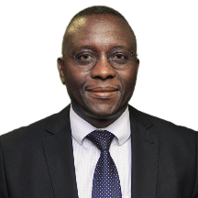


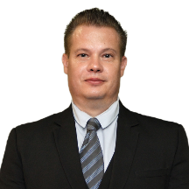



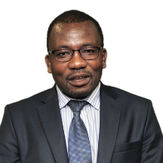
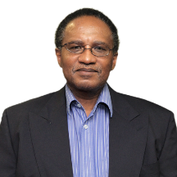


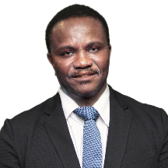
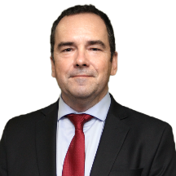
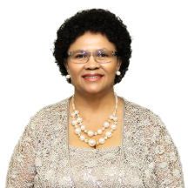
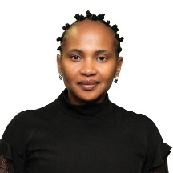


Board Members | 1 NOVEMBER 2020 – 31 MARCH 2021
PROF JOHNNY MAHLANGU
CHAIRPERSON
PROF LINDA SKAAL
VICE CHAIRPERSON
PROF SITHEMBISO VELAPHI
PROF BRANDON SHAW
PROF THOLENE SODI
PROF LINDIWE ZUNGU
PROF WILLIAM RAE
PROF COLLET DANDARA
DR MZIWANDILE MADIKIZELA
PROF EMMANUEL MUKWEVHO
PROF RONELLE CAROLISSEN
PROF THANDISIZWE MAVUNDLA
DR TIMOTHY TUCKER
PROF EUNICE SEEKOE
ADV DOROTHY KHOSA
MS JUNE WILLIAMS
PROF GLENDA GRAY
PRESIDENT & CEO

Slide 8

Human Resources

Slide 9
summary
HR manages and supports the needs of SAMRC staff to deliver on its mission of advancing the nation’s health by:
Acquiring, developing, and retaining talent
Aligning staff responsibilities with business requirements
Administration of employee remuneration, recognition, benefits, performance, and rewards
Managing employee wellness
Transformation and diversity management
Fair employment relations practices; and
Contributing to the SAMRC strategic plan/priorities and annual performance plan.

Slide 10
Transformation
Committed to transformation, aligned to the national agenda to systemically redress past inequalities through a long-term process of growing and transforming the current and future knowledge economy
Career/Capacity Development
Employee Performance Management
Employee Wellness Programme
Coaching of Executive and Senior Management
Relationship with organized labour
Human Resource Information System
Moratorium on Conditions of Service and Benefits

Slide 11
APPOINTMENTS BY RACE
11

Slide 12
APPOINTMENTS BY GENDER
12

Slide 13
SENIOR MANAGEMENT BY RACE
YEAR | WHITE | INDIAN | COLOURED | AFRICAN | TOTAL
2018-2019 | 29 | 8 | 8 | 8 | 53
2019-2020 | 28 | 8 | 12 | 9 | 57
2020-2021 | 28 | 8 | 10 | 9 | 55
13

Slide 14
SENIOR MANAGEMENT BY GENDER
14

Slide 15

Financial Information

Slide 16
Sisonke budget
Item | Total Cost
Vaccine Roll out
Site costs | 188 900 786
Core Salaries | 1 785 960
Training | 48 000
Vaccine enrolment platform (Mezzanine) | 4 347 826
Monitoring & Logistics | 10 000 000
Epidemiology/Surveillance | 5 000 000
Call centre and Printing costs | 8 300 000
Data management/dashboard development | 1 000 000
Vaccination Supplies | 5 000 000
Courier of product to sites | 8 608 696
Warehouse | 200 000
Research translation/ethics/SAHPRA | 900 000
Study Insurance | 1 700 000
Contingency | 5 000 000
Sub-total Vaccine Rollout Budget | 240 791 268
Indirect Cost | 15 653 293
Total Vaccine Rollout Budget | R256 444 561

Slide 17
Sisonke funding sources

Slide 18
Statement of financial performance
 | 2020/21 | Variance | 2019/20
Description | R | % | R
Revenue | 1 169 592 562 | 7% | 1 092 304 846
Other Income | 15 774 552 | (32%) | 23 072 669
Operating Expenses | (1 128 036 885) | 2% | (1 103 131 032)
Operating Surplus (Deficit) | 57 330 229 |  | 12 246 483
Investment Income | 19 638 086 | (40%) | 32 630 015
Fair Value Adjustment | 2 396 550 | (253%) | (1 565 659)
Finance Costs | (146 531) | (45%) | (268 853)
Surplus (Deficit) for the year | 79 218 334 |  | 43 041 986
18

Slide 19
Statement of financial performance
Revenue increased by 7% to R1,169b
  Baseline income increased by 24% to R743m
  Contract income decreased by 14% to R426m
  Investment income decreased by 40% to R19m
  Value of new research contracts signed R329m
Expenditure increased by 2% to R1,128b
  Collaborative research costs increased by 16% to R532m
  Travel costs decreased by 74% to R12m
  Staff costs decreased by 4% to R386m
  Laboratory Operating Costs decreased by 26% to R39m
  Computer Expenses increased by 17% to R28m
19

Slide 20
Revenue growth
20

Slide 21
Revenue vs expenditure
21

Slide 22
EXPENDITURE TRENDS
22

Slide 23
Expenditure trends per strategic objective
23

Slide 24
Expenditure per strategic objective 2020/21
SAMRC STRATEGIC OBJECTIVES | SPENDING (R'000’m) YTD | YTD % SPLIT | MTEF ANNUAL TARGET % SPLIT
Research Intra Mural | 349 863 | 31% | 54%
Research Extra Mural | 210 512 | 19%
Research Translation | – | – | –
Innovation | 329 755 | 29% | 22%
Capacity Development | 61 508 | 5% | 7%
Corporate & Support | 716 398 | 16% | 17%
TOTAL | 1 128 036 | 100% | 100%
Note: Research Translation is a new strategic objective with relative very low spending in the 2020/21 financial year in comparison to the other objectives.
24

Slide 25
Budget to actual
 | Budget | Actual
 | R | R
Total Revenue | 1 200 775 550 | 1 205 005 200
Total Expenditure | (1 149 020 233) | (1 125 786 866)
Nett | 51 755 317 | 79 218 334
25

Slide 26
Variances to budget
Surplus for
the period
Income | Original Budget (Rm) | Actual (Rm) | Difference (Rm)
Contract Income | 425 | 426 | (1)
Interest | 23 | 19 | 4
Other Income | 3 | 10 | (7)
Expenditure | Original Budget (Rm) | Actual (Rm) | Difference (Rm)
Collaborative Research | 531 | 532 | (1)
Personnel | 404 | 386 | 18
Consulting | 12 | 7 | 5
Infrastructure Costs | 36 | 43 | (7)
Repairs and Maintenance | 21 | 12 | 9
Laboratory Operating Expenses | 41 | 39 | 2
Depreciation and amortisation | 25 | 25 | 0
Travel | 13 | 12 | 1
Loss on foreign exchange | 0 | (5) | 5
Computer Expenses | 29 | 28 | 1
Original Budgeted surplus
R51,7m
Final Actual
R79,2m
26

Slide 27
Statement of financial position
ASSETS
Total assets increased by 37% to R922m
Receivables from exchange transactions decreased by 20% to R50m
Vat receivable decreased by 92% to R874k
Prepayments increased by 52% to R11m
Cash & cash equivalents increased by 62% to R601m
LIABILITIES
Payables from exchange transactions increased by 59% to R175m
Provisions decreased by 32% to R8m
Deferred income increased by 54% to R306m
CUMULATIVE RESERVES
Increased by 23% to R420m
27

Slide 28
Cash flow statement
Total cash received R1,330m
Total payments R1,046m
Operating cash inflows R284m
Investment cash outflows R54m
Nett increase in cash and cash equivalents R231m
28

Slide 29
Baseline allocation trend
Baseline grant | 2017/18 | 2018/19 | 2019/20 | 2020/21 | 2021/22 | 2022/23 | 2023/24 | 2024/25
 | 538 851 000 | 543 329 565 | 597 100 870 | 743 167 826 | 740 620 870 | 677 264 348 | 693 562 609 | 724 710 435
29

Slide 30
In summary
Revenue growth of 7% to R1.17bn due to growth in baseline grant mainly to fund vaccine study offset by decline in contract income
Decrease in contract income and costs recognised due to lower research activity during Lockdowns
Continued project efficiencies, lower research activity and the late transfer of the Sisonke
COVID-19 vaccine study funding from NT contributed to surplus of R79m.
SAMRC continues to maintain strong reserves as assets exceed liabilities by R420m.
A further R49m invested in improving SAMRC buildings, laboratories, offices and IT infrastructure.
30

Slide 31

Transformation in Science
31

Slide 32
I – The Mid Career Scientist Programme (MCSP) below:
The SAMRC Presidential initiative for leadership building in research

Slide 33
II – Bongani Mayosi National Health Scholars Programme for PhD development (BM-NHSP)
78.5%
52%
29%
9%
10%
22.5%

Slide 34
III – SAMRC Clinician PhD Development Programme (SAMRC-CRP)

Slide 35

Performance Information
35

Slide 36
RSA CONSTITUTION
  Chapter 2: Bill of Rights
Section 9: Equality: All the rights contained in this equality section
Section 10: Human Dignity: Everyone has inherent dignity and the right to have their dignity respected and protected”
Section 12(2)(c): Freedom and Security of the person: Everyone has the right to bodily and psychological integrity, which includes the right not to be subjected to medical or scientific experiments without their informed consent”
Section 16(1)(d): Freedom of Expression: Everyone has the right to freedom of expression, which includes academic freedom and freedom of scientific research”
Section 23: Labour Relations: All the rights contained in this labour relations section
Section 27: Healthcare, food water and social security
Section 28(2): Children: A child’s best interests are of paramount importance in every matter concerning the child”
Section 32: Access to Information: All the rights contained in this access to information section
Chapter 10: Public Administration
Section 195: Public administration must be governed by the democratic values and principles enshrined in the Constitution
Chapter 13: Finance
Section 217: Procurement
(1) When an organ of state in the national, provincial or local sphere of government, or any other institution identified in national legislation, contracts for goods or services, it must do so in accordance with a system which is fair, equitable, transparent, competitive and cost-effective.
(2) Subsection (1) does not prevent the organs of state or institutions referred to in that subsection from implementing a procurement policy providing for—
(a) categories of preference in the allocation of contracts; and
(b) the protection or advancement of persons, or categories of persons, disadvantaged by unfair discrimination.
(3) National legislation must prescribe a framework within which the policy referred to in subsection (2) must be implemented.

Slide 37
SUSTAINABLE DEVELOPMENT GOALS
37

Slide 38
GOVERNMENT 12 KEY OUTCOMES
Improved quality of basic education
A long and healthy life for all South Africans
All people in South Africa are and feel safe
Decent employment through inclusive economy
A skilled and capable workforce to support an inclusive growth
An efficient, competitive and responsive economic infrastructure network
Vibrant, equitable and sustainable rural communities with food security for all
Sustainable human settlements and improved quality of household life
A responsive, accountable, effective and efficient local government system
Environmental assets and natural resources that are well protected and continually enhanced
Created a better South Africa and contribute to a better and safer Africa and World
An efficient, effective and development oriented public service and an empowered, fair and inclusive citizenship

Slide 39
NSDA 2010: OUTPUTS WRT OUTCOME 2
Output | Indicators and targets by 2014
1. Increasing life expectancy | Males: from 53.5 to 58.0 years Females: from 57.2 to 60.0 years
2. Decreasing maternal and child mortality | Maternal: from 140-160 to 100 (or less) per 100 000 live births Child: from 69 to 45 (or less) per 1000 live births
3. Combating HIV and AIDS and decreasing the burden of TB | Increase TB cure rate from 65% to 85% 80% access to ARVs Reduce new HIV infections by 50%
4. Strengthening health system effectiveness | Health system based on PHC Emphasis on promotion and prevention (instead of curative) healthcare

Slide 40
SAMRC HEALTH RESEARCH PRIORITIES AND ITS IMPACT TO THE POLICIES (1)
Sub-programmes | Which research Units paly a role in the sub-programmes | Under which strategic goals (SG) do the research units conduct research | What are the research outcomes? | Which policy(ies) are impacted by the research outcomes?
Health promotion and disease prevention | Alcohol, Tobacco and Other Drugs Research Unit | SG 2 SG 3 SG 5 | Contribute towards the body of evidence by gaining a better understanding of how factors such as nutrition; physical activity; alcohol, smoking and drug use; mental health; healthy behaviours; environment and stress affect life expectancy. Conduct research using a life course approach to healthy lifestyles, early diagnosis, and cost-effective prevention and management of diseases through health promotion. | NSDA 1: Increasing life expectancy 10 Point Plan: Strengthening research and development NDP 2030 objectives and actions: Promoting health, social protection and building safer communities QBOD: non-communicable diseases QBOD: Injury & Trauma SDGs 3, 5, 6, 13, 15 & 16
 | Environment and Health Research Unit
 | Hypertension and Cardiovascular Disease Research Unit
 | Microbial Water Quality Monitoring Research Unit
 | Non-Communicable Diseases Research Unit
 | Risk and Resilience in Mental Disorders Research Unit
 | Rural Public Health and Health Transition Research Unit
 | Violence, Injury and Peace Research Unit
 | Centre for Health Economics and Priority Setting Research Unit
 | Centre for Health economics and Decision Science-PRICELESS
Maternal, child and women’s health | Child and Adolescent Lung Health | SG 2 SG 3 SG 5 | Improve the health status and quality of life of women and children through high-quality scientific research that informs policy and practice, improves health services, and promotes health. | NSDA 2: Decreasing maternal and child mortality QBOD: Maternal & child mortality
 | Development Pathways Research Unit
 | Gender and Health Research Unit
 | Maternal and Infant Health Care Strategies Research Unit

Slide 41
SAMRC health Research priorities and its impact to the policies (2)
Sub-programmes | Which research Units paly a role in the sub-programmes | Under which strategic goals (SG) do the research units conduct research | What are the research outcomes? | Which policy(ies) are impacted by the research outcomes?
Health Promotion and Disease Prevention: HIV, AIDS, TB and other communicable diseases | Centre for the Study of Antimicrobial Resistance | SG 2 SG 3 SG 4 | Conduct research on preventing HIV and related co-morbidities including TB and other infectious diseases, such as malaria. It seeks to contribute to the national and international science system by testing TB drugs and malaria insecticides, carry out the AIDS Vaccine project through coordinating development and test HIV vaccines in South Africa, in partnership with our funders and our regional counterparts. | NSDA 1: Increasing life expectancy NSDA 3: Combating HIV/AIDS and TB 10 Point Plan: Strengthening research and development QBOD: HIV/AIDS and TB
 | Centre for Tuberculosis Research Unit
 | HIV Prevention Research Unit
 | HIV-TB Pathogenesis and Treatment Research Unit
 | Molecular Mycobacteriology Research Unit
 | Respiratory and Meningeal Pathogens Research Unit
Health systems strengthening | Biostatistics Research Unit | SG 2 SG 3 SG 4 | Contribute to health systems strengthening by undertaking systematic reviews, health policy and health systems research to provide evidence for policy-makers, stakeholders and researchers seeking to address today’s most pressing health challenges. The programme aims to take advantage of information and technology by exploring and expanding the role of eHealth (health informatics, digital health, tile health, telemedicine, eLearning, and mobile health) in strengthening health systems. | NSDA 4: Strengthening health system effectiveness SDG 3 10 Point Plan: Implementation of NHI
 | Burden of Disease Research Unit
 | Health Services to Systems Research Unit
 | Health Systems Research Unit
 | South African Cochrane Centre
Public health innovation | Drug Discovery and Development Research Unit | SG 2 SG 3 | Promote the improvement of health and quality of life (impact prevention of ill health, improvement of public health and treatment) in the Republic of South Africa through innovation, and technology development and transfer. | 10 Point Plan: Strengthening research and development
 | Herbal Drugs Research Unit
 | Biomedical Research and Innovation Platform
 | Primate Unit and Delft Animal Centre
Biomedical research | Antiviral Gene Therapy Research Unit | SG 2 SG 3 SG 4 | Conduct basic research, applied research, and transactional research to determine predisposition to disease. This understanding is important for planning effective intervention and disease control. | 10 Point Plan: Strengthening research and development
 | Bioinformatics Capacity Development Research Unit
 | Immunology of Infectious Diseases Research Unit
 | Precision and Genomic Medicine
 | Stem Cell Research and Therapy Unit
 | Genomics of Brain Disorders Research Unit
 | Wound and Keloid Scarring Translational Research Unit
 | Antibody Immunity Research Unit
 | Cardiometabolic Health Research Unit

Slide 42
Annual performance plan
SOUTH AFRICAN MEDICAL RESEARCH COUNCIL
^{2020/21 PERFORMANCE REPORT}
PURPOSE | OUTCOME | OUTPUT INDICATOR | SP TARGET 2020/21-2024/25 | FINAL 2019/20 PERFORMANCE | 2020/21 PERFORMANCE TARGET | FINAL 2020/21 PERFORMANCE | VARIANCE
PROGRAMME 1 – ADMINISTRATION Administer health research effectively and efficiently in South Africa
IMPACT STATEMENT Strengthening of corporate governance processes towards an unqualified audit opinion from the Auditor General | 1.1 To ensure good governance, effective administration and compliance with government regulations | 1.1.1 A clean audit opinioan on the SAMRC from the Auditor-General | Clean audit | Clean audit | Clean audit | Clean audit
 | 1.2 To promote the organisation’s administrative efficiency to maximise the funds available for research | 1.2.1 Percentage of the government allocated SAMRC budget spent on administration | 20% | 19% | 20% | 16%
PROGRAMME 2 – CORE RESEARCH Lead the generation of new knowledge
IMPACT STATEMENT Promote the improvement of health and quality of life (prevention of ill health, improvements in public health and treatment) in South Africa through research | 2.1 To produce and promote scientific excellence and the reputation of South African health research | 2.1.1 Number of accepted and published journal articles, book chapters and books by SAMRC affiliated and funded authors | 3 550 | 1 187 | 800 | 1 261 | Compliance to the Publications SOP and information sessions have increased applicable publications
 |  | 2.1.2 Number of accepted and published journal articles by SAMRC grant-holders with acknowledgement of the SAMRC | 930 | 322 | 200 | 281 | Compliance to the Publications SOP and information sessions have increased applicable publications
 | 2.2 To provide leadership in the generation of new knowledge in health | 2.2.1 Number of accepted and published journal articles where the first and/or last author is affiliated to the SAMRC | 1 925 | 672 | 500 | 718 | Compliance to the Publications SOP and information sessions have increased applicable publications
 | 2.3 To provide funding for the conduct of health research | 2.3.1 Number of research grants awarded by the SAMRC | 750 | 247 | 130 | 190 | Due to the COVID-19 pandemic, more research grants were awarded than anticipated.

Slide 43
Annual performance plan
PURPOSE | OUTCOME | OUTPUT INDICATOR | SP TARGET 2020/21-2024/25 | FINAL 2019/20 PERFORMANCE | 2020/21 PERFORMANCE TARGET | FINAL 2020/21 PERFORMANCE | VARIANCE
PROGRAMME 3 – INNOVATION AND TECHNOLOGY Support, through funding and other mechanisms, technology development and implementation, translation of research into policy and practice, and innovations in health and technology delivery to improve health
IMPACT STATEMENT To build an innovation community, developing life changing health solutions for South Africa, Africa and beyond | 3.1 To support the development of new or improved innovations aimed at improving health and targeting priority health research areas of focus | 3.1.1 Number of new innovation and technology projects funded by the SAMRC aimed at developing, testing and/or implementing new or improved health solutions | 20 | New indicator | 4 | 29 | The annual performance target of 4 new innovation projects was based on the assumption that a small number of new strategic projects may be added, existing projects may be extended with a new scope of work and/or an RFA run to select 2-3 new projects. The major reason for the overperformance is the unanticipated COVID pandemic, which resulted in rapid mobilization of funds and the funding of 19 new innovation-focused COVID projects. Also culminating during the FY were the award of the new Newton AMR grants and Clinical Cancer Research Centres.
 |  | 3.1.2 Number of ongoing innovation and technology projects funded by the SAMRC aimed at developing, testing and/or implementing new or improved health solutions | 150 | New indicator | 30 | 41 | The annual performance target of 30 ongoing innovation projects was based on the GIPD portfolio of projects at the time of target setting. SIR grants were not included in the estimation as they change from year to year and are often not innovation focussed. When they are included, they will always result in overperformance on the target.
 | 3.2 To develop new or improved innovations aimed at improving health priority research areas of focus | 3.2.1 Number of innovation disclosures made by the SAMRC intramural research and innovation | 5 | New indicator | 1 | 1

Slide 44
Annual performance plan
PURPOSE | OUTCOME | OUTPUT INDICATOR | SP TARGET 2020/21-2024/25 | FINAL 2019/20 PERFORMANCE | 2020/21 PERFORMANCE TARGET | FINAL 2020/21 PERFORMANCE | VARIANCE
PROGRAMME 4 – CAPACITY DEVELOPMENT Build human capacity for the long-term sustainability of the South African health research
IMPACT STATEMENT To provide research support in the form of funding and supervision to the next generation of scientists in the broad field of health | 4.1 To enhance the long-term sustainability of health research in South Africa by providing funding for the next generation of health researchers | 4.1.1 Number of awards (scholarships, fellowships and grants) by the SAMRC for MSc, PhD, Postdocs and Early Career Scientists | 660 | 157 | 110 | 144 | Access to more budget because of a) reconfiguration of Grant programmes ( eg instead of 1 PI in an HDI, post docs and PhDs were prefered thus amplifying reportable number of awardees per institution) b) dissolving expensive international partnership of Vaccinology in preference of local partnerships, c)restructuring of the Clinician funding model allowing the Division to fund more scholars with less budget d) early exits. “The figure reported is aligned with Financial and legal profiles: thus the 86 are those who are actually receiving funding and have a funding contract in force in the reported period. However- the ones who are in the RCD register but are NOT receiving funding due to an extended period of scholarship or grantsmanship i.e. NCEs: “No Cost Extensions” have been excluded. These continue to be monitored and give reports per regular contract until the degree is delivered in the case of scholarships or a 12-month period is exhausted in the case of Grant funding.”
 |  | 4.1.2 Number of awards by the SAMRC to female MSc, PhD, Postdocs and Early Career Scientists | 488 | New indicator | 80 | 106
 |  | 4.1.3 Number of awards by the SAMRC to Black South African citizens and permanent resident MSc, PhD, Postdocs and Early Career Scientists classified as African | 495 | New indicator | 90 | 86
 |  | 4.1.4 Number of awards by the SAMRC to MSc, PhD, Postdocs and Early Career Scientists from historically disadvantaged institutions (HDIs) | 368 | New indicator | 60 | 38 | The target set for this indicator was over-estimated. The SAMRC will use the performance for this financial year as a baseline when allocating funding to MSc, PhD, Postdocs and Early Career Scientists from historically disadvantaged institutions (HDIs)
 |  | 4.1.5 Number of MSc and PhD students graduated or completed | 360 | 71 | 70 | 72 | The SAMRC graduated more scholars than anticipated. Unit Directors and managers were proactive in supporting and supervising scholars for this financial year.

Slide 45
Annual performance plan
PURPOSE | OUTCOME | OUTPUT INDICATOR | SP TARGET 2020/21-2024/25 | FINAL 2019/20 PERFORMANCE | 2020/21 PERFORMANCE TARGET | FINAL 2020/21 PERFORMANCE | VARIANCE
PROGRAMME 5 – RESEARCH TRANSLATION Translate new knowledge into policies and practices to improve health
IMPACT STATEMENT To contribute to building public and policy-maker understanding of health, drivers of ill-heath, and practice, interventions and technologies that can prevent ill health and strengthen health services and encouraging use of research evidence in policymaker, practitioner and public decision- making. | 5.1 To facilitate the translation of SAMRC research into public understanding policy and practice | 5.1.1 Number of local or international policies, reports and guidelines that reference SAMRC research | 27 | 7 | 5 | 44 | The SAMRC, as a world renowned science council, was approached for scientific input into finding solutions for the COVID pandemic. The input and guidance provided led to this indicator far exceeding the target set for 2020/21. The latter should level out once health solutions are found to combat or control the pandemic.
 |  | 5.1.2 Number of reports and guidelines (co)produced by the SAMRC intramural researchers | 25 | New indicator | 5 | 58 | The SAMRC, as a world renowned science council, was approached for scientific input into finding solutions for the COVID pandemic. The input and guidance provided led to this indicator far exceeding the target set for 2020/21. The latter should level out once health solutions are found to combat or control the pandemic.
 |  | 5.1.3 Number of national or international bodies/committees that SAMRC employees serve on | 250 | New indicator | 50 | 90 | The SAMRC is well sought after for its scientific expertise. This is evident in the number of committees and bodies that staff serve on. This performance will level out as most of the committees or bodies that staff serve on are on an ongoing basis.
 |  | 5.1.4 Number of conferences, seminars and continuing development points workshops supported by the SAMRC | 50 | New indicator | 10 | 26 | The reason for the overperformance is the unanticipated COVID pandemic. The SAMRC hosted more webinars than anticipated during this financial year. This led to this indicator far exceeding the target set for 2020/21. The latter should level out for the 2021/22 Financial Year.

Slide 46
Scientific Impact, Achievements
and Highlights
46

Slide 47





Innovation | Funding health care innovation
Supporting and developing pioneers in cutting edge medical innovations focusing on:
genomic
research
novel treatment and regimens
vaccines
diagnostic
tools
new drugs and devices
47

Slide 48
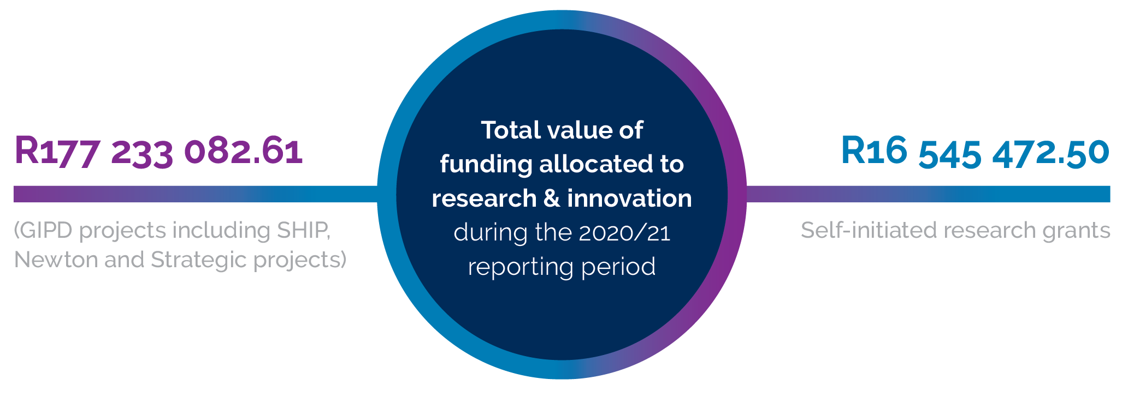
Funding health care innovation (continued)

Slide 49

Health
impact and innovation

Slide 50
SAMRC & The 41r
Genome Mapping & Research
Technological advances for Diagnostics
Precision Medicine & Drug Safety
Drug Formulation and Discovery
Big Data & Bioinformatics
AI/machine learning
Regulatory, legal and ethical framework for gene editing

Slide 51
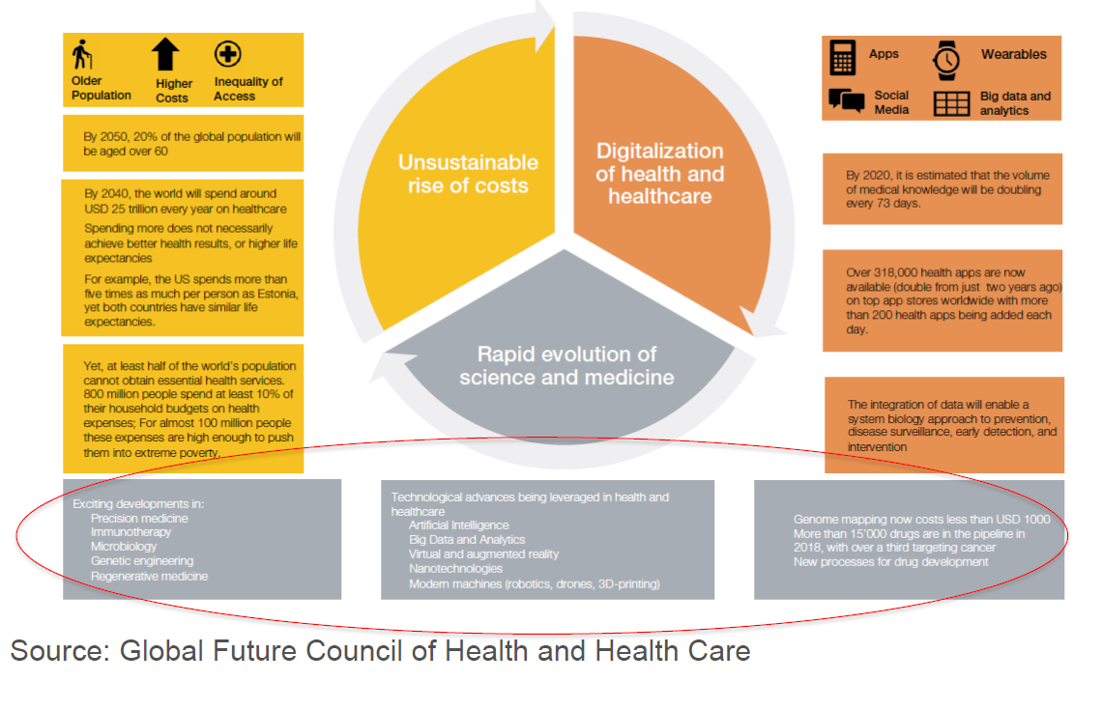
SAMRC & The 41r

Slide 52
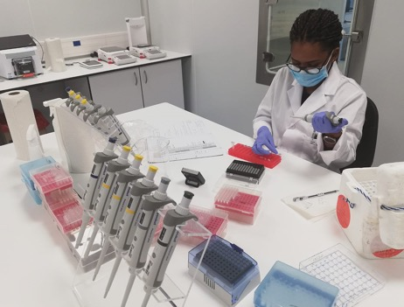
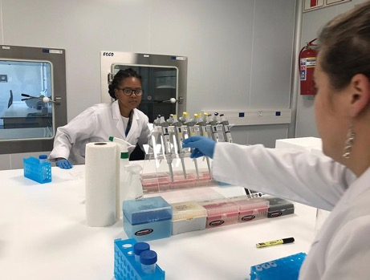
Genome mapping and research
SAMRC-BGI WHOLE GENOME RESEARCH INSTITUTE
The SAMRC established the SAMRC BGI WHOLE GENOME SEQUENCING Platform. The SAMRC & BGI jointly created a WGS laboratory to provide services for research including :
Sequencing & bioinformatics services
Next Generation Sequencing applications & collaborations in Genomic Research
Training Service in Whole Genome Sequencing
Establishing data registries in collaboration with existing programs
On-going joint collaborations to create Whole Genome Sequence projects and research capacity
Focus on Research projects for the country to address disease burden

Slide 53
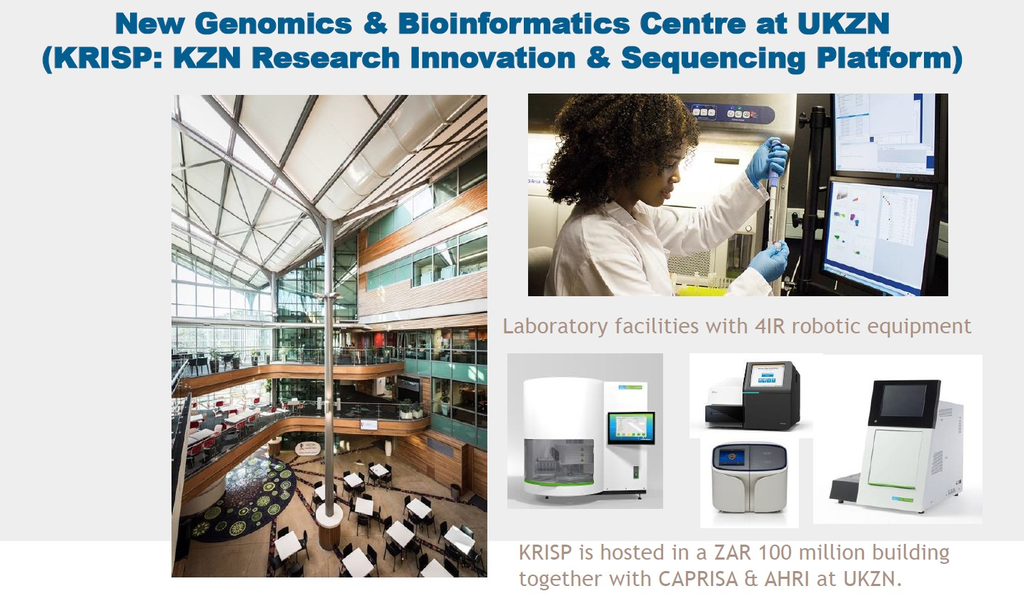
Genome mapping and research

Slide 54
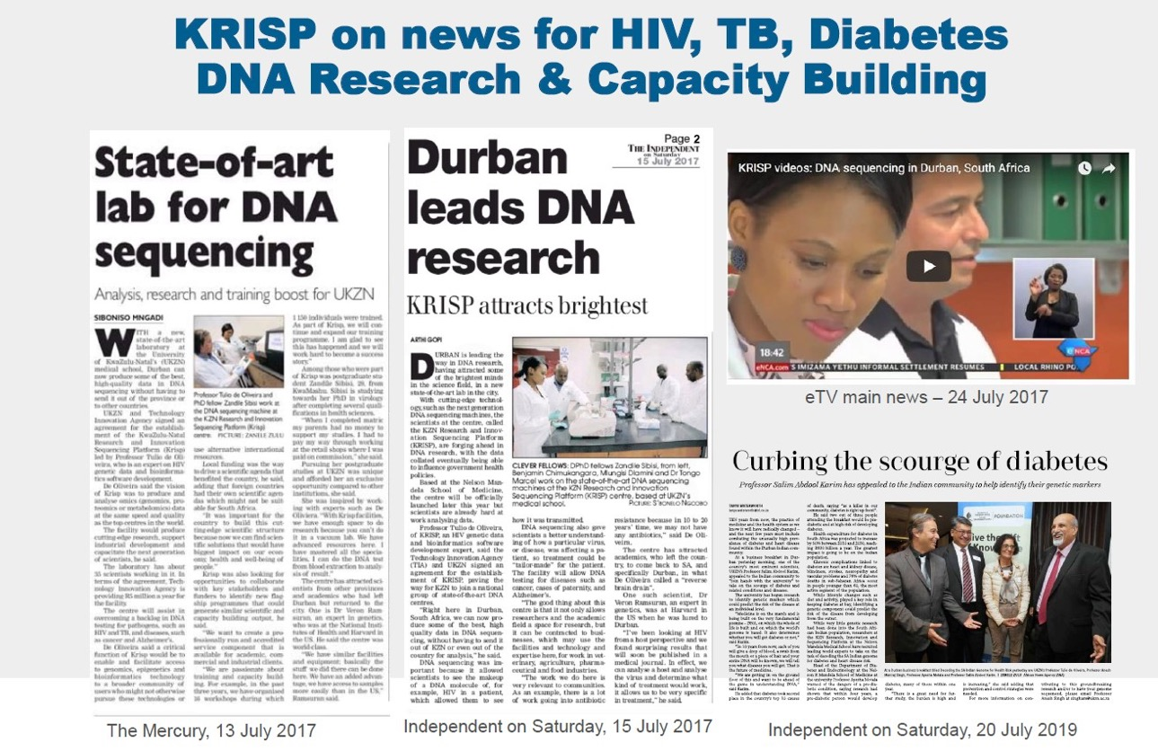
Genome mapping and research

Slide 55
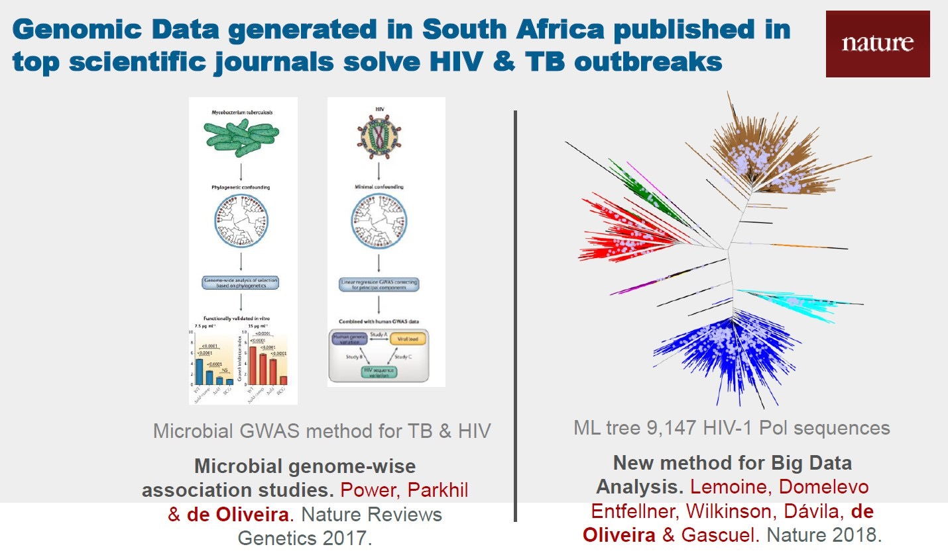
Genome mapping and research

Slide 56

Our Research at a Glance

Slide 57

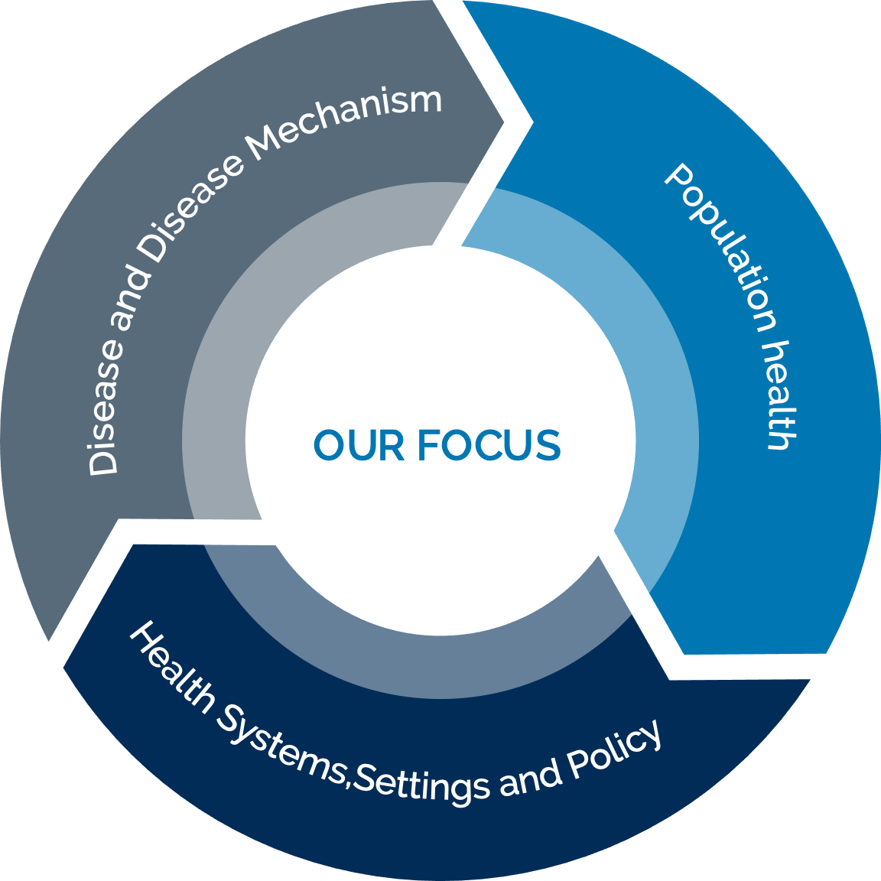
Our Research at a Glance

Slide 58
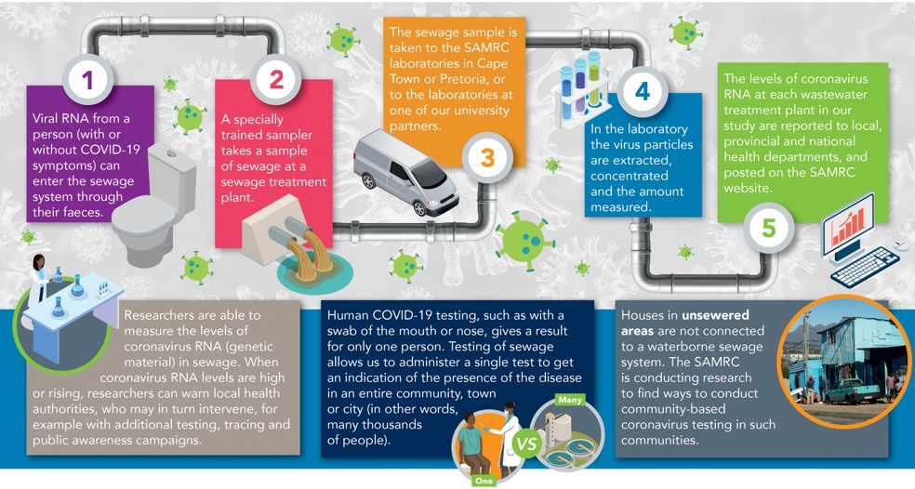
WASTEWATER SURVEILLANCE FOR SARS-CoV-2
Established the Wastewater Surveillance & Research Programme in July 2020
Interventions to support SA to manage the COVID-19 pandemic
Programme includes a SARS-CoV-2 Wastewater Surveillance Dashboard
More than 1400 wastewater samples analysed;
Wastewater results provided to local health authorities, on a weekly basis;
Correlations found between SARS-CoV-2 RNA levels in wastewater and local COVID-19 cases;
Three papers published in peer-reviewed, scientific journals (others in preparation);
Three historically disadvantaged institutions are key partners (University of Venda, University of Fort Hare and Sefako Makgatho Health Sciences University);
The project has become an important vehicle for research capacity development.

Slide 59
RESILIENCE IN A TIME OF COVID-19
Over R260M has been raised and allocated to more than 50 COVID-19 research and development projects
30 projects supported with Department of Science and Innovation (DSI) funds
SAMRC, in partnership with DSI and Technology Innovation Agency (TIA) funding COVID-19 diagnostic product development
Co-funded the participation of South Africa in vital global studies on COVID-19 treatment: Solidarity Trial, the CROWN Coronation study and several vaccine studies

Slide 60
IMPACT
Multiple SARS-CoV-2 epidemiological outbreak investigations undertaken, e.g. St Augustine’s Hospital for enhanced infection control practices in health care settings.
Trained CHWs to undertake door-to-door SARS-CoV-2 education and screening for National Active Case Finding Survey
Network for Genomics Surveillance in South Africa (Prof Tulio de Oliveira, KRISP) led the discovery and identification of the SARS-CoV-2 501Y.V2 variant
The South African component of the ChAdOx1 SARSCoV-2 vaccine trial (Astra Zeneca vaccine), led by Prof Shabir Madhi, showed the reduced efficacy of the vaccine on the local variants.
Prof Bavesh Kana at WITs, instrumental in developing controls for the COVID testing platforms which allows for standardization of the assays.
Gender & Health Research Unit led the development of the second GBV Strategy for the Solidarity Fund
Johnson and Johnson vaccine and the design and implementation of the Sisonke study by the SAMRC.

Slide 61

Communications and Stakeholder Engagements

Slide 62





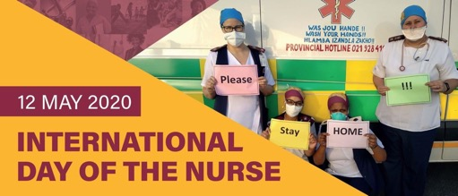




STAYING RESILIENT: COLLABORATING WITH STAKEHOLDERS TO DELIVER
ON OUR BRAND PROMISE
Communications and Stakeholder Engagements
Regular networking and collaborative opportunities brought about increased value and knowledge. The SAMRC, hosted and participated in several webinars, virtual events, and meetings, to collectively bring experts together and pioneer the way forward.

Slide 63
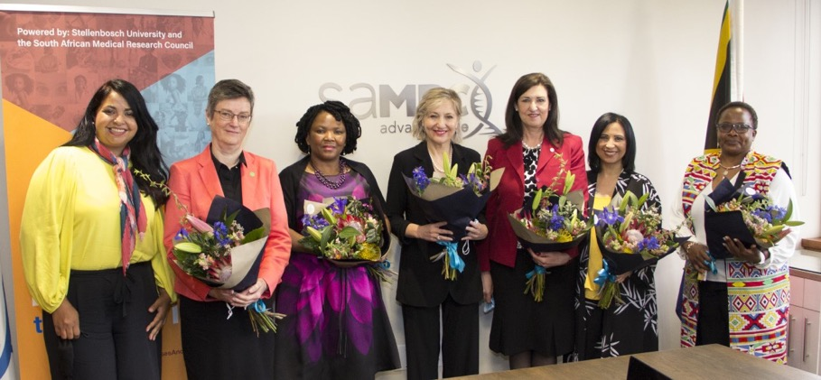
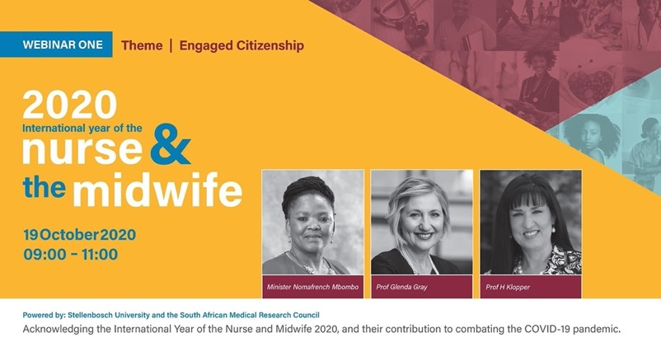
STAYING RESILIENT: 2020 International Year of the Nurse and
Midwife campaign
The SAMRC, together with Stellenbosch University, partnered on a campaign, by heeding to the call of WHO, to celebrate Nurses and Midwives during the year of 2021. The campaign brought experts together encouraging the need for continuous collaboration and knowledge sharing. The "Engaged Citizenship" under the campaign banner included Minister Nomafrench Mbombo – Western Cape Provincial Minister of
Health & Prof Glenda Gray, President and CEO of the SAMRC.
Carron Finnan, Corporate and Marketing Communications SAMRC, Prof Julia Blitz, Deputy Dean, Teaching and Learning, Faculty of Medicine and Health Sciences, Nomafrench Mbombo,
Western Cape Provincial Minister of Health, Prof Glenda Gray, President and CEO SAMRC, Prof Hester Klopper, Deputy Vice Chancellor, SU: Strategy, Prof Portia Jordan – Board member FUNDISA, Executive Head, Department of Nursing and Midwifery SU and Prof Doreen Social Impact, Department of Nursing and Midwifery, SU.

Slide 64




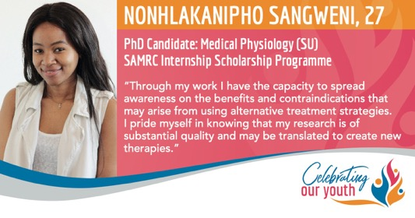



Staying resilient through active citizenship
Corporate and Marketing communications, continued to find ways of connecting and acknowledging staff, through the Champion Women campaign, for Women’s month and Celebrating rising SAMRC youth during Youth month.
The Our World Needs You Campaign, aimed at encouraging innovative ways of active citizenship.

Slide 65
Update on the Janssen®(JNJ) Ad26.COV2.S vaccine
Professors Glenda Gray & Linda-Gail Bekker
65

Slide 66

Sisonke provided the Janssen®(JNJ) Ad26.COV2.S vaccine to health workers ahead of the third wave
 | Sisonke vaccine
 | Pause of vaccinations
 | NDoH vaccine roll-out
Phase 1: health workers
Phase 2: Older adults & essential workers
Phase 3: Other adults
16 February
13 April
26 April
1 May
17 May
1 Sept
66

Slide 67
Sisonke phase 3B open label implementation study
Urgent intervention when national roll-out faltered because of Beta VOC
Able to offer HCW vaccine as part of this study as of the 17th February 2021
National Rollout 17th May 2021, so HCW got access months before general roll-out in time for 3rd wave
Provide effectiveness data on both Beta and Delta
Provide additional safety on the Ad26 SARS-CoV-2 data
67

Slide 68
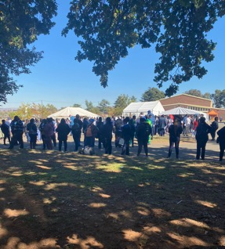
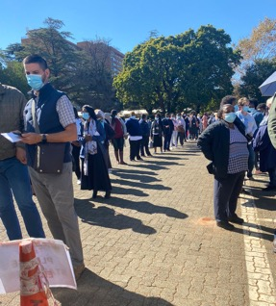
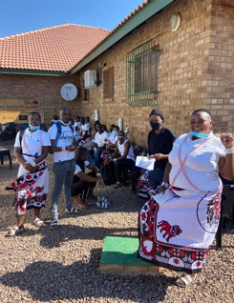
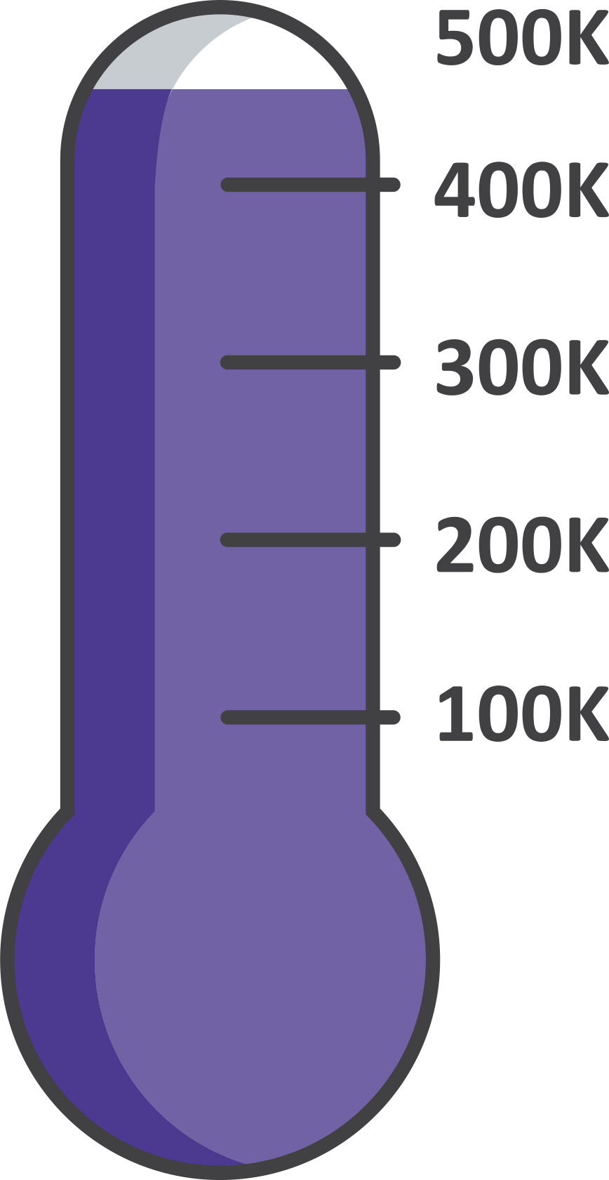
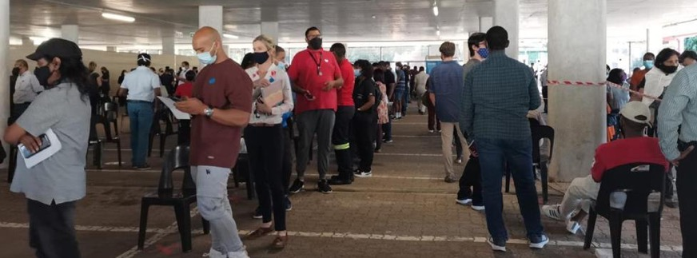
Sisonke Completed 17th May 2021
122
sites touched in total including rural extensions and mobiles
477 234
vaccinated health workers
68
Notes:
Please add photo of traditional health practitioners (sent via WhatsApp)

Slide 69
Criteria Considered for Analysis
Adjudication of infections: Mild/Mod/Severe
Used 3 data sets: 2 from medical insurers and one provincial persal data
Used 2-3 different analytical methods
For today we report on 2 data sets
69

Slide 70
Period of Analysis
70

Slide 71

The JNJ vaccine prevents hospitalisations and death
(results from two data sets)
1
100%
100%
91-95%
protection
65-66%
protection
0%
0%
Hospitalisation
Death
71

Slide 72
When breakthrough infections happen they are mild!
2
72

Slide 73
Protection is good against both beta and delta variants
3
100%
100%
71%
protection
67%
protection
0%
0%
Hospitalisation
(Beta dominant)
Hospitalisation
(Delta dominant)
N = 134 256 people
Protection is as good, if not better, against delta variant.
73

Slide 74
The JNJ vaccine is safe
4
No safety signal detected
In line with what we are seeing globally
Two cases of the rare clotting disorder (TTS – Thrombocytopenic Thrombosis Syndrome): Both have made a complete recovery.
74

Slide 75
Protection shows good durability
5
100%
100%
65%
Protection against hospitalisation
65%
Protection against hospitalisation
0%
0%
28-90 days post vaccination
90-120 days post vaccination
N = 134 256 people
There is no need for a booster yet.
75

Slide 76
Conclusion
We provide the world’s first evidence that the Ad26 COVID-19 (JNJ) is effective against the Delta VOC
Ad26 JNJ vaccine works well in South Africa and protects against severe disease and death
All the immune response data indicate good immediate and sustained immune response against Delta
Surprising durability in the immune response seen for single dose JNJ up to
8 months
Global real world effectiveness studies show similar VE as the phase 3 RCT
76

Slide 77

http://sisonkestudy.samrc.ac.za
Thank you to our staff, partners, funders and government.
77

Slide 78
Thank you
Any questions?

