Slide 1

2020/2021 Annual Report
30 September 2021

Slide 2
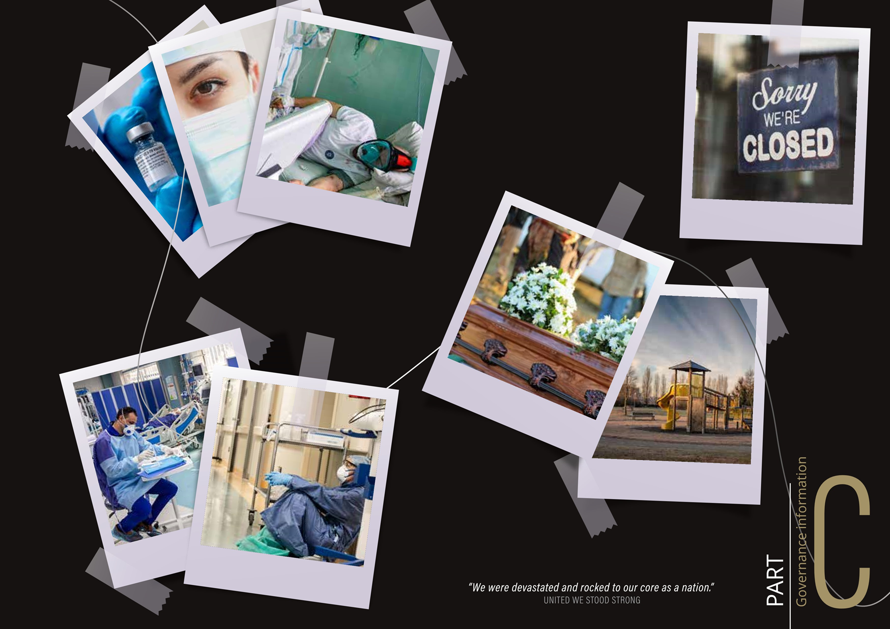

Scope of the Annual Report
The 2020/21 RTMC Annual Report complies with the PFMA (Act 1 of 1999), in line with Section 22 of the RTMCA (Act 20 of 1999), Section 55 of the PFMA and Treasury Regulation 29.2.
Scope of the report:
To provide financial and non-financial performance information of the Corporation based on the approved 2020/21 APP:
  Governance Report
  Performance Information
  Financial Performance
  Human Resource Management

Slide 3
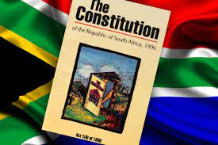
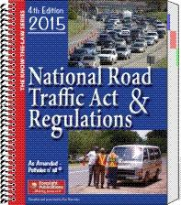
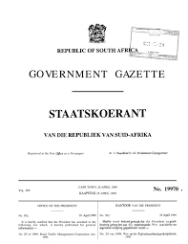
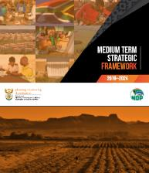
Chairman’s Overview
The RTMC is primarily guided by the:
Constitution of Republic of South Africa, the National Road Traffic Act (NRTA) and the Road Traffic Management Corporation Act (RTMCA).
Key Priorities of Government as outlined in the 2019-2024 Medium Term Strategic Framework
RTMC’s continued existence depends on the extent to which it can promote and create a safer road environment, the ability to coordinate and integrate road safety interventions from all spheres of government and facilitation of the development of road safety regulations

Slide 4
Chairman’s Overview…
Shareholders Committee
Board of Directors
Chief Executive Officer
Executive Committee
The Shareholders Committee consists of—
(a) the Minister;
(b) every MEC; and
(c) two representatives nominated by the national organisation recognised in
terms of section 2(a) of the Organised Local Government Act, 1997 (Act No. 50 52 of 1997).
The Board held 9 meetings during the year under review

Slide 5

Chairman’s Overview…
2020/21 financial year was a remarkable and challenging year for the RTMC, it was a year in which the:
organisational realignment was finalised.
Covid-19 pandemic broke out –
  which then compelled us to find new ways of working and tested our resilience

Slide 6
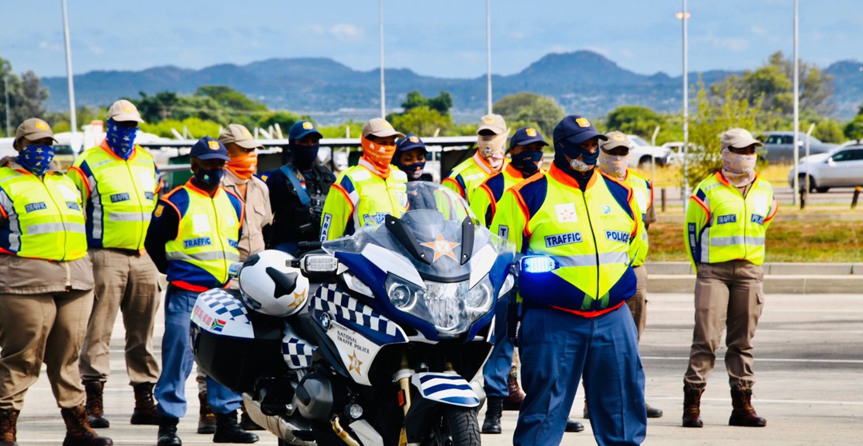
Chairman’s Overview ….
The Report we are presenting speaks to:
the commitment of the RTMC to improve safety of South Africa’s roads; and
lay the foundation for improved road traffic management through the harmonisation and professionalisation of the road traffic law enforcement sector in the country.

Slide 7

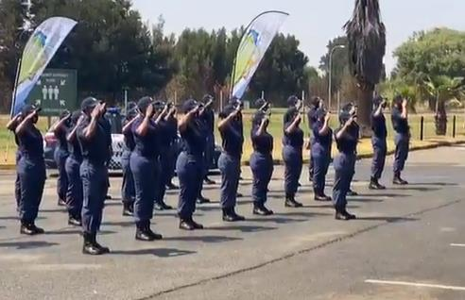
Chairman's’ Overview…
For the year under review, the Corporation had 14 targets:
8 targets were achieved
6 targets were not achieved
Underperformance can be attributed to numerous factors, however the impact of Covid-19 cannot be ruled out as a major contributor, as the Disaster Management Act (DMA) imposed several restrictions including travel and limitations on close contact training.

Slide 8
Chairman’s overview ….
The Board remains committed to improving safety on South Africa’s roads, adherence to the culture of sound governance, integrity and transparency.
Over the medium to long term period, the Corporation will pursue strategy implementation on three levels to achieve improved safety on the roads:
Targeted interventions to improve intelligence and awareness on road safety within the road traffic environment
leverage partners to maximise impact
targeted interventions to address poor driver behaviour and corruption

Slide 9
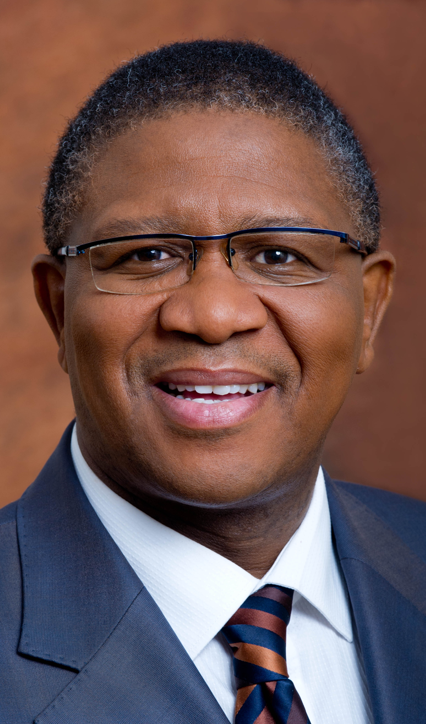
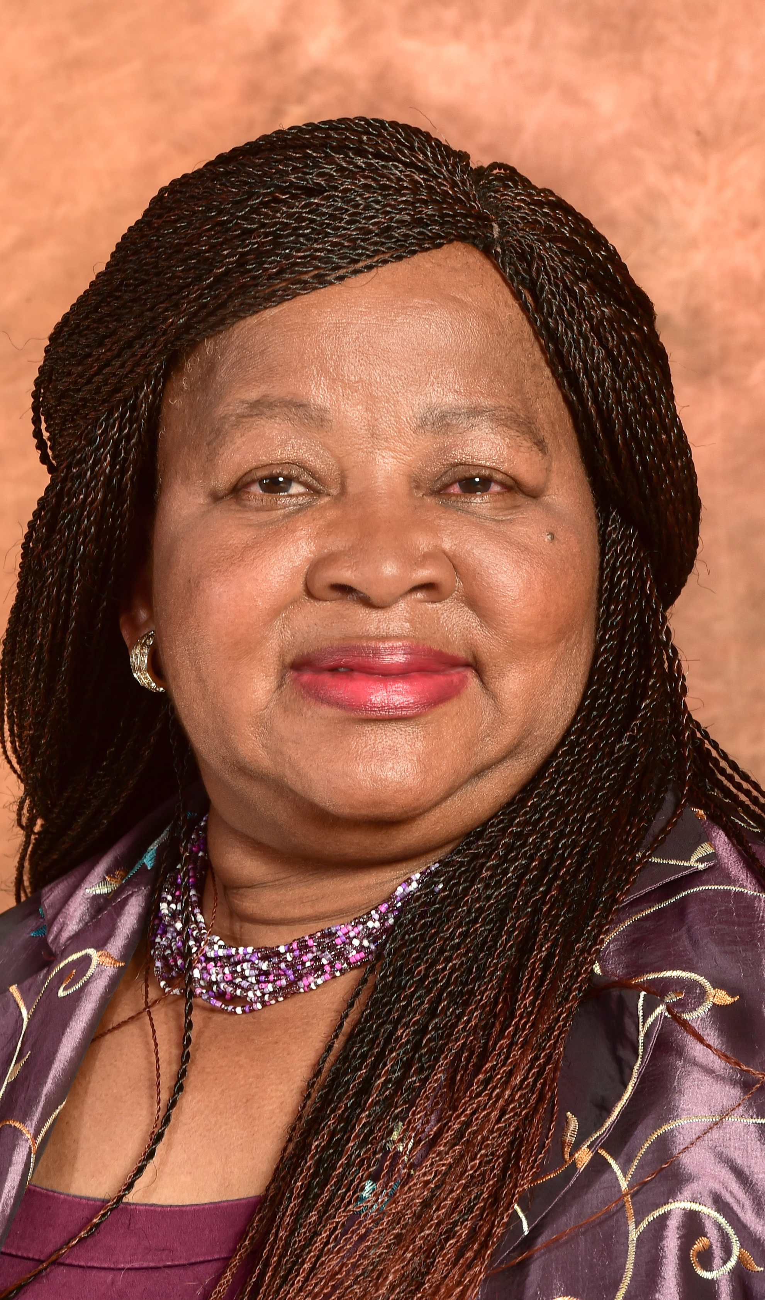
Chairman’s overview ….
The Board -
is grateful for the stewardship and continued support received from the Shareholder Committee under the leadership of the Honourable Minister of Transport, Mr Fikile Mbalula and Honourable Deputy Minister Mme Dikeledi Magadzi
commends the Executive Management team and the staff in general, for their unwavering commitment and dedication, often under difficult conditions.

Slide 10
2020/2021 Performance Report and Annual Financial Statements
Adv Makhosini Msibi - Chief Executive Officer

Slide 11
  Audit outcome and cost trend
  Audit outcome and cost trend

Slide 12

Performance of predetermined information
RTMC Programme Structure:
    Operations
    Law Enforcement
    Traffic Intelligence and Security
    Strategic Services
    Support Services

Slide 13
Performance Report
Audit of predetermined objectives:
The performance information fairly reflects the actual achievements against planned objectives, indicators and targets as per the approved strategic plan and APP of the RTMC for the financial year ended 31 March 2021
COVID-19 was declared a global pandemic on 11 March 2020, the traffic training colleges were closed on 17 March 2020 before the President declared the state of national disaster on 26 March 2020

Slide 14
Performance Report …
Some COVID-19 restrictions included:
  Limited contact with persons who may be infected
  Prohibition of gatherings of more than 100 people
  All non-essential domestic travel, particularly by air, rail, taxis, and bus discouraged
  Closure of premises for decontamination where positive cases of COVID-19 had been identified
  Quarantine for people who were in close contact with people who might have been or tested positive for COVID-19
  The areas of the Corporation which were negatively impacted during period are Training of Traffic Personnel, Law Enforcement Operations and Revenue, this is a result of reduction of traffic volumes and delays in the renewal of vehicle licenses

Slide 15
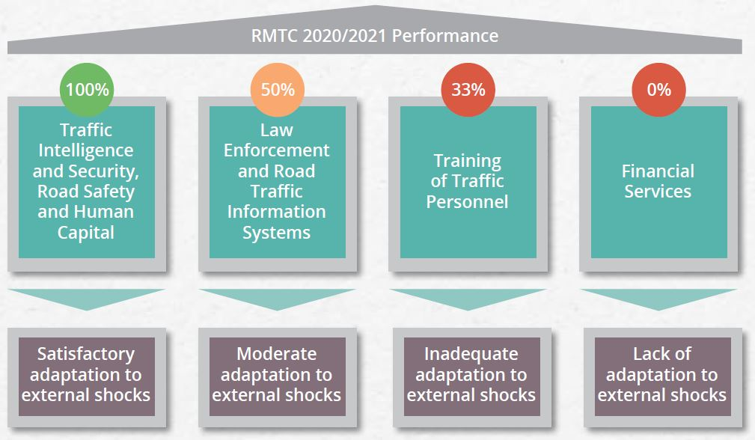
Performance Report …
RTMC Performance Summary:
The Corporation managed to attain 57% of its set targets, a regression in comparison to the recorded performance of 80% in the previous financial year

Slide 16
Performance Report …
Programme 1: Operations – Road Safety
Youth Programme
  collaboration with relevant stakeholder groups and included dissemination of supporting messaging for road safety promotion across all social media platforms to create awareness and complement other marketing initiatives
  Programme with Interest Groups: Driver Programme
  covered a range of initiatives such as workshops, recognition of national events and programmes linked to contributory factors in road safety management
  Community-based Road Safety Programme
  Aimed to support existing Community-based Road Safety structure stakeholders that implement road safety initiatives and activities. The role of the RTMC is to develop programmes that can be implemented by communities and to coordinate, provide resources and monitor the implementation of activities.

Slide 17
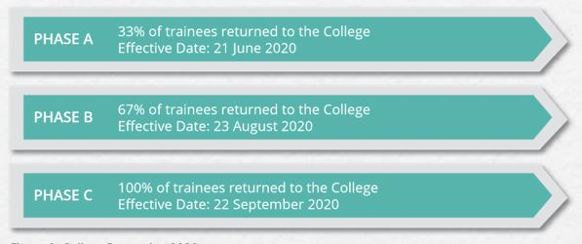
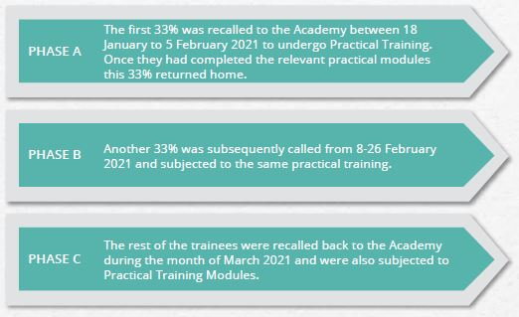
Performance Report …
Programme 1: Operations – Training of Traffic Personnel
Achieved
  3 traffic officers modules delivered to existing traffic officers
Not achieved
  5 modules on NQF level 6 traffic officer qualification completed for traffic trainees9 modules on
  NQF level 6
  road traffic safety officer qualification completed for road safety practitioners
Implementation of a phased approach on the reopening of the college
2020: Reopening phases
2021: Reopening phases

Slide 18
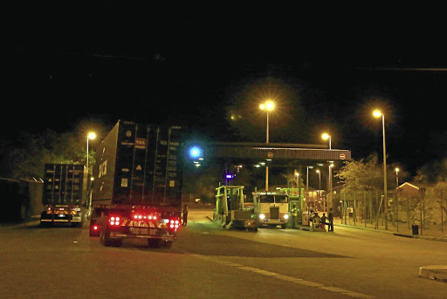
Performance Report …
Programme 2: Law Enforcement
Achieved: 4 322 targeted law enforcement interventions conducted | Number of targeted law enforcement interventions overachieved
Not Achieved: 212 737 of inspections conducted against a planned target of 332 424 | Impacted by disaster management restrictions on cross border movement

Slide 19
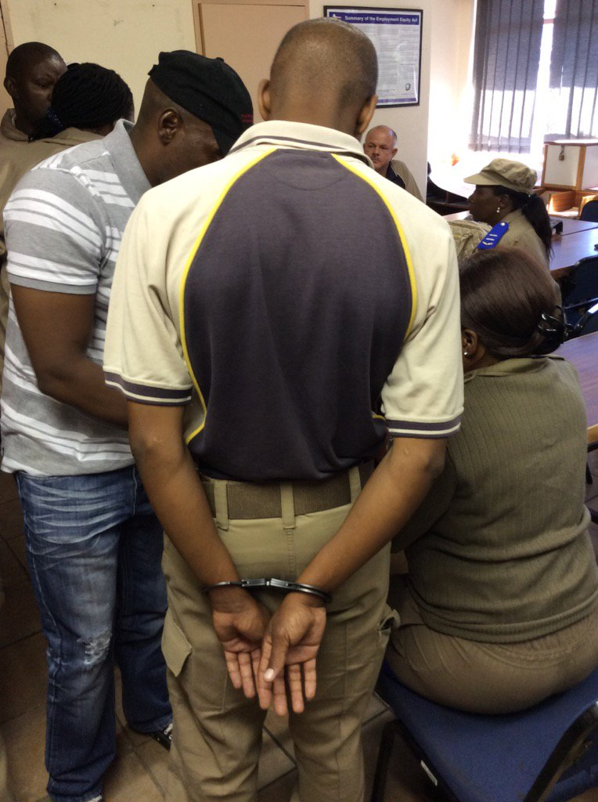
Performance Report …
Programme 3: Traffic Intelligence and Security
All Targets Achieved
100% of fraud and corruption complaints were investigated 130 self-initiated fraud and corruption cases were investigated

Slide 20

Performance Report …
Programme 4: Strategic Services
Achieved: 2 state of road safety reports published 3 research studies published | Research and Road Traffic Information reports achieved as planned
Not Achieved: 25 learner licence testing centres computerised against a planned target of 100 Zero vehicle testing stations using digitised roadworthy testing sheets | The underachievement is as a result of the Delay in the procurement of services

Slide 21
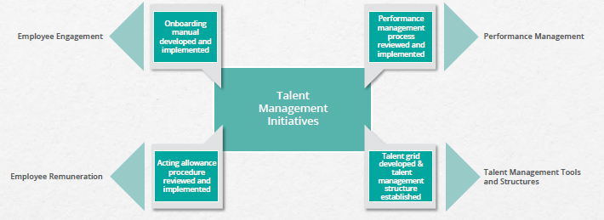
Performance Report …
Programme 5: Support Services – Human Capital
4 talent management initiatives implemented:

Slide 22

Performance Report …
Programme 5: Financial Services
Revenue declined by 5% in comparison to prior year
Impact of COVID-19 on ability to generate revenue

Slide 23

Performance Report …
Strategies to address underperformance
Performance Area | Strategy
Training of Traffic Personnel | Reallocation of personnel Implementation and adaptation to online learning Improved internal planning and coordination
Implementation of digital solutions | Improved internal planning and coordination
Traffic Law Enforcement | Improved deployment strategy
Revenue Generation | Implementation of funding model

Slide 24
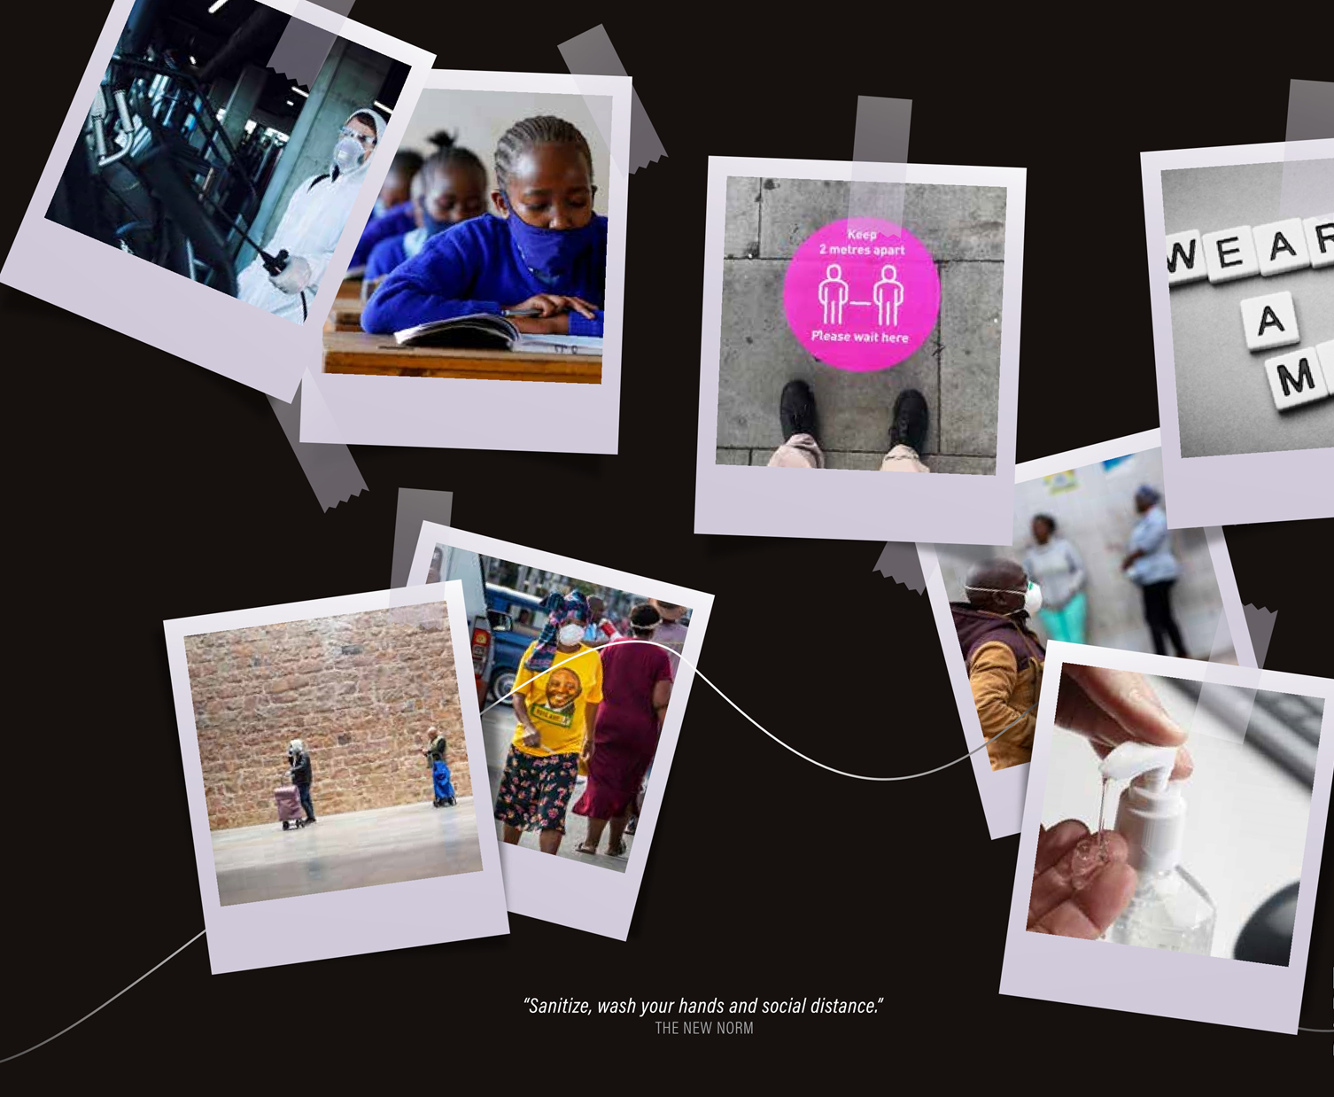
Human Resource Management
HR Focus Areas:
    Organisational Structure
    Employment and vacancies by programme
    Employment Equity targets
    Training costs

Slide 25
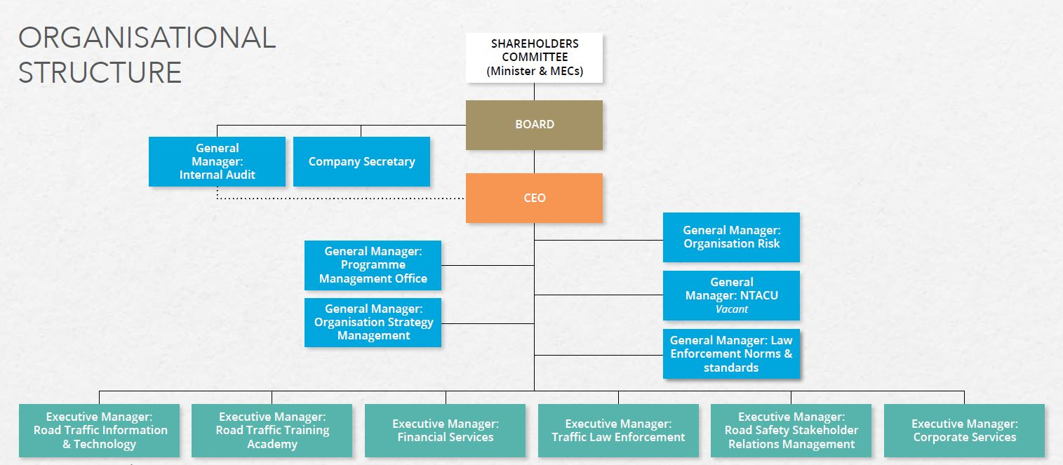
Organisational Structure

Slide 26
Employment and Vacancies by Programme
Programme | 2019/2020 number of employees | 2020/2021 approved posts | 2020/2021 number of employees | Vacancies | % Vacancies
Operations | 139 | 128 | 90 | 38 | 30%
Law Enforcement | 373 | 454 | 390 | 64 | 14%
Road Traffic Intelligence and Security | 29 | 101 | 24 | 77 | 76%
Strategic Services | 38 | 248 | 166 | 82 | 33%
Support Services | 214 | 218 | 181 | 37 | 17%
Total | 793 | 1149 | 851 | 298 | 26%
    The vacancy rate on 31 March 2021 was 26% compared to 12% for the previous year.
    The approved posts increased from 902 to 1149 due to the restructuring process.

Slide 27
Employment Equity targets
The EE representation shows that the Corporation has 56% male and 44% female employees respectively

Slide 28
Corporate Social Responsibility
  CSR Initiatives focused on COVID-19 relief support, emergency assistance and female empowerment initiatives

Slide 29
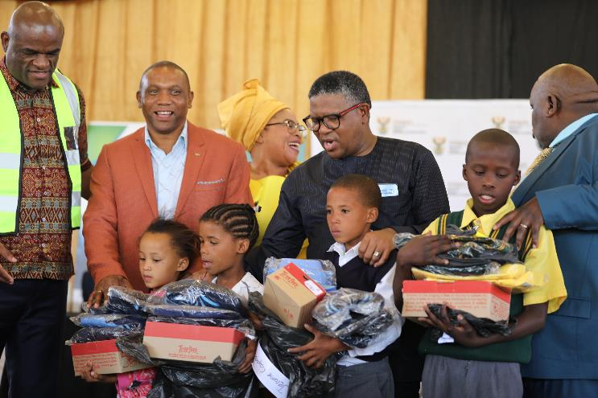
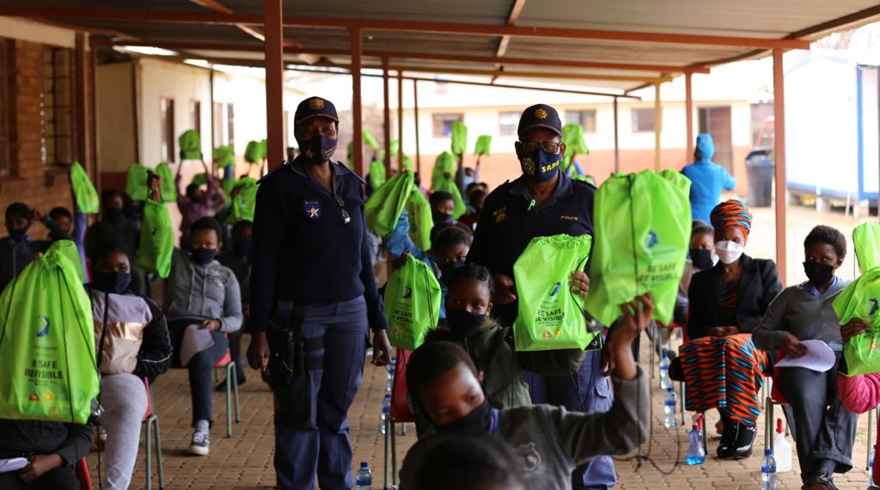
CSR Programmes
7 programmes implemented:
Nelson Mandela Day CSR Project
Fire Disaster Relief CSR Project
Women in Law Enforcement Feminine Care CSR Project
Festive Season Care Hamper Corporate Social Responsibility (CSR) Project
Road Safety Educational and Child Stimulating Toys CSR Project
School Readiness / Back to School Corporate Social Responsibility (CSR) Project
National Feminine Care Project, Northern Cape

Slide 30
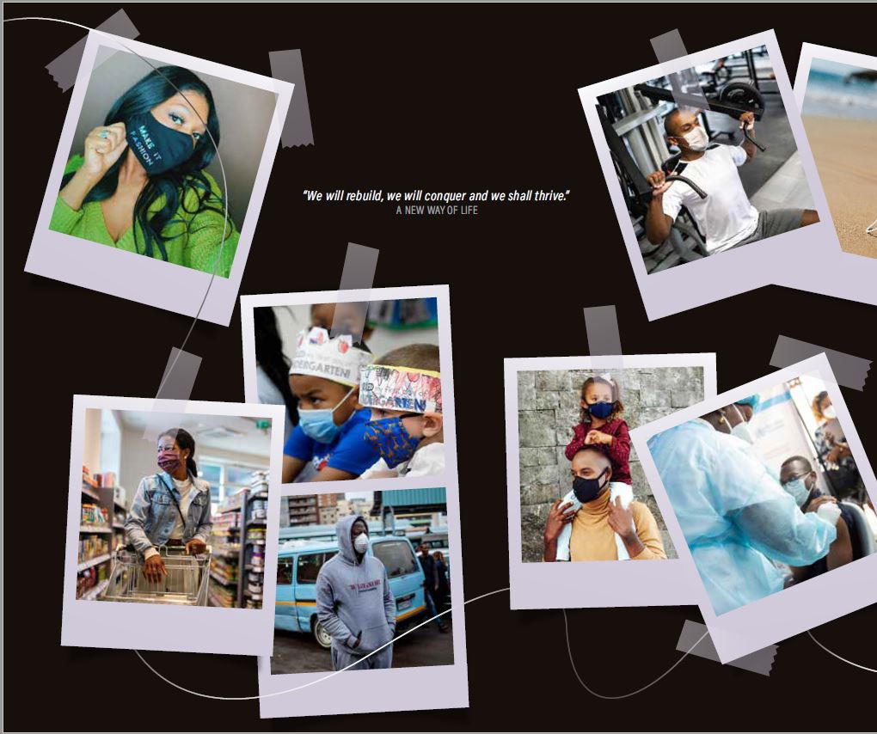
Audited Annual Financial Statements
Scope of financial report:
    Spending pattern
    Variance Analysis by programme
    Traffic Intelligence and Security
    Strategic Services
    Support Services

Slide 31
Spending pattern
  A year-on-year expenditure comparison reflects a decrease compared to the previous year, R1.18 billion was spent in the 2020/21 financial year compared to R1.26 billion in the 2019/20 financial year.
  There was over spending of 4% due to non-cash items e.g. depreciation and provisions
  The table below details spending patterns including capital expenditure:

Slide 32
Variance analysis by programme
Operations underspent by 9% against the adjusted allocated budget for the year as compared to prior year where an underspend of 7% was recorded. The variance can mainly be attributed to the delay in the traffic trainee project due to challenges experienced with the Covid-19 pandemic throughout the financial year. The traffic trainee project continued with only 300 trainees.
Law Enforcement underspent by 10% against the adjusted allocated budget for the year as compared to the previous year, which reflects an underspending of 5%. During the first half of the period under review the country was hit by the global Covid-19 pandemic which impacted negatively on the deployment of law enforcement officers. This had an impact specifically on planned events such as the National Wreath-laying event commemorating the fallen traffic officers throughout the country.
Traffic Intelligence and Security underspent by 9% against allocated budget for the year against an underspend of 2% in the previous year. Despite vigorous operations done during the financial year, most operations took place in Gauteng and the neighboring provinces accounting for the budget underspend.

Slide 33
Variance analysis by programme…
Strategic Services underspent by 4% against the allocated budget for the year vis-à-vis a recorded underspend of 21% in the previous year. During the financial year the Corporation commenced on implementing the digitalization of learner licenses at driver license testing stations. The underspent can be attributed to the fact that not all were done at the end of the financial year.
Support Services reflects a 124% spend of the allocated adjusted budget against a 101% spent in the previous year. The overspend can be attributed to the expenditure incurred on non-cash items i.e., depreciation, provisions.

Slide 34
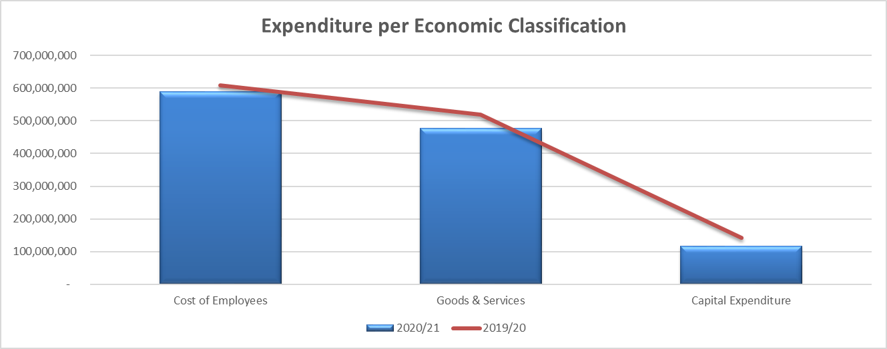
  Spending per Economic Classification
The expenditure per classification shows that 96% of the budget for Compensation of Employees (CoE) was spent as compared to the previous financial year, wherein 105% of the budget for CoE was utilised.
During the year under review 120% of the budget for goods and services was spent as compared to the previous financial year, wherein there was spend of 89%.
Only 90% of the capital budget was spent due to the acquisition of the new fleet and computer equipment, and the delay in the finalisation of the acquisition of land contributed to the non-spending of 10%.

Slide 35
Revenue pattern
There was over-collection of revenue by 5% on the adjusted budget due to amongst others, the following:
  The budgeted amount for Transaction Fees was R860 million (2019/20: R1 053 billion; a collection of R885 million (2019/20: R915 million) was recorded. This resulted in over recovery of Transaction Fees in relation to the budget by 3%. This revenue stream accounts for 73% of the total revenue.
  The Grant income was increased by 9% due to additional funding from Department of Transport, from R220 million to R240 million, this accounts for 20% of the total revenue of the Corporation.
  There was a significant decline of the Road Traffic Inspectorate infringements due to closure of borders as a result of COVID-19 .
  The below table depicts the year-on-year revenue patterns:

Slide 36
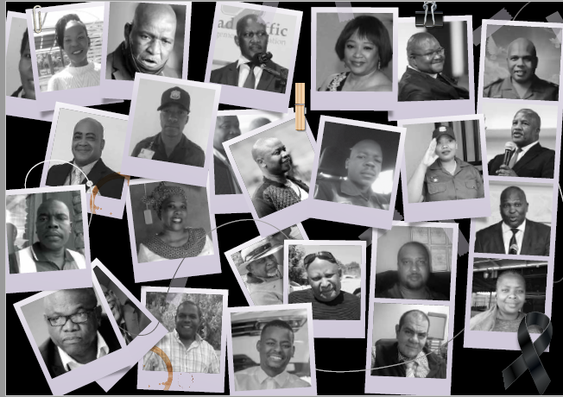

In conclusion… Asiphelelanga

