Slide 1
BRIEFING ON THE CCB’S 2020/21 ANNUAL REPORT TO THE PORTFOLIO COMMITTEE ON DEFENCE AND MILITARY VETERANS
Lt Gen JS Mbuli (Chairman) & Mr CT Gilfellan (CEO) Cape Town, Wednesday, 10 November 2021

Slide 2
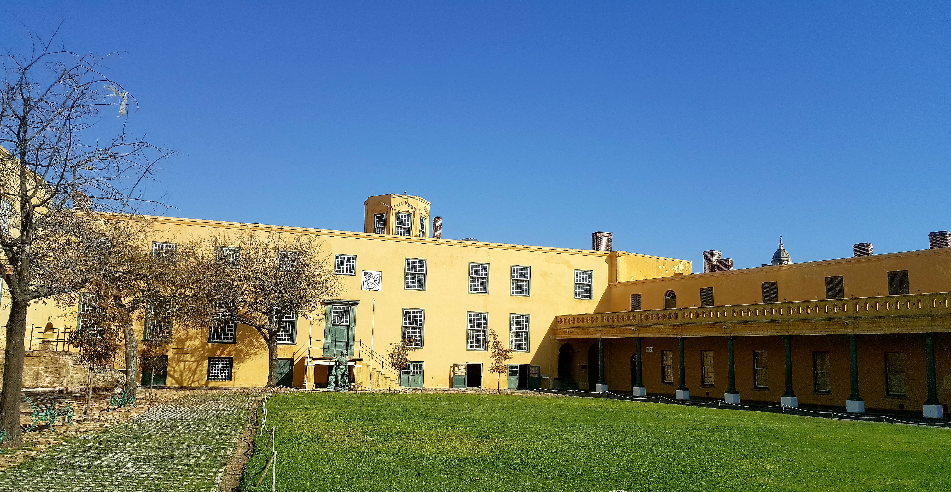

Slide 3
General introduction
1. Castle Control Board (CBB) Mandate from Castle Management Act (1993) and other relevant Legislation
2. Four (4) strategic objectives:
Good Corporate Governance and Administration
Develop the museum and interpretative heritage components
Develop and promote the Castle as a heritage tourism destination
Ensure broad, public accessibility
3. Alignment with national policy and strategic imperatives
4. The CCB manages the Castle on an enterprise-risk basis/partnerships
5. A regular, diligent process of risk assessment, risk register and mitigation i.e. going concern, revenue, safety & security, human resource management

Slide 4
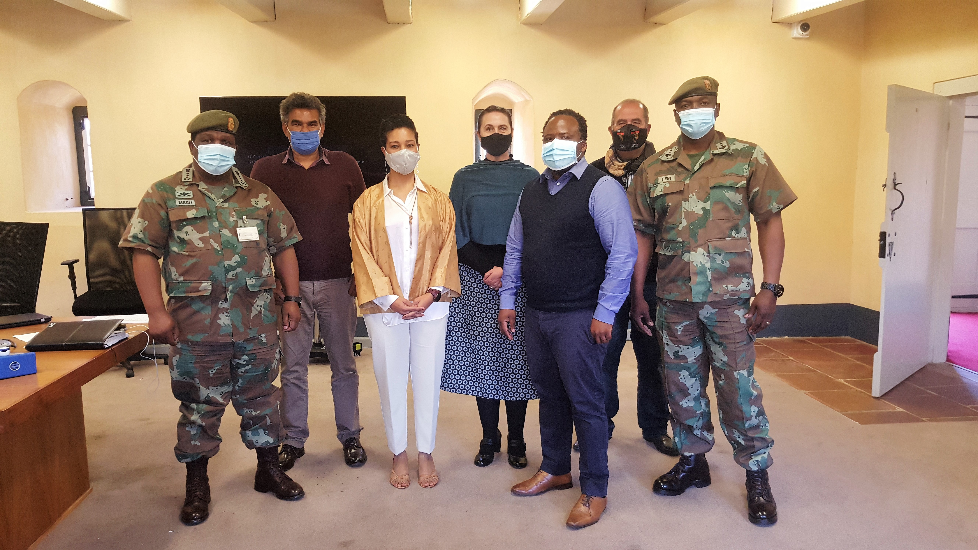

Slide 5
BRIEF: Expected outcomes
Performance against 2020/21 targets set
Programmes and areas that require additional funding
Impact of any reprioritisation on the operations and management in the light of COVID-19 (R4.9 million DOD relief)
Areas of underperformance and measures to address these
Measures in place to address audit & other queries (BRRR)

Slide 6
SUMMARY of ccb’s performance FY2020/21
Clean AGSA Audit Outcome.
Judicious programmatic spending of the R4.8 million relief funding.
Despite little tourism business during COVID-19 lockdown, self-generated R777k in revenue.
Achieved more than 80% (17/21) of our KPI’s (pp. 21 – 36)
Massive drop in visitor numbers to the Castle (14 522).
Deployment of six Regional Works Unit (WC) artisans significantly enhanced maintenance.
Media coverage reached a global audience of 554.6 million people translating in an AVE of R70 million.
Castle sustained 26 full-time and 800 temporary jobs.

Slide 7
SUMMARY OF ACTUAL PERFORMANCE AGAINST (2020/21 APP TARGETS, AR PP. 21 - 31)
PERFORMANCE AREA | NUMBER OF KPI’S | UNDER/OVER | MITIGATION
Administration and Good Corporate Governance (3.1) | 7 | All seven targets met | None
Preservation, interpretation and showcasing of the Castle’s History (3.2) | 4 | All four targets met; majority exceeded. | None
Maximizing Tourism potential (3.3) | 6 | Two (2) out of 6 not met (visitor numbers and commercial events) but all others above KPI targets. | Limited access to the Castle during lockdown, affected these targets
Increase public access and perception (3.4) | 4 | One target out of four (Number of Interns) missed. | Closure of Tertiary Institutions hampers access to students

Slide 8
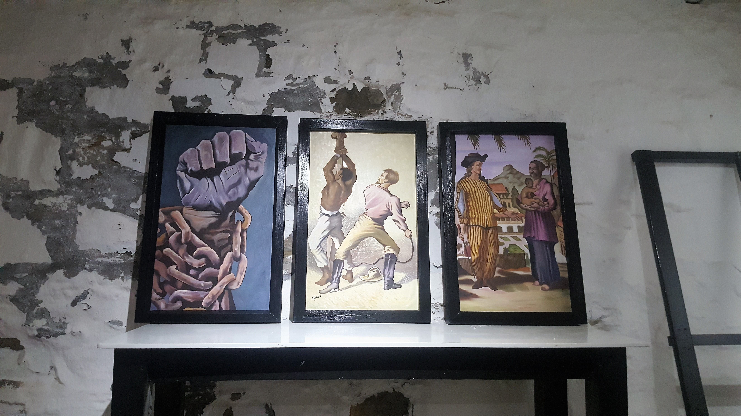

Slide 9
SUMMARY OF FINANCIAL PERFORMANCE (2020/21 BUDGET, AFS PP. 39 - 76)
Programme/ activity/ objective | 2019/2020 |  |  | 2020/2021
 | Budget | Actual Expenditure | (Over)/Under Expenditure | Budget | Actual Expenditure | (Over)/Under Expenditure
 | R’000 | R’000 | R’000 | R’000 | R’000 | R’000
Administration through corporate governance | 8 031 | 5 299 | 2 732 | 4 711 | 5 407 | (696)
Preservation and protection of military and cultural heritage | 662 | 428 | 234 | 304 | 386 | (82)
Maximising the Castle’s tourism potential | 15 | 9 | 6 | 0 | 0 | 0
Increased public profile and positive perception of the Castle | 250 | 109 | 141 | 150 | 30 | 120
TOTAL | 8 958 | 5 845 | 3 113 | 5 165 | 5 823 | (658)

Slide 10
SUMMARY OF FINANCIAL PERFORMANCE (2020/21 REVENUE
 | 2018/2019 |  |  | 2020/2120
Sources of Revenue | Estimate | Actual Amount Collected | (Over)/Under Collection | Estimate | Actual Amount Collected | (Over)/Under Collection
 | R’000 | R’000 | R’000 | R’000 | R’000 | R’000
Sales | 5 870 | 3 921 | 1 949 | 1 100 | 475 | 625
Rental Income | 2 456 | 1 496 | 960 | 1 056 | 255 | 801
Other Income | 622 | 394 | 228 | 9 | 555 | (546)
Interest Income | 10 | 0 | 10 | 0 | 34 | (34)
Grant |  |  |  | 3 000 | 4 900 | (1 900)
Total | 8 958 | 5 811 | 3 147 | 5 165 | 6 220 | (1 055)

Slide 12
HUMAN RESOURCES(Pp. 45 – 46)
Since the CCB is a services/hospitality organization, it relies heavily on people to execute its mandate (this currently means a high staff: operations ratio).
Although the CCB only had 16 full-time posts, interns and short-term contracts (28) pushed this number up to 44 (figures exclude SANDF and other entities on site).
Save for senior management, our employment equity status is positive given our size.
The salary bill for FY 2020/21 was R3 875k.
Although we were off-site for months, we maintained contact with our client base and ensured that the Castle remains in good condition.

Slide 13
Covid-19 measures
Castle closed 19 March 2020 causing lost of unease amongst staff.
When we received R4.9 million relief funding from DOD and continue delivering our mandate, the CCB team gelled together.
Castle re-opened 1 September 2020 with a trickle of visitors
Despite heavily scaled-down activities, we had a few good filming events.
Visitor numbers (and business) down by 309%.
But – we shall remain hopeful for some recovery in the two last quarters of the new FY.

Slide 14
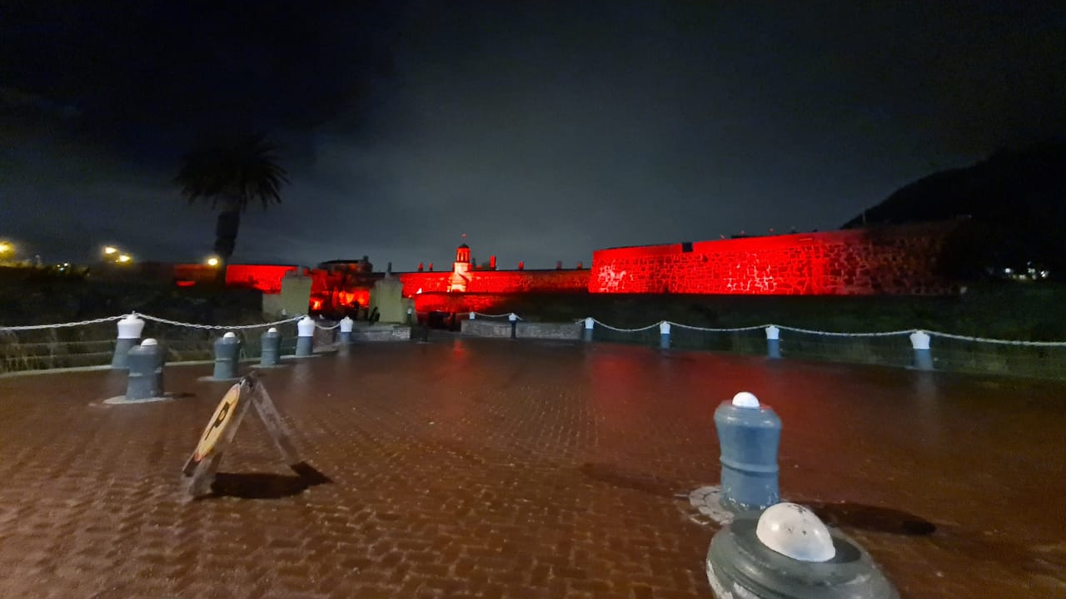

Slide 15
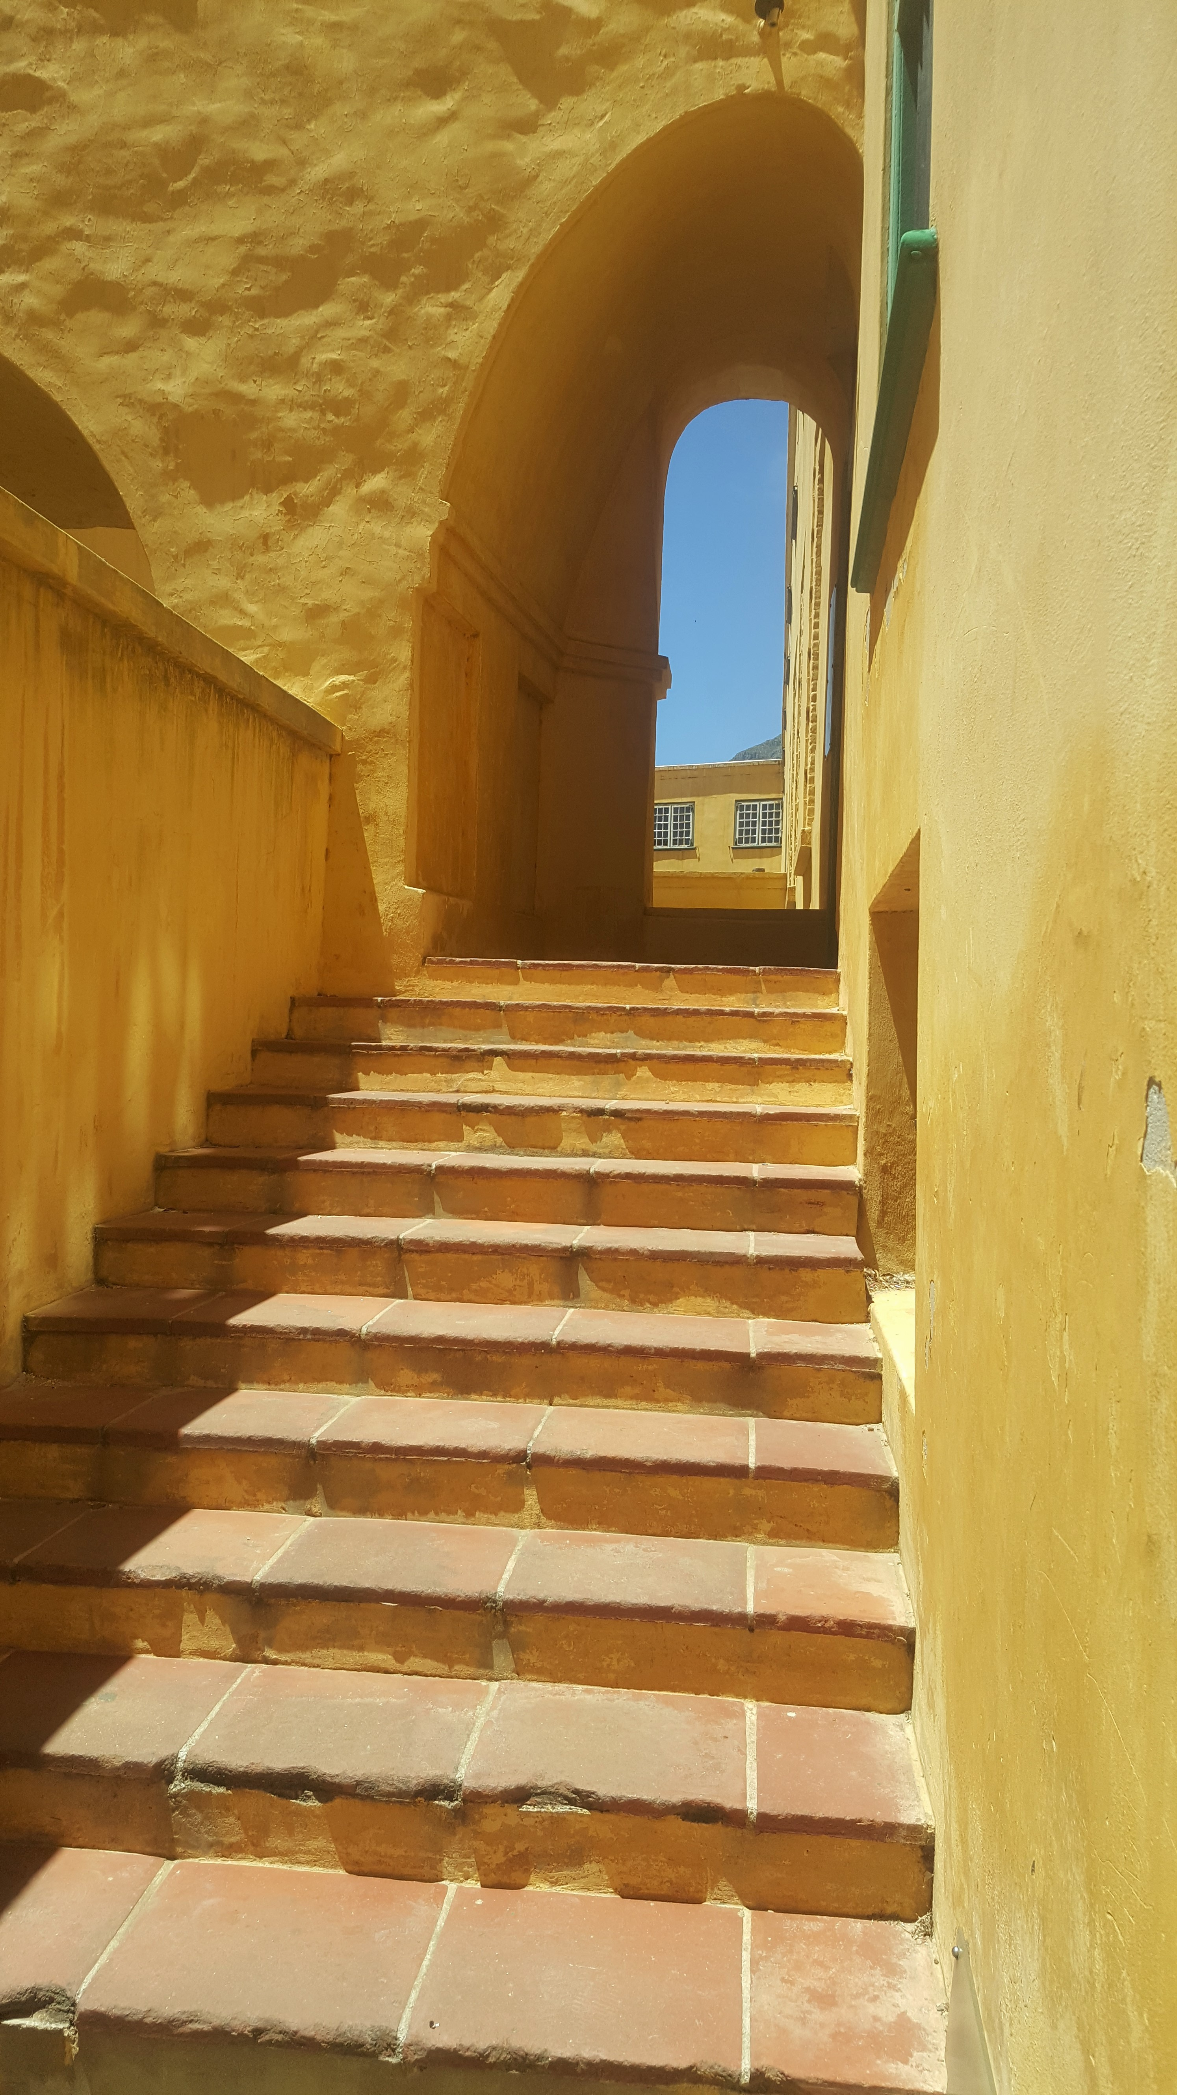
Good Corporate Governance…

Slide 16
Previous HIGH-LEVEL brrR & AGSA (2020) queries
PCDMV BRRR ISSUE | MITIGATION PROGRESS REPORT
One Castle, one Controlling Body | Briefing document to new EA has this item high on the Agenda.
SANDF Guards | Vast improvement; it is a matter of the quality of soldier (reserves) deployed at the Castle: Colonel Feni.
Decreasing Surplus/Going Concern | Wrote to EA for bridging subsidy; the R3 million COVID-relief funding, albeit under very dire circumstances, is a precedent.

Slide 17
Previous brrR (2020) queries
PCDMV BRRR ISSUE | MITIGATION PROGRESS REPORT
Strategic Risks | The Board has a Risk Register/Action Plan to deal with organizational Risks. These are thoroughly dealt with at Management, Internal Audit, Audit & Risk Committee and Board levels.
Performance Bonuses | No performance bonuses paid for the last three years.
AGSA findings and queries | The critical findings and queries are listed on a so-called dashboard, addressed by management and presented to the Audit Committee.

Slide 18
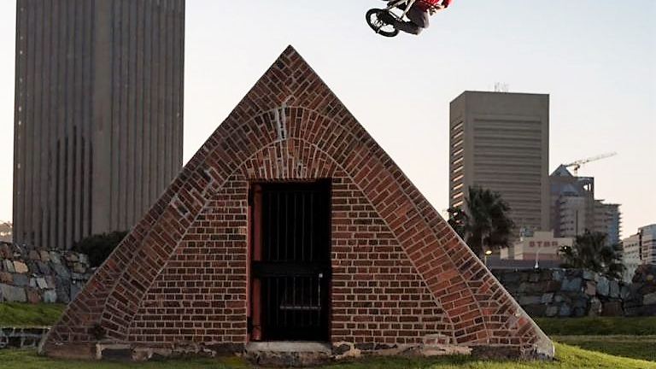

Slide 19
CONCLUSION 1. The Board wants to build and maintain good relations with this esteemed Committee; 2. Thank you for unwavering support and huge role to save 20+ jobs with the R4.9m relief funding; 3. Note that with nominal support, the CCB can significantly increase its social, economic and employment impact (Koba- Tlala) in the heritage sector; and 4. The focus is on resilience, economic recovery and the building of a brighter future for all!

