Slide 1
Presentation on 2020/2021 Annual Performance Report
Joint Standing Committee on Financial Management of Parliament

Slide 2
Part 1
Highlights:
Parliamentary Business

Slide 3
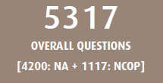
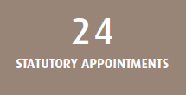
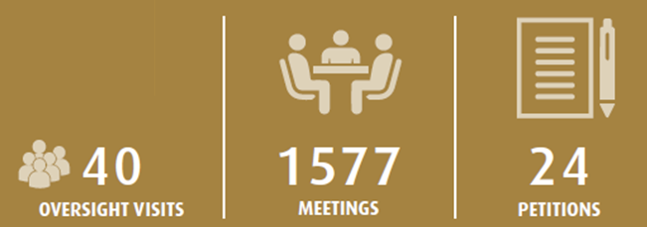

Slide 4
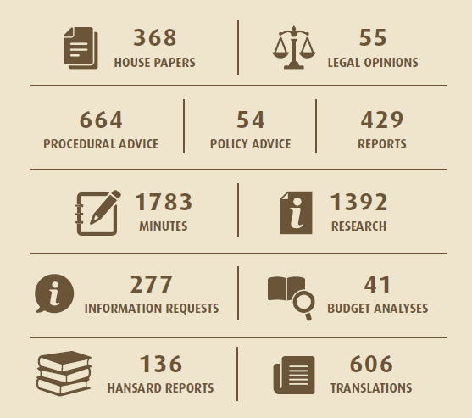
The above represents a synopsis of the key services provided by the Parliamentary Administration in support of the work of Parliament.

Slide 5
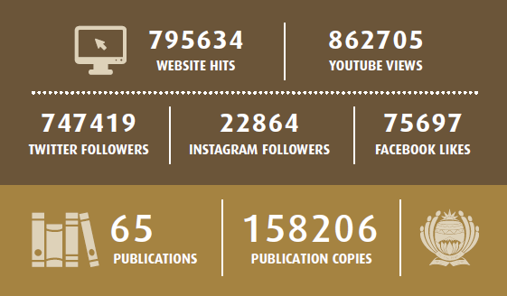
The above gives a view of the reach and involvement of citizenry in the work of Parliament.

Slide 6
Part 2
High level Performance Trends

Slide 7
Institutional performance – 6 years
45,87%
2015/2016
48,78%
2016/2017
57,89%
2017/2018
78,57%
2018/2019
75%
2019/2020
64%
2020/2021
YEAR | Targets Met | Targets Not Met | Total Indicators | Percentage of Targets Met
2015/16 | 15 | 17 | 32 | 46,88%
2016/17 | 20 | 21 | 41 | 48,78%
2017/18 | 11 | 8 | 19 | 57,89%
2018/19 | 12 | 2 | 14 | 78,57%
2019/20 | 12 | 4 | 16 | 75%
2020/21 | 9 | 5 | 14 | 64%

Slide 8
7 Consecutive Clean Audits
2014/15
2015/16
2016/17
2017/18
2018/19
2019/20
2020/21
Institutional performance improved consistently over the last 6 years.
Seven consecutive clean audits affirm a clean governance record.
Auditor-General Report confirms no material financial or performance information findings.
High level of performance achieved despite the impact of COVID-19 and declining budgets.

Slide 9
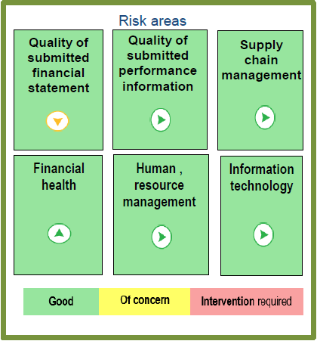
The Auditor General Management Report identified all 6 risk areas as green (Good).

Slide 10
Governance and Internal Controls
Executive Authority timeously signing off on monthly financial statements, quarterly performance reports, mid-year reports and annual reports for tabling as per the FMPPLA.
Financial and performance reports presented on a quarterly basis to Parliament’s Audit Committee.
Internal Audit and Audit Task Team audit the evidence required for performance information and predetermined objectives in preparation for the AG audit.
Verification of performance information by Management
Year-on-year improvement is achieved through scrutiny and implementation of audit action plans to improve and maintain the status of internal controls.
All of the above have contributed to the 7th consecutive clean audit outcome.

Slide 11
Part 3 Programme Performance Information

Slide 12
Overall Institutional performance
Overall Institutional Performance
Annual 2020/21
There were 14 performance indicators in the 2020/2021 APP.
Of these, 9 indicators met or exceeded target.
5 indicators performed below the target level.
64%
Total Indicators | Targets Achieved | Targets Not Achieved
14 | 9 | 5

Slide 13
Non-financial Performance indicator Snapshot
PERFORMANC BY INDICATOR |  |  | STATUS
Prog. 1 | % of legal and procedural provided within 7 days
 | % of analysis reports provided within agreed timeframes
Prog. 2 | % of programmes implemented
 | Number of reports prepared on implementation of Sector Strategy
Programme 3 | Number of annual parliamentary frameworks adopted
 | Number of NA programmes adopted
 | Number of NCOP programmes adopted
 | % of information available as per Service Charter levels
 | % Population having access to participate in parliamentary processes
 | % Population participating in parliamentary processes
Programme 4 | % of population who are aware of the business of Parliament
 | % of universal access
 | Client satisfaction level (% clients satisfied with service levels)
 | % increase in talent management index
Target Met |  | Target Not Met

Slide 14
Programme 1: Strategic Leadership & Governance
PROGRAMME 1 ANNUAL PERFORMANCE 2020/21
50%
Indicators Measured: 2
Total Met: 1
Targets Not Met: 1
Strategic Leadership and Governance
Indicator | Performance
 | 2019/20 | 2020/21
% of legal and procedural provided within 7 days | 80% | 83,33%
% of analysis reports provided within agreed timeframes | 100% | 100%

Slide 15
Programme 1: Strategic Leadership & Governance
Parliamentary Service | Indicator | Annual Target 2020/21 | Actual performance | Variance | Status | Reasons for variance & mitigation factors
Procedural and legal to support Parliament on ISDs related matters. | % of legal and procedural provided within 7 days | 90% | 83,33% (65 of 78) | -6,67% |  | All reports were produced, however 18 were not done within the 7-day timeframe due to the fact that there was a significant increase in work volumes arising from committee activities.
PERFORMANCE TREND
In respect of the strategic, procedural and legal advice prepared, within the required 7-day turnaround time – 100% of advice was provided.

Slide 16
Programme 1: Strategic Leadership & Governance
Parliamentary Service | Indicator | Annual Target 2020/21 | Actual performance | Variance | Status | Reasons for variance & mitigation factors
Analytical services (research, content and secretariat support) to support Parliament on ISDs related matters | % of analysis reports provided within agreed timeframes | 100% | 100% (12 of 12) | 0%
PERFORMANCE TREND
All analysis reports for the year were produced within the agreed timeframes.

Slide 17
Programme 2: Administration
PROGRAMME 2 ANNUAL PERFORMANCE 2020/21
100%
Indicators Measured: 2
Total Met: 2
Targets Not Met: 0
Administration
Indicator | Performance
 | 2019/20 | 2020/21
% of programmes implemented (Number of programmes implemented) | 1 | 100% (4 of 4)
Number of reports prepared on implementation of Sector Strategy | 4 | 4

Slide 18
Programme 2: Administration
Parliamentary Service | Indicator | Annual Target 2020/21 | Actual performance | Variance | Status | Reasons for variance & mitigation factors
Member’s capacity building programmes | % of programmes implemented | 100% | 100% (4 of 4) | 0%
PERFORMANCE TREND
The four (4) capacity building programmes implemented during the 2020/21 reporting year included the following:
Advanced Governance and Public Leadership: University of the Witwatersrand
Continuing Education Programme (CEP) by the University of Johannesburg
Post Graduate Diploma in Public Policy and African Studies at the University of Johannesburg
Personal Mastery Course (In-House)

Slide 19
Programme 2: Administration
Parliamentary Service | Indicator | Annual Target 2020/21 | Actual performance | Variance | Status | Reasons for variance & mitigation factors
Legislative sector cooperation | Number of reports prepared on implementation of Sector Strategy | 4 | 4 | 0%
PERFORMANCE TREND
The SA Constitution, requires that Parliament and Provincial Legislatures maintain oversight over the Executive to ensure a government that is open, responsive and accountable.

Slide 20
Programme 3: Core Business
PROGRAMME 3 ANNUAL PERFORMANCE 2020/21
50%
Indicators Measured: 6
Total Met: 3
Targets Not Met: 3

Slide 21
Programme 3: Core Business
Core Business
Indicator | Performance
 | 2019/20 | 2020/21
Number of annual parliamentary frameworks adopted | n/a | 1
Number of NA programmes adopted | n/a | 4
Number of NCOP programmes adopted | n/a | 4
% of service provision as per Service Charter | 91,57% | 87,33%
% Population having access to participate in parliamentary Processes | 14% | 13%
% increase in participation in the House and Committee activities | 7,2% | -2%

Slide 22
Programme 3: Core Business
Parliamentary Service | Indicator | Annual Target 2020/21 | Actual performance | Variance | Status | Reasons for variance & mitigation factors
Joint Parliamentary Programming | Number of annual parliamentary frameworks adopted | 1 | 1 | 0
National Assembly | Number of NA programmes adopted | 4 | 4 | 0
Programming | Number of NCOP programmes adopted | 4 | 4 | 0
PERFORMANCE TREND
The programming framework was implemented over time, with a strategic shift between dedicated constituency, committee and plenary weeks. The new framework started to schedule joint committee and joint inter-sectoral work. In addition, the Parliamentary Service prepared a draft Oversight Plan, based on the inputs of Officer Bearers and key stakeholders, to direct the oversight work of Parliament.

Slide 23
Programme 3: Core Business
Parliamentary Service | Indicator | Annual Target 2020/21 | Actual performance | Variance | Status | Reasons for variance & mitigation factors
Advisory, research and information services | % of information available as per Service Charter levels | 93% | 87,19% | -5,81% |  | Overall, 7 of the 13 sub-indicators met their target, with 6 missing target. Some services were impacted by Covid-19 lockdown conditions.
PERFORMANCE TREND
Due to the COVID 19 lockdown conditions during the 2020/21 reporting period, several challenges contributed to decreased performance including: limited access to the precinct during hard lockdown, inadequate tools of trade for those working from home; and the limitation of the available technology.

Slide 24
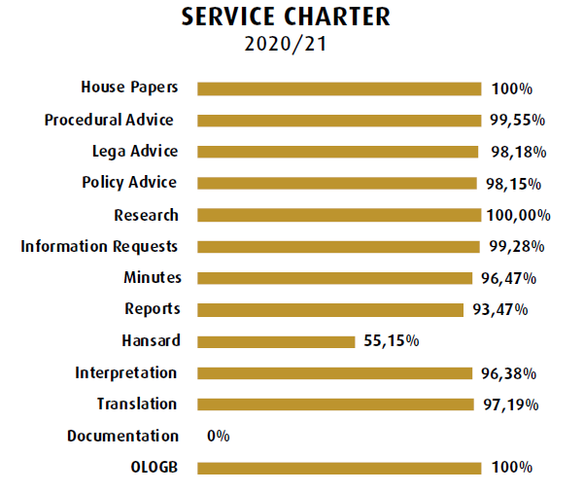
Programme 3: Core Business Service Charter
The following figure shows performance per sub- indicator for the service charter

Slide 25
Programme 3: Core Business
Parliamentary Service | Indicator | Annual Target 2020/21 | Actual performance | Variance | Status | Reasons for variance & mitigation factors
Access to participate | % population having access to participate in parliamentary processes | 16% | 13% | -3% |  | Public Participation activities were impacted by the Covid-19 lockdown conditions
PERFORMANCE TREND
This indicator is measured by an IPSOS survey which gauges public access to participate in the processes of Parliament. This declined by about 3%, mainly as a result of travel restrictions imposed by the national lockdown.

Slide 26
Programme 3: Core Business
Parliamentary Service | Indicator | Annual Target 2020/21 | Actual performance | Variance | Status | Reasons for variance & mitigation factors
Participate in parliamentary activities | % increase in participation in the House and Committee activities | 10% | -2% | -12% |  | Participation in House- and Committee activities were impacted by the Covid-19 lockdown conditions. The performance of -2% is caused by the decline in participation from 28% previously to 26% currently – this constitutes a decrease of 2% in performance for this indicator.
PERFORMANCE TREND
This indicator is measured by an IPSOS survey which gauges public participation in Parliamentary activities. This declined by about 2%, mainly as a result of public participation activities that did not happen because of travel restrictions imposed by the national lockdown.

Slide 27
Programme 4: Support Services
PROGRAMME 4 ANNUAL PERFORMANCE 2020/21
75%
Total indicators: 4
Total Met: 3
Targets Not Met: 1
Support Services
Indicator | Performance
 | 2019/20 | 2020/21
% of population who are aware of the business of Parliament | 23% | 24%
% of universal access | 94,12% | 94,12%
% of clients satisfied with service levels | 69% | 48%
% increase in talent management index | 9% | 9%

Slide 28
Programme 4: Support Services
Parliamentary Service | Indicator | Annual Target 2020/21 | Actual performance | Variance | Status | Reasons for variance & mitigation factors
Participate in parliamentary activities | % of population who are aware of the business of Parliament | 24% | 24% | 0%
PERFORMANCE TREND
Awareness levels of Parliament is consistent across age groups but tends to be much higher among adults with higher levels of education (93% among adults with higher levels of education compared to 63% among adults with no education). Awareness levels are highest in the North West (98%), Eastern Cape (97%) and Gauteng (96%).

Slide 29
Programme 4: Support Services
Parliamentary Service | Indicator | Annual Target 2020/21 | Actual performance | Variance | Status | Reasons for variance & mitigation factors
Participate in parliamentary activities | % of universal access | 94% | 94,12% | +0,12% |  | The marginal over performance was not statistically significant
PERFORMANCE TREND
The average in respect of web and mobile accessibility of systems in Parliament is 94,12%.

Slide 30
Programme 4: Support Services
Parliamentary Service | Indicator | Annual Target 2020/21 | Actual performance | Variance | Status | Reasons for variance & mitigation factors
Participate in parliamentary activities | % clients satisfied with services | 70% | 48% | -22% |  | Facilities Management Services were impacted by lockdown conditions and remote working
PERFORMANCE TREND
The Survey Report was completed and the report received by Parliament. ISSD achieved a satisfaction rate of 48%. Customer satisfaction is defined as the number of customers, or percentage of total customers, whose reported experience with services (Household, Catering, Protection Services, Fleet Management, SHE, Mail Distribution, and Post/Courier Services) exceeds specified satisfaction targets. During the financial year, these services did not operate as normal due to remote working and lockdown conditions.

Slide 31
Programme 4: Support Services
Parliamentary Service | Indicator | Annual Target 2020/21 | Actual performance | Variance | Status | Reasons for variance & mitigation factors
Talent Management Services | % increase in Talent Management Index | 1% | 9% | 8% |  | Performance was boosted by the low turnover rate and faster implementation of the succession planning programme
PERFORMANCE TREND
Increased performance of 8% was achieved as a result of the low turnover rate and faster implementation of succession planning.

Slide 32
Programme 5: Associated Services
This programme is comprised of Direct Charges and consequently does not have any performance indicators.
PERFORMANCE TREND
Members’ Support Services
The objective seeks to review and implement the facilities needs of Members, and to integrate various services into a seamless support service. For the reporting year, services have been provided to Members of Parliament on a daily basis. The average working days to reimburse Members’ claims was 2.16 days for the period under review.
Transfers to Political Parties
All transfers to political parties were processed timeously in accordance with policy.

Slide 33
Part 4 Financial Statement
Overview

Slide 34
Statement of Comparison of Budget and Actual Amounts: Revenue
Annual Appropriation The budget allocation for the annual appropriation was reduced by R195,293m by National Treasure and we received R2,015bn. Statutory Appropriation The budget allocation for the annual appropriation was reduced by R30,683m by National Treasure and we received R476,474m The overall reduction of the budget was R195,293m. Public contributions and donations Parliament received donor funds from European Unions amounting to R26,117m for Deepening Public Participation and Representation, strengthening capacity in law making and oversight, building an efficient and effective legislative sector and to strengthen the sector's capacity to engage, participate in, and oversee international relations. The only condition attached to these funds is the fact that they cannot be used for any other Parliament business and are therefore recognized as revenue on receipt. Own revenue generated – R2,294m (2021): R11,344m (2020) Department revenue decreased significantly compared to prior year due to the National lockdown. Most Staff and Members are working from home and therefore there is less demand for catering services. Also the departments’ accounts to Parliament through use of virtual platforms that do not require catering services. Interest Income – R13,906m (2021):R16,815m (2020) This amount has decrease compared to last year even though there has been more money in the bank , due to cuts on the interest rate compared to prior year.

Slide 35
Statement of Comparison of Budget and Actual Amounts
Expenditure
Line Item | Final Budget R‘000 | Actual Amounts R‘000 | Variance in Amounts R’000 | Variance in percentage
Compensation of employees | 1217,642 | 1,117,091 | 100,551 | 8%
Compensation of members | 476,474 | 510,613 | -34,139 | -7%
Goods and services | 365,493 | 189,470 | 176,023 | 48%
Transfer to non-profit organisations | 500,302 | 495,400 | 4,902 | 1%
Acquisition of Property, plant and equipment | 30,005 | 18,208 | 11,797 | 39%
Purchase of intangible and heritage assets | 328 | 316 | 12 | 4%
Total | 2,590,244 | 2,331,098 | 259,146 | 10%

Slide 36
Narrative on Expenditure Percentage Variance
Expenditure
Line Item | Variance | Reasons for variance | Remedial Actions
Compensation of employees | 8% | The underspending on compensation of employees is due to terminations during the year and delays in filling critical vacant positions as result of suspension of recruitment process as a result of the national lockdown. | The amount will be made available for spending in the next financial year and will relieve the impact of R257m budget cuts for the 2021/22 financial year. Parliament is not required to return to the National Treasury any money appropriated for a particular financial year but not spent in that year in line with section 23(1) of the FMPPLA.
Compensation of members | (7%) | The overspending of 7% is due to the payment of loss of office and exit gratuities to retired/resigned/deceased Members over and above the payment of the salaries and benefits of Members of Parliament. Further National Treasury reduced the initial allocation for Direct Charges by R30 683m. | The overspending was refunded by National Treasury in terms of section 23(4) of the FMPPLA.
Goods and services | 48% | The underspending on goods and services is due to the national lockdown as travel restrictions as precautionary measures were introduced. There have been significant reduction in local travel and no international travelling. There is also significant reduction in items such as printing & stationery, catering and operating lease rentals (non renewal of printing lease contracts) as the majority of employees and Members of Parliament are working remotely from home. | The amount will be made available for spending in the next financial year.

Slide 37
Narrative on Expenditure Percentage Variance
Expenditure
Line Item | % Variance | Reasons for variance | Remedial Actions
Transfer to non-profit organisations | 1% | The underspending of 1% is as result of monies that were withheld from Political Parties that spent some monies in contravention of the policy on transfer to political parties. | Letters were written to parties to provide the reason for non compliance and the responses received were not acceptable, therefore the money will be made available in the next financial year.
Acquisition of Property, plant and equipment | 39% | The underspending on property, plant and equipment is due to delivered assets that were not paid as at year end. Also lockdown restrictions contributed in late delivery of computer assets close to year end and others were delivered after year end. | The amount owed for these assets is accounted for as part of payables from exchange transactions and the underspending will be used to pay for it.
Purchase of intangible and heritage assets | 4%

Slide 38
Overview of Financial Position
Statement of Financial Position
Parliament is in net liability amounting to (R1,480,588b), due to the post medical provision made, for the former members of Parliament and Provincial Legislatures.
During 1999 Parliament approved that the medical aid contribution for former Members of Parliament and Provincial legislatures will be paid by Parliament. There were 820 former members who received the subsidy as at end of the financial year. The actual contribution made by Parliament was R84,372m during the year and is funded from the annual appropriation.
Parliament wrote to National Treasury (NT) on numerous occasions to take over the management and payment of post-retirement medical aid (PRMA) benefit for former Members of Parliament and Provincial Legislatures. National Treasury responded and indicated that National Treasury has limited scope to take over the liability of retired Members as Parliament falls outside the scope of NT’s post retirement medical scheme . On the meeting of the 25th August 2021 National Treasury Officials promised to engage their legal department on the matter and update the new Minister., with the hope of finding a solution.
Parliament’s financial position without the post-retirement medical aid liability will be as per the second Pie chart, and will be in net liability of R145,247m. Included under liabilities are provisions of R102,257m, and R160,293m for Members’ loss of office and exit gratuities respectively which are paid from direct charges. Also includes R116,570m for former Members and Minister’s post travel benefits. An amount of R1,508m (12,530m in prior year) was paid for this benefit during the year and is funded from the annual appropriation.

Slide 39
Statement of Financial Position…continuation
2021
R’000
2020
R’000
Non current - Employee benefit obligation (exclude Finance Leases) | 1,719,686 | 1,697,837
Non-Current liabilities
Post-retirement medical aid plan 1,334,858 1,299,510
The employee benefits relates to the post-retirement medical aid plan for all Members and pensioners who belong to PARMED medical aid (Parliament and Provincial Legislature). Increase of 2% is due to increase in discount rates and increased in number of Members compared to prior year.
Members Gratuity 102,257 89,969
The provision for Members' gratuities is calculated for all current Members of Parliament with service of five years and more assuming termination of service at the reporting date. Liability also includes Members with service of less than 5 years taken into account the probability of some Members leaving before reaching 5 years. It is calculated as 4 months pensionable salary for every five years in service or pro-rata share of the five year period. Pensionable salary is 60% of their total gazetted remuneration package. The increase of 14% is due increase in years of service of Members. Also last year there were significant payments made for the Members who lost their seats.
Exit Gratuity 160,293 166,254
The exit gratuity is payable to relevant eligible Members of Parliament who are Members of Political Office Bearers Pension Fund and who exist the fund before or as a consequence of the 2019 general elections due to amendments made in rules in terms of the Proclamation 48 of 21 July 2016. It is calculated as the difference between the value payable based on new rules and the value payable in terms of old fund rules. This amount is increased by CPI each year until is paid to the Member when they exit the Fund. . The decrease of 4% is due to Members who qualified for the gratuity and paid during the year.

Slide 40
Statement of Financial Position…continuation
2021
R’000
2020
R’000
Non-Current liabilities
Non current - Employee benefit obligation | 1,719,686 | 1,697,837
Post employment Travel Benefit 112,763 132,706
Parliament provide domestic travel benefits to former members, former executives (ministers and deputy ministers) and their spouses. Beneficiaries are given a set travel allocation each calendar year. Any unused allocation does not carry over to the following year. The travel privileges come into effect on the first day following the date on which they relinquish their office, excluding the journeys made when vacating State-owned residences to the places where they intend to settle. The decrease of 15% due to change in assumptions made like net discount rate. Also access was obtained from Home Affairs department for the validation if the beneficiariess were still alive.
Long Service Awards 9,515 9397
The long service awards are for rewarding employees for the years of Service to Parliament, management agreed with organised labour that effective from 01 April 2019, the employees will be rewarded in terms of monetary value. The 1% increase is linked to the increase in number of years in service.

Slide 41
Statement of Financial Position
2021
R’000
2020
R’000
Current assets
.
Current Assets – Only material balances
Overspent statutory appropriation | 34,139 | 22,185
The increase of 54% is due to reduction of the initial allocation by National Treasury of Direct Charges amounting to R30 683m. This amount was refunded by NT in terms of section 23(4) of FMPPLA.
Prepayments | 8,641 | 13,011
Prepayments includes payments) in advance for contingencies, S&T advances, petty cash advances and other prepayments for subscriptions to professional bodies
Contingencies, S&T advances and petty decreased due enforcement of the S&T policy which provides that “the employees will forfeit the right to claim travel expenses if its not done within 20 working days after the trip. Also advances will be deducted from employees if travel documents are not submitted within 20 working days after the trip”.
Prepaid expenses relates to portion of the payments made relating to periods in the next financial year, such as annual subscriptions and membership fees. The decrease of 34% is due to prepayment in the prior year for open tickets which were not used amounting to R5,704m and these monies were refunded during this year. The membership of employees to professional bodies increased due to increase in subscription prices.
There were no prepayments to DIRCO this year as there was no international travelling.

Slide 42
Statement of Financial Position
2021
R’000
2020
R’000
Cash and cash equivalents | 326,140 | 113,892
Non- Current assets
The main purpose of the cash is to fund Parliament business and not for investment. The cash from National Treasury is requested monthly for use. Parliament submits requisitions for drawings to National Treasury monthly based on the annual budget and cash flow projections. The 186% increase of in cash and cash equivalents as compared to last year is attributable to low spending during the year as result of national lockdown.
Property, plant and equipment (PPE) | 62,907 | 70,319
This relates to furniture, equipment, motor vehicles, computer equipment and library books.
The decrease of 11% is due to less additions purchases compared to prior year and increase in depreciation for the year. New computer equipment were procured for the Members after 2019 general elections.
Intangible assets | 6,965 | 10,400
The decrease of 33% as compared to prior year is mainly attributable less purchases of software purchased more amortization for the financial year..
Heritage assets | 55,493 | 55,437
Heritage asset is defined as an asset that has a cultural, environmental, historical, natural, scientific, technological or artistic significance, and are held and preserved indefinitely for the benefit of present and future generations. The change is minimal due to the fact that heritage assets are not depreciated as they have long economic life and few additions.

Slide 43
Statement of Financial Position …continuation
2021
R’000
2020
R’000
Current liabilities
Finance lease obligations (Current plus Non current) | 5,898 | 15,823
Finance lease liability consists of the cell phone, tables and modems contracts. The average lease term is 2 years. The decrease of 63% is due the significant increase of the lease contracts for Members of Parliament last year for cell phones and laptops/tablets contracts on their behalf which is reducing with amortization.
Payables from exchange transactions | 42,258 | 38,627
These are all monies owed to the service providers for goods and services provided. The 9% increase is due to services rendered close to year end that were not paid and invoices not provided by some service providers for invoices listed on their statements.
Payables from non-exchange transactions | 5,187 | 3,585
Payables from non-exchange transactions consists of disability support to provided political parties represented in Parliament in respect of Members with disabilities. The increase of 45% is due to the disability support that was not paid as at year end.
Current employee benefits | 188,797 | 186,348
Current employee benefits relates to short term benefits owed to staff for the services rendered such as provisions for leave liability, performance bonus provision, salary savings, long service awards and overtime worked and that will be paid during the following year and any other monies owed to staff for services rendered. This also includes Members’ benefits for gratuities, current post medical benefits and current portion of travel benefits.
Employee benefits 95,274 76,291
For Staff benefits there was increase of 24% due to increase in leave that accrues to Staff than the leave taken. Employees will forfeit the leave days by end of October 2021 if the days are not taken.

Slide 44
Statement of Financial Position …continuation
2021
R’000
2020
R’000
Current liabilities
Current employee benefits (continue | 188,797 | 186,348
Members current benefits 93,523 110,057
Decreased due to less amounts that are expected to be paid the following year for post medical and travel benefits as per actuarial valuation. Less travelling is expected to occur in the following year due to Covid-19 pandemic.
Provisions | 16,966 | 5,339
The provision relates to the legal cases where Parliament is liable to pay costs however the bill of costs have not yet been granted. The amount is estimated based on Parliament experience regarding the cost normally paid for the same matters. The increase of 218% is due to slow response from State Attorney in providing reconciliation and billing Parliament due to lock down as the State Attorney Staff did not have tools of trade at the beginning of lockdown to be able to work remotely and were goingg to office on a rotational basis.

Slide 45
Disclosures
2021
R’000
2020
R’000
Irregular and Fruitless & wasteful Expenditure
Fruitless and wasteful expenditure | 51 | 40
The case on interest incurred and are with the Governance Committee for Investigation and recommendation on remedial actions.
Operating Leases | 1,119 | 3,861
This relates to rentals payable by Parliament for office equipment and rental of Parliamentary Democracy Offices (PDO) . Leases are negotiated for an average term of three years and rentals are fixed for the entire lease term. The decrease of 71% is due to fact that the lease term has reduced over the financial year and Parliament did not enter into new lease contracts, as most Staff are working from home and not using the Printers.
Capital Commitments | 2,909 | 2,603
This committed expenditure relates to property, plant and equipment and will be financed by existing cash resources. The increase of 11% is due to committed funds for procurement of ICT equipment's that were not delivered by yearend.
Contingent Liabilities - Litigations | 42,609 | 11,500
The following amounts are in respect of pending claims against Parliament. The increase is mainly due to the Nehawu case for non payment of performance bonus & notch increase and the EPMO terminated contracts. All these cases are with the CCMA.

Slide 46
Conclusion
A high level of performance was maintained despite challenges relating to the COVID-19 pandemic and declining operational budgets.
Strategic prioritisation of scarce resources has been embedded in the planning processes of Parliament to minimise disruption of performance levels and ensure institutional sustainability.
Constrained, declining operational budgets still remain an institutional risk, which highlights the need for the 6th Parliament to continue to strategically prioritise and use our resources effectively.
The 7th clean audit outcome affirms Parliament’s strong internal control environment and commitment to clean governance.

Slide 47
Thank you

