Slide 1
Presentation to the Parliamentary Portfolio Committee on Communications Annual Report 2020/21 Dr Keabetswe Modimoeng Chairperson 03 November 2021

Slide 2
Presentation Outline
Part A: Strategic Overview
Part B: Performance Information
Part C: Governance
Part D: Human Resources Management
Part E: Complaints and Compliance Committee
Part F: Financial Performance

Slide 3
PART A: General Information

Slide 4
Strategic Overview
2. MISSION
To ensure that all South Africans have access to a wide range
of high-quality communication services at affordable prices
1. VISION
An inclusive digital society
3. VALUES
All ICASA’s regulatory activities are centred on five core values, which are innovation, collaboration, accountability, results-driven and stakeholder-centric

Slide 5
Legislative and Other Mandates
Legislative Mandates
Policy Mandates
The Constitution of the Republic of South Africa, 1996
The Independent Communications Authority Act of No. 13 of 2000
The Broadcasting Act No.4 of 1999
The Electronic Communications Act No. 36 of 2005
The Postal Services Act No. 124 of 1998
The Promotion of Administrative Justice Act No.3 of 2000
Outcome 12: Providing an Efficient, Effective and Development-Oriented Public Service
Outcome 14: Providing a diverse, socially cohesive society with a common national identity

Slide 6
Organisational Structure
ICASA COUNCIL
COMMITTEES
Audit, Risk, Ethics & Disclosure Committee (AREDC), HR & REMCO, IT Review Committee (ITRC), Complaints & Compliance Committee (CCC)
Chief Executive Officer
Executive Personal Assistant
Strategy & Programme Management Office
Risk & Compliance Office
Chief Financial Officer
Chief Information Officer
Chief Audit Executive
Executive: Human Resources
Executive: Corporate Service
Executive: Legal & CCC
Chief Operating Officer
Executive: Regions & Consumer Affairs
Executive: Licensing & Compliance
Executive: Engineering & Technology
Executive: Policy, Research & Analysis

Slide 7
PART B: Performance Information

Slide 8
Auditor General’s Findings on Predetermined Objectives
The Auditor General of South Africa audited ICASA’s performance information for the 2020/21FY and made the following finding on the Programme it selected for auditing (being Programme 4: Engineering & Technology):
“I did not identify any material findings on the usefulness and reliability of the reported performance information of this Programme”
Source: AGSA, ICASA Annual Report 2019/21

Slide 9
Service Delivery Environment
The Authority’s performance was attained against backdrop of service delivery environmental factors which supported and also challenged the achievement of targets
Political
Economic
Social
Issuing of the high demand spectrum was supported by further funding received from National Treasury
Further, a proposal was submitted to National Treasury and DCDT on an alternative optimal funding model for the Authority
Licensing of the IMT spectrum and the WOAN was suspended pursuant to a court interdict
Low levels of GDP growth were exacerbated by the advent of COVID – 19
The Authority played a critical role by ensuring an adaptive and flexible regulatory regime
COVID-19 presented a challenge to the Authority’s operations especially as regards to conducting of public hearings. Some of the regulatory processes and compliance requirements had to be suspended
Technological
Legal
Environmental (Nature)
COVID – 19 highlighted the urgency to address digital inequality. The Authority responded by issuing temporary high demand spectrum
The inherent risk of litigation against the Authority’s execution of its mandate materialised: the Authority was interdicted from proceeding with the licensing of HDS and WOAN
Concerns pertaining to human exposure to Electromagnetic Fields (EMF) Radiation were elevated due to widespread misinformation that linked 5G to the outbreak of COVID-19

Slide 10
Organisational Environment
The Authority’s performance on predetermined objectives was attained amid organisational environment factors which either supported or challenged achievement of targets
Structure
Strategy
Systems
The Authority began the year with the finalisation of organisational structure review process which began in 2019. Some Councillors term of office came to an end and new members of Council were sworn-in. By year-end one Councillor had resigned
Due to the COVID-19 pandemic, teleworking became the new normal. Some human resource policies had to be revised to accommodate the COVID – 19 demands. Systems had to be put in place to mitigate against COVID-19 infections among staff members.
The Authority’s Strategic Plan had to be reviewed to take into account the effect of COVID-19. Some projects had to be removed from the APP. COVID-19 interventions had to be developed in line with the DPME Circular 2 of 2020
Skills/Staff
Style of Leadership
Shared Values
COVID – 19 challenged the Authority’s style of leadership. The Authority’s Disaster Management Committee and Crises Management Committee had to be activated to allow leadership to consult on an ongoing basis on a variety of matters bred by the National State of Disaster. The Authority adjusted to disaster levels that government put out from time to time
Organisational shared values allowed staff to remain resilient amid the challenging environment exacerbated by COVID-19
The moratorium on recruitment continued to be in force and the Authority resorted to filling of critical positions only

Slide 11
Key Policy Developments and Legislative Changes
There were several policy developments and legislative changes which the Authority had to take into account
Electronic Communications, Postal and Broadcasting Directions
Draft White Paper on Audio and Audio-Visual Content Services Policy Framework: A New Vision for South African 2020
Minister of Communications and Digital Technologies amended the Electronic Communications, Postal and Broadcasting Directions issued under regulations 10(8) of the Disaster Management Act, 2002 (Act No.57 of 2002) (“Directions”) to facilitate the availability and use of the digital technologies to combat the spread of COVID-19 in South Africa
On 9 October 2020, the Department of Communications and Digital Technologies (DCDT) published the draft White Paper on Audio and Audio-visual Content Services Policy Framework for public comment in the Government Gazette No. 43797 to create an enabling environment for the provision of inclusive audio and audio-visual content services (AAVCS) to all South Africans in a way that promotes social-economic development and investment.

Slide 12
Key Policy Developments and Legislative Changes
The Authority’s performance was supported and or challenged by several policy developments and legislative changes
Policy Direction on the Introduction of Digital Sound Broadcasting in South Africa
The Draft Rapid Deployment Policy
The Policy Direction on the Introduction of Digital Sound Broadcasting in South Africa (DSB Policy) was published on 10 July 2020 in Government Gazette 43524 by the DCDT to determine priorities for the introduction of DSB networks and services in South Africa.
On 22 July 2020, the DCDT published the Proposed Policy and Policy Direction on Rapid Deployment of Electronic Communication Networks and Facilities (“the Draft Rapid Deployment Policy”) in Government Gazette 43537 to solicit comments on the DCDT’s intention to issue the policy and policy direction to the Authority in terms of section 21 read with section 3 (2) of the ECA

Slide 13
Impact Statement and Outcomes
The Authority maintained its Impact Statement and Outcomes during the year under review
Impact Statement | Access for all South Africans to a variety of affordable and reliable communication services for inclusive economic growth
Outcome | Outcome Indicator | Baseline | Target
Access to quality broadband Services increased | Average download speed | 15 mbps | 50 mbps
Status of Social Cohesion (Inclusive of Diversity of Views) enhanced | Percentage of status of social cohesion (inclusive of diversity of views) enhanced | - | 50%
Rights of Consumers Protected | Level of consumer rights protected | - | 5
Competition in the ICT sector promoted | Number of pro-competitive regulatory interventions | 3 | 15
Organisational service delivery maintained | Percentage of organisational service delivery maintained | 91% | 91%

Slide 14
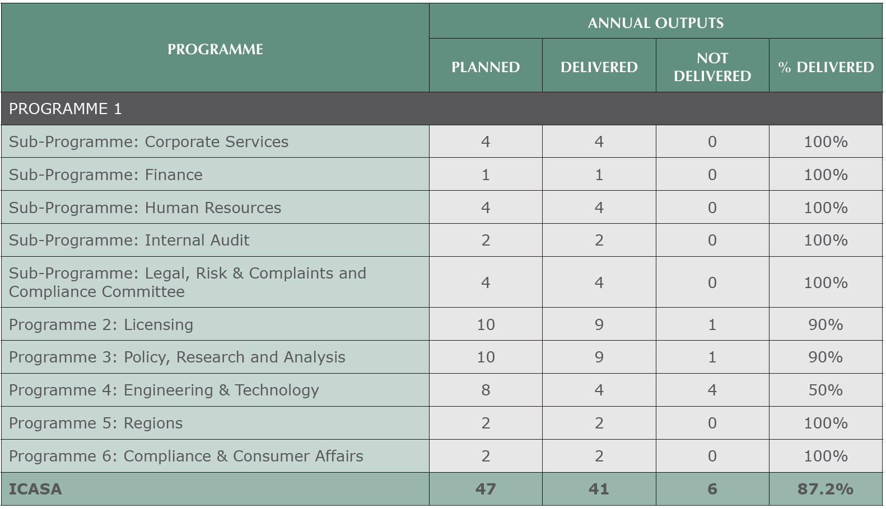
Performance On Predetermined Objectives
The Authority planned 47 outputs, 41 of which were achieved whilst 6 were not achieved - the performance translates to 87.2%

Slide 15
Outputs Contribution towards Outcomes
Outcome | Contributing Output
Access to Quality Broadband Services | Process for the assignment of high demand spectrum completed Recommendations towards enabling SA’s uptake of 5G technologies Certification of the Secondary Geolocation Spectrum Database providers 4 provinces on quality-of-service monitoring on voice and data
Social Cohesion and Diversity of Views | Production of findings document on must carry regulations Broadcasting of national sporting events regulations reviewed Regulations on municipal elections developed Process for licensing of commercial sound broadcasting services in Northern Cape initiated (ITA published) 50% of process to licence digital community television broadcasting on MUX1 completed 100% of the process to license community sound broadcasting services completed
Promotion of Competition | 50% of Equipment Authorisations Regulations process completed Processes for the amendment of the Standard Terms and Conditions Regulations for Class Licenses Amendment of Processes and Procedures Regulations for Class Licenses and Licensing of digital community television broadcasting services on MUX 1 have all been completed 50% of the process for the licensing of the Individual Electronic Communications Network Service completed Finding Document on the mobile broadband services market inquiry produced

Slide 16
Outputs Contribution towards Outcomes (cont…)
Outcome | Contributing Output
Protection of Consumers | SAPO tariffs reviewed Regulations on pricing of reserved postal services developed Draft regulations on customer care in the postal sector developed Discussion document on regulation relating to the definition of advertising and the regulation of Infomercials and Programme Sponsorship in Respect of Broadcasting Activities produced Bi-annual tariff analysis undertaken 99.5% of the radio frequency cases reported resolved within 30 working days 5559 compliance monitoring inspections completed 95% of the complaints received resolved Customer satisfaction level of seventy-seven percent (77%) achieved against a target of seventy percent (70%)
Organisation Service Delivery | Nine (9) affiliations to international bodies across the postal, broadcasting and telecom sectors maintained Staff vacancy rate reduced from 7% to 4.2% (notwithstanding the moratorium) Implementation of the workplace skills plan as developed in 2019/20

Slide 17
Performance Information: COVID-19 Interventions

Slide 18
Intervention | Immediate Outcome
Programme 1: Administration
Sub-programme: Corporate Services
Rental of 60 laptops and procurement of 35 Wi-Fi network adapter cards | Continued provision of ICT services to consumers
Development of a Workplace Plan to make the workplace COVID-19 ready | Compliance to Disaster Management Regulations & Guidelines
Procurement of PPE, cleaning, hygiene materials, equipment, consumables and related services (e.g. office disinfection) | Compliance to Disaster Management Regulations & Guidelines
Implementation of Workplace protocols | Compliance to Disaster Management Regulations & Guidelines
Sub-programme: Finance
Introduction of an emailing system by SCM for tender submissions Provision of data to Finance essential staff | Collection and transfer of tender bids
Sub-Programme: Human Resources
Development and Amendments of Human Resources Policies and procedures to follow COVID -19 Regulations | No COVID – 19 misconduct cases
Developed an employee response programme through Careway’s main contract on the Employee Wellness Services | Emergency medical response and life risk solution provided by Careways for ICASA employees
Sub-Programme: Legal Risk & CCC
Drafting the ICT National State of Disaster Regulations and amendments thereto. | Continued provision of ICT services to consumers

Slide 19
COVID – 19 Interventions (cont…)
Intervention | Immediate Outcome
Programme 2: Licensing
Issued 5 special event licences (service and radio frequency spectrum licences) | Communities able to get Covid-19 information through radio
Authorised educational TV channels for SABC, On-Digital Media and MultiChoice | Learners able to get educational programmes during lockdown.
Issued 5 temporary Radio Frequency Spectrum licences in the high demand spectrum bands, including waiver of spectrum acquisition fees | Access to broadband services during Covid-19 National Lockdown, including schools’ internet connectivity
Issued 3 Authorisations for the use of Television Whites Spaces | Access to broadband services during Covid-19 National Lockdown, in the under-serviced areas
Developed and published the National ICT National State of Disaster Regulations | Regulatory Relief to Licensees during Covid-19 National Lockdown. Provided framework for temporary licensing of IMT Spectrum
Programme 3: Policy Research & Analysis
Interventions on 369 tariff notifications that were received and processed by the Authority. | Reduced prices
Intervention on 28 tariff notifications on price reduction. | Reduced prices

Slide 20
Transfer Payments, Conditional Grants, Donor Funds, Capital Investments
Transfer Payments
Conditional Grants
Donor Funds and Capital Investments
None
R 459 019 000 was received for the four quarters from the DCDT
R 84 700 000 was received from National Treasury as an additional grant allocated towards the auction of the High Demand Spectrum and related projects

Slide 21
PARTC: Governance

Slide 22
Council
Councillor | Date Appointed | Meetings Attended
Dr. Keabetswe Modimoeng (Chairperson) | 15/09/2020 | 22
Palesa Kadi | 26/09/2017 | 35
Yolisa Kedama | 15/09/2020 | 22
Dr. Charles Lewis | 24/08/2020 | 22
Zolani Kgosietsile Matthews | 09/07/2020 | 21
Adv. Luthando Simphiwe Mkumatela | 01/09/2020 | 19
Adv. Dimakatso Qocha | 21/09/2017 | 35
Thembeka Semane | 01/02/2018 | 35
Peter Zimri | 24/08/2020 | 22

Slide 23
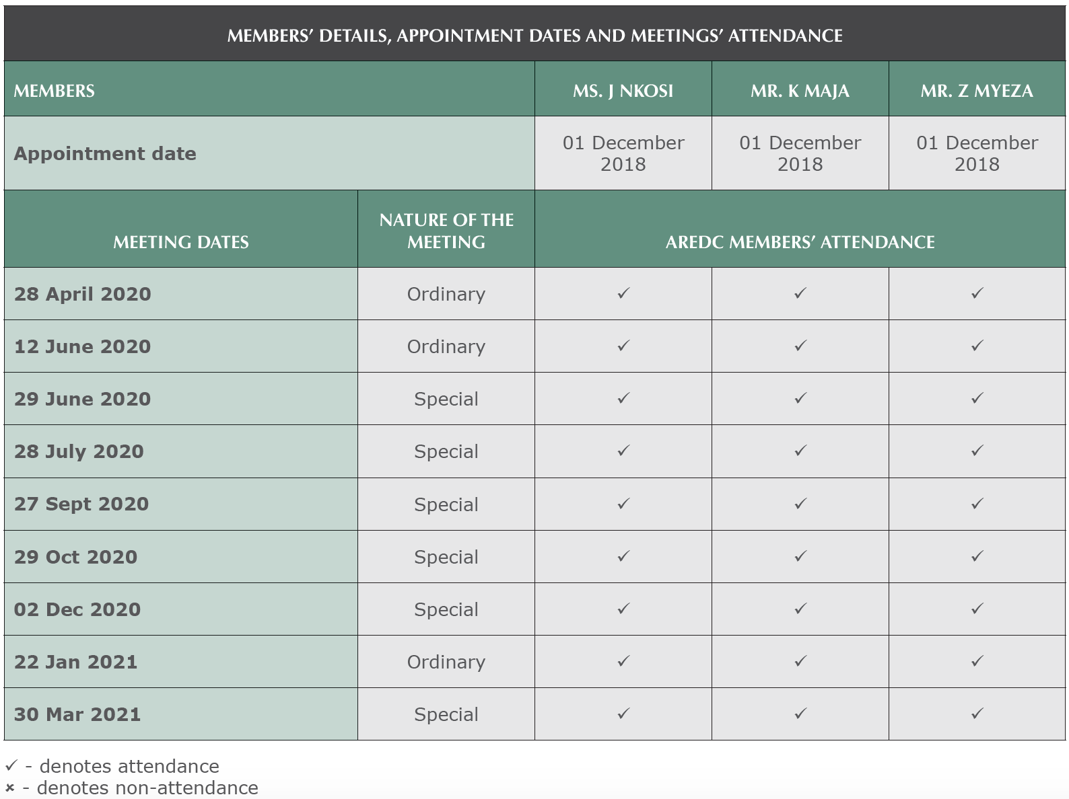
Audit Risk Disclosure & Ethics Committee

Slide 24
HR & Remuneration Committee

Slide 25
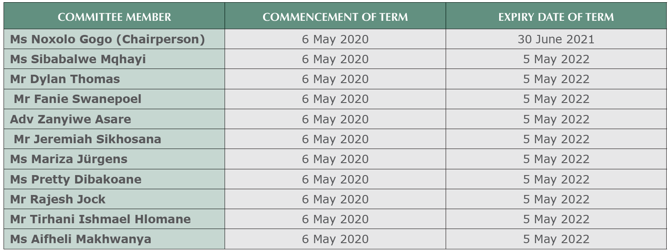
Consumer Advisory Panel

Slide 26
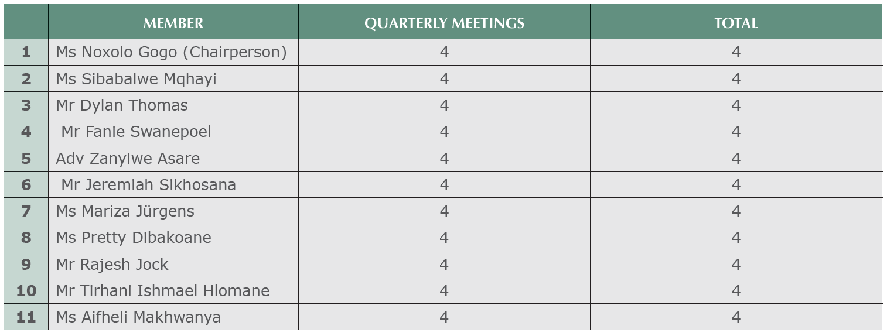
Consumer Advisory Panel meetings attended

Slide 27
PART D: Human Resources Management

Slide 28
Staff Complement

Slide 29
Personnel Costs

Slide 30
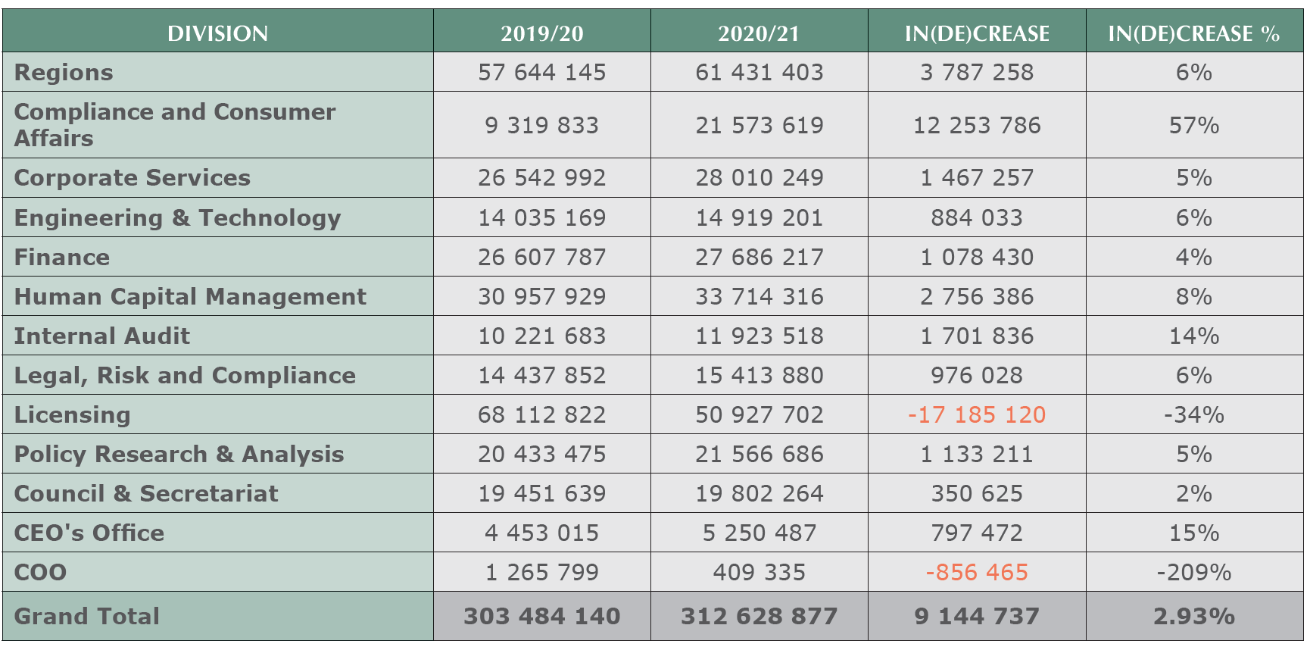
Divisional Staff Costs

Slide 31
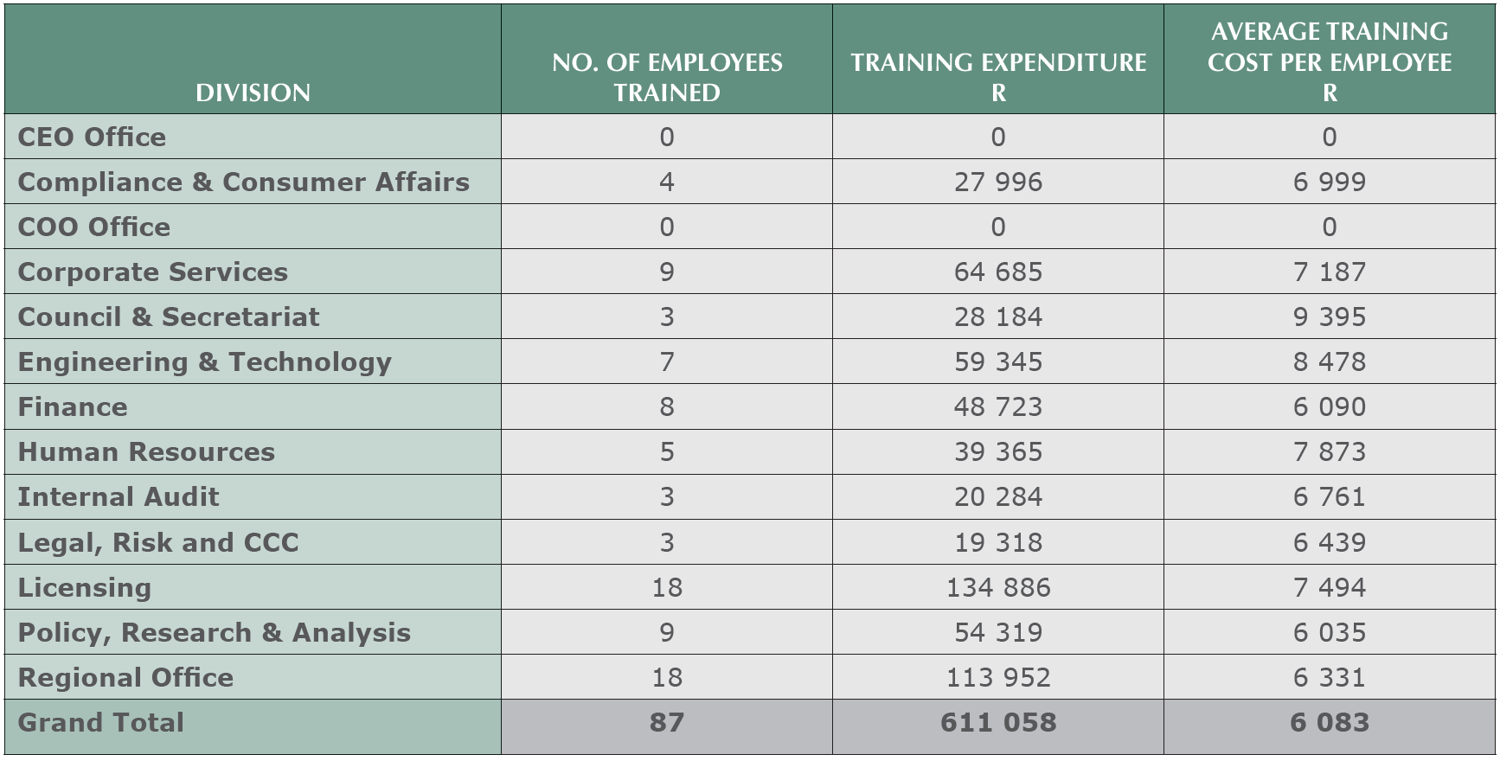
Employees Training Costs

Slide 32
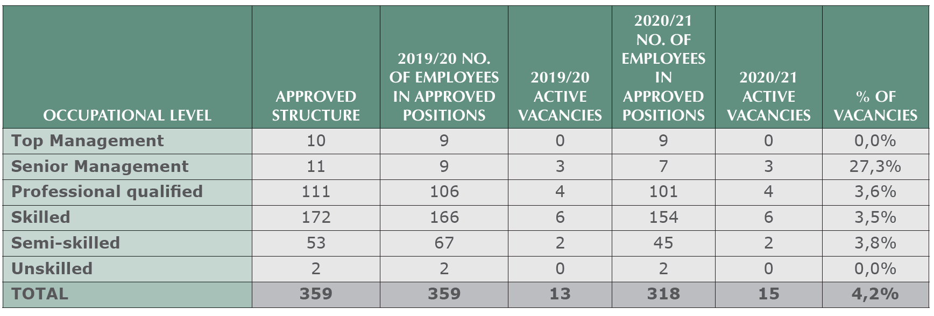
Headcount and Vacancies per Occupational Level

Slide 33
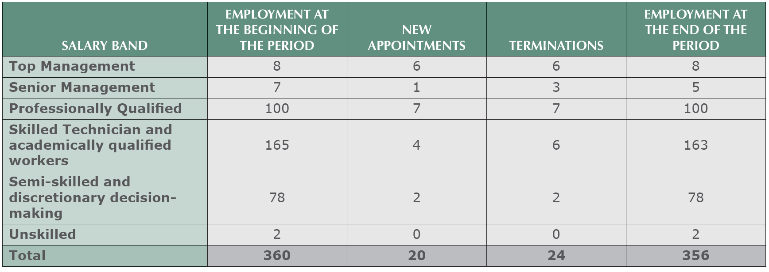
Employment Changes

Slide 34
Reasons for Staff Attrition

Slide 35
Labour Relations: Misconduct and Disciplinary Action

Slide 36
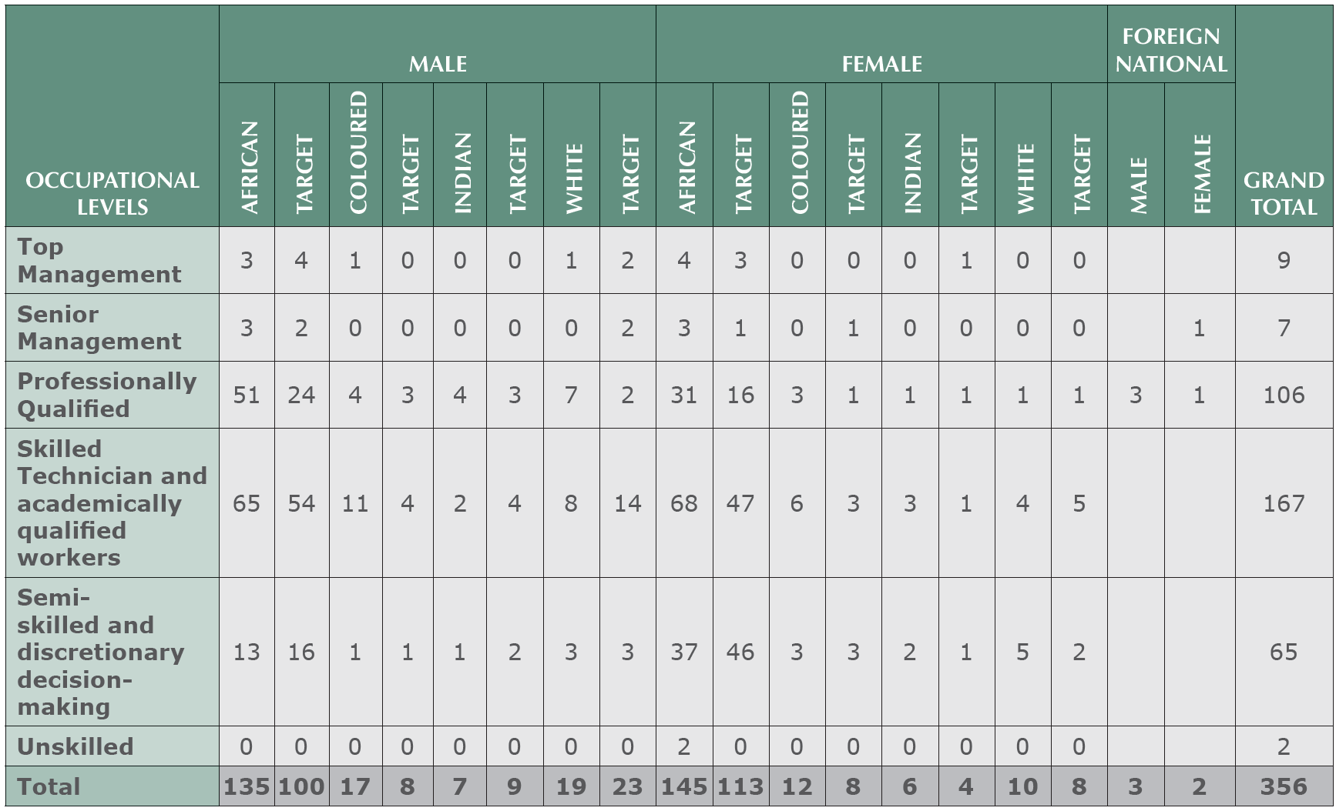
Employment Equity

Slide 37
Employees Living with Disability per Gender

Slide 38
PART E: Complaints & Compliance Committee

Slide 39
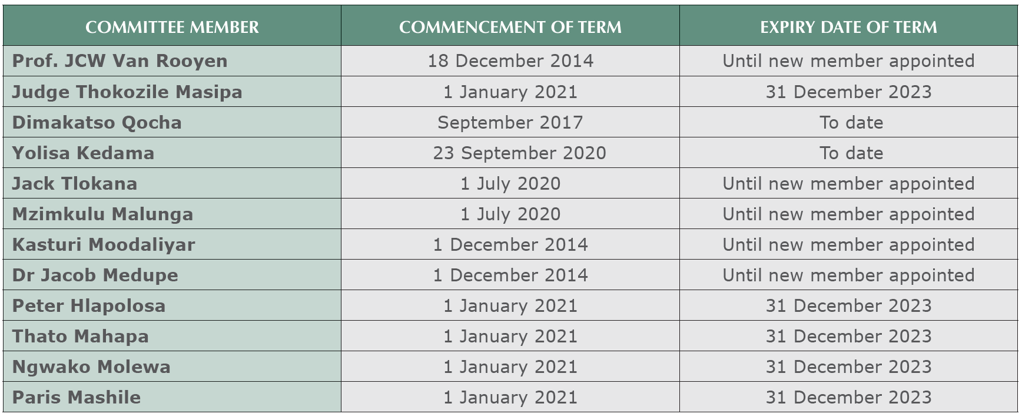
Terms of Office _CCC Members

Slide 40
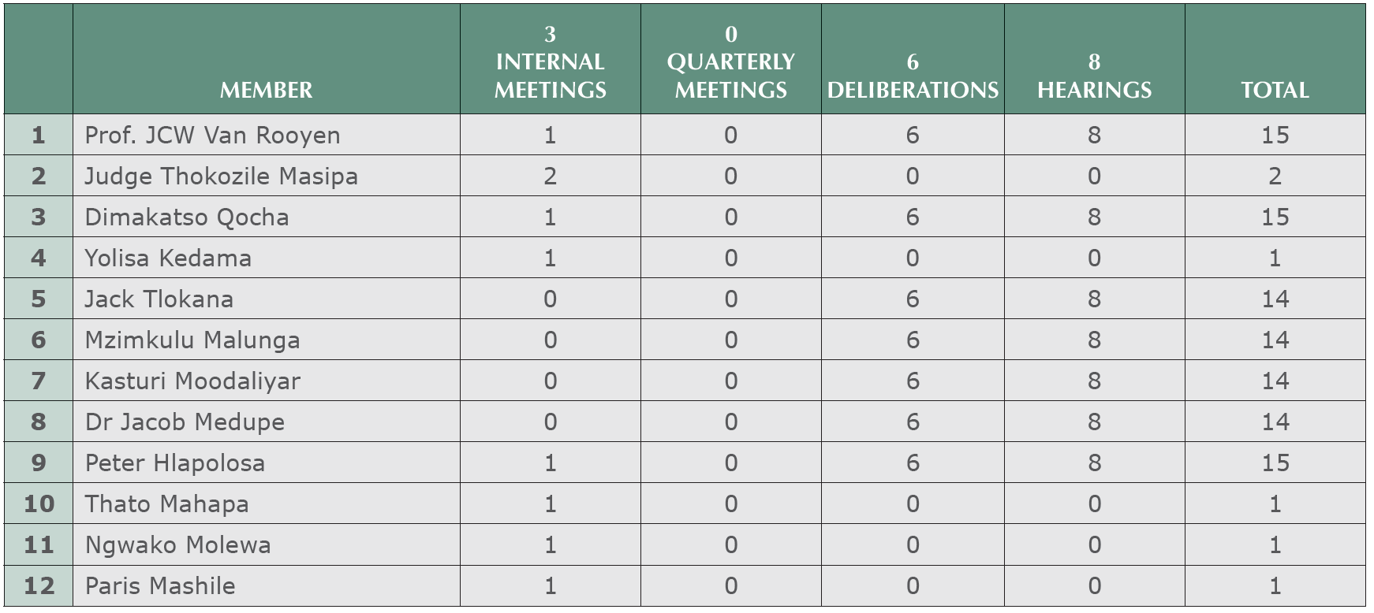
No. of Hearings and Deliberations

Slide 41
Number of Cases Adjudicated

Slide 42
PART F: Financial Performance as at 31 March 2021

Slide 43
Auditor General’s Findings
Audit Outcome of ICASA
Improvement over 3 years in the ICASA non compliance areas
Types of audit outcomes
Financial audit outcomes over 3 years
Unqualified with no findings
Unqualified with findings
Qualified with findings
Adverse with findings
Disclaimed with findings
2020-21
2019-20
2018-19
Non compliance Paragraphs | 2020-21 | 2019-20 | 2018-19
AFS |  |  | X
SCM |  | X | X
AOPO |  |  | X
OTHER COMPLIANCE | X | X | X
Source: Auditor General - ICASA Audit Report 2020/21FY

Slide 44
Auditor General’s Findings
Financial year | 2020/21 FY | 2019/20 FY
Audit Opinion | Unqualified | Unqualified
Material findings | Yes | Yes
Expenditure Management | Effective and appropriate steps were not taken to prevent irregular expenditure of R947 768 | Effective and appropriate steps were not taken to prevent irregular expenditure of R3 369 931
 | Payments were not made within 30 days or an agreed period after receipt of an invoice, as required by treasury regulation 8.2.3
Consequence Management | n/a | Disciplinary steps were not taken against some of the officials who incurred or permitted irregular expenditure and fruitless and wasteful expenditure.
Procurement and contract management | n/a | Some goods and services with a transaction value below R500 000 were procured without obtaining the required price quotations.

Slide 45
Statement of Financial Position
 | Notes | 2021 R | 2020 R
Assets
Current Assets
Inventories | 7 | 505 885 | 636 895
Operating lease asset | 5 | 3 644 046 | 4 808 794
Receivables from exchange transactions | 8 | 10 801 373 | 8 563 400
Receivables from non‑exchange transactions | 9 | 971 383 299 | 928 587 527
Prepayments | 6 | 4 374 035 | 6 664 049
Cash and cash equivalents | 10 | 489 728 765 | 343 149 899
 |  | 1 480 437 403 | 1 292 410 564
Non‑Current Assets
Property, plant and equipment | 3 | 109 363 404 | 123 327 180
Intangible assets | 4 | 23 026 987 | 23 019 208
 |  | 132 390 391 | 146 346 388
Total Assets |  | 1 612 827 794 | 1 438 756 952

Slide 46
Statement of Financial Position
 | Notes | 2021 R | 2020 R
Liabilities
Current Liabilities
Finance lease obligation | 11 | 391 263 | 394 598
Payables from exchange transactions | 14 | 37 960 422 | 32 836 545
Taxes and transfers payable (non‑exchange) | 15 | 3 374 575 | -
National Revenue Fund Payables | 16 | 1 233 099 345 | 1 202 190 196
Unspent conditional grants and receipts | 12 | 112 209 788 | 37 699 839
Provisions | 13 | 38 112 274 | 17 415 810
 |  | 1 425 147 667 | 1 290 536 988

Slide 47
Statement of Financial Position
 | Notes | 2021 R | 2020 R
Non‑Current Liabilities
Finance lease obligation | 11 | 130 068 | 521 528
Operating lease liability | 5 | 19 902 336 | 15 634 533
Provisions | 13 | 2 513 052 | 2 339 688
 |  | 22 545 456 | 18 495 749
Total Liabilities |  | 1 447 693 123 | 1 309 032 737
Net Assets |  | 165 134 671 | 129 724 215
Accumulated surplus |  | 165 134 671 | 129 724 846
Total Net Assets |  | 165 134 671 | 165 134 671

Slide 48
Statement of Financial Performance
 | Notes | 2021 R | 2020 R
Revenue
Revenue from exchange transactions
Other income | 19 | 9 774 279 | 12 099 159
Revenue from non‑exchange transactions
Transfer revenue
Revenue from non‑exchange transactions | 20 | 459 019 000 | 452 645 000
Other revenue from non‑exchange transactions | 17 | 10 758 657 | 3 846 018
Total revenue from non‑exchange transactions |  | 469 777 657 | 456 491 018
Total revenue |  | 479 551 936 | 468 590 177
Expenditure
Employee related costs | 21 | 312 628 877 | 308 425 721
Depreciation and amortisation | 22 | 18 716 601 | 20 449 318
Impairment Loss | 23 | - | 88 039
Finance costs | 24 | 240 725 | 276 985
Lease rentals on operating lease | 18 | 38 501 063 | 36 401 193
General expenses | 25 | 67 015 498 | 95 250 765
Repairs and maintenance | 26 | 3 664 772 | 4 193 286
Total expenditure |  | 440 767 536 | 465 085 307
Surplus for the year |  | 38 784 400 | 3 504 870

Slide 49
Statement of Changes in Assets
 | Accumulated surplus R | Total net assets R
Opening balance as previously reported | 126 177 249 | 126 177 249
Adjustments
Correction of errors | 42 727 | 42 727
Balance at 01 April 2019 as restated* | 126 219 976 | 126 219 976
Changes in net assets
(Deficit) surplus for the year | 3 504 870 | 3 504 870
Total changes | 3 504 870 | 3 504 870
Opening balance as previously reported | 129 724 846 | 129 724 846
Adjustments
Correction of errors | (3 374 575) | (3 374 575)
Restated* Balance at 01 April 2020 as restated* | 126 350 271 | 126 350 271
Changes in net assets
(Deficit) surplus for the year | 38 784 400 | 38 784 400
Total changes | 38 784 400 | 38 784 400
Balance at 31 March 2021 | 165 134 671 | 165 134 671

Slide 50
Cash Flows from Operating Activities
 | Notes | 2021 R | 2020 R
Cash flows from operating activities
Receipts
Finance income |  | 9 774 279 | 11 646 719
Cash received from Department of Communications and Digital Technologies |  | 543 719 000 | 452 645 000
Other receipts |  | 568 606 | 589 494
Cash received by Administered Revenue for NRF |  | 2 147 900 716 | 1 491 098 095
 |  | 2 701 962 601 | 1 955 979 308
Payments
Employee costs |  | (291 416 131) | (295 987 768)
Suppliers |  | (95 805 344) | (136 660 318)
Finance costs |  | (10 717) | (1 070)
Cash paid by Administered Revenue for NRF |  | (2 159 786 003) | (1 643 512 773)
 |  | (2 547 018 195) | (2 076 161 929)
Net cash flows from operating activities | 28 | 154 944 406 | (120 182 621)
Cash flows from investing activities
Purchase of property, plant and equipment | 3 | (3 213 752) | (5 639 136)
Purchase of other intangible assets | 4 | (5 038 901) | (2 533 672)
Net cash flows from investing activities |  | (8 252 653) | (8 172 808)
Cash flows from financing activities
Finance lease payments |  | (112 887) | (285 319)
Net increase/(decrease) in cash and cash equivalents |  | 146 578 866 | (128 640 748)
Cash and cash equivalents at the beginning of the year |  | 343 149 899 | 471 790 647
Cash and cash equivalents at the end of the year | 10 | 489 728 765 | 343 149 899

Slide 51
Comparison of Budget and Actual Amounts
 | Approved budget | Adjustments | Final Budget | Actual amounts on comparable basis | Difference between final budget and actual | Reference
Revenue
Revenue from exchange transactions
Interest received ‑ investment | 25 500 000 | - | 25 500 000 | 9 774 279 | (15 725 721) | 39
Revenue from non‑exchange transactions
Government grants & subsidies | 40 956 363 | - | 40 956 363 | 10 190 051 | (30 766 312) | 39
Funding from the Department of Communications and Digital Technologies | 477 721 000 | - | 477 721 000 | 459 019 000 | (18 702 000) | 39
Other Revenue from Non‑exchange transactions | - | - | - | 568 606 | 568 606 | 39
Total revenue from non‑exchange transactions | 518 677 363 | - | 518 677 363 | 469 777 657 | (48 899 706)
Expenditure
Personnel | (361 370 636) | - | (361 370 636) | (313 527 579) | 47 843 057 | 39
Depreciation and amortisation | (22 426 046) | - | (22 426 046) | (18 819 909) | 3 606 137 | 39
Finance costs | (803) | - | (803) | (240 725) | (239 922) | 39
Lease rentals on operating lease | (54 445 314) | - | (54 445 314) | (38 677 972) | 15 767 342 | 39
General Expenses | (48 346 287) | - | (48 346 287) | (67 036 414) | (18 690 127) | 39
Repairs and maintenance | (1 436 848) | - | (1 436 848) | (3 636 571) | (2 199 723) | 39
Total expenditure | (488 025 934) | - | (488 025 934) | (441 939 170) | 46 086 764
Surplus before taxation | 56 151 429 | - | 56 151 429 | 37 612 766 | (18 538 663)
Actual Amount on Comparable Basis as Presented in the Budget and Actual Comparative Statement | 56 151 429 | - | 56 151 429 | 37 612 766 | (18 538 663)

Slide 52
Material Differences Between the Budget and Actual Amounts
Item | Descriptor
Other income | The authority did not have sufficient cash reserves to invest during the year
Other revenue from non-exchange transactions | The deferred grant is realized when capital expenditure is incurred. CAPEX has reduced in the current year.
Personnel | The reduction in expenditure is due the high rate of vacancies.
Depreciation and amortisation | The reduction is due to the lack of assets acquisitions during the year
Finance costs | The increased expense is due to the unwinding of Dismantling and Restoration costs
Repairs and maintenance | The overspending is due increased maintenance cost of systems.
General Expenses | The overspending was as a result of an increase in legal fees due increased number of review applications.
Lease rentals and operating lease | The underspending is due to delays experienced in the finalization of the computer rental contract

Slide 53
Thank You

