Slide 1
Portfolio Committee on Health
Financial and Fiscal Commission
10 November 2021

Slide 2
1. Introduction
The Financial and Fiscal Commission is a constitutional institution established under Chapter 13: Finance, Sections 220-222 of the Constitution, which makes recommendations envisaged in the following sections of the Constitution; to Parliament, provincial legislatures and any other authorities determined by national legislation:
s214(2) Equitable shares and allocations of revenue;
s218(2) Government guarantees;
s228(2)(b) Provincial taxes;
s229(5) Municipal fiscal powers and functions;
s230(2) Provincial loans; and
s230A(2) Municipal loans.
All legislations referred in these sections “may be enacted only after” any “recommendations of the Financial and Fiscal Commission have been considered”.
This submission is in response to the invitation by the Portfolio Committee to brief the Committee on its analysis on the National Department of Health, Provincial Departments and entities (Health Sector) annual reports for 2020/21 financial year and also on recommendations made by the FFC to the department.

Slide 3
2. Current Health issues

Slide 4
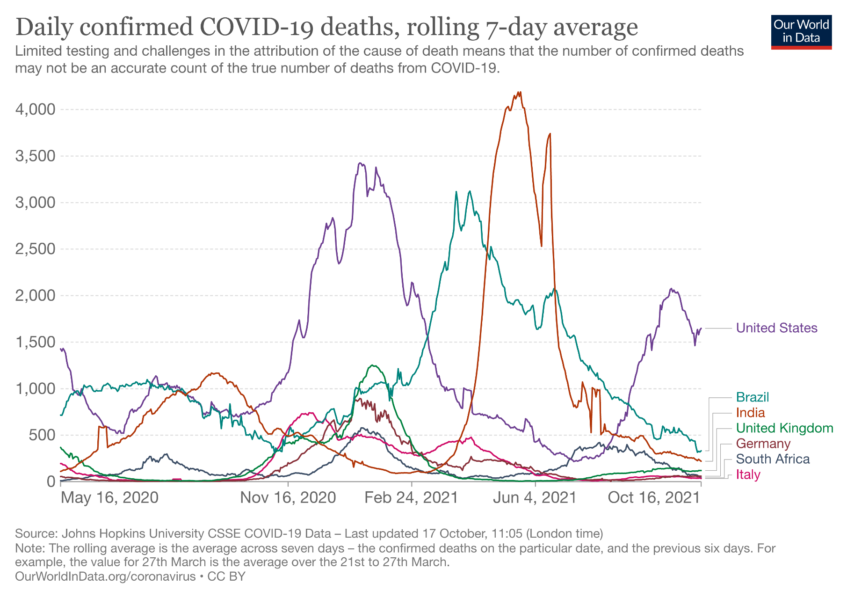
2. COVID-19 Pandemic

Slide 5
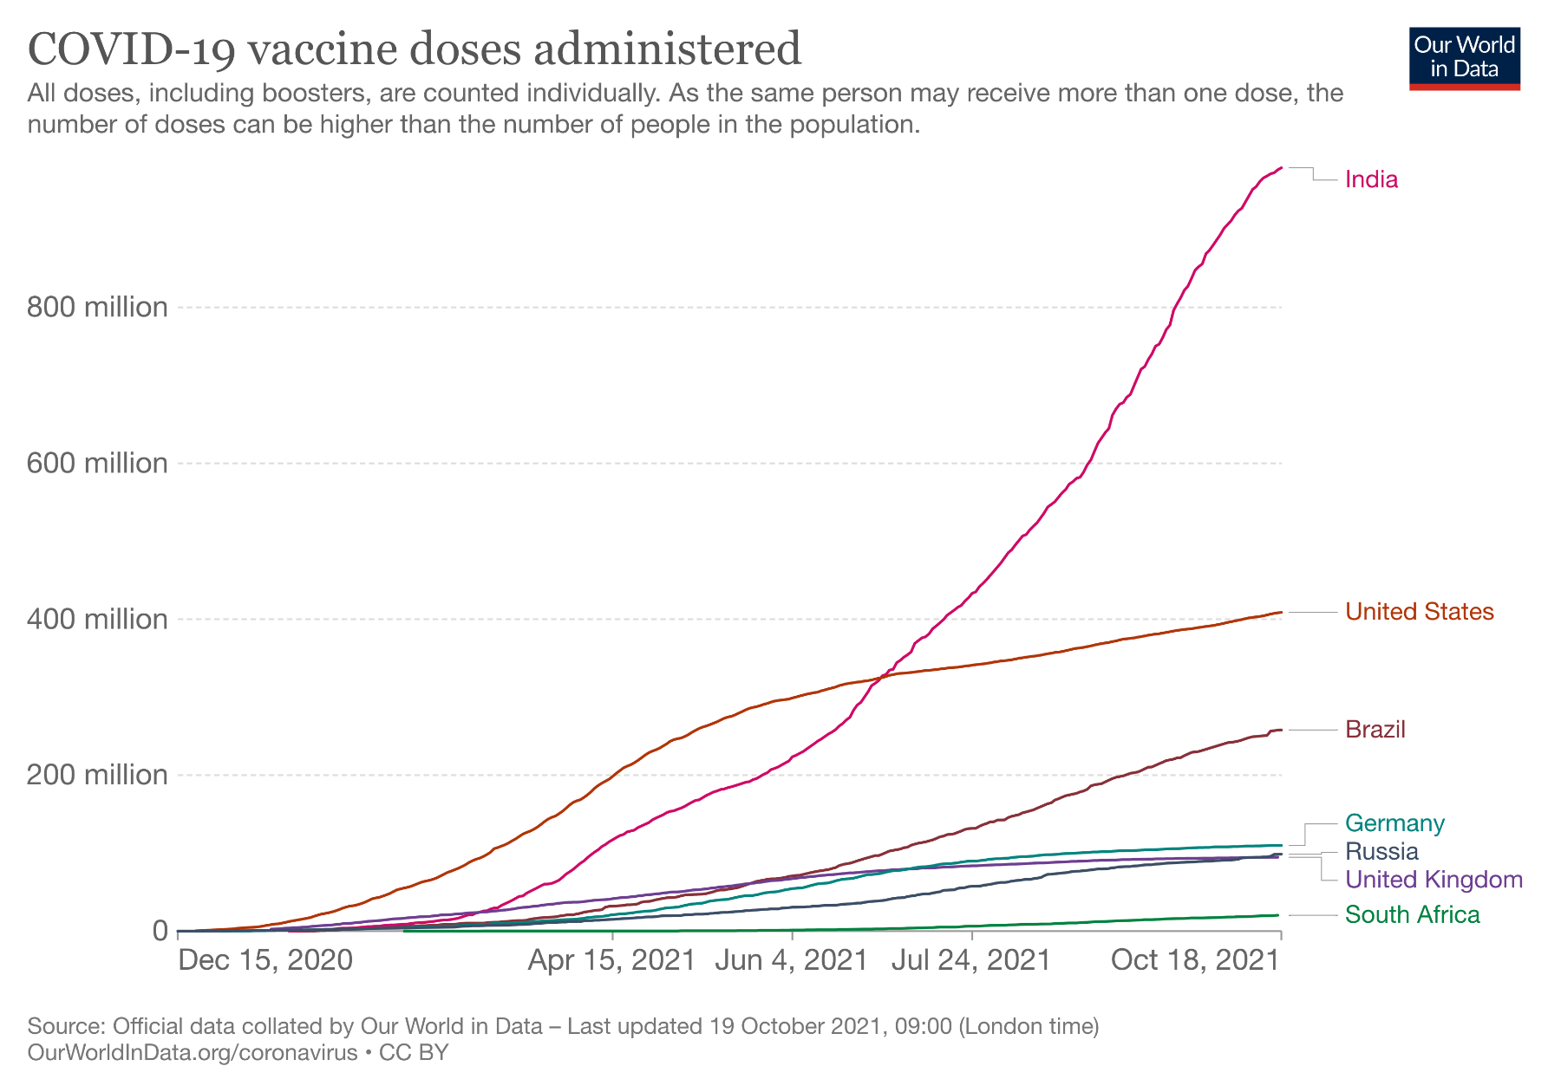
2. COVID-19 Pandemic

Slide 6
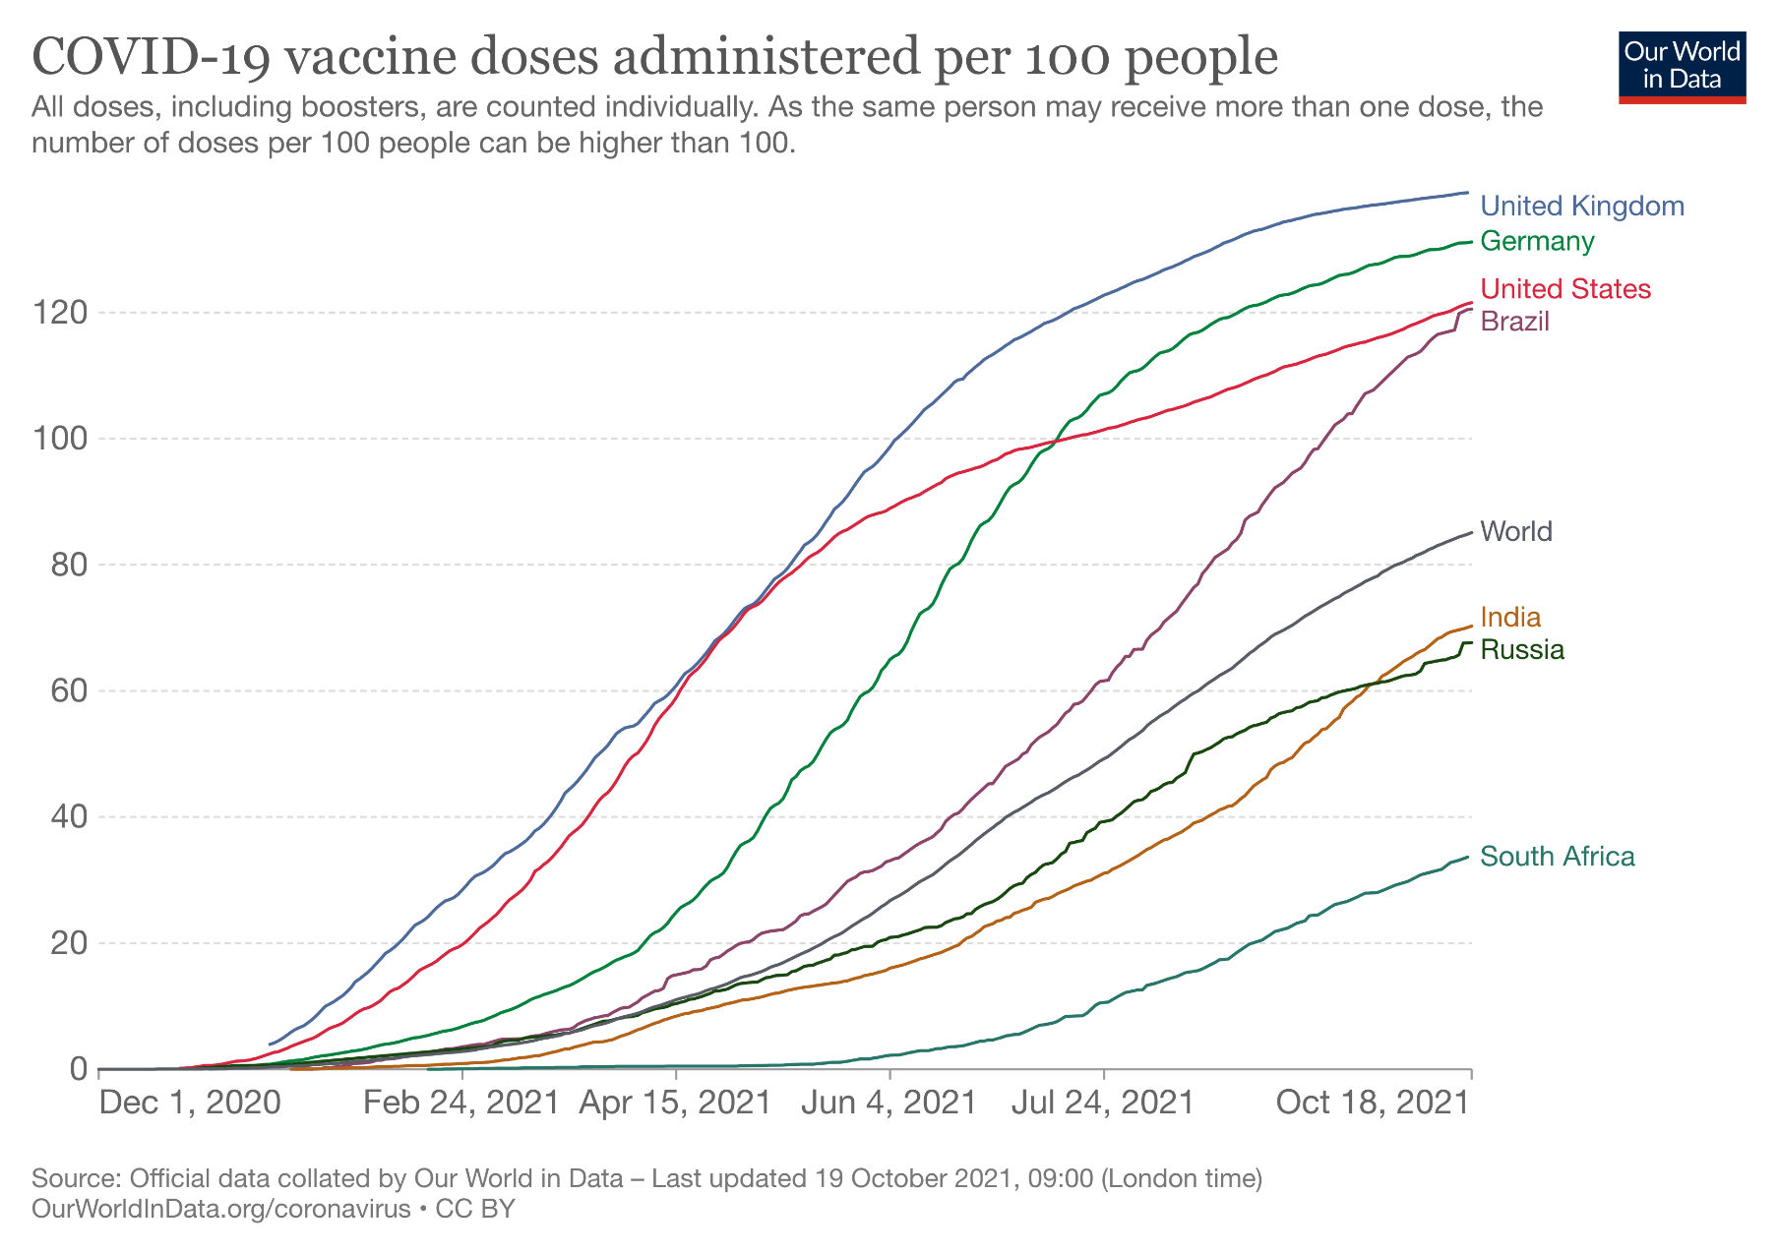
2. COVID-19 Pandemic

Slide 7
2. COVID-19 Pandemic
Furthermore, the DoH announced that, “a COVID-19 Vaccine Injury No-Fault Compensation (NFC) Scheme is hereby established in terms of section 27(2)(c), (m) and (n) of the Act…”. The NFC would be a guarantee and assurance to citizens that their rights are fully protected during the process of the vaccination.
The DG of DoH noted on the 9th of September 2021, that the most pressing challenge at present was to find and convince people that vaccinations were good for them. He emphasized the need to provide clear and transparent information to citizens to reduce the level of vaccine hesitancy.
The Presidency announced that mandatory vaccinations were not being considered at this time, however, the government cannot limit any non-governmental businesses and institutions who require all employees and scholars to be vaccinated.
Although the country has been moved to adjusted alert level 1 on the 1st of October 2021, the economy is still negatively affected mainly by the COVID-19 pandemic - resulting in many South Africans experiencing high levels of poverty and unemployment. The Government has extended the COVID-19 SRD grant to March 2022.
Notes:
Appropriation of additional amount of money to vote of Health 1. An amount of R1.250 billion is hereby appropriated out of the National Revenue Fund for expenditure authorised in terms of section 16(1) of the Public Finance Management Act, 1999 (Act No. 1 of 1999), and attributed to the vote of Health in order to procure COVID-19 vaccines and implement a related COVID-19 vaccine research project, as set out in the Schedule.
3 Communicable and Non-Communicable Diseases Develop and support the implementation of national policies, guidelines, norms and standards, and the achievement of targets for the national response needed to decrease morbidity and mortality associated with communicable and non-communicable diseases. Develop strategies and implement programmes that reduce maternal and child mortality. Ensure protection against vulnerability by creating an enabling environment for the provision of a comprehensive, integrated and sustainable social development service. 6 Health System Governance and Human Resources Develop policies and systems for the planning, managing and training of health sector human resources, and for planning, monitoring, evaluation and research in the sector. Provide oversight to all public entities in the sector and statutory health professional councils in South Africa. Provide forensic laboratory services

Slide 8
3. Departmental Budget Analysis

Slide 9
The 2021 fiscus: Main budget: national estimates – 2020 vs 2021 Budget
 | 2021/22
R million | 2020 Budget | 2021 Budget | Difference
Main budget revenue
Current revenue | 1 478 538.9 | 1 344 235.9 | (134 303.0)
Tax revenue (gross) | 1 512 193.8 | 1 365 124.3 | (147 069.5)
Total revenue | 1 484 294.1 | 1 351 672.1 | (132 622.0)
Main budget expenditure
Direct charges against the National Revenue Fund | 872 909.4 | 830 023.0 | (42 886.3)
Debt-service costs | 258 482.1 | 269 741.1 | 11 259.1
Provincial equitable share | 573 989.5 | 523 686.4 | (50 303.2)
Appropriated by vote | 988 835.6 | 980 583.9 | (8 251.7)
Provisional reduction to fund Land Bank allocation | - | (5 000.0) | (5 000.0)
Provisional allocations not assigned to votes | 1 852.6 | 12 645.2 | 10 792.6
Provisional allocation for Eskom restructuring | 33 000.0 | - | (33 000.0)
Infrastructure Fund not assigned to votes | 4 000.0 | 4 000.0 | -
Compensation of employees adjustments | (54 929.1) | - | 54 929.1
Total | 1 845 668.5 | 1 822 252.2 | (23 416.3)
Contingency reserve | 5 000.0 | 12 000.0 | 7 000.0
Main budget balance | (366 374.3) | (482 580.0) | (116 205.7)
Percentage of GDP | -6.0% | -9.0% | -3.0%
The difference between the two Budgets shows the policy shift in the fiscus for the year ahead and contextualises it as real fiscal values; signalling the government's intent.
Significant downward adjustment in tax revenue projected for the financial year ahead with a shortfall of R132.6 billion in total.
Non-interest expenditure was adjusted downward by R23.4 billion, resulting in the main budget balance deficit increasing by R116.2 billion – in total a R482.6 billion deficit for 2021/22 alone or 9 per cent of GDP.
Source: Commission's own calculation using National Treasury Budget Review Statistical Annexure 2020/21

Slide 10
3. Departmental Budget Analysis Over/(under) expenditure as a proportion of the Main Budget
Total departmental actual expenditure for the 2020/21 financial year is R58.1 billion in the annual report, R55.5 billion in the main budget and R58.1 billion in the adjusted budget.
Reminder: R2.5 billion was added in the department’s 2020/21 adjusted appropriation relative to the Main Budget. Amongst the adjustments, R2.9 billion was allocated for transfers and subsidies. Most of this transfer includes the R2.4 billion to the COVID‐19 component of the HIV, TB, malaria and community outreach grant: provinces to administer vaccines to eligible people as per the roll-out phases.
Actual spending on COVID-19 special appropriation amounts to R612.3 million for the 2020/21 financial year.
The 2020/21 actual expenditure showed an over-expenditure in transfers and subsidies for the COVID-19 vaccine rollout at 5.5% of the total departmental budget.
Source: Estimates of National Expenditure (2021)
& Annual Report (2020/21)

Slide 11
3. Departmental Budget Analysis Over/(under) expenditure as a proportion of the main budget (cont.)
Programme 6: Health System Governance and Human Resources
Health sector human resources, oversight of sector public entities and professional councils. Provide forensic laboratory services.
Programme 5: Hospital Systems
Strengthen the referral system & health infrastructure.
Programme 4: Primary Health Care
District health system, including emergency, environmental and port health services.
Programme 3: Communicable and Non‐communicable Diseases
To decrease morbidity and mortality associated with communicable and non‐communicable diseases.
Programme 2: National Health Insurance
Achieve universal health coverage
Programme 1: Administration
leadership, management and support services
Source: Estimates of National Expenditure (2021)
& Annual Report (2020/21)

Slide 12
Departmental Budget Analysis: Explanations
An amount of R1.25 billion was allocated in a Second Special Adjustment Budget Bill for the procurement of COVID-19 vaccines (R1.1 billion), and R150 million was allocated to the South African Medical Research Council in a Second Special Adjustment Budget Bill to research the effectiveness of the COVID-19 vaccines and its resistance against mutant strains at the end of February 2021, in accordance with Section 16 of the Public Finance Management Act. The expenditure of R462.3 million and R150 million, totalling R612.3 million are funded as a direct charge against the National Revenue Fund.
Under expenditure for Programme 1: Administration - The Department did not pay the officials notch increases for two years. The rental payment for the Civitas Building were withheld due to COVID-19 and not all the invoices received could be paid before financial year-end.
Under expenditure for Programme 2: National Health Insurance - Some payments could not be made due to COVID-19 protocol and systematic issues experienced at the end of the financial year-end.
Programme 3: Communicable and Non-Communicable Diseases – Additional expenditure accounted for in the Budget adjustment for the COVID pandemic.
Over expenditure for Programme 4: Primary Health Care – Overtime worked at Ports of Entry due to COVID-19.
Programme 5: Hospital Systems – no variances after Budget adjustment.
Over expenditure for Programme 6: Health System Governance and Human Resources - Overpayment was incurred on Statutory Human Resources & Training Grant by KZN Province, refund was received on 21 May 2021.

Slide 13
3. Departmental Budget Analysis 2021 Budget vs. 2020 Budget
 | 2021/22 |  |  |  | 2022/23
R million | 2020 MTEF | 2021 MTEF | Diff. | % | 2020 MTEF | 2021 MTEF | Diff. | %
1. Administration | 727.6 | 816.3 | 88.7 | 0.1% | 722.1 | 818.4 | 96.2 | 0.2%
2. National Health Insurance | 1 499.5 | 1 340.5 | (159.0) | -0.3% | 1 525.3 | 1 437.0 | (88.3) | -0.1%
3. Communicable and Non-communicable Diseases | 28 782.9 | 32 605.4 | 3 822.5 | 6.3% | 30 279.3 | 30 674.2 | 394.9 | 0.6%
4. Primary Health Care | 254.2 | 222.3 | (31.9) | -0.1% | 265.4 | 223.5 | (41.9) | -0.1%
5. Hospital Systems | 22 863.1 | 21 372.3 | (1 490.8) | -2.5% | 23 953.0 | 22 439.9 | (1 513.1) | -2.4%
6. Health System Governance and Human Resources | 6 511.1 | 6 186.5 | (324.6) | -0.5% | 6 745.8 | 6 062.5 | (683.3) | -1.1%
Total expenditure estimates | 60 638.3 | 62 543.3 | 1 905.0 | 3.1% | 63 491.0 | 61 655.4 | (1 835.6) | -2.9%
Over the 2021 MTEF, an additional R9 billion has been allocated to the department’s baseline (R6 billion in 2021/22 and R3 billion in 2022/23). Of this amount, R6.5 billion is ring‐fenced in the Communicable and Noncommunicable Diseases programme to fund the procurement and distribution of COVID-19 vaccines. Should the need arise, the additional allocation of funding regarding vaccine rollouts would be generated through the government’s contingency reserves and cross-subsidised from the vaccines to the private sector.
The National Health Insurance (NHI) Indirect Grant is purposed to strengthen the health system in preparation for NHI rollout. A R4.4 billion allocation to the health facility revitalisation component of the NHI Indirect Grant is to be transferred to provincial departments of health through the Health Facilities Infrastructure Management subprogramme in the Hospital Systems programme. However, overall this programme allocation does not grow.
The movement of funds between programmes and subprogrammes needs to be made clearer to ensure function-funding alignment.
Source: Estimates of National Expenditure (2021)

Slide 14
3. Departmental Budget Analysis Personnel headcount and cost
 | 2019/20 | 2020/21 | 2021/22 | 2022/23 | 2023/24
Count | Actual | Revised | Medium-term estimate
 | number | number
 | of posts | of posts
1 – 6 | 572 | 572 | 588 | 618 | 615
7 – 10 | 636 | 634 | 565 | 569 | 561
11 – 12 | 167 | 165 | 123 | 126 | 126
13 – 16 | 111 | 111 | 88 | 96 | 105
Other | 2 | 2 | 2 | 2 | 2
Total | 1 488 | 1 484 | 1 366 | 1 411 | 1 409
R million | Actual | Revised | Medium-term estimate
 | cost | cost
1 – 6 | 169 | 182 | 193 | 192 | 191
7 – 10 | 347 | 401 | 360 | 351 | 346
11 – 12 | 162 | 179 | 146 | 144 | 144
13 – 16 | 148 | 161 | 141 | 151 | 164
Other | 5 | 5 | 6 | 6 | 6
Total | 831 | 928 | 845 | 843 | 851
The substantial difference between the number of posts in 2020/21 and the 2021 MTEF for the junior, middle and senior management postings within the department is a cause for concern, decreasing from 910 in 2020/21 to 776 in 2021/22 for levels 7-16. It may suggest structural weaknesses in the operational and administrative consistency, capacity and capabilities of the national department.
The department documents an overall decline of only 4 posts between actual number and revised number of posts, yet there is a discrepancy with the increase of R97 million between revised cost for 2020/21 and the actual cost in 2019/20. Differently put, there appears to be a disconnect between the headcount and the total cost of personnel within the department.
Source: Estimates of National Expenditure (2021)

Slide 15
Annual Performance Plan - Departmental performance
Selected performance indicators:
Performance indicator for Programme 2: NHI indicates that “Total number of individuals registered on the national health insurance patient beneficiary registry” already registered 46 million in 2020/21, increasing to 50 million in 2021/22. In the re-tabled Annual Performance Plan: the department claims that Health Patient Registration System has achieved 59.1 million individuals registered.
“The NDOH has also arranged a meeting in March 2021 for PMIS and NHI systems (HPRS) to discuss interoperability in relation to the Master Facility Index (MFI) and aligning all tools and projects to the
Master Facility List as part of this project.”
It is unclear how these systems integrate data with one another and from other data systems across private-public sectors to ensure inter-sector integration for efficiency of national health care services.
The 2 100 “…primary health care facilities that qualify as ideal clinics per year” could consider a measure of its proximity to the population, in order to improve ease-of-access (i.e., healthcare efficiency) as well as the service quality.
The importance of accessible healthcare services is highlighted by the COVID-19 pandemic.
“Number of points of entry where port health services comply with international health regulations per year” this is an indicator of the department striving for quality, yet the department (33%) ranks well below regional (41%) and global (63%) benchmarks regarding health service provision when using the same international health regulation standards.

Slide 16
4. Entities

Slide 17
4. Entities
National Health Laboratory Service
Established in terms of the National Health Laboratory Service Act (2000) and provides pathology services to over 80% of South Africans, playing a significant role in monitoring TB and HIV.
10 months after firing the acting CEO due to charges related to irregular payments to service providers, the CFO and supply chain manager were suspended on 17 November 2020 following charges of failing to apply due diligence to fraud and misconduct allegations regarding the procurement of PPE.
The NHLS was also under investigation by the SIU for alleged financial irregularities in awarding R170 million worth of Covid-19 tenders. Additionally, on 13 March 2020, R113 million in fraud and theft from the NHLS were uncovered in a Hawks investigation. Some arrests have since been made.
Substantial reduction in the budget surplus from R1 billion in 2019/20 to R373 million in 2020/21, with total revenue at R9.7 and R9.9 billion in 2019/20 and 2020/21, respectively. This surplus is projected to decrease until the end of the MTEF period, to R83 million, as expenses are growing at a faster rate than revenue.
In a meeting for the Portfolio Committee of Health on 10 March 2021, considering the high litigation costs associated with outstanding provincial debt (totaling R4 billion), maintaining its level of liquidity was considered pertinent.
As of 17 October 2021, NHLS had conducted 8.3 million COVID tests. Over the medium term, they intend to play a critical role in the surveillance of Covid-19 with the National institute for Communicable Diseases.
85 posts with salary level 17-22 totaling R229 million in 2020/21. This contrasts with 9 posts (totalling roughly R25 million) audited, estimated and projected over the 2020 MTEF in 2020 Budget.

Slide 18
4. Entities (cont.)
South African Medical Research Council
Conducts and funds health research and medical innovation, in terms of the amended South African Medical Research Council Act (1991). The entity conducted research regarding the deployment and procurement of vaccines.
Number of published journal articles by (first and/or last) affiliated authors, grant holders with acknowledgement of the council etc. could lead to double counting of performance indicators. Four indicators of number of awards by the council to MSc, PhD and post-doctoral candidates could also include double counting.
There is a decrease in number of accepted and published journal articles associated with the Council in 2020/21, across all three indicators, projected to fall further over the medium term. Number of research grants awarded by the council were reduced from 247 in 2019/20 to 130 in 2020/21. Four new performance indicators, for number of awards and innovation/technology projects, are presented in 2020/21, which do not allow for prior comparison.
A budget deficit in 2020/21 of R36.4 million, after a surplus of R43 million in 2019/20, which is projected to a budget balance by 2022/23. Total turnover is R1.2 billion in 2020/21. The deficit is mostly due to increased expenditure. However, revenue is projected to grow at a higher rate over the medium term. Expenditure on innovation and technology is expected to account for 24% of the budget in the MTEF. Additionally, there is an increase in cash and cash equivalents from -92 million in 2019/20 to 12 million in 2020/21.
Unit personnel cost for level 13-16 increasing from R1.7 million to R2 million; and for level 17-22 from R3.3 million to R4.0 million between 2019/20 and 2023/24.

Slide 19
4. Entities (cont.)
Compensation Commissioner for Occupational Diseases in Mines and Works
The Occupational Diseases in Mines and Works Act (1973) mandates the commissioner to collect levies from controlled mines and compensate lost earnings caused by occupational diseases of cardiorespiratory organs (e.g. Silicosis is a disease that results from the inhalation of silica dust, which makes mine workers vulnerable to tuberculosis).
Substantial decrease in number of workers in controlled mines and works paid for loss of earnings while undergoing TB treatment per year from 4 498 in 2019/20 to 1 045 workers in 2020/21, with questionable projections for the outer years to remain at only 1 045 workers per year.
Over the medium term, the commissioner intends to focus on improving access to services provided to mineworkers, thereby increasing the number of claims paid and fast-tracking the claims management process.
Large cash outflows from investing activities, R57 million in 2020/21, increasing to R60 million outflow, which is projected as a cash inflow of R35 million in 2022/23. In 2020/21, total revenue is estimated at R544 million. Substantial net increase in cash and cash equivalents, from R188 million to R261 million in 2019/20 and 2020/21 respectively, mostly due to changes in investing activities.

Slide 20
4. Entities (cont.)
Council for Medical Schemes (CMS)
Regulatory authority responsible for overseeing the medical schemes industry in South Africa, set out in section 7 of the Medical Schemes Act (1998) to protect the interests of the beneficiaries in line with the provision of the National Health Act (2003). Advisor to the Minister of Health on related matters.
On 4 December 2019, CMS issued Circular 80 of 2019: Low-Cost Benefit Option & Demarcation Products that no Low-Cost Benefit Options (LCBO) will be allowed for low-income market segments going forward, and no products based on the Demarcation Exemption Framework and/or the Medical Schemes Act will be allowed beyond 2021. Over the MTEF period, CMS intends to develop a guidance framework for low-cost benefit options and finalise proposals for the Medical Schemes Amendment Bill and the health market inquiry.
CMS reported substantial additional reserves and budget surpluses in 2020 across SA’s medical schemes as members avoided health care of all kinds, owing to Covid-19 risks. Furthermore, out-of-pocket expenditure has increased over recent years for medical scheme members. Combined with rising costs of medical scheme cover, this may indicate that health schemes are not serving their intended purpose amidst the Covid-19 pandemic, confirmed in Competition Commission Health Market Enquiry Report (2019).
Unexplained performance issues and volatility in “percentage of category 1 clinical opinions provided within 30 days of receipt of complaints adjudication” – from 98% in 2017/18 to 54% and 69% in 2018/19 and 2019/20, respectively, before estimated to be 90% in 2020/21.
Relatively stable financial statements of income and cash flow. Turnaround of the budget deficit of R26.6 million in 2019/20 to a surplus of R4 million in 2020/21, where total revenue is R177 million and R201 million in 2019/20 and 2020/21, respectively. Budget surpluses are projected to continue over the MTEF period.
The number of people covered by medical schemes has not been growing for over a decade. Discovery Health Medical Scheme lost over 50 000 beneficiaries during 2020 as individuals moved to smaller medical schemes.

Slide 21
4. Entities (cont.)
Office of Health Standards Compliance
Established in terms of National Health Amendment Act (2013) to monitor and enforce the compliance of health establishments, private and public, with the norms and standards.
“Percentage of public sector health facilities inspected per year” is projected to decline over MTEF, creating an uncertain impact of enforcing norms and standards. Out of 3816 health facilities, 24% were inspected in 2017/18, 19.1% in 2018/19, 17% in 2019/20, 10% in 2020/21, and are projected to fall to 7% in 2023/24.
Relatively stable financial statements of income and cash flow, with a balanced budget and net zero change in cash and cash equivalents in 2020/21 and over the MTEF. Estimated total revenue in 2020/21 is R137 million.

Slide 22
4. Entities (cont.)
South African Health Products Regulatory Authority (SAHPRA)
Established in terms of the National Health Act (2003) and Medicines and Related Substances Act (1965) which governs the manufacturing, distribution, sale and marketing of medicines and medical devices to promote the health, wellbeing and safety of the public by ensuring access to safe, effective and quality health products. They are playing a prominent role in the assessment and approval of vaccines in SA.
On 4 October 2019 President Ramaphosa issued a proclamation SIU to investigate any alleged “serious maladministration in connection with the affairs of the SAHPRA.”
“Percentage of medicine registrations in the backlog cleared per year” was only estimated at 40% in 2020/21, optimistically projected to improve to 95% and 100% in 2021/22 and 2022/23, respectively. Yet, overall there is a decrease in all performance indicators in 2020/21.
Accelerating the licensing of its backlog of medicine products remains a priority, which the entity aims to clear by 2022/23.
Projected reduction in expenditure in the health product authorization programme is at an annual rate of 21% over the medium term. This is due to revising and reviewing business models to reduce unnecessary bureaucracy and delays. Compensation of employees will decline, as 25 employment contracts are expected to be terminated once the backlog clears. Revenue is expected to decrease in line with expenditure.
Several public health experts working at SAHPRA are experiencing pay delays for the last few months (October 2021). A SAHPRA spokesperson cited technical glitches with the payroll system.

Slide 23
5. Estimates of Provincial Revenue and Expenditure on Health

Slide 24
Provincial Health Budget and Health COE as a % of Total (Provinces, 2019)
Source: Provincial Budget, National Treasury (2021)

Slide 25
Health Conditional Grants (2020 and 2021 Division of Revenue Bills)
2020 Division of Revenue Bill |  |  |  | 2021 Division of Revenue Bill
Grant Schedule | Grant name | 2021/22 | 2022/23 | Grant Schedule | Grant name | 2021/22 | 2022/23
 |  | (R millions) | (R millions) |  |  | (R millions) | (R millions)
4A | Statutory Human Resources. Training and Development Grant | 4 334 | 4 494 | 5A | Human Resources and Training Grant | 4 055 | 3 999
4A | National Tertiary Services Grant | 14 694 | 15 294 | 4A | National Tertiary Services Grant | 13 708 | 14 000
5A | HIV. TB. Malaria and Community Outreach Grant | 27 931 | 29 405 | 5A | HIV. TB. Malaria and Community Outreach Grant | 27 585 | 27 910
5A | Health Facility Revitalisation Grant | 6 658 | 7 034 | 5A | Health Facility Revitalisation Grant | 6 445 | 6 886
5A | National Health Insurance Grant | 300 | 311 | 5A | National Health Insurance Grant | 269 | 272
Total Direct Allocation |  | 53 917 | 56 537 | Total Direct Allocation |  | 52 062 | 53 068
6A | National Health Insurance Indirect Grant | 2 529 | 2 652 | 6A | National Health Insurance Indirect Grant | 2 118 | 2 541
Total Allocation |  | 56 446 | 59 189 |  |  | 54 179 | 55 609
 |  |  |  | Changes to baselines |  | - 2 267 | - 3 580
Source: Division of Revenue Bill Schedule, National Treasury (2021)

Slide 26
Expenditure Overview
An additional R8 billion is allocated to the provincial equitable share through National Treasury in 2021/22 to enable provincial health departments to continue their prevention, testing and treatment interventions, including managing hospitalisations resulting from a possible fourth wave of COVID‐19 infections.
The HIV, TB, malaria and community outreach grant is the main vehicle for funding disease‐specific programmes in the sector and is allocated R82.6 billion over the MTEF in the HIV, AIDS and STIs subprogramme in the Communicable and Non‐communicable Diseases programme. The largest component of the grant is the HIV and AIDS component with an allocation of R69.3 billion over the MTEF period. This component funds government’s antiretroviral treatment programme, which aims to reach 6.7 million people by 2023/24, as well as a range of HIV‐prevention services.
An additional R129.4 million, within the Health Facilities Hospital Systems grant, over the MTEF period is allocated for the construction of the Tygerberg and Klipfontein hospitals in Western Cape.
Tertiary health care services are highly specialised referral services subsidised through the national tertiary services grant, which is allocated R41.7 million over the MTEF in the Hospital Systems programme. Due to their nature, these services are offered at tertiary and central hospitals, which are limited in numbers and concentrated in urban centres. This unequal distribution results in patients often being referred from one province to another, which requires strong national coordination. Accordingly, the grant compensates provinces for providing tertiary services to patients from elsewhere.

Slide 27
6. SIU Investigations into NDoH

Slide 28
SIU Findings
SIU reported that that the appointment of Digital Vibes in the awarding of the NHI and COVID-19 media campaigns by the NDOH had been irregular and former Minister (Mkhize) had vested interests in the appointment of Digital Vibes.
Digital Vibes, contractors for the campaign (close associates of Mr Mkhize), family members and other associates of Mr Mkhize paid and received gratifications.
Irregular expenditure amounted to R150 million and wasteful expenditure amounting to between R72 million and R80 million.
Two contracts amounting to R176 million (R141 for NHI and a R35 million quote for COVID-19) were entered into irregularly. R125 million spent in respect of the COVID-19 campaign where only a R35 million quotation had been approved.
Former minster approved budgets related to the NHI media campaign months after the agreement between the NDOH and Digital Vibes had already been signed.
A 2019 cabinet decision indicated that the GCIS (who would be more cost-effective) would be responsible for the NHI and COVID-19 media campaigns – but the former Minister ignored the decision by awarding Digital Vibes the contract.
Considering the amounts of money that were received from the NDOH and bank account(s) of Digital Vibes, it appears that Digital Vibes failed to declare and pay company tax as well as VAT to SARS.
Former Acting DG, Dr Pillay, attempted to deviate from the normal procurement procedures to award the contract and made intentional misrepresentations to the National Treasury in May 2020.

Slide 29
SIU Analysis & Recommendations
Evidence shows a direct lack of oversight on the part of the former Minister.
There has been misappropriation of government funds in the pandemic, costing the country unbudgeted funds, peoples’ lives and livelihoods.
Current Minister, Dr Phaala, says NDoH is committed to clean governance and will consider findings to assess required disciplinary, corrective and preventative interventions required.
SIU recommends:
Officials should adhere to Cabinet decisions and make use of intergovernmental services that can reasonably be rendered by other State institutions especially ones resulting in cost savings for the State before unnecessarily outsourcing such services.
Ensure effective project and contract management in respect of all contracts, including checks to ensure fair value for all payments made.
Undertake timeous and proper needs identifications.
Identify and approve relevant budgets before the Supply Chain Management process commences.
Take steps to eliminate the need for consultants and favouritism when considering appointment of such consultants.
The SIU report regarding Digital Vibes was compiled and reported to the President on the 30th June 2021, however, the report was only authorised for the public on the 28th of September in order to allow those mentioned an opportunity to object.
The SIU is investigating approximately R14.8 billion of COVID-19 expenditure of which R1.39 billion had been referred to the Special Tribunal to recover losses.

Slide 30
SIU Analysis & Recommendations
FFC Recommendations:
The FFC agrees with the recommendations listed in the SIU report.
The FFC notes the severe misuse and abuse of public funds that has taken place at the National Department of Health as investigated by the SIU. The FFC recommends that as a principle, reports such as this should be made available to the public automatically on release, given the severe misuse of public funds.
Departments should adhere to procurement and budget processes, ensure proper and effective management of contracts and related payments, and refrain from unnecessarily outsourcing services when more cost-effective intergovernmental services can be used.
Furthermore, the FFC notes with concern that as of 1 September, the government had spent at least R351 million on corruption investigations as this money could have been diverted from spending on pressing matters of social and economic development.
Hence, the FFC is in favour of more prompt stringent preventative and corrective measures with real consequences on the individuals accountable. More concrete protective measures for whistle-blowers are further encouraged.

Slide 31
7. Adapting to COVID-19

Slide 32
SA healthcare expenditure in comparison to advanced economies
SA is considered a small economy in comparison to the other economies; however, SA spends nearly the same proportion of their GDP on Healthcare as advanced economies (e.g., Canada, United Kingdom).
SA Healthcare expenditure is essentially above average for a developing economy.
There is a weak correlation between healthcare service delivery and tax revenue collections. The key question is about the equitability, quality and delivery of healthcare – the how, and not just the how much. The inequity is borne in the separating equilibrium of the South African healthcare system and financing (Annual Submission for the 2021/22 Division of Revenue, Chapter 4).
Source: 2018 World bank data. Retrieved 2021-04-21.
Notes:
We are above average on tax revenue and expenditure given our tax revenue collection
The healthcare access, inequality, quality

Slide 33
National Health Insurance (NHI)
According to the Competition Commission (2019), “the South African private healthcare market is characterised by high and rising costs of healthcare and medical scheme cover…” This indicates a desperate need for more inclusive and affordable healthcare services in South Africa.
Tracking NHI through Parliament (18 May 2021 - 10 September 2021) Portfolio Committee on Health briefings by the National Department of Health.
The NHI proceedings are currently in the third phase (121 oral submissions).
The key concerns of stakeholders:
There are largely concerns about funding of the NHI and the current bill does not contain enough detail on the financing mechanism for different providers.
Clarity needs to be given to the tax implications to fund NHI. i.e., will specific tax collected go straight to NHI.
The South African Medical Research Council felt that the issue of provisional accreditation had not been fully addressed.
Concerns of corruption and poor implementation is a great concern to all stakeholders, since oversight has not worked in the past to ensure that officials that were deployed to implement government’s programme of action did so in a manner that they should.
The Commission notes and supports the progress made in the NHI parliamentary processes.
Notes:
It is essentially non- competitive

Slide 34
Update on COVID-19 Vaccinations
24 August 2021: Portfolio Committee on Health briefing by the National Department of Health
09 September 2021: Portfolio Committee on Health briefing by the Deputy Minister of the National Department of Health
Vaccines Administered:
Johnson & Johnson vaccines: 3 103 658
Pfizer vaccines: 10 961 708
Total administered: 14 065 366
Over 10 559 947 people had registered for vaccinations:
888 858 - Healthcare workers
3 519 704 - over 60 population
2 019 257 - 50 – 59 population
3 299 176 - 35 to 49 population
832 952 - 18 to 34 population
It was highlighted that there were a greater number of females than males who had been vaccinated across age-groups.
The country would need to administer 1.2 million vaccinations per week to reach 60 to 70 percent of the population by the end of 2021. The biggest issue is keeping the momentum and enthusiasm of South Africans. Of the patients currently in hospital with Covid-19, 17% are vaccinated and 83% are not vaccinated.
Notes:
The Department was in advanced stages of discussion
for 20 million doses. Potential cover for 10 million people.
Discussions were also being held with African Union Platform to supply vaccines to cover 10 million people
dependent on the publication of phase 3 trial data
Janssen Pharmaceutical and Pfizer required indemnification and the establishment of a no-fault compensation scheme as a condition precedent to the contract.
The Department had held engagements with virtually all the manufacturers that came to the fore and made their findings public. These findings included information on the vaccines, the three-phased trials from the laboratory, animal trails and the outcome of the human trials.
There will be an expansion of sites to include private sector.
There is a steady increase in number of vaccine sites in the country.

Slide 35
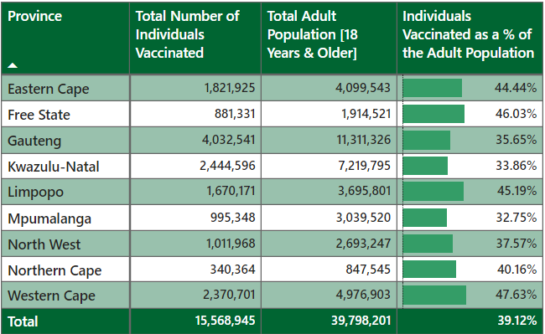
Vaccination roll-out programme
SA Corona Virus Online Portal. 2021. Latest Vaccine Statistics - SA Corona Virus Online Portal. [Accessed 8 November 2021].

Slide 36
Adapting to COVID-19: After
Recommendations (FFC 2021/22 Annual Submission Chapter 4: Sustainable Financing of South Africa’s Healthcare System and NHI):
Prioritise the development of an integrated national information system of patient, doctor registries as well as vaccination rollout to patients with real-time data.
This is to inform health care financing and provisioning decisions using the demand-based costing methodology.
Secondly this will reduce administration for South Africans who are attempting to get vaccinated and who have gotten vaccinated.
Lastly, it will keep the general public informed on the recent developments of the vaccination rollout.
Re-examine the prescribed PHC package based on the needs of the people.
Refocusing from informing, promoting, identifying, facilitating and educating activities to providing health care services. [particularly regarding Covid-19 vaccine roll-out, further traction may require going out to communities to make provision more accessible]
There should be an examination and eradication of the inefficiencies such as:
Wastages, corruption and leakages that result from the disparity of the two-tiered (private and public) health care system.
The ministers of health and finance must ensure that an enabling policy and legislative framework, aligned among the spheres of government, is put in place with due regard to:
Setting norms and standards that are enforced with proper oversight by the established technical committees.

Slide 37
Thank you

