Slide 1
Department of Higher Education and Training
Briefing on the 2020/21 Annual Report (Financial and Non-Financial Performance Information)
Presentation to the Joint Meeting:
Portfolio Committee on Higher Education, Science and Technology
Select Committee on Education & Technology, Sports, Arts & Culture
Presentation by the Director General: Dr SNP Sishi
Date: 10 November 2021

Slide 2
Outline of the Presentation
Mandate of the Department
Overview of the PSET landscape
Vision and Mission
Five-Year Strategic Plan Outcomes
Highlights of Achievements: 2020/21
Programme Performance against Annual Targets
Financial Performance

Slide 3
Mandate of the Department
The Constitution of the Republic of SA Act, 1996
Section 29, read with Schedule 4
May 2009 DHET established
Post School Education and Training System
On the supply side:
Must serve a growing number of young people and adults
Provide different entry points and pathways through the learning system
Ensure quality learning wherever learning takes place
On the demand side:
Identify the skills needed to drive our country’s economic growth and social development
Availability of quality skills will enhance both investment and service delivery
Legislative Framework Governing the work of the Department
Higher Education Act, Act No. 101 of 1997; Continuing Education and Training Act, Act No. 16 of 2006, National Qualifications Framework Act, as amended, Act No. 12 of 2019; Skills Development Act, Act No. 97 of 1998; Skills Development Levies Act, Act No. 9 of 1999; General and Further Education and Training Quality Assurance Act, Act No. 58 of 2001; National Student Financial Aid Scheme Act, Act No. 56 of 1999 and South African Council for Educators Act, Act No. 31 of 2000.

Slide 4
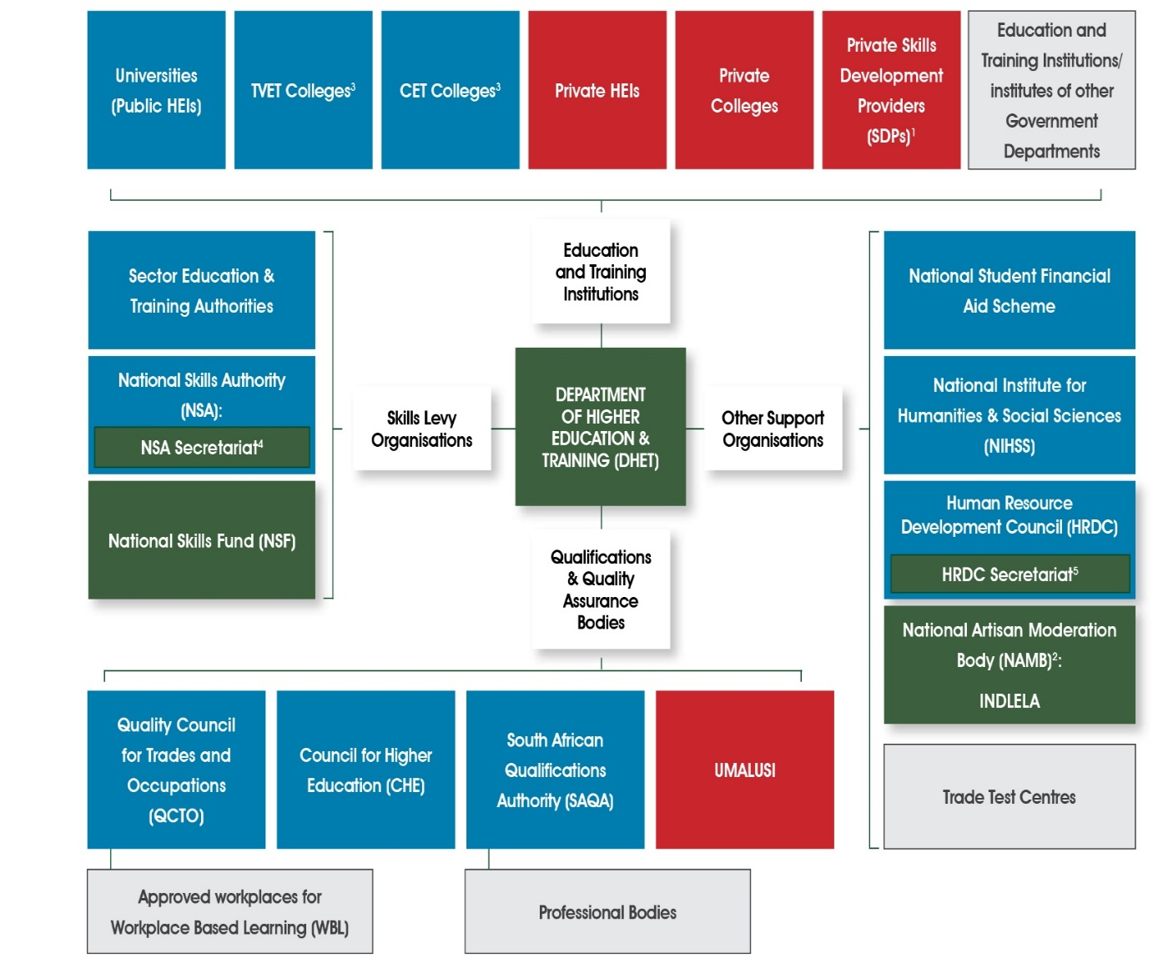
Overview of the PSET landscape

Slide 5
Vision and Mission
Vision
An integrated and coordinated PSET system for improved economic participation, and social development of youth and adults.
Mission
To provide strategic leadership to the PSET system through:
Development of appropriate steering mechanisms
Effective oversight, monitoring and evaluation
Funding of PSET institutions and entities
Provision of support services in relation to teaching and learning

Slide 6
DHET Contribution to Government Priorities
Government identified seven apex priorities announced by the President in July 2019 for the 2019-2024 Medium Term Strategic Framework (MTSF):
Priority 1: A capable, ethical and developmental state
Priority 2: Economic transformation and job creation
Priority 3: Education, skills and health
Priority 4: Consolidating the social wage through reliable and quality basic services
Priority 5: Spatial integration, human settlements and local government
Priority 6: Social cohesion and safe communities
Priority 7: A better Africa and world
DHET is one of the lead departments for Priority 3 and contributes directly to Priority 2.
This is implemented through joint efforts with departments such as Science and Innovation; Basic Education, Health, Agriculture, Land Reform and Rural Development.

Slide 7
The Impact of COVID – 19 on the Plans of the Department
A Special Adjustments Budget was tabled by the Minister of Finance on 24 June 2020.
Targets for 2020/21 had to be reviewed to take into account:
The impact of the adjusted budget allocations to programme delivery
The interventions towards mitigating the impact of COVID-19 pandemic
To prioritise departmental programmes and projects for continued service delivery during the 2020/21 financial.
The Annual Report is informed by the work done based on the adjusted budget and the revised APP

Slide 8
Planned Five-year Outcomes: 2020 – 2025 (SP)
Improved quality of PSET provision
A responsive PSET system
Excellent business operations within DHET
Expanded access to PSET opportunities
Improved efficiency and success of the PSET system
Five year Outcomes

Slide 9
Progress on Key Priorities
Integrated Infrastructure Development Programme
Establishment of the two new universities
Developed a high-level plan in relation to the feasibility study regarding the construction of two new Higher Educations Institutions for science and innovation in Ekurhuleni and crime prevention in Hammanskraal.
The Minister has approved the Plan and a Steering Committee has also been established, and meets on a monthly basis.
A Project Manager was appointed in August 2021 to manage activities related to the feasibility study, including to assemble a team of specialists required and manage their outputs.
TVET college infrastructure
60% (6/10) of the TVET college sites have been completed.
Percentage completion for the remaining four sites ranges from 75% to 95%.

Slide 10
Progress on Key Priorities
The Student Housing
Feasibility studies have commenced for the development of large scale student housing projects at six additional universities and six TVET colleges, comprising of the following sites:
The Cape Peninsula University of Technology: 2 150 beds
The Central University of Technology: 2 000 beds
Tshwane University of Technology: 3 500 beds
The University of Johannesburg: 2 048 beds
The University of KwaZulu-Natal: 3 000 beds
Walter Sisulu University: 3 200 beds
Lephalale TVET College: 1 200 beds
Gert Sibande TVET College: 1 500 beds
Northlink TVET College: 1 500 beds
Majuba TVET College: 1 500 beds
Sekhukhune TVET College: 1 500 beds
Vhembe TVET College: 1 300 beds

Slide 11
Progress on Key Priorities of
The Imbali Education and Innovation Precinct
The development of the Imbali Education and Innovation Precinct continued throughout 2020.
A project manager has been appointed to coordinate the project (through the Durban University of Technology (DUT).
The Plan for the Precinct has been revised to include recommendations of Steering Committee.
The precinct will be made up of an interconnected network of education and support institutions that will work together in a locality for the mutual benefit of all involved and in order to create seamless, enhanced, quality education pathways from early childhood education to higher education for the community that it serves.

Slide 12
Progress on Key Priorities
The Historically Disadvantaged Institutions Development Framework
The HDI-DP has been renamed the Sibusiso Bengu Development Programme (SB-DP) following the review of the programme.
A new strategic development implementation programme for HDI development has been developed.
HDI-DG was utilised during 2020/21 to support critical activities at the eight HDIs and HDI campuses of other universities in response to the adverse impact of the COVID-19 pandemic on their functions and ensure the successful completion of the academic year.

Slide 13
Progress on Key Priorities
Managing the impact of COVID-19 Pandemic at institutional level
Worked closely with HIGHER HEALTH and released comprehensive COVID-19 PSET guidelines, protocols and interventions to ensure that lives are saved whilst saving the academic year
This initiative played a critical role in helping our institutions to understand their unique risks and needs
The working relationship between the Department and Higher Health is continuing to mitigate the impact of the pandemic on the PSET sector

Slide 14
Highlights of Achievements: 2020/21
Excellent business operations within DHET
Five year Outcomes
Filling of vacancies
It took at average of 136 days to fill advertised positions
The vacancy rate in 2020/21 was 11%.
Payment of creditor invoices
97% of creditor invoices were paid within 30 days.
Invoices not paid within 30 days were as a result of a backlog caused by faulty email migrations and unavailability of staff who contracted COVID-19 and had to isolate.
Audit Opinion by the Auditor General South Africa (AGSA)
The Department achieved an unqualified audit opinion from the AGSA

Slide 15
Highlights of Achievements: 2020/21
Expansion of access to PSET opportunities
Continued to support students from poor and working class backgrounds through the DHET bursary scheme to access higher education and training opportunities.
A Ministerial Task Team has been established to look into the urgent policy review of student funding policy (including the TVET sector). Work is already underway in this regard
Various scholarship opportunities have been extended to the Department by China, Turkey, Hungary, Russia, Iran, Algeria, Mauritius, United Arab Emirates, Tunisia, the Julius Nyerere African Union Scholarship and UNESCO.
Approved Advocacy Strategy for the CET college sector to brand the sector and attract potential students.
Five year Outcomes

Slide 16
Highlights of Achievements: 2020/21
Expansion of access to PSET opportunities
Five year Outcomes
The 2019 enrolments did not meet the mid-term Ministerial enrolment targets, which had projected that the system would grow to 1 080 000 headcount enrolments.
We continue to monitor this against the new Ministerial Statement on Enrolment Planning 2020 to 2025 for better planning.

Slide 17
Highlights of Achievements: 2020/21
Expansion of access to PSET opportunities
Five year Outcomes
The increase in the number of students receiving funding through bursaries is attributed the financial injection received from the fiscus.

Slide 18
Highlights of Achievements: 2020/21
Expansion of access to PSET opportunities
Five year Outcomes
Enrolment funding is not completely aligned as a result colleges are receiving an allocation that is not fully covering all planned enrolments into the ministerial approved programmes.
Colleges are gradually adapting to plan enrolment within available funding.

Slide 19
Highlights of Achievements: 2020/21
Expansion of access to PSET opportunities
Five year Outcomes
The number of beneficiaries increased due to the increased funding cap from R122 000 to R350 000 which resulted in more students qualifying for NSFAS funding.

Slide 20
Highlights of Achievements: 2020/21
Expansion of access to PSET opportunities
Five year Outcomes
Targets could not be achieved because of (a) inappropriate infrastructure to enable colleges to offer programmes that are attractive to adults and the youth and (b) the CET college sector does not have institutional identity as it largely operates in public schools and absence of a coherent advocacy at both national and institutional level.
Poor advocacy and inadequate infrastructure remain the biggest challenge, but poor planning at college level equally creates a challenge.

Slide 21
Highlights of Achievements: 2020/21
Expansion of access to PSET opportunities
Five year Outcomes
COVID-19 negatively impacted the placement of learners during the 2020/21 financial year.
Employers could not take learners because SETAs could not issue calls as expected to employers in the second and third quarter to take learners because of the restrictions placed by the COVID-19 pandemic.
The Department has anticipated this during the mid year review and reduced the target but it still could not be achieved.

Slide 22
Highlights of Achievements: 2020/21
Expansion of access to PSET opportunities
Five year Outcomes
For the 2020/21 financial year, employers could not take in the learners because SETAs could not issue calls as expected to employers in the second and third quarter to take learners because of the restrictions placed by the COVID-19 pandemic

Slide 23
Highlights of Achievements: 2020/21
Improving efficiency and success of the PSET system
Graduations (public universities) have been growing at an average annual growth of 4.2% over the past five years to 2019 as compared to 2.1% average annual growth in enrolments over the same period.
As sign that the system is improving its efficiency, as output (graduates) are increasing at a substantially higher rate than inputs (enrolments).
Research Masters and Doctoral graduates also increased at a higher rate than the overall number of graduates
3 597 TVET students were enrolled in the Pre-Vocational Learning Programme (PLP) in the 2019 academic year, increasing to 5 254 student in 2020 (unverified and unaudited) to ensure student success in the sector .
Five year Outcomes

Slide 24
Highlights of Achievements: 2020/21
Improving efficiency and success of the PSET system
Graduates for Scarce skills areas such as Engineering Sciences and Natural and Physical Sciences have exceeded targets:
13 714 Engineering graduates (314 more graduates than the target),
9 121 Natural and Physical Science graduates (101 more graduates than the target).
In terms of artisan development, 15 107 (80%) artisans were found competent when measured against the revised target of 19 000 artisans - under performance due to COVID-19 as INDLELA had to close several times.
Five year Outcomes

Slide 25
Highlights of Achievements: 2020/21
Improving the quality of PSET provisioning
Continued to implement the transformation agenda of the Department in the higher education system through the ‘Staffing South African Universities’ Framework (SSAUF):
New Generation of Academics’ Programme (NGAP) –(100 posts allocated to 24 universities)
The Future Professors Programme –( 25 awards)
University Staff Doctoral Programme (designed to support staff to obtain doctorates - universities have allocated 47% of the grant to staff development activities)
Developed a National Policy on Student and Community Support Services to improve the quality of learning at CET colleges.
Developed a strategy to build the capacity of TVET college lecturers and managers to improve teaching and learning.
Five year Outcomes

Slide 26
Highlights of Achievements: 2020/21
Responsiveness of PSET system
The Minister launched two critical research reports from the Labour Market Intelligence Programme:
The 2020, National List of OIHD comprising of occupations for which labour demand is high and increasing.
A Technical Report in relation to the 2020 List of Critical Skills in support of the Department of Home Affairs in its work in relation to the recruitment of critically skilled foreign nationals, especially where the South African labour market in the short- to medium-term is unable to provide the required skills.
Developed a Skills Strategy for the ERRP which was presented at the Cabinet Lekgotla convened on 29 January 2021 – it is currently being finalised following a protracted consultation process.
Five year Outcomes

Slide 27
Highlights of Achievements: 2020/21
Responsiveness of PSET system
Provided support to universities for entrepreneurship education and development, as well as the development of leadership and management skills through EDHE and HELMP.
Developed a plan on the establishment of entrepreurship hubs in TVET colleges.
Expanded programme provisioning at CET colleges to include occupational skills programmes (in collaboration with SETAs).
Developed a strategy on the placement of lecturers in Industry for experiential learning
Five year Outcomes

Slide 28
Performance against the 2020/21 APP targets
Of the 86 targets for the year under review, 60 (70%) targets were achieved while 26 (30%) were not achieved.
Of the 32 system targets, 11 (34%) were achieved, and 21 (66%) were not achieved.
Performance per sector:
University Education = 6 (43%),
TVET Colleges = 4 (36%),
Skills Development =0 (0%)
CET Colleges =1 (17%)

Slide 29
Consolidated Performance: 2020/21 APP targets
Total number of targets: 118 (system and DHET direct outputs)
Achievements: 71 (60%)
Targets not achieved: 47 (40%)

Slide 30
Programme Performance Annual Targets (2020/21)
Programme 1: Number of Targets: 7
Number of Targets achieved: 4
Number of Targets Not Achieved: 3
Programme | Annual Target | Target Achievement
Programme 1: Administration | Approve the Demand and procurement plan for 2021/22 | Target achieved The Plan was Approved by the Director-General on 29 March 2021
 | An average of 150 days to fill an advertised post | Target achieved It took 136 days to fill advertised posts
 | 98% network connectivity uptime | Target achieved Uptime network connectivity was 99.5%
 | Receive an unqualified Audit opinion from the Auditor-General South Africa | Target achieved Unqualified Audit opinion was received from the Auditor-General South Africa

Slide 31
Targets not achieved and reasons for non achievement
Programme | Target | Actual | Reason
Programme 1: Administration | Resolve all (100%) disciplinary cases within 90 days | 79% | Cases were delayed by the COVID-19 lockdown restrictions.
 | Pay all (100%) valid invoices received from creditors | 97% | Staff members contracting COVID-19 and isolating Invoice discrepancies Faulty Information Management Systems
 | Conclude all (100%) Investigations on irregular, fruitless and wasteful expenditure concluded within 90 days (100%) | N/A | No investigations on irregular, fruitless and wasteful expenditure were concluded

Slide 32
Programme Performance against Annual Targets
Programme 2: Number of Targets: 12
Number of Targets achieved: 8
Number of Targets Not Achieved: 4
Programme | Annual Target | Achievement
Programme 2: Planning, Policy and Strategy | Approve a Strategy for expanding online learning in PSET | Target achieved- The Strategy was approved by the Minister on 30 March 2021
 | Avail two courses or subjects on the National Open Learning System (NOLS) | Target Achieved- Two courses or subjects were available on the NOLS by 31 March 2021
 | Approve a report on the recommendations and proposed amendments to the Recognition of Prior Learning Coordination Policy | Target Achieved- The report was approved by the Director-General on 04 March 2021
 | Approve a model for programme articulation of TVET college programmes into university programmes | Target Achieved – The model was approved by the Director-General on 03 March 2021

Slide 33
Programme Performance against Annual Targets (2020/21)
Programme | Annual Target | Achievement
Programme 2: Planning, Policy and Strategy | Publish PSET system reports | Target Achieved Report on Statistics on PSET was submitted and approved by the Director-General on 26 March 2021 PSET monitoring report was submitted and approved by the Director-General on 29 and published on 31 March 2021
 | Approve a report on the implementation of social inclusion in the PSET System | Target achieved: - A report on the implementation of social inclusion in the PSET System was approved by the Director-General on 31 March 2021
 | Submit Integrated infrastructure Development Support Programme (IIDSP) for PSET to the Minister for approval | Target achieved- The IIDSP for PSET was submitted to the Minister for approval for implementation 20 October 2020
 | Develop a Multifaceted student accommodation strategy and submit to the Minister for approval | Target achieved - A Policy on accommodation strategy was developed and approved by the Minister on 31 March 2021

Slide 34
Targets not achieved and reasons for non achievement
Programme | Target | Actual | Reason
Programme 2: Planning, Policy and Strategy | Sign at least two new agreements for international scholarships | One international scholarship agreement was signed between South Africa and France | A Memorandum of Understanding with the Hungarian Government will be signed during 2021/22
 | Approve the NQF Amendment Bill for public comments | NQF Amendment Bill was not approved by the Minister as planned | The 2019 NQF Amendment Act has not yet come into operation, it would therefore be pointless to publish a second draft Amendment Bill for public comment when the first
 | Approve reports to inform decision making in respect enrolment planning, funding and policy | A research report on Critical Skills was approved by the Director- General on 31 March 2021 List of Occupations in High Demand was gazetted by 31 March 2021 A draft PSP was developed based on the engagements with Master Plan teams and other stakeholders | The development of Master Plans, and the attendant identification of skills needs were significantly impeded by the COVID-19 pandemic and the economic contraction. The PSP was then reconceptualised to become an implementation plan for the ERRP Skills Strategy.
 | Approve a conceptual framework on integrated planning for the PSET System | A Concept Note and desktop assessment of the current state of planning in the sector was undertaken and submitted to the Director-General for approval | The Integrated Planning Framework (IPF) development was to be based on final NPPSET which was not yet approved by the Minister by 31 March 2021

Slide 35
Programme Performance against Annual Targets (2020/21)
Programme 3: University Education
Number of Targets: 23
Number of Targets achieved: 21
Number of Targets Not Achieved: 2
Annual Targets | Achievement
Approve a framework for monitoring annual enrolment targets | Target achieved - A framework for monitoring annual enrolment targets approved by the Director-General on 18 December 2020
Approve a report on the achievement of Ministerial enrolment planning targets | Target achieved - A report on the achievement of Ministerial enrolment planning targets was approved by the Director-General on 26 March 2021
Approve a monitoring report on progress towards the achievement of the MIF milestones approved by the Director-General | Target achieved - A monitoring report on progress towards the achievement of the MIF milestones was approved by the Director-General on 29 March 2021
Submit draft norms and standards for PSET student housing to the Minister for approval | Target achieved - Draft norms and standards for PSET student housing were approved by the Minister for public comments on 31 March 2021
Approve HDI Development Framework for implementation by 30 September 2020 | Target achieved - HDI Development Framework approved by the Minister on 13 September 2020
Submit updated Imbali Education Precinct Development Plan for approval | Target Achieved - An updated Imbali Education Precinct Development Plan was submitted to the Minister on 31 March 2021

Slide 36
Programme Performance against Annual Targets (2020/21)
Annual Targets | Achievement
Approve a report on the University Capacity Development Programme (UCDP) | Target Achieved - A report on the UCDP was approved by the Director-General on 30 March 2021
100 new Generation of Academics Programme (nGAP) lecturer posts allocated to universities | Target Achieved - 100 Posts were allocated to 24 universities
25 Awards made to permanent instructional or research staff at universities to participate in the Future Professors Programme | Target Achieved - 31 Participants were sent letters of award
Approve a Programme for Entrepreneurship Development in Higher Education (EDHE) | Target Achieved - The Programme for EDHE was approved by the Director-General on 26 March 2021
Approve a report on the evaluation of creative and innovation outputs by public universities | Target achieved - A report on the evaluation of creative and innovation outputs by public universities approved by the Director-General on 28 December 2020

Slide 37
Programme Performance against Annual Targets (2020/21)
Annual Targets | Achievement
Approve a report on the financial health of all public HEIs | Target achieved - A report on the financial health of all public HEIs approved by the Director- General on 29 March 2021
Approve a report on effective governance of all public HEIs | Target achieved - A report on effective governance of all public HEIs was approved by the Director-General on 11 March 2021
Approve a report on the compliance of Private Higher Education Institutions (PHEI) to the regulations | Target achieved - A report on the compliance of PHEIs to the regulations was approved by the Director-General on 30 March 2021
Approve the Higher Education Leadership and Management Programme (HELMP) | Target achieved - The HELMP report was approved by the Director-General on 29 March 2021
Approve a research quality evaluation framework | Target achieved - A research quality evaluation framework was approved by the Director-General on 29 March 2021

Slide 38
Programme Performance against Annual Targets (2020/21)
Annual Targets | Achievement
Approve a report on the evaluation of the 2019 research outputs of public universities | Target achieved - A report on the evaluation of the 2019 research outputs of public universities was approved by the Director-General on 29 March 2021
2 Intergovernmental International Scholarship Forum meetings convened | Target achieved -Two intergovernmental scholarship forum meetings were convened
Approve a report on the implementation of the International Scholarships Programme | Target achieved - A report on the implementation of the International Scholarships Programme was developed and approved by the Director-General on 29 March 2021
2 Centres for African Language Teaching supported | Target achieved - 2 Centres for African Language Teaching have been supported
Approve 26 three-year funded UCDP plans approved | Target achieved - 26 three-year funded UCDP plans have been approved by the Director-General

Slide 39
Targets not achieved and reasons for non achievement
Target | Actual | Reason
Updated guidelines for the implementation of bursary scheme for poor and working class students at public universities submitted to the Minister for approval | Updated guidelines for the implementation of the DHET bursary scheme for poor and working class students at public universities submitted to the Minister for approval on 26 March 2020 | Reduced 2021 MTEF allocation meant that the guidelines could not be finalised until the funding issues were resolved
Six public universities and nine TVET colleges utilising CAS by 31 March 2021 | Only two universities (SMU and UL) agreed to participate in the pilot | Six pilot universities and eighteen colleges requested an extension for sign-off between April and June 2021

Slide 40
System performance: University Education
Indicators | Annual Target | Achievement
Number of graduates in engineering annually | 13 400 | Target achieved 13 714
Number of graduates in natural and physical sciences annually | 9 020 | Target achieved 9 121
Number of Doctoral graduates annually | 3 500 | Target achieved 3 445 -1.6% deviation. Universities are permitted to move within 2% deviation.
Percentage of university lecturers (permanent instruction or research staff) who hold Doctoral degrees | 49% | Target achieved 48% Universities are permitted to move within 2% deviation.
Number of nGAP posts allocated to universities annually | 100 | Target achieved 100
Number of universities offering accredited TVET college lecturer qualifications | 2 | Target achieved 9

Slide 41
University System Targets not achieved and reasons for non achievement
Indicators | Annual Target | Actual | Reason for deviation
Number of student enrolments at public universities annually | 1 080 000 | 1 074 912 | -0.47% deviation. Universities are permitted to move within 2% deviation. However due to UNISA not enabling registrations on qualifications not registered on the NQF they did not meet their targets.
Number of university students receiving funding through NSFAS bursaries annually | 395 591 | 393 767 | This is the 2019 academic year final audited numbers as per the 2019/20 NSFAS Annual Report.
Number of students completing a university qualification annually | 229 000 | 221 942 | -3% deviation Universities are permitted to move within 2% deviation.
Number of human and animal health sciences graduates annually | 11 000 | 10 760 | -2.2% deviation Universities are permitted to move within 2% deviation

Slide 42
University System Targets not achieved and reasons for non achievement
Indicators | Annual Target | Actual | Reason for deviation
Number of master’s graduates (all master’s) annually | 14 000 | 13 519 | -3.4% deviation Universities are permitted to move within 2% deviation
Number of initial teacher education graduates annually | 29 200 | 28 335 | -3% deviation Universities are permitted to move within 2% deviation
Percentage increase of first-time students entering university | 210 800 | 187 722 | -10.9% deviation. Universities are permitted to move within 2% deviation. However due to UNISA not enabling registrations on qualifications not registered on the NQF they did not meet their targets.
Number of universities that are implementing student-focused entrepreneurship development activities | 10 | 8 | 8 draft reports have been submitted by universities thus far

Slide 43
Programme Performance Annual Targets
Programme 4: TVET
Number of Targets: 19
Number of Targets achieved: 13
Number of Targets Not Achieved: 9
Annual Target | Achievement
Approve a final conceptual framework for the development of a three-year enrolment plan with differentiation in programme enrolment | Target achieved - The final three-year enrolment plan for the development of a three-year enrolment plan with differentiation in programme enrolment was approved by the Director-General on 31 March 2021
Approve draft framework to accommodate students with disabilities | Target achieved - The draft framework and guidelines have been completed and approved by the Minister on 26 March 2021
Approve a report with recommendations on the investigation of services offered to students with disabilities in TVET colleges | Target achieved - A report with recommendations on the investigation of services offered to students with disabilities in TVET colleges was approved by the Director-General on 18 March 2021
Approve a report on the cooperation agreement with Germany on SAIVCET work approved by the Director-General | Target achieved - A report on the cooperation agreement with Germany on SAIVCET work was approved by the Director-General on 18 March 2021

Slide 44
Programme Performance Annual Targets
Programme 4: TVET
Annual Target | Achievement
Approve a report on User Acceptance Tests (UAT) and factory acceptance tests (FAT) | Target achieved - Progress report was approved by Director-General on 29 March 2021
Certification backlog reduced to less than 0.5% of qualifying students per examination | Target achieved - The certification backlog was reduced to 4.82% of outstanding certificates for qualifying students
Gazzette revised policy on examinations, conduct, management and administration | Target achieved - Revised policy on examinations, conduct, management and administration was approved by the Minister on 15 March 2021
Approve a Strategy (regulations, guidelines, implementation plan) to build the capacity of TVET college lecturers and managers | Target achieved - Draft strategy to build the capacity of lecturers and managers approved by the Director-General on 31 March 2021
100 TVET college lecturers holding appropriate qualifications supported to acquire professional qualifications | Target achieved - 161 lecturers obtained professional qualifications

Slide 45
Programme Performance Annual Targets
Programme 4: TVET
Annual Targets | Achievement
Approve institutional maturity model for TVET colleges | Target achieved - Institutional maturity model for TVET college approved by the Director-General on 26 March 2021
Approve infrastructure maintenance plans for 2021/22 for TVET colleges relating to 50% of all sites of delivery | Target achieved - Infrastructure maintenance plans for 2021/22 for TVET colleges relating to 59% of all sites of delivery were approved by the Director - General on 24 March 2021
Approve draft norms for differentiated infrastructure curriculum delivery | Target achieved - Norms for differentiated infrastructure curriculum delivery was approved by the Deputy Director-General: TVET on 4 March 2021
Approve a plan for the establishment of entrepreneurship hubs in TVET colleges | Target achieved - A plan for the establishment of entrepreneurship hubs in TVET colleges was approved by the Director-General on 24 March 2021

Slide 46
Targets not achieved and reasons for non achievement
Programme 4: TVET
Annual Targets | Actual | Reason
Approve a comprehensive proposal for the expansion of the TVET college system | Revised Terms of Reference (ToR) with the African Development Bank have been developed | The Memorandum of Agreement (MoA) between the Department and the African Development Bank was not signed by both parties
Approve draft Governance Standards and Regulations for TVET College Councils | The draft governance standards and regulations were developed, but not approved. | The State Legal Advisor advised however that the draft governance standards and regulations could not be promulgated as a regulation, thereby compelling TVET colleges to develop and adhere to the proposed Governance Standards and Regulations.
Approve Guidelines for placement of students and lecturers in the workplace for experiential learning | Strategy for the placement of lecturers in industry for experiential learning was developed and approved by Director-General | The guidelines for student placement in industry for experiential learning was developed but not completed due to disruptions caused by COVID-19
Approve draft regulations to ensure the conduct of credible examinations | No regulations were developed following advice from the State Law Advisors | In terms of advice received from the State Law Advisors, the Minister does not have powers to develop regulations under the current CET Act

Slide 47
Targets not achieved and reasons for non achievement
Programme 4: TVET
Target | Actual | Reason
Five new or revised subject curricula for TVET colleges approved by the Director-General for implementation | At least 5 subjects curricula were reviewed | The delay of submission to the Director-General was to accommodate more subjects which are close to completion beyond the targeted 5
25 TVET colleges offering digital skills training: | A total of fifty TVET colleges, during the period under review, offered training programmes that included digital skills capacitation which was approved by the Director-General on way of a submission. | An Addendum has also been finalised and will be attached to the Teaching and Learning Plan which will be disseminated to colleges.

Slide 48
System performance: TVET
Programme 4: TVET
Indicators | Annual Targets | Achievement
Number of TVET college students receiving funding through NSFAS bursaries annually | 240 406 | Target exceeded 289 418
Number of TVET college students completing N6 qualification annually | 65 761 | Target exceeded 113 393
Throughput rate of TVET (NC(V) | 36% | Target exceeded 46.8%
Number of students enrolled in PLP to improve success | 3 500 | Target exceeded 3 597

Slide 49
TVET System Targets not achieved and reasons for non achievement
Indicators | Target | Actual | Reason for deviation
Number of student enrolments at TVET colleges annually | 680 000 | 673 490 | The funding of enrolment as outlined in the norms and standards for funding is not completely in alignment and colleges are receiving an allocation that is not fully covering all planned enrolment into the ministerial approved programmes.
Number of COS’s established to support students with disabilities | 1 | - | The target was a report on the services available to students with disabilities which was approved by the DG on 18/03/2021.
Number of TVET college students completing NC(V) Level 4 annually | 12 144 | 10 920 | The pass rate could have been affected by the drop in NC(V) enrolment numbers. Colleges used to enrol matric graduate to bolster the results and this has been discouraged by the Department and this could be the reason for the drop in performance.

Slide 50
TVET System Targets not achieved and reasons for non achievement
Indicators | Annual Targets | Actual | Reason for deviation
Percentage of TVET college lecturers with professional qualifications | 75% | 59% | Not as many lecturers took up professional qualifications as expected leading to the end of this reporting period
Percentage of TVET college lecturing staff appropriately placed in industry or in exchange programmes | 20 | 6 | Due to the COVID-19 pandemic and partial closure of many industries and businesses, access for placements was greatly reduced
Number of hubs established to promote entrepreneurship | 3 | A plan was developed and approved by the DG on 24/03/2021 | A comprehensive Plan needed to be developed first before actual establishment is undertaken
Number of artisan learners trained in COS per annum | 840 | 200 | Due to COVID-19 -19 lockdown, the planned enrolment at COS was deferred to 2021 to allow employers and SETAs to re-look on their commitment

Slide 51
Programme Performance against Annual Targets (2020/21)
Programme 5: Skills Development
Number of Targets: 11
Number of Targets achieved: 6
Number of Targets Not Achieved: 4
Annual Targets | Achievement
Approve 21 Sector Skills Plans aligned to the updated SSP Framework | Target Achieved 21 SSPs aligned to the updated SSP Framework were approved by the Minister on 24 March 2021
Approve revised Service Level Agreements with SETAs | Target Achieved Revised SLAs with SETAs were approved by the Director-General on 9 March 2021
Approve Sectoral Occupations in High Demand | Target Achieved Sectoral Occupations in High Demand was approved by the Director-General on 2 December 2020
4 550 Learners completing internships | Target Achieved - 5 284
Approve quarterly reports on the implementation of the NSDS by SETAs | Target Achieved - Quarterly reports on the implementation of the NSDS by SETAs were approved by the Director-General
Average lead time of 40 days from qualifying trade test applications received until trade test is conducted | Target Achieved - 30 days

Slide 52
Targets not achieved and reasons for non achievement
Programme 5: Skills Development
Annual Targets | Actual | Reason
20 000 Learners entering artisanal programmes | 10 302 (52%) | Employers could not take in the leaners because SETAs could not issue calls as excepted because of the restrictions placed by COVID-19
100 000 Learners or students placed in workplace-based learning (WBL) programmes | 78 317 (78%)
146 000 Learners registered in skills development programmes | 43 885 (30%)
30 000 learners who completed learnerships | 24 136 (80%)
19 000 Artisans found competent | 15 107 (80%) | Due to closure of trade test centres in the 1st and 2nd quarters, trade test centres have a certification backlog

Slide 53
Programme Performance against Annual Targets CET
Programme 6: CET
Number of Targets: 14
Number of Targets achieved: 8
Number of Targets Not Achieved: 6
Annual Target | Achievement
Approved Advocacy strategy for CET colleges | Target achieved -Advocacy Strategy for CET Colleges was approved by the Director-General on 11 March 2021
Approved Guidelines on the provision of open access Learning and Teaching Support Material (LTSM) for students in CET colleges | Target achieved - Guidelines on the provision of open access LTSM for students in CET colleges were approved by the Director-General on 11 March 2021
Approved report on capacity-building workshops conducted to capacitate centre managers, management and Councils | Target achieved - A report on capacity-building workshops conducted to capacitate centre managers, management and councils approved by the Director-General on 24 March 2021
Approved National Policy on Student and Community Support Services for CET colleges | Target achieved - National Policy on Student and Community Support Services for CET colleges was approved by the Minister on 11 February 2021

Slide 54
Programme Performance against Annual Targets CET
Programme 6: CET
Annual Target | Achievement
10% of earmarked funding allocated to capacitate 54 pilot centres | Target achieved - 20% of earmarked funding was allocated to CET colleges to capacitate 54 pilot centres.
Approved reports (2) on CET college sector’s performance | Target achieved – 2 reports on CET college sector’s performance were approved by the Director-General on 7 July 2020 and 26 March 2021
Register of CET programmes approved by the Director-General | Target Achieved - Register of CET programmes was approved by the Director-General on 2 March 2021
One digital skills programme in CET colleges approved | Target Achieved - One digital skills programme in CET colleges approved

Slide 55
Targets not achieved and reasons for non achievement
Programme 6: CET
Annual Targets | Actual | Reason
An entrepreneurship programme in CET colleges approved | The entrepreneurship programme has not yet been introduced in CET colleges | The impact of Covid-19 delayed the process to introduce the programme
100% CET Colleges compliance with the policy on the conduct and management of examinations and assessments | 99.5% CET Colleges complied with the policy on the conduct and management of examinations and assessments. | None compliance with the regulations
Accredit 54 pilot community learning centres | Only 3 out of 54 pilot CLCs and one ordinary CLC were accredited out of the 54. | Negative impact of Covid-19, lack of resources and budget reprioritisation

Slide 56
Targets not achieved and reasons for non achievement
Programme 6: CET
Annual Targets | Actual | Reason
1 220 CET college lecturers trained | No training was conducted for CET college lecturers. | Negative impact of COVID-19 and lack of resources
Terms of Reference for the development of the sustainable funding model for CET colleges approved by the Director-General on 31 March 2021 | Terms of Reference were not developed as planned | Unavailability of funding to develop a sustainable funding model
Reports on teaching and learning improvement plans approved by the Director-General on 30 September 2020 | A report on teaching and learning improvement plans was not developed | Monitoring of teaching and learning could not be conducted due to the national lockdown

Slide 57
CET System Performance
Indicators | Annual Targets | Actual | Reason for deviation
Number of programmes and qualifications offered in CET colleges increased | 2 | 8
Number of students enrolled at CET colleges | 375 035 | 171 409 | inappropriate infrastructure to enable colleges to offer programmes that are attractive to adults and the youth and
Number of CET college students completing GETC: Level 4 | 221 028 | Information was not readily available at the time of reporting | Information was not readily available at the time of reporting
Number of CET college students completing Grade 12 | 96 384
Number of CET lecturers trained | 1 220 | 198 | Negative impact of the COVID-19 pandemic. CET Lecturers did not have required equipment for virtual training
Percentage of NEET taking part in CET colleges’ occupational skills programmes becoming economically active | 40% | 0 | This is not in the control of DHET. DPME subsequently approved the removal of the target in the MTSF since the Department.

Slide 58
Financial Information

Slide 59
Annual Report: Part E
Financial Information
Financial information presented in the Annual Report (Part E) comprises of the following:
The Report of the Accounting Officer
The Report of the Audit Committee
The Report of the Auditor-General to Parliament
Financial Statements (including the Appropriation Statement, Notes to the Appropriation Statement, Statements of Financial Performance, Financial Position and Changes in Net Assets as well as the Cash Flow Statement, Accounting Policies, Notes to the Annual Financial Statements and Supplementary Annexures)
The focus on this section is on the following aspects:
A brief summary of each report
A summary of the Financial Statements
The Action Plan to address audit findings and to enhance controls
The impact of the 2020/21 financial outcome on Departmental operations

Slide 60
Report of the Accounting Officer
The Report of the Accounting Officer provides a summary of the financial affairs of the Department including an overview of significant events, key policy decisions and spending trends that includes the matters addressed by the relevant Branch Heads on the performance of each Branch.
It further includes a narrative pertaining to services, capacity constraints and organisational arrangements alongside corporate governance arrangements endorsed within the Department.
The Report of the Accounting Officer is presented from page 175 to 202 of the Annual Report

Slide 61
Report of the Audit Committee
The Report of the Audit Committee expresses the Committee’s views on the effectiveness of internal controls within the Department, the quality of reporting in terms of PFMA requirements, as well as the operations of Internal Audit and Risk Management within the Department.
Based on the information contained in the Report, the Audit Committee has expressed its satisfaction with the content and quality of both the interim and annual financial statements.
The performance information reporting still require improvement
The Committee expressed concerns on the weaknesses in the system of internal control.
Concerns were raised on action plans that were not effectively and timely implemented during the year.
The Audit Committee accepted the conclusions of the Auditor-General on the AFS and were of the opinion that the audited AFS be accepted and read together with the report of the AGSA
The detail of the Report of the Audit Committee is presented on page 203 and 204 of the Annual Report.

Slide 62
Report of the Auditor-General
The Report of the Auditor-General is available from page 205 to 208 of the Annual Report.
The Department received an unqualified audit opinion regarding its financial statements, without material misstatements.
Material findings were, however, identified on the usefulness and reliability of the performance information on the following:
Percentage of TVET college lecturing staff appropriately placed in industry or in exchanges programmes
Number of TVET college students completing NC(V) level 4 annually
Number of TVET college students completing N6 qualification annually
Procurement and contract management (Non-compliance)
Some goods and services were procured without inviting competitive bids

Slide 63
Financial Statements:
Appropriation Statement
The Appropriation Statement provides an indication of the Department’s spending against the final Appropriated Funds for the year.
In summary, the position is as follows: R’000
Final Appropriation: 106 507 918
Including: Voted Funds 94 094 944
Direct Charges (Skills Development Levies) 12 412 974
Actual Expenditure: 106 110 453
Including Voted Funds 93 697 479
Direct Charges 12 412 974
Variance (Underspending) 397 465(0.4%)
The variance is within National Treasury parameters of 8%
Detailed Information per Programme and Economic Classification is presented from page 210 to 233 of the Annual Report

Slide 64
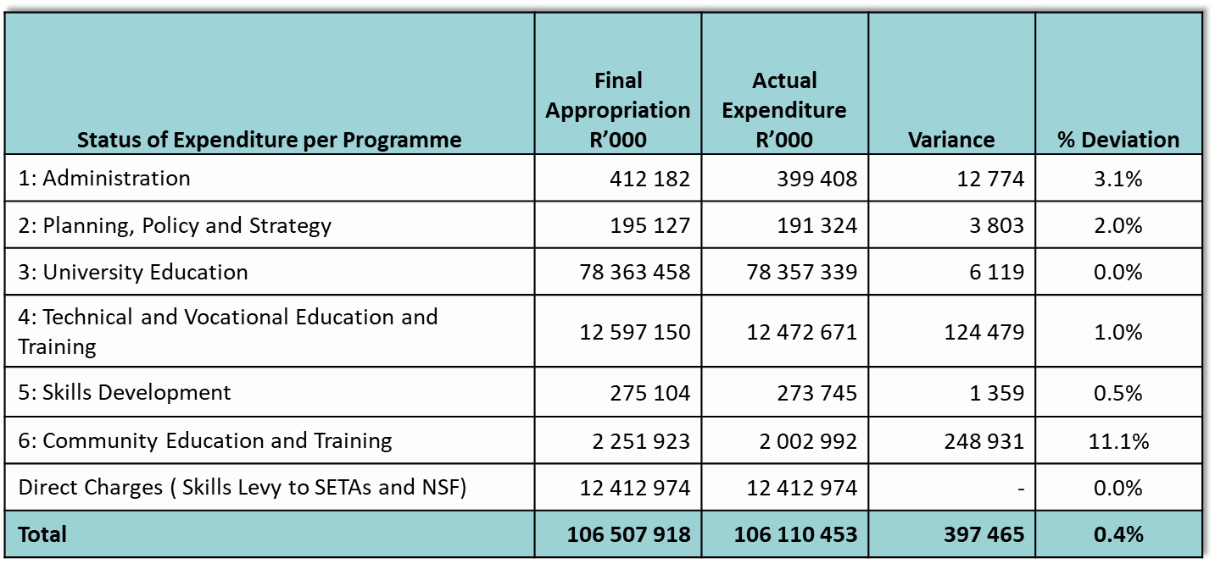
Financial Statements:
Appropriation Statement
The spending analysis per programme was as follows:

Slide 65
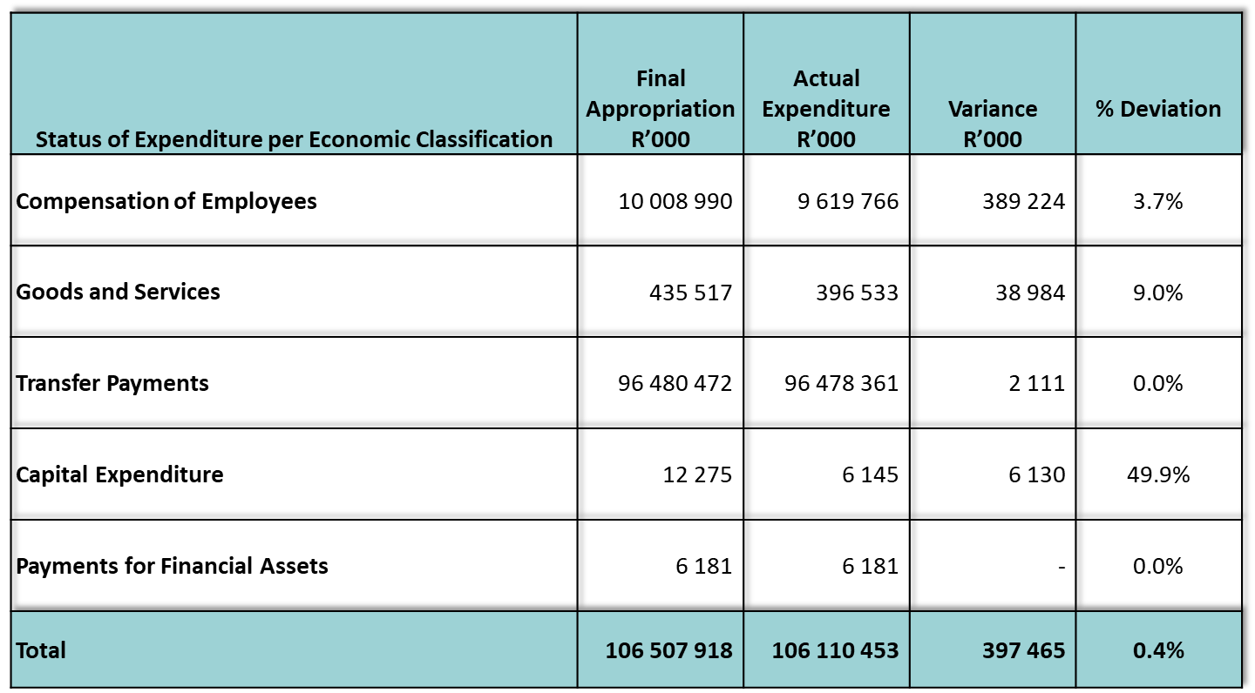
Spending on Top 10 Goods and Services Items
Financial Statements:
Appropriation Statement
 | Final Appropriation R’000 | Actual Expenditure R’000 | Variance R’000 | % Variance
Computer services | 114 750 | 114 269 | 481 | 0.4%
Operating leases | 92 362 | 91 666 | 696 | 0.8%
Travel and subsistence | 69 669 | 65 583 | 4 086 | 5.9%
Operating payments | 57 271 | 32 583 | 24 688 | 43.1%
Training and development | 21 653 | 21 529 | 124 | 0.6%
Property payments | 19 267 | 19 140 | 127 | 0.7%
Audit costs: External | 9 600 | 9 594 | 6 | 0.1%
Communication | 8 757 | 7 753 | 1 004 | 11.5%
Consultants: Business and advisory services | 7 213 | 6 887 | 326 | 4.5%
Consumable: Stationery, printing and office supplies | 12 218 | 6 012 | 6 206 | 50.8%
The spending analysis per economic classification was as follows:
65

Slide 66
2020/21: Transfers and Subsidies
Institution/Entity | R’000
Universities | 43 070 379
Public Entities
National Student Financial Aid Scheme (NSFAS) | 35 135 413
Council on Higher Education (CHE) | 54 770
South African Qualifications Authority (SAQA) | 72 519
Quality Council for Trades and Occupations (QCTO) | 25 507
HEAIDS Project | 30 621
National Institute for Humanities and Social Sciences | 38 187
TVET Colleges Subsidies | 5 315 043
CET College Subsidies | 156 812
Public Services SETA | 118 516
TOTAL | 84 017 767

Slide 67
2020/21: COVID 19 EXPENDITURE
Institution or Entity | Final Appropriation R’000 | Actual Expenditure R’000 | Variance R’000
Department | 2 803 | 2 803 | -
Universities | 2 701 385 | 1 188 889 | 1 512 496
TVET Colleges | 172 203 | 218 814 | (46 611)
Higher Health | 10 808 | 10 808 | -
Total | 2 887 199 | 1 421 314 | 1 465 885
67

Slide 68
Financial Statements: Irregular Expenditure
R10.674 million was incurred in 2020/21.
The closing balance for Irregular expenditure for the 2020/21 financial year amounts to R148.913 million as reflected under Note 25 of the Financial Statements (Page 259).
The detail of the amount of R148.913 million is as follows:
 |  | R'000
 | Opening Balance (from previous years) | 138 329
 | Incurred during 2020/21: Non-compliance with legislation | 10 674
 | Total | 148 913

Slide 69
Progress on the Irregular Expenditure cases reported in the previous years: 2015/16- 2019/20) (R 138 239m)
Item |  | FY incurred | Amount (R’000) | Status
1 | Appointment of service provider not scoring highest point during evaluation. | 2015/16-2017/18 | 137 840 | The investigation is concluded and disciplinary action was taken against the official. Based on guidance from National Treasury the Department will remove the expenditure in the current financial year.
2 | Incorrect procurement procedures were not followed | 2017/18 | 228 | The matter was investigated and a disciplinary process was completed. National Treasury approval was requested to condone the irregular expenditure.
3 | Incorrect procurement procedure due to time constraints: Catering | 2018/19 | 5 | The investigation was completed and the matter was concluded in the current financial year whereby it was determined that the expenditure was not irregular. Processes are underway to remove this expenditure from the register.
4 | Incorrect procurement procedure: Catering | 2018/19 | 2 | The matter was investigated and and it was revealed that remedial action be taken against the relevant official. The relevant official resigned. National Treasury approval was requested to condone the irregular expenditure.

Slide 70
Progress on the Irregular Expenditure cases reported in the previous years: 2015/16- 2019/20) (R 138 239m)
Item |  | FY incurred | Amount (R’000) | Status
5 | Incorrect procurement procedure: Appointment of Legal Services | 2018/19 | 96 | The matter was investigated and a disciplinary process was completed. Relevant officials to be held accountable. National Treasury approval was requested to condone the irregular expenditure.
6 | Incorrect procurement procedure: Maintenance and repairs of machinery | 2018/19 | 5 | Investigation was completed and referred to Legal Services
7 | Incorrect procurement procedure: External Computer Services: Maintenance | 2018/19 | 18 | Investigation was completed and it was revealed there is no clear and cogent evidence or grounds to rebuked the relevant official. It was further indicated that the incumbent concern must ensure that the incumbent become acquainted with the relevant Departments procurement policy, any applicable circulars as well as the relevant Treasury Regulations or Practice Notes. National Treasury approval was requested to condone the irregular expenditure.
8 | Incorrect procurement procedure for performance of extra work outside the scope of the original contract: Consultants | 2018/19 | 45 | The investigation was completed and the matter was concluded in the current financial year whereby it was determined that the expenditure was not irregular. Processes are underway to remove this expenditure from the register.

Slide 71
Progress on the Irregular Expenditure cases incurred in the current year
Item | 2020/21 | Amount (R’000) | Status
1 | Incorrect procurement procedure followed for the procurement of goods and services for tooling and training materials in support of the World Skills International Competition in Kazan (R723 518.00; R149 500.00 and R191 806.39) | 1 065 | The matter is under determination
2 | Appointments not in line with Public Service Regulations | 6 545 | The matter is under determination
3 | Appointments not in line with State Attorneys Act | 3 064 | The matter is under determination

Slide 72
Financial Statements:
Fruitless and Wasteful Expenditure
Fruitless and Wasteful expenditure is presented in Note 26 of the Notes to the Financial Statements (page 260 of the Annual Report).
No Fruitless and Wasteful expenditure incurred by the Department in the year under review.
The Fruitless and Wasteful expenditure incurred in the previous years (R9.593 million) that relates to fraudulent salary overpayments to CET College employees that are under investigation.

Slide 73
Action Plan to improve Audit Findings
Each Branch completed an audit action plan to address the control deficiencies based on the audit findings.
These plans address the areas raised in the Audit Report in conjunction with all other matters identified during the audit resulting in audit queries.
The action plan have been approved by the Accounting Officer.
Progress will be monitored and reports will be submitted on a regular basis to the Minister, the Director-General and the Audit Committee.

Slide 74
Financial Statements:
Impact on Operations
The level of spending did not have a negative impact on the operations of the Department.
Measures were put in place to prevent overspending and material underspending of the Vote.
The outcome of expenditure within the current economic pressures could place additional pressures on the Department for the 2021/22 reporting period, but all possible measures are being implemented to prevent it.
Significant pressure is still experienced to manage the additional responsibilities and functions for the TVET and CET sectors.

Slide 75
Thank You

