Slide 1
The Compensation Commissioner for Occupational Diseases (CCOD)
Presentation to Portfolio Committee on Health
Update on Activities and Performance
2020/21 Financial Year
10 November 2021
Slide 1

Slide 2
What do we do?
Provide medical assessments (benefit medical examinations) for eligible current & ex-mineworkers for occupational lung diseases
Certification of claims by medical panels
Payments of pensions and claims
Collect revenue (levies on risk shifts in controlled mines and works)

Slide 3
Highlights for 2020/21
Annual Reports for 2014/15, 2015/16 and 2016/17 submitted to parliament
2017/18 (almost finalised by Auditor-General); 2018/19 (submitted to Auditor-General)
Performance (as at 31 March 2021)
111 Benefit Medical Examinations per month ~ 718 (2019/20)
1 090 certifications per month ~ 1 482 (2019/20)
446 claims finalised per month ~ 608 (2019/20)
Total Paid – R172m to 5354 claims ~ R211m to 7291 claims (2019/20)
Neighbouring countries – R58m to 2 058 claims ~ R73m to 2 832 claims (2019/20)
During the 2020/21 year the Covid-19 pandemic affected operations

Slide 4
Annual Reports / Financial Statements
Year | Action | Target Date
2010-11 | Submitted to parliament | Completed
2011-12 | Submitted to parliament | Completed
2012-13 | Submitted to parliament | Completed
2013-14 | Submitted to parliament | Completed
2014-15 | Submitted to parliament | Completed
2015-16 | Submitted to parliament | Completed
2016-17 | Submitted to parliament | Completed
2017-18 | Annual report – signed by Minister of Health | 30 September 2021
2018-19 | AFS formally submitted. Audit opinion received. Audit&Risk Committee to review Annual report | 31 December 2021
2019-20 | AFS formally submitted. Audit finalisation in progress. Annual report in progress | 31 December 2021 (AGSA dependent)
2020-21 | AFS prepared. Audit to commence in November 2021 | 31 March 2022
2021-22 | Live processing in place for the 2021/22 AFS | 31 May 2022

Slide 5
Personnel (Level) (31 March 2021)
Designation | Level | No. of Posts | Filled | Vacant
Commissioner | 14 | 1 | 1 | 0
Director | 13 | 2 | 2 | 0
Deputy Directors | 12 | 3 | 3 | 0
Assistant Directors | 10 | 3 | 2 | 1
Senior State Accountant (Finance) | 8 | 1 | 0 | 1
Senior State Accountant (Inspector) | 8 | 2 | 2 | 0
Senior Administration Officer | 8 | 1 | 0 | 1
Administration Officer | 7 | 2 | 2 | 0
Senior Administration Clerks | 7 | 1 | 1 | 0
Personal Assistant | 6 | 2 | 1 | 1
Senior Administration Clerk | 6 | 4 | 3 | 1
Administration / Finance Clerk | 5 | 21 | 19 | 2
Switchboard operator | 4 | 1 | 1 | 0
Cleaner | 3 | 1 | 0 | 1
Messenger | 3 | 1 | 1 | 0
TOTAL |  | 46 | 38 | 8
Slide 5

Slide 6
Personnel (Profile) (31 March 2021)
Level | African |  |  |  | Coloured |  |  |  | Indian |  |  |  | White |  |  |  | Total
 | M | D | F | D | M | D | F | D | M | D | F | D | M | D | F | D | M | D | F | D
14 |  |  |  |  |  |  |  |  | 1 |  |  |  |  |  |  |  | 1
13 | 2 | 1 |  |  |  |  |  |  |  |  |  |  |  |  |  |  | 2 | 1
12 |  |  | 3 |  |  |  |  |  |  |  |  |  |  |  |  |  |  |  | 3
10 | 1 |  | 1 |  |  |  |  |  |  |  |  |  |  |  |  |  | 1 |  | 1
8 | 2 |  |  |  |  |  |  |  |  |  |  |  |  |  |  |  | 2
7 | 3 |  |  |  |  |  |  |  |  |  |  |  |  |  |  |  | 3
6 | 2 |  |  |  |  |  |  |  |  |  |  |  |  |  | 2 |  | 2 |  | 2
5 | 5 |  | 14 |  |  |  |  |  |  |  |  |  |  |  |  |  | 5 |  | 14
4 |  |  | 1 |  |  |  |  |  |  |  |  |  |  |  |  |  |  |  | 1
3 | 1 |  |  |  |  |  |  |  |  |  |  |  |  |  |  |  | 1
TOTAL | 16 | 1 | 19 |  |  |  |  |  | 1 |  |  |  |  |  | 2 |  | 17 | 1 | 21
Slide 6

Slide 7
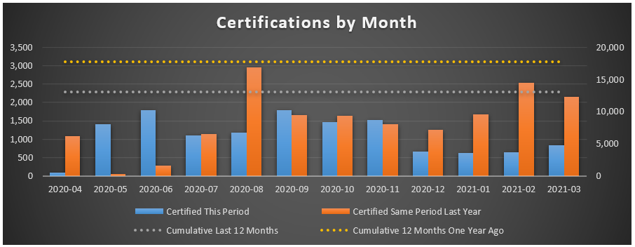
Certifications (2019/20 & 2020/21)
Slide 7

Slide 8
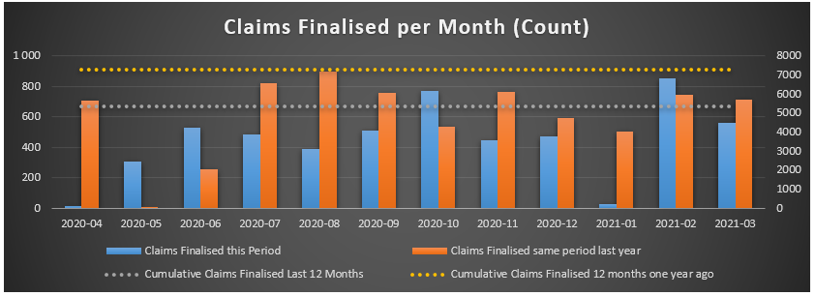
Claims finalised (2019/20 & 2020/21)
Slide 8

Slide 9
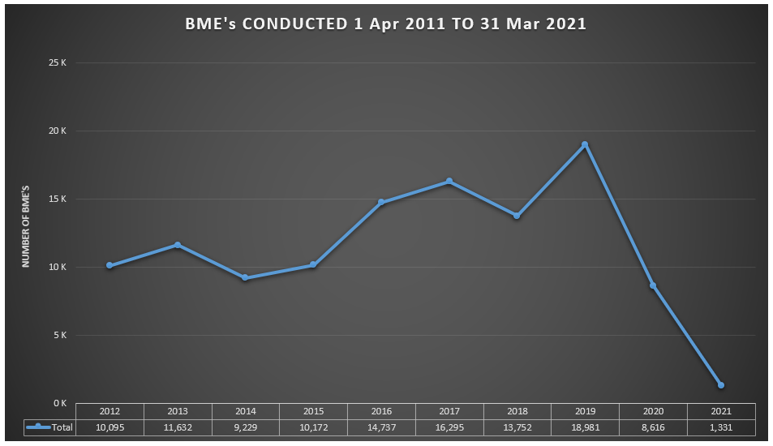
Benefit Medical Examinations (BMEs) 2011/12 to 2020/21
Slide 9

Slide 10
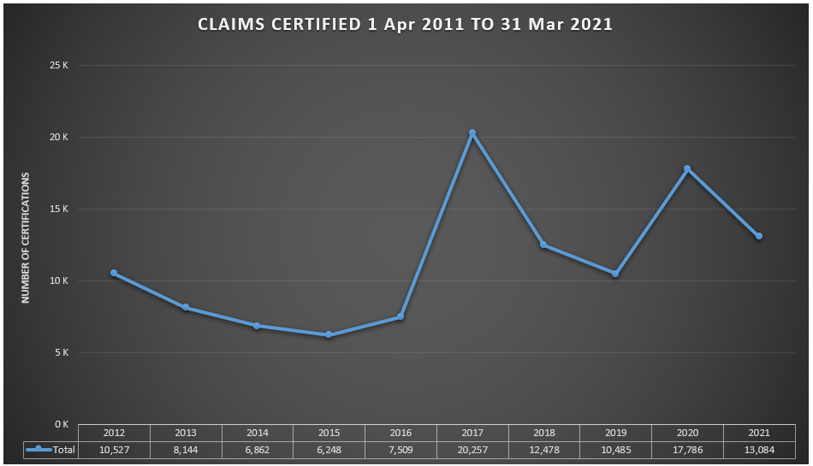
Claims certified 2011/12 to 2020/21
Slide 10

Slide 11
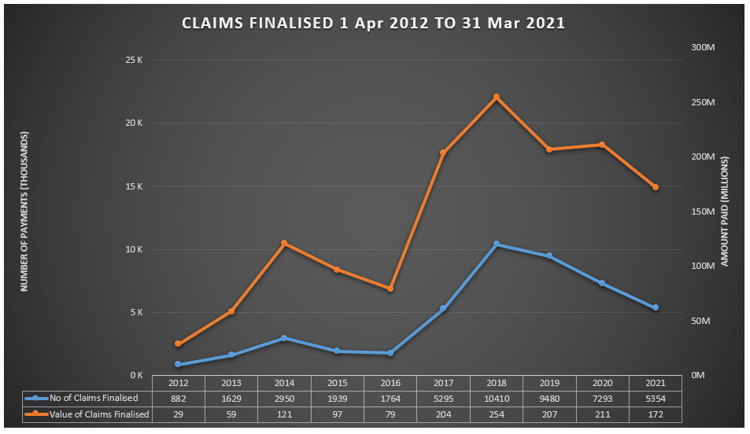
Claims finalised 2011/12 to 2020/21
Slide 11

Slide 12
Performance information
Objective | Indicator | Target (2020/21) | Performance (2020/21)
Submission of amendments to ODMWA to the Director-General of the National Department of Health | Report on the submission of amendments to the Director-General of the National Department of Health | Submission of amendments to ODMWA to the legal section of the National Department of Health | Legal team began drafting of amendments to ODMWA and one virtual consultative workshop was held with mining companies and trade unions
Ensure the effective and efficient management of the CCOD | Report on updates of database of claims at the CCOD in terms of claims, payments, certifications and data exchange updates and/or additions | Master database updated for payments made, new claims and new certifications for the month before the 7th of the next month. External data exchange updates and/or additions to the master database once a quarter | Updates were made to the master database for payments made, new claims and new certifications. External data exchanges to the master database were done once a quarter.

Slide 13
Performance Information
Objective | Indicator | Target (2020/21) | Performance (2020/21)
Ensure the effective and efficient management of the CCOD | Report on the number of certifications finalised on the Mineworkers Compensation System per year | 12 000 | 13 084
 | Report on the number of benefit payments made by the CCOD (other than pension payments) | 7 000 | 4 212

Slide 14
Performance Information
Objective | Indicator | Target (2020/21) | Performance (2020/21)
Ensure the effective and efficient management of the CCOD | Report on the number of claims finalised by the CCOD (other than pensioners) | 7 700 | 5 354
 | Of all claims finalised in the period, what percentage were finalised within 90 days of receipt of all completed claim documents | 50% | 81.6%

Slide 15
Performance Information
Objective | Indicator | Target (2020/21) | Performance (2020/21)
Ensure the effective and efficient management of the Compensation Fund | Percentage of controlled mines and works liable for payment of levies per the financial system paying levies to the CCOD | 80% of controlled mines and works paying levies to the CCOD | 65%
 | Report on the submission of annual reports of the CCOD to the Auditor General of South Africa | Submission of the 2017/18 and 2018/19 annual reports to the Auditor-General of South Africa | The 2017/18 and 2018/19 annual reports were submitted to the Auditor-General of South Africa

Slide 16
Performance Information
Objective | Indicator | Target (2021/22) (2020/21) | Performance (2020/21)
Ensure the effective and efficient management of the Compensation Fund | Report on the number of controlled mines and works inspected | 77 | 41

Slide 17
Fund Financial Performance* (31 March 2021)
R’ 000 | 2020/21 Budget | 2020/21 Actual | 2021/22 | 2022/23 | 2023/24 | 2024/25
Tax (levy) | 305 000 | 107 002 | 120 000 | 125 000 | 128 000 | 130 000
Non-tax (interest) | 235 000 | 208 603 | 205 500 | 209 500 | 217 500 | 221 500
Transfers | 4 058 | 4 058 | 1 437 | 1 544 | 1 735 | 1 183
Total Revenue | 544 058 | 319 663 | 326 937 | 336 044 | 347 235 | 353 313
*Unaudited

Slide 18
Fund Financial Performance* (31 March 2021)
R’ 000 | 2020/21 Budget | 2020/21 Actual | 2021/22 | 2022/23 | 2023/24 | 2024/25
Administration | 8 910 | 4 967 | 2 336 | 2 353 | 2 370 | 2 389
Pensioners | 4 058 | 4 058 | 1 437 | 1 544 | 1 735 | 1 813
Compensation paid | 218 330 | - | - | - | - | -
Interest Expense | - | 284 000 | 284 000 | 284 000 | 284 000 | 284 000
Valuation Gain/loss | - | 166 513 | - | - | - | -
Total | 231 298 | 459 538 | 287 773 | 287 897 | 288 105 | 288 202
*Unaudited

Slide 19
Fund Financial Performance* (31 March 2021)
R’ 000 | 2020/21 | 2021/22 | 2022/23 | 2023/24 | 2024/25
Investments | 4 936 636 | 5 142 136 | 5 251 636 | 5 469 136 | 5 590 636
Receivables | 27 073 | 27 073 | 27 073 | 27 073 | 27 073
Cash and cash equivalents | 98 587 | 41 251 | 83 898 | 24 528 | 62 139
Total assets | 5 062 296 | 5 210 460 | 5 362 607 | 5 520 737 | 5 679 848
Accumulated surplus / (deficit) | 1 551 409 | 1 590 573 | 1 638 720 | 1 697 850 | 1 762 961
Trade and other payables | 116 832 | 118 832 | 120 832 | 122 832 | 124 832
Provisions | 3 394 055 | 3 501 055 | 3 603 055 | 3 700 055 | 3 792 055
Total equity and liabilities | 5 062 296 | 5 210 460 | 5 362 607 | 5 520 737 | 5 679 848
*Unaudited

Slide 20
Voted Funds – Actual Vs Budget 2020/21 (Dept of Health) (31 March 2021)
 | Budget R’ 000 | Actual R’ 000 | Available R’ 000 | % Spent
Compensation of Employees | 39 298 | 34 702 | 4 596 | 88%
Goods and Services | 15 389 | 19 391 | (4 002) | 126%
Transfers | 4 058 | 4 058 | - | 100%
Capital | 2 893 | 2 742 | 151 | 95%
Total | 61 638 | 60 893 | 745 | 99%

Slide 21
Voted Funds - Budget (MTEF) (Dept of Health)(31 March 2021)
R’ 000 | 2020/21 | 2021/22 | 2022/23 | 2023/24
Compensation of Employees | 39 298 | 38 871 | 36 161 | 41 572
Goods and Services | 15 389 | 19 429 | 21 923 | 20 947
Transfers | 4 058 | 1 437 | 1 544 | 1 735
Capital | 2 893 | 3 415 | 3 620 | 4 160
Total | 61 638 | 63 152 | 63 248 | 68 414

Slide 22
Summary
Annual reports and audited financial statements – should clear backlog by end of this financial year
Audit qualification on revenue (recurring)
DMRE link register of mines and works & closure certificates
Completeness of revenue (contractors / owners & risk shifts)
3 finance inspectors ~ 231 controlled mines and 21 controlled works
Electronic revenue database of mineworkers and risk shifts
Continued support of Minerals Council South Africa
Working closely with the Class Action Settlement Trusts
Covid-19 pandemic and lockdowns affected performance and activities

Slide 23
Thank You
Dr Barry Kistnasamy Compensation Commissioner Department of Health barry.kistnasamy@health.gov.za 011-356 5602 0722200247
Slide 23

