Slide 1
2021 Annual
Report Presentation
Chairperson of the Board: Leah Khumalo
10 Nov 2021

Slide 2
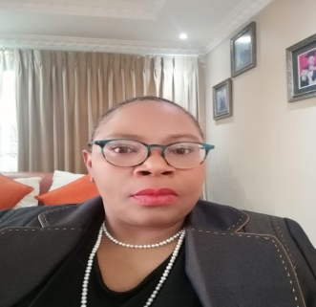
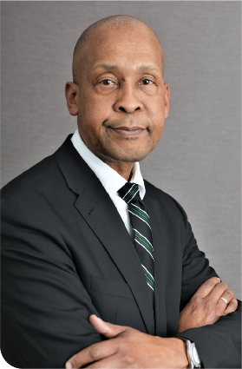
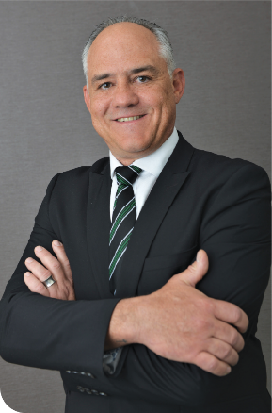
Agenda
Introduction and Performance Highlights
Leah Khumalo (Chairperson)
Performance Overview / Governance
Andrew Matseke (CEO)
Audited Annual Financial Statements
Ian van Niekerk (CFO)
Future Outlook
Andrew Matseke (CEO)

Slide 3
PERFORMANCE OVERVIEW
Slide 3

Slide 4
Executive Summary
The Company contracted with the Shareholders to achieve 19 targets as encapsulated in the Corporate Plan. This occurred prior to the outbreak of the COVID-19 pandemic. The performance for this financial year attests to the resilience of BBI employees who were not only impacted by the pandemic, but also faced the challenges caused by the Company’s OEM supplier for core network equipment.
BBI achieved 14 of the 19 targets. Out of the five targets that were not met, three were for financial sustainability; one for governance and the last was for socio-economic transformation.
Sales volumes and revenue were affected by one large customer cancellation that could have impacted the performance significantly. Despite the reduction in the number of Key Accounts Managers within the Sales team, revenue only declined by 1%. The Company could not replace these resources due to the moratorium on the filling of vacancies, as a result of the pending merger with Sentech.
It is important to note that the decline in revenue remained minimal. This was a result of the concerted efforts focused on customer retention, in order to protect the base revenue. This was achieved by the Sales team in very challenging times, and an independent Customer Satisfaction Survey conducted on behalf of the Company by BMIT is testament to the outstanding efforts of the team. The BMIT Survey report commended the efforts of the Account Management team in maintaining stability during an exceedingly challenging period in the Company’s history.
Another noteworthy achievement of BBI during the reporting period, is that it improved its B-BBEE status from Level 7 in the prior year to Level 4. This despite the various challenges that the Company had faced in this regard. The Company plans to improve on this in the next financial year.
2018
2020
2021

Slide 5
5 Years Performance Review - p75
Zero irregular expenditure
OHSAS 18001 certification retention
ISO 9001-2015 certification process started
18 PoPs optimised
The number of customers increased to 30
B-BBEE level 2
Positive EBITDA
72% achievement of the Shareholder Compact
OHSAS 18001 certification retention
ISO 9001-2015 certification 2 external audits completed successfully
The number of customers increased to 46
B-BBEE level 7
Positive EBITDA
Positive Cash flow generated from operations
64% achievement of the Shareholder Compact
OHSAS 18001 certification retention
ISO 9001-2015 certification 2 external audits completed successfully
The number of customers increased to 57
B-BBEE level 7
Positive EBITDA
Positive Cash flow generated from operations
95% achievement of the Shareholder Compact
359 SA Connect sites connected and 333 sites tested successfully end-to-end
72% increase in Sales
ISO 9001-2015 certification maintained
B-BBEE level 7
Customers increased to 79
Positive EBITDA
Positive Cash flow from operations
68% achievement of the Shareholder Compact
2017
2018
2019
2020
41 SA Connect sites connected and 67 sites tested successfully end-to-end
Decline in Sales volume and revenue
ISO 9001-2015 certification maintained
B-BBEE level 4
The number of customers increased to 101
45 Debtors days
Positive EBITDA
Positive Cash flow generated from operations
74% achievement of the Shareholder Compact
2021

Slide 6
Financial Capital – p34 & 76
Sales: R89 million new sales contracts against a target of R350 million
Improve Operating Profit: Improved by R3 million against a target of R12 million.
Debtors days: Debtors’ days were at 45 days against a target of 60 days
SMMEs payment: SMME invoices were paid within 15 days against a target of 30 days.
Revenue: 1% year-on-year decline against a target of an increase of 22% increase
Gearing Ratio: 11% Debt to Equity was achieved against a target of 154%.
Cash Balance: R88 million positive cash balance was maintained against a target of R15 million

Slide 7
Manufactured Capital – p35 &76
SA Connect Sites
Network Rebates
0.2% of gross profit paid for network rebates against a target of 0.3%
Mean time to repair
713 SA Connect Sites connected to BBI network maintained against a target of 713
6.70 hours to repair network faults against a target of 7.50 hours

Slide 8
Social and Relationship Capital – p36 &77
SMMEs
6 SMMEs were allocated installation work
Black Owned Entities
83% of total B-BBEE spend, spend on BOE
Black Women Owned
44% spend of 40% spend on BWOE
B-BBEE Spend 127% of total discretionary budget to be spend on B-BBEE
B-BBEE Level
B-BBEE Level 4 achieved against a target of Level 4
CSI
No school and province were identified

Slide 9
Human Capital
Governance – p37 & 77
Training Spent
External Audit Findings
SOC Rationalisation
1.02% of payroll spent on training
Integration Plan submitted
4 Repeat external audit findings
5
Not Achieved
19 KPIs
74%
14 Achieved

Slide 10
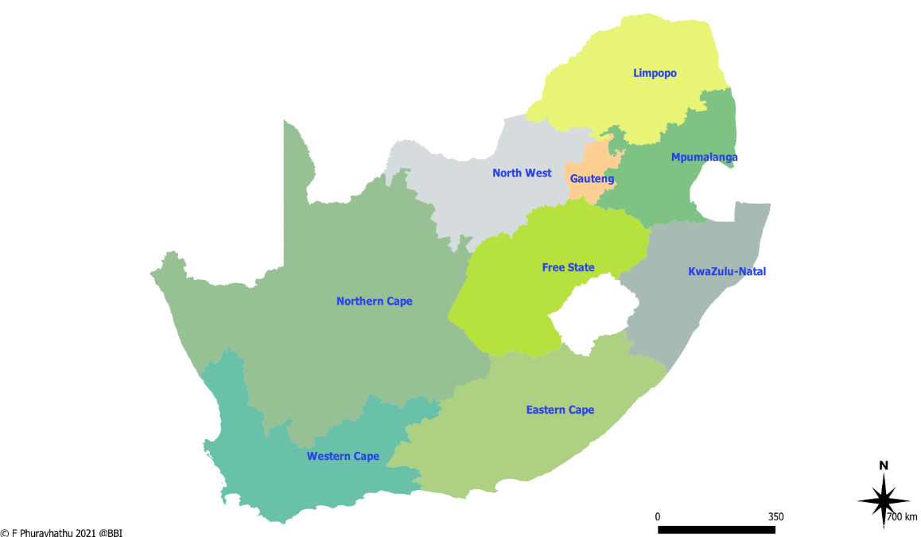
SA Connect Sites maintained
Zimbabwe
51
Botswana
Mozambique
125
77
eSwatini
Namibia
Under-capitalisation of the Company.
Difficulty in securing short to medium-term funding from external parties.
Continued poor financial performance.
122
122
54
Lesotho
162

Slide 11
SOC Rationalisation
Activities | Date
Service Provider Tender Adjudication | 16 & 17 November 2020
SDIC Strategy Development Entities Kick Off Workshops | 7 December 2020
SDIC Strategy presented to entity Excos & SMs | 29 January 2021
SDIC Strategy presented to Boards | 2 February 2021
SDIC Strategy presented to DCDT | 31 March 2021
Slide 11

Slide 12
GOVERNANCE
Slide 12

Slide 13
Top Strategic Risks: p48- 51
Key Risks
Strategic Objective | Risk Description | Root causes | Inherent Risk Rating | Residual Risk Rating | Management Action Plan
To strengthen BBI's financial position for growth and sustainability. | Delay in conversion of the Shareholder loan to Equity. | Dependency on long governance processes. Lack of buy in from stakeholders. | Level 1 Very High | Level 3 Medium | Minister and IDC intervention to convert the Shareholders loans Implementing conversion of Shareholders loans
To strengthen BBI's financial position for growth and sustainability. An increased base achieved through customer fulfilment and state of the art infrastructure and services. | Possible failure to continue as a going concern. | Under-capitalisation of the Company. Difficulty in securing short to medium-term funding from external parties. Continued poor financial performance. | Level 1 Very High | Level 2 High | Embed and continue to optimise pricing strategy. Renegotiation of key suppliers’ contracts. (Single supplier sourcing) Rigorous cash management. Continue to apply for funding from third parties. Faster execution or implementation of projects which are billable or fundable
To enable the organisation to deliver upon the mandate. | Moratorium on filling of vacancies | Intention to minimise job losses in preparation for the merger between BBI and Sentech. Cost containment strategy aiming at reducing employment cost within SOCs environment. | Level 1 Very High | Level 1 Very High | Submission to the shareholder to lift the moratorium. Co- sourcing. Internal redeployment of staff through secondment and rotation.
Dependency on long governance processes.
Lack of buy in from stakeholders.
Under-capitalisation of the Company.
Difficulty in securing short to medium-term funding from external parties.
Continued poor financial performance.

Slide 14
Top Strategic Risks: p48- 51
Key Risks
Strategic Objective | Risk Description | Root causes | Inherent Risk Rating | Residual Risk Rating | Management Action Plan
To strengthen BBI's financial position for growth and sustainability. | Difficulty to raise funds. | No track record of historical debt. Risk Adversity of Banks to fund technically insolvent institutions. Delay in conversion of shareholders loan into equity. Lack of shareholder support on issuing of required guarantees to access funding. | Level 1 Very High | Level 2 High | Extended credit terms with major suppliers (rated and international suppliers). Continue to apply for funding from external parties.
To strengthen BBI's financial position for growth and sustainability. A preferred partner of Government in enabling the digital transformation. | Lack of access to state-owned fibre infrastructure. | Non-approval and lack of support from relevant Government structures to consolidate state owned infrastructure. Includes the process of changing relevant legislation and policies. Internal ability to influence national policy decision. Lack of understanding of the BBI Act. | Level 1 Very High | Level 2 High | Draft a business case for Minister to intervene on behalf of BBI.
Dependency on long governance processes.
Lack of buy in from stakeholders.
Under-capitalisation of the Company.
Difficulty in securing short to medium-term funding from external parties.
Continued poor financial performance.

Slide 15
Governance: Board Meetings - p89
Number of Meetings | 2017/18 |  | 2018/19 |  | 2019/20 |  | 2020/21
 | No | % | No | % | No | % | No | %
Members
M Ngcobo* | 7/8 | 85 | 7/8 | 85 | 7/7 | 100 | 7/7 | 100
Z Kabini | N/A | - | N/A | - | 6/7 | 86 | 7/7 | 100
S Mabalayo | 5/8 | 61 | 5/8 | 62 | 5/7 | 71 | 7/7 | 100
L Mabece | N/A | - | N/A | - | 7/7 | 100 | 6/7 | 86
G Mphefu | N/A | - | N/A | - | 7/7 | 100 | 6/7 | 86
N Selamolela | 7/8 | 85 | 7/8 | 85 | 6/7 | 86 | 5/7 | 71
J Schreiner | N/A | - | N/A | - | 6/7 | 86 | 6/7 | 86
Mr A Matseke | 2/2 | 100 | 2/2 | 100 | 7/7 | 100 | 7/7 | 100
Mr I van Niekerk | 8/8 | 100 | 8/8 | 100 | 7/7 | 100 | 7/7 | 100
Chairperson
N/A Not a Member

Slide 16
Status of addressing audit findings 2020/21
The Audit Report received was Unqualified with findings
The findings on the report related to:
Going concern
Irregular Expenditure
Assets, and financial information

Slide 17
Status on addressing audit findings
Area of Audit Findings | Details of Findings | Action Plan to Address Audit Findings | Progress on implementation of Action Plan
Finance | Material uncertainty related to going concern | The Company is in discussion with funders for specific ring-fenced projects that would generate sufficient revenue to service the loans and add to the overall profitability of the Company. Management further notes the recommendations made by the auditors and which to direct the auditors to the action plan that was developed and being implemented as part of the turnaround strategy of Company. | This is ongoing
SCM | Irregular expenditure incurred | BBI implemented the new Framework, setup a Loss Control Steering Committee and complies to the relevant legislation. Management is presenting previous reported irregular expenditure to National Treasury to request condonation. Once this avenue is completely exhausted, with the Accounting Authority (the Board of Directors) be approached to request the write off of the irregular expenditure, per the framework and BBI’s policy. | This is ongoing
 | Creditors with debit balances not reclassified | Reallocation of Creditors with Debit balances and Debtors with Credit balances are always the last correction made to the AFS and is merely an administrative action. It is not a reflection on any internal control deficiencies. | Completed

Slide 18
Status on addressing audit findings
Area of Audit Findings | Details of Findings | Action Plan to Address Audit Findings | Progress on implementation of Action Plan
Finance | Non cashflow items included on the cash flow statement. | The reversal of the day one gain was mistakenly shown on the cash flow, and later corrected. There was not breakdown in controls, as it was the accounting for the conversion of the Shareholders’ loan into equity. | Completed
 | Assets carried at R1 net book value or less. | The fully depreciated assets will continue being in operation until the asset replacement plan is fully implemented. | Not Yet Due
 | Asset attributable costs not capitalized to the main asset. | For the last number of years, all individual capital expenses relating to specific asset have been capitalised as part of that specific PPE item, as an example project management costs. It is only historical individual capital costs that remain. | Not Yet Due
 | Lack of descriptive information on fixed asset register Analysis | Management will engage with the OEM that supplies most of the infrastructure equipment and request the database of licenses and other software information pertaining to our intangible assets so that the fixed asset register can be updated accordingly. | 31 March 2022
SCM | Discrepancies identified in the supply chain management policy | The above comment is noted. Management will correct this discrepancy during the next SCM policy review. | Due 31 December 2021.

Slide 19
ANNUAL FINANCIAL STATEMENTS
Slide 19

Slide 20
Financial Position - p108
Assets
^{Increased by R14m}
^{ROU assets R26m}
Cash
^{Maintained at R88 million.}
Equity
^{Shareholders Loans}
Converted into equity in 2021 – Net asset value
Non-current Liabilities
^{Lease Labilities – R30m}

Slide 21
Statement of Profit or Loss – p109
R’m | Audited March 2017 | Audited March 2018 | Audited March 2019 | Audited March 2020 | Audited March 2021
Revenue | 397 | 379 | 411 | 469 | 463
Cost of sales | (222) | (187) | (181) | (217) | (222)
Gross profit | 175 | 192 | 230 | 252 | 241
Other Income | 83 | 90 | 178 | 103 | 1
Operating expenses | (303) | (304) | (320) | (351) | (334)
Results from operations | (46) | (23) | 87 | 4 | (93)
Finance income | 6 | 3 | 4 | 7 | 3
Finance costs | (85) | (94) | (106) | (122) | (16)
Profit/ (Loss) before taxation | (124) | (113) | (14) | (111) | (106)
Income tax expense | (3) | (0) | (0) | (0) | 0
Profit/ (Loss) for the year | (127) | (113) | (14) | (111) | (106)
EBITDA | 35 | 36 | 102 | 71 | 78
Revenue
^{Decreased by 1% year on year}
Cost of Sales
^{Increased by 2% year on year}
Operational Expenses
^{Decreased by 5% year on year}
Operational Loss
^{Decreased by R5m to R106m}
(normalised loss in 2019 – R114m)

Slide 22
Financial Performance

Slide 23
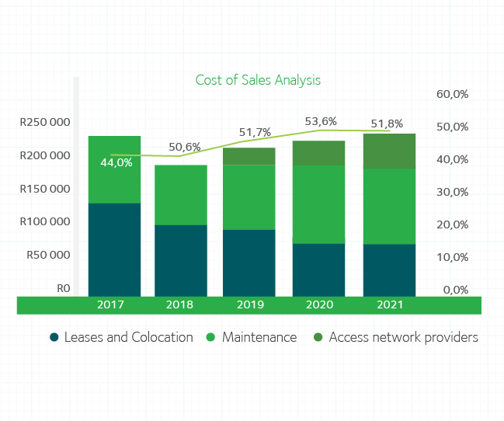
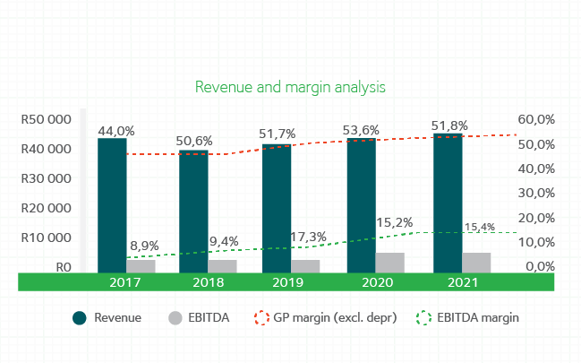
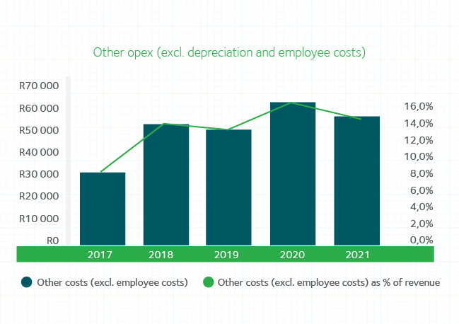
Financial Performance

Slide 24
Internal Control: Irregular Expenditure - p139
R’000 | Audited March 2018 | Audited March 2019 | Audited March 2020 | Audited March 2021
Opening balance | 0 | 1 603 | 53 935 | 82 747
Incurred and identified in current year
Continued to utilise services after contract expired |  |  |  | 247
Contract renewal not approved by NT |  |  |  | 51
Incurred in previous years incurred in the current year
Non-compliance to cost containment instructions issued by National Treasury | 202
Non-compliance to a provision of legislation (Co Act) | 1 401
Continued to utilise services after contract negotiations failed |  | 6 398
Website Hosting |  | 31
Tender not advertised for 21 working days |  | 5 974 | 15 095
Continued to utilise services after contract expired |  | 874 | 858 | 793
Contract renewal not approved by NT |  | 0 | 5 467 | 4 984
Carried forward | 1 603 | 14 879 | 75 355 | 88 822

Slide 25
Internal Control: Irregular Expenditure - p139
R’000 | Audited March 2018 | Audited March 2019 | Audited March 2020 | Audited March 2021
Brought forward | 1 603 | 14 879 | 75 355 | 88 822
Incurred in prior year, identified in the current year
Continued to utilise services after contract negotiations failed |  | 26 324
Tender not advertised for 21 working days |  | 3 885 | 7 392
Continued to utilise services after contract expired |  | 9 049
Removal from register |  | (202) |  | (32 346)
Condoned during the year
Amount not condoned carried over* | R1 603 | R53 935 | R82 747 | R56 476
*Internal processes in progress
Note that the irregular expenditure relating to the tender that was not advertised for 21 days has now been removed from the register. We received confirmation from the AG in terms of the new framework on irregular expenditure, transgressions of own policies are still a non-compliance, but no longer seen to be irregular expenditure.
We are in process of requesting condonation through the process for the rest of the irregular expenditure.

Slide 26
Five Years External Audit Findings - p100 - p103
Department | Finding Category | Total number of findings 2016/17 | Total number of findings 2017/18 | Total number of findings 2018/19 | Total number of findings 2019/20 | Total number of findings 2020/21
Finance | Going Concern (Repeat 1) | 1 | 1 | 1 | 1 | 1
 | Commitments; Provisions and Revenue, Financial Classifications (Repeat 1) | 4 | 5 | 1 | 4 | 1
 | Property Plant and Equipment (Repeat 1) |  | 3 | 4 | 5 | 3
 | Trade and other payables (Repeat 1) | 1 |  | 2 | 3 | 1
 | Irregular, fruitless and wasteful expenditure |  | 1 |  |  | 1
SCM | Compliance |  | 2 | 2 | 1 | 1
HRM | Compliance |  | 1
CEO Office | Compliance :Performance Information | 5 | 2 |  | 1
Shareholder | Compliance (Repeat) (MOI) | 1 |  | 1
IT | User Access; General and Application controls |  | 7 | 1
Company secretariat | Compliance |  | 2 | 1
Total |  | 12 | 24 | 13 | 15 | 8

Slide 27
FUTURE OUTLOOK
Slide 27

Slide 28
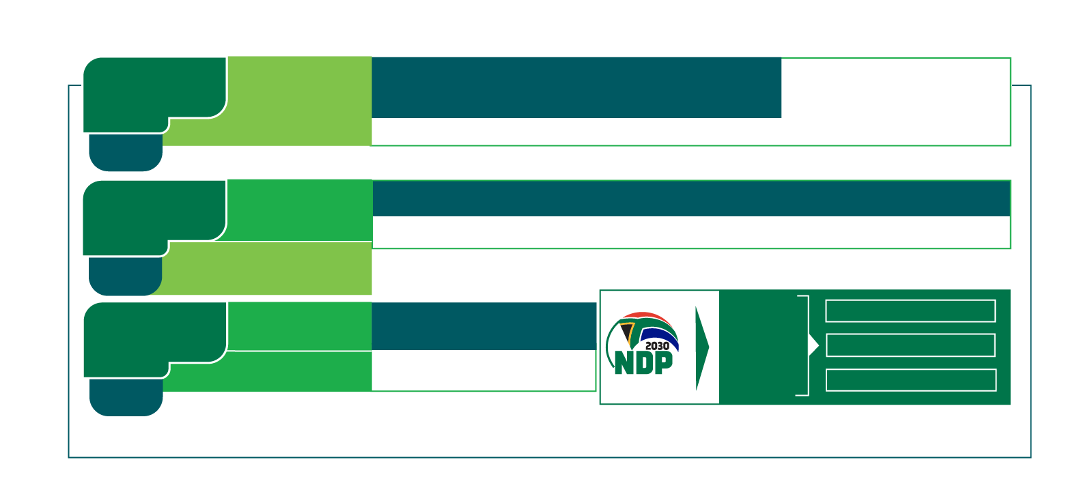
Review 2030 strategy
Focus Area
Outcome
Grow Services to
Enable Digital
Transformation
Enable
Last Mile
Connectivity
5. The preferred partner of Government in enabling the digital transformation
Phase 3 considers growth beyond the infrastructure core mandate that will enable the digital transformation of the State
6. Facilitated Socio-Economic Transformation
PHASE 3
Build Infrastructure
& Grow Customer
Base
Enable Digital
Transformation
& Infrastructure
3. An increased base achieved through customer fulfillment and state-of-the-art infrastructure and services
4. The preferred partner of Government in enabling the digital transformation
PHASE 2
Enable Last Mile
Connectivity
Financial &
Operational
Sustainability
1. To strengthen BBI’s financial position
for growth and sustainability
Supports the attainment of key DCDT
Focus Areas as well as NDP targets
DIGITAL TRANSFORMATION
Stabilise & Mobilise
ENABLING DIGITAL ENVIRONMENT
Organisational
Enablement
2. To enable the organisation to deliver upon the mandate
DIGITAL INFRASTRUCTURE
PHASE 1
FY2020/21
FY2024/25
FY2029/30

Slide 29
Future Outlook: Shareholder Funding
BBI Act & established
BBI Licensed
Neotel ROU End
 | 2006 /2007 | 2007/2008 | 2008/2009 | 2009/2010 | 2010/2011 | 2011/2012 | Total
DPE * | - | R 627 000 000 | R 377 000 000 | R 208 530 000 | R 138 599 926 | - | R 1 351 129 926
IDC | - | - | R 352 756 756 | R 73 267 298 | R 48 697 297 | - | R 474 721 351
Total | - | R 627 000 000 | R 729 756 856 | R 281 797 298 | R 187 297 223 | - | R 1 825 851 277
The above is an indication of the capitalisation received by BBI to date from Shareholders.
The Company requires further capitalisation to remain financially sustainable.
BBI is a Schedule 2 entity in terms of the PFMA, and can raise capital from the markets using its Balance Sheet.
In FY 2016/17 there was a change in accounting standards which classified the above Shareholders’ Loans as long-term liabilities and not Equity.
BBI started the process of having these Shareholders’ Loans converted to Equity, in order to strengthen the Balance Sheet and make it possible to raise funding.
The Minister of Communications and Digital Technologies approved the conversion of the DCDT Shareholder Loan to Equity on 7 June 2019.
In November 2019, the Board of the IDC supported the conversion of the IDC Shareholder Loan into Equity. The Minister of Trade, Industry and Competition endorsed the conversion on 4 March 2021.
The conversion is now complete.
Slide 29

Slide 30
Future Outlook: Network Investment Plan and Funding
Lack of investment by shareholders
The last investment made by the Shareholders was in FY 2010/11.
This lack of investment has forced BBI to operate in an inefficient survival mode.
Using cash flow from operations to fund capex requirements which is insufficient.
Causes limited funds to be available for working capital requirements.
Some claw back now required to spend on infrastructure and manage working capital.
Over the last 6 years, more than R460 million of cash generated from operations has been utilised for infrastructure investments.
Grow Services to
Enable Digital
Transformation
Enable
Last Mile
Connectivity
PHASE 3
Build Infrastructure
& Grow Customer
Base
3. An increased base achieved through customer fulfillment and state-of-the-art infrastructure and services
PHASE 2
Enable Last Mile
Connectivity
Financial &
Operational
Sustainability
1. To strengthen BBI’s financial position
for growth and sustainability
Supports the attainment of key DCDT
Focus Areas as well as NDP targets
DIGITAL TRANSFORMATION
Stabilise & Mobilise
ENABLING DIGITAL ENVIRONMENT
DIGITAL INFRASTRUCTURE
PHASE 1

Slide 31
Future Outlook: Network Investment Plan and Funding
Network Upgrade Strategy
One of the key challenges that needs to be addressed urgently is the lack of available capacity on the network.
Capacity is required both for redundancy as well as direct customer provisioning.
Further investment for additional capacity upgrade is required in order to run a resilient network smoothly.
A scalable network is required to match the growing demand for bandwidth. The network capacity increase needs to cater for the expected introduction of 5G.
Problem Statement
BBI has identified over R1 billion of critical investment in infrastructure that needs to be carried out over the next 4 years;
The key challenge is the funding mechanism for these projects – especially at a time when BBI is expected to be self-funding and self-sustaining.
Investment Rationale
BBI has an opportunity to grow the 10% Wholesale Market Share (per BMIT) through capacity investment.
Grow Services to
Enable Digital
Transformation
Enable
Last Mile
Connectivity
PHASE 3
Build Infrastructure
& Grow Customer
Base
3. An increased base achieved through customer fulfillment and state-of-the-art infrastructure and services
PHASE 2
Enable Last Mile
Connectivity
Financial &
Operational
Sustainability
1. To strengthen BBI’s financial position
for growth and sustainability
Supports the attainment of key DCDT
Focus Areas as well as NDP targets
DIGITAL TRANSFORMATION
Stabilise & Mobilise
ENABLING DIGITAL ENVIRONMENT
DIGITAL INFRASTRUCTURE
PHASE 1

Slide 32
Future Outlook: Network Investment Plan and Funding
Investment Rationale (cont.)
2019 Performance is indicative of the potential, where performance was close to target and this was with reasonable capacity and cash flow as well as adequate staff capacity.
BBI is positioned to take on SADC integrator of choice due to established relationships and long term development of SATA (Southern African Telecommunications Association) relationships which support BBI.
BBI has managed to acquire, grow and retain the most sought after Key Accounts despite all the challenges.
Solution
BBI’s projects and assets are all revenue generating assets.
BBI has over the years, increased its customer base and managed to conclude contracts with its customers – this has resulted in steady cashflows from these customers/ contracts
A funding structure, backed by these contracts and cashflows, is considered the most appropriate for the company.
A hybrid Project Finance/Balance Sheet funding model – with ringfenced project cash flows are being implemented
This model is most suitable for on balance sheet funding of projects that have distinctive and clearly attributable cashflows.
Grow Services to
Enable Digital
Transformation
Enable
Last Mile
Connectivity
PHASE 3
Build Infrastructure
& Grow Customer
Base
3. An increased base achieved through customer fulfillment and state-of-the-art infrastructure and services
PHASE 2
Enable Last Mile
Connectivity
Financial &
Operational
Sustainability
1. To strengthen BBI’s financial position
for growth and sustainability
Supports the attainment of key DCDT
Focus Areas as well as NDP targets
DIGITAL TRANSFORMATION
Stabilise & Mobilise
ENABLING DIGITAL ENVIRONMENT
DIGITAL INFRASTRUCTURE
PHASE 1

Slide 33
Future Outlook: SOC Rationalisation
Activities | Date
High level Acquisition Strategy | 17 September 2021
Detailed Acquisition Strategy | 1 December 2021
Employee Engagements, including Regional Visits | Oct 2021 – Feb 2022
SDIC Corporate Plan | 28 February 2022
Integrated Company | 1 April 2022
Slide 33

Slide 34
Grow Services to
Enable Digital
Transformation
Enable
Last Mile
Connectivity
PHASE 3
Build Infrastructure
& Grow Customer
Base
THANK YOU
PHASE 2
Enable Last Mile
Connectivity
Financial &
Operational
Sustainability
Stabilise & Mobilise
DIGITAL INFRASTRUCTURE
PHASE 1

