Slide 1
Presentation- GCIS Annual Report 2020

Slide 2
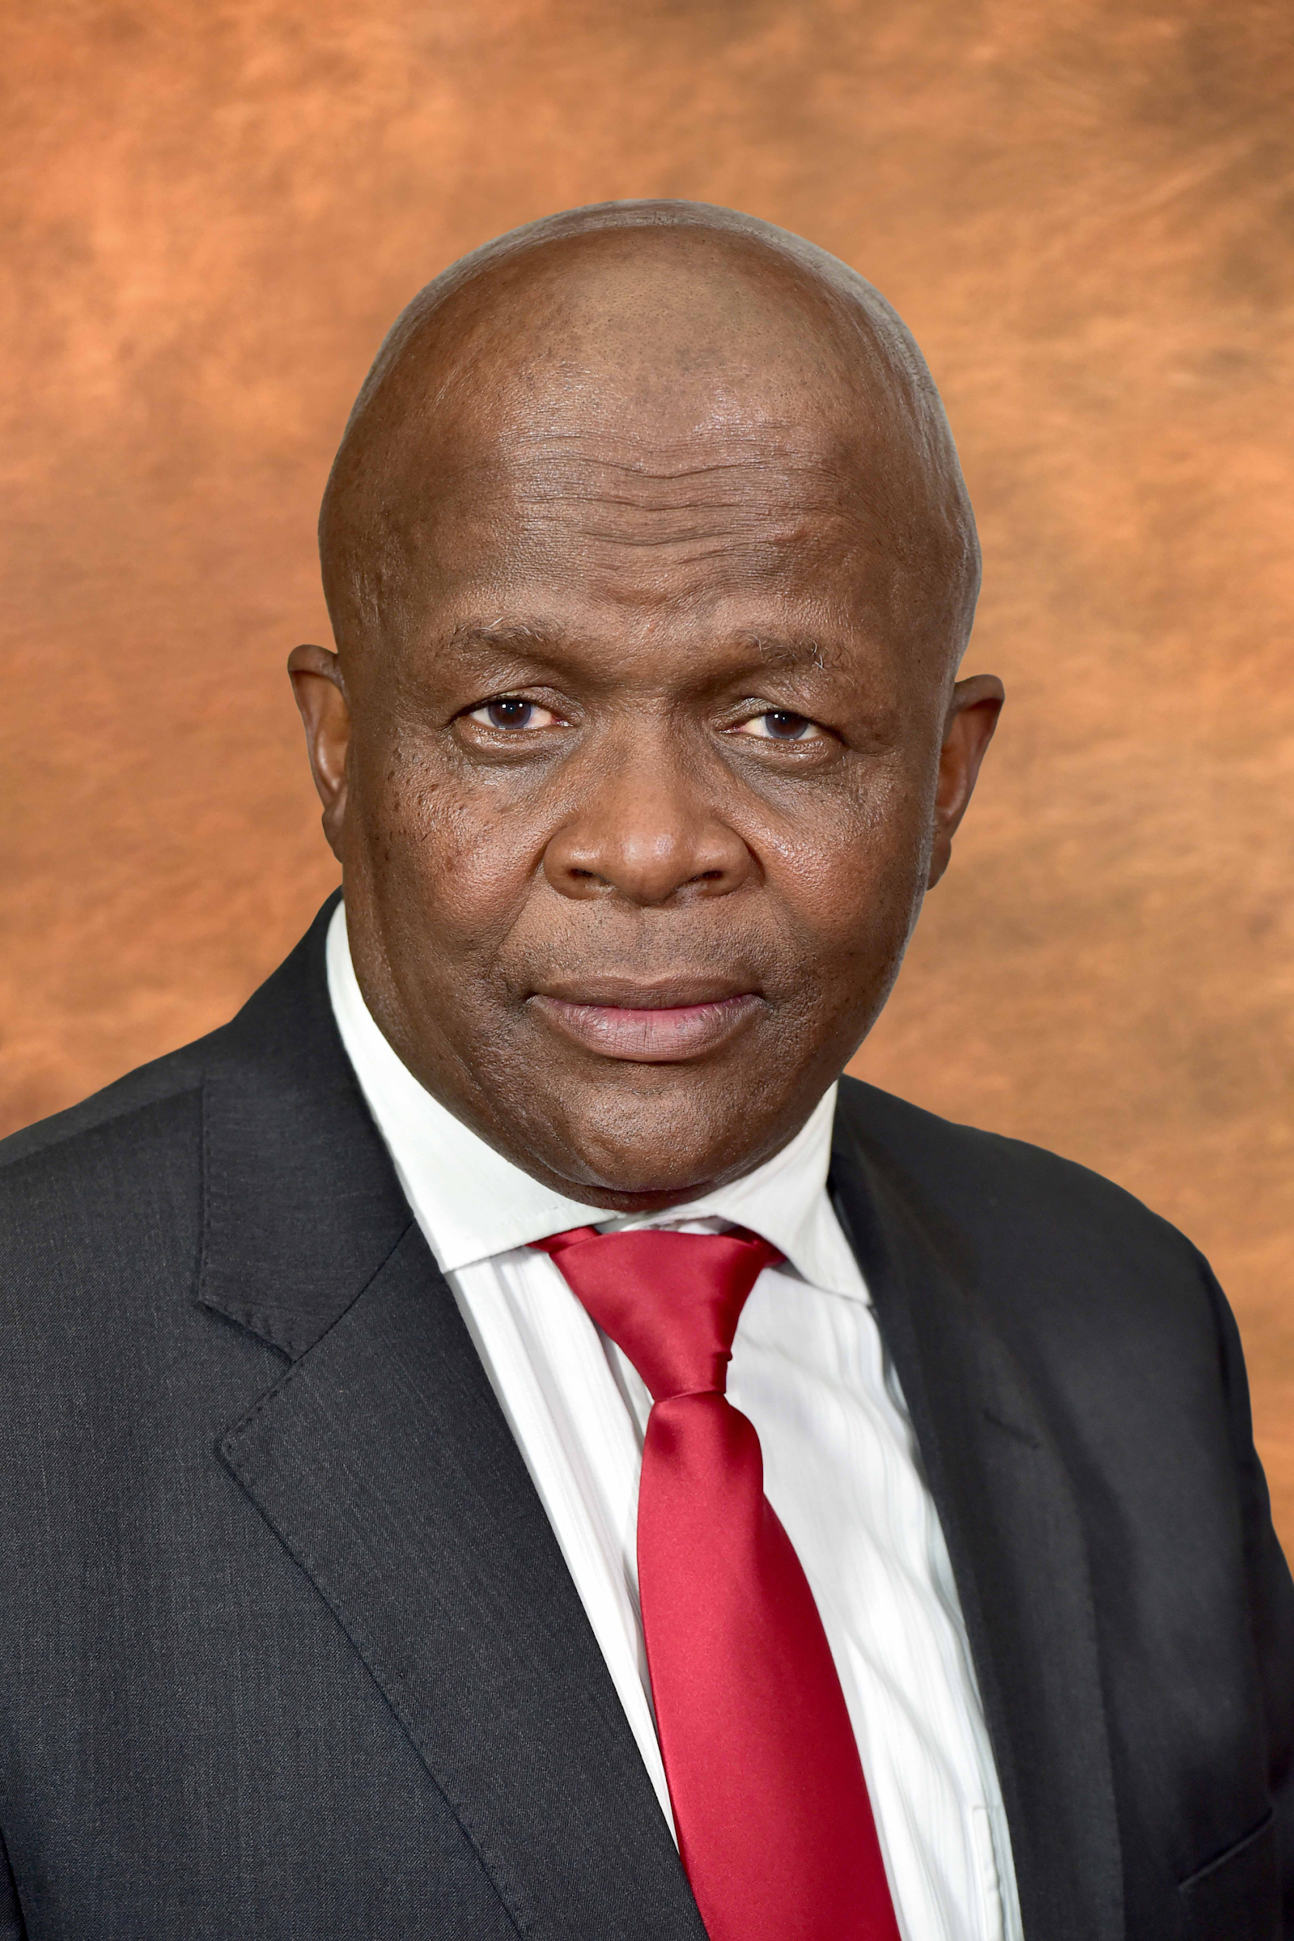
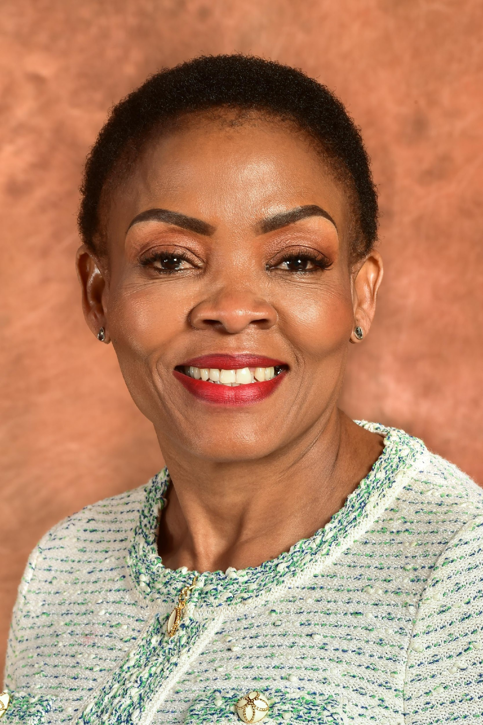
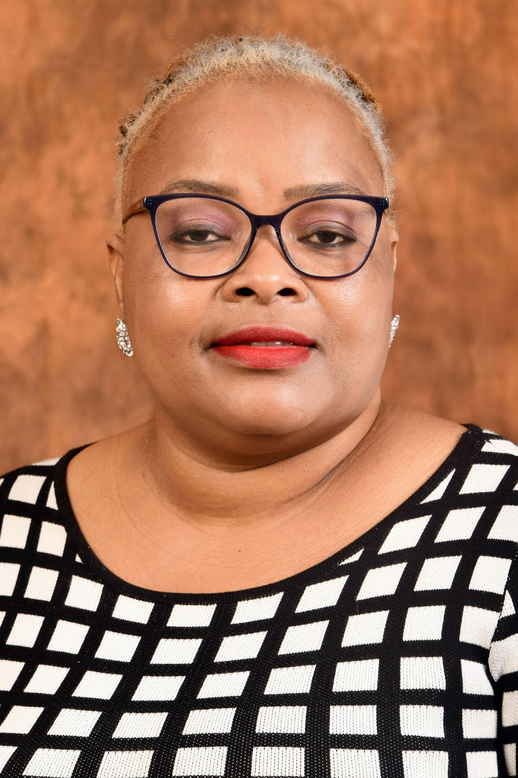

Slide 3
Presentation Outline
Mandate
Vision, Mission and Values
Organisational context
Strategic Overview
Response to Covid-19
Communication Focus
2021 Summary of Ogranisational Performance
Overview of Achievement Programme 1
Overview of Achievement Programme 2
Overview of Achievement : Programme 3
Financial Performance
Areas of Underachievement
Conclusion

Slide 4
1. GCIS MANDATE
To coordinate, guide and advise on government communications, including media liaison, development communication and marketing.
Achieve integrated, coordinated and clear communications between government and South African citizens to enable the public involvement in the country’s transformation.

Slide 5
2. VISION, MISSION AND VALUES
Vision : To be the pulse of communication excellence in government.
Mission: To deliver effective strategic government communication.
Set and influence adherence to standards and coherence of
message and proactively communicate with the public about
government policies, plans, programmes and achievements.
Values:
Professionalism; Diversity; Openness & transparency, Innovation,
Honesty & integrity

Slide 6
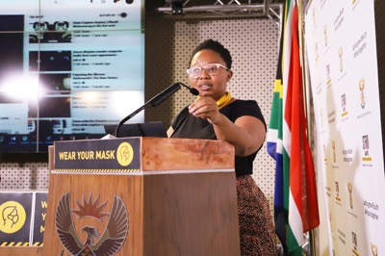
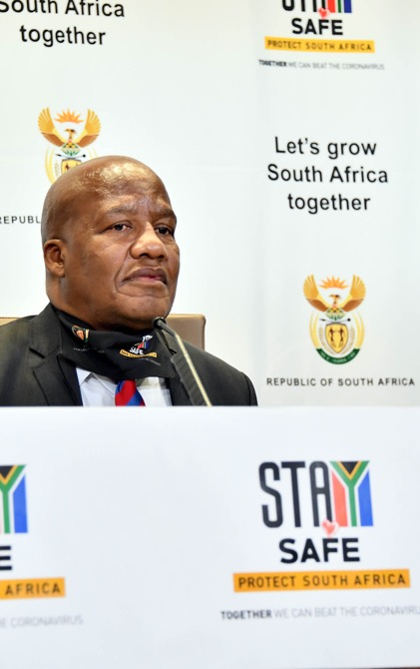
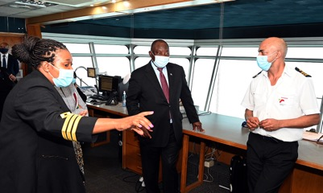
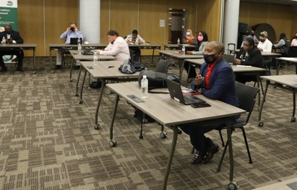
3. ORGANISATIONAL CONTEXT
The priority of the GCIS and its entities is to ensure that the public is provided with timely, accurate and accessible information.
The focus has been on information dissemination on COVID-19 as well as access to economic opportunities and social-relief packages.
The GCIS enjoys a footprint in all nine provinces in line with its mandate.

Slide 7
4. STRATEGIC OVERVIEW
The 2020/21 financial year was a period during which government continued its efforts to grow the economy, build a capable and ethical state, improve the living conditions of South Africa and contribute to a better Africa and a better world.
SA was confronted by unprecedented challenges that mirrored the global public health and economic crisis. Covid -19 This situation created unprecedented demand and responsibility for official communications
GCIS coordinated all-of-government communications on all dimensions of the pandemic. We placed a focus on the depth of successive waves of illness and death. We helped South Africans understand the serious threat posed by an unseen enemy in the form of a virus
We also created information resources that gave economically vulnerable people access to the broad range of economic and social relief measures that government had innovated

Slide 8
STRATEGIC OVERVIEW
communications extended to the global community so that people in our region, on our continent and around the world .
We built partnerships with communicators in civil society - including organised business and labour as well as faith-based communities and traditional leadership - to ensure messaging was clear, consistent and relevant to all sectors of society. We further worked with epidemiologists and behavioural scientists to empower the nation with information on how best to protect themselves
We supported and profiled South Africa’s role as Chair of the African Union and President Ramaphosa’s rapidly developing role as a champion for the fight against COVID-19 and the fight for vaccine equity at the global level.
While our communications relied on evolving scientific insights, we dealt as vigorously with the dangerous and disruptive reality of misinformation and disinformation

Slide 9
STRATEGIC OVERVIEW
We explored and exploited the facilities offered by technology that allowed us to work and communicate remotely. We adopted webinars and virtual engagements as fundamental tools of trade.
The vaccination roll out programme open a new focus on informing about benefits of vaccination and we sought to inform and inspire South Africans to protect themselves and enable our march towards economic recovery and the transformation of our society
The year 2020/21 has also ensure our information and advocacy on GBVF and anti corruption focus was also factored in , though not to the extent we focused on COVID-19. This is due to the fact that GCIS was only given budget to do awareness and mobilisation on COVID and not in any of the other campaigns

Slide 10
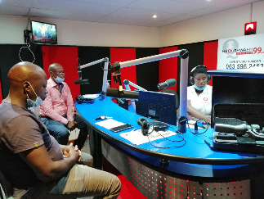
5. INSTITUTIONAL RESPONSE TO COVID-19
GCIS was allocated a budget of R50m towards the advocacy on COVID-19
The partnerships we developed with business, media and civil society almost tripled the coverage of the campaign we ran across all the provinces;

Slide 11
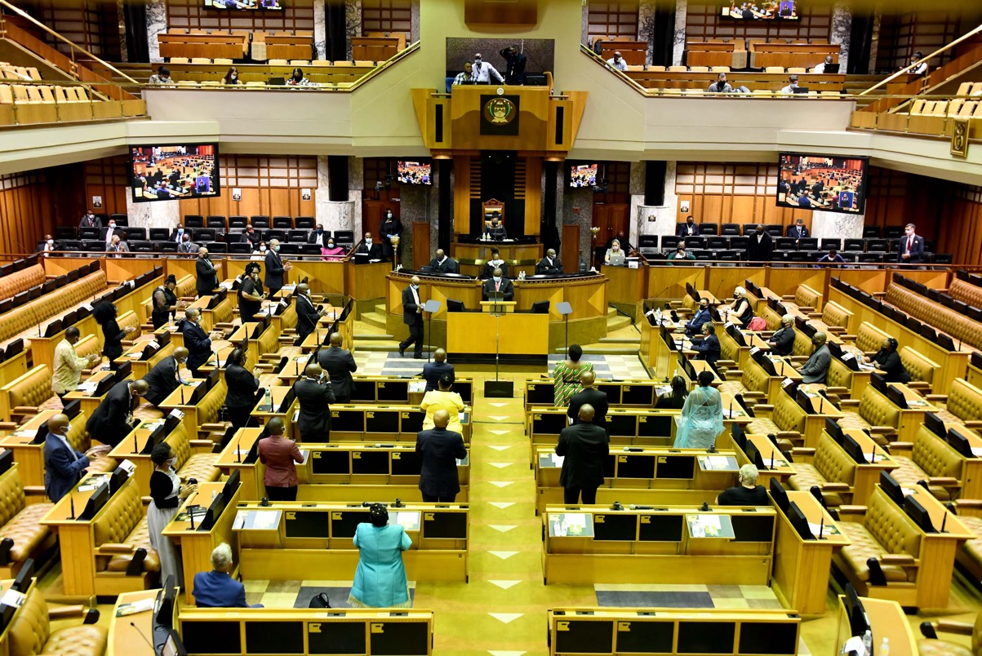
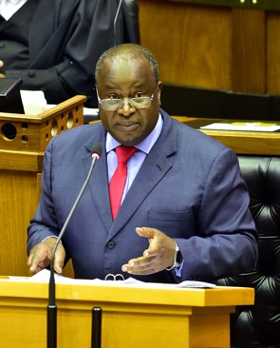
6. 2020/21 COMMUNICATION FOCUS
COVID -19 (daily stats, interventions, national lockdown information, vaccine roll-out and education)
Gender Based Violence (GBVF)
Economic Reconstruction and Recovery Plan (ERRP) - (Entrepreneurship and the economy)
Anti-corruption

Slide 12
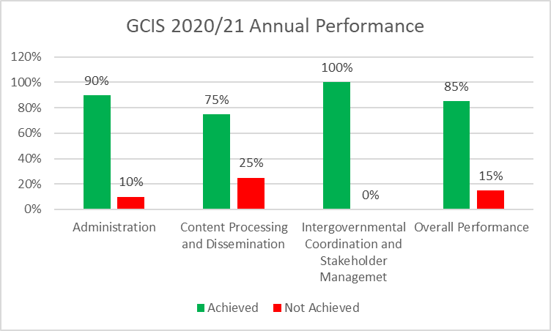
7. 2020/21 SUMMARY OF ORGANISATIONAL PERFORMANCE
GCIS achieved 85% performance (40 targets achieved out of 47 planned targets) for the 2020/21 Financial Year
The GCIS received
a Clean-Audit Outcome for the 2020/21 financial year

Slide 13
8. 2020/21 PERFORMANCE PER PROGRAMME
Programme 1: Administration
Purpose: Provide strategic leadership, management and support services to the department
OVERVIEW OF ACHIEVEMENTS
Reduced the vacancy rate from 10.49% in 2019/2020 to 8.44% in 2020/21.
Established a Legal and Compliance Directorate to allow for a more streamlined contracts management system.
641 training and development interventions were attended by employees.

Slide 14
2020/21 PERFORMANCE PER PROGRAMME
Programme 1: Administration
Purpose: Provide strategic leadership, management and support services to the department
OVERVIEW OF ACHIEVEMENTS
EE Targets:
- Target for Women representation at SMS level has been exceeded at 54% vs 50%.
- People with disability target was over achieved at 3% vs 2%
Financial Disclosure
All designated categories disclosed their financial interests and the department maintained the achievement of 100% throughout the financial year.

Slide 15
9. 2020/21 PERFORMANCE PER PROGRAMME
Programme 2: Content Processing and Dissemination
Purpose: Provide strategic leadership in government communication to ensure coherence, coordination, consistency, quality, impact and responsiveness of government communication.
OVERVIEW OF ACHIEVEMENTS
Government website, www.gov.za, emerged as the first port of call for many South Africans looking for information on Covid-19 and government support.
Our social media platforms increased following Twitter increased by 65% and Facebook up by 85%. We leveraged these platforms to communicate nationally and internationally
Extensive translation of content into all official languages to off-set the absence of Izimbizo and other public participation engagements
Negotiated zero-rating with mobile network operators for Covid-19 related content.

Slide 16
2020/21 PERFORMANCE PER PROGRAMME
Programme 2: Content Processing and Dissemination
Purpose: Provide strategic leadership in government communication to ensure coherence, coordination, consistency, quality, impact and responsiveness of government communication.
OVERVIEW OF ACHIEVEMENTS
Supported the daily Coronavirus Communication Command with key messaging based on daily scanning of communication environment.
Conducted national research on public reaction to official Covid-19 information and the research results indicated that the public trusted government information around the pandemic
SAnews.gov.za was at the forefront of providing pertinent information to citizens daily, including on health protocols to prevent the spread of the pandemic.
GCIS audio visual crews supported The President and Deputy President in their adoption of virtual platforms to conduct public and closed meetings

Slide 17
2020/21 PERFORMANCE PER PROGRAMME
Programme 2: Content Processing and Dissemination
Purpose: Provide strategic leadership in government communication to ensure coherence, coordination, consistency, quality, impact and responsiveness of government communication.
OVERVIEW OF ACHIEVEMENTS
Live broadcasting of most media briefings to community radio stations which reach the far-flung rural areas in the country.
The number of requests for radio services increased as a result of departments using radio due to the restrictions in physical movement.
Implemented 76% of approved media-buying campaigns (amounting to R285, 893 million) versus the target of 40%. This means that we processed R76, 768 million more than 2019/20 financial year despite the Covid-19 challenges.
Produced and distributed 14.4 million copies of the bi weekly government newspaper
Vuk editorial focus was on government 4 priorities for the year: Covid safety, economic opportunities (both before and after the adoption of ERRP), GBVF and Fight against corruption

Slide 18
10. 2020/21 PERFORMANCE PER PROGRAMME :
.
Development Communication & Stakeholder Engagement
Overview Achievements
Through direct and unmediated communication engagements in the reporting period, over 53 million people were reached with government messages. This was achieved through 843 development communication activities especially around COVID-19
Over 1600 community and stakeholder liaison visits in communities lockdown regulations considered – amongst others presented the COVID-19 lockdown regulations at communication structures in provinces.
Through Cluster Coordination drove various campaign with two being critical – COVID-19 and the ERRP.
Sustained improved and healthy working relationships with media and introduced hybrid models (virtual and physical) for media briefings during lockdown periods. Included shared media Webinars with the National Press Club on dominant issues in the communication environment.
Hosted a series of continental media platforms recognizing the Chairship of the AU of the President of South Africa.

Slide 19
11. 2020/21 BUDGET AND EXPENDITURE
ECONOMIC CLASSIFICATION | FINAL BUDGET | FINAL EXPENDITURE | % SPENT AGAINST BUDGET | VARIANCE (UNDERSPENDING)
 | R'000 | R'000 |  | R'000
COMPENSATION OF EMPLOYEES | 276 999 | 267 574 | 96.6% | 9 425
GOODS AND SERVICES | 226 086 | 222 622 | 98.5% | 3 464
TRANSFERS | 213 925 | 213 753 | 99.9% | 172
CAPITAL | 8 130 | 8 129 | 100% | 1
PAYMENT FOR FINANCIAL ASSETS | 0 | 32 | - | (32)
TOTAL | 725 140 | 712 110 | 98.2% | 13 030

Slide 20
12. 2020/21 BUDGET AND EXPENDITURE
PROGRAMME | FINAL BUDGET | FINAL EXPENDITURE | % VARIANCE (UNDERSPENDING) | VARIANCE (UNDERSPENDING)
 | R'000 | R'000 | % | R'000
P1: ADMINISTRATION | 179 454 | 177 791 | 99.1% | 1 663
P2: CONTENT PROCESSING AND DISSEMINATION | 422 262 | 416 339 | 98.6% | 5 923
P3: INTERGOVERNMENTAL COORDINATION AND STAKEHOLDER MANAGEMENT | 123 424 | 117 980 | 95.6% | 5 444
TOTAL | 725 140 | 712 110 | 98.2% | 13 030
20

Slide 21
13. GCIS 2020/21 COVID-19 RELATED EXPENDITURE
EXPENDITURE PER QUARTER
Quarter | Amount
Quarter 1 | R 11, 801, 326,90
Quarter 2 | R 26, 842, 522.59
Quarter 3 | R 10, 047, 056.57
Quarter 4 | R6, 588, 203.21

Slide 22
14. AREAS OF UNDER ACHIEVEMENT
Administration: GCIS achieved 92% of its target of processing payment of invoices within the stipulated 30 days. This was due to the Supply Chain Management being affected by the COVID -19 resultin in more that once the closure of the whole section.
Content Processing and Production: Off the annual production plan of 15,4 million copies of Vuk’uzenzele Publication. GCIS was short by 850k copies This was due to the total Lockdown when we were meant to go on production.
Off the 11 Online print of the PSM Magazine. We managed to produce 10 issues for the period. The outstanding issue was only approved after the end of the financial year.

Slide 23
15. AREAS OF UNDER ACHIEVEMENT
Content Processing and Production: In terms of production
Photography: . Off the planned photographic assisgnment of 450, we
only received 366 (81%) assignment. This was also due to the less
outdoor activities during this period
Video : 600 Services envisaged. Only 581( 97%) assigned services. Also this was due to less travelling during this period
Production and Distribution: 19 planned print and distribution was envisaged. We only achieved 18 this was due to the late production of the Vuks
MAC Council: The finalization of the appointment of the members of the Council was finalized after the end of the financial year.

Slide 24
16. CONCLUSION
GCIS annual performance programme for 2020/21 continued to perform its mandated duty of providing information to South Africans as directed by the Constitution of the country.
In terms of adhering to the governance regime as defined in the PFMA and the Public Service Act, GCIS received an unqualified audit with an overall expenditure of 98% of its allocated budget;
The underachievements highlighted were largely occasion by the COVID 19 which impacted negatively on a number of areas we had planned for
The partnerships developed in the period reported on, has enabled the GCIS to maximize its allocated budget of communication

Slide 25
THANK YOU

