Slide 1
MDDA 2020/21 ANNUAL REPORT PRESENTATION
PORTFOLIO COMMITTEE ON COMMUNICATIONS
09 November 2021

Slide 2
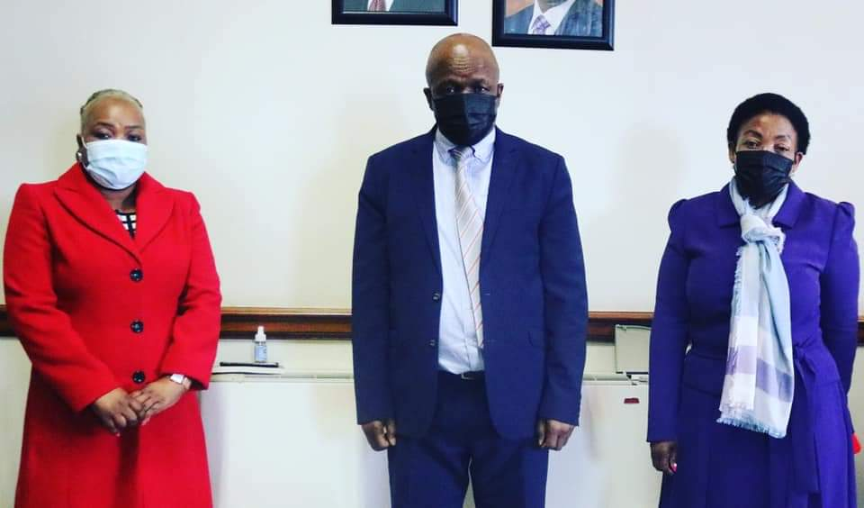
THE MDDA EXTENDS A WARM WELCOME TO ITS NEW POLITICAL LEADERS

Slide 3
TABLE OF CONTENTS
1
AGENDA ITEM 01
7
AGENDA ITEM 07
01
07
Constitutional & Legislative Mandates
2020/21 Organisational Performance
2
8
AGENDA ITEM 08
02
AGENDA ITEM 02
08
Alignment with the National Development Plan (2030)
Progress: Strategic Risks
3
9
03
AGENDA ITEM 03
09
Summary of Supported Projects (2020/21)
MDDA Strategic Goals and Objectives
4
10
04
AGENDA ITEM 05
10
Sources of Funding
Vision, Mission, Values
11
5
AGENDA ITEM 05
11
2020/21 Medium Term Framework Budget
05
6
2020/21 Key Highlights
12
06
AGENDA ITEM 06
12
Sector Challenges/Way Forward
Responding to Covid 19

Slide 4
LEGISLATIVE MANDATES
CONSTITUTIONAL MANDATE
Section 16:
Everyone has a right Freedom of Expression
Section 32: Everyone as a Right to Access to Information
Section 15 (1)
“Everyone has the right to freedom of conscience, religion, thought, belief and opinion

Slide 5
THE MDDA MANDATE
SECTION 3 OF THE MDDA ACT, 2002
Encourage ownership of, and access to media by Historically Diminished Groups as well as by historically diminished indigenous language and cultural groups
Encourage the development of human resources and training, and capacity building, within the media industry, especially amongst historically disadvantaged groups
A
B
Raise public awareness with regard to media development and diversity issues and support initiatives which promote literacy and a culture of reading.
C
Encourage channeling of resources to the community and small commercial media sectors.
D

Slide 6
OTHER RELATED LEGISLATION
REGULATORY FRAMEWORK
Broadcasting Act, 1999 as amended
Community media broadcasting
Independent Communications Authority of SA Act, 2000
Powers to grant, renew, amend, transfer and revoke licences.
The Eco System
Electronics Communications Act, 2005
Provides for the promotion and facilitation of the convergence of telecommunications, broadcasting, information technologies and other services.
Promotion of Administrative Justice Act, 2000
Administration of Justice
Public Finance Management Act, 2009
Regulates financial management in the national government and provincial government,
BBBEE Act No.59 of 2003

Slide 7
NATIONAL DEVELOPMENT PLAN
ALIGNMENT TO VISION 2030
Priority 6
Priority 1
Priority 5
Building a Capable, Ethical and Developmental
State
Economic Transformation and Job Creation
Social Cohesion and Safe communities
MDDA Goal:
Media diversity promoted through the growth and sustainability of community-based media in SA.
MDDA Goal:
Capable, effective and efficient organisation in support of the delivery of the mandate
MDDA Goal:
Capacitated, digital responsive community- based media in SA.

Slide 8
FIVE YEAR GOALS
Building A Resilient and Future-Forward Community Media Sector
GOAL 1
Capable, effective and efficient organisation in support of the delivery of the MDDA mandate by 2024
GOAL 2
Media diversity promoted through the growth of sustainable community-based media in South Africa by 2024
GOAL 3
Capacitated, digital responsive community-based media sector by 2024

Slide 9
ORGANISATIONAL CORE BUSINESS PROGRAMMES
Board
Chief Executive Officer
Programme 1 - Governance and Administration
Programme 2 - Grant and Seed Funding
Programme 3 - Partnerships, Public Awareness and Advocacy
Programme 4 - Capacity Building and Sector Development
Programme 5 - Innovation, Research and Development

Slide 10
STRATEGIC OBJECTIVES
2020/2024 MEDIUM TERM STRATEGIC FRAMEWORK
Objective 1
Objective 2
Objective 3
Facilitate ownership, control and access to information and content production of community broadcasting by historically advantaged communities.
To facilitate ownership, control and access to information and content production of community and small commercial publications by historically Advantaged communities.
To monitor and evaluate input, output and compliance to MDDA grant-in-aid contracts to measure the effectiveness and efficiency of the MDDA support
Objective 4
To ensure compliance with applicable legislative requirements and sustainability of the Agency
Objectives 5
Objective 6
To position the MDDA as an authoritative leader and voice on community and commercial media by proactive advocacy and lobbying interventions and established stakeholder relationships
To expand our footprint as the MDDA by creating a positive image in pursuance of the MDDA’s mandate to grow the community and small commercial media.

Slide 11
VISION, MISSION & VALUES
Vision
An accessible, transformed
and diversified media.
Mission
To support the development of a vibrant, innovative, sustainable and people-centred community media sector through resourcing, knowledge-based research and capacity building, in order to give a voice to historically disadvantaged communities.
Vision
Values
Mission
Values
Accountability, Inclusivity, Integrity, Ubuntu, Professionalism.

Slide 12
2020/21 KEY HIGHLIGHTS
Governance
MDDA awarded clean audit outcome for 2020/21 financial year. 4 Board Members appointed by Parliament in September 2021. 7,3% vacancy rate by end of financial year down from 27% in the same period in 2019/20.
Project Support
MultiChoice increased its support to MDDA by R6 million from a R40 year agreement resulting to more projects being funded in the year. Also agreed to increase its non-discretionary fund from R13m to R20m. Board approved R20 million for MDDA’s first emergency relief. Disbursed R16m.
Support for Signal Distribution for Community Broadcasters
Over 18 million paid to Sentech towards our beneficiaries’ signal distribution costs.
Stakeholder Engagement
Held virtual consultative conference to consult the Sector and Sector Bodies, UNESCO, Government and the Academia on the Terms of Reference for the Sustainability Research. Attended by observers from Zimbabwean Community Broadcasting Sector. Commemorated the World Radio Day, Virtually Participated at the World Press Freedom Day, Panellist at the UNESCO’s 40th IPDC conference, Black Wednesday masterclass, Women’s Month Commemoration and Sector engagement on Draft White Paper on Audio and Audio Visual Content Services Policy Framework.

Slide 13
RESEARCH AND CAPACITY BUILDING
Community media sustainability model
Research tender about to be awarded to service provider following virtual workshop which brought together stakeholders – local and international – to input to ToR for research on developing model
Preparing sector for digital ‘flight’
Digital strategy and plan approved for MDDA to lead sector in navigating challenges and capitalising on opportunities of digital era
Capacity building partnerships established
Partnership agreements to offer specialized courses, eg SEDA, SAASTA, Nemisa, Mict SETA
Media literacy and culture of reading
Focus changed to digital literacy and safe use of internet and social media and programmes that promote culture of reading
Trends of Media Ownership and Control in South Africa
Update study to research (completed in 2009) planned for2021
Notes:
© Copyright PresentationGo.com – The free PowerPoint template library

Slide 14
2020/21 INTERNAL ENVIRONMENT HIGHLIGHTS
Organogram | Regraded & amended organogram, based on 2020/2021 – 2024/2025 organisational strategy, approved. 41 funded positions including 2 positions for growth at a junior level. One labour matter.
Vacancy rate | 7,3% by end of March, following lifting of moratorium in July 2019 by Minister in The Presidency. Down from 27% in the same period in 2019/20. 1 termination through retirement.
Business Continuity Management Progress | MDDA staff ended 2020/21 working remotely from home, in line with Government’s National Lockdown requirements. Rotating at Alert Level 2. No fatalities. 3 positive cases reported. Repurposed some of the targets in line with the Lockdown requirements & improved ICT business tools and support.

Slide 15
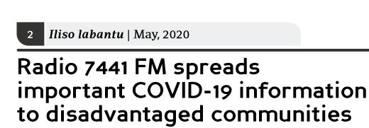
MDDA’S COVID-19 Emergency Relief Fund

Slide 16
MDDA’S RESPONSE TO COVID-19
LAUNCHED R20 MILLION EMERGENCY RELIEF FUND (APRIL- OCTOBER 2020)
Phase I: R10m
Phase II: R10m
TOTAL PACKAGE PER PROJECT
TOTAL PACKAGE PER PROJECT: R45 000.00
For content generation
Telecommunications,
Fuel & PPEs
Printing & Distribution.
R50 000 for Broadcasters
R20 000 for Publishing
R290 000 for Television
FULLY DISBURSED R10m:
114 Radio Stations
1 Television
116 Publishers
DISBURSED
Disbursed R6 232 485.00.
98 print projects
93 Radio stations
2 Television stations
Total Disbursed
R14 735 000.00

Slide 17
SUPPORTING GOVERNMENT’S MESSAGES ON COVID 19
Cascading Covid Messages to rural communities
Appeals for Donation
Cascading Govt Messages
MDDA Emergency Funding is not sufficient for vital content generation as the coronavirus stays with us longer.
Distributed Government messages to MDDA & ICASA broadcast databases.
Key Messages
Facebook & Google
Key messages to community and small commercial print and digital media
Could not assist, however, initiated discussions for future engagements.
Engaging community radio stations
Standard Bank & National Treasury
Minister in The Presidency interviewed on various community radio stations on the pandemic.
Approached for funding. Could not assist.
Broadcast Funders/MultiChoice
Communications Task Team
Received additional R6 million from Multichoice
MDDA member of the NCC Comms Task Team

Slide 18
ORGANISATIONAL PERFORMANCE
AUDITED THREE YEAR PERFORMANCE TREND
2018/19 – 2020/21
2018/19
UNQUALIFIED AUDIT
2019/20
CLEAN AUDIT
2020/21
CLEAN AUDIT

Slide 19
2020/21 Under-Achieved Targets

Slide 20
2020/21 ORGANISATIONAL PERFORMANCE
PROGRAMME 2: GRANT AND SEED FUNDING
Sub-Programme 2.1: Community and Small Commercial Media
Purpose: The purpose of this sub-programme is to facilitate ownership, control and access to information and content production of community and small commercial media by historically disadvantaged communities by 2024.
Outcome | Outputs | Output Indicator | Audited/actual performance |  | Actual Performance Against Target |  | Variance | Reason for Variance
 |  |  | 2018/2019 | 2019/20 | Target 2020/21 | Actual 2020/21
Media diversity promoted through the growth of sustainable community-based media in South Africa by 2024 | Community Media Sustainability Model | 2. Community Media Sustainability Model developed | New indicator | New Indicator | Service provider appointed | Service provider not appointed | Service provider appointed | Annual target was not achieved. The tender was advertised in December and closed in January 2021, after the evaluations by the Bid Evaluation Committee (BEC), it was reported that the tender was non-responsive. The tender was re-advertised in February 2021 but, due to the Government printers been offline it delayed the advert for up to 3 weeks, this compromised the conclusion of the Tender before the year end. As at 31 March the BEC has made a recommendation to the BAC for submission to the Board.

Slide 21
SUSTAINABILITY MODEL UNPACKED
Strategic Thrust: ‘Building a Resilient & Future-Forward
Community & Small Commercial Media Sector’
PILLAR ONE
PILLAR FOUR
Technology, Digital Innovation and Signal Distribution.
Transformation of the Print Media Sector
PILLAR TWO
PILLAR FIVE
Corporate Governance and Compliance
Consolidating Government Support
PILLAR 3
PILLAR 6
Content Generation and Professionalizing the Sector through skills and capacity
Audience Measurement

Slide 22
2020/21 ORGANISATIONAL PERFORMANCE
PROGRAMME 5: INNOVATION, RESEARCH AND DEVELOPMENT
Purpose: The MDDA Act 14 of 2002 on Section 3 (VI) outlines the objectives of the Agency to include (amongst others) to “encourage research regarding media development and diversity”. There is also a lack of research and information specific to the sectors that inform programme development and strategic focus (e.g., not much information on the number of indigenous language newspapers in SA, number of readers of such newspapers, etc.). The purpose of this programme is therefore to champion research, development and innovation to create a media development and diversity body of knowledge by 2024.
Outcome | Outputs | Output Indicator | Audited/actual performance |  | Actual Performance Against Target |  | Variance | Reason for Variance
 |  |  | 2018/2019 | 2019/20 | Target 2020/21 | Actual 2020/21
Capacitated, digital responsive community-based media sector by 2024 | Research projects on key trends/developments impacting on community media sector | 18.Number of Research projects funded on key trends/developments impacting on community media sector | 3 | 1 | 3 | 2 | -1 | Annual target was not achieved. The elections training did not occur during the period under review. South Africa was under level 3 lockdown restriction during quarter four (4) which prohibited face to face training as per disaster management act. The contract was not signed with the service provider by the end of the financial year.

Slide 23
2020/21 ORGANISATIONAL PERFORMANCE
PROGRAMME 1: GOVERNANCE AND ADMINISTRATION
Purpose: The programme ensures effective leadership, strategic management and operations, through continuous refinement of organisational strategy and the implementation of the appropriate legislation and best practice.
Outcome | Outputs | Output Indicator | Audited/actual performance |  | Actual Performance Against Target |  | Variance | Reason for Variance
 |  |  | 2018/2019 | 2019/20 | Target 2020/21 | Actual 2020/21
Capable, effective and efficient organisation in support of the delivery of the MDDA mandate by 2024 | Unqualified audit with no significant findings | 1. Unqualified audit with no significant findings | Unqualified audit opinion | Unqualified audit opinion | Unqualified audit opinion | Unqualified audit opinion | 0 | Annual target achieved.

Slide 24
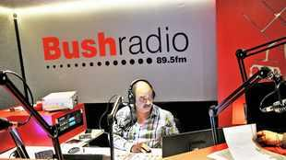
GRANT AND SEED FUNDING

Slide 25
2020/21 ORGANISATIONAL PERFORMANCE
Sub-Programme 2.1: Community and Small Commercial Media
Purpose: The purpose of this sub-programme is to facilitate ownership, control and access to information and content production of community and small commercial media by historically disadvantaged communities by 2024.
Outcome | Outputs | Output Indicator | Audited/actual performance |  | Actual Performance Against Target |  | Variance | Reason for Variance
 |  |  | 2018/2019 | 2019/20 | Target 2020/21 | Actual 2020/21
Media diversity promoted through the growth of sustainable community-based media in South Africa by 2024 | Community broadcast project funding | 3. Number of community broadcast project funding proposals submitted to Board | 29 | 18 | 20 | 25 | 5 | • Multichoice our main funder gave MDDA more funds than expected. • There is a high demand for funding from the community broadcast sector and the Agency had to rationalise in its funding approach.
 | Small Commercial Media project funding | 4. Number of funding proposals for Small Commercial Media projects submitted to Board | 8 | 6 | 5 | 5 | 0 | Annual target achieved.
 | Community print/digital media funding | 5. Number of funding proposals for Community print/digital media submitted to Board | 4 | 4 | 3 | 4 | 1 | The reason for overachievement is because of the budget for the community/digital and small commercial print was augmented from R2m to R3,2m due to previous year roll over, and as a result, an additional project was accommodated in the funding cycle.

Slide 26
2020/21 ORGANISATIONAL PERFORMANCE
Sub-Programme 2.2: Monitoring and Evaluation
Purpose: The purpose of this sub-programme is to monitor and evaluate input, output and compliance to MDDA grant-in-aid contracts to measure the effectiveness and efficiency of MDDA support by 2024.
Outcome | Outputs | Output Indicator | Audited/actual performance |  | Actual Performance Against Target |  | Variance | Reason for Variance
 |  |  | 2018/2019 | 2019/20 | Target 2020/21 | Actual 2020/21
Media diversity promoted through the growth of sustainable community-based media in South Africa by 2024 | Annual evaluation of M&E reports | 6. Annual evaluation of funded projects to identify thematic findings from M&E reports submitted to Board | - | Final annual evaluation report submitted to Board for approval | 1 | 1 | 0 | Annual target achieved.
 | Monitoring reports on input, output and compliance to MDDA grant-in-aid contracts | 7. Number of monitoring reports produced on input, output and compliance to MDDA grant-in-aid contract | 86 | 80 | 80 | 80 | 0 | Annual target achieved.
 | Evaluation reports | 8. Number of evaluation reports produced | 10 | 2 | 2 | 2 | 0 | Annual target achieved.

Slide 27
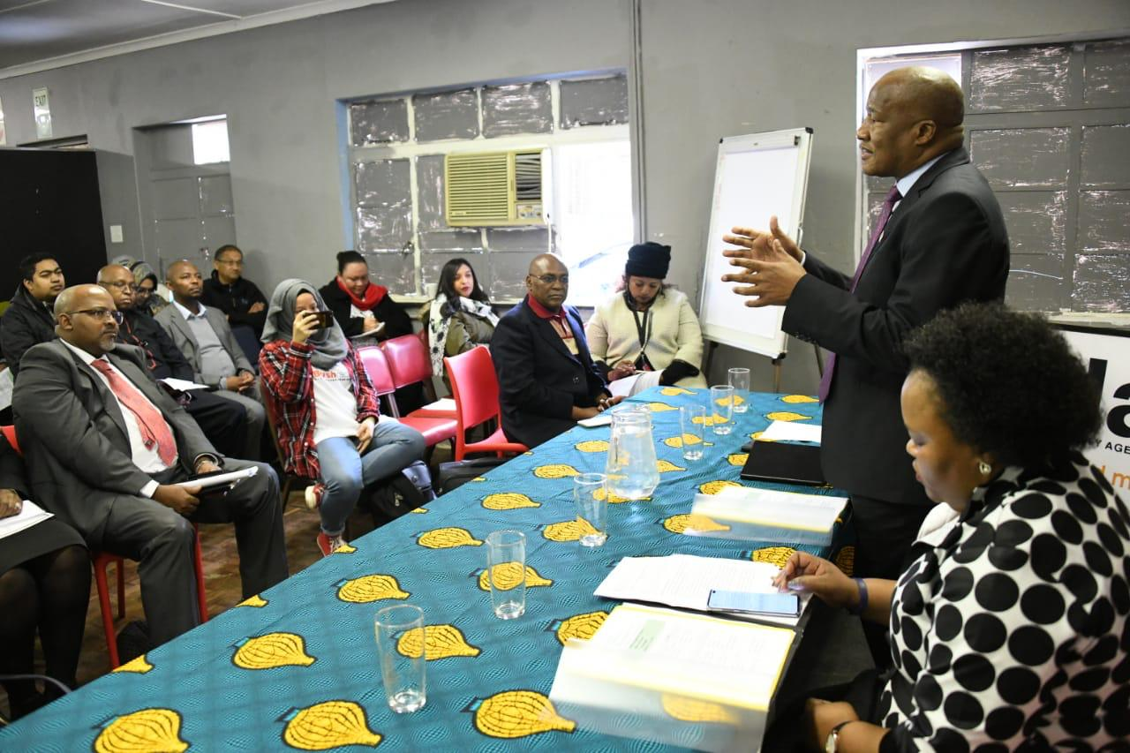
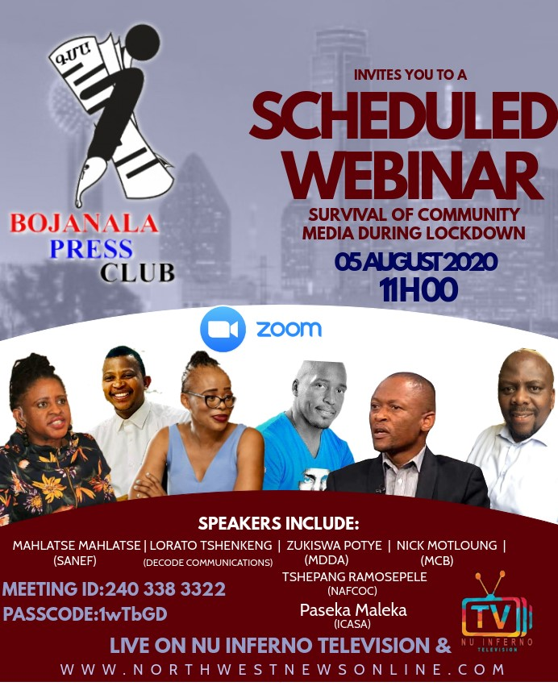
2020/21 STAKEHOLDER ENGAGEMENT & BRAND AWARENESS

Slide 28
2020/21 ORGANISATIONAL PERFORMANCE
PROGRAMME 3: PARTNERSHIPS, PUBLIC AWARENESS AND ADVOCACY
Purpose: This programme seeks to position the MDDA as a leading influencer and authoritative voice in the community and small commercial media, by playing a key role in the national dialogue on the sector, through implementation of strategic partnerships to carry out media development and diversity interventions.
Sub-programme 3.1: Strategic programmes
Purpose: The purpose of this sub-programme is to position the MDDA as an authoritative leader and voice on community and small commercial media by proactive advocacy and lobbying interventions and established stakeholder relationships by 2024.
Outcome | Outputs | Output Indicator | Audited/actual performance |  | Actual Performance Against Target |  | Variance | Reason for Variance
 |  |  | 2018/2019 | 2019/20 | Target 2020/21 | Actual 2020/21
Media diversity promoted through the growth of sustainable community-based media in South Africa by 2024 | Stakeholder engagement policy | 9. Stakeholder engagement policy reviewed and submitted to Board | Reviewed stakeholder engagement policy approved by Board in last quarter of financial year | Reviewed stakeholder engagement policy submitted to Board for approval | Reviewed stakeholder engagement policy submitted to Board | Reviewed stakeholder engagement policy submitted to Board | 0 | Annual target achieved.
 | Stakeholder engagement strategy | 10. Stakeholder engagement strategy reviewed and submitted to Board | Reviewed Stakeholder engagement plan approved by Board in last quarter of financial year | Reviewed stakeholder engagement strategy submitted to Board for approval | Reviewed stakeholder engagement strategy submitted to Board | Reviewed stakeholder engagement strategy submitted to Board | 0 | Annual target achieved.
 | Community Media digital migration strategy | 11. Community Media digital migration strategy submitted to Board | - | Community Media digital migration strategy commissioned | Reviewed community Media digital migration strategy submitted to Board | Reviewed community Media digital migration strategy submitted to Board | 0 | Annual target achieved.

Slide 29
2020/21 ORGANISATIONAL PERFORMANCE
Sub-programme 3.2: MDDA Brand Building
Purpose: The purpose of this sub-programme is to expand our footprint as MDDA by creating a positive image in pursuance of MDDA’s mandate to grow the community and small commercial media by 2024.
Outcome | Outputs | Output Indicator | Audited/actual performance |  | Actual Performance Against Target |  | Variance | Reason for Variance
 |  |  | 2018/2019 | 2019/20 | Target 2020/21 | Actual 2020/21
Media diversity promoted through the growth of sustainable community-based media in South Africa by 2024 | Communications policy | 12. Communications policy, reviewed and submitted to Board | - | Reviewed communications policy submitted to Board | Reviewed communications policy submitted to Board | Reviewed communications policy submitted to Board | 0 | Annual target achieved.
 | Communications strategy | 13. Communications strategy reviewed and submitted to Board | Reviewed communications strategy approved by end of last quarter of financial year | Reviewed communications strategy submitted to Board for approval | Reviewed communications strategy submitted to Board | Reviewed communications strategy submitted to Board | 0 | Annual target achieved.

Slide 30
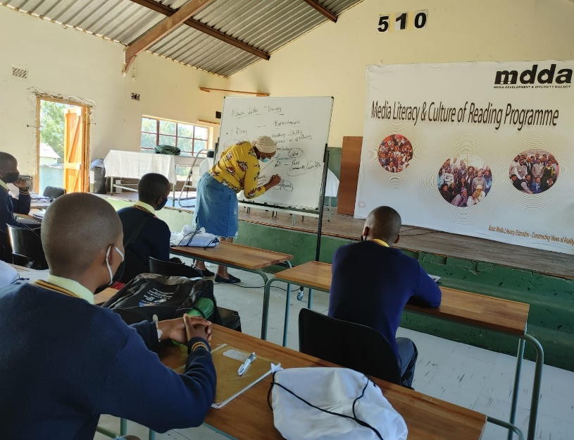
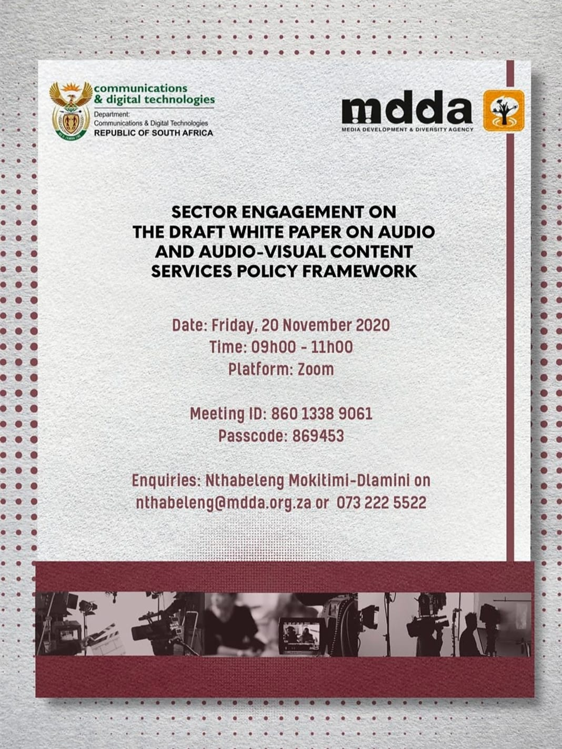
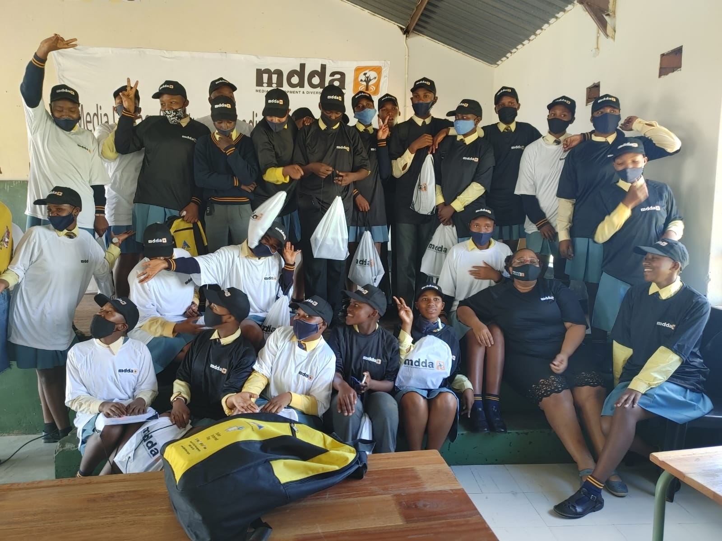
SECTOR DEVELOPMENT

Slide 31
2020/21 ORGANISATIONAL PERFORMANCE
PROGRAMME 4: CAPACITY BUILDING AND SECTOR DEVELOPMENT
Purpose: One of the objectives of the Agency outlined in the MDDA Act of 2002 is to “encourage the development of human resources, training and capacity building within the media industry, especially amongst historically disadvantaged groups”. In response to this, the Agency has developed capacity building programmers, which aim to provide community and small commercial media with necessary skills needed for effective performance in day-to-day work.
Outcome | Outputs | Output Indicator | Audited/actual performance |  | Actual Performance Against Target |  | Variance | Reason for Variance
 |  |  | 2018/2019 | 2019/20 | Target 2020/21 | Actual 2020/21
Capacitated, digital responsive community-based media sector by 2024 | Capacity building strategy for community and small commercial media projects | 14. Capacity building strategy for community and small commercial media projects developed and submitted to Board | - | Baseline skills assessment of community media completed | Capacity building strategy for community and small commercial media projects developed and submitted to Board | Capacity building strategy for community and small commercial media projects developed and submitted to Board | 0 | Annual target achieved.
 | Training interventions aimed at capacitating the community media with skills aligned to sector specific needs | 15. Number of training interventions aimed at capacitating the community media in key sustainability skills | 9 | 6 | 6 | 6 | 0 | Annual target achieved.
 | Media literacy workshops | 16. Number of media literacy workshops conducted | 1 | 3 | 3 | 3 | 0 | Annual target achieved.

Slide 32
2020/21 ORGANISATIONAL PERFORMANCE
PROGRAMME 5: INNOVATION, RESEARCH AND DEVELOPMENT
Purpose: The MDDA Act 14 of 2002 on Section 3 (VI) outlines the objectives of the Agency to include (amongst others) to “encourage research regarding media development and diversity”. There is also a lack of research and information specific to the sectors that inform programme development and strategic focus (e.g., not much information on the number of indigenous language newspapers in SA, number of readers of such newspapers, etc.). The purpose of this programme is therefore to champion research, development and innovation to create a media development and diversity body of knowledge by 2024.
Outcome | Outputs | Output Indicator | Audited/actual performance |  | Actual Performance Against Target |  | Variance | Reason for Variance
 |  |  | 2018/2019 | 2019/20 | Target 2020/21 | Actual 2020/21
Capacitated, digital responsive community-based media sector by 2024 | Research strategy to address key issues impacting on sustainability of community media sector | 17. Research strategy developed and submitted to Board | - | Research strategy developed and submitted to the Board | Research strategy developed and submitted to the Board for approval | Research strategy developed and submitted to the Board | 0 | Annual target achieved.
 | Research projects on key trends/developments impacting on community media sector | 18.Number of Research projects funded on key trends/developments impacting on community media sector | 3 | 1 | 3 | 2 | -1 | Annual target was not achieved. The elections training did not occur during the period under review. South Africa was under level 3 lockdown restriction during quarter four (4) which prohibited face to face training as per disaster management act. The contract was not signed with the service provider by the end of the financial year.

Slide 33
2020/21 STRATEGIC RISKS
IMPLEMENTATION REPORT
# | RISK DESCRIPTION | MITIGATION PLAN
1 | Fraud, corruption and theft. | Approved. Fraud prevention strategy, plan and whistle blowing policy Outsourced whistle blowing hotline. No fraud identified or reported. No substantive incidents reported.
2 | Regression on Auditor General audit opinion | Retained Clean Audit for 2020/21.
3 | Reputational risk | Several stakeholder engagements held.
4 | Insufficient budget allocation by Government and Funders (Budget growing slower than the demand). | Lobbied for support. Developed a fundraising strategy to enhance funding.
5 | Failure to deliver on entity mandate due to pandemic outbreak (Business continuity) | Covid 19 organizational plan in place. Funded PPEs for projects on emergency relief
RISK CONSEQUENCE
Low
Medium
High
High
RISK LIKELIHOOD
Medium
Low
Risk Level:
Low
Medium
High

Slide 34
2020/21 STRATEGIC RISKS
Implementation Report
# | RISK DESCRIPTION | RISK MITIGATION PLAN
6 | The Small Commercial and Community Media industry sustainability is at risk | Consulted on sector sustainability model research. Developed ToRs and advertised Tender for research.
7 | Incapacitated Industry | Implemented MDDA Training and capacity building initiatives (Research and training operational plan). Board approved Digital Migration Strategy and Plan. Submitted funding proposal to the MICT Seta.
8 | Inadequate corporate governance | Board engaged the Executive Authority about the vacancies on the Board.
RISK CONSEQUENCE
Low
Medium
High
High
RISK LIKELIHOOD
Medium
Low
Risk Level:
Low
Medium
High

Slide 35
2020/21 CALL FOR FUNDING APPLICATIONS: 15 OCTOBER – 30 NOVEMBER 2020
Call Announced through 95 radio stations interview, country-wide roadshows, 2 x media statements. Application method interpreted in videos in 11 official languages

Slide 36
SUMMARY OF PROJECTS SUPPORTED FOR THE FINANCIAL YEAR: 2020/21
Grant and Seed Funding
Summary of projects supported in 2020/21 financial year
Description | Broadcast | Research | Print | Covid-19 Emergency | Total
Opening Balance | 81 155 925.95 | 535 111.62 | 5 668 730.00 | 14 735 000.00 | 102 094 767.57
Approvals | 52 228 308.79 | - | 3 295 945.55 | - | 55 524 254.34
Payments | - 41 408 868.15 | - 429 248.00 | - 4 690 315.20 | - 11 350 210.00 | - 57 878 641.35
Write backs | - 8 236 883.04 | - | - | - | - 8 236 883.04
Closing Balance | 83 738 483.55 | 105 863.62 | 4 274 360.35 | 3 384 790.00 | 91 503 497.52

Slide 37
Projects Funded
The MDDA mandate is to support community and small commercial media projects as well as projects targeting historically disadvantaged communities, the support was weighted heavily towards media projects in rural areas. The Board approved 22 compliant broadcast and 9 print and digital projects in February 2021.
Project type | Project name | Amount approved current year
Community Broadcast Radio | Aganang | 2 044 500.00
Community Broadcast TV | Bodumedi | 2 369 500.00
Community Broadcast Radio | Barberton CRS | 2 124 500.00
Community Broadcast Radio | Engcobo FM | 3 267 061,00
Community Broadcast Radio | Giyani CR | 2 823 873.00
Community Broadcast Radio | Good News CRS | 320 290.00
Community Broadcast Radio | Intokozo FM | 2 454 000.00
Community Broadcast Radio | Kurara FM | 1 988 200.00
Community Broadcast Radio | KZN FM | 2 775 163.70
Community Broadcast Radio | Kathorus FM | 2 178 500.00
Community Broadcast Radio | Mash FM | 2 499 874.00
Community Broadcast Radio | Mdantsane FM | 1 600 805.00
Community Broadcast Radio | Moletsi CR | 994 462.05
Community Broadcast Radio | Motheo FM | 1 895 000.00
Community Broadcast Radio | Radio Riverside | 1 700 000.00
Community Broadcast Radio | Radio KC | 1 388 620.00
Community Broadcast Radio | Thetha FM | 2 434 552.00
Community Broadcast Radio | Vision FM | 2 676 000.00

Slide 38
Projects Funded
The MDDA mandate is to support community and small commercial media projects as well as projects targeting historically disadvantaged communities, the support was weighted heavily towards media projects in rural areas. The Board approved 22 compliant broadcast and 9 print and digital projects in February 2021.
Project type | Project name | Amount approved current year
Community Broadcast Radio | Voice of Wits | 614 101.00
Community Broadcast Radio) | Vukani Community Radio Station | 1 700 000.00
Community Broadcast Radio | West Coast Radio | 1 575 944.00
Community Broadcast Radio | Zebediela CR | 2 566 480.00
Community Print | Garankuwa Voice (Malatsi Media) | 394 200.00
Community Print | Kasi Voice | 212 405.71
Community Print | Mabopane Sun | 361 200.00
Community Print | Mamre News | 343 200.00
Community Print | Namakwalander | 461 200.00
Community Print | Puisano News | 288 000.00
Community Print | Soshanguve Sun (Arts of Hope) | 400 200.00
Community Print | The Youth Voice | 478 339.84
Community Print | Umjindi-Elukwatini Guardian (MD Publishing) | 357 200.00

Slide 39
2020/21 THE SOURCES OF FUNDING
PROVISION UNDER SECTION 15 OF THE MDDA ACT (2002)
Broadcast Funders (USAF Levies)
58%
Government Grant
38%
Interest on
Investment
4%
Money lawfully accruing from any other source.
0%
Fundiraising Strategy to prioritise these
Foreign Donors
0%

Slide 40
Financial Performance 2020/21 And the MTEF Budget

Slide 41
SECTOR CHALLENGES
Sustainability in Spotlight
High Operating Costs
Poor Content
Signal Distribution costs
High printing & Distribution costs
Maintenance costs
SAMRO/SAMPRA fees
Rentals and office accommodation, etc.
Standardized content generation funding
Seda SLA
Unreliable Audience
research
Requisite Skills
Training and capacity development interventions informed by Skills Audit.
Met with Broadcast Research Council for possible partnership
Poor governance & compliance
Training, mentorship and coaching interventions.
Sector Engagements.
Advertising
Unregulated & poor coordination of government advertising (30% set aside)
Technological Changes
& Innovation
Regulation and Policy

Slide 42
WAY FORWARD
FUTURE PLANS
Sustainability Model for the Sector
Appointed Service Provider to undertake extensive research on sustainability for purposes of developing a Sustainability Model for the Sector.
Amendment Bills
Participate in the amendments of the i) MDDA Amendment Bill
ii) Media Transformation Charter, iii) Electronics Act &
iv) Board through the Executive Authority initiate legislation to compel commercial print to fund the MDDA.
20 Years: MDDA Review from Jan 2022
Review impact of Mandate &
Achievements & Failures
Strengths/Weaknesses.
Sectoral Digital Presence
Implement Board approved Digital Strategy and Plan with relevant partners.
Partners being sources.
Facebook SA, MICT Seta on board
Fundraising Strategy
Implement 2021 Board approved fundraising strategy with focus on foreign donations.

Slide 43
THE COUNTRY BADE FAREWELL TO MINISTER
JACKSON MTHEMBU
ON 21 JANUARY 2021

