Slide 1
  ANNUAL REPORT 2020/21
  PRESENTATION TO THE PORTFOLIO COMMITTEE ON AGRICULTURE, LAND REFORM AND RURAL DEVELOPMENT
  09 NOVEMBER 2021

Slide 2
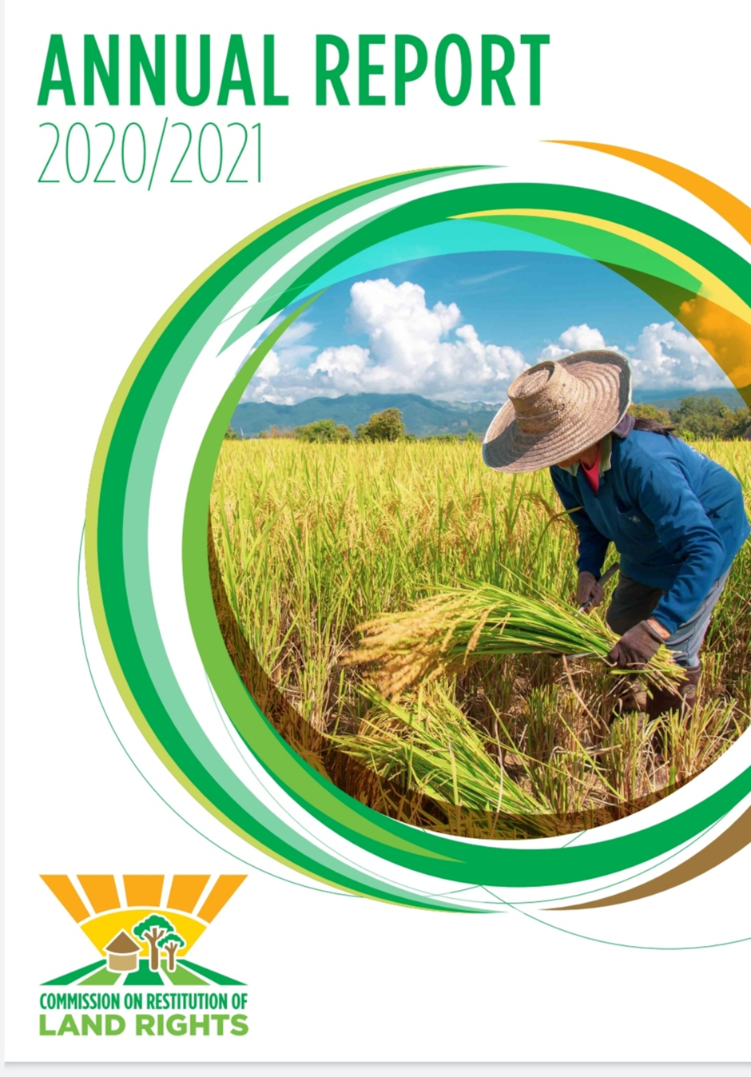
PRESENTATION OUTLINE
2
  Introduction
  Part A: General Information (Vision, Mission, Values, Mandate and State land)
  Part B: Performance Information
  Part C: Financial Information
  Part D: Governance
  Part E: Human Resource Management

Slide 3

INTRODUCTION
3
Section 21 of the Restitution of Land Rights Act, No. 22 of 1994, as amended, prescribes that the CRLR submit an annual report to Parliament by no later than 1 June every year.

Slide 4
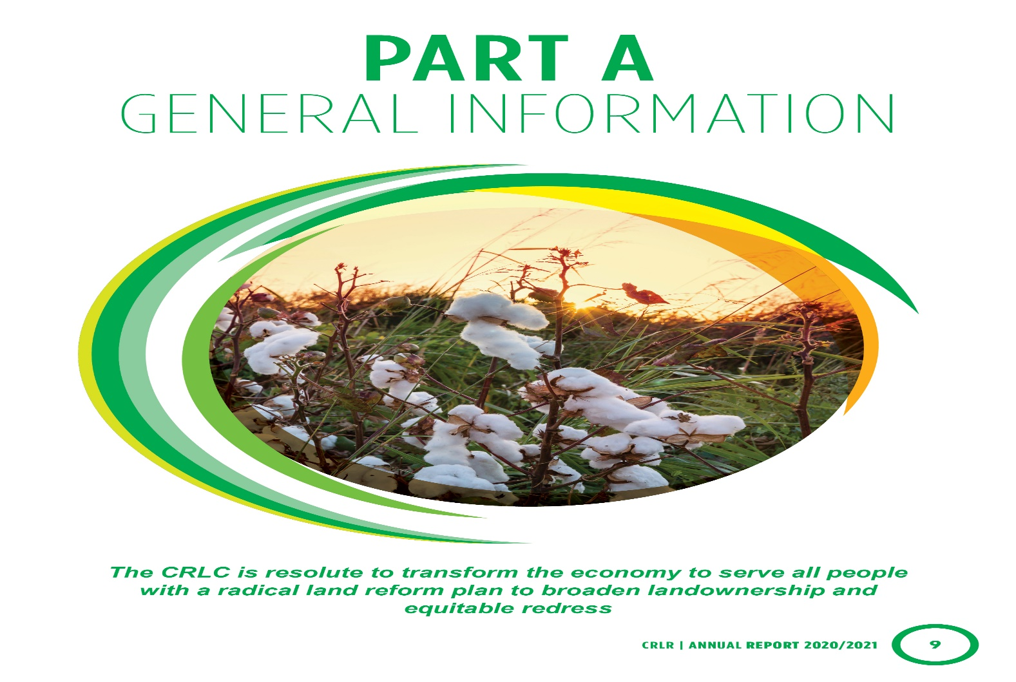

Slide 5
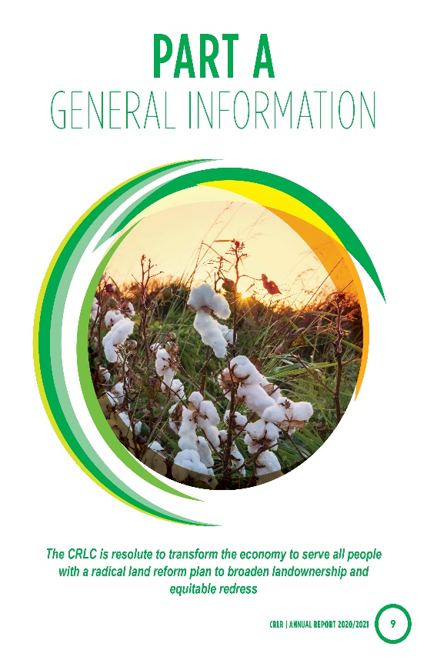
VISION AND MISSION
4
Vision
A commission of excellence that ensures that effective, efficient and speedy redress is provided to victims of racially based land dispossessions.
Mission
We exist to provide equitable redress to victims of racially motivated land dispossession, in line with the provisions of the Restitution of Land Rights Act, 1994 (Act No. 22 of 1994).

Slide 6

VALUES
5
We uphold the following values:
We value and encourage diversity and will not discriminate against anyone. We uphold the rights of individuals as enshrined in the Constitution of the Republic of South Africa.
We strive to be transparent, accountable and responsive in all the services we offer to claimants and other stakeholders, in order to ensure equitable redress.

Slide 7

VALUES
6
We strive towards maintaining high service standards through improved business processes and a focus on ethical and professional operational principles.
We ensure that we have a dedicated, loyal, results-orientated, professional and people-focussed workforce that is passionate and committed to serve the people of South Africa.
In collaboration with all stakeholders, the CRLR will comply with all laws of this country and will not implement any policy that is in conflict with the Constitution.

Slide 8

MANDATE
7
Section 4(1) of the Restitution of Land Rights Act, 1994 establishes the Commission on Restitution of Land Rights (CRLR).
The Commission is responsible for the settlement of land restitution claims.
The functions of the Commission are to solicit, investigate, and to resolve through negotiations and mediation, claims for restitution from persons and communities dispossessed of rights in land, after 19 June 1913, as a result of past racially discriminatory laws and practices or refer such matters to the land claims court for adjudication.

Slide 9
Constitutional Court Judgments
8
Speaker of the National Assembly and Another vs Land Access Movement of South Africa (LAMOSA 2) handed down 19 March 2019, the court ordered the Chief Land Claims Commissioner to file a report with the Land Claims Court at six-monthly intervals.
Four (4) Reports have been submitted the last submitted in May 2021.
The court confirmed that the 2014 claims (New Order) are still interdicted pending finalization of the Old Order claims or a new Amendment legislation.
The LCC subsequently ordered the Commission to refer all claims the CRLR is unable to resolve to the Land Claims Court in terms of Section 14(1) of the Restitution Act.

Slide 10
ROAD TO AUTONOMY
9
“Road to Autonomy” the Comission is developing a business case for approval
In progress:
Cabinet Memo requesting approval for autonomy.
Business case document outlining feasibility study, situational analysis, Budgetary implications, Strategic Plan etc.
Review of possible Legislative amendments.
Consultation on the business case to the various forums i.e. DPSA, National Treasury and Parliament until approval is granted.
Commencement and formalization of the Public Entity Schedule 3A, embarking on a process to implement and ensure that all policy requirements are in place and manage the process as outlined by our Transition plan.

Slide 11
STATE LAND TRANSFERS
10
The Inter-Ministerial Committee (IMC) on Land Reform has mandated the Commission to prioritise the transfer of state land to Restitution Beneficiaries.
National and Provincial Joint Strategic Committees were set up with various stakeholder department key to unlocking transfer of state land including have been co-opted including Public Works.

Slide 12
State land transfers
10
During the year under review, a total of 120 land parcels were transferred, measuring 24 703,63916 ha in extent.
The Breakdown of the land parcels transferred are as per the table below:
Province | Transferred from 261 list | Transferred from 278 list | Additional List | Total | Hectares
Eastern Cape | 0 | 0 | 0 | 0 | 0
Free State | 0 | 0 | 0 | 0 | 0
Gauteng | 0 | 0 | 6 | 6 | 19.5933
KwaZulu-Natal | 1 | 0 | 10 | 11 | 5660.4452
Limpopo | 0 | 0 | 0 | 0 | 0
Mpumalanga | 0 | 0 | 4 | 4 | 13099.5103
Northern Cape | 0 | 0 | 2 | 2 | 6.3714
North West | 10 | 0 | 86 | 96 | 5913.98745
Western Cape | 0 | 1 | 0 | 1 | 3.7315
Total | 11 | 1 | 108 | 120 | 24 703.63916

Slide 13
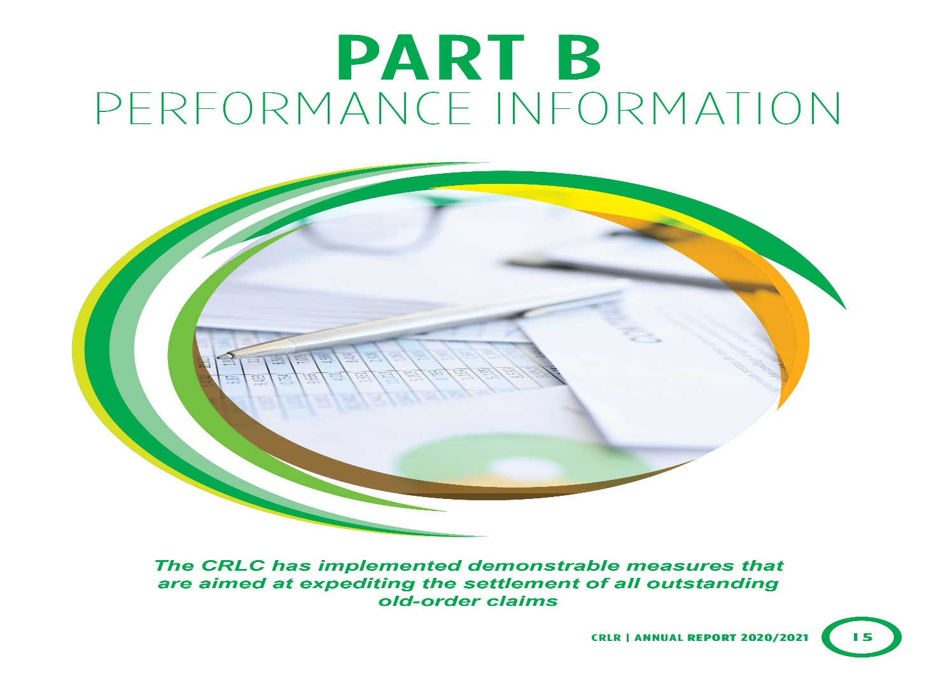

Slide 14

PERFORMANCE INFORMATION
11
Performance indicator | Actual performance against target
 | Target (2020/21) | Achievement (2020/21)
Number of land claims settled | 244 | 324
Number of land claims finalised | 295 | 385

Slide 15
PROVINCIAL Breakdown – APP SETTLED claims
11
Province | APP Target | APP Target Achieved
Eastern Cape | 60 | 40
Free State | 2 | 2
Gauteng | 7 | 46
KwaZulu-Natal | 29 | 37
Limpopo | 64 | 112
Mpumalanga | 40 | 39
North West | 1 | 2
Northern Cape | 1 | 6
Western Cape | 40 | 40
GRAND TOTAL | 244 | 324

Slide 16
PROVINCIAL Breakdown – APP SETTLED claims
12

Slide 17

PROVINCIAL BREAKDOWN - APP FINALISED Claims
13
Province | APP Target | APP Target Achieved
Eastern Cape | 65 | 74
Free State | 6 | 0
Gauteng | 9 | 37
KwaZulu-Natal | 50 | 84
Limpopo | 32 | 31
Mpumalanga | 54 | 66
North West | 14 | 18
Northern Cape | 5 | 15
Western Cape | 60 | 60
GRAND TOTAL | 295 | 385

Slide 18
PROVINCIAL BREAKDOWN - APP FINALISED Claims
13

Slide 19
Land claims settled and finalised per province
14
Province | Claims Settled |  |  | Claims Finalised
 | APP Target | APP Target Achieved | Total Achieved | APP Target | APP Target Achieved | Total Achieved
Eastern Cape | 60 | 37 | 40 | 65 | 65 | 74
Free State | 2 | 1 | 2 | 6 | 0 | 0
Gauteng | 7 | 45 | 46 | 9 | 35 | 37
KwaZulu-Natal | 29 | 37 | 37 | 50 | 50 | 84
Limpopo | 64 | 112 | 112 | 32 | 30 | 31
Mpumalanga | 40 | 38 | 39 | 54 | 64 | 66
North West | 1 | 2 | 2 | 14 | 17 | 18
Northern Cape | 1 | 6 | 6 | 5 | 15 | 15
Western Cape | 40 | 36 | 40 | 60 | 60 | 60
Total | 244 | 314 | 324 | 295 | 336 | 385

Slide 20
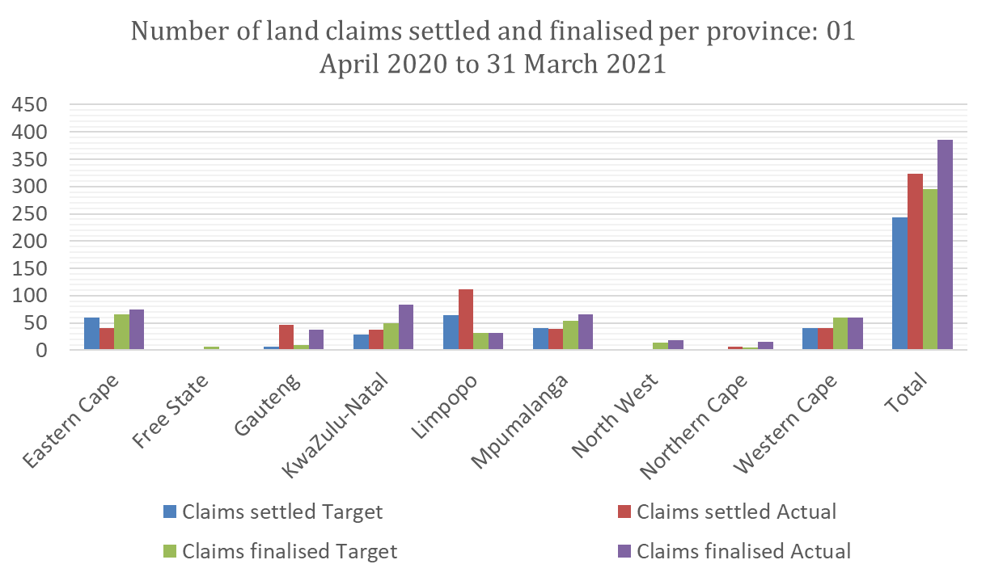
Land claims settled and finalised per province
14

Slide 21
PERFORMANCE – HECTARES & BENEFICIARIES
15
Province | Hectares awarded | Land cost | Financial compensation | Grants | Total award
Eastern Cape | 4 717,7730 | 2 800 000,00 | 596 555 160,68 | - | 599 355 160,68
Free State | 627,9014 | 13 376 000,00 | - |  | 13 376 000,00
Gauteng | - | - | 35 593 556,30 | - | 35 593 556,30
KwaZulu-Natal | 12 752,1901 | 199 438 953,80 | 191 082 673,63 | 7 340 000,00 | 397 861 627,43
Limpopo | 15 677,4680 | 124 301 000,00 | 229 907 436,36 | - | 354 208 436,36
Mpumalanga | 5 740,7470 | 23 230 000,00 | 206 203 624,46 | - | 229 433 624,46
Northern Cape | 87,0000 | - | 3 028 069,78 | - | 3 028 069,78
North West | 25 523,8742 | 238 768 462,95 |  | 312 709,15 | 239 081 172,10
Western Cape | 7,2811 | 170 447 304,00 | 65 387 691,38 | 50 745 637,00 | 286 580 632,38
Total | 65 134.2348 | 772 361 720.75 | 1 327 758 212.59 | 58 398 346.15 | 2 158 518 279.49
Quarter | Beneficiaries | Hectares awarded
Quarter 1 | 8 245 | 4 840,4605
Quarter 2 | 8 199 | 20 330,4699
Quarter 3 | 5 928 | 23 540,1562
Quarter 4 | 17 000 | 16 423,1482
TOTAL | 39 372 | 65 134.2348

Slide 22
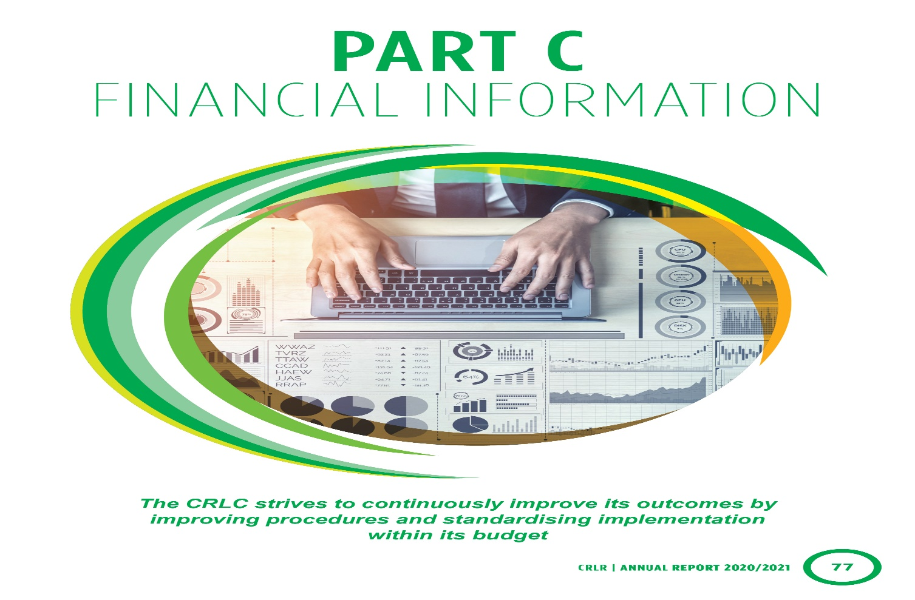

Slide 23
FINANCIAL INFORMATION
16
The CRLR is an entity under the Department of Agriculture Land Reform and Rural Development. The department’s financial year is from 1 April to 31 March each year. The CRLR follows the same financial year period. The annual financial statements of the CRLR consists out of the functions performed by the entity which only includes the investigation and recommendation of the settlement of claims.
The settlement and finalisation of claims is performed by the branch Restitution within DALRRD. The budget and expenditure are reported in the department’s annual financial statements and annual report. Only a high-level overview will be included in this annual report

Slide 24
Financial PERFORMANCE OVERVIEW
17
Summary of budget expenditure the 2020/21 financial year

Slide 25
Project expenditure summary per province for the 2020/21 financial year
18
OFFICE | LAND PURCHASE (R'000) | LAND & SUBSOIL (R'000) | GRANTS (R'000) | FINANCIAL COMP (R'000) | CONVEYANCING FEES (R'000) | TOTAL (R'000)
Eastern Cape | 3 150 | 0 | 0 | 415 996 | 0 | 419 146
Free State | 4 013 | 3 429 | 0 | 505 | 0 | 7 947
Gauteng | 0 | 0 | 0 | 37 767 | 129 | 37 896
Kwazulu Natal | 226 943 | 21 690 | 8 394 | 229 720 | 2 276 | 489 023
Limpopo | 124 736 | 0 | 2 775 | 334 588 | 0 | 462 099
Mpumalanga | 17 829 | 419 | 1 299 | 159 565 | 353 | 179 465
Northern Cape | 1 633 | 0 | 0 | 2 228 | 82 | 3 943
North West | 244 129 | 477 | 17 892 | 6 452 | 1 134 | 270 084
Western Cape | 165 991 | 1 176 | 171 154 | 54 561 | 0 | 392 883
Total | 788 425 | 27 191 | 201 515 | 1 241 382 | 3 974 | 2 262 487

Slide 26
Commitment reduction breakdown between backlog and new claims for the 2020/21 financial year
18
Province | Expenditure - claims approved prior to 2020/21 | Expenditure- claims approved 2020/21 | Total Expenditure
Eastern Cape | 327 227 | 91 920 | 419 146
Free State | 431 | 7 442 | 7 873
Gauteng | 13 274 | 24 622 | 37 896
KwaZulu Natal | 210 375 | 274 326 | 484 700
Limpopo | 184 193 | 277 906 | 462 099
Mpumalanga | 95 874 | 83 591 | 179 465
Northern Cape | 3 622 | 321 | 3 943
North West | 34 482 | 223 669 | 258 151
Western Cape | 127 312 | 277 505 | 404 816
TOTAL | 996 788 | 1 261 302 | 2 258 090

Slide 27
% FINANCIAL EXPENDITURE PER PROVINCE
19

Slide 28
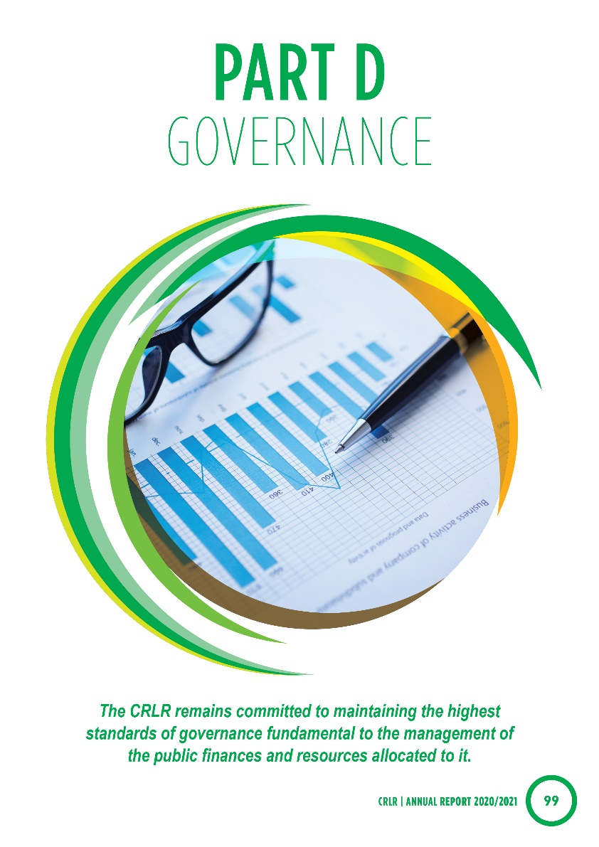

Slide 29

PART D: GOVERNANCE: RISK, AUDIT AND OVERSIGHT
Risk type | Risk | Risk response/mitigation plan
Financial risks
Budgetary risks | Limited budget | Offers to be negotiated and linked to the recommendations of the Valuer-General Annual submissions to National Treasury to indicate funds required in adjustment and medium-term expenditure framework cycle
Expenditure risks | Under-spending | Monthly expenditure monitoring and cash flow revision(s) to be done
IT systems | Lack of effective information and records management system | Development of standardised business process to be fed into the project and management information system Apply change management principles during implementation
Human resource risks | Inadequate human resources | Development of revised institutional form and continual training
Process risks | Delays in implementation of settlements No standardised business process with timeframes | Developed detailed business process that is elaborated into standard operating procedures and time frames. Implementation of reviewed settlement models
Reputational risks | Reputational risk linked to delays in the settlement of claims | Statutory Commission meetings to be held with formal and widespread communication aims, including media, as well as quarterly statistics releases. Communication process underway in collaboration with the Government Communication Information System (GCIS)
Legal and regulatory risks | Overlap of define mandate of the CRLR (e.g. scope creep into post-settlement issues) Litigation risks | Clarification of mandate in the context of future autonomy and develop plans to ensure synergy with the DALRRD ( Post settlement) Improvement of tracking and management of matters in court Compliance checklist and quality control by quality assurance Increased quality assurance capacity
20

Slide 30
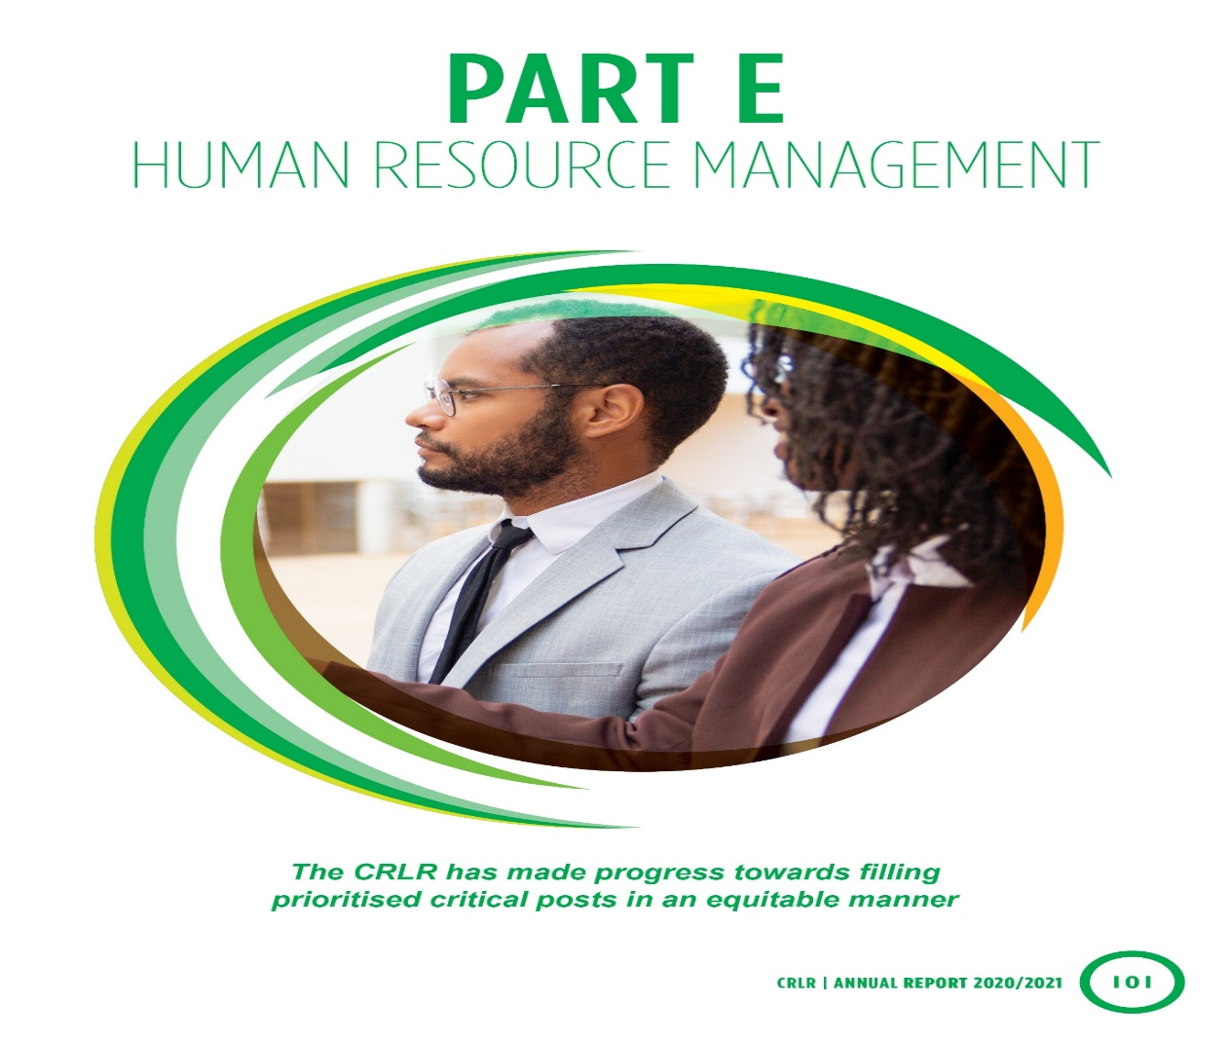
21

Slide 31

  Status of posts and vacancies per office
21
Office | Number of funded posts | Number of posts filled | Number of posts vacant | Percentage vacancy rate | Employees additional employed | Head count
National Office | 87 | 66 | 21 | 24% | 0 | 66
Eastern Cape | 70 | 62 | 8 | 11% | 0 | 62
Free State | 34 | 34 | 0 | 5.88% | 1 | 34
Gauteng | 66 | 60 | 6 | 9% | 0 | 60
KwaZulu-Natal | 111 | 101 | 10 | 9% | 1 | 101
Limpopo | 100 | 96 | 4 | 4% | 0 | 96
Mpumalanga | 116 | 107 | 9 | 8% | 0 | 107
Northern Cape | 38 | 32 | 6 | 16% | 0 | 32
North West | 74 | 66 | 8 | 11% | 0 | 66
Western Cape | 72 | 64 | 8 | 11% | 1 | 64
Total | 768 | 688 | 80 | 10% | 3 | 688

Slide 32
Number of staff and vacancies per salary band
23
Salary band (permanent employees) | Number of permanent posts | Number of posts vacant | Vacancy rate | Number of posts filled additional to the establishment
Lower skilled (levels 1–2) | 0 | 0 | N/A | 0
Skilled (levels 3–5) | 123 | 15 | 12.20% | 0
Highly skilled production (levels 6–8) | 365 | 43 | 11.78% | 0
Highly skilled supervision (levels 9–12) | 240 | 31 | 12.65% | 3
Senior management (levels 13–16) | 40 | 5 | 13% | 0

Slide 33

Positions filled and vacancies
22

Slide 34
Termination of service during the period under review
23
There were 15 terminations of service during the period under review. As a result of 15 terminations, it also resulted in 15 vacant posts which could not be filled since the 2020 moratorium.
Of the terminations of service 40% were resignations. Resignations of 40% of the total number of staff employed shows that the turnaround of staff due to resignations is very high.

Slide 35

Termination of service
23

Slide 36
SUMMARY
24
During the period under review the CRLR settled 324 claims, finalised 385 and therefore, exceeded the APP targets.
The Commission spent 100% of the budget during the period under review.

Slide 37


