Slide 1
Annual Report 2020/21 for the Municipal Infrastructure Support Agent (MISA)
Briefing to the Portfolio Committee on Cooperative Governance and Traditional Affairs (CoGTA)
Presenter: Ntandazo Vimba, CEO: MISA
Date: 09 November 2021

Slide 2
OUTLINE OF THE PRESENTATION
1. | Purpose
2. | Vision, Mission and Mandate
3. | MISA’s Functions
4. | Performance Information by Programme
5. | Financial Performance
6. | Audit Outcomes
7. | HRM Progress
8. | Conclusion

Slide 3
Purpose
The purpose of the presentation is to:
Brief the Portfolio Committee on Cooperative Governance and Traditional Affairs on the 2020/21 annual report of the Municipal Infrastructure Support Agent (MISA).
Give highlights of financial performance for the agency in the 2020/21 financial year.
Present the audit outcomes in relation to both the annual financial statements and the audit of predetermined objectives (AoPO).

Slide 4
Vision, mission and mandate
Our Vision
Leaders in Municipal Infrastructure Support.
Mission
To provide integrated municipal infrastructure support services to municipalities through technical expertise and skills development towards the efficient infrastructure delivery systems, processes and procedures.
Mandate
To render Technical Advice and Support to municipalities towards the optimisation of municipal infrastructure provision.

Slide 5
KEY FUNCTIONS OF MISA
Supporting municipalities to conduct effective infrastructure planning to achieve sustainable service delivery;
Supporting and assisting municipalities with the implementation of infrastructure projects as determined by the municipal integrated development plans (IDPs);
Supporting and assisting municipalities with the operation and maintenance of municipal infrastructure;
Building the capacity of municipalities to undertake effective planning, delivery, operations and management of municipal infrastructure; and
Performing any function that may be deemed ancillary to those listed above

Slide 6
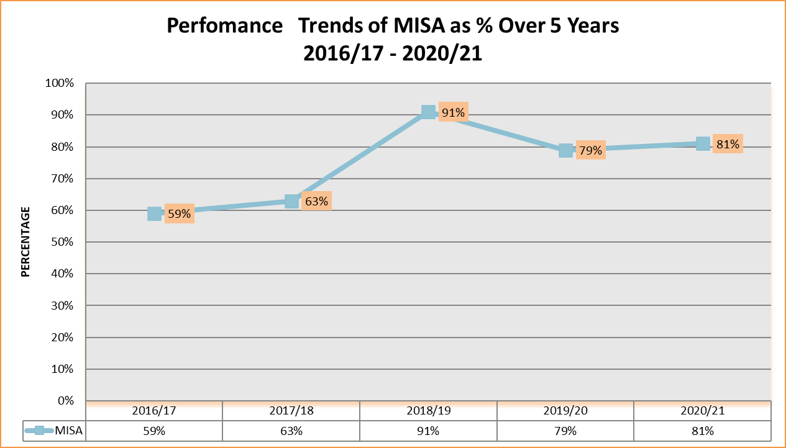
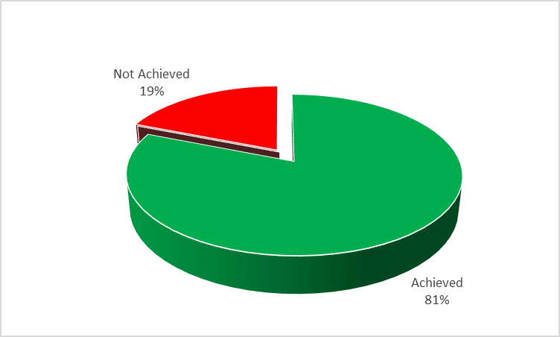
Summary of Performance against Planned Targets
MISA achieved performance targets for 25 of the 31 output indicators in the annual performance plan (APP) for 2020/21.
This overall achievement of 81% for 2020/21 performance reflects an improvement in comparison to the achievement of 79% in the previous financial year.

Slide 7
PROGRAMME 1: ADMINISTRATION
PLANNED TARGETS | 6 | ACHIEVED | NOT ACHIEVED
 |  | 6 | 0
Key Achievements: Unqualified audit opinion on our AFS Implementation of our approved communication strategy; risk and internal audit plans; ICT operational plan; and procurement plan

Slide 8
PROGRAMME 2: TECHNICAL SUPPORT SERVICES
PLANNED TARGETS | 19 | ACHIEVED | NOT ACHIEVED
 |  | 15 | 4
Key Achievements: 10 Districts supported with development and/or implementation of Water Conservation or Water Demand Management Strategies 30 Districts supported with the implementation of Operations and Maintenance plans 104 apprentices enrolled into our programme; 75 students awarded with bursaries; 123 municipal officials enrolled into Recognition of Prior Learning programmes; and 482 municipal officials trained in municipal infrastructure management Implemented municipal capacity development plans in 15 municipalities and supported 23 districts with the implementation district-wide infrastructure plans. 10 Districts supported with implementation of integrated Waste Management Plans

Slide 9
PROGRAMME 2: TECHNICAL SUPPORT SERVICES
PLANNED TARGETS | 19 | ACHIEVED | NOT ACHIEVED
 |  | 15 | 4
Key Achievements: 30 Districts supported with implementation of SPLUMA compliant municipal spatial plans, SDF’s and land-use schemes 10 districts supported with implemented standard operating procedures (SOPs) for reliable water services and 10 districts supported with SOPs for improved household access to sanitation services 8 Districts supported with implementation of a performance monitoring strategy and electricity supply management strategies 3 districts supported with the implementation of the RMSC programme Conducted municipal infrastructure functionality assessments and reports developed in 11 districts municipalities

Slide 10
PROGRAMME 2: TECHNICAL SUPPORT SERVICES
Not Achieved
Output Indicator | Planned Target | Actual Achievement | Reasons for deviation
The number of municipalities supported to implement infrastructure programmes/projects through Labour Intensive methods. | 15 | Progress report (Business Case approval, consultation with stakeholders, etc.) developed. | Targeted municipalities were only identified and services providers appointed in March 2021 due to delays in the approval of a revised business case and allocation of funds.
Number of districts with improved MIG spending to at least 90% | 44 | 11 out of 44 districts were able to improve their expenditure to at least 90% of their total allocation. | Due to Financial Management challenges in municipalities (notably delays in procurement, cash flow challenges), as well as Lack of Technical Capacity in municipalities (failure to manage projects throughout the project life from project preparation, contract administration & reporting on MIG–MIS system), Council and administrative instability (that led to non-compliances and lack of accountability)

Slide 11
PROGRAMME 2: TECHNICAL SUPPORT SERVICES
Not Achieved
Output Indicator | Planned Target | Actual Achievement | Reasons for deviation
Number of youth enrolled in the MISA Experiential Learnership Programme | 70 | 30 Experiential Learners enrolled in the Programme. | Recruitment process affected by COVID-19 restrictions, i.e. delayed advertisement, prolonged response handling, and delayed finalisation of criminal record checks and verification of qualifications.
Number of Youth enrolled in the MISA Young Graduate Programme | 150 | 114 Young Graduates enrolled in the programme | Recruitment process affected by COVID-19 restrictions, i.e. delayed advertisement, prolonged response handling, and delayed finalisation of criminal record checks and verification of qualifications.

Slide 12
Programme 3: infrastructure delivery management support
PLANNED TARGETS | 6 | ACHIEVED | NOT ACHIEVED
 |  | 4 | 2
Key Achievements: 5 Districts supported with the implementation of the Infrastructure Delivery Management System 17 districts supported with the utilisation of Framework Contracts 14 Municipalities supported to access private funding to implement infrastructure projects through the Private Sector Participation (PSP) model 5 Water Services Authorities (WSA’s) supported with the integration of priority projects with the municipal IDP projects

Slide 13
Programme 3: infrastructure delivery management support
Not Achieved
Output Indicator | Planned Target | Actual Achievement | Reasons for deviation
Number of districts supported with implementation of long-term infrastructure investment plans | 5 | Engagements held with the 5 municipalities, but no plans were developed for the identified municipalities. | Support was provided to municipalities on the identification of priority projects from their long-term plans and we facilitated engagements with potential funders for implementation of the long-term plans. However, due to the misalignment in the Technical indicator description in the APP, where the means of verification was the number of plans developed, this resulted in non achievement.
Number of municipalities supported to prepare municipal infrastructure project plans to access funding earmarked for climate change mitigation and adaptation | 5 | Engagements held with the 5 municipalities, but no funding agreements have been signed between municipalities and the identified funders. | Numerous engagements with the targeted municipalities and potential funders were conducted. However, the municipalities delayed in the submission of projects that could be considered for preparation for funding access.

Slide 14
INSTITUTIONAL RESPONSE TO COVID-19
R109 million (MISA – R48m; DBSA – R41m and KZN Cogta – R20m) spend in the 2020/21 FY towards Covid-19 interventions in 7 provinces – EC, FS, KZN,LP, MP, NC & NW.
These interventions included amongst others:
Drilling of boreholes; Purchasing of water tanks; Construction of pump houses; Equipping boreholes with solar power; Refurbishment of existing boreholes; Water Reticulation and upgrading of Wastewater Treatment Works
Impact of COVID-19 interventions for 2020/21 FY:
Over 52 000 households benefitted with portable water, across 6 districts and 14 local municipalities
Our 2021/22 FY Covid-19 interventions:
The continuation of the drilling and equipping of boreholes in a number of provinces
Completion of the Emondlo Wastewater Treatment Works in KZN – 4 900 households expected to benefit.

Slide 15
FINANCIAL POSITION AS AT 31 MARCH 2021

Slide 16
FINANCIAL PERFORMANCE AS AT 31 MARCH 2021

Slide 17
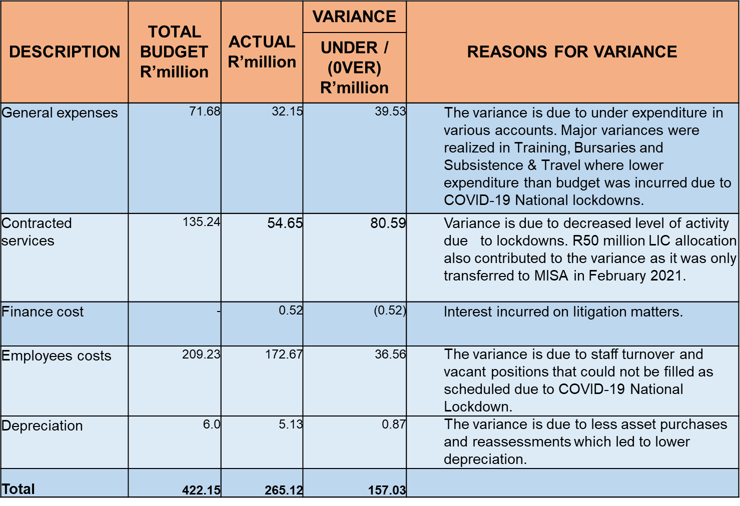
BUDGET VARIANCE REPORT PER COST ITEM AS AT 31 MARCH 2021

Slide 18
CASH FLOW /BANK RECON AS AT 31 MARCH 2021

Slide 19
FRUITLESS AND WASTEFUL EXPENDITURE AS AT 31 MARCH 2021

Slide 20
PAYMENTS OVER 30 DAYS VS PAYMENTS UNDER 30 DAYS NUMBER OF PAYMENTS 31 MARCH 2020

Slide 21
Three-Year Audit Outcomes Trend
Audit Opinion
Audit Area | 2018/19 | 2019/20 | 2020/21
Annual Financial Statements | Clean Audit | Clean Audit | Clean Audit
Audit of Predetermined Objectives (AoPO) | Clean Audit | Clean Audit | Clean Audit

Slide 22
Progress on 2019/20 Audit Findings
Area | Concern/Issue | Progress
Procurement and Contract Management | Supply chain management – various internal control deficiencies Management not being aware that they should maintain evidence of the downtime of the system when attempting to publish the awards on eTender to support their compliance with the NT Instruction no. 1 of 2019/2020 Management not ensuring that evidence to support the submission to DTI is filed/stored centrally as part of the procurement documentation so that such information is easily obtainable/retrievable Management not ensuring that adequate supporting evidence is maintained and filed to support the tax verification checks performed | These AGSA audit concerns raised in 2019/20 annual report were implemented in the 2020/21 financial year.
IT Cyber security | Systems limitation on SAGE VIP and SAGE Pastel to generate user function modification report | These AGSA audit concerns raised in 2019/20 annual report were implemented in the 2020/21 financial year.
IT Cyber security | Inadequate implementation of IT Disaster Recovery Site
Expenditure | Payment to supplier not made within 30 days

Slide 23
SUMMARY OF AGSA FINDINGS 2020/2021

Slide 24
HRM PROGRESS
Approved staff establishment 221, total of 171 were filled and 50 vacant posts as at end of the FY
Appointments of professionals (engineers) = 82% (69 out of 84 posts); and
SMS appointments = 92% (33 out of 36 posts).
Employment Equity Targets
People with disabilities = 1% achievement against the target of 2%
Woman at SMS level = 50% achievement against the target of 50%
Vacancy rate at end of the 2020/21 financial year = 23%, compared to 24% at the end of the 2019/20 financial year.

Slide 25
RECOMMENDATIONS
For the Committee to note:
MISA overall achievement of 81% for the 2020/21 FY.
That the agency received an Unqualified Audit Opinion without material findings (Clean Audit) for a third consecutive year.
MISA institutional response to the COVID-19 pandemic.
Deficiencies identified by the AGSA is addressed by Management through the implementation of remedial actions in the Post Audit Action Plan (PAAP).
HRM progress towards staff capacity

