Slide 1
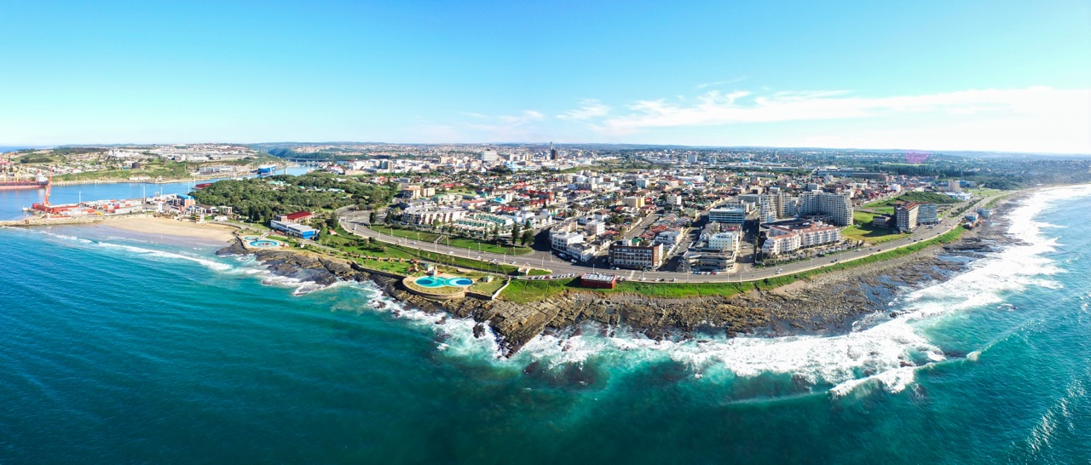
BUFFALO CITY SOCIO-ECONOMIC OUTLOOK
PRESENTATION TO THE SELECT COMMITTEE ON TRADE AND INDUSTRY, ECONOMIC DEVELOPMENT, SMALL BUSINESS DEVELOPMENT, TOURISM, EMPLOYMENT AND LABOUR
09 NOVEMBER 2021

Slide 2
OUR PRIORITIES AS A CITY ARE FRAMED THROUGH OUR 2030 METRO GROWTH AND DEVELOPMENT PLAN
introduction
Vision: Buffalo City: well governed, connected, green and innovative
An innovative and productive city
A green city
A connected city
A spatially transformed city
A well governed city

Slide 3
Buffalo City Growth 1997-2023
The BCMM economy mirrors the national economy
Growth levels have been low since 2012 due to global commodities down-cycle which has led to SA economic slump (SA is too dependent on commodities exports as core source of growth)
The economy contracted by 7% in 2020
Prospects for 2021 onwards are better with 4% growth forecast (possibly better in light on new national forecasts), dropping to between 2% and 3% for the MTREF period
We want to pick this up to 3%-5% with the right measures to increase competitiveness and investment

Slide 4
BUFFALO CITY INVESTMENT 1995-2019
At least until COVID hit, investment levels in Buffalo City have been consistent (around R7.5 billion) despite the weak growth
Partly this has been because of infrastructure investment (counter-cyclical stance of city to invest in CAPEX)
This space has now run out with COVID-19 decreasing the capacity of the metro to sustain own revenue CAPEX

Slide 5
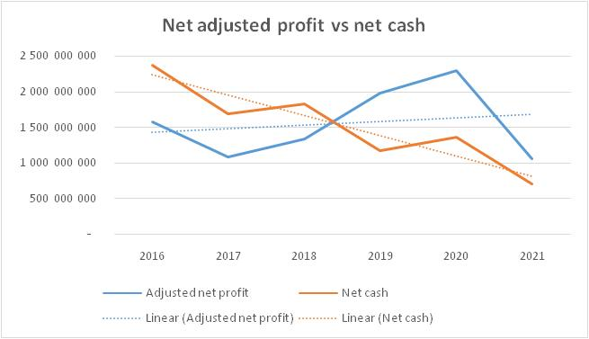
IMPACT OF COVID-19 ON BCMM’S FINANCIAL POSITION
The blue curve shows how since 2017 until 2020 the BCMM was becoming increasingly profitable
2020 was heading towards the 90% collection target which was closely missed in 2019
This would have allowed increasing concessions to be made to citizens and business (lower administered costs) once there had been adequate recovery of cash reserves
These cash reserves (brown curve) had been used since 2016 on CAPEX but were being replenished (as seen in the upward trend since 2019)
The BCMM now finds itself in a difficult position of declining profitability until the economy recovers
This will require firm leadership and cutting the suit to fit the cloth

Slide 6
ECONOMIC RECOVERY AND INVESTMENT PLAN
Aligned to the Economic Recovery and Reconstruction Plan
6 Mission directed goals
Automotive consolidation and value chain localization (retain MBSA, build on ELIDZ supplier park, establish automotive incubator, shift to auto digital hub)
Diversification towards a future fit economy (digital, green, agro-industry, creative economy, tourism)
Inclusivity (township economy, small enterprise support, local procurement, incubator programmes, future skills hub)
Enabling infrastructure (port, roads, water and sanitation, digital)
Investment retention and promotion (red-tape reduction, becoming the cheapest metro to do business, investment centre with automated property application process)
Eco-system co-ordination and partnerships (partnerships with Border Kei Business Chamber around Invest Buffalo City, Business Intelligence, IGR through DDM)

Slide 7
AUTOMOTIVE
We have done well on the automotive sector- R13billion MBSA investment, and 30 or so suppliers in the IDZ and other industrial parks
ELIDZ gone from 30% capacity to 75% capacity utilization over past 3 years
We need to make sure we win the next MBSA bid which will follow when W206 production ends in 2027 and which be decided around 2023/24.
This will mean addressing logistics and port constraints, and building digital capabilities
Huge opportunities to deepen auto supply chain (for 2nd and 3rd tier suppliers - proposal developed by ELIDZ with dtic committing 50%, additional 50% funds required).
We are disadvantaged by what we feel is a national perception of NMB as manufacturing and automotive hub of the EC (we need to shift towards a clear narrative of 2 hubs)

Slide 8
TOURISM AND AGRO-PROCESSING
Before COVID, tourism was on the up, but has now been heavily affected by COVID lockdowns and recession – in the meantime we have invested heavily in the beachfront and water-world (through BCMDA) and expect to see returns
EL based agro-processors (Nestle and Sundale) both on expansion plans
New plans to rejuvenate grain elevator through private partnership are encouraging
Plans for agricultural support infrastructure - Berlin agro-park, cold storage at EL Airport, Dimbaza etc – remain at concept and require activation and project preparation support

Slide 9
GREEN ECONOMY
Lots of progress on green economy developments
Planned IPP (Thezi Langa) awaiting NT approvals; Berlin Green Hub (extension of ELIDZ, photovoltaic, solar panel production for all government buildings and RDP houses); Energy Storage Systems (Bushveld Energy and Platinum Fuel Cells) including Vanadium Redox Flow Battery manufacturing plant in the ELIDZ ; ELIDZ Wind Farm – a 100% locally designed wind turbine has been designed by a company which now requires to take this innovation to production; Clariter R&D facility; Duncan Village buy-back centres, recycling and re-use (with BCMDA)

Slide 10
Service delivery
COVID-19 has accelerated digital transition and revealed our shortcomings
BCM has expansive plans for SMART City development
This includes the undersea cable, landing station, hyper-scale data centre, BPO Park, data recovery centre, free wifi, 5G connectivity, science and technology park
Strong potential growth in global business services sector (Global Business Services), with a number of investors secured
Digital and high end skilling (Digital Skills Hub with Harambee and BPESA, ELIDZ Science Park and MBSA’s Learning Academy)
MBSA establishing ICT hub to service other global plants
Partnership with World Bank (Smart City Strategy)
Need undersea cable and data centre infrastructure

Slide 11
INFRASTRUCTURE
BCMM has invested significantly over past few years - Fleet Street, Qumza Highway, Sleeper Site Road, Quinera-Gonubie Phase 1 etc
Shovel ready on Mdantsane Access, Quinera-Gonubie Phase 2,
Settlers Way Expansion has commenced
Detailed planning done on NW Expressway, and underway with Harbour Arterial Rd
Resources for road projects going forward an issue (very little own revenue as before, need to think about alternative funding utilizing project preparation fund)
Some progress on port development (Transnet have agreed to shared approach to feasibility and business case development with province and city)
Transnet upgrading rail link to NMB (just completed)
Reeston Tunnel loan funding secured

Slide 12
CONCLUSION
We have laid a good basis during this term but now need to build on the stable platform we have created to improve service delivery.
We are targeting being in the top 3 metros for sustainability and financial management; governance; service delivery; administered costs like rates and tariffs; and cutting red-tape (SNDB).
We also need to prioritize Economic Recovery, and increasing the share of the BCMM economy to national investment, growth, jobs and exports.
This will only work if we join up as the three spheres of government

Slide 13
THE END

