Slide 1
REDUCING TEENAGE PREGNANCY IN SOUTH AFRICA
THE ROLE OF THE DEPARTMENT OF BASIC EDUCATION IN ADDRESSING LEARNER PREGNANCY
Portfolio Committee on Basic Education

Slide 2
Introduction and Context
Adolescent girls and young women (10-19) make up 12.67% of the total population in South Africa, and are argued to be the most vulnerable cohort.
AGYW face complex and serious challenges during the course of their lives: poverty, HIV and STI infection and a range of health related issues, early and unintended pregnancy, gender based violence, rape and abuse.
While over the past 4 decades, positive development is noted including a decrease in fertility rates, numbers of early and unintended pregnancy remains unacceptably high.
Consequentially AGYW bear the brunt of the negative consequences, these include:
That 1/3 of girls that fall pregnant and do not don’t return to school and are known to experience multiple pregnancies post the first pregnancy (General Household Survey, 2018)
Health outcomes are compromised, mortality rates higher and many don’t have access to healthcare as they should.
Lack of access to education also results in knowledge gaps.
The creation of poverty traps that impact that social and economic development of the country.
2

Slide 3
ADOLESCENT GIRLS AND YOUNG WOMEN [AGYW]
UNPACKING SOUTH AFRICA’S MOST VULNERABLE POPULATION GROUP
3

Slide 4
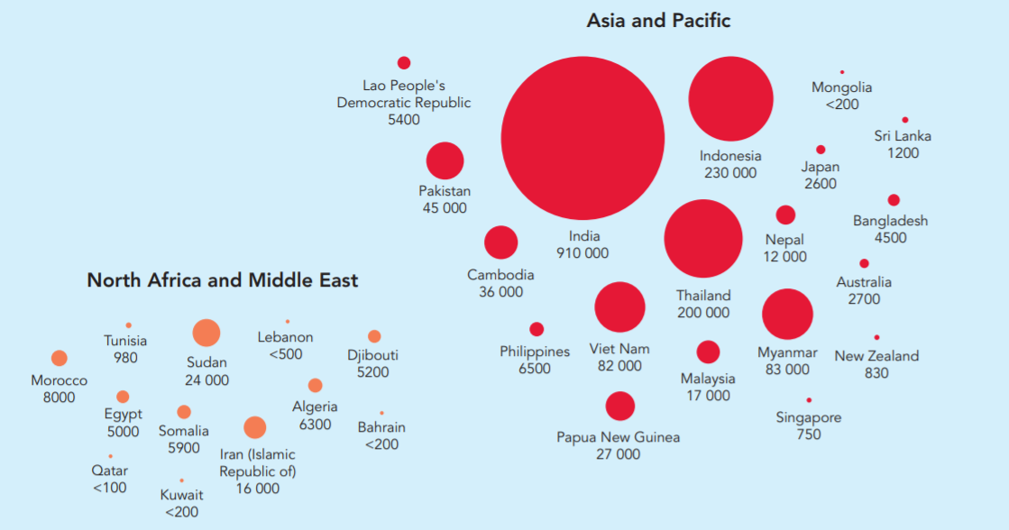
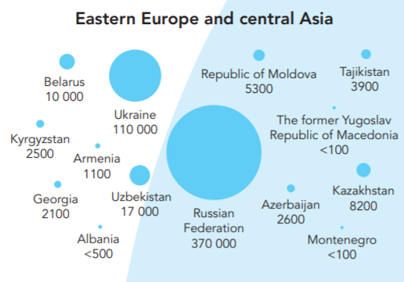
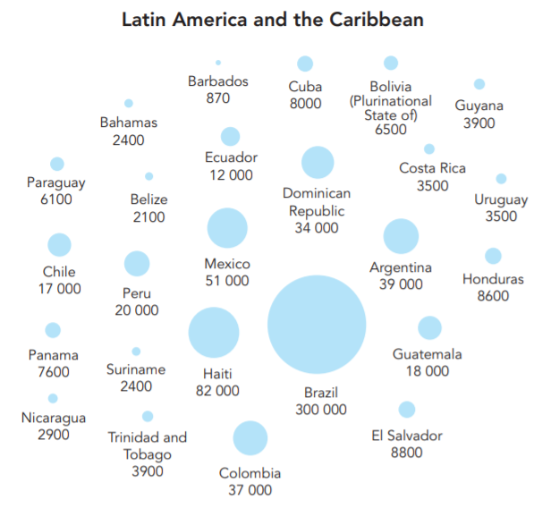
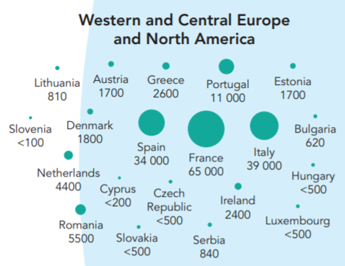
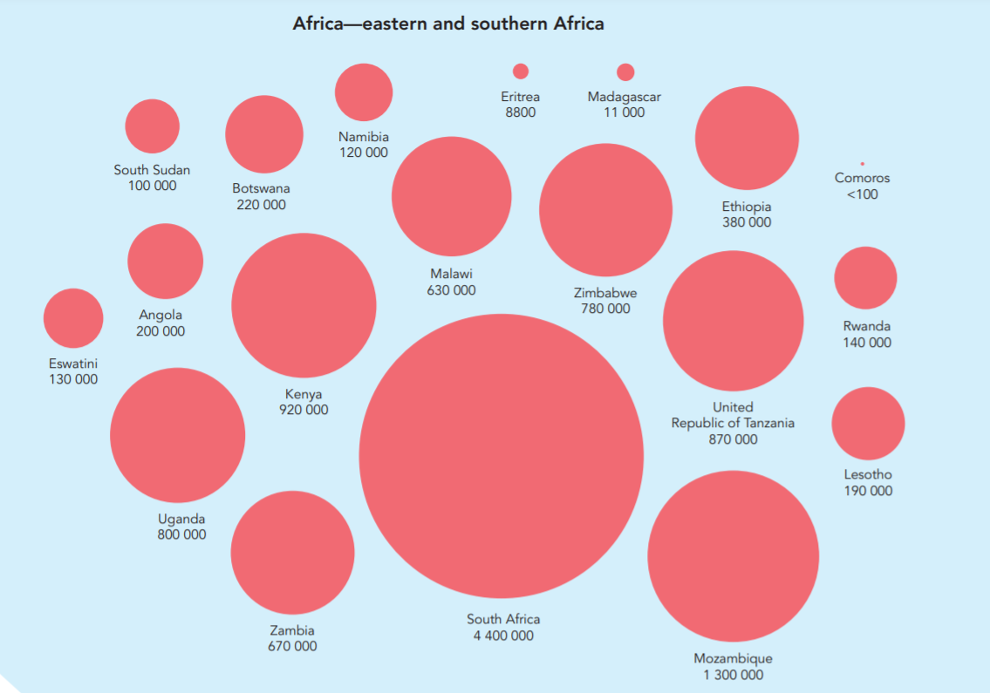
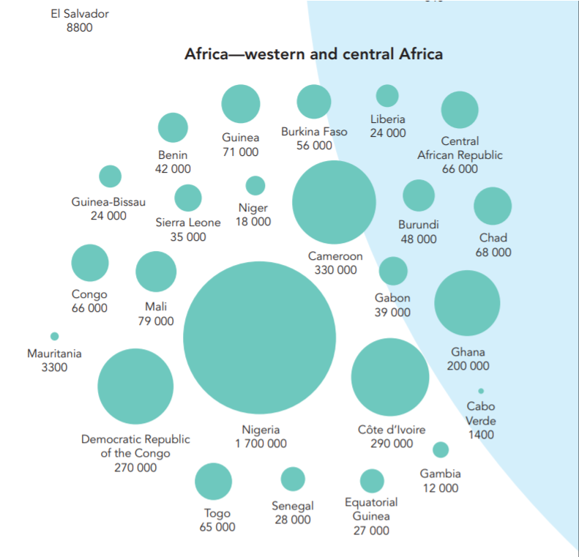
GLOBAL AGYW STATISTICS: HIV
19.1 MILLION GIRLS AND WOMEN LIVING WITH HIV GLOBALLY
Girls and women make up more than half of the 36.9 million people living with HIV.
UNAIDS 2018 ESTIMATES
4

Slide 5
GLOBAL AGYW STATISTICS: HIV
4.4 MILLION INFECTED AGYW ARE SOUTH AFRICAN
23% OF THE GLOBAL AVERAGE
UNAIDS 2018 ESTIMATES
5

Slide 6
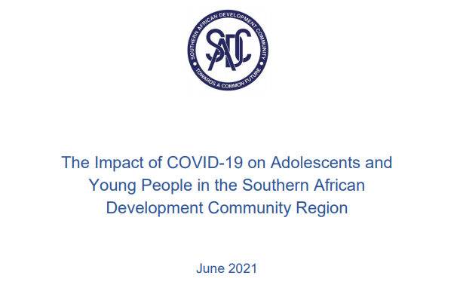
IMPACT OF COVID-19
KEY FINDINGS
School closures have impacted 127M learners in E. and S. Africa
ONE MILLION girls in SSA are at risk of not returning to school because of pregnancy (65% increase in early pregnancies in SADC Member states)
For the most vulnerable young people, education is lifesaving – schools are spaces of support, providing nutrition, PSS and SRHS
CSE provided in school is a critical support and service for AGYW.
6

Slide 7
IMPACT OF COVID-19
In South Africa, 37% spike in GBV complaints in the first week of total lockdown
Children are often victims/witnesses of domestic violence – exacerbated during COVID-19 lockdown
Harmful impact on physical health, mental development and well-being
School closures and containment measures result in loss of education, and social protections – esp. for adolescent girls
Results in significant increases in teen pregnancy, sexual exploitation, sexual violence and forced/early marriages in SSA
KEY FINDINGS
7

Slide 8
NATIONAL AGYW STATISTICS: HIV, STIs AND GBV
4 X GREATER!!
HIV prevalence among YOUNG WOMEN is nearly FOUR TIMES GREATER than that of young men
46%
OF SEXUAL ABUSE COMPLAINANTS ARE CHILDREN
180,000
540,000
3
BOYS
GIRLS
1
Number living with HIV in 2018
15.1%
1. South African National AIDS Council (SANAC) (2017) ‘National Strategic Plan 2017-2022' [pdf]
OF GIRLS EXPERIENCE RAPE, SEXUAL HARRASMENT, VERBAL ABUSE AND/OR BULLYING IN SCHOOLS
Approx. 1300 newly HIV infected AGYWs in South Africa per WEEK
4
3. https://www.justice.gov.za/vg/gbv/NSP-GBVF-FINAL-DOC-04-05.pdf
4.https://www.education.gov.za/Portals/0/Documents/Publications/Opening%20Our%20Eyes%20Manual%20for%20TeachersReduced.pdf

Slide 9
NATIONAL AGYW STATISTICS: HIV, STIs AND GBV
4 X GREATER!!
HIV prevalence among YOUNG WOMEN is nearly FOUR TIMES GREATER than that of young men
46%
OF SEXUAL ABUSE COMPLAINANTS ARE CHILDREN
180,000
540,000
3
BOYS
GIRLS
1
Number living with HIV in 2018
15.1%
1. South African National AIDS Council (SANAC) (2017) ‘National Strategic Plan 2017-2022' [pdf]
OF GIRLS EXPERIENCE RAPE, SEXUAL HARRASMENT, VERBAL ABUSE AND/OR BULLYING IN SCHOOLS
Approx. 1300 newly HIV infected AGYWs in South Africa per WEEK
4
3. https://www.justice.gov.za/vg/gbv/NSP-GBVF-FINAL-DOC-04-05.pdf
4.https://www.education.gov.za/Portals/0/Documents/Publications/Opening%20Our%20Eyes%20Manual%20for%20TeachersReduced.pdf
9

Slide 10
NATIONAL AGYW STATISTICS: HIV, STIs AND GBV
4 X GREATER!!
HIV prevalence among YOUNG WOMEN is nearly FOUR TIMES GREATER than that of young men
46%
OF SEXUAL ABUSE COMPLAINANTS ARE CHILDREN
180,000
540,000
3
BOYS
GIRLS
1
Number living with HIV in 2018
15.1%
1. South African National AIDS Council (SANAC) (2017) ‘National Strategic Plan 2017-2022' [pdf]
OF GIRLS EXPERIENCE RAPE, SEXUAL HARRASMENT, VERBAL ABUSE AND/OR BULLYING IN SCHOOLS
Approx. 1300 newly HIV infected AGYWs in South Africa per WEEK
4
3. https://www.justice.gov.za/vg/gbv/NSP-GBVF-FINAL-DOC-04-05.pdf
4.https://www.education.gov.za/Portals/0/Documents/Publications/Opening%20Our%20Eyes%20Manual%20for%20TeachersReduced.pdf
10

Slide 11
NATIONAL AGYW STATISTICS: HIV, STIs AND GBV
4 X GREATER!!
HIV prevalence among YOUNG WOMEN is nearly FOUR TIMES GREATER than that of young men
46%
OF SEXUAL ABUSE COMPLAINANTS ARE CHILDREN
180,000
540,000
3
BOYS
GIRLS
1
Number living with HIV in 2018
15.1%
1. South African National AIDS Council (SANAC) (2017) ‘National Strategic Plan 2017-2022' [pdf]
OF GIRLS EXPERIENCE RAPE, SEXUAL HARRASMENT, VERBAL ABUSE AND/OR BULLYING IN SCHOOLS
Approx. 1300 newly HIV infected AGYWs in South Africa per WEEK
4
3. https://www.justice.gov.za/vg/gbv/NSP-GBVF-FINAL-DOC-04-05.pdf
4.https://www.education.gov.za/Portals/0/Documents/Publications/Opening%20Our%20Eyes%20Manual%20for%20TeachersReduced.pdf
11

Slide 12
NATIONAL AGYW STATISTICS: HIV, STIs AND GBV
4 X GREATER!!
HIV prevalence among YOUNG WOMEN is nearly FOUR TIMES GREATER than that of young men
46%
OF SEXUAL ABUSE COMPLAINANTS ARE CHILDREN
180,000
540,000
3
BOYS
GIRLS
1
Number living with HIV in 2018
15.1%
1. South African National AIDS Council (SANAC) (2017) ‘National Strategic Plan 2017-2022' [pdf]
OF GIRLS EXPERIENCE RAPE, SEXUAL HARRASMENT, VERBAL ABUSE AND/OR BULLYING IN SCHOOLS
Approx. 1300 newly HIV infected AGYWs in South Africa per WEEK
4
3. https://www.justice.gov.za/vg/gbv/NSP-GBVF-FINAL-DOC-04-05.pdf
4.https://www.education.gov.za/Portals/0/Documents/Publications/Opening%20Our%20Eyes%20Manual%20for%20TeachersReduced.pdf
12

Slide 13
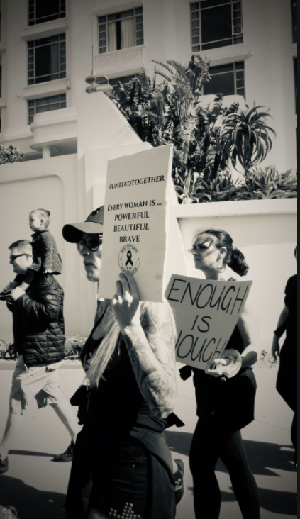
NATIONAL AGYW STATISTICS: GBV AND RAPE
GBV
South Africa has one of the HIGHEST RATES of violence against women and girls globally.
According to SAPS, 202 170 cases of contact crimes and sexual offences against women, and 64 418 cases against children were reported in 2019/20.
FEMICIDE
The femicide rate in South Africa is FIVE TIMES the global average.
2 695 counts of murder against women were recorded in 2019/20.
COVID-19
There has been an exponential increase in GBV cases
The Govt GBV command centre recorded 120 000 cases in the first three weeks of lockdown, and cases of sexual assault and rape almost tripled the pre-lockdown rates.
THE SECOND EPIDEMIC
In 2019/20: 53 170 sexual offences were reported, (approx. 146 per day)
Of this, 42 919 rape cases were recorded in 2019/20 (approx. 118 per day)
(SAPS Crime Stats)
13

Slide 14
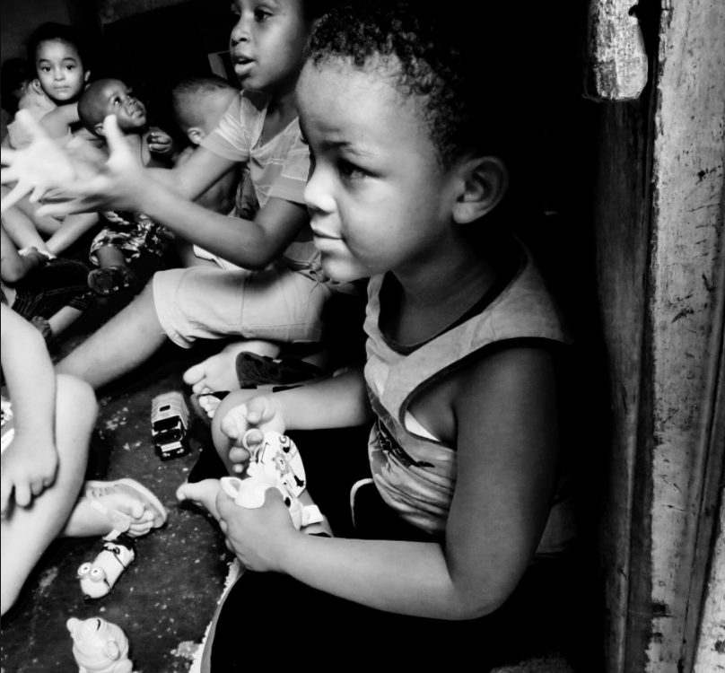
NATIONAL AGYW STATISTICS: CHILD ABUSE
20 – 34 % of children experience contact violence before the age of 18
CHILD ABUSE
12% of children report neglect
16% of children report emotional abuse
Cases of attempted rape against children increased by 4,3% from 2018/19 to 2019/20
17 118 cases of rape against children were reported in 2019/20
Jamieson L, Sambu W & Mathews S (2017) Out of harm's way? Tracking child abuse cases through the child protection system in five selected sites in South Africa. Cape Town: Children’s Institute, University of Cape Town.
SAPS Crime Stats.

Slide 15
EARLY AND UNINTENDED TEENAGE PREGNANCY
15

Slide 16
NATIONAL AGYW STATISTICS: TEEN PREGNANCY
OF TEENAGE GIRLS FALL PREGNANT
30%
IN SOUTH AFRICA, MORE THAN...
5
AND MORE THAN 65% OF THESE PREGNANCIES ARE UNPLANNED
6
5. Willan S. A Review of Teenage Pregnancy in South Africa – Experiences of Schooling, and Knowledge and Access to Sexual & Reproductive Health Services. Cape Town: Partners in Sexual Health, 2013.
6. Adeniyi OV, Ajayi AI, Moyaki MG, Ter Goon D, Avramovic G, Lambert J. High rate of unplanned pregnancy in the context of integrated family planning and HIV care services in South Africa. BMC Health Serv Res 2018;18:140. https:// doi.org/10.1186/s12913-018-2942-z
16

Slide 17
NATIONAL AGYW STATISTICS: TEEN PREGNANCY
30,47% of annual average
TOP | 9327 | 14069 | 16199 | 14043 | 3228
17

Slide 18
PROVINCIAL AGYW STATISTICS: TEEN PREGNANCY
29,90% of annual average
18

Slide 19
PROVINCIAL AGYW STATISTICS: TEEN PREGNANCY
31,42% of annual average
19

Slide 20
PROVINCIAL AGYW STATISTICS: TEEN PREGNANCY
33,61% of annual average
20

Slide 21
PROVINCIAL AGYW STATISTICS: TEEN PREGNANCY
28,97% of annual average
21

Slide 22
PROVINCIAL AGYW STATISTICS: TEEN PREGNANCY
28,84% of annual average
22

Slide 23
PROVINCIAL AGYW STATISTICS: TEEN PREGNANCY
34,00% of annual average
23

Slide 24
PROVINCIAL AGYW STATISTICS: TEEN PREGNANCY
28,12% of annual average
24

Slide 25
PROVINCIAL AGYW STATISTICS: TEEN PREGNANCY
34,46% of annual average
25

Slide 26
PROVINCIAL AGYW STATISTICS: TEEN PREGNANCY
27,59% of annual average
26

Slide 27
Delivery in facility rates: National and Provinces (10-19 years ) , 2018-2020
Province | Apr 2018 to Mar 2019 | Apr 2019 to Mar 2020 | Apr 2020 to Mar 2021
NC Northern Cape | 18.4 | 18.4 | 19.3
ec Eastern Cape | 16.4 | 16.7 | 17.1
kz KwaZulu-Natal | 17.4 | 16.3 | 16.5
mp Mpumalanga | 15 | 14.9 | 15.5
nw North West | 13.4 | 13.1 | 14
lp Limpopo | 13.4 | 14.1 | 13.8
fs Free State | 12.1 | 12.8 | 13.1
wc Western Cape | 11.1 | 11.1 | 10.8
gp Gauteng | 7.1 | 7.5 | 8.9
za South Africa | 13.1 | 13.2 | 13.6
27

Slide 28
WHAT ARE THE STATISTICS TELLING US?
Schools provide a protective environment to children:
There is a significant cohort of AGYWs within the schooling system
Programmes are aimed at retaining learners in this protective environment
AGYW are more vulnerable and face many overlapping challenges in society:
HIV prevalence among girls is four times greater than boys
Girls are prone to high levels of sexually transmitted infections
Girls are particularly vulnerable to GBV, rape and abuse
Gender inequity and power imbalances in relationships
Poverty and inequitable access to health and social services
28

Slide 29
WHAT ARE THE STATISTICS TELLING US?
Teenage pregnancy statistics reveal the following :
There are high numbers of early and unintended pregnancies and the numbers are not new
Approx. 33% of girls not return to school after falling pregnant and are likely to experience multiple pregnancies
The complexities that underlie teen pregnancy are many
Rape, child abuse and GBV are highly prevalent contributing to the issue of teenage pregnancy:
Most pregnancies under the age of 14 constitute statutory rape
(sexual activity between adolescents within two years of each other has been decriminalised)
A multi-sectoral approach is needed to also ensure protection outside of schools:
Systemic vulnerabilities and structural drivers must be addressed
29

Slide 30
UNDERSTANDING LEARNER PREGNANCY
OBJECTIVES:
The only South African study to date that focuses on pregnancy among school-going adolescents
KEY FINDINGS:
With proper interventions and access to focused sexual and reproductive health services and education, positive attitudes towards early pregnancies recorded in the 1990’s have shifted
Two thirds of women now report early pregnancies as UNWANTED, and value educational aspirations instead
Contraceptive use has dramatically increased, and fertility decreased
Teen pregnancy was as a result of school drop-out, and not often the cause of school drop-out
Social conditions and environment influence teen fertility rates
Commissioned by UNICEF on behalf of the DBE, conducted by HSRC
STUDY PROVIDES EVIDENCE OF COMPLEXITIES OF TEEN PREGNANCY
Teenage pregnancy in South Africa: with a specific focus on school-going learners
Panday et al. (2009)

Slide 31
UNDERSTANDING LEARNER PREGNANCY
- Economic barriers - Poor school performance - Poverty - Single parent/child-headed household - Poor access to health services/contraceptives - Power imbalances in relationships - Multiple sexual partners
- Bio-medical drivers
- GAPS IN CSE KNOWLEDGE
AGYWs
PREGNANCY RATES
Overlapping factors that increase the vulnerability of AGYWs as well as the risk of early and unplanned pregnancy
Factors are structural, sexual, bio-medical and relational
Shows complexities of the learner pregnancy issue
Teenage pregnancy in South Africa: with a specific focus on school-going learners
Panday et al. (2009)
31

Slide 32
UNDERSTANDING LEARNER PREGNANCY
Given the drivers that influence teenage pregnancy, a MULTI-SECTORAL approach is needed
Particular responsibilities lie with the following sectors:
Department of Basic Education (DBE)
Department of Health
Department of Social Development
Department of Women
Department of Justice
South African Police Services
This will also require robust collaboration with civil society, communities, parents, religious, traditional, and other relevant stakeholders.
32

Slide 33
THE ROLE OF THE DBE
EDUCATION AS A PROTECTIVE FACTOR
33

Slide 34
EDUCATION IS A PROTECTIVE FACTOR
Various UN studies have revealed that education is indeed a protective factor:
Conditional cash transfer study aimed at keeping girls at schools -Remme et. Al. 2014 in the region revealed the following significant outcomes:
35% reduction in school drop-out
40% reduction in early marriages
30% reduction in teenage pregnancy
64% reduction in HIV risk
Keeping Girls in Schools Programme – looks at how schooling works for HIV prevention. Found that increased school attendance can reduce adolescent girls’ risk of acquiring HIV in three different ways:
Firstly, being in school can be protective and reduce HIV by reducing early marriage and risky sexual partnerships.
Secondly, in advanced HIV epidemics, higher educational attainment is itself associated with reduced HIV prevalence later in life and with safer behaviours.
Thirdly, keeping girls in school ensures that greater numbers of adolescent girls can access HIV prevention information in the context of comprehensive sexuality education or school-based campaigns.
Other studies showed:
That limited access to secondary and tertiary education among adolescent girls and young women contributes to increased HIV incidence risk with uneducated girls are twice as likely to acquire HIV than those who have some schooling
34

Slide 35
DBE POLICY ENVIRONMENT
The following policies frame the DBE’s approach:
Integrated School Health (2012)
Policy Framework on Care and Support for teaching and learning (2015)
National Policy on HIV, STIs and TB for Learners, Educators, School Support Staff and Officials in all Primary and Secondary Schools in the Basic Education Sector (2017)
National School Safety Framework (2018)
Protocol for the management and reporting of sexual abuse and harassment in schools (2018)
Standard Operating Procedure for the Provision of Sexual and Reproductive Health Rights and Social Services in Secondary Schools (2018)
DBE Policy on the Prevention and Management of Learner Pregnancy in Schools (2021 - draft)
All of the above is couched within the SA Constitution – Bill of Rights, the National Development Plan 2030, the National Strategic Plan for HIV, TB and STIs 2017-2022
DBE is well positioned to respond to the complexities as part of a multi-faceted approach
RETENTION with comprehensive WRAP AROUND SUPPORT is KEY!
35

Slide 36
AGYW PROGRAMMES IN SCHOOLS
DBE INTERVENTIONS:
HIV Prevention - Policy and Conditional grant
Integrated School Health Policy (ISHP)
Social Impact Bond – Medical Research Council (MRC) investment case for AGYW programming
Education Plus Initiative – United Nations (UN) agencies
Gender-Based Violence and Gender Equity Programming
Let’s Talk: Early and Unintended Pregnancy (UNESCO)
AGYW:
DREAMS (She Conquers Framework)
Global Fund AGYW
Government to Government Agreement (G2G) AYGW
36

Slide 37
PREVENTION APPROACHES TO END SCHOOL RELATED GBV
From Policy to Practice using Five Key Levers:
Curriculum and Assessment implementation
Life Skills & Life Orientation; Comprehensive Sexuality Education
Learning and Teaching Support Materials
State-owned Life Orientation Textbooks, Scripted Lesson Plans, Learner Workbooks
Teacher Training and Development
L.O. Teaching Guide, Teaching 4 ALL, Gender Responsive Pedagogy Toolkit for Early Child Education (GRP4ECE)
Co-curricular and Enrichment Programmes and Care and Support Services
Ending SRGBV, Gender Empowerment (G/BEM), Protocol for the Management & Reporting of Sexual Abuse, Youth-friendly health services, Post-violence care, LGBTQI
Advocacy and information
Community engagements, publications, advertorials, radio & TV
37

Slide 38
AGYW PROGRAMME (2019-2022)
Offers an age-tailored combination prevention programme for AGYW aged 10-19.
The programme targets AGYW, in and out of school, but will not deny service provision to other populations who are engaged by the programme (i.e. ABYM in-school).
An adolescent girl or young women will be introduced to the programme through a number of entry points from where she would be receiving services via two main service components called the Core Service and Layered Services.
She would first receive the Core Service and then follow a path of receiving additional services layered over time as required.
The layered services are not necessarily provided in specific order but dependent on the needs of the Learner.
38

Slide 39
AGYW PROGRAMME OBJECTIVES
Increase retention in school
Decrease HIV incidence
Decrease teenage pregnancy
Decrease gender based violence
Increase economic opportunities
GOAL 1:
Accelerate prevention to reduce new HIV and TB infections and STIs.
Reach all key and vulnerable populations with customized and targeted interventions.
Address the social and structural drivers of HIV, TB and STIs, and link these efforts to the National Development Plan (NDP).
GOAL 3:
GOAL 4:
* DBE HIV Policy
NSP GOALS
39

Slide 40
AGYW MODEL OF DELIVERY
Clinics NGOs
Schools
Faith Based Organisations
Public Spaces Police Social Dev TVETs
AGES
10-24
ADOLESCENT GIRLS & YOUNG WOMEN
JOURNEY
PLAN
LAYERED SERVICES
Information
Risk Assessment
Offered HIV Test
Condoms
Service Plans
HIV, TB, Pregnancy testing & self-screening
Emergency contraception & contraception
Vending machines
STI screening, investigation & treatment
PrEP, Post-violence care (PEP)
ART & viral load monitoring
PMTCT, TOP & post-abortion care
TB Isoniazid Preventative Therapy (IPT) & treatment
Peer education
Individual & group psycho-social support
PrEP demand creation
SRH knowledge
Mental health support & services
Physical activity
Substance use programmes
Teen parenting
Teen & caregiver communication
Adherence Support
GBV Response
CSE INSTITUTIONAL SUPPORT (10-14, 15-19)
Academic support & career guidance
Return to school
Economic strengthening
Access to work opportunities & bursaries
Dignity packs
Accessing social grants
Men’s dialogues, gender norms
Youth leadership
GBV awareness & self-defense
HEALTH
BEHAVIOR
STRUCTURE
CORE SERVICES
HEALTHY | EDUCATED | STRONG | SAFE

Slide 41
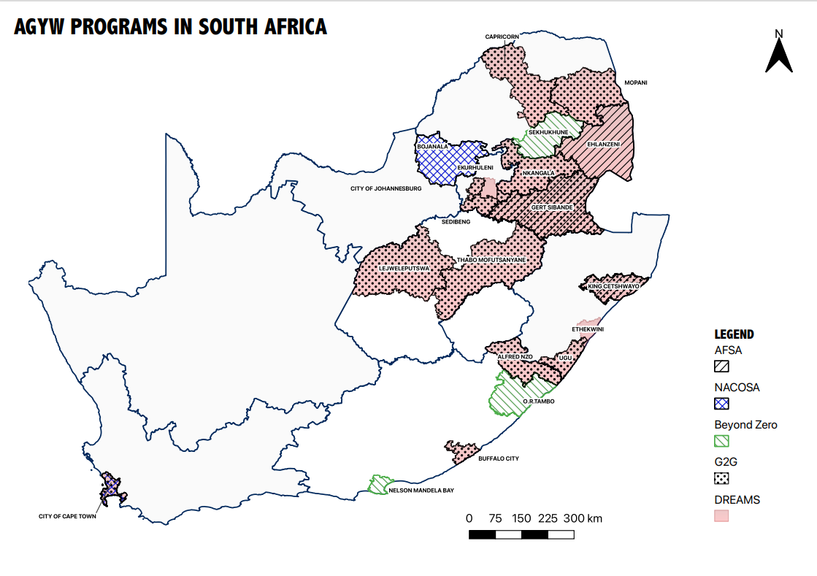
DISTRIBUTION OF AGYW PROGRAMMES
41

Slide 42
COMPREHENSIVE SEXUALITY EDUCATION (CSE)
DBE leads in the provision of CSE
Realize their health, well-being and dignity
Develop respectful social and sexual relationships
Consider how their choices affect their own well-being and that of others
Understand and ensure the protection of their rights throughout their lives.
CSE is a curriculum-based process of teaching and learning about the cognitive, emotional, physical and social aspects of sexuality.
CSE is offered in formal setting, scientifically accurate, culturally relevant, based on human rights approach, age and developmentally-appropriate (UNESCO, 2018)
CSE aims to equip children and young people with knowledge, skills, attitudes and values that will empower them to:
42

Slide 43
CSE OBJECTIVES
CSE aims to empower learners to:
Identify and report sexual abuse
Remain HIV negative & remain on treatment if positive
Prevent pregnancy
Prevent bullying & to deal with negative peer pressure
Know where to get help (in cases of rape, TB & ART, contraception, substance abuse)
Stay in school until they complete Grade 12
43

Slide 44
CSE IMPLEMENTATION APPROACH
Key Implementors: Care & Support, Curriculum, Teacher Development, Governance & Management, EMIS, ISHP
Scripted Lesson Plans for grades 4-12 developed and approved by DBE
Trained Officials & LO Educators on the use of CSE Scripted Lesson Plans
Scripted Lesson Plans (Classroom)
Trained School Governing Bodies members in addressing adolescent and youth challenges through CSE
Parental
Support through
SGBs (Home)
Learner & Educator Mentorship
(Outside Class)
Ambassador program to support leadership and behaviour change of learners. Mentoring and coaching of educators.
The Learner
School Management Teams sensitised to support educators in CSE implementation
School Management
Support
(School)
Access to ASRH
Services
(Health Facility &
School- based)
Linkages to ASRH services and referrals strengthened

Slide 45
IN-SCHOOL POPULATION: PHASE, GRADE AND SCHOOL Scripted Lesson Plans
Phase | Grade | Age (a year older or younger) | SLP Focus | School: Primary/High
Intermediate | 4 | 10 years | Safety of learners empower them against abuse and bullying (basis for GBV later). Link learners to psycho social services (PSS). | Primary School
 | 5 | 11 years
 | 6 | 12 years
Senior | 7 | 13 years | Risk reduction, contraception and HIV prevention messages, prevent GBV and provides information to the learner to make the right choices. Link to health services.
 | 8 | 14 years |  | High School
 | 9 | 15 years
Further Education & Training | 10 | 16 years | Risk reduction messages, contraception and support the learner to finish matric and lead a productive adult life post high school. Link to health services.
 | 11 | 17 years
 | 12 | 18 years

Slide 46
SEXUALITY EDUCATION IS NOT SEX EDUCATION
Sexuality Education
Sex Education
Addresses relationships
Developmental and age-appropriate
Does not compromise the innocence of the child
Addresses the whole person: psychological, emotional, mental and physiological aspects of the human being
Includes morals, life skills and values
Offered in schools
The “how” of having sex
Mostly focused on the physical aspects
NOT offered in school
46

Slide 47
CONCERNS AND MISCONCEPTIONS OF CSE IN SOUTH AFRICA
MYTHS | FACTS
CSE leads to early sexual initiation | CSE leads to later debut and more responsible sexual behaviour
CSE deprives children of their innocence | Evidence shows that children benefit from receiving appropriate information that is scientifically accurate, non-judgmental and age and developmentally appropriate
CSE goes against our culture or religion | CSE stresses the need to engage with the local contexts including engagements with traditional leaders, religious communities and local stakeholders. CSE addresses harmful social norms and negative practices that are not in line with human rights or that increase vulnerability and risk, especially for young women and girls
47

Slide 48
CONCERNS AND MISCONCEPTIONS OF CSE IN SOUTH AFRICA
MYTHS | FACTS
Teaching masturbation in Grade 4 | No masturbation topic in Grade 4 topics
Teaching of sexual pleasure in the curriculum | The focus of the SA curriculum is not on sexual pleasure but on prevention of HIV, STIs, early and unintended pregnancy, healthy lifestyle choices and avoidance of risky behaviours using a rights based approach
Teaching of UNESCO ITGSE | LO Curriculum is based on SA context. The ITGSE was adjusted to strengthen the content of the CAPS topics. There are no new topics.
It is the role of parents to educate children about sexuality | Parents play an important role in educating young people about sexuality. However, CSE complements this role by providing holistic education in a safe and supportive environment
48

Slide 49
CONCERNS AND MISCONCEPTIONS OF CSE IN SOUTH AFRICA
MYTHS | FACTS
The CSE is using pornographic imagery | Images used in the curriculum are based on protocols and standards set by the DBE that ensures protection of human dignity and rights and does not expose learners to offensive content
Teaching of types of sex in the curriculum | The CSE in the CAPS focuses on the total person and is teaching age-appropriate content that focuses on relationships, life skills, values and does not teach learners how to have any form of sex
CSE will be rolled out without teacher training and teachers are expected to teach new content they are not comfortable with | Since 2000, the Department has been providing in-service teacher training on Life Skills and Life Orientation. Training manuals on the Sexuality Education Scripted Lessons Plans has also been developed to build the capacity of LO educators to deliver the strengthened content
49

Slide 50
EFFICACY OF CSE
INTERNATIONAL TECHNICAL GUIDANCE ON SEXUALITY EDUCATION:
Provides evidence base for the effectiveness of CSE:
Curriculum-based sexuality education programmes contribute to the following outcomes:
Delayed initiation of sexual intercourse
Decreased frequency of sexual intercourse
Decreased number of sexual partners
Reduced risk taking
Increased use of condoms
Increased use of contraception
Sexuality education increases knowledge and improves attitudes about different aspects of sexuality, behaviours and risks of pregnancy, HIV and STIs
CSE has the desired positive effect on young people’s health outcomes when delivered as intended
(UNESCO, 2018)
Comprehensive Sexuality Education does not increase sexual activity, sexual risk-taking behaviour or STI/HIV infection rates

Slide 51
EFFICACY OF CSE WITHIN PREVENTION PROGRAMMING
THE ZIMELE PROJECT:
A comprehensive HIV prevention programme for adolescents (aged 10-24 years)
Implemented by the Desmond Tutu HIV Foundation
A prototype of what a comprehensive, integrated, and sustainable model of adolescent health provision could look like
Supplied through the national Young Women and Girls programme funded by The Global Fund to Fight AIDS, Tuberculosis and Malaria, under the Young Women and Girls programme.
STUDY PROVIDES EVIDENCE OF THE EFFICACY OF CSE INTERVENTIONS FOR AGYWs

Slide 52
EFFICACY OF CSE
Adolescents require comprehensive, wrap-around services with multiple entry points across the age-continuum.
CSE drives demand creation and improves uptake of SRHS
It should be offered in tandem with differentiated models of adolescent healthcare.
School health programmes are an effective, feasible, safe and acceptable way to reach adolescents of school-going age.
Engagement with teachers, parents, caregivers improves acceptability of school health programmes and CSE.
HIV education programmes need to adopt a public health approach, and include an approach based on gender norms and power dynamics.
Young men and boys cannot be left out of programmes that aim to achieve HIV prevention or improved SRH outcomes among young women and girls.
Programmes should be deployed in tandem, and focus on aspects of gender norms and the prevention of gender-based violence.
FINDINGS

Slide 53
EFFICACY OF CSE
Adolescents require comprehensive, wrap-around services with multiple entry points across the age-continuum.
CSE drives demand creation and improves uptake of SRHS
It should be offered in tandem with differentiated models of adolescent healthcare.
School health programmes are an effective, feasible, safe and acceptable way to reach adolescents of school-going age.
Engagement with teachers, parents, caregivers improves acceptability of school health programmes and CSE.
HIV education programmes need to adopt a public health approach, and include an approach based on gender norms and power dynamics.
Young men and boys cannot be left out of programmes that aim to achieve HIV prevention or improved SRH outcomes among young women and girls.
Programmes should be deployed in tandem, and focus on aspects of gender norms and the prevention of gender-based violence.
FINDINGS

Slide 54
EFFICACY OF CSE
Adolescents require comprehensive, wrap-around services with multiple entry points across the age-continuum.
CSE drives demand creation and improves uptake of SRHS
It should be offered in tandem with differentiated models of adolescent healthcare.
School health programmes are an effective, feasible, safe and acceptable way to reach adolescents of school-going age.
Engagement with teachers, parents, caregivers improves acceptability of school health programmes and CSE.
HIV education programmes need to adopt a public health approach, and include an approach based on gender norms and power dynamics.
Young men and boys cannot be left out of programmes that aim to achieve HIV prevention or improved SRH outcomes among young women and girls.
Programmes should be deployed in tandem, and focus on aspects of gender norms and the prevention of gender-based violence.
FINDINGS

Slide 55
EFFICACY OF CSE
Adolescents require comprehensive, wrap-around services with multiple entry points across the age-continuum.
CSE drives demand creation and improves uptake of SRHS
It should be offered in tandem with differentiated models of adolescent healthcare.
School health programmes are an effective, feasible, safe and acceptable way to reach adolescents of school-going age.
Engagement with teachers, parents, caregivers improves acceptability of school health programmes and CSE.
HIV education programmes need to adopt a public health approach, and include an approach based on gender norms and power dynamics.
Young men and boys cannot be left out of programmes that aim to achieve HIV prevention or improved SRH outcomes among young women and girls.
Programmes should be deployed in tandem, and focus on aspects of gender norms and the prevention of gender-based violence.
FINDINGS

Slide 56
EFFICACY OF CSE
Adolescents require comprehensive, wrap-around services with multiple entry points across the age-continuum.
CSE drives demand creation and improves uptake of SRHS
It should be offered in tandem with differentiated models of adolescent healthcare.
School health programmes are an effective, feasible, safe and acceptable way to reach adolescents of school-going age.
Engagement with teachers, parents, caregivers improves acceptability of school health programmes and CSE.
HIV education programmes need to adopt a public health approach, and include an approach based on gender norms and power dynamics.
Young men and boys cannot be left out of programmes that aim to achieve HIV prevention or improved SRH outcomes among young women and girls.
Programmes should be deployed in tandem, and focus on aspects of gender norms and the prevention of gender-based violence.
FINDINGS

Slide 57
EFFICACY OF CSE
Adolescents require comprehensive, wrap-around services with multiple entry points across the age-continuum.
CSE drives demand creation and improves uptake of SRHS
It should be offered in tandem with differentiated models of adolescent healthcare.
School health programmes are an effective, feasible, safe and acceptable way to reach adolescents of school-going age.
Engagement with teachers, parents, caregivers improves acceptability of school health programmes and CSE.
HIV education programmes need to adopt a public health approach, and include an approach based on gender norms and power dynamics.
Young men and boys cannot be left out of programmes that aim to achieve HIV prevention or improved SRH outcomes among young women and girls.
Programmes should be deployed in tandem, and focus on aspects of gender norms and the prevention of gender-based violence.
FINDINGS

Slide 58
EFFICACY OF CSE
Adolescents require comprehensive, wrap-around services with multiple entry points across the age-continuum.
CSE drives demand creation and improves uptake of SRHS
It should be offered in tandem with differentiated models of adolescent healthcare.
School health programmes are an effective, feasible, safe and acceptable way to reach adolescents of school-going age.
Engagement with teachers, parents, caregivers improves acceptability of school health programmes and CSE.
HIV education programmes need to adopt a public health approach, and include an approach based on gender norms and power dynamics.
Young men and boys cannot be left out of programmes that aim to achieve HIV prevention or improved SRH outcomes among young women and girls.
Programmes should be deployed in tandem, and focus on aspects of gender norms and the prevention of gender-based violence.
FINDINGS

Slide 59
STATUS OF CSE IMPLEMENTATION
1) SLPs (grade 4-12) developed as teaching and learning support material
2) Manuals developed and distributed to capacitate educators to use the SLPs and implement CSE effectively in the classroom
3) Manuals developed and distributed to capacitate school governing bodies to support the implementation of CSE in schools
4) Manuals developed and distributed to capacitate school management teams and subject officials to support the implementation of CSE in schools
While implementation challenges exist, the DBE is implementing a programme that strives to capacitate and prepare the school environment to deliver comprehensive sexuality education in these ways:
In addition to these strategies, parent and community sensitisation workshops have been developed to ensure community buy-in, and an enabling environment.
Access to adolescent sexual and reproductive health and social services is also being prioritised, both in- and out- of school.
In school: ISHP
Out of school: referral mechanisms
59

Slide 60
STRATEGIES TO REDUCE LEARNER PREGNANCY
Encourage schools to report pregnancy/rape/abuse
(as per the Protocol for the Management and Reporting of Sexual Abuse and Harassment in Schools)
Improve implementation of policy and guidelines (governance and accountability)
Create partnerships for a multi-sectoral approach – between government departments and civil society
Reduce child abuse in schools – encourage reporting, ensure implementation of policies and protocols in place to ensure prevention
DBE POLICY ON THE PREVENTION AND MANAGEMENT OF LEARNER PREGNANCY IN SCHOOLS – ensure that schooling is not interrupted if a girl falls pregnant
60

Slide 61
DBE POLICY ON THE PREVENTION AND MANAGEMENT OF LEARNER PREGNANCY IN SCHOOLS (DRAFT)
POLICY GOALS
To reduce the incidence of learner pregnancy through the provision of quality Comprehensive Sexuality Education (CSE) and access to adolescent and youth-friendly sexual and reproductive health (SRH) services.
To promote the constitutional right of girls to education by ensuring they are not excluded from school as a result of pregnancy and birth, and to provide a supportive environment for the continuation of learning.
61

Slide 62
DBE POLICY ON THE PREVENTION AND MANAGEMENT OF LEARNER PREGNANCY IN SCHOOLS (DRAFT)
POLICY PROVISIONS:
An enabling environment that supports all learners and prevents discrimination and stigmatisation of pregnant learners;
Prevention of learner pregnancy through access to comprehensive pregnancy prevention information and sexual and reproductive health services.
Care, counselling and support: Learners who fall pregnant are referred for care, counselling and support through the Integrated School Health Programme (ISHP) in collaboration with other partners.
Impact mitigation: Schools are encouraged to enhance efforts, within reasonable limits, to retain pregnant learners in school; provide academic support during absences and facilitate return to school post-delivery.
Policy management and coordination: The DBE will endeavour to maintain sustainable management structures at all levels to plan, implement, monitor and report on the progress of the policy.
The Policy will be reviewed every five years to ensure relevance.
62

Slide 63
FINDING A WAY FORWARD
63

Slide 64
SUMMARY
Fertility is declining – but rates of learner pregnancy remain high.
HIV incidence rates have also reduced from 0,85% (2012) to 0,48% (2017), and the number of new HIV infections per year decreased by nearly 40%. However, the statistics still show significantly higher rates among young women. ⁷
There is a need to address structural barriers, issues of poverty, and particularly issues of rape, GBV and transactional sex
Ensuring retention of children in school, and reducing rates of drop-out is key
Accelerate the implementation of the DBE Policy on the Prevention and Management of Learner Pregnancy in Schools
Policy addresses the issues surrounding what happens if a girl falls pregnant, ensures that girls come back to complete their schooling after giving birth, and reduces the chance of becoming pregnant again
7. South African National HIV Prevalence, Incidence, Behaviour and Communication Survey, 2017. HSRC
64

Slide 65
EDUCATION IS A PROTECTIVE FACTOR

Slide 66
EDUCATION IS A PROTECTIVE FACTOR!
Discussion
THANK YOU
66

