Slide 1
WC Ad-hoc Committee
COVID-19:
Information and mis-information
Dr Ridhwaan Suliman
Senior Researcher
CSIR
@rid1tweets
WC AHCC19
3 September 2021

Slide 2
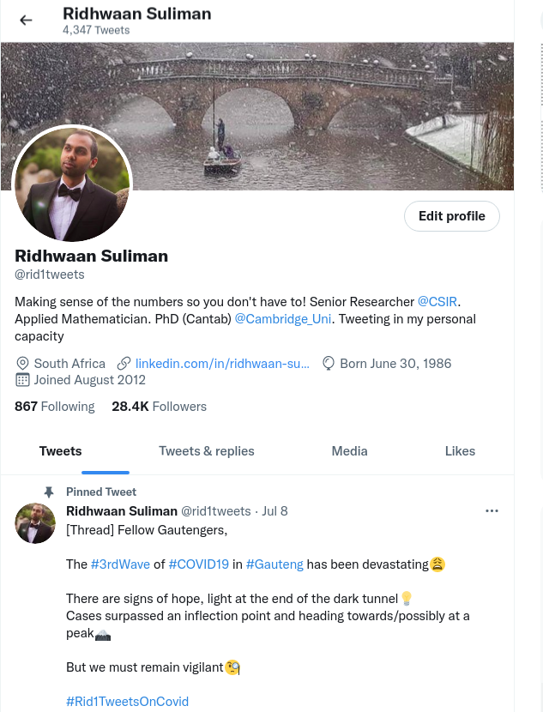
COVID-19: Information
and mis-information
- Communication platforms
- Motivating factors
- Social media drivers
- Lessons learned

Slide 3
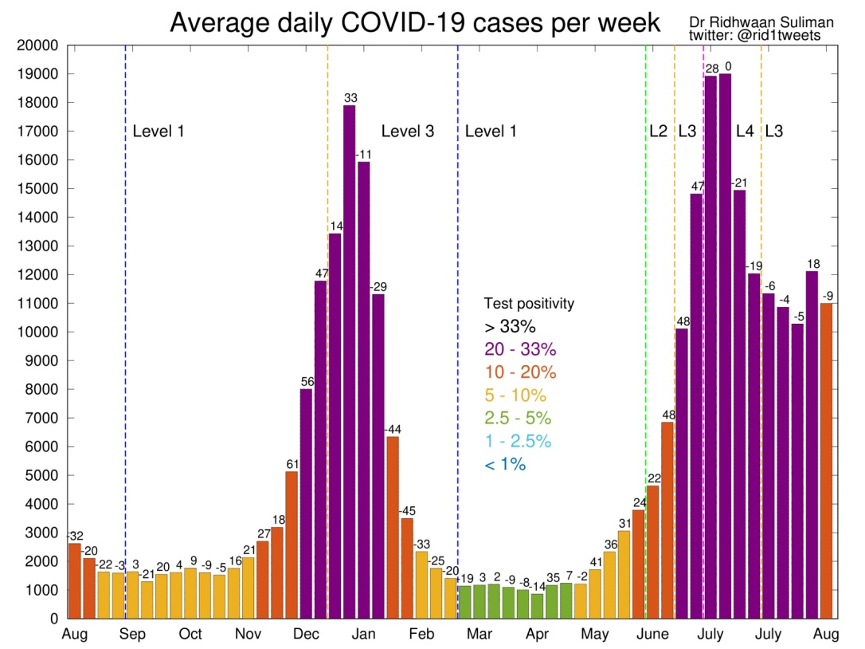
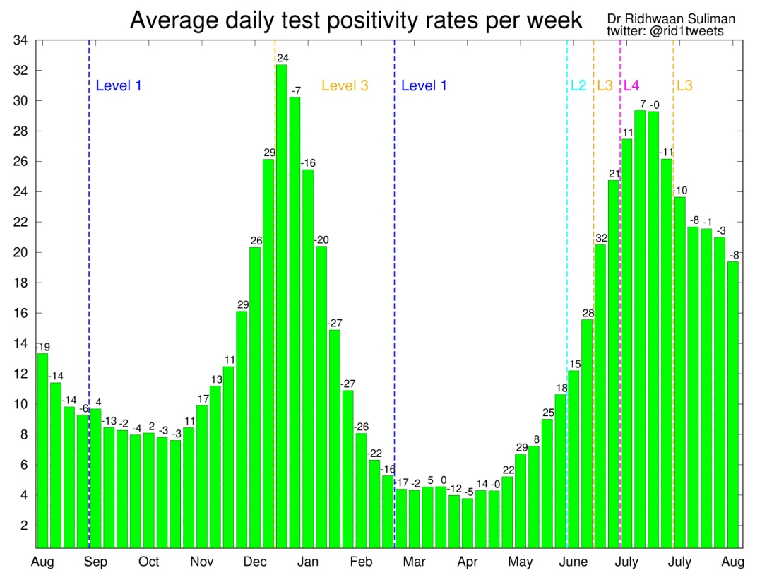
COVID-19 information sharing
Communication platforms
National Policy Data Observatory (NPDO)
Weekly updates to NATJOINTS
GCIS, DPME, DSI
MAC technical working group (NDoH)
Regular interviews and updates in media
TV channels: SABC, eNCA, Newzroom Afrika
Radio stations
Online and print media (national & international)
Social media
Twitter: @rid1tweets

Slide 4
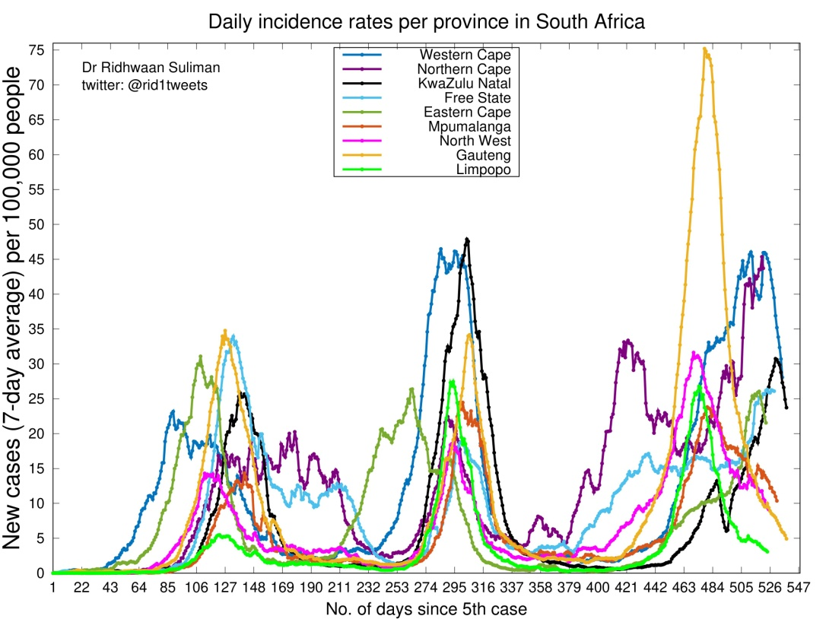
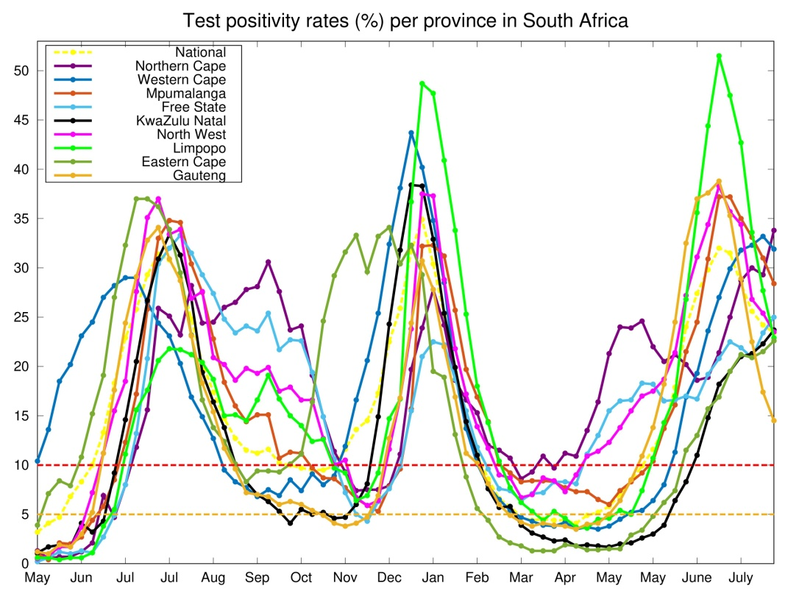
COVID-19 data and trends
Motivating factors
Make sense of daily COVID-19 numbers
Analyse and understand the trends in various indicators
Social media:
Share analysis and trends
Also engage and receive information
Use data to counteract fear, uncertainty, mis-information and conspiracy theories
Pandemic affects us all

Slide 5
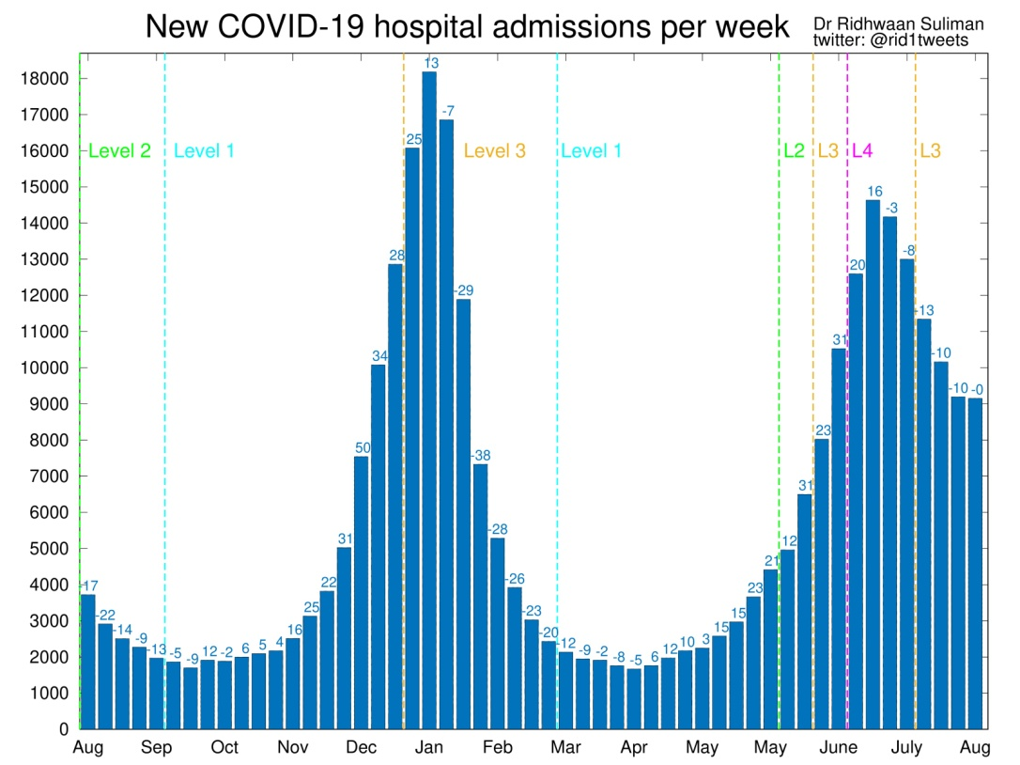
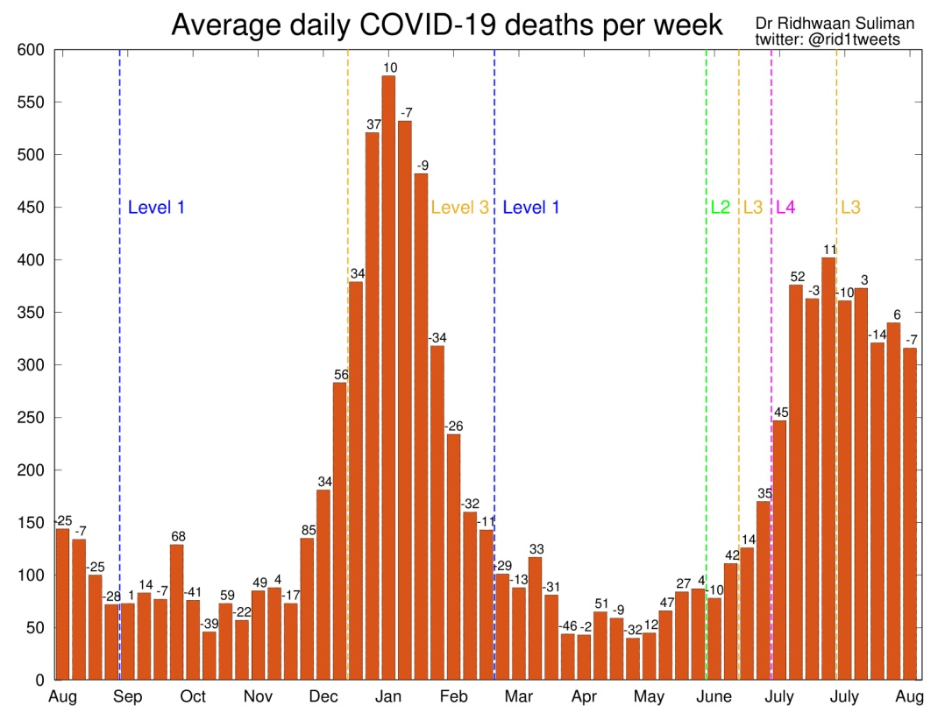
COVID-19 data and trends
Social media drivers
Consistent, accurate, unbiased reporting
Simple and clear messaging of various indicators
Graphics to understand trends instead of raw numbers
Open and honest communication of data, using reliable sources

Slide 6
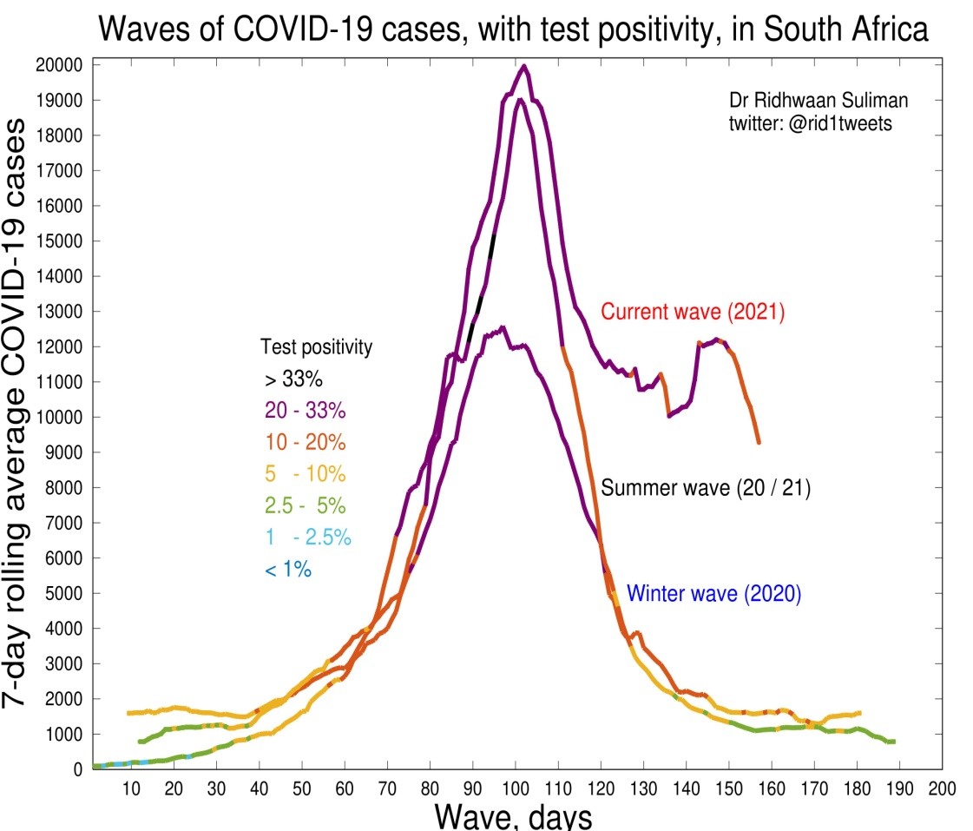
COVID-19 information and mis-information
Lessons learned
Simple and clear messaging
Data can overcome fear and uncertainty
Don’t cherry-pick data, this fuels conspiracy theories
Consistent and accurate reporting
Weekly trends: rolling 7-day average
Understand lag in hospitalisations and death
Understand limitations and nuances
Treat public like adults
Open and honest communication
Gain agency with relevant information
Make informed decisions through data

Slide 7
Thank You!

