Slide 1
NSP PILLAR 1: ACCOUNTABILITY , LEADERSHIP AND COORDINATION
DoJ&CD
25 AUGUST 2021

Slide 2
OUR PRESENTATION AT A GLANCE…
Relevant Articles of the Presidential Summit Declaration against GBVF, 2019
Overview of the NSP Pillars
Relevant Key Interventions for Pillar 1
Legislative Developments Supporting Pillar 1
Public Awareness Programmes on GBVF and Constitution
Governance Structures Supporting Pillar 1

Slide 3
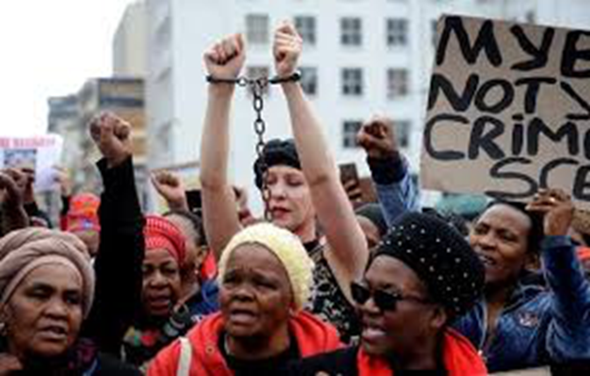
1st Aug 2018
62 years later
Aluta continua!

Slide 4
Presidential Summit Declaration against GBVF, 2019
ARTICLE 1: Political, government, business and community leadership take responsibility and support the cause of eradicating gender-based violence and femicide.
ARTICLE 2: Political, government, business and community leaderships, and families be held accountable for actions and omissions that are contrary to the achievement of a South Africa that is free from gender-based violence and femicide, as determined in a national Code of Conduct or similar measure which will be developed by the multi-sectoral coordinating body, without excluding the existing related matters.

Slide 5
Presidential Summit Declaration call:
BE ACCOUNTABLE!
BE A CHANGE AGENT!

Slide 6
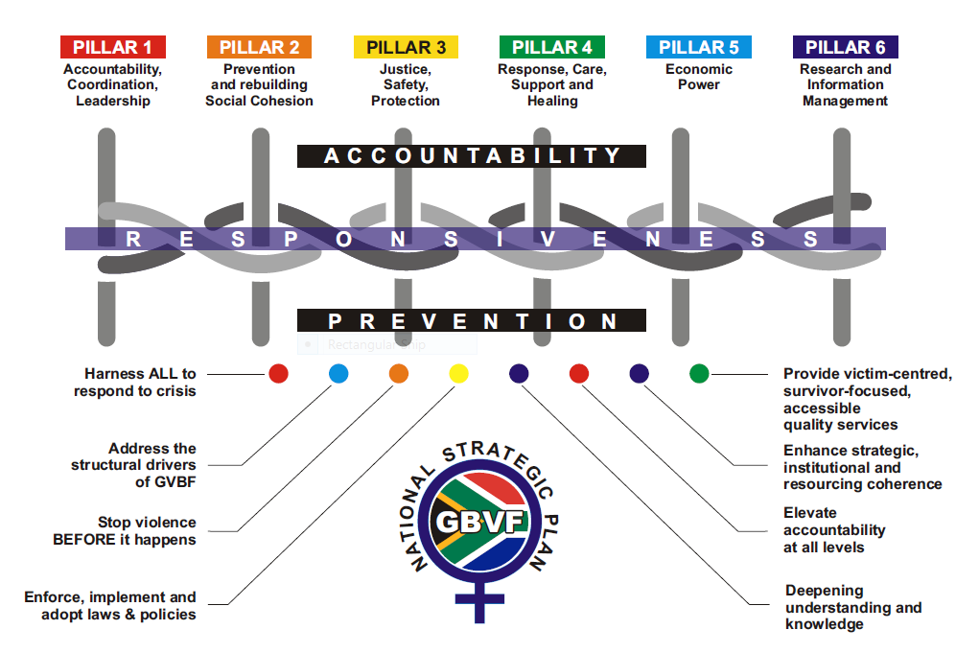
OVERVIEW OF THE NSP PILLARS

Slide 7
RELEVANT KEY INTERVENTIONS FOR NSP PILLAR 1
KEY INTERVENTION #1
Strengthen leadership and accountability across government and society to effectively respond to the GBVF crisis in a strategically and institutionally coherent way with adequate technical and financial resources.
KEY INTERVENTION #2
Effective multi-sectoral coordination by lead agency and collaboration across different tiers of government and across different sections of society based on relationships of mutual benefit and trust to give effect to the pillars of the NSP.
RELEVANT INDICATORS
NCGBVF legislation in place
Governance structures established
Programmes reviewed, developed and implemented to create awareness on GBVF, Constitution and Bill of Rights

Slide 8
GBVF is rooted in patriarchal social norms, gender inequalities, socio-economical inequalities, family dysfunctions, low social value attached to women and girls, lack of accountability, etc.
Some of these core drivers cannot be addressed by law.

Slide 9
RECENT LEGISLATIVE DEVELOPMENTS: 2020/2021
DoJ&CD
Domestic Violence Amendment Bill, 2020
DoJ&CD
Criminal Law (Sexual Offences and Related Matters Amendment Act Amendment Bill, 2020
DoJ&CD
Criminal Matters Amendment Bill, 2020
DoJ&CD Developed the initial Draft Bill for the NCGBVF
Regulations relating to Sexual Offences Courts approved by the Min in Feb 2020

Slide 10
HOW THE DOMESTIC VIOLENCE ACT SUPPORTS PILLAR 1
Domestic Violence Act
Any person with the material interest in the wellbeing of the complainant may apply for PO on behalf of the complainant- s4(3)
Any person may apply for PO on behalf of a child- s4(4)
Not more than 3 persons may attend proceedings to provide support to the complainant- s11
The court may direct any person to serve documents-s13
No prosecutor may withdraw a charge of Violation of PO without being authorized to do so by the DPP or designated senior official

Slide 11
HOW THE DOMESTIC VIOLENCE ACT SUPPORTS PILLAR 1
Domestic Violence Amendment Bill
Functionaries have the obligation to report domestic violence- clause 2A
Adult person has obligation to report domestic violence committed against a child, PWD or older person- clause 2B
Electronic Communication service providers may be directed by court to furnish certain particulars to assist court- clause 5B(1) and (6)
Issuing of Domestic Violence Safety Monitoring Notice to police to contact the complainant at regular intervals by means of an electronic service to ensure the safety of the complainant- clause 4A(6)
Legal aid services to be offered in appropriate cases to complainant, respondent or child when applying for PO-clause 19(1);

Slide 12
HOW THE DOMESTIC VIOLENCE ACT SUPPORTS PILLAR 1
Domestic Violence Amendment Bill
Directives for clerks of the court must be issued with adequate disciplinary measures against non-compliance- clause 18A

Slide 13
How DVA Bill supports Pillar 1
Directives by various stakeholder departments
Clause 18B of the Bill provides that the Directors-General of the departments responsible for Health, Social Development, Basic Education, Higher Education, Science and Innovation and Communications and Digital Technologies must—
(a) in consultation with Cabinet members responsible for health, social development, basic education, higher education, science and innovation, police and communications and digital technologies; and
(b) after consultation with the Director-General: Justice and Correctional services, National Director of Public Prosecutions and National Commissioner of the South African Police Service,
publish in the Gazette directives regarding matters which are reasonably necessary or expedient to be provided for and which are to be followed by functionaries and other relevant persons when dealing with incidents of domestic violence, in order to achieve the objects of this Act. This promotes coordination amongst the relevant stake-holder departments.

Slide 14
HOW THE CRIMINAL AND RELATED MATTERS AMENDMENT BILL SUPPORTS PILLAR 1
The primary aim of the Bill, is to amend numerous Acts, which are intended to -
address gender-based violence and its related offences; and
provide for additional procedures to reduce secondary victimisation in court proceedings
provides for stricter bail and sentencing provisions,
Clause 4 (a) requires a prosecutor to place on record the reasons for not opposing a bail application in respect of an offence —
committed against a person who is in a domestic relationship with the accused; or
related to the violation of a protection order which was issued

Slide 15
HOW THE CRIMINAL LAW (SEXUAL OFFENCE AND RELATED MATTERS) AMENDMENT BILL SUPPORTS PILLAR 1
It requires that the particulars of persons who have been convicted of sexual offences against children and persons who are mentally disabled be recorded in the NRSO.
The Chapter places a prohibition on the aforementioned persons to work with or to be placed in circumstances where they have access to children or persons who are mentally disabled.
Employers are required to vet existing employees and those who apply for work against the NRSO in order to determine whether they are suitable to work with children or persons who are mentally disabled, or not.
The Bill seeks to extend the protection afforded in terms of Chapter 6
The Bill seeks to introduce a new offence of sexual intimidation and to extend the ambit of the offence of incest.

Slide 16
Key Intervention #2: Governance Structures in Support of Pillar 1

Slide 17
POLITICAL AND NSP
GBVF IMC (Min a member)
IMC Technical Task Team (member)
SEXUAL OFFENCES
Directors-General Intersectoral Committee for the Management of Sexual Offences Matters- chaired by DG: DoJ&CD
National Technical Committee (incl CBOs)
DOMESTIC VIOLENCE
National Intersectoral Committee on DV and Femicide- chaired by DoJ&CD
Provincial Multisectoral Committees on Domestic Violence and Femicide- chaired by DoJ&CD
Provincial Technical Committees- chaired by DoJ&CD
NSP Pillar 3 Committee – chaired by DoJ&CD

Slide 18
VICTIM SUPPORT AND CHILD JUSTICE
Court-based Support Services Intersectoral Committee- chaired by DoJ&CD
LGBTQIA+
National Task Team on LGBTQIA+ Persons
UNDER THE TREE MEN’S GROUP
National Men’s Committee
Provincial Task Teams on LGBTQIA+
Rapid Results Team on LGBTIA+ Persons
Provincial Men’s Committees
Directors- General Intersectoral Committee on Child Justice- chaired by DG: DoJ&CD
Provincial Child Justice Forums- chaired by DoJ&CD

Slide 19
Common Members of the Governance Structures
Department of Justice and Constitutional Development
National Prosecuting Authority
South African Police Service
Department of Social Development
Department of Health
Department of Correctional Services
Department of Basic Education
Department of Higher Education and Training
Legal Aid SA
COGTA (National House of Traditional Leaders
Civil Society Organisations
Every year, the Minister submits Departmental Annual Reports on the Implementation of the Criminal Law (Sexual Offences and Related Matters) Amendment Act, 2007 and the Child Justice Act

Slide 20
Key Intervention #2:Public Awareness Programmes

Slide 21
2020/2021
NSP Pillar 3 Committee conducted
6 Webinars on Victim-Centric Justice System: Now and Not later series
Delegates reached: judiciary and other criminal justice government officials, CBOs and the general public.
The webinars were coordinated by DoJ&CD.
71 GBVF public education interventions on multi-media platforms which took the form of radio talk shows (Let’s Talk Justice Radio Talk Show aired in over 80 community radios), social media live chats, webinars dialogues, Under the Tree Dialogues for Men, and Webinar Dialogues for the LGBTQIA+ persons and Persons with Disabilities
LGBTQIA+ RADIO TALK SHOWS: #7

Slide 22
2021/2022: 25th Anniversary of Constitution
NSP Pillar 3 Committee conducted 3 Webinars on Victim-Centric Justice System: Now and Not later series
Online child exploitation and cyberbullying- 15 Jul 21
Online child exploitation and cyberbullying- 29 Jul 21
Domestic Violence Amendments – 11 Aug 21
25th Anniversary of the Constitution:
Todate, 49 outreach activities to commemorate the 25th Anniversary of the Constitution have been held Some of these were the Ministerial events in the form of Webinars, community dialogues, public exhibitions, youth engagements, etc.

Slide 23
THANK YOU

