Slide 1




Workshop on provincial and local government equitable share formulas
Risenga Maluleke
Statistician-General
Statistics South Africa
statssa.gov.za
twitter.com/StatsSA
facebook.com/StatsSA

Slide 2





Statistical production system
Line Departments
Official Statistics
Input
Process
Output
Outcome
Impact
Registers/Administrative records
Surveys & Censuses
Policy analysis
Research
Sector statistics
Stats SA
2

Slide 3
Stats SA releases over 300 publications a year, providing insight on four general themes:
People of South Africa
Living conditions in South Africa
Economy of South Africa
The natural environment
3

Slide 4
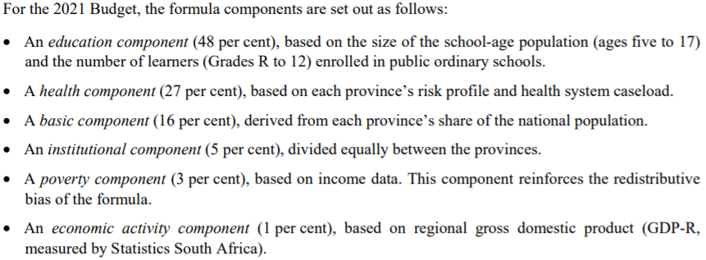
Data for Equitable Share includes
Source: Treasury Explanatory memorandum to the division of revenue 2021
http://www.treasury.gov.za/documents/National%20Budget/2021/dor.aspx

Slide 5
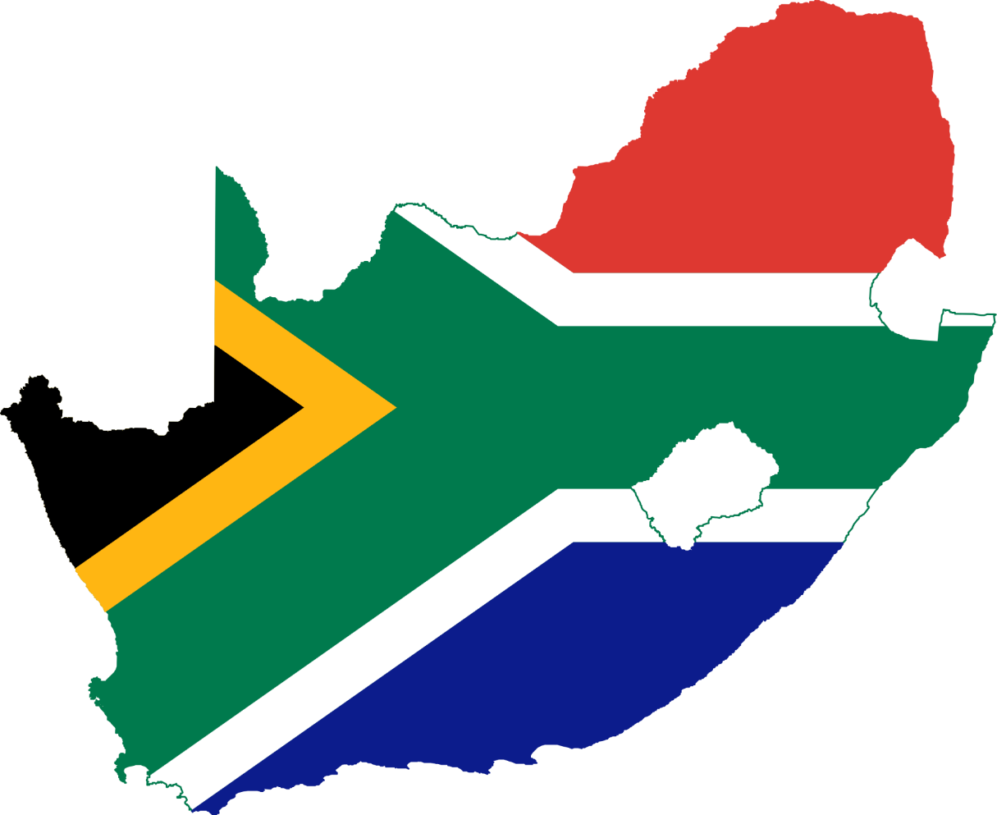

The South African population in 2021 is estimated at
60, 1 Million
up by 604 281 (1,01% change)
from 2020 estimates
Source: Mid Year Population Estimates 2021
5

Slide 6
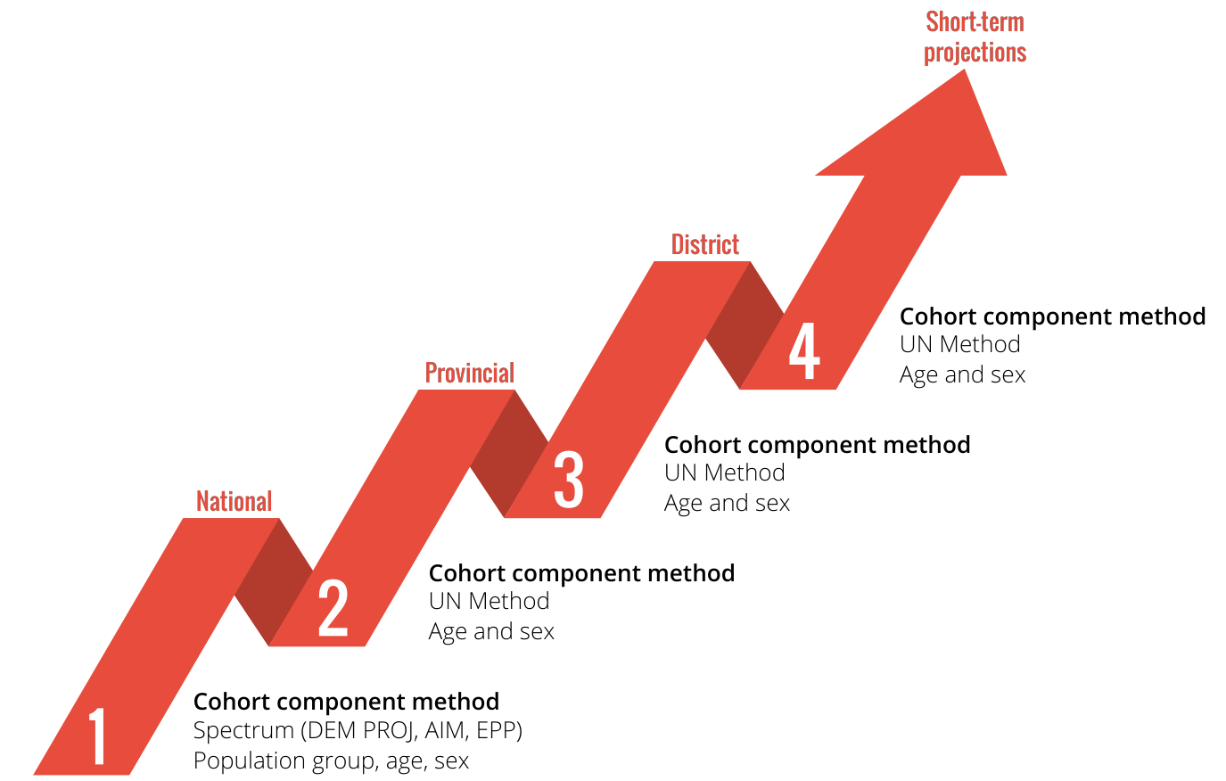
Moving from national to lower geographic level estimates: cohort component method
The cohort component technique uses the components of demographic change to project population growth using demographic information from Census and administrative records
The technique projects the population by age groups, in addition to other demographic attributes such as sex and ethnicity. This projection method is based on the components of demographic change including births, deaths, and migration.
The cohort component method takes each age group of the population and ages it over time using survival rates.

Slide 7
More than half of the population live in 3 provinces (GP, KZN and WC)
Mid-year population estimates for South Africa by province, 2021
GP
KZN
WC
EC
LP
MP
NC
NW
FS
26,3%
19,1%
11,8%
11,1%
9,9%
7,9%
6,9%
4,9%
2,2%
57,2%
57,1%
Source: Mid Year Population Estimates 2021
7

Slide 8
GP has increased its share of the total population by 5,4% points between 2002 and 2021
EC saw the largest drop in its proportion of the total population from 14% in 2002 to 11% in 2021
Change in provincial population proportions 2002-2021
Share of Total Population
2002
2021
Over time internal migration has impacted population growth across the provinces
Gauteng
Source: Mid Year Population Estimates 2021
8

Slide 9
Local Municipality Population and Household Estimates are available
Local Municipality Estimates are prepared using a ratio method by identifying the proportion living in a LM relative to the DC it is in from previous Census. This proportion is projected to future years and then applied to the District Population Estimates to calculate the LM population estimates. This is done across all age groups and sex as per the district estimates published
Household Estimates use the UN headship method which takes the proportion of household heads within an age group/sex from previous Census, projects them forward to a future date and applies this proportion against population estimates for the same age/sex/geography group
Due to the small numbers of households in small provinces (NC) in youngest ages, there might be instances where age groups need to be merged in certain years.

Slide 10
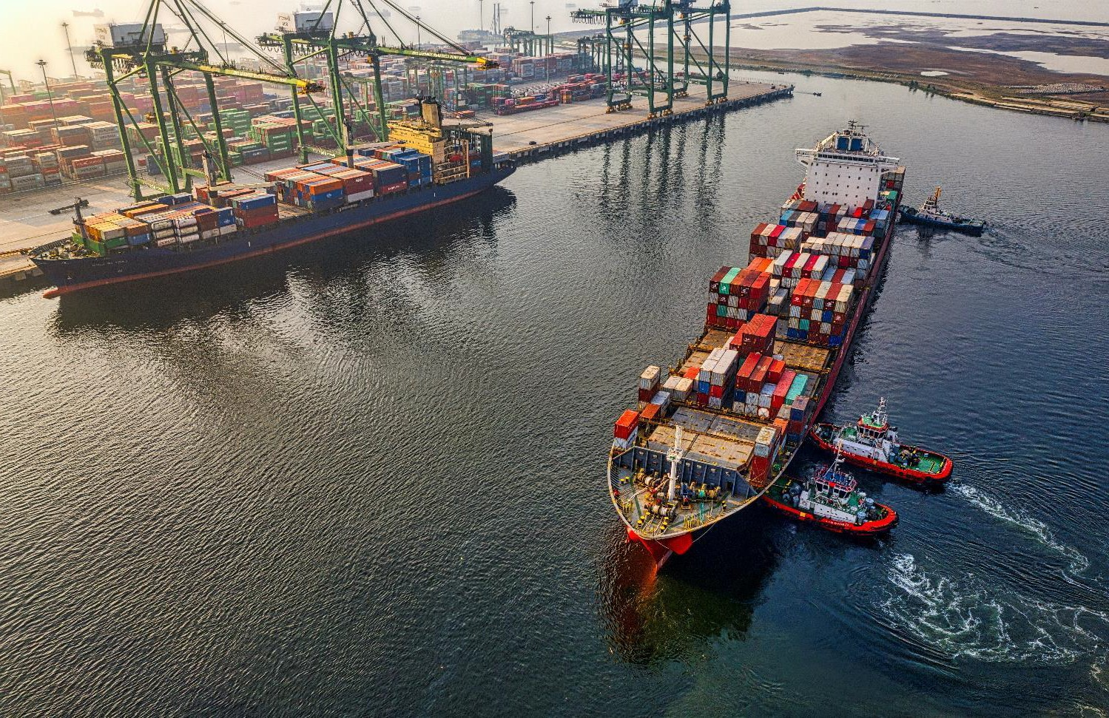
National
and Regional
Economy
10

Slide 11
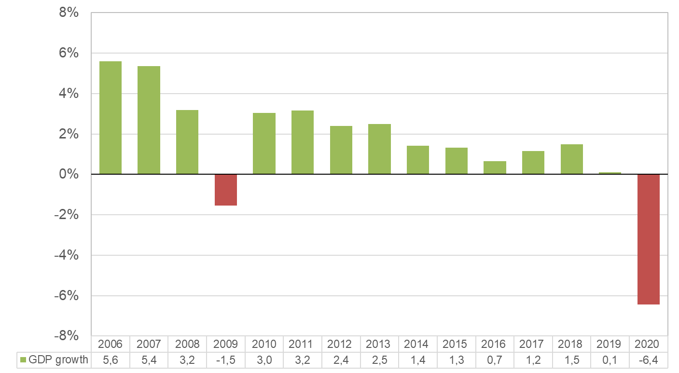
The South Africa economy contracted by 6,4% in 2020
Annual GDP growth rate
Constant 2010 prices
Source :GDP Q4 2020 (revised)
11

Slide 12
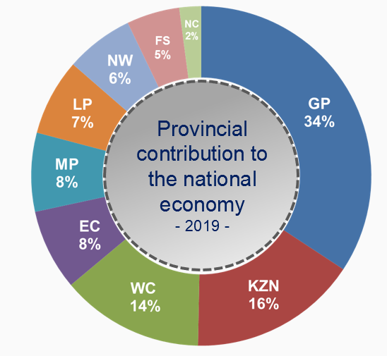
GP contributed more than a third (34%) to the national economy
Source :GDP Q4 2020
12

Slide 13
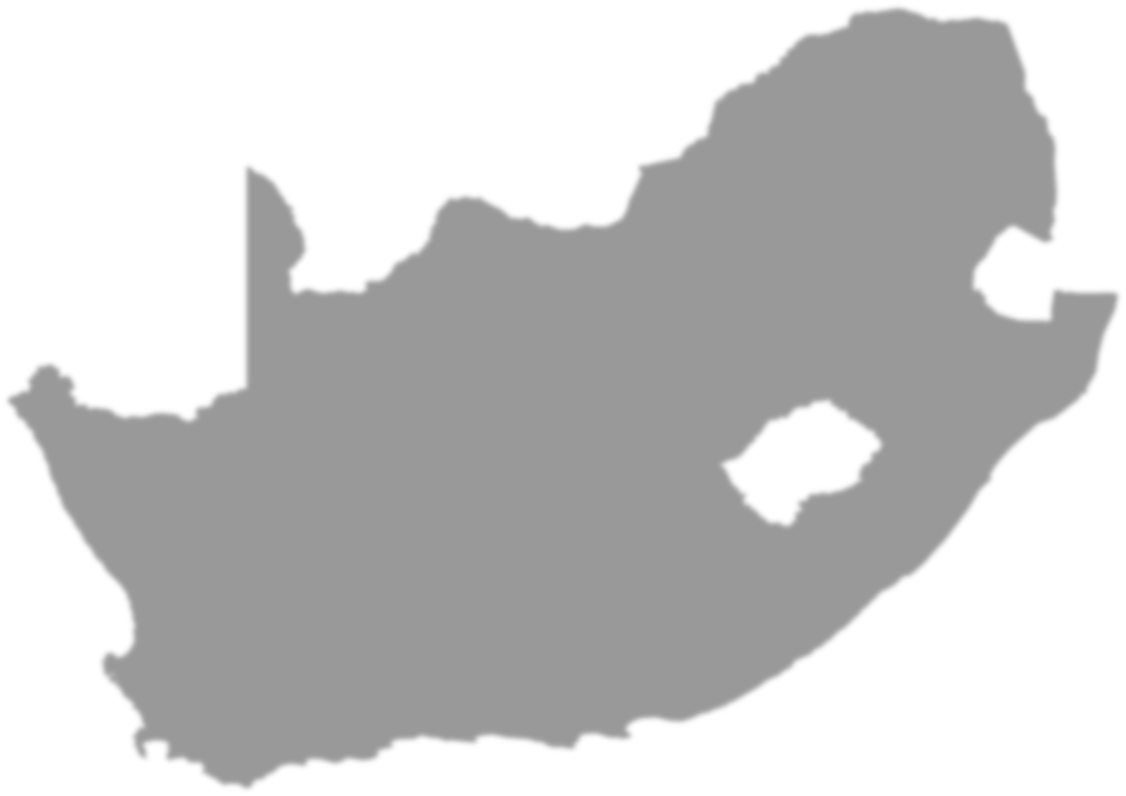
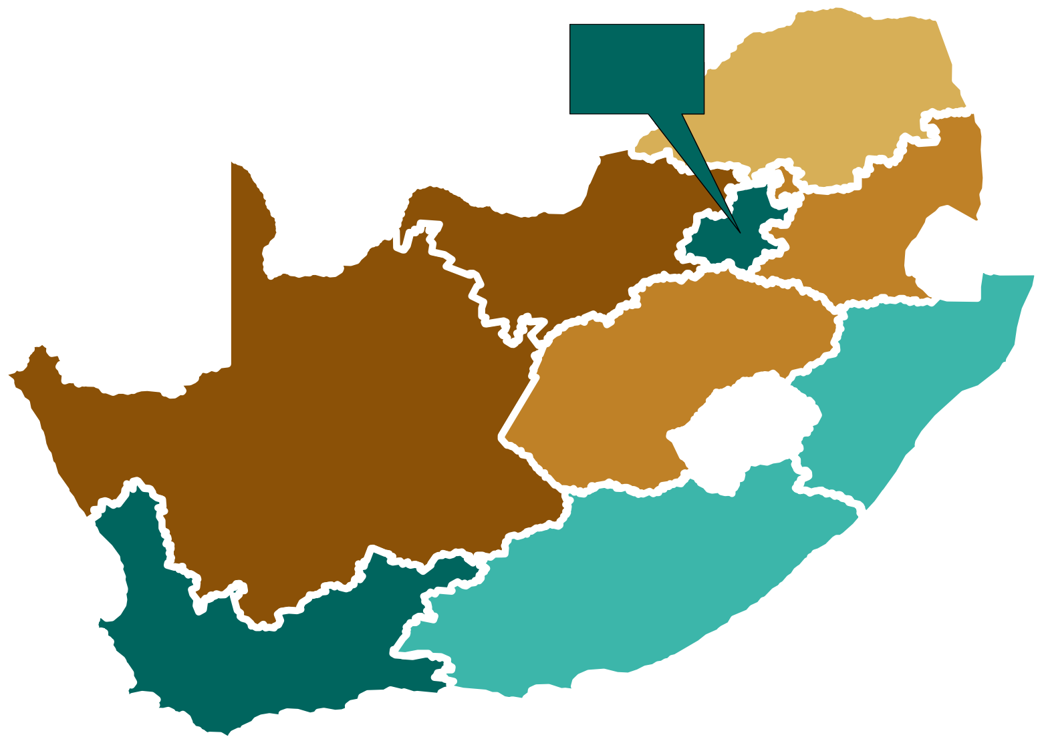
Which provincial economies grew in 2019?
Annual change: constant prices
GP 0,6%
LP
-0,2%
NW
-0,5%
MP
-0,4%
South Africa
0,2%
FS
-0,4%
KZN 0,1%
NC
-0,6%
EC 0,0%
WC 0,4%
-0,6%
0,0%
0,6%
Source :GDP Q4 2020
13

Slide 14
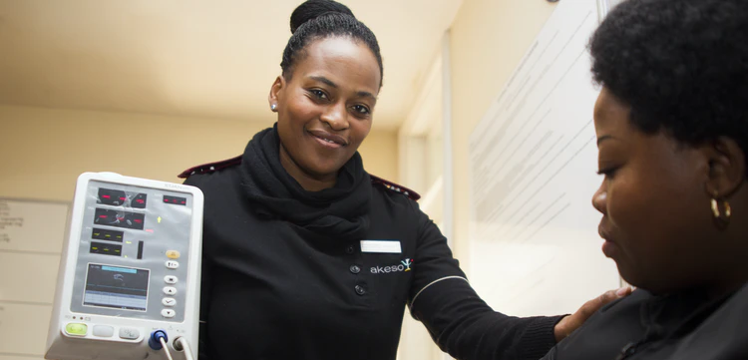
Selected
Healthcare
Indicators

Slide 15
Public facilities still first port of call for the vast majority of South Africa.
Only highly urbanised provinces of Gauteng and WC have medical aid coverage rates higher than the average
Healthcare facility normally consulted by household when someone is ill, 2019
Traditional Healer
Other
Private Facilities
Public Facilities
Due to rounding numbers may not add up to 100%
Source :GHS 2019
15

Slide 16
About 17% of the SA population had medical aid coverage in 2019.
% of individuals who are members of medical aid schemes, 2019
Population with Medical Aid
Source :GHS 2019
16

Slide 17
Less than 10% of individuals in Limpopo had medical aid coverage in 2019.
% of individuals who are members of medical aid schemes per province, 2019
Source :GHS 2019
17

Slide 18

Selected
Education
Statistics

Slide 19
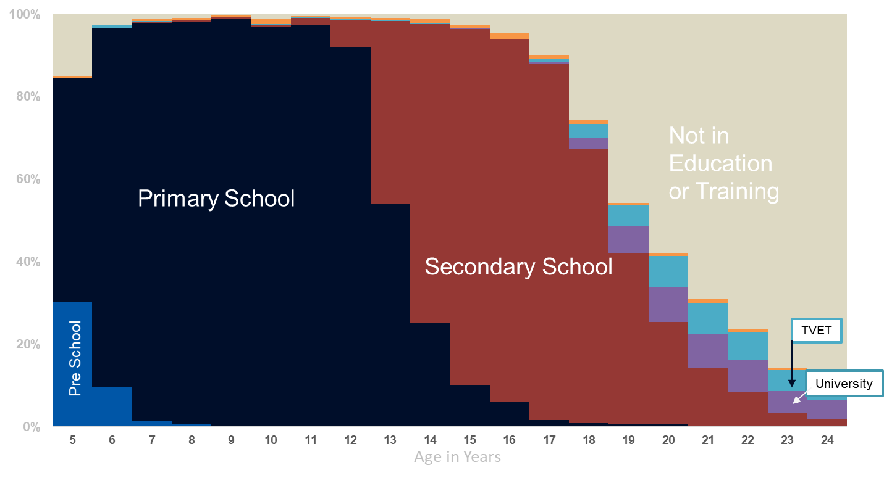
There is noticeable representation of learners who are older than the ideal graduation age in primary and secondary schools.
Percentage of those aged 5 – 24 years who attend educational institution, 2019
Source GHS 2019
19

Slide 20
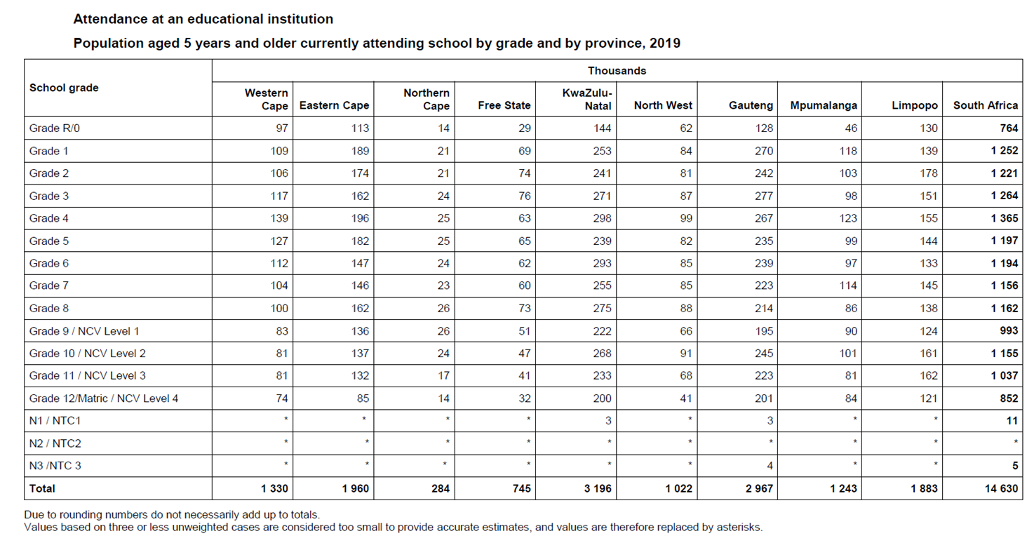
GHS Provides figures for attendance at educational institutions
Source GHS 2019
20

Slide 21
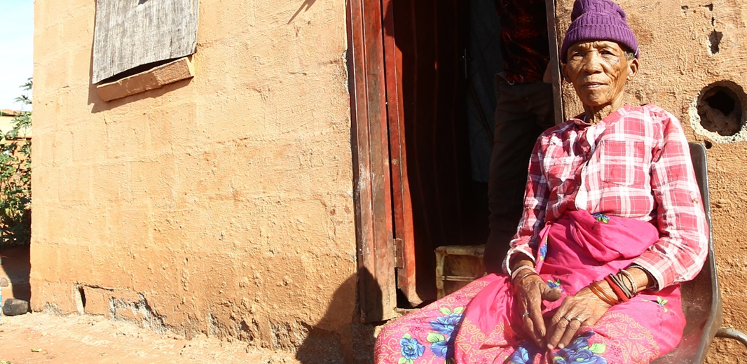
Selected
Poverty
Indicators
21

Slide 22




Stats SA applies and measures various definitions of poverty
Money-metric (lack of
income/expenditure)
Inequality (Gini coefficient, share of expenditure, etc.)
Subjective poverty (self-perceived)
Multidimensional poverty (lack of basic services, education, etc.)
22

Slide 23
In 2015, more than a quarter of the population were living below the food poverty line
Money-metric Poverty headcounts in 2015
Lower-Bound Poverty Line
Upper-Bound Poverty Line
Food Poverty Line
Is the Rand value below which individuals are unable to purchase or consume enough food to supply them with minimum per-capita-per-day energy requirement for good health
Provides an unambiguous threshold of relative deprivation below which people cannot afford the minimum lifestyle desired by most South Africans
Provides an austere threshold below which one has to choose between food and important non-food items
Source: Poverty Trends Report
23

Slide 24
The poorest three provinces in the country have consistently been Limpopo, Eastern Cape & KwaZulu-Natal
Poverty Measures of Households (LBPL)
Increasing Poverty
LP
EC
KZN
NW
MP
NC
FS
Decreasing
Poverty
Gauteng & Western Cape remain the two provinces with the lowest poverty headcounts at 13,6 % & 12,8% respectively.
GP
WC
For Periods 2006 / 2009 / 2011 / 2015
KZN
Source: Poverty Trends Report
24

Slide 25
In 2015, Average household income was R138 168 Median income was R54 349
Average Annual HH Income by Province
Source: Living Conditions of Households in South Africa
25

Slide 26
In 2015, Average household consumption expenditure was R103 293 and Median expenditure was R42 522
Average Annual HH Expenditure by Province
LP
R61,011
GP
NW
R140 676
MP
R69,192
R83,517
FS
KZN
R85,298
73,503
NC
R81,258
EC
R72,390
WC
R163 220
Source: Living Conditions of Households in South Africa
26

Slide 27
Selected GHS indicators by province, 2019
 | Households benefitting from grants | Informal dwellings | Electricity used for cooking | Access improved water | Access improved sanitation | Kerbside refuse removal | Inadequate access food
WC | 35,8 | 18,7 | 76,3 | 98,5 | 94,5 | 58,4 | 17,8
EC | 60,6 | 5,5 | 76,9 | 73,9 | 87,6 | 59,7 | 21,9
NC | 55,9 | 14,9 | 84,2 | 94,0 | 83,9 | 63,1 | 28,4
FS | 56,6 | 17,9 | 86,3 | 91,9 | 82,3 | 61,9 | 26,1
KZN | 50,0 | 5,5 | 79,2 | 85,4 | 80,9 | 64,1 | 17,5
NW | 49,6 | 18,4 | 77,0 | 82,1 | 68,8 | 64,5 | 29,6
GP | 31,5 | 18,7 | 73,4 | 97,6 | 90,0 | 66,4 | 13,9
MP | 54,1 | 7,3 | 72,0 | 85,2 | 63,7 | 67,4 | 24,1
LP | 58,2 | 3,6 | 62,2 | 70,0 | 63,4 | 66,4 | 5,5
SA | 45,5 | 12,7 | 75,1 | 88,2 | 82,1 | 61,2 | 17,8
Source: GHS 2019
27

Slide 28

Survey data allows Stats SA to report on National, Provincial and Metropolitan geographic levels
Survey Data such as General Household Survey or the Quarterly Labour Force Survey is collected from about 30 000 households
It allows coverage of all settlement types( e.g. rural/urban) across the country
Reporting at local municipality level requires use of Census and Community Survey data
Census is conducted once in 10 years
The Community Survey is an intercensal survey

Slide 29






COVID Impacts the Census 2021 preparations
5y
10y
10y
29

Slide 30

statssa.gov.za
twitter.com/StatsSA
facebook.com/StatsSA

