Slide 1
SAHPRA update on COVID-19 vaccines Dr B Semete-Makokotlela SAHPRA CEO 1 September 2021

Slide 2
Contents
Vaccines authorization process
COVID-19 vaccines updates
COVID-19 vaccines safety updates

Slide 3
Vaccines authorization process

Slide 4
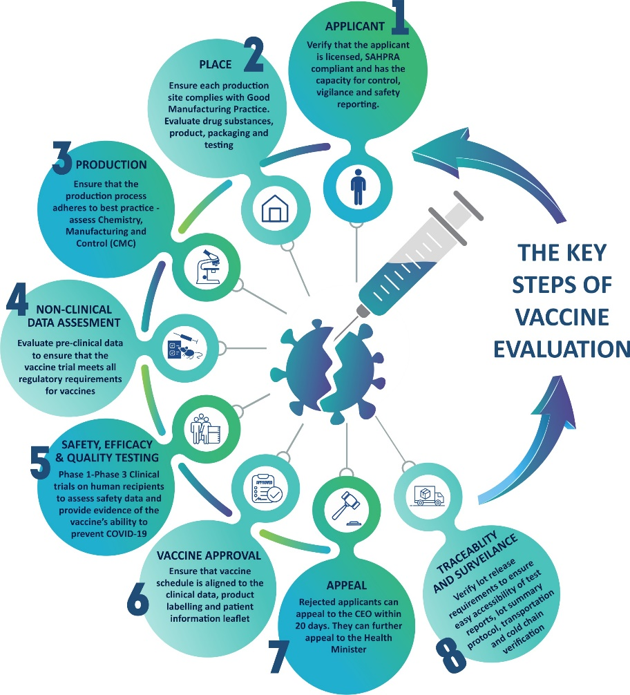
Key steps of COVID-19 vaccine assessment

Slide 5
Assessment of cGMP
Compliance of Good Manufacturing Practice
Sites producing drug substance (DS), drug product(DP), filling, packing, testing
NOTE
Inspections performed at sites that are not GMP certified must be executed by an authority SAHPRA aligns with

Slide 6
Assessment of CMC
CHEMISTRY | MANUFACTURING | CONTROL
FOCUS ON HOW DS AND DP ARE
MANUFACTURED
CHARACTERIZED
IMPURITIES ARE CONTROLLED
CONTROL TESTS AND LIMITS ARE JUSTIFIED
TEST METHODS ARE USED
TESTS ARE VALIDATED
STANDARDS ARE REFERENCED AND USED
PACKAGED – PACKING MATERIALS AND STABILITY
Sites producing drug substance (DS), drug product(DP), filling, packing, testing

Slide 7
Key steps of COVID-19 vaccine assessment

Slide 8
CLINICAL STUDIES ASSESSMENT
ASSESSMENT OF SAFETY DATA
Requires an adequate number of vaccine recipients and monitoring for a sufficiently long time
ASSESSMENT OF EFFICACY DATA
Requires robust evidence of the vaccine's ability to prevent COVID-19 infection from well-conducted phase 3 clinical trials in humans
ASSESSMENT OF RISK MANAGEMENT PLAN
Sites producing drug substance (DS), drug product(DP), filling, packing, testing
Applicant ability to record and report side effects. Assessment of efficacy against variants of concerns is critical

Slide 9
Key steps of COVID-19 vaccine assessment

Slide 10
COVID-19 vaccines updates

Slide 11
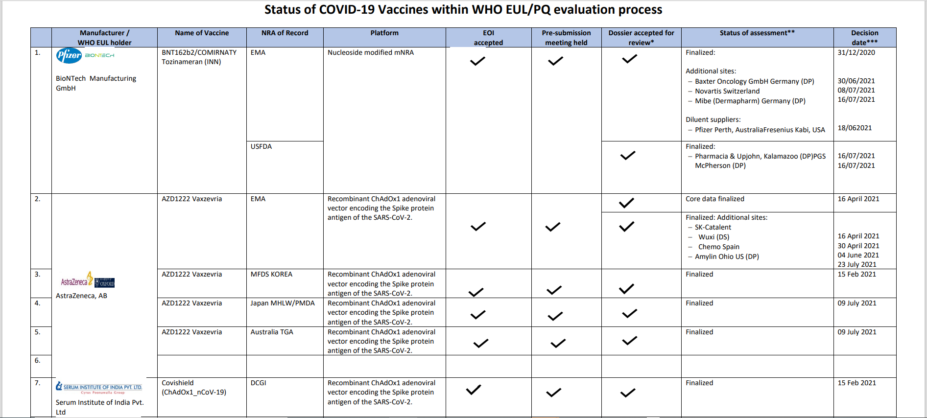
COVID-19 Vaccine Applications and approvals
19 August 2021
Section 21 for | Applicant | Application Date | Status
AZ/SII ChadOx | NDoH | 07/01/2021 | Section 21 Authorisation Issued 22/01/2021
Pfizer/Biontech Comirnaty | Pfizer | 03/02/2021 | Section 21 Authorisation issued 10/03/2021
J&J Ad-26 | Janssen | 04/11/ 2020 | Conditional Market authorization on 30/03/2021
Sinovac Coronavac | Curanto pharma | 10/03/2021 | Section 21 Authorisation issued 2/07/2021
Sputnik V | Lamar pharmaceuticals Dr Reddys | 23/02/2021 30/04/2021 | In review.
Sinopharm | LHC MC pharma | 22/06/2021 08/07/2021 | In review

Slide 12
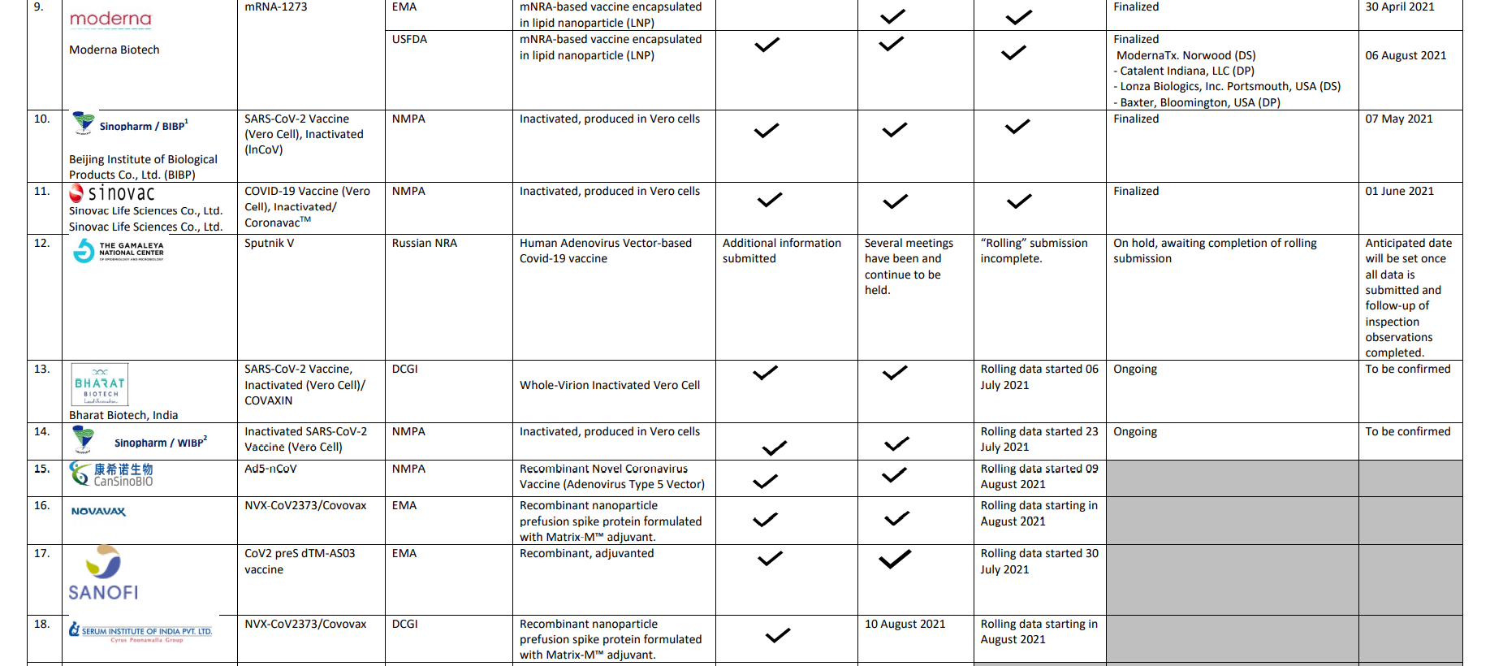
Status of COVID-19 vaccines within WHO EUL/PQ Evaluation process
19 August 2021
Section 21 for | Applicant | Application Date | Status
AZ/SII ChadOx | NDoH | 07/01/2021 | Section 21 Authorisation Issued 22/01/2021
Pfizer/Biontech Comirnaty | Pfizer | 03/02/2021 | Section 21 Authorisation issued 10/03/2021
J&J Ad-26 | Janssen | 04/11/ 2020 | Conditional Market authorization on 30/03/2021
Sinovac Coronavac | Curanto pharma | 10/03/2021 | Section 21 Authorisation issued 2/07/2021
Sputnik V | Lamar pharmaceuticals Dr Reddys | 23/02/2021 30/04/2021 | In review.
Sinopharm | LHC MC pharma | 22/06/2021 08/07/2021 | In review

Slide 13
Status of COVID-19 vaccines within WHO EUL/PQ Evaluation process
19 August 2021
Section 21 for | Applicant | Application Date | Status
AZ/SII ChadOx | NDoH | 7/01/2021 | Section 21 Authorisation Issued 22/01/2021
Pfizer/Biontech Comirnaty | Pfizer | 03/02/2021 | Section 21 Authorisation issued 10/03/2021
J&J Ad-26 | Janssen | 4/11/ 2020 | Conditional Market authorization on 30/03/2021
Sinovac Coronavac | Curanto pharma | 08/03/2021 | Section 21 Authorisation issued 2/07/2021

Slide 14
Pre-Submission Meetings between SAHPRA and Applicants
Vaccine | Applicant | Date | Outcome
J&J Ad-26 | Janssen | 4/11/ 2020 | Submission of a rolling review application (Rolling review Part 1)
AZ/ RPharm | RPharm/AZ | 15/12/2020 | Rpharm-Russian Manufacturer
 | RPharm | 18/01/2020 | Establish Rpharm local Intend for S21 and rolling submission
AZ/SII-ChadOX | NDoH | 31/12/2020 | Section 21 NDoH granted 22 Jan 2021
Pfizer/BioNtec Comirnaty mRNA | Pfizer | 7/01/2021 03/02/2021 | Submission for Reliance review application Section 21 application 04/02/2021
Sputnik V Ad-26 and Ad-5 | Lamar Pharmaceuticals | 11/02/2021 18/02/2021 | Applicant to provide details of vaccine and available data, Applicant to submit Section 21 and rolling review for registration 23/02/2021
Sinovac CoronaVac (Vera-cell) | Numulox/Curanto Pharma | 18/02/2021 | Intend to submit Section 21
Sputnik V Ad-26 and Ad-5 | Dr Reddy (Pty) Ltd | 08/04/2021 | Proceed with submission of application (A submission to be made as rolling review submission)

Slide 15
Pre-Submission Meetings between SAHPRA and Applicants cont…
Vaccine | Applicant | Date | Outcome
UB-612 Multitope Peptide-Based Vaccine (MPV) Against COVID-19 | Vaxxinity | 16/04/2021 | Will establish local presence of Vaxxinity. Data up to phase II available; phase 3 India commenced in March 2021. Intend for EUL WHO mid 2021
Coronavac (Vera-cell) | Solace | 16/04/2021 | Applicant not licensed for Pharmaceuticals and will apply for SAHPRA license. Applicant required to gain more knowledge and information of their product
Covaxint | Bharat Biotech Limited ( Usembe Healthcare ) | 05/05/2021 | A submission to me made for a rolling review
Sinopharm | LHC Pharmaceutical | 11/06/2021 | Submitted application subsequently
Sputnik V Ad-26 and Ad-5 | Mbabala Biotech | 11/06/2021 | Contract with RDIF requested
ZIfivax | Advance Medicals/Bliss Pharma | 14/06/2021 | Proceed with submission of application
Moderna | Tautomer (Pty) Ltd | 22/06/2021 | Intention for booster-No stock of Moderna for 2021
Sputnik V Ad-26 and Ad-5 | E Trade Health Solutions (Pty) Ltd | 03/07/2021 | E-Trade brought in MC PHARMA as Applicant for duplicate of Sputnik V
Coronavac (Vera-cell)
Solace
16/04/2021
Applicant not licensed for Pharmaceuticals and will apply for SAHPRA license. Applicant required to gain more knowledge and information of their product

Slide 16
SAHPRA COVID-19 Vaccine Applications and approvals
Section 21 for | Applicant | Application Date | Status
AZ/SII ChadOx | NDoH | 07/01/2021 | Section 21 Authorisation Issued 22/01/2021
Pfizer/Biontech Comirnaty | Pfizer | 03/02/2021 | Section 21 Authorisation issued 10/03/2021
J&J Ad-26 | Janssen | 04/11/ 2020 | Conditional Market authorization on 30/03/2021
Sinovac Coronavac | Curanto pharma | 10/03/2021 | Section 21 Authorisation issued 02/07/2021
Sputnik V | Lamar pharmaceuticals | 23/02/2021 | Rolling review and Section 21 application In review. 1st review report to applicant on 29/04/ 2021 + meeting with applicant 2nd communication to applicant 05/05/2021 Sequence 0002 submitted on 28 May 2021 Sequence 0003 submitted on 23rd of June 2021 Sequence 0004 responding to inspectorate matters submitted on 28 June 2021 Sequence 0005 was submitted on 29 June 2021 All sequences under review

Slide 17
SAHPRA COVID-19 Vaccine Applications and approvals
Section 21 for | Applicant | Application Date | Status
Sputnik V | Dr Reddys | 30/04/2021 | Sequence 0002 submitted on 08 June 2021 outstanding sequences of data still awaited from the applicant. Review of the submitted information in progress
Sinopharm | LHC | 22/06/2021 | Rolling Review submission cGMP review report - 12/07/ 2021 Technical screening queries -15/07/2021 (Information in Chinese e.t.c and request for rolling review submission plan 1st review report – 23/08/2021 1st review report - 19/08/2021.
Sinopharm | MC pharma | 08/07/2021 | Rolling Review submission cGMP review report - 06/08/ 2021 1st review report - 23/08/2021.

Slide 18
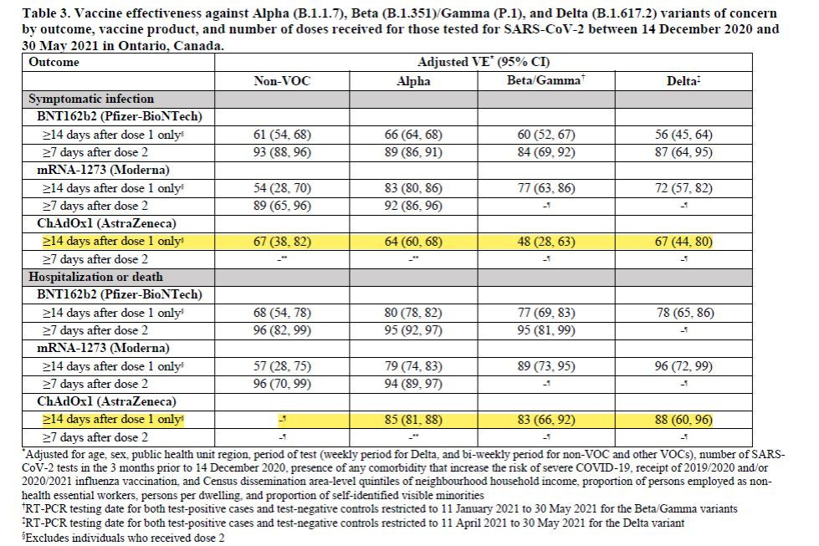
Vaccine effectiveness

Slide 19
COVID-19 clinical trials update worldwide

Slide 20
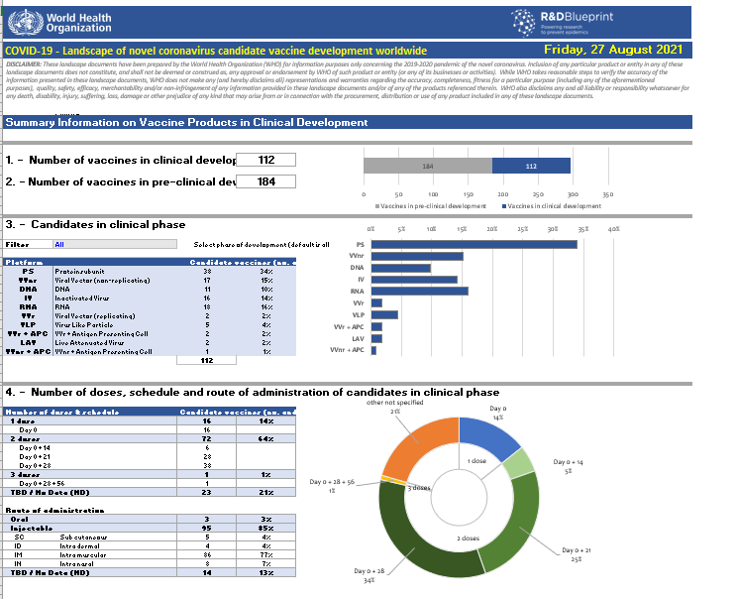
WHO COVID-19 vaccine tracker and landscape

Slide 21
COVID-19 safety report

Slide 22
The overall safety monitoring of vaccines – Reporting
Tools for reporting
Med Safety App
E-Reporting portal on SAHPRA Website
Paper-Based system
Captured into Vigilance Hub – Back office of Med Safety App
Captured at district, provincial, National or SAHPRA
Vigilance Hub is accessible by both SAHPRA & NDoH
Data on Vigilance Hub feeds directly into VigiFlow system

Slide 23
The overall safety monitoring of vaccines
In 2017, The National Immunisation Safety Expert Committee (NISEC) was appointed
NISEC is a non-statutory standing Ministerial appointed Expert Committee responsible for:
Review and assessment of all reported serious and severe adverse events following immunisation (AEFIs)
Review of individual serious and unusual AEFIs
Perform causality assessment of AEFIs
Provide feedback on the causality assessment outcome to relevant stakeholders e.g. SAHPRA
Submit recommendations to National Department of Health who also engages with the serious AEFIs reporters

Slide 24
AEFI Data Analysis
Vaccine name | # of ICSRs | # of AEFIs | # of fatalities | # of AESIs | Total Vaccinations | Prevalence of death
Comirnaty | 1249 (67% female; 30% male; 3% unknown) | 2826 | 68 | 488 | 7 296 977* | 0,93/100 000
COVID-19 Vaccine Janssen | 1055 (74% female; 21% male; 5% unknown) | 2 758 | 07 | 233 | 1 599 924* | 0,44/100 000
Total | 2304 | 5584 | 75 | 721 | 8 896 901* | 0,84/100 000
*8 896 901= 5 301 561 1st Dose + 1 995 416 2nd Dose
*1 599 924 = (495 488) Sisonke + 1 589 187 National roll-out
It should be noted that all the AEFIs reported directly to Sisonke are not available to both SAHPRA & NDoH
Data up to 13 August 2021
ICRS: individual case reports
AESIs: adverse events of special interest

Slide 25
AEFI Data Analysis

Slide 26
AEFI Data Analysis

Slide 27
NISEC Causality Assessment
Cases with NISEC | Death cases | Other cases | Total number of cases
Cases causality assessed | 32 | 65 | 97
Follow-up cases | 14 | 20 | 34
Cases under review | 5 | 22 | 27
Causality assessed | Death cases | Other cases | Total number of cases
Comirnaty | 29 | 25 | 54
J&J Vaccine | 3 | 31 | 34
Outcome of death cases
30 cases are co-incidental
2 insufficient information provided
Other cases under assessment
Myocarditis/pericarditis
Capillary leak syndrome
Guillain-Barre Syndrome
Vascular disorders etc

Slide 28
Thank you

