Slide 1
Debriefing on Procurement Disclosure Report
Progress Report to Standing Committee on Finance, Economic Opportunities & Tourism
MsTeams
N Ebrahim

Slide 2
Background
Transparency is a key element of good governance, which is the bedrock of effective service delivery
Strengthens trust by citizens in the use of public resources
Builds accountability of government to citizens
Significant increase in requests for procurement related information warranted a need for regular reporting on procurement in the public space.
Also an opportunity to implement SCM strategy
Under the leadership of Minister Maynier, the WCG took a decision to make public all COVID-19 procurement in the interest of transparency and accountability.
“We are committed to clean government in the Western Cape. We were the first provincial government to disclose detailed information on COVID-19 related expenditure. We now: publish a monthly Procurement Disclosure Report; a quarterly Procurement Disclosure Report; and will publish an annual Procurement Disclosure Report on COVID-19 related expenditure in the Western Cape”.
Budget Speech 2021 : A Budget for Hope
The annual PDR provides the public, oversight bodies and other interested parties with useful information on Western Cape Government public procurement activities related to the COVID-19 pandemic.

Slide 3
What’s in the PDR
Procurement Disclosure Report includes the following information sets:
PPE items procured by each Department, including associated costs;
Unit cost;
Total cost;
Other Covid-19 Expenditure
Supplier(s) name;
Total payment to supplier(s)
SMME spend for Covid-19
This information is extracted from various procurement systems, except for term of contract and contract commencement date. Departments augment this information further on an Excel workbook for National Treasury Reporting purposes.
Public entity information is manually provided on an Excel spreadsheet.

Slide 4
Consolidating the Report
The information in the PDR is drawn from various systems:
(the Departmental Bids awarded Registers; the LOGIS provisioning system, the ePS procurement system for quotations (now used for formal bids during the emergency dispensation), the BAS payment and accounting system and then matched and verified against National Treasury Central Supplier Database (CSD) and the Western Cape Supplier Evidence Bank, supplier information.
Supplier information must further be matched to check conflict of interest for state employees (i.e., against the Persal personnel information system and checked against the National Treasury register for tender defaulters.
Through this regular and standardized report, the department wishes to be pro-active in its response to procurement related queries.
At this point it is just the disclosure of expenditure as it occurs monthly and not a reflection on value for money purchasing. Expenditure still needs to be audited.
A pathbreaking and continuously developing process and product: PT has sought to continuously refine and improve procurement disclosure reporting over the course of the period under review. The first iteration of the PDR was issued on 28 July 2020 for the period 1 April 2020 to 30 June 2020 with subsequent versions being issued monthly in the 2020/21 financial year.

Slide 5
PDR Process

Slide 6
Snapshots from the first Annual PDR

Slide 7
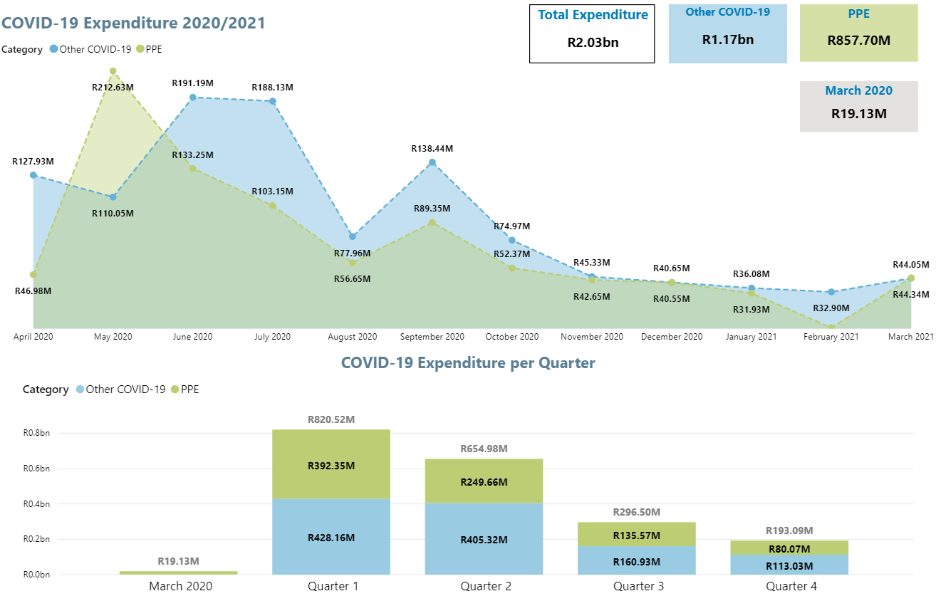
Summary of Expenditure

Slide 8
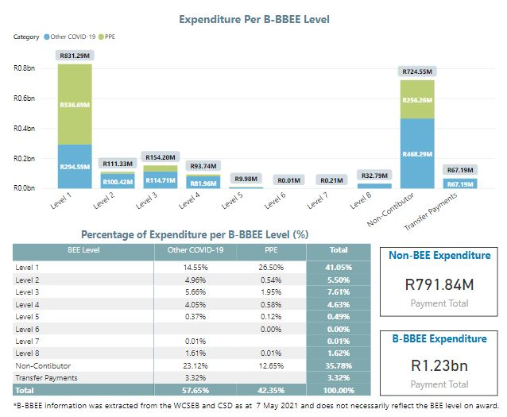
Analysis of Expenditure per B-BBEE level

Slide 9
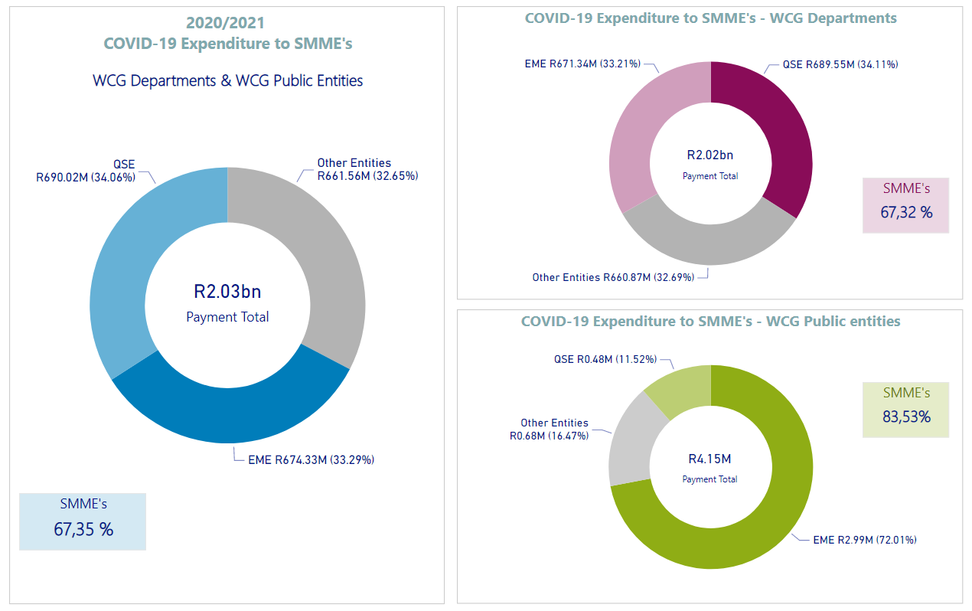
Summary of Expenditure to SMME’s

Slide 10
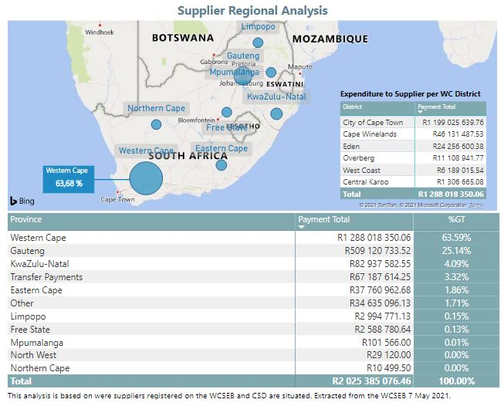
Regional Analysis

Slide 11
Lessons Learnt, Gaps and further Exploration

Slide 12
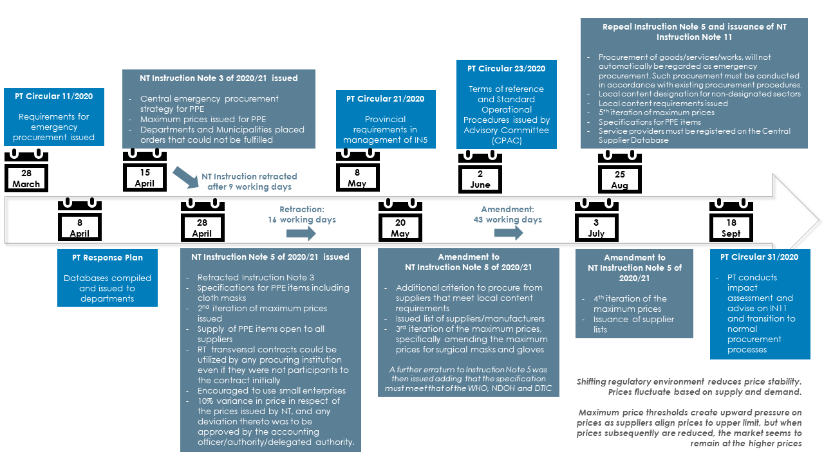
Prescripts during the Period

Slide 13
Local content requirements added additional complexity
Compliance with minimum specification as determined by the WHO; NDOH and DTIC
Prices equal to or lower than NT benchmark prices with 10% allowable variance
Registration on Central Supplier Database and any other database as approved by NT
Suppliers of cloth masks required registration with the Department of Small Business Development (28 April - 20 May 2020)
Compliance with local content and production for textile, clothing, leather and footwear sector, where applicable
The National Treasury, in addition issued Instruction Note 11 of 2020 which became applicable to the Province from 1 October 2020. The following requirements are applicable as stipulated in compliance to Instruction Note 11:
All PPE procurement at a 100% threshold in terms of the local content and manufacture designation for clothing and textiles. Bidders not meeting the 100% local content and manufacture requirements will be deemed to be unresponsive to tender requirements;
These requirements are to be included in bid advertisements when procuring PPE items;
Normal exemption processes with the Department of Trade, Industry & Competition;
3 July 2020 benchmark pricing for PPE and fabric masks to be applied and negotiations with service providers where prices are higher with 10% allowable variance;
Necessary approvals be obtained from the accounting officer, accounting authority or delegated person with justifiable reasons and confirmation that the prices are market related should it be more than the benchmark pricing; and
Suppliers with exorbitant prices be reported.

Slide 14
Experiences and Lessons Learnt
Inconsistent and unstable regulatory environment making it difficult to maintain consistency and standardisation on purchasing requirements throughout the period.
Many iterations of Instructions, process procedure, deviations;
Supplier lists issued by NT were not maintained, creating difficulty in establishing available suppliers as well as compliant suppliers. The use of the Central Supplier Database (CSD) became the default position;
Local content criteria applicable during the disaster issued on 20 May 2020 also encumbered processes during the pandemic in terms of red tape required for certification and securing compliant suppliers for PPE, noting that PPE items and cloth masks were not in the norm purchased by departments, nor were they previously designated for local content and production;
Normal procurement procedures (application of normal prescripts) became applicable from 18 September 2020. The practical experience drew attention to the fact that governance requirements for procurement during ordinary emergencies and within a disaster, are distinctly different.
PPE specifications issued by NT assisted with compliance to applicable standards when purchasing PPE requirements in the Western Cape.

Slide 15
Experiences and Lessons Learnt
Market Instability:
Supply and demand of Personal Protective Equipment (PPE) was affected at a global scale, resulting in prices fluctuating and significant price increases, driven by the scale of the sudden increase in global demand relative to available supply.
Maximum price thresholds of 15 April 2020 created upward pressure on prices as suppliers aligned prices to upper limits, however when prices were subsequently reduced, the market remained at the high price without making the downward adjustments in terms of the NT benchmarks. In certain instances, a hike in prices was felt as is evident in the purchasing of thermometers in the Western Cape.
Service Delivery Challenges
NT transversal contract suppliers could not deliver to the demand of the Western Cape Government and departments had no option but to revert to product buyouts and contract extensions to maintain stock levels and to meet service delivery needs. (A product buy-out is when a department buys all available stock that a supplier has available).
Trade-offs in terms of service delivery and cumbersome governance processes needed to be made to manage delivery needs and to save lives in the long term. This required innovative ways of purchasing playing a critical role whilst at the same time maintaining and managing internal controls and risk mitigation processes from a governance perspective.

Slide 16
Information published
Information published is unaudited and must still undergo a full internal and external audit processes. This means that some changes to the data will occur as transactions are reconciled and validated.
Transactional information is secured as a data upload from various financial, non-financial, manual and electronic systems that must be manually reconciled. While all efforts have been made to ensure the correctness of the data, in cases where these are identified after publication then corrections will be issued.
Transactional information is based on orders placed on a month-to-month basis. Therefore, this information:
does NOT reflect journalised entries and corrections done by procuring entities from an in-year monitoring perspective and does not include subsequent financial reconciliations or amendments made at this stage.
does NOT reconcile back to a contract as the current financial systems have not been configured to house this information and there is a National embargo on purchasing and development of financial systems due the National Treasury requirements as they relate to the Integrated Financial Management System(IFMS). So, transactions only reflect what has been transacted per supplier.
Therefore, information published does not go into value for money considerations within procurement per se, but is in the main focused on expenditure against procurement as it occurs.

Slide 17
Way Forward

Slide 18
WCG SCM Strategy- Value Chain Linkages
CAPACITATION & DEVELOPMENT: Organisational Structure, Capacity & Skill
Dedicated structure; Intuitional memory for
policies, best practices; Training (and
development Business Process optimisation;
Client Support (Helpdesk) Supplier Development
SCM TECHNOLOGY: REPORTING & DATA INTEGRITY
Reporting; Enterprise Content and Information
Management; Integrated financial and Non-
Financial System; Reliable data that supports
operational planning and strategic decisions and
Surveillance
STRATEGIC PROCUREMENT
Procurement Planning and informed; Commodity
Strategies; Effective Utilisation of Resources; Value
for Money; Economies of Scale (transversal
contracts; Market intelligence and technical
expertise; Service Delivery Future Improvements
GOVERNANCE : Strategy & CONTROL
Standardised Strategy & Procedure;
Sensitive; Responsibility & Accountability
Management; Contract Management; Positive
Audit Outcomes

Slide 19
Embedded Good Governance
Issuance of Provincial Treasury Instructions; 2019
Issuance of Revised Blueprint Accounting Officers’ System (Sept 2021)
Procurement Planning Toolkit
Institutional Memory (Knowledge Management)
Monitoring and Evaluation(Surveillance) – PDR and SCM assessments
Performance Information – SCM Insight Reports

Slide 20
Technology Enablement- (Conformance to Performance)- Levers for Change
ODS
(Data Store)
1. Procurement Planning Toolkit
2. eProcurement System and WC Supplier Evidence Bank + NT CSD
3. Financial Systems Data (BAS; LOGIS; Vulindlela and other
PLANNING
RESULTS
OPERATIONS
SCM Insight Reporting and PDR
FINANCIAL INTEGRATION
ONE SOURCE OF FACTS
(The Value of using Business Intelligence capabilities)

Slide 21
SUPPORT AND DEVELOPMENT- ICT Levers- Catalysts for Change
Customer Relationship Management
(Helpdesk; Booking Tools; Knowledge Management & Institutional Memory)
PT Web-enablement
(Brand; Information, FAQS; what we do and how we do it)
e-Learning
(webinars; videos; Moodle platform)

Slide 22
SCM Client Support- 2020/21
SERVICE DESK
Query handling; Advice & Guidance
LEARNING
Training; Videos; Podcasts, Webinars; Open days; Web enablement
TECHNOLOGY SERVICES
e- Procurement; WCSEB; CSD
COMPLAINTS HANDLING
Mediation; Redress
SERVICE MANAGEMENT
Transparency (PDR); Booking tool; Perception surveys
34 372 events advertised vis ePS (IPS)
Procurement Planning Toolkit - 12 Proc plans captured except DOH manual plan
In-House ePS development
18 429 suppliers regd. on WCSEB
Web enablement
Training videos
15 869 queries
11575 WCSEB support
1 754 CSD
2 169 ePS
371 SCM –depts only
26 web-based interventions for depts (AOS , proc planning)
CPAC-17 emergency procurement advised on
53 SCM insight Reports
Monthly PDR, Quarterly and Annual
SCM forums
FAQs
2x Programmes of support
Procurement Client Centre launched

Slide 23
Data Challenges make Progress on Reporting Slow
It was the intent to brief committee on the Top commodity spend , but unfortunately PT experienced data credibility challenges in the information sets, although the capability to do the report is in place: This is because:
transactional information is secured as a data upload from various financial, non-financial, manual and electronic systems that must be manually reconciled;
Data does not reflect journalised entries and corrections done by procuring entities from an in-year-monitoring perspective, and
does not include subsequent financial reconciliations or amendments made at this stage.
For Covid-19 Departments put in mechanisms to ensure credibility of reporting that ensured that information reported on was correct at the transactional level
Management of Data Credibility issues on Financial Systems and change management requirements have been put in place by the Directorate: PT Supporting Interlinked Financial Systems- Circular issued to departments and ongoing work to support and enable departments and Systems through PT Data Centre Project.

Slide 24
Next Steps
Management of Data Credibility issues on Financial Systems and change management requirements have been put in place by the Directorate: PT Supporting Interlinked Financial Systems- Circular issued to departments and ongoing work to support and enable departments and Systems through PT Data Centre Project
On the procurement side: enablement of Strategy through delivery with a focus on linking procurement data and information to the financial transactional information (linking procurement to the budget and to actual purchasing and contracts):
Procurement Planning Toolkit
e-Procurement system
Bring different data sets into one datastore
Automation of information from Legacy Systems through the “Evergreening of the Legacy Systems” –ICT Project
Progressively improve and expand on the information being published in the PDR, POPIA permitting.
Monthly reports published with Quarterly and then an Annual PDR for 2021-22 financial year.

Slide 25
Nadia Ebrahim

