Slide 1
Public hearings on
Cannabis for Private Purposes Bill
Presentation to Portfolio Committee on Justice and Correctional Services
Doron Isaacs, CEO Karoo Bioscience
1 September 2021

Slide 2
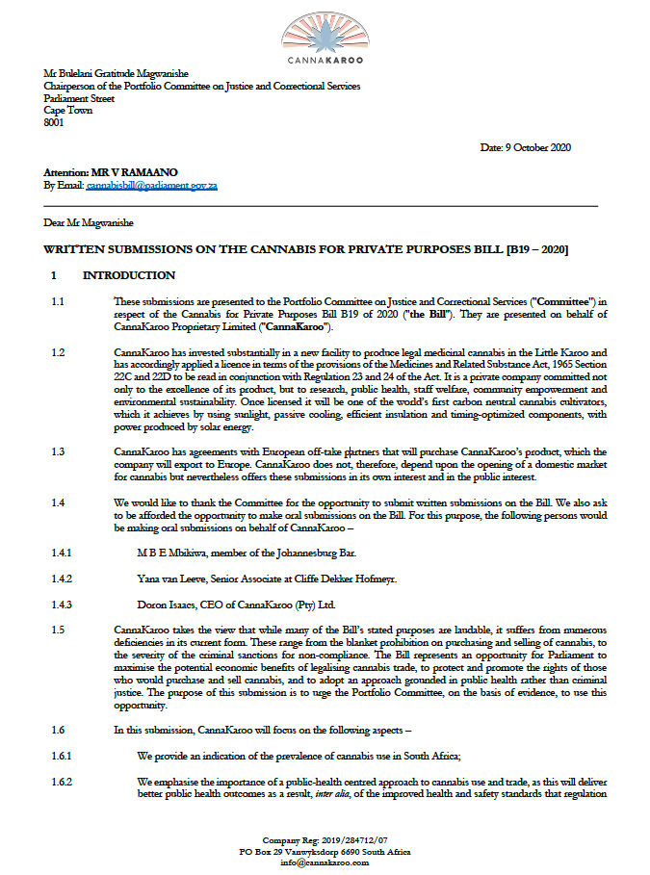
Written submission was made in October 2020 in the name of CannaKaroo (Pty) Ltd.
Company name has since changed to Karoo Bioscience.
Karoo Bioscience is a cultivation, research and processing company within the Medicines Act licensing framework.

Slide 3
Structure of Presentation
Public Health impact
Criminal Justice impact
Economic impact
Constitutional Court judgment
Analysis of the Bill
Comparative analysis with other countries

Slide 4
Public health risks of legalisation of trade
Cannabis use does involve risk.
The main risks are: dependence and psychosis in a small proportion of very regular users of high potency cannabis. Most users do not become addicted or suffer ill effects.
It causes “much less harm than do illicit opioids and stimulants or legal drugs such as alcohol and tobacco.” [Lancet 2019].
The number of cases where cannabis causes death is close to zero. Death by overdose basically impossible. Alcohol and tobacco are leading causes of death.
In the US:”daily marijuana use has remained relatively stable and at low levels” over the past 20 years, despite legalization of trade.

Slide 5
Public health benefits of legalisation of trade
Quality can regulated and subject to inspection and testing.
Labelling can be regulated.
Dosage can be regulated.
Potency can be regulated.
Age-limits can be regulated.
The public can know what they are putting in their body and be confident that it is safe.

Slide 6
Public health benefits of legalisation of trade
Cannabis has proven and potential medical uses.
From 1996 cannabis use was permitted in California for nausea, pain and muscle spasm, among other conditions.
Cannabis medicines are permitted by the European Medicines Agency and the Federal Drug Administration (FDA) for treatment of childhood epilepsies.
In 2019 the European Parliament passed a non-binding vote to improve access to medical cannabis.
The WHO recommended in 2019 that governments remove cannabis from Schedule IV of the Single Convention on Narcotic Drugs.
In Germany over 130,000 patients receive medical cannabis.

Slide 7
Public health benefits of legalisation of trade
In 2016 the South African Medical Research Council similarly concluded, following a systematic review of the evidence, that there was sufficient proof that cannabinoids could be used to treat chronic pain and spasticity in multiple sclerosis.
A 2014 report published in the medical journal JAMA Internal Medicine found that U.S. states with medical cannabis laws had almost a quarter fewer fatal opioid overdose deaths than those without such laws, between 1999-2010.

Slide 8
Criminal Justice impact of legalising trade
Arial spraying of chemicals to remove cannabis plants costs the SA government millions each year. In the year 2014-2015, R3.5-billion was spent on cannabis criminalisation by the SAgovernment and SAPS.
In California, cost savings were achieved after legislative steps were taken to legalise cannabis of approximately $150 million in 2010.
WHO study 2008: “The Netherlands, with a less criminally punitive approach to cannabis use than the US, has experienced lower levels of use, particularly among younger adults. Clearly, by itself, a punitive policy towards possession and use accounts for limited variation in nation-level rates of illegal drug use.”

Slide 9
Economic impact of legalization of trade
Former Minister of Finance’s tweet: “The economy […] is waiting for legal growth of the stuff!! R4bn plus!! Tax money!!”
The Institute on Taxation and Economic Policy (in 2019) found that in the six US states where legal recreational cannabis sales had been underway for 12 months or more, the revenue raised from cannabis taxes ($1.04 billion) was almost equivalent to that raised through taxes on alcohol.

Slide 10
The Constitutional Court judgment in 2018
No reason for the judgment in Prince to be the beginning and the end of the Bill.
The Constitutional Court specifically declined to widen the case to deal with "the whole criminalisation of cannabis by various statutory provisions”.
The Court declined to go beyond the right to privacy "because other rights were not properly canvassed in Mr Prince's founding affidavit in the High Court".
Parliament is not similarly constrained. It has the power to legislate in a manner that covers the field. It is obligated under section 7(2) of the Constitution to respect, protect, promote and fulfil the rights in the Bill of Rights.

Slide 11
Problems with the Bill
The Bill misses an opportunity to allow not only the private consumption of cannabis, but, subject to careful regulation, cannabis trade, which brings benefits discussed above.
The Bill underminess its own laudable objectives by adopting an approach to non-compliance that is punitive and criminal.

Slide 12
Six ways to improve the Bill
Remove the outright prohibition and criminalisation of cannabis trade.
Revise the severe criminal penalties of up to 15 years imprisonment.
Remedy the violation of Constitution Section 22: “Every citizen has the right to choose their trade, occupation or profession freely.”
The Bill discriminates irrationally between people who live in different ways – not everyone can grow.
Remedy the irrational nature of the Bill – how can you grow without buying seeds?
Remedy the irrational distinction between cannabis, alcohol and tobacco.

Slide 13
Comparative Regulatory Analysis
Adult-use legalisation and regulation in force in various place: Canada, Uruguay, California, Colorado, Oregan, Washington, Mexico, Luxembourg etc.
Medical legalisation and regulation: Germany with similar developments happening in UK, Australia and other places.
Various approaches to regulating quality, labelling and potency, as well as different approaches to taxation can be discussed.

Slide 14
Conclusion
Public health risks of cannabis are modest
Public health risks of cannabis are much lower than those for alcohol and tobacco – which are both legal and regulated.
Public health risks are raised by criminalisation and lowered by legalisation.
Some medical benefits from cannabis do exist.
Benefits of legalisation of trade include public health impact, economic impact (including taxation) and criminal justice impact.
The Bill can and must go further than the 2018 judgment.

Slide 15
Thank you.
Contact: doron@karoobioscience.com

