Slide 1
Cannabis Bill / Act
Cannabis Master Plan
Cannabis White Paper
Cannabis Research

Slide 2
Cannabis Research
1999 >R1 Billion Reports
Cannabis Licenses were issued by DOH sans annual reports
DAFF/LLRD, DOH, SAPS, DTI, SOEs ARC and various other departments and government vehicles were involved without PMFA overisght or reporting.
NAMC National Agricultural Marketing Council present the Hemp Feasability Study to Parliament Jan 2017. All projections were based on Colorado hemp trials, and not South African research data.
The research that has been performed at great cost needs to be made available for peer and scientific review as this data will inform the viabliity of hemp in South Africa if at all.

Slide 3
Cannabis White Paper
Requested by the National Assembly of the CDA 1999
Released 2004 incomplete
Rejected by Parliament for not being scientific 2009
The Cannabis Working Group presented their White Paper to CDA and Parliament 2013
CDA held a Cannabis Round Table which was to inform the Cannabis Master Plan
All that was forthcoming were the pieces from the MRC and CDA regarding cannabinoind use and alcohol respectively in response to the Members bill brought by Mario Ambriosini the Medical Innovation Bill.

Slide 4
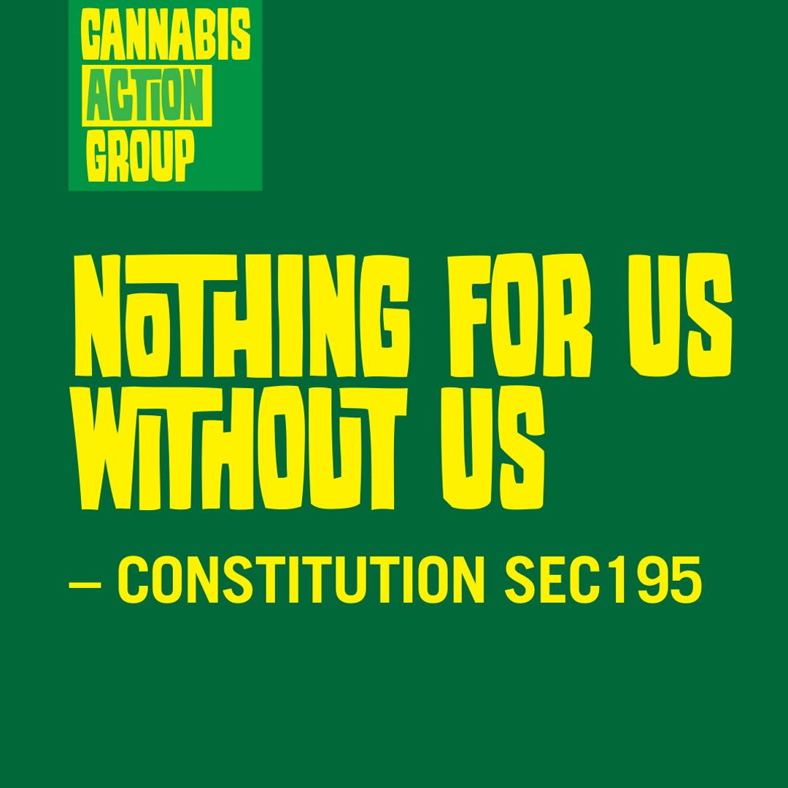
Master Plan
2014 a Cannabis Master Plan was requested by Parliament of DSD and the CDA
2021 DALLRD
In direct opposition to the cannabis for private purposes bill

Slide 5
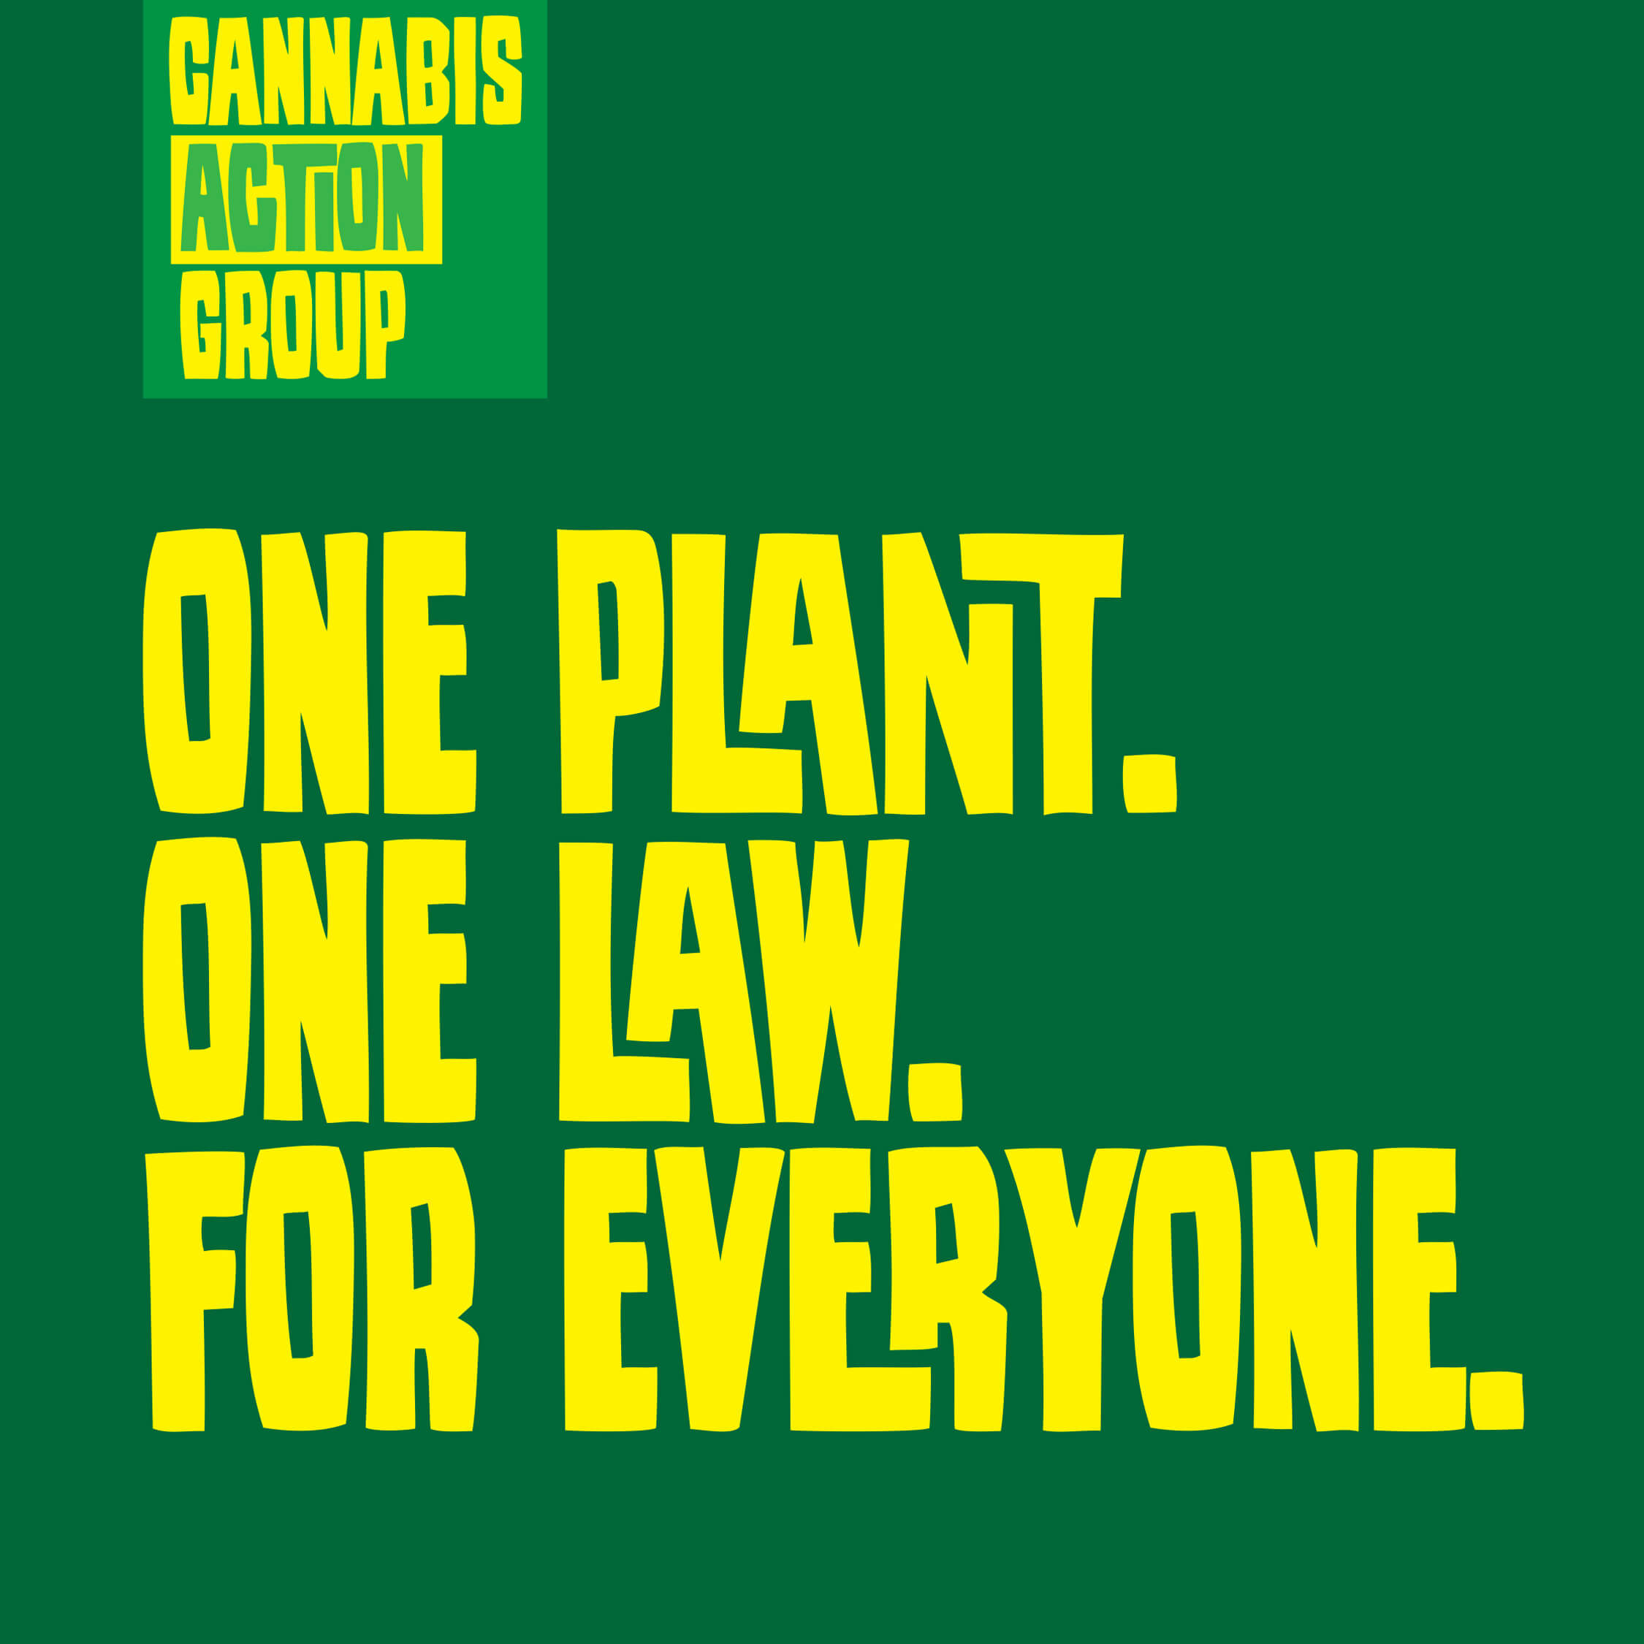
Bill Definitions
FROM
Cannabis/Dagga, the whole plant or any portion thereof except dronabinol ((-)-transdelta-9-tetrahydrocannabinol)
TO A definition that now spans 3 Schedules
M&RSA 1965
inclusion of ‘or product thereof’
inclusion of ‘hemp’ exclusions
inclusion of other cannabinoids, cannabinols
inclusion of synthetic substances with ‘cannabis like’ effects
D&DTRA 1992
inclusion of ‘or product thereof’
inclusion of Tetrahydrocannabinol

Slide 6
Unscientific Definition Insanity
2015 DSD got stuck on is it a tree, is it a leaf, is it a plant?
A simple understandable definition is easily found on Google
From simple definition with exception, exception is the rule
22 May 2020 Gazette 43347 ammendments to M&RSA 1968
Embarrasingly the exception shows the ill qualified group writing this legislation.
D&DTA 1992
Changes and additions made by DOJ in contravention of a Consititutional Court finding
Scheduling, M&RSA preamble, CPPB , ACT, Master Plan definitions all these definitions created behind closed doors and without public or scientific review.
Schedules moved only on threat of court or after court instructions.

Slide 7
Direction - Solution
Article 36 INCB - Single Convention Treaty
This path has already been set by the Consitutional Court of the Republic of South Africa
Section 36 of the South African Constitution
A less invasive more reasonable restriction can be set as per
Section 22 of the South African Constitution
The right to choose your occuption and trade, provided regulations are set.

Slide 8
Conclusions
CAG Oppose the CPPB, Master Plan and unconsitutional changes already made to the various acts, will at the NCOP and in court if need be for the reasons mentioned.
Research, reports, white paper, master plan, bill, licensing and definitions are all corrupt
Cannabis Action Group suggest
Continue with the path set by the concourt to allow the Signitory Party the Republic Of South Africa to set it’s own regulations as other juridictions have
Remove cannabis, and all definitions from the M&RSA and D&DTRA
Engage in public participation to create a new bill with proper and correct definitions upon which a sensible policy can be built.
Any further delay will only expand the black market created by this legislative catchup.

