Slide 1
REJECTION
Critical reflection on the Cannabis for Private Purposes Bill:
A built environment perspective
PORTFOLIO COMMITTEE ON JUSTICE AND CORRECTIONAL SERVICES
Public hearings on the Cannabis for Private Purposes Bill
Dr Anita Venter
Adv Zwelonke Mamba
Thulani Mahlangu
info@cidasa.org
1 September 2021
CANNABIS INDUSTRY
DEVELOPMENT ASSOCIATION
OF SOUTHERN AFRICA

Slide 2
CIDASA
082 081 2972
info@cidasa.org
www.cidasa.org
Cannabis Industry Development Association of Southern Africa (CIDASA) NPC established 2018
CIDASA response response and support to the Constitutional Courts ruling in September 2018
unconstitutional for people to be arrested for using Cannabis for their own personal benefits in their own home
Third party between the state and citizen who are using cannabis for various reasons
CIDASA
Create awareness / inclusive facilitation of the cannabis industry to fight poverty in Africa continent in line with the SDGs (United Nations).
Skills transfers in the various cannabis and hemp value chain
Promote the safe use of cannabis in communities / offer advice on various developmental platforms / rural focus
Presenter: Dr Anita Venter on behalf of CIDASA
Researcher at the Centre for Development Support (UFS)
Ecological /natural building built environment practitioner in the informal sector
Climate crisis activist + design survival shelter models for the future
REJECTION: Critical reflection on the Cannabis for Private Purposes Bill from a ‘Private Purpose’ built environment perspective
Promote indigenous ways of cultivating and use, not only recent technological development

Slide 3
MAIN BUILT ENVIRONMENT ARGUMENTS
082 081 2972
info@cidasa.org
www.cidasa.org
Rejection of on behalf of many ecological and indigenous built environment practitioners
Cannabis for Private Purposes Bill violates rights embedded in the Constitution
Environmental legislation: The Paris Climate agreement of 2015, and Section 24 (a and b) of the Bill of Rights:
Right to an environment that is not harmful to their health or wellbeing
Protect environment for the benefit of present and future generations.
Deter persons from accessing adequate housing: Section 26, 1 and 2 of the Bill of Rights.
Everyone has the right to access adequate housing
The state must take reasonable legislative measures, within its to achieve the progressive realisation of a person's right to access housing (or rather shelter) in times of a climate crisis.
Inhibit a person's freedom of expression (Section 1, c and d of the Bill of Rights).
This freedom includes freedom of artistic creativity, and academic freedom and freedom of scientific research.
Research error: excluding ecological / environmental / climate crisis perspective
Bill not well thought through in terms of the whole plant structural properties

Slide 4
THE ANCIENT CANNABIS PLANT
082 081 2972
info@cidasa.org
www.cidasa.org
Ecology history long before humans
Vital role in the evolutions of ancient societies throughout many millennia
11 000 to 12 000 years ago earth entered an era of a stable climate - Holocene, birth of modern civilisation
Ancient domesticated crop with many ‘private purpose’ uses beyond medicinal and recreational use
building materials, ropes, fishing nets, fabrics, textiles, canvas, paper, (list go on and on)
Archaeological sites in Asia, Western and Eastern Europe, the Americas and Africa show industrial use
Cannabis use in South Africa by indigenous groups precedes colonisation in 1652
1700s & 1800s: Industrial revolutions
Fossil fuels, quick solution, started to replace cannabis and carbon-negative building materials
Little consideration for destructive environmental impact of fossil fuels replacing the ecological benefits of hemp / cannabis in general.
Fossil fuel products replacement escalated to climate crisis in the 21st century
New climatic era of the Anthropocene (climate uncertainty)

Slide 5
CANNABIS PROHIBITION / TRANSITION ERA
082 081 2972
info@cidasa.org
www.cidasa.org
1900s:
Cannabis innovation potential violently disrupted and prohibited by Western laws
Geneva Opium Convention and various controls of substances acts.
Prohibition spearheaded by medicinal councils /political agendas / neo-liberal agendas / discrimination against indigenous communities
2000s:
Cannabis favourable ecological properties, became prohibited less than a century ago
South Africa:
the constitutional Court decriminalised cannabis in 2018
the Cannabis Bill for Private Purposes focuses mainly on recreational and medicinal use
ignoring the industrial purposes of just ecological / indigenous private purposes products
Critical question:
What is the consequences of medicinal legislation (that control illegal use of substances) bringing industrial /indigenous innovation of cannabis to a standstill?

Slide 6
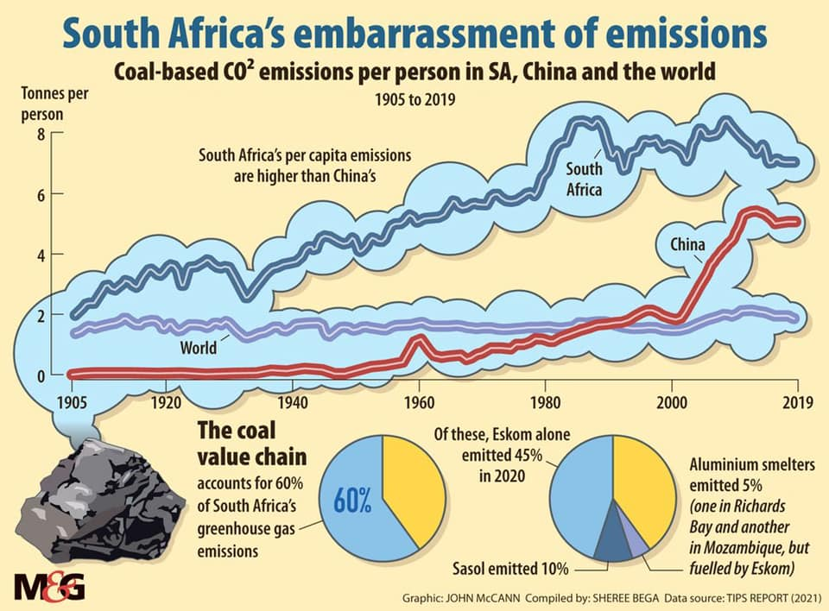
082 081 2972
info@cidasa.org
www.cidasa.org
CLIMATE CRISIS
SA signatory of the 2015 Paris Climate Agreement
"surface air temperatures in Africa are projected to rise faster than the global average increase and likely to increase by more than 2°C and up to 6°C"? (IPCC, 2021)
Sea level rise 0.44 m and 1.01 meters before 2100. Will keep on rising for thousands of years (IPCC, 2021)
Government obligated to mainstream zero-carbon technologies into industries
Carbon emissions greater concern than counting plants or policing human species consuming a plant for recreational / medicinal purposes
Cannabis actively lessens the impact of the climate crisis by sequestrating carbon from the atmosphere
One hectare of outdoor hemp absorb ±15 tonnes of CO2 per hectare
Regenerate soil / nutrition back in soils
Most cannabis grow quickly to repeat sequestrating cycles
Don’t have to cut down trees that take much longer to grow to achieve similar climate positive results
Humanity cannot ignore linkages between outlawing of cannabis/hemp products and the replacement of carbon loaded material options and the climate crisis

Slide 7
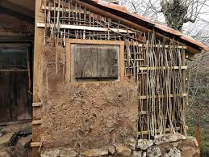
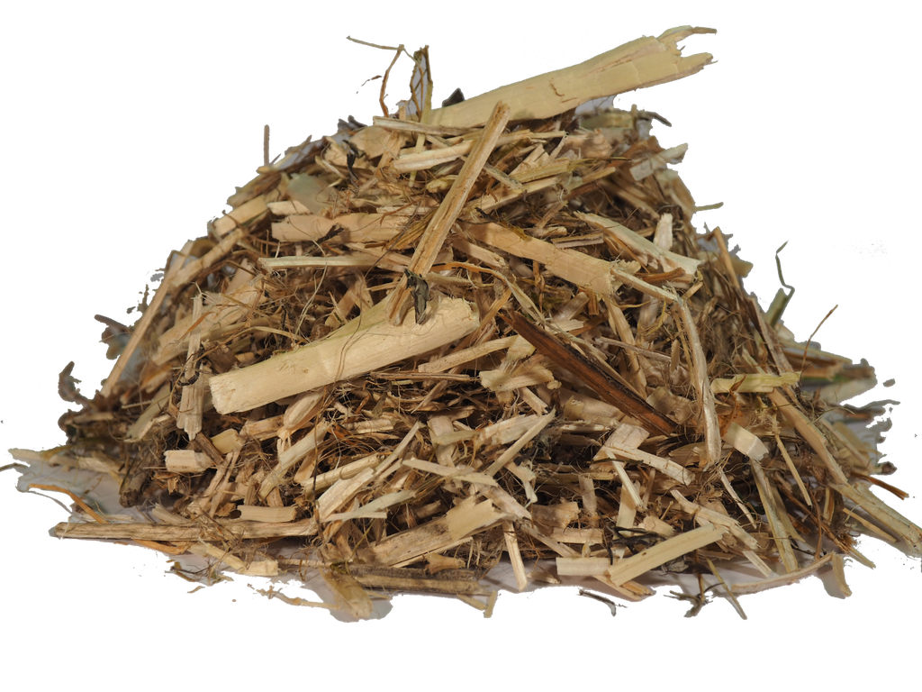
EVOLVING INDIGENOUS BUILDING TECHNOLOGIES
(Informal sector)
Traditional wattle and daub
All cannabis stalks enhance the climate strength of traditional indigenous buildings technologies through low-skills applications in the informal sector
Fully grown cannabis (hemp/other strains) produces excellent strong stalks
used in the place of wood for wattle and daub frames
Fast turnover you can incrementally build your shelter as you grow cannabis for other purposes
any cannabis stalk can be chipped into small one to five-centimetre pieces (shives)
replace straw or grass in traditional adobe/cob mixtures (mixture of soil, manure, straw)
different lengths, have much higher structural strength than using straw on its own
add greater the insulation value to your natural material
Formal Sector: Properties of hemp / hempcrete well researched (Gov needs to enable implementation)
Cannabis shives
Informal evolving technologies do not need big research labs
Best conducted in real-world applications by experienced natural / indigenous builders

Slide 8
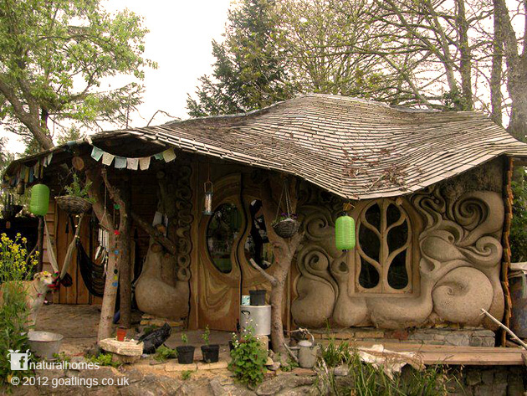
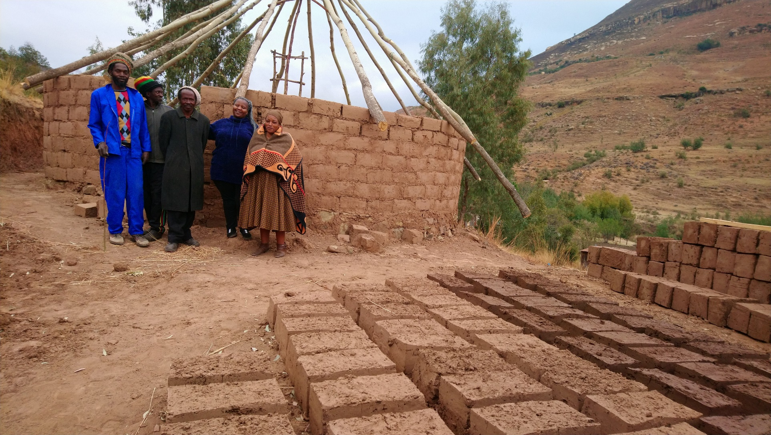
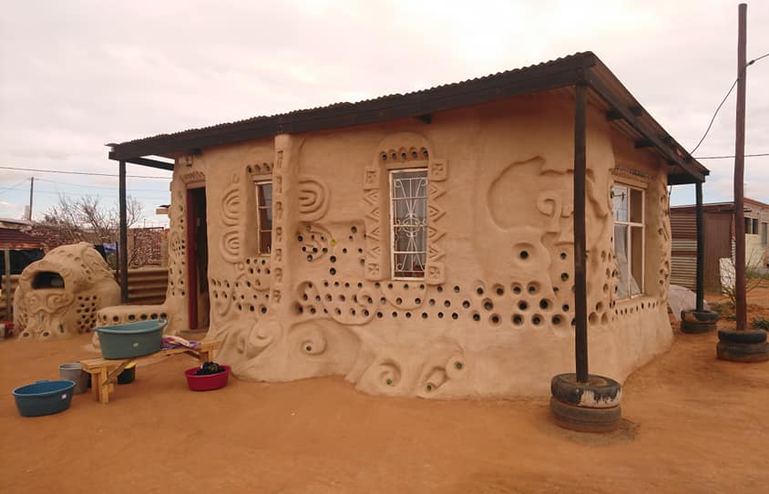
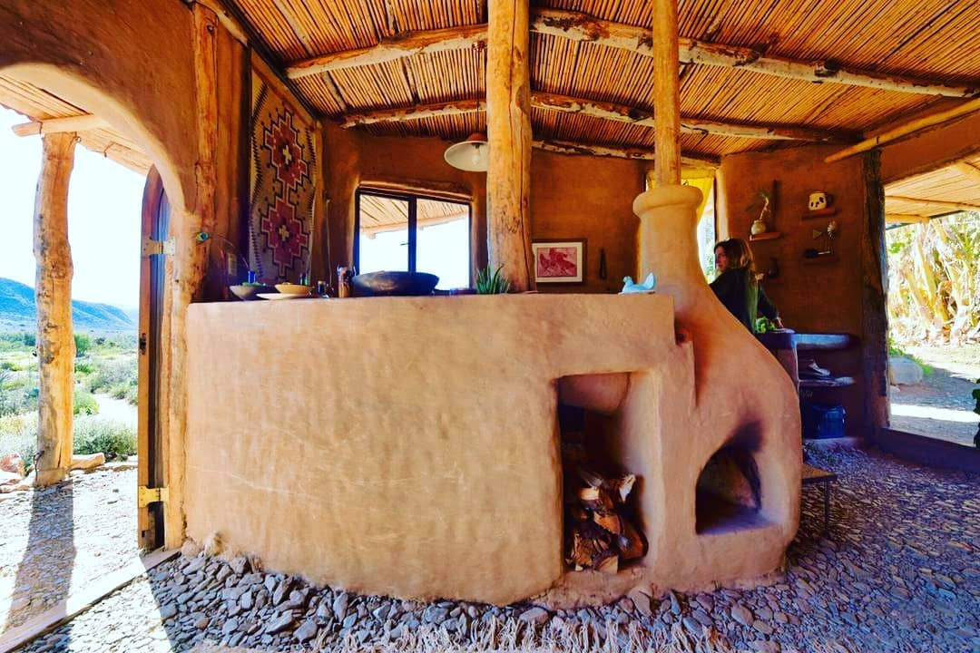
EARTH BUILDINGS
Can structurally be enhanced by cannabis by-products
Somerset- England
Qwa-Qwa
Mangaung homestead
De Rust Permaculture Farm

Slide 9
CONCLUDING COMMENTS
The government failed to rectify the Constitutional Court ruling to provide a comprehensive Cannabis for Private Purposes Bill.
Little consideration for cannabis rich historical indigenous context that helped to build the modern world as we know it today.
Ignorance of indigenous rights in the bill is unconstitutional
The requirement of a few plants per household will not enable the marginalised to explore the potential of cannabis in stimulating a revival of own cultural indigenous building practices
This include the exclusion of natural building in the formal building codes 27 years after apartheid
CIDASA challenge the over-regulated control of the medicinal council on industrial (private purposes) activities that have nothing to do with their mandate
People fought for centuries for the liberation of the plant, cannot afford stringent rules and regulations
Indigenous peoples right to create an informal sector market, which is familiar to them
The Bill cannot be viewed in isolation from broader societal discourses like climate crisis and international committed to the Paris Agreement.
Should any plant with carbon sequestrating properties should be regulated at all?
What comes first, the planet or people? Without a liveable planet, there will be no people.
Omission of the built environment in that the Cannabis for Private Purposes Bill did not fulfil its mandate to provide the holistic context of the use of cannabis for all purposes
Much more research needs to be done on the potential of cannabis building material in the informal sector.
How can you do research if ecological building material are outlawed
by illogical decisions rather than pure reason?

Slide 10
CONSIDERATIONS FOR THE FUTURE….
082 081 2972
info@cidasa.org
www.cidasa.org
The alternatives existed for a century to stop much ecological destruction. But the medical councils and Western neo-liberal politics outlawed cannabis.
What gave one industry the right to make critical decisions to stop innovation and critical important ecological friendly value chains?
How much health issues and environmental destruction have resulted from cannabis criminalisation?
How much attention is given to science and indigenous rights when decisions about a plant are made?
How thoughtless are we to still sustain laws without really digging deep to ask why cannabis was outlawed in the first place?

Slide 11
Stakeholders / partnerships
082 081 2972
info@cidasa.org
www.cidasa.org

Slide 12
Thank you for your time
CANNABIS INDUSTRY DEVELOPMENT ASSOCIATION OF SOUTHERN AFRICA
082 081 2972
CIDASA2018
info@cidasa.org
www.cidasa.org
CIDASA_2018
8285 Section 36, Sinethemba Street, Gauteng, 0175
CIDASA(AFRICA)

Slide 13
Reading list / References consulted
Abel, E.L., 1980. Marijuana: The First Twelve Thousand Years. Springer. US: New York.
Adovasio, J., Soffer, O., and Klima, B. 1996. Upper palaeolithic fibre technology: interlaced woven finds from Pavlov I, Czech Republic, c. 26,000 years ago. Antiquity 70: 526–534.
Allegret, S. 2013. The History of Hemp. In: P. Bouloc, S. Allerget, L. Arnaud (ed)., Hemp Industrial Production and Uses. CABI: pp. 4-26.
Anwara, F., Latifa, S. and Ashrafb, M., 2006. Analytical Characterisation of Hemp (Cannabis sativa) Seed Oil from Different Agro-Ecological Zones of Pakistan, 83: 323–329.
Apotsos, M., and Venter, A. 2020. Post-Natural building and eco-vernacular architecture in contemporary South Africa. In de Jager (ed)The Sustainability Handbook, Chapter 9, pp. 138-151. Alive2Green: Cape Town.
Armstrong, K., Venter, A., Maphalane, M., Maphalane, E. 2020. Folio comprising Caleb Motshabi replacement house and Seven Stage Futures 2015-2017. Creative Design/ Architectural publication by the University of the Free State: South Africa.
Arnaud, L. and Gourlay, E. 2011. Experimental study of parameters influencing mechanical properties of hemp concrete. Construction and Building Materials 28(1): 50–56.
Bonini, S.A., Premoli, M., Tambaro, S., Kumar, A., Maccarinelli, G., Memo, M. and Mastinu, A. 2018. Cannabis sativa: A comprehensive ethnopharmacological review of a medicinal plant with a long history. Journal of Ethnopharmacology, 227: 300-315.
Cigasova, J., Stevulova, N., Schwarzova I. and Junak, J. 2014. Innovative Use of Biomass Based on Technical Hemp in Building Industry. Chemical Engineering Transactions, 37: 685- 690.
Cherney, J.H. and Small, E. 2016. Industrial hemp in North America: production, politics and potential. Agronomy 6: 58.
Constitutional Court of South Africa. 2018. Minister of Justice and Constitutional Development and Others v Prince (Clarke and Others Intervening); National Director of Public Prosecutions and Others v Rubin; National Director of Public Prosecutions and Others v Acton (CCT108/17) [2018] ZACC 30; 2018 (10) BCLR 1220 (CC); 2018 (6) SA 393 (CC); 2019 (1) SACR 14 (CC). 18 September 2018. Government printers: Pretoria.
Cultrone, G., Sebastian E. and Ortega Huertas, M. 2005. Forced and natural carbonation of lime-based mortars with and without additives: mineralogical and textural changes. Cement and Concrete Research, 35: 2278–2289.
De Meijer, E. P. M. 1995. Fibre hemp cultivars: a survey of origin, ancestry, availability and brief agronomic characteristics. Journal of the International Hemp Association, 2(2): 66–73.

Slide 14
Duvall, C. 2019. A brief agricultural history of cannabis in Africa, from prehistory to canna-colony, EchoGéo [Online], 48.
Elfordy S., Lucas F., Tancret F., Scudeller Y. and Goudet L. 2008. Mechanical and thermal properties of lime and hemp concrete manufactured by a projection process. Construction and Building Materials, 22: 2116-2123.
IPCC, 2021: Climate Change 2021: The Physical Science Basis. Contribution of Working Group I to the Sixth Assessment Report of the Intergovernmental Panel on Climate Change [Masson-Delmotte, V., P. Zhai, A. Pirani, S. L. Connors, C. Péan, S. Berger, N. Caud, Y. Chen, L. Goldfarb, M. I. Gomis, M. Huang, K. Leitzell, E. Lonnoy, J. B. R. Matthews, T. K. Maycock, T. Waterfield, O. Yelekçi, R. Yu and B. Zhou (eds.)]. Cambridge University Press. In Press.
Ip, K. and Miller, A. 2012. Life cycle greenhouse gas emissions of hemp–lime wall constructions in the UK. Resources, Conservation and Recycling, 69:1–9.
Jami, T. Rawtani D. and Agrawal Y.K. 2016. Hemp concrete: carbon-negative construction. Emerging Materials Research, 5(2): 240-247.
Jami ,T. 2016. A Study on Carbon Sequestration of Lime Hemp Concrete. MS Thesis, Inst. of R&D, Gujarat Forensic Sciences University, Gandhinagar. Gujarat: India.
Jami, T., Karade, S.R. and Singh, L.P. 2018. Hemp Concrete – A Traditional and Novel Green Building Material. Conference: International Conference on Advances in Construction Materials and Structures. Roorkee, Uttarakhand, 7-8 March. Roorkee: India.
Jami, T., Karade, S.R. and Singh, L.P. 2019. A review of the properties of hemp concrete for green building applications. Journal of Cleaner Production, 293: 1-15.
Latif, E., Lawrence, M., Shea, A. and Walker, P. 2015. Moisture buffer potential of experimental wall assemblies incorporating formulated hemp–lime. Building and Environment, 93: 199–209.
Lawrence, R. 2006. A Study of Carbonation in Nonhydraulic Lime Mortars. PhD thesis, Department of Civil Engineering, University of Bath. Bath: UK.
Lawrence, M., Fodde E., Paine K. and Walker, P. 2012. Hygrothermal performance of an experimental hemp-lime building”, Key Engineering Materials 517 pp.413–421.
Li, H., 1974. An archaeological and historical account of Cannabis in China. Econ. Bot. 28, 437–448.
McIntosh, P. 2017. Q&A with Anita Venter, from Start Living Green grassroots development in Bloemfontein. Natural Building Collective, [Online], Available: http://www.naturalbuildingcollective.com/tag/anita-venter/

Slide 15
McPartland, J.M. 1997. Cannabis as repellent and pesticide. Journal of the International Hemp Association 4(2): 87-92.
Mercuri, A., Accorsi, C. and Bandini Mazzanti, M. 2002. The long history of cannabis and its cultivation by the Romans in central Italy, shown by pollen records from Lago Albano and Lago di Nemi. Vegetation History and Archaeobotany, 11: 263–276.
Perold, R., Delport, H. and Venter, A. 2020. Conversations with a practitioner. Reflections on built projects in South Africa from a community engagement perspective. Peer-reviewed conference proceedings for the Building Beyond Borders - Reflecting on the dynamisms of intercultural collaboration in build projects. UHasselt: Belgium.
Piot A., Béjat T., Jay A., Bessette L., Wurtz E. and Barnes-Davin, L. 2017. Study of a hempcrete wall exposed to outdoor climate: Effects of the coating. Construction and Building Materials, 139: 540-550.
Rizwanullah, S. 2016. Hemp Shielding Ellora Caves from Decay for 1500 Years: Study. The Times of India, [online] Available at: https://timesofindia.indiatimes.com/india/Hempshielding-Ellora-caves-from-decay-for-1500-years-Study/articleshow/51334725.cms
Sauer, C.O. 1952. Agricultural Origins and Dispersals. American Geographical Society: New York.
Scoggin, C., 2020. Strong Houses, Strong Voices: Sharing the lived experiences of post-natural builders in South Africa through digital storytelling. Doctoral Thesis in the Creative Industries. Queensland University of Technology, Brisbane
Small, E. 1974. American law and the species problem in cannabis. Microgram 7: 131–132.
Small, E. 2015. Evolution and Classification of Cannabis sativa (Marijuana, Hemp) in Relation to Human Utilization. The Botanical Review, 81:189–294.
South Africa. 1996. The Constitution of the Republic of South Africa, Act no.108 of 1996. Government printers: Pretoria.
South Africa. 2020. Draft Cannabis for Private Purposes Bill. Government printers: Pretoria.
Venter, A. 2017. South African housing policy and housing-policy research: Theoretical discourse in the post-apartheid era. Doctoral Thesis in Development Studies. University of the Free State: Bloemfontein.
Venter, A. and McIntosh, P. 2019. Post-natural building technologies in a climate change world. In.KNOW.vation: Sharing Municipal Knowledge, Innovation & Excellence, 5, p. 41-44. South African Local Government Association: Pretoria.
Walker R., Pavia S. and Mitchell R. 2014. Mechanical properties and durability of hemplime concretes. Construction and Building Materials, 61: 340–348.

