Slide 1
AGSA STATUS OF RECORDS REVIEW 2020/21
Presentation by DMV on its responses to matters raised in the AGSA report on status of records review

Slide 2
PRESENTATION OUTLINE
Purpose
Audit outcomes and internal control environment
Matters raised in the AGSA Report on status of records review
Conclusion

Slide 3
Purpose
The purpose of the presentation is to apprise the Portfolio Committee on high level results of matters raised in the AGSA Report on status of records review

Slide 4
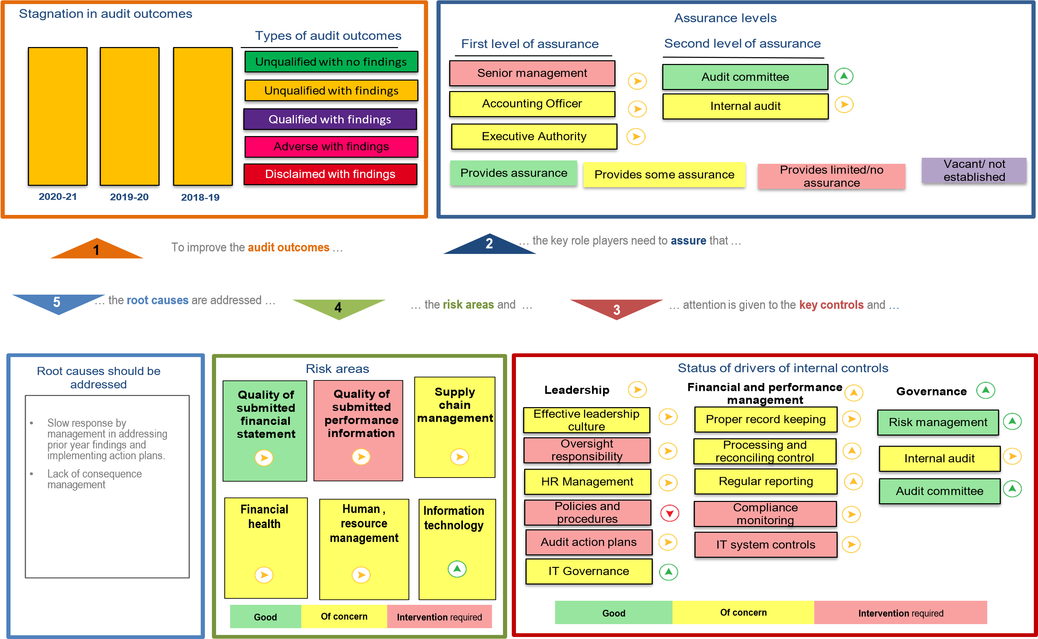
Audit outcomes and internal control environment

Slide 5
AG audit outcomes
Description | 2018-19 | 2019-20 | 2020-21
Audit findings raised | 46 | 60 | 73
New audit findings | 7 | 26 | 37
Management dissagreements | 8 | 10 | 9
Matters affecting the audit report | 17 | 6 | 9
No management responses | 0 | 0 | 0
Recurring audit findings | 39 | 33 | 25
Matter of emphasis
The department is the defendant in contract cancellation lawsuits amounting to R 189 159 000.00. The ultimate outcome of these matters cannot presently be determined and no provision for any liability that may result has been made in the financial statements.

Slide 6
Matters raised in the AGSA Report on status of records review
No. | Commitment | Responsible person | Date | Status
1. | Enforcement of consequence management on all identified cases of irregular, fruitless and wasteful expenditure incurred as well as cases of fraud identified. | Human resources Management, Labour relations | 30 August 2021 | Following a report issued by DPME and NT, further investigation began internally in April 2021 by Labour Relations office (LRO) and former ADG. Sixteen (16) audit letters were since drafted with some issued to the officials during the month of April 2021 before the investigation team was appointed by the former ADG. Of the sixteen (16), four (4) officials were not served with the letters due to their unavailability. After the investigating team was appointed it was then left upon them to proceed with the process. The investigating team appointed took an approach of dealing with each financial year starting from 2013/14. The process however was adjourned to allow for intervention by the new Director General to ensure that a comprehensive investigation is performed and finalised by 31 March 2022.
2. | Keep reliable and accurate assets register | S Ndlovu, CFO | 30 June 2021 | The Department undertook an assets verification exercise through the usage of an external service provider. Once the exercise is concluded, the cleansed assets register will be loaded on LOGIS to eliminate the manual system presently being used. This will assist the Department to ensure automation and improvement in controls related to assets management. The physical security of assets is being managed through the DMV Physical Security Services.

Slide 7
Matters raised in the AGSA Report on status of records review
No. | Commitment | Responsible person | Date | Status
3. | Ensure a reliable and secure IT System will provide confidence on the military veteran’s database and business continuity. | Ms Masekoameng GITO | 30 August 2021 | The Department is in the process of upgrading its ICT environment. This includes: Development of a secure military veterans database through SITA Procurement of both the firewall and antivirus are also underway, requests for SITA to facilitate procurement on behalf of DMV were finalised. Military Veterans database backups are performed daily The integrated databased management system (IDMS) is going live for registration on MV on the database by 1 October 2021.
4. | Formalization of key policies mainly in the service delivery environment with more priority to Education Support, Housing Assistance, Business Support and Skills Development and Burial Support | Mr Siyengo, CD Research & Policy | 30 June 2021 | The Heritage, memorialisation and honour policy was approved in February 2021 and the Burial policy in August 2021. The skills development policy was submitted to the Accounting Officer for approval. The Accounting Officer has not yet signed off on the policy. The updated housing, pension and education support are still being consulted based on the latest developments in the Presidential Task Team. A commitment has been made for these policies to be approved after the Act has been ammended.

Slide 8
Matters raised in the AGSA Report on status of records review
No. | Commitment | Responsible person | Date | Status
5. | Encourage a DMV compliance system which will proactively assist the Department in ensuring continuous adherence with legislation. | Mr Siyengo, CD Research & Policy | 30 June 2021 | The department does have a compliance management unit whose role is to, among others, develop a compliance universe for the department. The department does not have a Compliance Management System but depends on manual documentation. A letter requesting assistance on the Compliance system was sent SITA in 2016. SITA said they are currently working on the request and present the findings to all the interested parties in due course. The compliance policy was approved November 2020. The compliance register was developed and presented to MANCO in November 2020. There will be a challenge in monitoring in this area as the compliance officer retired at the end of March 2021, however the position was advertised in April 2021.
6. | Provide reliable and validated reports including Portfolio of Evidence. | Mr Siyengo, CD Research & Policy | 30 June 2021 | The department will ensure that, Portfolio of Evidence is validated prior to submission to Internal audit and the Auditor General. Alignment of submitted POE with evidence required per Technical Indicator Description (TID) will be monitored. The departmental reporting guidelines have been developed which highlight the process that needs to be taken for the submission and quality assurance of the submitted PoE. The planning unit provides quality assurance for the reports submitted to the planning unit and provides feedback to the branches for rectification before Internal Audit provides the overall quality assurance.

Slide 9
Conclusion
Branches were directed to update the audit action plans in response to the audit outcomes.
The Director General issued letters to the Branch / unit Heads to ensure that officials responsible for AGSA findings are held accountable and that branches / units must ensure that all findings are addressed by 31 December 2021.
Thank you

