Slide 1
Support to Municipalities: Special Focus on 2019/20 Audit outcomes 31 August 2021

Slide 2
2019/20 Audit Outcomes: A Reflection

Slide 3
Audit Outcomes: 2015 - 2020
AUDIT RESULTS: 2015 - 2020
Key:- | New audit | Adverse | Disclaimer | Qualified | Unqualified with findings | Unqualified with no findings
MUNICIPALITY | 2015 | 2016 | 2017 | 2018 | 2019 | 2020
Beaufort West
Berg River
Bitou
Breede Valley
Cape Agulhas
Cape Winelands DM
Cederberg
Central Karoo DM
City of Cape Town
Drakenstein
Garden Route
George
Hessequa
Kannaland
Knysna
Laingsburg
Langeberg
Matzikama
Mossel Bay
Oudtshoorn
Overberg DM*
Overstrand
Prince Albert
Saldanha Bay
Stellenbosch
Swartland
Swellendam
Theewaterskloof
West Coast DM
Witzenberg

Slide 4
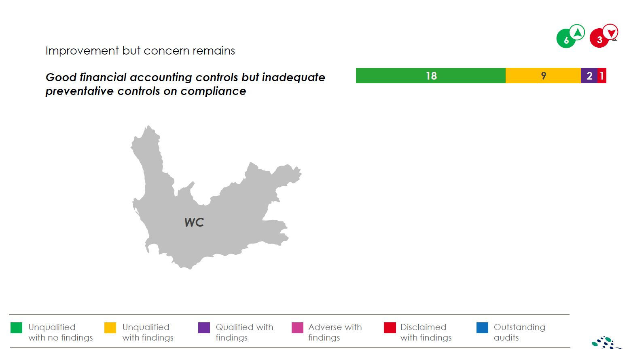
Provincial Message from the AG (2019/20)

Slide 5
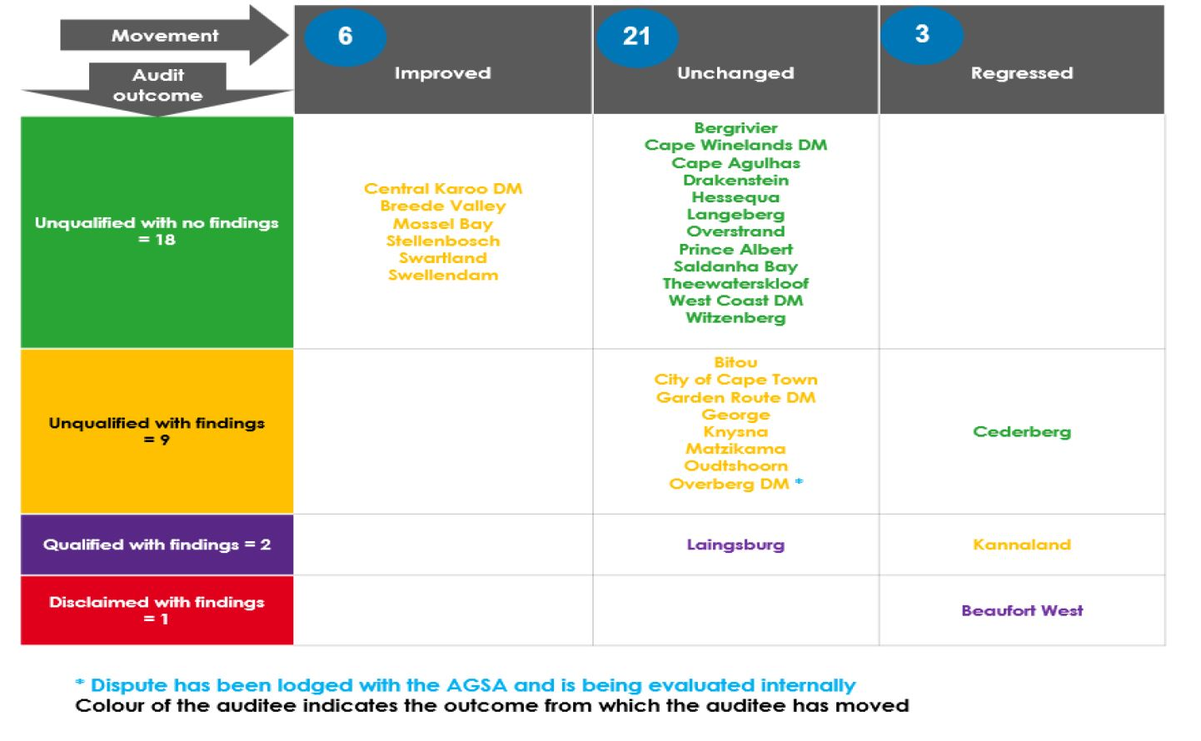
Audit Outcomes: 2018/19 vs 2019/20 (AG)

Slide 6
Audit Outcomes – Marked Improvement
Audit outcomes 2019/20
Improved municipal audit outcomes for 2019/20 financial year.
18 out of 30 municipalities in the Province with clean audit opinions for the 2019/20 financial year.
A further 9 municipalities received unqualified opinions with findings.
This translates into 90% of the 30 municipalities in the Western Cape that have received either clean or unqualified opinions with findings.
Beaufort West is the only municipality in the Western Cape that received a disclaimer, while Kannaland and Laingsburg received qualified opinions.
AUDIT OUTCOMES FOR PAST 3 YEARS
OUTCOME | 2018 | 2019 | 2020
Unqualified with no findings | 12 | 13 | 18
Unqualified with findings | 14 | 15 | 9
Qualified | 4 | 2 | 2
Disclaimer | 0 | 0 | 1
Adverse | 0 | 0 | 0
 | 30 | 30 | 30

Slide 7
Improvement in Audit Outcomes (AG)

Slide 8
AG Findings: Unpacked

Slide 9
Financial Statements
Non-current Assets: None
Current Assets: None
Liabilities: None
Capital & Reserves: None
Other Disclosure Items: None
Revenue: None
Expenditure: None
Unauthorised, Irregular& Fruitless& Wasteful Expenditure: None
Aggregate misstatements: None

Slide 10
Predetermined Objectives
Reported information not useful: 1
Reported information not reliable: 1
Information not submitted in time for audit: None
Annual performance report: None
Underlying records/planning documents not submitted for audit: None

Slide 11
Non-Compliance
Material misstatement or limitations in submitted AFS: 1
Unauthorised, irregular, as well as fruitless and wasteful expenditure: 4
Annual financial statements and annual report: None
Asset management: None
Liability management: None
Budgets: None
Expenditure Management: 1
Financial Misconduct: 1
Audit Committees: None
Internal Audit: None
Revenue Management: None
Strategic planning and performance management: 2
Transfer and conditional grants: 1
Procurement management: 5
Other: None

Slide 12
Specific Risks
Quality of submitted performance reports: 6
Supply chain management: 17
Financial Health: 6
Human resource management: None
Information Technology: 2

Slide 13
Persistent Risks, as highlighted by the AG
SCM regulation 32
Deviations
Bid Adjudication Committee (BAC) composition and reference to Government Gazette No. 43281
Material irregularities
Verification of indigents
Debt-collection

Slide 14
In response… (MFMA Section 131) Measures to address matters raised by the AG

Slide 15
Legislative Framework
In terms of Section 131(1) and 131(2)(a)(b) of the MFMA, a municipality must address any issues raised by the Auditor-General in an audit report.
The Mayor of a Municipality must ensure compliance by the municipality with this subsection.
The MEC for Local Government in the Province must—
assess all annual financial statements of municipalities in the Province, the audit reports on such statements and any responses of municipalities to such audit reports, and determine whether municipalities have adequately addressed any issues raised by the Auditor-General in audit reports; and
report to the Provincial Legislature any omission by a municipality to adequately address those issues within 60 days. (a combined submission made between the DLG and PT)

Slide 16
The Response… Municipal Audit Action Plans
Following the issuing of the final audit report by the AG, every municipality prepares a Audit Action Plan.
This plan is adopted by the Audit Committee and progress reports submitted accordingly
Copies provided to DLG and PT
Each Plan is tailor made to address the findings of the AG in a given year. The plan is detailed as follows;
The exact finding is highlighted, root cause for each finding is unpacked and any recommendations by the AG is detailed, where applicable.
A responsible official is assigned to address the finding
Controls are identified to be put in place by management
A target date is assigned
0

Slide 17
Municipal Audit Action Plans (2)
DLG and PT identifies specific matters highlighted in these plans where hands-on or other support can be rendered.
Provincial Support packages tailored accordingly
Province uses an automated system to track the progress made by the municipalities to address these issues.
Slow progress made by municipalities to address these matters are monitored by Province and addressed directly with slow performing municipalities.
Quarterly reports submitted to the Provincial Executive to reflect progress per municipality.

Slide 18
Factors contributing towards achieving Positive Audit Outcomes

Slide 19
Contributing factors: A positive Audit Outcome
Instilling a culture of good governance through ethical, efficient and effective leadership that enables service delivery
Municipal Political Leadership:
Politically stable councils that fulfil their oversight responsibility effectively and provide the necessary assurance.
Ethical Leadership that is democratic, accountable and encourages citizen engagement and participation to encourage good governance and facilitate efficient service delivery
Internalise and live servant leadership principles
Focus on a citizen centric approach and responsive solutions to challenges faced by the community

Slide 20
Contributing success factors (2)
The establishment of a culture of good governance - continue
Administrative Leadership:
Administration led by experienced and competent executive management and staff that ensures effective service delivery while maintaining statutory compliance
putting measures in place to institutionalise good administrative and cooperative governance practices
Uphold the integrity and credibility of the municipality by ensuring that public funds can be accounted for:
putting measures in place to ensure good financial management & quality reporting
strong internal control measures
efficient systems of delegations, compliance and oversight
Focus on putting the community first and ensure universal access to quality services

Slide 21
Leadership should lead the change

Slide 22
Our Contribution towards achieving positive Audit Outcomes (Support Actions: DLG)

Slide 23
Provincial Approach towards Municipal support
Provincial support efforts are aimed at strengthening Council oversight, governance and service delivery in municipalities.
In achieving this, strong focus is put on the objects of Local Government, as defined in the Constitution, Section 152.
Section 154 is used to:
Strengthen the capacity of municipalities to mange their own affairs through the introduction of “Transversal Support Initiatives”
Build comprehensive and holistic, bespoke support packages where this may be required (Back-to-Basics Province)
Based on a set or pre-determined criteria, provide financial support to municipalities based on predetermined criteria

Slide 24
Transversal Support Initiatives
Functional Area | Provincial Support Rendered
Strengthening Political Leadership in Municipalities (Oversight) | Dedicated training and personal capacity development sessions for Councilors Ethical training & sessions on roles and responsibilities. Ongoing support, guidance and monitoring of functionality of oversight structures (MPAC) Guidance and clarity provided on legal documents, regulations and other statutory documents i.e. circulars, good governance practice notes Improvement of collaboration through vertical and horizontal integration to the advantage of the citizen (JDMA) – DCF (political leadership playing a stronger political oversight role) Implementation of the LG anti corruption strategy and Integrity Management Training

Slide 25
Transversal Support Initiatives (2)
Functional Areas | Provincial Support Rendered
Administrative Leadership | Monitoring of critical vacant senior management posts and providing legal guidance on the appointment of competent, qualified and skilled senior managers through the: Distribution of good governance practice notes & advises The enforcement of statutory prerequisites Hosting of intergovernmental support forums i.e. sharing of best practices, guidance and assistance with legal interpretations (MPRA Focus Group, Infrastructure Forum) Development of targeted support initiatives based on diagnostic assessments Section 154 support packages, and Transversal support programmes (Shared Services, Standard Organizational Structures) On going research (Basket of Services, Municipal Financial Sustainability) Training and mentorship programmes for officials Development of Municipal ICT action plans – specific focus on response plan in the Municipal ICT Forum( support actions to reduce risk of cyber attacks)

Slide 26
Transversal Support Initiatives (3)
Functional Area | Provincial Support Rendered
Basic Service Delivery | Conduct infrastructure and service delivery assessments to determine the root cause and make recommendations in response to specific challenges.(Wupperthal Bridge) Provision of direct engineering support and technical advisory services i.e. Hands-on and dedicated support by deployed engineers and geohydrologists Introduce new planning and funding models for bulk infrastructure (SIDAFF programme – to take new catalytic projects from feasibility to bankability) Development of an integrated Drought and water Response Plan 15-year Water Resilience Strategy Establishment of dedicated technical platforms to engage on infrastructure planning, expenditure and service delivery enhancement.

Slide 27
Municipal Specific Support Plan (Operational Plans)
Aim: Develop a comprehensive and holistic, bespoke support package per municipality - where this may be required (Back-to-Basics)
First Step: Diagnostic Assessment
Principles:
Premised on the 5 pillars of the Back-to Basics programme
Applicable National and Provincial departments secured to provide support where required
Co-ownership with the Municipal Leadership a prerequisite – Plan must be adopted and supported by Council.
Progress to date:
10 municipalities started, to date: 4 exited the programme
Due to the successes achieved through the model, municipalities request to be included in the programmes

Slide 28
Audit outcomes: Corrective Actions/Support
Audit outcomes 2019/20
Beaufort West is the only municipality in the Western Cape that received a disclaimer, while Kannaland and Laingsburg received qualified opinions.
Municipality | Status/Support
Beaufort West Municipality | Section 139 (5) adopted by Cabinet NT requested to commence with the development of the FRP – DLG to refine Section 154 support package
Kannaland Municipality | Section 139 (5) under way New FRP approved by NT – with Section 154 support package Ongoing litigation
Laingsburg Municipality | Continued support in terms of the Back-to-Basics programmes Diagnostic assessment conducted with the aim to review current support package

Slide 29
Interventions

Slide 30
Kannaland Municipality:
Municipality | Status/Support
Kannaland Municipality | Status of Intervention: The Executive resolved to put Kannaland LM under a Section 139 (5), mandatory Intervention with a financial recovery plan. A dedicated official was identified and deployed to act as Administrator (FRP) to implement of the FRP New FRP developed and approved by NT – with Section 154 support package. General Functionality/Stability Ongoing instability experienced in the Council Number of irregular and unlawful decisions taken As a result, the Executive instituted urgent court proceedings against the Municipality – ongoing litigation Impact Dysfunctional Administration Resignations/negative morale Service delivery directly impacted

Slide 31
Enhancing Municipal Monitoring

Slide 32
Municipal Performance Monitoring
Holistic view of the functioning and status of a municipality to inform its support and capacity building requirements – Hybrid Model:
Evidence-based information – statutory compliance (Diagnostic assessments)
Local insights – information from other reputable sources
Oversight, Governance
and
Service Delivery
Municipal Categorisation
Political Oversight
Administrative Stability
Service Delivery and Infrastructure
Public Participation
Investigations
Local Insights
Good
Rating Criteria
Satisfactory
Statutory Compliance
Poor
Statutory Compliance
Local Insights
In line with COGTA and NT categorization

Slide 33
Municipal M&E and Support Cycle
Support
Improved lived experience
Targeted /Transversal support packages based on diagnostic assessment & outcomes and /or M&E processes
M&E
Outcome
Knowledge Management:
Municipal Oversight, Governance and Service Delivery Status
Progression
1
Good
2
Satisfactory
3
Poor
Regression
Intervention

Slide 34
JDMA: Status of Implementation

Slide 35
JDMA Rationale
The JDMA is the mechanism that drives and facilitates collaboration in a specific geographical space. In practice, this means that the JDMA is the vehicle that reinforces horizontal alignment between Western Cape Government Departments and vertical alignment between the 3 spheres of Government.
For the first time, this will ensure that the needs and priorities of the citizens are reflected in National, Provincial and Private Sector planning, budgeting and implementation.
Jobs
Safety
Wellbeing

Slide 36
JDMA: Institutionalization in the 5 Districts
District Interface Teams
Established from July 2019 in all districts, convene monthly to quarterly
13 WCG depts, district and local municipalities; national depts within a footprint in the Province
HOD and Provincial Minister per district
Strategic and planning priorities – also unblock service delivery issues
DCF and DCF Technical Committees
DCF: Oversight and strategic guidance
DCF Tech: Monitor progress made on the Implementation Plans
Implementation Plans
Initial JDMA Implementation Plans adopted by DCFs: Nov 2019 to Feb 2020.
Informed by municipal priorities per district - catalytic projects identified using DCFs: infrastructure projects and “social” projects
DCoG accepted Implementation Plans as One Plans – 29 June 2021 letter
Revised Implementation Plans submitted to DCoG on 28 July 2021

Slide 37
JDMA: Institutionalization in the Metro
WCG and CoCT agreed on “Committee System” as a version of the JDMA:
Strategic Planning: engage and share information on strategic plans and policies to ensure alignment between the two spheres of government
Infrastructure Planning: engage, share information and assumptions on infrastructure plans and pipelines. To identify overlaps or gaps and address provincial infrastructure plans and pipeline within the metro
Service Delivery: engage, share information on the delivery of services and co-ordinate services: municipal, provincial and concurrent functional areas of competence
Governance & Reporting: engage and share information on governance matters affecting local government

Slide 38
JDMA Implementation: Key Highlights
New way of working and doing business:
Improved relationships, coordination and collaboration: across functional areas and beyond mandates
Approach for WCG, National Departments and key stakeholders to communicate and collaborate in a geographical space
Institutionalise and introduce models/measures to manage and facilitate future co-planning, budgeting and implementation
Effective Collaboration resulting in …
Water Security programmes (DRAP)
JDMA structures effectively utilised to support the Provincial Response to the COVID-19 Pandemic and related economic recovery initiatives (close working relationships with the JOC established)
JDMA structures and networks utilised part of the COVID-19 Humanitarian Relief efforts.
In excess of 80 tons of citrus fruit distributed in the Overberg, West Coast and Cape Winelands Districts.
3 Departments and a High school involved in a “land swop” arrangement to secure land for new primary school
As a result of successes achieved:
Secured the support of new stakeholders and resources in support of the JDMA initiatives
Model utilised to resolve cross cutting challenges in Districts (land invasions and stray animals)

Slide 39
The End

