Slide 1

National Implementation Plan to Address DLTCs, VTSs and RAs Challenges
31 August 2021
Notes:
1

Slide 2
Purpose
Backlog Status
DLTC Plan of Action Focus Areas
Status Update on the proposed interventions

Slide 3
Backlog as at the end of July 2021 (March to December 2020 Driving Licences)

Slide 4
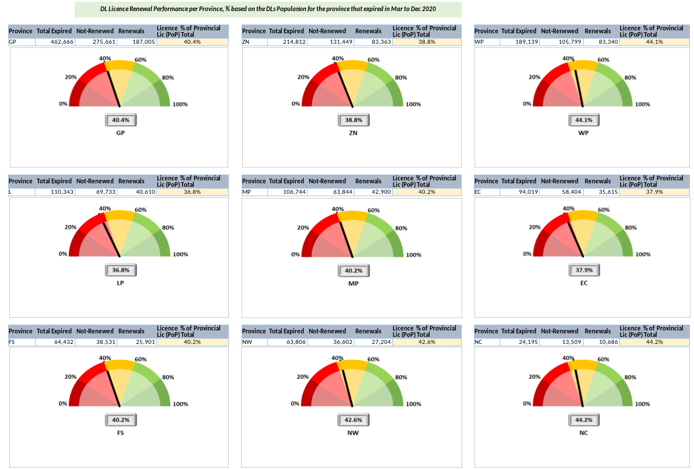
Status for all provinces as at 31 July 2021

Slide 5
Purpose
Backlog Status
DLTC Plan of Action Focus Areas
Status Update on the proposed interventions

Slide 6
The key focus areas that were identified to improve service delivery focused on
Updating of the
Oracle Database
to improve the
processing
speed
Upgrading of the
Network lines to
improve the
Performance of
the NaTIS system
Security
Improvement of
Face value
documents.
Backlog
reduction
and
Improvement in
service delivery
Digitalisation of
Mobile Centres
Sandton,
Diepsloot
Establishment of
DLTCs managed
by RTMC
(Waterfall,
Eco Park &
Koedoespoort)
Introduce
electronic online
Eye Testing
interface with
HPCSA.
Improvements
to the online
booking system
Expansion of
the
online booking
services to other
Provinces
Operationalisation
of online services

Slide 7
Purpose
Backlog Status
DLTC Plan of Action Focus Areas
Status Update on the proposed interventions

Slide 8
Timelines for various solutions and progress
Digitalisation Diepsloot Mobile Centre
Digitalisation of Sandton Mobile Centre
Establishment of DLTC managed by RTMC (Waterfall, Eco Park & Koedoespoort)
Improvements & expansion of the online booking system/Payment Gateway
Complete
In progress OnTrack
In progress At Risk
At Risk
Upgrading of network lines for better performance of LEUs and NaTIS.
Introduce electronic online Eye Testing interface with HPCSA
Computerisation of Learner Licence Testing Centres (CLLT)
Digitalisation of roadworthiness testing sheet
June 2021
July 2021
Aug 2021
Sep 2021
Notes:
8

Slide 9
Phase 1: Short Term interventions and Timelines
NO | INTERVENTIONS |  | ACTIVITIES | RESPONSIBLE | DUE DATE | STATUS
1 | Decreasing backlog | Extension of Operating hours | Communication of new operation hours | All Provinces | Ongoing | GP - Provincial Registering Authorities instructed to work extended hours and over weekends. COJ – working Saturdays Ekurhuleni/Mogale City – working 3 Saturdays a month Tshwane – July 2021, reduced working hours FS – Med and high-capacity testing stations to work on Sat from 1 July EC – Certain DLTCs to operate on Sat NC – No extended hours WC - A few municipalities who were by means to work longer hours complied with the request, although admittedly some even requested the opportunity out of own accord. This matter is attached to the review of the miscellaneous fees as per the feedback letter of 29 May 2021. LP – All centres are operating over weekends MP – Op hours not extended since operating above the National norm of 90% KZN – July-Aug 2021 RAs and DLTCs operating over Weekends
 |  | Digitalisation of Mobile Centres | Diepsloot | City of Johannesburg | 31 July 2021 | RTMC Deployed bus with equipment in May 2021 Date not met, processes yet to be finalised

Slide 10
Phase 1: Short Term interventions and Timelines cont’d..
NO | INTERVENTIONS |  | ACTIVITIES | RESPONSIBLE | DUE DATE | STATUS
 |  |  | Sandton Mobile DLTC | City of Johannesburg | 31 July 2021 | RTMC Deployed bus with equipment in May 2021 Date not met, processes yet to be finalised
 |  | Address human Resources needs. | Identification of resource needs | All Provinces | 1 July 2021 | EC – Provincial examiners are ready (awaiting HR requests from DLTCs GP - All DLTC’s instructed to avail and dedicate 70% of their resources to only service Driving License renewal applications NC – Challenges with labour relations WC - Likewise the review of human resources are also attached to the review of the miscellaneous fees MP – Recruitment process to fill 37 vacant posts to be concluded by 31 Aug 2021

Slide 11
Phase 1: Short Term interventions and Timelines
NO | INTERVENTIONS |  | ACTIVITIES | RESPONSIBLE | DUE DATE | STATUS
2 | Introduction of online eye-test results | Introduce electronic online Eye Testing interface with Health Professional Council of South African (HPCSA) and deploy at all Provinces. | Signing of contracts between RTMC and HPCSA. | RTMC and HPCSA | 31 August 2021 | MOU submitted to HPCSA
 |  |  | Integrations with the identified providers. | RTMC | 1 July – September 2021 | Roll out discussions with HPCSA in progress
 |  |  | Launch | RTMC | 30 September 2021

Slide 12
Phase 1: Short Term interventions and Timelines
NO | INTERVENTIONS | ACTIVITIES | RESPONSIBLE | DUE DATE | STATUS
3 | Computerisation of Learner Licence Testing Centres (CLLT) | CLLT roll out | RTMC | 31 August 2021 | Site visits completed in EC and LP. Site visits for GP is at 56% Discussions are ongoing with KZN who will advise on sites. Deployments will commence in July 2021.
 |  |  | RTMC | 30 September 2021 | FS site visits have been completed. In Bloemfontein, the old CLLT was replaced and old equipment parts are used as spares for other provinces (until the full roll out plan has been completed). 8 completed to date. Deployments started in August 2021. Site visits for MP is completed.

Slide 13
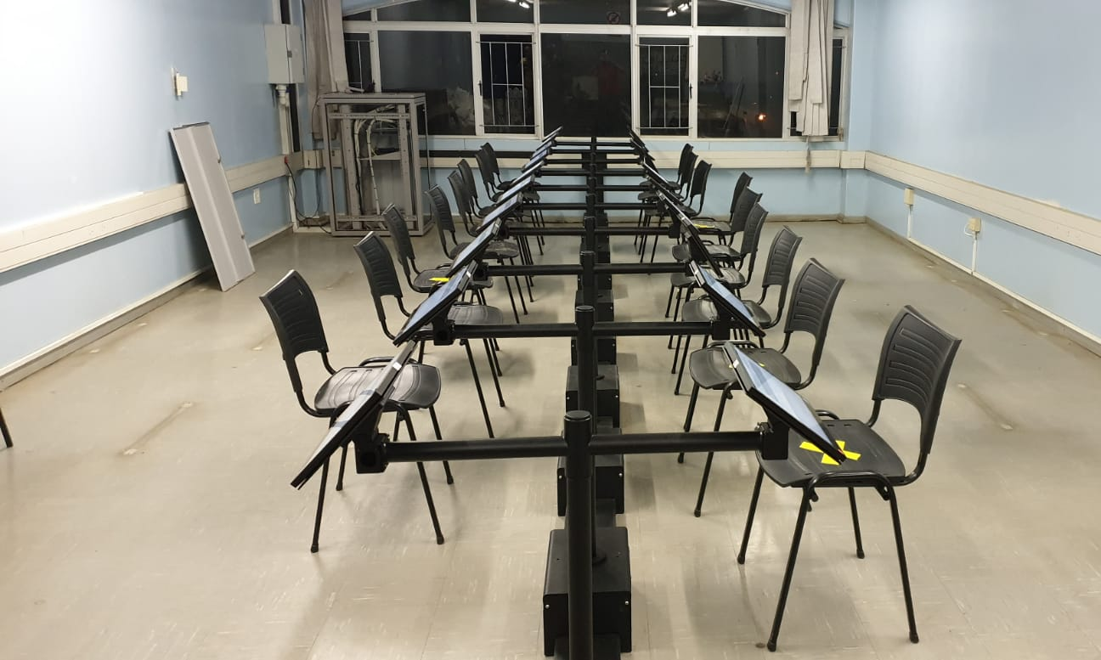
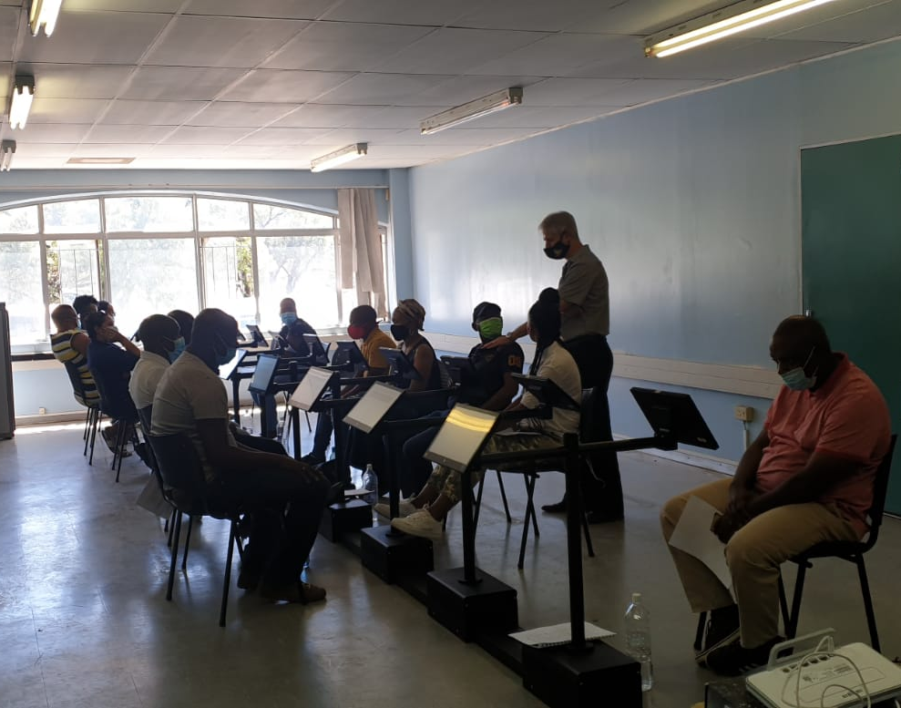
The new CLLTs are aimed at ensuring learner driver testing is modernised and reduce/remove the element of corruption in the system

Slide 14
RTMC Sites for the establishment at the following sites and update to date
Eco Park
  All equipment has been deployed
  Staff appointed and trained
  The centre was inspected on the 19 August awaiting Gauteng internal processes
WaterFall
  All equipment has been deployed
  Staff appointed and trained
  The centre was inspected on the 19 August awaiting Gauteng internal processes
Koedoespoort
  The building has structural problems that need to be addressed prior equipment deployment
The centres were due to be operational by the 1 August 2021, however this deadline has been deferred to 01 October 2021

Slide 15
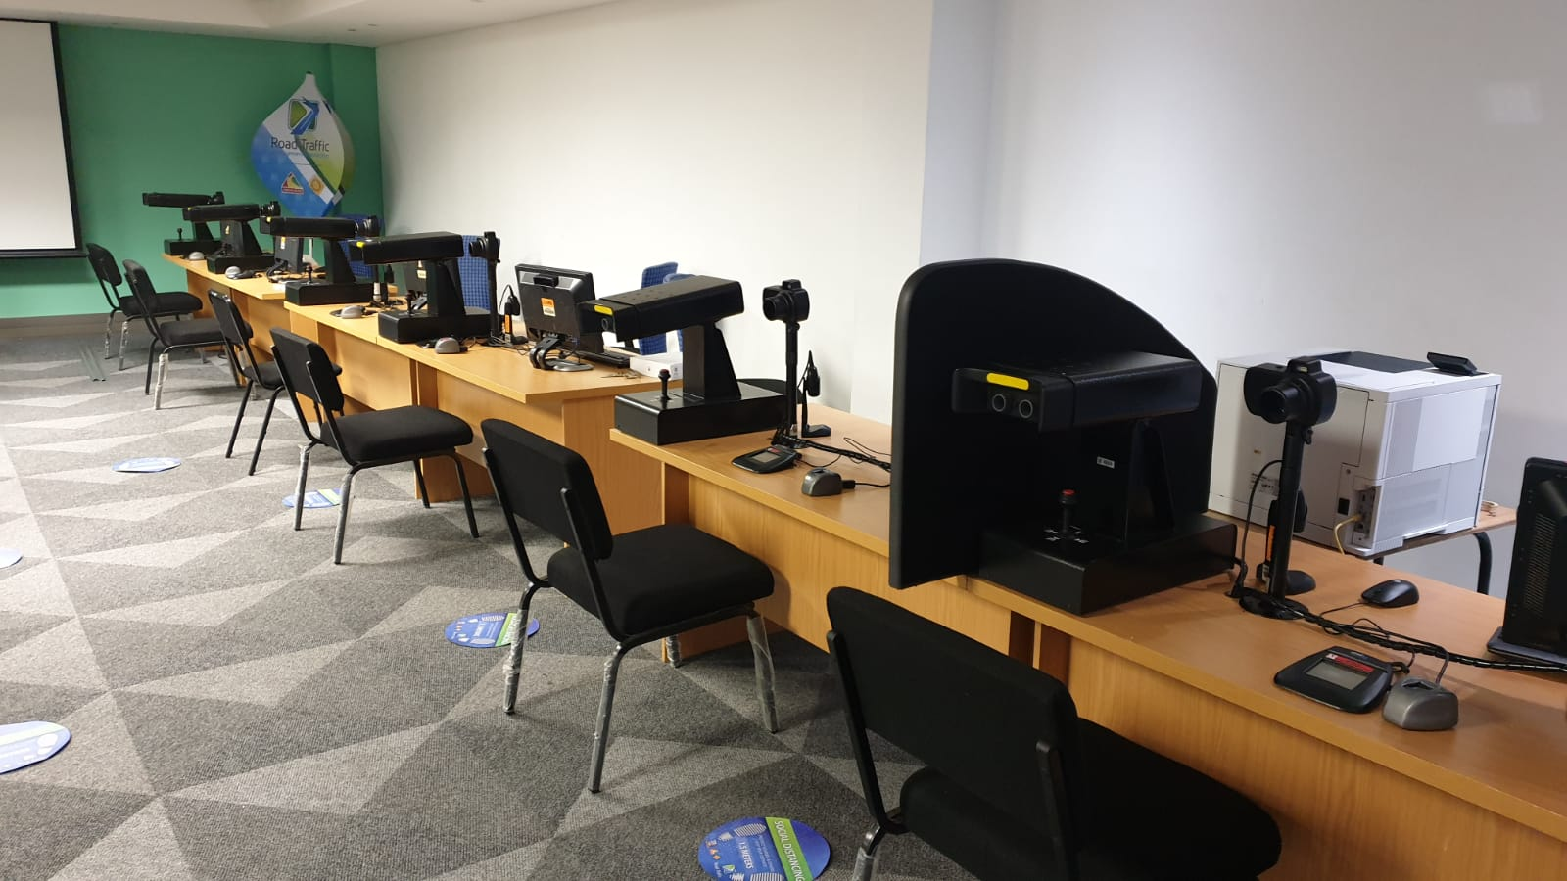
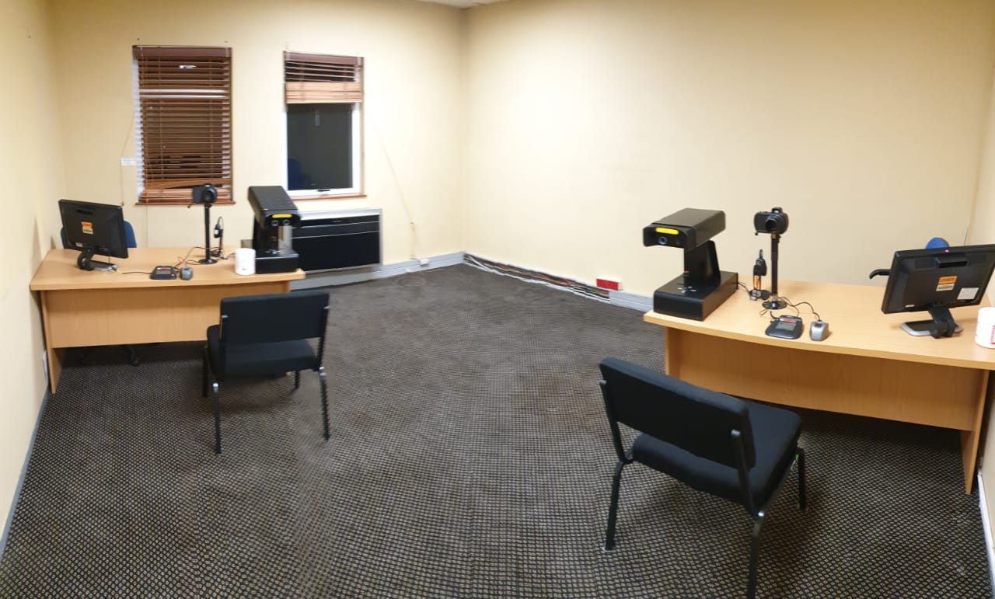

Slide 16
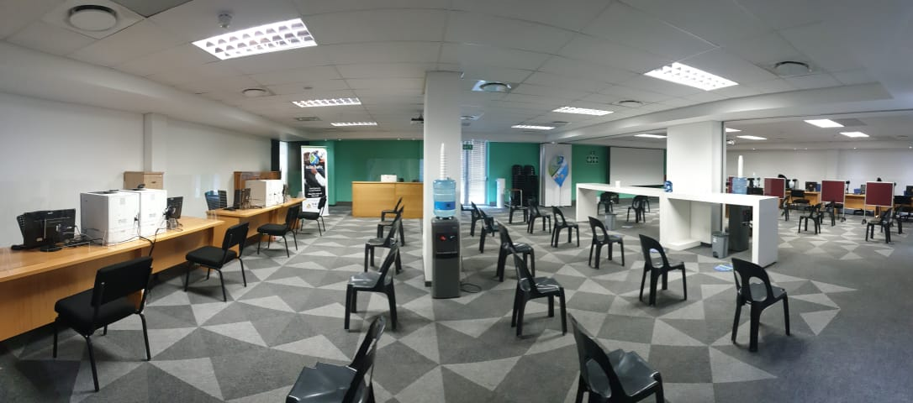

Slide 17
Operating model of the centres
The centre and will operate 7 days a week
The operating times will be from 7AM to 9PM. It will be a two-shift model. The centre will close at 9PM
The required human resources have been appointed and underwent NaTIS and Customer Care training
The total number of registered Examiners for Driving Licences is 37

Slide 18
Enhanced Capacity in Terms of Slots
16 hours per day (1 260)
7 days a week (8 820)
Per month the 2 DLTCs can add 35 380 renewal slots.
Since January to July, Gauteng averaged 73 000 renewal bookings per month.
RTMC will increase capacity by 48% for renewal slots only.

Slide 19
Interventions implemented to date
Upgrade of NaTIS network
Upgrade of the connectivity for seven Gauteng DLTCs (from copper to fibre/microwave)
Commenced with the deployment of the CLLT in the Free State, Eastern Cape and Gauteng
Equipment installation of the mobile buses
Extension of the operating hours at certain DLTCs
Tembisa DLTC operational from 25 July 2021

Slide 20
Progress made in the last two weeks
The Minister to extend the grace period – Completed
DOT will publish the amendments to the RTMCA by the end of August 2021 - Completed
DOT will approve the Sec 54 (Infrastructure upgrade) – Approved
  Infrastructure upgrade – 6 weeks from Sec. 54 approval

Slide 21
Progress made in the last two weeks (cont’d)
Gauteng appointed the RTMC to operationalise the EcoPark and Waterfall DLTCs – MEC signed the Gazette on Friday, 27 August 2021
RTMC will deploy the smart enrolment solution by end of September – On track
Smart enrolment system integrated with Department of Home Affairs to be tested
  Manual integration testing complete with DLCA on 03 August 2021
Online services to be launched 60 days from publication of amendment

Slide 22
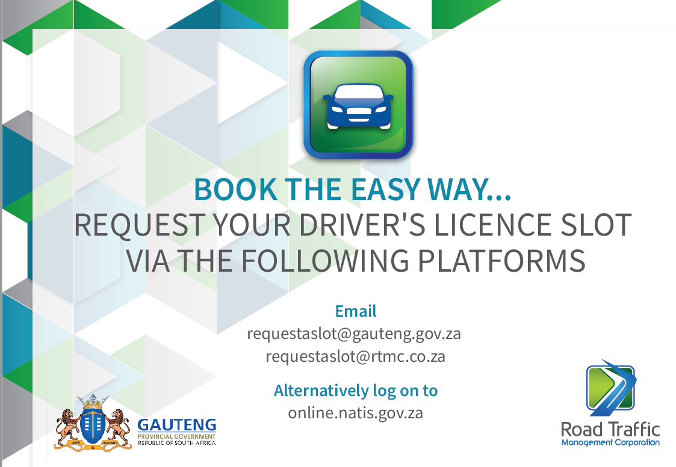
Introduction of a new APP for Gauteng and dedicated email addresses

Slide 23
Impact of Approvals
Catch up on the driving licence renewal backlog by 31 March 2022
Immediate 48% increase in capacity in Gauteng for renewals
Immediate convenient services for the public (online transactions)
Improved system performance and reliability of equipment
Improved stakeholder relations and public perception

Slide 24
Marketing Interventions

Slide 25
Intensified communication to inform the public
Social Media Platforms
Radio
TV
Webinars
Interviews with the media

Slide 26
Target Audience
Driving license holders
Local and national media
Learner licence, driving licence and vehicle licence applicants
Driving school operators
Vehicle dealerships and banks
Short term insurance companies

Slide 27
Communication Platforms
Media launches for new services
PR events to showcase improved services
Social media messages to sustain messages
Current affairs media interviews
Opinion pieces

Slide 28





Focused Marketing Interventions per Group – 1 of 3
Social Media
  Minister Mbalula to be the face of service improvement delivery
  MECs to support the Minister
Radio & Print
  To consider the SABC & commercial stations (YFM, Metro FM)
Under 25 years old
Techno savvy
Impatient
Receives info via social media
Provides ratings on social media and Google Maps
25 – 35 years
Techno savvy
Current Affairs follower
Receives info via social media
Provides ratings on social media & Google Maps
36 – 44 years
Techno savvy
Current Affairs follower
Receives info via social media
Likely to use 3rd party service providers

Slide 29




Focused Marketing Interventions per Group – 2 of 3
Ministerial DLTC visits with media
  Minister Mbalula to be the face of service improvement delivery
  MECs to support the Minister
Radio & Print
  To consider the SABC & commercial stations
Digital Marketing
  Use of the RTMC and DOT websites
45 – 59 years
Still prefers human interaction
Current Affairs follower
Information can be sourced from younger generation
Likely to use 3rd party service providers (e.g. weq4u)

Slide 30




Focused Marketing Interventions per Group – 3 of 3
Ministerial DLTC visits with media
  Minister Mbalula to be the face of service improvement delivery
  MECs to support the Minister
Radio & Print
  To consider the SABC & commercial stations
Digital Marketing
  Use of the RTMC and DOT websites
70 years
60 – 69 years
Still prefers human interaction
Current Affairs follower
Ample time to attend to personal affairs
70 years or older
Still prefers human interaction
Current Affairs follower
Ample time to attend to personal affairs

Slide 31
Medium Term Deliverables - Media Launches
Product/Service | Venue | Authority
Showcase new Natis equipment at DLTCS | Gauteng/RTMC | Gauteng Transport/RTMC
Anti-Corruption Arrests | RTMC | RTMC
Digitalization of Mobile Centres – Speed Point Services for Driving Licence Card Renewal | KZN | KZN Transport / RTMC
Implement Driving Licence Card registered mail collection from the applicant appointed nearest post office for a nominal additional fee. | KZN
 |  | KZN Transport / DLCA
Computerisation of Learners licence testing centres (CLLT) | Limpopo | Limpopo Transport/ RTMC

Slide 32
Start by doing what's necessary; then do what's possible; and suddenly you are doing the impossible.
Francis of Assisi

