Slide 1
Economic Procurement Strategy Feedback to PAC
27 Agust 2021

Slide 2
OVERVIEW
ECONOMIC PROCUREMENT STRATEGY

Slide 3
Purpose of the Economic Procurement Strategy
To provide a unified transversal approach that is focused on maximising the economic impact of public procurement in the Western Cape, with a special focus on the development of SMMEs, businesses located in townships, rural areas and secondary towns.

Slide 4

STRATEGY FOCUS AREAS
1. Create greater awareness and understanding of the WCG’s overall procurement spend
2. Review, continually reform, & streamline procurement processes & administration
8. A strengthened capacity to scale-up focused supplier and enterprise development programmes to improve supplier performance
3. A comprehensive biennial survey of suppliers and prospective suppliers
7. An expanded economic focus to strategic sourcing
4. Establish & maintain a Community Vendor Database to enable EMEs to compete for specific contracts within their communities
The establishment of a public-facing procurement portal that builds on existing IT infrastructure.
5. Strengthening data, its use and analytical capability within the relevant supplier database and across all WCG departments

Slide 5
INTEGRATED APPROACH
FA1: Spend on SMMEs (EMEs & QSEs0 and B-BBEE; Geo mapping of businesses; sustainable green economy; access to info
FA2: Least distortion vs Most Impactful; Procurement process focus, red tape reduction, better governance; surveys
FA3: Expand survey to firms contracting with gov, feedback to CFOs; PTM; VIP Steercom and Cabinet;
FA8: Enterprise development; supplier selection, entry and exit processes; WSG ESD focus; support and better access
FA4: Opportunities for EMEs; Unbundling of large contracts; Vendor database; Threshold values
FA5: Data Analysis and M&E; Use of Business Intelligence; Expand capacity of supplier database; Turnover; B-BBEE status and geo location
FA6: Access to markets by SMMEs beyond gov; availing supplier database to private sector; SMME capacity Development
FA7: selection of sectors; industries and commodities; SMME Growth; dedicated capacity; Economic Impact Assessment

Slide 6
1. WCG SCM STRATEGY RESPONSE

Slide 7
WCG SCM Strategy Linkages to the 8 Strategy areas
CAPACITATION & DEVELOPMENT: Organisational Structure, Capacity & Skill
Dedicated structure; Intuitional memory for policies, best
practices; Training (and development Business Process
optimisation; Client Support (Helpdesk) Supplier Development
1; 2; 4; 5; 6; 7; 8 (EPP action linkages)
SCM TECHNOLOGY: REPORTING & DATA INTEGRITY
Reporting; Enterprise Content and Information Management;
Integrated financial and Non- Financial System; Reliable data that
supports operational planning and strategic decisions and
Surveillance
4; 5; 6 (EPP action linkage)s
STRATEGIC PROCUREMENT
Procurement Planning and informed; Commodity Strategies;
Effective Utilisation of Resources; Value for Money; Economies of
Scale (transversal contracts; Market intelligence and technical
expertise; Service Delivery Future Improvements
1; 7; 8 (EPP action linkages)
GOVERNANCE : Strategy & CONTROL
Standardised Strategy & Procedure; Functional Ops. Transactional
credibility; compliance; Risk Sensitive; Responsibility &
Accountability Management; Contract Management; Positive
Audit Outcomes
1; 2; 7; 8 (EPP action linkages)

Slide 8
Imbedded Good Governance
Issuance of Provincial Treasury Instructions; 2019
Issuance of Revised Blueprint Accounting Officers’ System (Sept 2021)
Procurement Planning Toolkit
Institutional Memory (Knowledge Management)
Monitoring and Evaluation(Surveillance) – PDR and SCM assessments
Performance Information – SCM Insight Reports

Slide 9
Technology Enablement- (Conformance to Performance)- Levers for Change
ODS
(Data Store)
1. Procurement Planning Toolkit
2. eProcurement System and WC Supplier Evidence Bank + NT CSD
3. Financial Systems Data (BAS; LOGIS; Vulindlela and other
PLANNING
RESULTS
SCM Insight Reporting and PDR
OPERATIONS
FINANCIAL INTEGRATION
ONE SOURCE OF TRUTH
(The Value of using Business Intelligence capabilities)

Slide 10
SUPPORT AND DEVELOPMENT- ICT Levers- Catalysts for Change
CUSTOMER RELATIONSHIP MANAGEMENT
(Helpdesk; Booking Tools; Knowledge Management & Institutional Memory)
PT Web-enablement
(Brand; Information, FAQS; what we do and how we do it)
e-Learning
(webinars; videos; Moodle platform)

Slide 11
SCM Client Support- 2020/21
SERVICE DESK
Query handling; Advice & Guidance
LEARNING
Training; Videos; Podcasts, Webinars; Open days; Web enablement
TECHNOLOGY SERVICES
e- Procurement; WCSEB; CSD
COMPLAINTS HANDLING
Mediation; Redress
SERVICE MANAGEMENT
Transparency (PDR); Booking tool; Perception surveys
15 869 queries
11575 WCSEB support
1 754 CSD
2 169 ePS
371 SCM –depts only
26 web-based interventions for depts (AOS , proc planning
CPAC- 17 emergency procurement advised on
53 SCM insight Reports
Monthly PDR, Quarterly and Annual
SCM forums
FAQs
2x Programmes of support
34 372 events advertised vis ePS (IPS)
Procurement Planning Toolkit- 12 Proc plans captured except DOH manual plan
In-House ePS development
18 429 suppliers regd. on WCSEB
Web enablement
Training videos
Procurement Client Centre launched

Slide 12
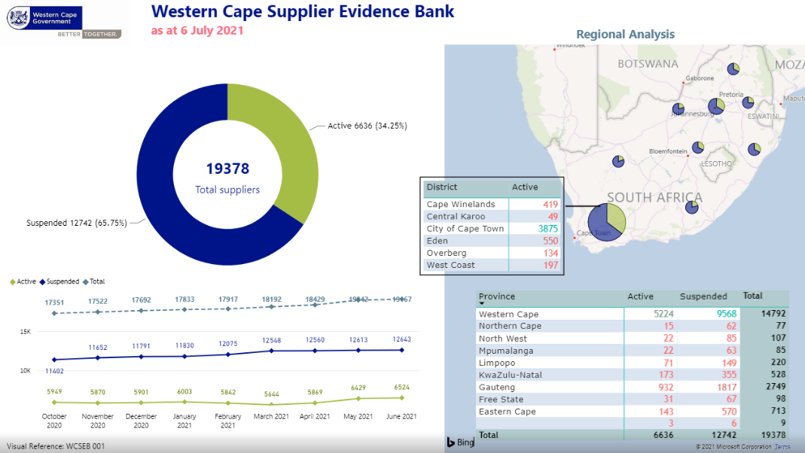
Supplier Spread that want to engage in Procurement with WCG

Slide 13
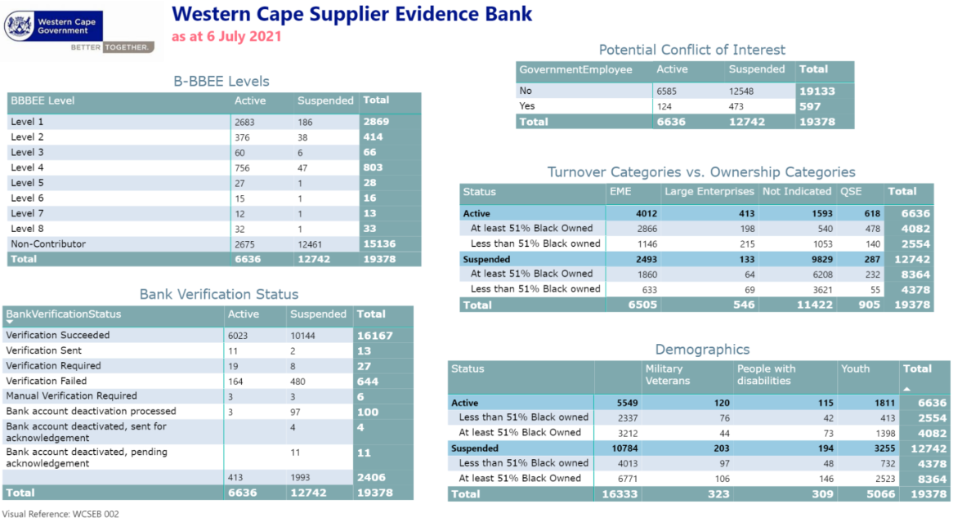
Database Information sets

Slide 14
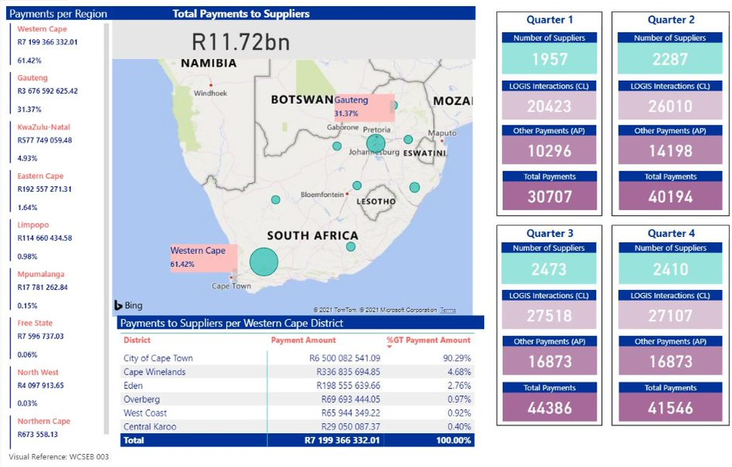
Procurement Regional Spend 2020-21

Slide 15
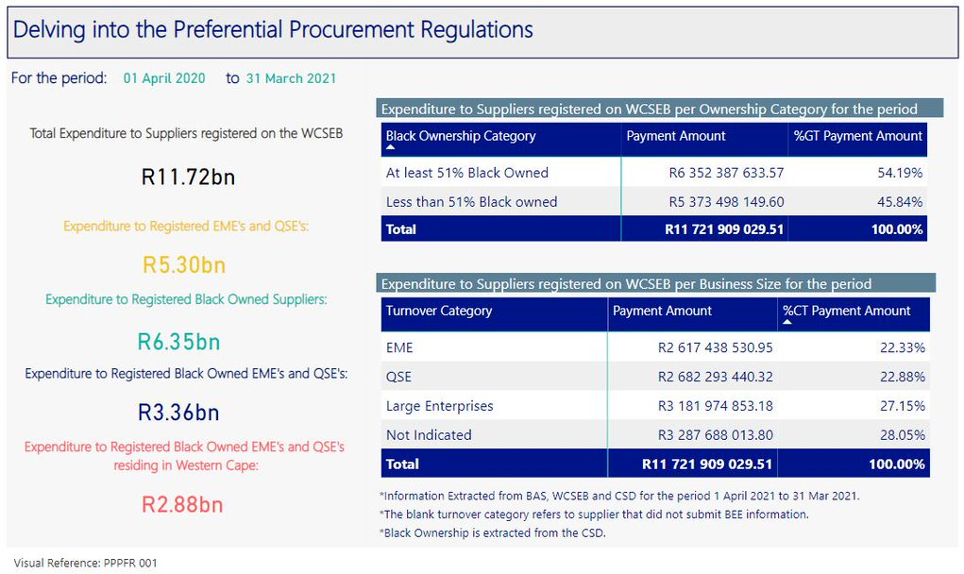
Preferential Procurement
1 April 2020-31 March 2021

Slide 16
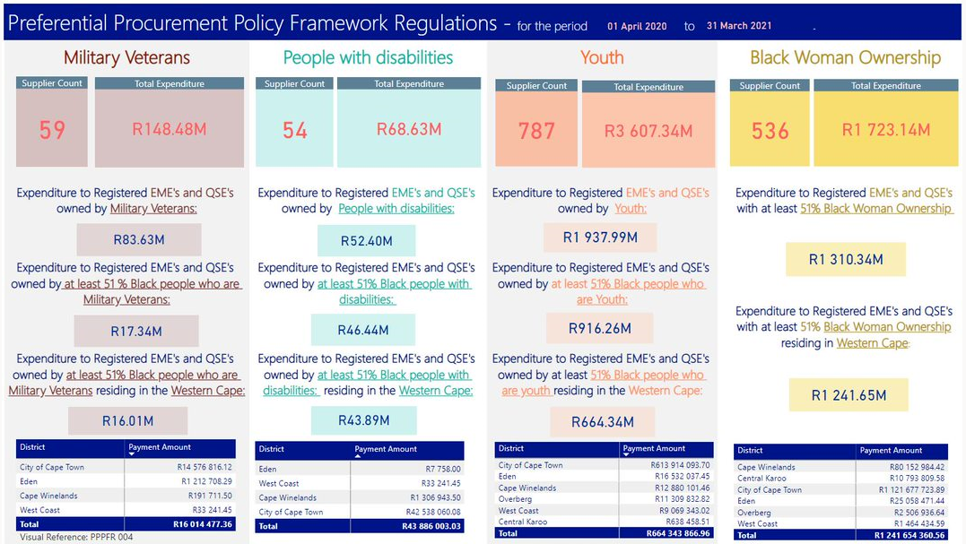
PPPFR- cont

Slide 17
2. BROADER WCG ECONOMIC RESPONSE AND WAY FORWARD

Slide 18
DEDAT - SMALL BUSINESS SUPPORT INTERVENTIONS
SMME Booster Fund – In partnership with SMME support organisations and municipalities provide support and assistance (directly or indirectly) to SMMEs to maintain and/or enhance sustainability, develop the capacity of the business and/or the owner/entrepreneur with the objective to grow, expand and create jobs over time.
COVID-19 Business Relief Fund to alleviate the economic impact on small and micro enterprises (formal and informal) operating in the Western Cape caused by COVID-19.
COVID-19 Supplier Development Programme - to increase the capacity and ability of micro and small businesses who manufacture cloth masks, hand sanitisers, sanitiser dispensers (e.g., foot operated dispenser) and those that provide disinfecting services.
Long Street Kiosks – 12 month rent free trading space for micro businesses
Western Cape Entrepreneurship Recognition Awards - recognise and support the province’s most deserving and inspiring, high-potential entrepreneurs (increased entrepreneurship awareness and inculcates a culture of entrepreneurship).
Pick n Pay Market Store initiative - the conversion of existing spaza shops within townships into independently owned mini supermarkets.

Slide 19

WAY FORWARD
  The current projects implemented by the DEDAT is focused on the long-term sustainability and growth of SMMEs thereby creating access to economic opportunities for SMMEs – this links directly to the objectives of the Economic Procurement Strategy
  The embedded Good Governance, Supplier Support, Data Integrity Enhancements and Electronic Procurement Enhancement implemented by the Provincial Treasury paves the way for the seamless implementation of the Economic Procurement Strategy and Implementation Plan by all departments to the benefit of SMMEs and the broader citizens
  The intent is to relook at the Strategy going forward to align to current economic context (Economic Recovery Plan post Covid-19 analysis) in view of further refinements to the Strategy.

Slide 20
TMS Chase

