Slide 1
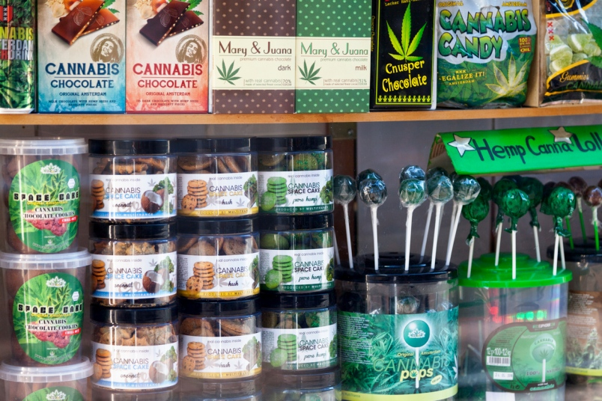
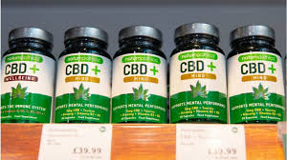
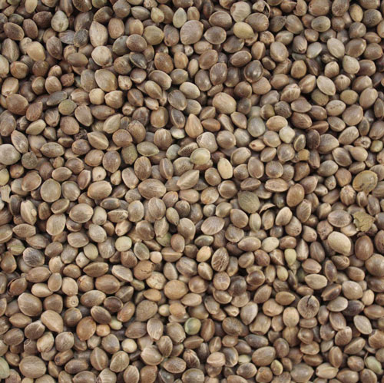
NATIONAL CANNABIS MASTER PLAN FOR SOUTH AFRICA
PRESENTATION TO THE PORTFOLIO COMMITTEE ON JUSTICE AND CORRECTIONAL SERVICES
25 AUGUST 2021

Slide 2
Purpose
PURPOSE OF THE PRESENTATION
Present an integrated government approach towards unlocking the economic potential of hemp and dagga in South Africa.
Provides an update on
Progress made in the development of Cannabis Master Plan
Analyses of various Cannabis value chains
Investment opportunities in the Cannabis industry (dagga and hemp)
Clarify the roles and responsibilities of all social partners; that is business, labour, communities and government.

Slide 3
BACKGROUND
Cabinet took a decision in July 2019 that South Africa needs a national strategy for industrialisation and commercialisation of Cannabis in order to increase economic growth, create jobs and poverty alleviation. The Minister of Agriculture, Land Reform and Rural Development was appointed as the convener of this process.
The Inter-departmental Committee was established to guide the development of the National Cannabis Master Plan. This committee is composed of representatives from departments like Health, Justice, DALRRD, Small Business Development; Science and Innovation; DTIC; Presidency; and SAPS. Representatives of state owned entities like SAHPRA, ARC, CSIR, and some universities were also co-opted into the committee.
The scope of the master plan includes both hemp and dagga (marijuana).
Lessons were learnt from major Cannabis producing countries in the world which include Canada, Portugal, Uruguay, Spain, USA, China, Mexico, etc.
Experiences from other countries on the African continent were taken into consideration. These include Nigeria, Ethiopia, Egypt, DRC, Tanzania and Kenya. Lesotho had also started issuing licenses for medicinal Cannabis.
South Africa also experienced instances where rural communities had been cultivating and selling dagga for hundreds of years in South Africa, even though it was illegal to do so. Dagga contributed to improved livelihoods at household levels as well as economic development of those communities. The dagga was sold mostly for recreational purposes in large cities and towns. There are reports that some of this dagga is been exported illegally out of this country.

Slide 4
RATIONALE
Establishment of the Cannabis industry will lead to diversification of the economy and thus increase economic growth, create jobs and for poverty alleviation.
The potential size of the Cannabis industry in South Africa is estimated at about R 28 billion. It is estimated that it can create between 10 000 to 25 000 jobs across the entire value chain.
The Cannabis sector also has huge potential in terms of development of SMMEs; attracting domestic and foreign investment; value addition in processing and manufacturing of various products for local and export markets.

Slide 5
IMPORTANCE OF CANNABIS
MEDICINE
Critical active ingredients: CBD and THC
Diseases and ailments that can be treated:
Chronic pain
Asthma and TB
Glaucoma
Epilepsy
Cancer
Arthritis
Appetite
Covid 19 virus ????
FOOD
Fastest and largest growing sector
Both seeds and leaves are used for food and beverages.
Products:
Hemp meal
Baking
Sweets and gummies
Energy drinks
Cookies and muffins
Ice-creams
Animal feeds
INDUSTRIAL
Almost all parts of the plants are used: stalks, seeds and leaves.
Products:
Textiles, clothing, shoes, etc.
Building material: bricks and ceiling boards, paints, etc.
Cosmetics
RECREATIONAL
Critical active ingredient is the THC in leaves and flower buds.
Consumed through all kinds of smoking.
Purpose:
Relaxation
Good mood
Creativity
Religious

Slide 6
CHALLENGES FACING THE CANNABIS SECTOR
Legislative restrictions
No formal seed supply systems
High entry barriers
Negative public perceptions
Lack of manufacturing capacity.
Limited investments in research and technology development programmes for Cannabis
Highly fragmented sector
Proliferation of illegal products
Market challenges
Threat of takeover or dominance by big corporations and pharmacy groups with big money .

Slide 7
CURRENT LEGAL STATUS
There are two pieces of legislation that regulates Cannabis and related matters:
Drugs and Drug Trafficking Act
The Medicines and Related Substances Control Act
The Schedules in the Medicines and Related Substances Control Act had been amended to reschedule Cannabis and its compounds.
Challenges still remain with regard to the Drugs and Drug Trafficking Act.
The Regulations of the Plant Improvement Act had been amended to provide for the regulation of hemp.
There is work been done on the Plant Breeders Rights Act to provide for the protection of intellectual properties.
South Africa may have to develop a new policy and legislation to provide for commercialisation of Cannabis.

Slide 8
NATIONAL CANNABIS MASTER PLAN FRAMEWORK
The Master Plan is aimed at providing a framework for the establishment, growth and development of the Cannabis industry in South Africa in order to contribute to economic growth, poverty alleviation and job creation
OBJECTIVES
Increase the volumes and variety of Cannabis products destined for both local and export markets.
Establish and increase the capacity of South African farmers to produce dagga and hemp
Create opportunities for creation of small and medium size enterprises across the Cannabis value chain.
Replace imported Cannabis products with locally produced products.
Increase investments in research and technology development to support increased production, productivity and competitiveness of the Cannabis industry.
Establish and increase the manufacturing capacity of the South African Cannabis industry.
Development and maintenance of an effective regulatory system by strengthening law enforcement measures to deter the production, manufacturing and sale of Cannabis outside the legal framework.
1. EFFECTIVE REGULATORY SYSTEMS
2. SUSTAINABLE SEED SUPPLY SYSTEMS
3. RESEARCH AND TECHNOLOGY DEVELOPMENT
4. SUSTAINABLE PRODUCER SUPPORT SYSTEMS
5. MARKET DEVELOPMENT
6. SUPPLIER DELOPMENT SYSTEMS
7. MANUFACTURING AND PRODUCT DEVELOPMENT
8. EDUCATION AND TRAINING
9. COMMUNICATION AND AWARENESS

Slide 9
PILLAR1: EFFECTIVE REGULATORY SYSTEMS
The pillar focuses on developing a new regulatory framework for both hemp and dagga.. This might include amendment of existing legislation by removing existing constraints that are hindering commercialisation.
The Department of Health leads this pillar, supported by the Department of Justice and Correctional Services.
The key intervention measures regarding this pillar include the following:
Finalise the amendments to both the Drugs and Drugs Trafficking Act to remove the remaining restrictions that prohibits commercialisation of all aspects of the Cannabis value chain.
Develop a policy to provide a framework for development of a new regulatory system and related matters of the Cannabis industry in South Africa.
Develop a new legislation to regulate the commercialisation of Cannabis in South Africa.

Slide 10
PILLAR 2: SUSTAINABLE SEED SUPPLY SYSTEMS
The pillar will focus on production, processing, packaging and trade of seed and related products.
The Department of Agriculture, Land Reform and Rural Development lead this pillar, supported by the Department of Small Business Development.
The key intervention measures regarding this pillar include the following:
Compulsory registration. All companies and organisations involved in in breeding, multiplication and sale of Cannabis seed must be registered and have valid permits to conduct their activities.
Certification schemes. All Cannabis seed producers, packers and other role players will need to be included in a compulsory certification scheme. The schemes will ensure that all members comply with regulations regarding seed quality and all other related matters.
Import and export control systems. There is a need for import and export control systems and protocols for Cannabis seed to be developed and implemented.
Variety control and listing. All cultivars of dagga and hemp will undergo testing to ensure their distinctiveness, uniformity and stability before they are released for sale on the South African market.
Seed testing. Seed that is destined for export market as well as that for local markets will be tested for quality and viability. This is aimed at ensuring that only high quality seed is used locally as well as exported to other countries.

Slide 11
PILLAR 3: RESEARCH AND TECHNOLOGY DEVELOPMENT
The pillar will focus on supporting research and development programmes for the South African Cannabis industry. This will include breeding programmes, development of new technologies needed across the entire value chain.
The Department of Science and Innovation is the leader of this pillar, supported by the Department of Trade, Industry and Competition.
The key intervention measures in terms of this pillar are as follow:
Breeding of new cultivars for both marijuana and hemp. The main objective will be developing new cultivars that will be suitable for a wide range of production areas in South Africa as well as catering for the needs and preferences of consumers, users and manufacturers.
Product development. This relates to development of new products that can be produced from Cannabis. The products will be aimed at been used for food, medicine, beverages, textiles, construction material, cosmetics, etc.
Technology adoption. Increase and facilitate access by all farmers to all available technologies. This also include the promoting the Promote the use of high yielding cultivars.

Slide 12
PILLAR 4: PRODUCER SUPPORT SYSTEMS
The pillar will focus on mobilisation and supporting farmers to participate in the Cannabis value chains. This also involve the inclusion of current “illegal” dagga growers into the formal system.
The lead department will be Department of Agriculture, Land Reform and Rural Development supported by the Department of Small Business Development.
The key interventions in terms of this pillar are:
Technical support. The farmers will need to be supported in terms of cultivar choices, cultivation practices, pest and disease control, harvesting and post-harvest practices.
Financial support. There is a need for dedicated funding for farmers participating in the Cannabis industry. Financial support may in forms of grant funding, loans, equity, blended funding, etc.
Zoning. Areas where conditions are conducive for growing Cannabis should be identified and zoned. These areas should preferably be in those areas where poverty and unemployment high.

Slide 13
PILLAR 5: MARKET DEVELOPMENT
The pillar will focus on developing new domestic and export markets for the South African Cannabis industry.
The Department of Trade and Industry will lead this pillar supported by Department of Small Business Development.
The critical intervention measures in terms of this pillar include the following:
Facilitate the development of domestic market for Cannabis products.
Facilitate and co-ordinate the opening of export markets for South African Cannabis products
Facilitate public sector procurement of Cannabis products from resource poor farmers and manufacturers.
Facilitate the development of appropriate market support infrastructure like processing plants and storage facilities.
Development and implementation of incentive programmes to support the participation of resource poor suppliers in the local and export markets for Cannabis products

Slide 14
PILLAR 6: SUPPLIER DEVELOPMENT SYSTEMS
The pillar focuses on supporting a wide range of suppliers to participate in the Cannabis value chains in order to ensure sustainable growth and development of this industry.
The indigenous dagga growers and sellers should be included in the Cannabis value chains. The same also apply to new small-scale growers from other poverty stricken areas of the country.
The Department of Small Business Development leads the pillar, supported by the Department of Trade, Industry and Competition.
Key intervention measures in terms of this pillar are as follow:
Development and implementation of special incubation programmes for new suppliers.
Facilitating and supporting the development and signing of off-take agreements between growers of Cannabis and the manufacturers.
Providing advisory services to new and emerging suppliers in the Cannabis industry.

Slide 15
PILLAR 7: MANUFACTURING AND PRODUCT DEVELOPMENT
The pillar will focus on supporting the growth and development of the manufacturing sector for Cannabis products.
The Department of Trade, Industry and Competition leads this pillar supported by Department of Science and Innovation, and the Department of Small Business Development.
Key intervention measures include the following:
Infrastructure development. There is a need for investments in establishment of manufacturing plants that will be used for producing food, medicine, beverages and a whole of other value added products from raw material of both hemp and dagga. The investments will come from government, private sector, donors, and state owned entities.
Incentive programmes. Development and implementation of incentive programmes for development of new products from dagga and hemp.

Slide 16
PILLAR 8: EDUCATION AND TRAINING
The pillar is focused on providing a framework on education and training matters in support of the Cannabis industry. This pillar will be led by the Department of Higher Education and Training with the support of the Department of Basic Education; as well as the Department of Labour and Employment.
Some of the intervention measures under this pillar include the following:
Development and implementation of formal and informal training programmes on Cannabis related matters across its value chains.
Integration of Cannabis related matters in curricula of schools, colleges and universities.
Support Cannabis education and training programmes through the appropriate Sector Education and Training Authorities (SETAs).

Slide 17
PILLAR 9: COMMUNICATION AND AWARENESS
Cannabis had been shrouded in controversy for many years. The pillar is focused on communicating a clear and unambiguous message about the Cannabis industry and related matters to all stakeholders and the general public. This pillar will be led by the GCIS and supported by the Department of Communications; and communication units in sector departments. The pillar provides support to all other pillars.
Some of the intervention measures under this pillar include the following:
Development and implementation of information and awareness programmes. The core messages will be around demystifying some of the negative perceptions about hemp, dagga and their products.
Promote consumer education and awareness regarding regulatory matters in order to promote compliance to government legislation and root out wrong doers.

Slide 18
DEVELOPMENTAL PATHWAYS FOR CANNABIS
HEMP VALUE CHAIN
MEDICAL CANNABIS VALUE CHAIN
RECREATIONAL CANNABIS VALUE CHAIN

Slide 19
UNLOCKING THE HEMP VALUE CHAIN
PRODUCTION INPUTS
PRIMARY PRODUCTION
MANUFACTURING AND PRODUCT DEVELOPMENT
MARKETING
Breeding Companies
Seed Companies
Nurseries
Chemical Companies
Smallholder Growers
Commercial Growers
Contractors
Cosmetics and Body Care Products
Foods and Animal Feeds
Nutraceuticals
Beverages
Textiles
Building Material
Paper
Industrial Products
Local Markets
Export Markets

Slide 20
UNLOCKING THE MEDICINAL CANNABIS (DAGGA) VALUE CHAIN
PRODUCTION INPUTS
PRIMARY PRODUCTION
MANUFACTURING AND PRODUCT DEVELOPMENT
MARKETING
Breeding Companies
Seed Companies
Nurseries
Chemical Companies
Smallholder Growers
Commercial Growers
Contractors
Pharmaceuticals
Cannabis Oil
African Medicines
Foods
Nutraceuticals
Health Infused Products (Energy Drinks, Teas, etc.)
Cosmeceuticals
Industrial Products
Local Markets
Export Markets

Slide 21
UNLOCKING THE RECREATIONAL CANNABIS (DAGGA) VALUE CHAIN
PRODUCTION INPUTS
PRIMARY PRODUCTION
VALUE ADDITION
MARKETING
Breeding Companies
Seed Companies
Nurseries
Chemical Companies
Smallholder Growers
Own use
Not Allowed

Slide 22
MODEL FOR INCLUSION OF SMALLER GROWERS INTO HEMP AND DAGGA VALUE CHAINS
Govt provide seed & other production inputs
FARMER
Govt provide infrastructure & issues group permits
Private sector invest in manufacturing facilities
LOCAL MARKETS
FARMER
CENTRAL PROCESSING FACILITY
MANUFACTURERS OF VARIOUS PRODUCTS
Private sector provide market opportunities
FARMER
EXPORT MARKETS
FARMER
FARMER

Slide 23
CONSULTATION PROCESSES FOR THE CANNABIS MASTER PLAN
Version 5 National Cannabis Master Plan was endorsed by EXCO, Ministerial Advisory Committee and IMC to be subjected to consultation with key stakeholders, namely government, business, labour and communities.
During February to May 2021, consultation workshops were held with:
All provinces (Agriculture, Health and Economic Development)
Researchers and experts in Cannabis sector
COGTA and the National House of Traditional Leaders
SARS, IDC, ITAC, etc.
Departments of Social Development, as well as Higher Education and Training
Industry
Major issues raised thus far include:
Licensing challenges
Confusion regarding hemp permits
Illegal products on the local markets
High entry barriers
Inclusion of the current dagga growers and traders in the proposed Cannabis industry
Roles and responsibilities of provinces
The National Cannabis Master Plan was tabled at NEDLAC on 23 June 2021. The process of co-creation of content with all social partners is currently in progress.

Slide 24
IMPLEMENTATION AND MONITORING STRUCTURES
The following structures will be responsible for guiding and monitoring the implementation of the Master Plan:
Executive Oversight Committee. Will be responsible for providing high-level leadership and co-ordination of the Master Plan implementation and ensure shared ownership and accountability for outcomes and commitments amongst the social partners. Composed of line Ministers, Farmer Associations, Manufacturers, and Retailers.
Master Plan Task Teams. Will be responsible for supporting the implementation of various pillars of the master plan. They will be made up of representatives of sector departments, state owned entities, industry, and other social partners. The teams will report to the Executive Oversight Committee.
Provincial Cannabis Committees. Will be responsible for supporting the implementation of various pillars of the master plan. They will be made up of representatives of sector departments, state owned entities, industry, and other social partners. The teams will report to the Executive Oversight Committee.
Programme Management Office. Will be responsible for providing secretariat support to the Executive Oversight Committee and co-ordinate the work of the Master Plan Task Teams and Provincial Master Plan Committees.

Slide 25
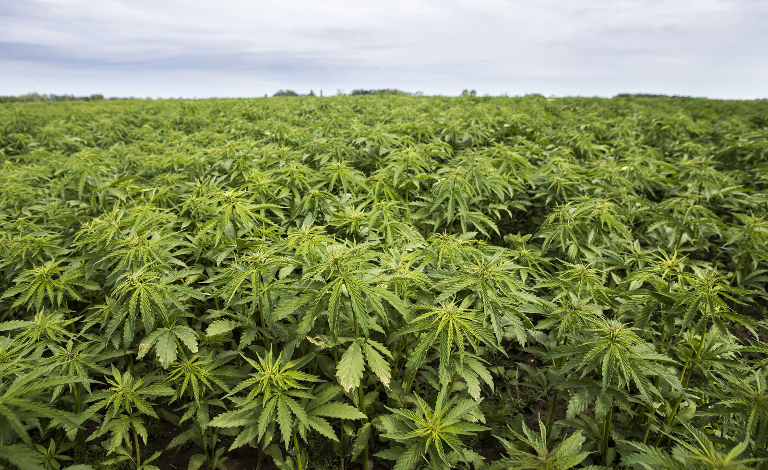
Thank You

