Slide 1
BRANCH:HRMD
Department of Public Service and Administration (DPSA)
1
“Growing South Africa together for a
capable and ethical Public Service”

Slide 2
Outline of the presentation
Purpose and Introduction
Pillar 1: Accountability, coordination and leadership
Key intervention
Key activities
Indicators
Background information
The establishment of mechanisms and processes to hold state and societal leadership accountable for taking a firm stand against GBVF
The challenges that hamper progress made in terms of the above, and steps taken or required to mitigate these
Conclusion

Slide 3
Purpose and Introduction
To respond to the two issues raised by the committee, namely;
The establishment of mechanisms and processes to hold state and societal leadership accountable for taking a firm stand against GBVF
The challenges that hamper progress made in terms of the above, and steps taken or required to mitigate these
The Public Service is the biggest employer in the country with approximately 1.3 million employees. It therefore it has the biggest responsibility to provide a workplace that is free from any form of violence.
The DPSA participates in three of the six pillars of the National Strategic Plan on Gender Based Violence and Femicide (NSP-GBV-F) that was developed by the resolution of the Presidential Summit on GBV-F held in November 2018:

Slide 4
Pillar 1: Accountability, coordination and leadership
Key intervention-Strengthen leadership and accountability across government and society to effectively respond to the GBVF crisis in a strategically and institutionally coherent way with adequate technical and financial resources.
Key activities:
Put mechanisms and processes in place to hold state and societal leadership accountable for taking a firm stand against GBV
Hold private and public sector accountable for the development and roll out of sexual harassment policies and workplace strategies
Indicators:
% workplaces that have Sexual harassment policies in place
% of private and public institutions reporting on implementation of sexual harassment policies in workplaces

Slide 5
Background information
The Public Service as a workplace is obligated to provide a safe, healthy and amicable working environment and shall take steps to maintain this, either by meeting legal obligations or in terms of what amounts to fair practice, therefore it shall neither permit nor condone sexual harassment. To this end, the DPSA Gender Equality Strategic Framework for the Public Service (GESF) provides a wide set of options for the transformation of the workplace premised on the promotion and protection of human dignity and the rights of women. It recognizes the role of government in promoting non-sexism and non-discrimination for employees in the Public Service.
In the monitoring tool of the GESF, departments are expected to plan on report on this under Strategic Objective 2: Adopt a wide set of options for organizational support in order to promote women’s empowerment and gender equality; Sub-Objective 4: Focus on sexual harassment, workplace gender based violence, work-life balance, provision of child care facilities.
Furthermore, DPSA developed the Policy and Procedure on the Management of Sexual Harassment in the Public Service (PPMSHPS) during 2013 with first implementation by April 2014. The purpose of this policy is to promote a workplace that is free of sexual harassment, sexual favours, intimidation and victimization, where the employer and employees respect one another’s integrity, dignity, privacy and the right to equality in the workplace. It also provides a systematic and consistent approach to managing sexual harassment and steps to be taken when sexual harassment occurs within the course and scope of the Public Service. Departments are required to annually report to the DPSA the number of cases reported and resolved amongst other information

Slide 6
The establishment of mechanisms and processes to hold state and societal leadership accountable for taking a firm stand against GBVF
Subsequent to the 2018 Summit on GBVF, DPSA made a concerted effort to improve the implementation of the existing policies and strategies (mentioned above and others), as these, if properly implemented will curb Sexual harassment in the work place (which is a form of Gender Based Violence and is prohibited whether it is based the grounds of sex, gender and/ or sexual orientation. Furthermore, Sexual Harassment is a form of sex discrimination that violates the rights of individuals and undermines the integrity of the employment relationship). DPSA is responsible for the monitoring of the Public Service and the DWYPD is responsible to monitor all sectors.
One of the major objectives of both monitoring and evaluation initiatives are to provide an evidence base for public resource allocation decisions and to help identify how challenges should be addressed and successes replicated. Government-wide monitoring and evaluation of any policy is, however, a very complex and time consuming process. The capacity constraints in most government departments, including the Chief Directorate: Transformation Programmes at DPSA has prompted the development of electronic templates to reduce the burden of collation, analysis and feedback, but also to improve the quality of reports submitted to DPSA. During 2018, the Public Service Women Management Week reporting template was changed to an electronic format and this was implemented with huge success, improving both the quality of data received and the feedback report to departments. Similarly, the annual reporting format for the PPMSH and the GESF has been converted to an electronic format.

Slide 7
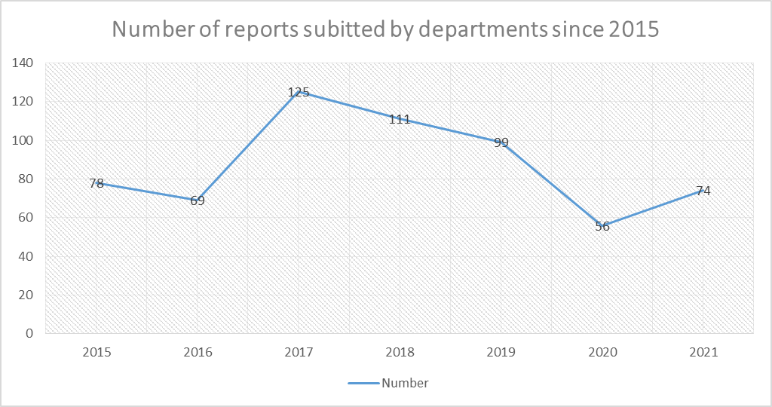
The establishment of mechanisms and processes to hold state and societal leadership accountable for taking a firm stand against GBVF
Submission of reports on the implementation of the Policy and Procedures on the Management of Sexual Harassment in the Public Service

Slide 8
The establishment of mechanisms and processes to hold state and societal leadership accountable for taking a firm stand against GBVF
Progress: - % workplaces that have Sexual harassment policies in place:
All departments either have drafts or approved policies and some have adopted the PPMSH in their departmental bargaining councils. 90% are aligned to the PPMSH.
35 sensitivity sessions were conducted by departments in 2019/2020 and 12 778 officials attended these sessions. The information is disaggregated by salary levels, age, race and gender.
33 departments reported that they have appointed sexual harassment advisors as required by the policy. There has not been any measure of what difference the appointment of the said advisors have made – this will be measured in due course.
40 cases were reported by departments and 19 cases were carried over from the previous year as they were not resolved.
In the Gender Mainstreaming Course offered by the NSG there is a section that focuses on Sexual harassment and up to date 6000 officials have been trained in all three spheres of government, but as at 1st April 2020, there is a stand-alone training programme based on the PPMSHPS policy that was developed by the NSG and up to date the course has been attended by 238 officials.
In August 2020, the NSG launched a specific training course on Gender Based Violence in collaboration with the Department of Women, Youth and Persons with Disabilities. The virtual sessions cover the following critical areas: Gender Mainstreaming in the Public Service; Gender Based Violence; and Gender Responsive Planning and Budgeting. To date eight training sessions have been rolled out and was attended by over 200 participants.
Progress: - % of private and public institutions reporting on implementation of sexual harassment policies in workplaces.
# Note the DWYPD is responsible for monitoring private sector – the progress reported is thus only for the Public Service which is where the mandate of DPSA resides.
•

Slide 9
The establishment of mechanisms and processes to hold state and societal leadership accountable for taking a firm stand against GBVF
To support and commit to the implementation of the ILO CONVENTION 190 theDeputy Minister Ms Sindisiwe Chikunga presented on behalf of the Public Service
We, the leaders of Government of the Republic of South Africa and the Public Service, Assembled on 2nd December 2020 commit to implement of the ILO Convention 190 to provide a work environment that doesn’t tolerate violence, including sexual harassment. Noting the following challenges of violence, harassment, including Gender Based Violence in the workplace: Despite having legislation and policies, violence, harassment, including GBV still remains high in the Public Service. Very few people report sexual harassment for fear of victimization and retaliation Will take the following interventions: Review the Policy and Procedures on the Management of Sexual Harassment in the Public Service to incorporate the issues raised in Convention 190 Support the implementation of Pillars 1 (PILLAR 1: accountability, coordination and leadership), 4 (response, care support and healing) and 5 (economic empowerment) of the National Strategic Plan on Gender Based Violence and Femicide Recognize that: Addressing gender-based violence and femicide in SA is a key national priority, including in the world of work; South Africa has embarked on an extensive process of consultation (code of good practice) South Africa is in the process of Ratifying ILO Convention (No.190) which puts clear responsibilities on all employers and all sectors to take concrete actions to respond to violence and harassment, including gender-based violence in the world of work, Pledge to take the call by the President to take the following 4 key actions to support these initiatives: Ensure the implementation of legislation and policies to prevent sexual harassment and GBV in the Public Service Conduct sessions to inform, educate and communicate policies and legislation on GBV and sexual harassment in the Public Service Protect victims of sexual harassment and GBV in the Public Service Offer psychosocial support to victims of sexual harassment and GBV in the Public Service

Slide 10
The challenges that hamper progress made in terms of the above, and steps taken or required to mitigate these
Poor submission rate of reports by departments
Inconsistent submission of reports by departments hamper comparative analysis of each department
Number of officials who underwent sensitivity training: very few departments conduct sessions, very few managers attend training sessions, the majority are below level 8, racial disaggregation also shows that very few white and Indian officials attend sessions, very few men attend these sessions, sometimes disaggregation is very poor and it’s difficult to understand who attended these sessions, some departments have never conducted a single session since 2015
Number of cases reported: very few cases are reported, and yet during face to face interaction with departments, officials will relate incidents of sexual harassment
Number of disciplinary cases arising from sexual harassment on PERSAL: departments will report that they have no cases and yet on PERSAL there will be a record of such cases, the highest are in the Departments of Education in all nine provinces
Number resolved: even when departments report cases, resolution takes very long some as long as a year.
Problems that hinder the conclusion of cases: lack of cooperation victims, witnesses and perpetrators, unavailability of presiding officers, insufficient evidence.
Despite having legislation and policies, violence, harassment, including GBV still remains high in the Public Service.
Very few people report sexual harassment for fear of victimization and retaliation

Slide 11
The challenges that hamper progress made in terms of the above, and steps taken or required to mitigate these
Planned interventions:
Letters have been sent to Head of Departments to request reasons for non-compliance, both in terms of reporting requirements and non-compliance to policy implementation. Responses on interventions from departments are currently being collected and documented.
New initiatives:
Review the Policy and Procedures on the Management of Sexual Harassment in the Public Service to incorporate the issues raised in ILO Convention 190.
Support the implementation of Pillars 1 (PILLAR 1: accountability, coordination and leadership), 4 (response, care support and healing) and 5 (economic empowerment) of the National Strategic Plan on Gender Based Violence and Femicide.
The DPSA is participating in the series of awareness webinars planned for Pillar 5.
The first two webinar was held on the 28th of April 2021 and the DPSA presented on the extent of sexual harassment in the Public Service.
The second one was held on 29 June 2021 with the theme “Young Women you are not on your own in challenging sexual harassment”.

Slide 12
Thank You

