Slide 1
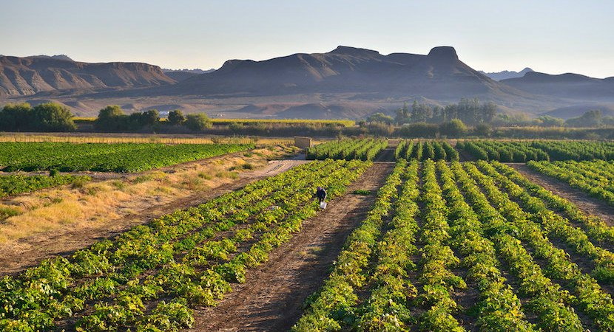
DEPARTMENT OF AGRICULTURE, LAND REFORM & RURAL DEVELOPMENT:
INPUTS ON CANNABIS FOR PRIVAE PURPOSES BILL
PORTFOLIO COMMITTEE ON JUSTICE AND CORRECTIONAL SERVICES
25 Aug 2021

Slide 2
TABLE OF CONTENTS
Purpose of the Bill
Selected Definitions
Cultivation Offences
Regulation
Repeal or amendment of laws
Alignment of the Bill with Policy Pronouncements
Other considerations
Concluding remarks

Slide 3
1. Purpose of the Bill
Provide the right to an adult person to possess, cultivate prescribed quantity of cannabis plants and consume cannabis
No Commercialization is intended
DALRRD Position: Cannabis Master Plan:
The purpose of the Master Plan is to provide a broad framework for the development and growth of the South African Cannabis industry in order to contribute to economic development, job creation, inclusive participation, rural development and poverty alleviation.
The Master Plan:
focuses on both Dagga and Hemp but mindful of the legislation which still prohibits commercialization of Dagga & Hemp.
Proposes a pillar to deal with the development of the appropriate legal framework

Slide 4
2. SELECTED DEFINITIONS
‘‘cannabis plant’’ means a plant of the genus Cannabis, but excludes hemp
‘‘hemp’’ means a plant of the genus Cannabis which—
(a) has a concentration of THC in the leaves and flowering heads that does not exceed the percentage as may be prescribed in terms of; and
(b) is cultivated under authority of, a law that regulates its cultivation;

Slide 5
2. DEFINITIONS cont.
DALRRD Position:
Hemp and dagga belong to the same species known as Cannabis sativa L. The difference between dagga and hemp is that dagga contains higher levels of the narcotic substance called tetrahydrocannabinol (THC), whereas hemp contains lower levels of this substance. The other difference is that hemp is generally growing taller whereas dagga plants grow short and bushy.
Agrees with the exclusion of hemp from the definition of “Cannabis” but it is not clear if hemp is equally excluded form the definition of “Cannabis plant.”
DALRRD has already developed regulation of hemp as an agricultural crop and defines hemp as:
“hemp” means low THC plants or parts of plants of Cannabis sativa L. cultivated for agricultural or industrial purposes, of which the leaves and flowering heads do not contain more than 0.2% THC;
When Regulations are developed for this Bill, the THC content must agree with what is provided for in the DALRRD Regulation & Medicines & Related Substances Act, 1965.

Slide 6
3. CULTIVATION OFFENCES
The Bill creates different classes of offences for cultivation depending on whether the material involved is Cannabis plant (Class C offence for an immature Cannabis plant) or Cannabis Cultivation material (Class D offence for a seedling)
The difference between immature Cannabis plant and seedlings (Cultivation material) is determined by length:
Immature Cannabis plants: taller than 15cm and wider than 15cm
seedlings (no taller than 15cm and not wider than 15 cm).
Manner of measurement is to be established through Regulation.

Slide 7
3. CULTIVATION OFFENCES
DALRRD Position:
More information on the science-based for the discriminatory measurements applied.
The Department of Justice & Correctional Services to consider that environmental conditions impact growth of Cannabis plants and it might be difficult to discriminate between growth stages based on plant length and width.
ARC and CSIR to be consulted during the development of the Regulations related to measurement of immature Cannabis plants and seedlings.

Slide 8
4. REGULATIONS
DALRRD Position:
DALRRD and Science Councils to be consulted on the following Regulations:
(a) the manner of measuring immature cannabis plants and seedlings as contemplated in section 1;
(b) the requirements or standards regarding the cultivation of cannabis plants in a private place for personal use as contemplated in section 3(2)(b);

Slide 9
5. Repeal or amendment of laws
The Bill amends Schedule 2 of the Drugs Act, 1992 Act (Parts II & III).
deleting “Dronabinol [transdelta-9-tetrahydrocannabinol]” from the schedule of Dangerous Dependence Producing Substances; and
Deleting “Cannabis” and “tetrahydrocannabinol” from the schedule of Undesirable Dependence producing substances.
DALRRD Position:
DALRRD has been engaging DoJCS on the amendment of the Schedules of the Drugs Act.
To date, this has not been possible due to constitutional challenges on the powers of the Minister to affect changes to Schedules.
The current amendment makes no contribution towards commercialisation since possession of Cannabis is limited to small quantities.

Slide 10
6. Alignment of the Bill with Policy Pronouncements
Mindful that the Bill aims to respond to the Prince judgement, it fails to establish a regulatory framework to:
Take into account the 2018 Job Summit Agreement to develop the Cannabis sector;
support the 2019 Cabinet decision to develop an Industrial Strategy for Cannabis;
Support the 2020 SONA pronouncement on the development of regulatory measures to “open up and regulate the commercial use of hemp products”

Slide 11
7. Other considerations:
Cannabis has an extended history amongst growers in EC & KZN and the associated traditional knowledge (medicinal & recreational purposes) is well-known.
Despite criminilisation, Cannabis remains the main cash crops in areas of KZN & EC. It is estimated that a typical Cannabis grower in Mpondoland generates an income of close to R30 000 per annum from half a hectare of cultivation.
It is therefore important that a comprehensive legal and policy framework be put in place to ensure that legalisation and formalization of the Cannabis industry do not lead to exclusion of these traditional growers.

Slide 12
8. CONCLUDING REMARKS
DALRRD
generally supports the Bill; but the Committee to seriously consider the opportunity to comprehensively deal with Cannabis commercialization;
seeks clarity on the areas identified; and
requests an opportunity to engage extensively on the development of the Regulations.

Slide 13
Thank You

