Slide 1
IMPLEMENTATION PROGRESS OF PILLAR 1 OF THE NATIONAL STRATEGIC PLAN ON GENDER BASED VIOLENCE AND FEMICIDE: ACCOUNTABILITY, LEADERSHIP AND COORDINATION )
Minister N Dlamini Zuma, MP 25 August 2021

Slide 2
INTRODUCTION
Thank you for the opportunity.
Today, marks almost 65 years since the approximately 20,000 fearless women who marched to the Union Buildings in Pretoria in defiance of the apartheid pass laws and demand for women’s rights to be recognized. Today we sadly still talk of violence against women.
We must intensify the fight for tougher gender-based violence laws, public awareness and access to legal protections for all women, especially the poor.
We need to capitalize on the District Development Model (DDM) as a vehicle to tackling this persistent challenge.

Slide 3
Our responsibilities - ACCOUNTABILITY, LEADERSHIP AND COORDINATION
We have aligned our Plans to the National Strategic Plan- Gender Based Violence and Femicide and committed on the following:
Put mechanisms and processes in place to hold state and societal leadership accountable for taking a firm stand against GBVF
Roll out of a national response to GBVF through provincial and local structures
Drive the National framework on municipal engagements with Civil Society Organisations
Effective multi-sectoral coordination by lead agency and collaboration across different tiers
Foster partnerships to respond to the crisis by locating the response in locally based structures, activism and agency within communities.

Slide 4
LOCALISING THE RESPONSE through the ddm approach
We committed to ensure that the DDM Framework Contains gender Responsive Indicators and Targets aligned to the GBVF- NSP and GRPBMEA
NSP
DDM
The DDM implementation framework was developed to guide the whole of government and society with a common approach in implementing the DDM.
DCOG through the Annual Performance Plan has incorporate GBVF indicators and targets based on the National Strategic Plan on Gender Based Violence and Femicide into the DDM Framework.
We are working with the Department of Women, Youth and Persons with Disabilities on the proposed indicators to be incorporated into the DDM Framework.
We continue to engage with the Commission for Gender equality on issues affecting communities.
IDP / One Plan
Enter your
text here
Ward Plans
In all 44 Districts and 8 Metros

Slide 5
LOCALISING THE RESPONSE through the DDM approach
The overall adoption of gender lens (gender mainstreaming) is critical in the development of municipal plans in order integrate NSP on GBVF priorities.
DCOG has partnered with the Department of Women, Youth and Persons with Disabilities to conduct provincial workshops with municipalities on the mainstreaming of the GBVF issues into the IDP and to sensitise municipalities on their role in the implementation of the NSP on GBVF and implications thereof on municipal planning. Workshops already conducted with Eastern Cape and KwaZulu Natal provinces.
Implementation of the GBVF NSP is also a standing item on the National Public Participation Coordinating Forum, and IGR structure established to support and monitor community participation in municipalities. Forum meetings are held quarterly, and all provinces are required to report on the implementation of GBVF activities by their municipalities and the support is provided accordingly.
The Department also provides direct support to provinces to customize performance indicators relating to the implementation of the NSP and inclusion thereof in their Annual Performance Plans.

Slide 6
Effective multi-sectoral coordination by lead agency and collaboration across different tiers of government
Two Provinces have been supported to prepare for the establishment of new ward committees following the 2021 Local Government Election. Upon establishment, ward committee members will be inducted on prevention and response to GBVF incidents.
Gauteng, Western Cape and Mpumalanga Provinces have already committed to include GBVF in ward committee induction as well as in ward operational plans. This will be reported on in the 2022/23 FY when the new ward committees have been established.
The GBVF feature on the GovChat App was launched on 8 March 2021 and to date, 51 GBVF related reports and 9 of those relating to domestic violence have been recorded. 50 requests for the GBVF Contact Centre details and 31 safe space ratings have been made through the platform.

Slide 7
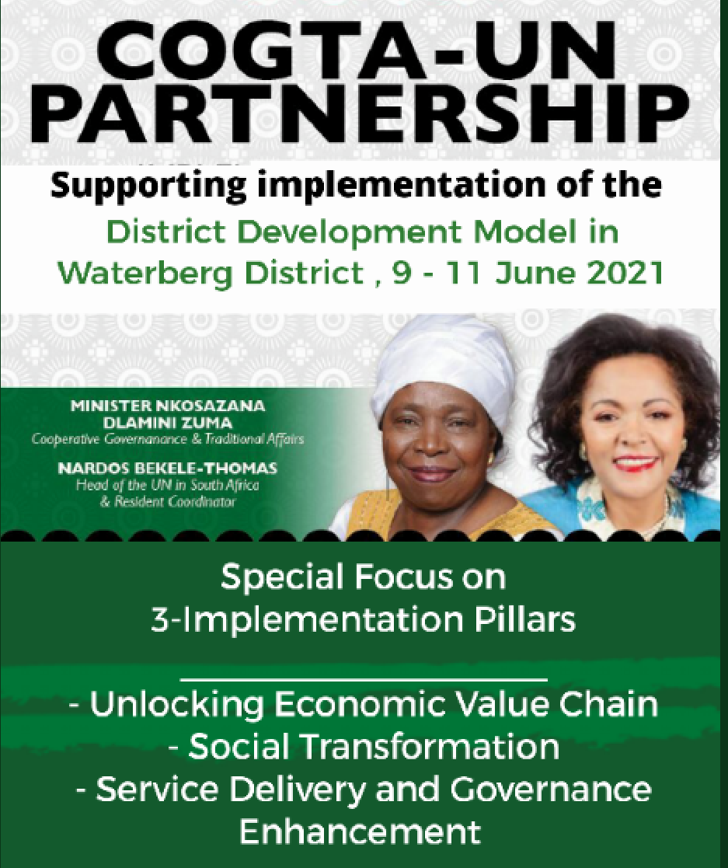
Fostering partnerships to respond to the GBVF
There are joint COGTA-UN extensive consultations in the three pilot districts in support of the implementation of the District Development Model (DDM) to understand their development priorities. The partnership has identified specific areas of support that the UN can provide to the districts.
The partnership has developed district-specific implementation plans based on three interrelated pillars:
Unlocking Economic Value Chains, which will provide opportunities for inclusive and sustainable growth;
Social Transformation, which is intended to result in increased stakeholder commitment; and Advocacy in Gender-Based Violence and Femicide.
Service Delivery Enhancement will focus on resuscitating and restructuring entities such as the Thusong Centres.

Slide 8
Community work programme activities on Gender based violence
Name of Province | Activities
Eastern Cape | “Football For Youth”. The programme is also used to spread the message and awareness to our youth about GBVs and to refrain from such activities Male youth are also encouraged to refrain from abusive activities and to respect women. They are also encouraged to report such activities whenever they see them happening. The Football For Youth programme also encourages youth to stay away from alcohol and drug abuse which are regarded as some of the main cause of GBV. In the Eastern Cape the programme is active is the following areas; Ntabankulu, KSD, Amatlhatsi and Ngquza Hill. Under Enoch Mgijimi, through partnerships, Nokulunga NGO under Social Development trained 50 participants on GBV.
Limpopo | There is implementation of Football For Youth programme in Limpopo. But the programme is still implemented at the schools level in Sekhukhune District As the programme grow it’ll also be taken to the broader community where CWP participants and other community members will also participates in sports as in the Eastern Cape to encourage community members to refrain from GBV Youth in Limpopo will also be encouraged through the programme to stay away from alcohol and drug abuse which are regarded as some of the main cause of GBV.

Slide 9
Community work programme activities on Gender based violence
Name of Province | Activities
Free State | The following are the partnerships in Mangaung specifically on addressing issues around Gender Based Violence and Child Welfare. T.A.W.A- Tshireletso Against Women Abuse Child Welfare – Bloemfontein Branch Extended Territories (AGS Church) The Female participants who were trained on Gender based Equality will be conducting awareness campaigns in and around their communities as well as in community clinics. These campaigns are designed to create awareness around gender inequality and gender based violence. There was an event on the 19 August in Dewetsdorp to commemorate Women’s month. This even was appropriately named “ Beyond the dent” ( I am a woman of infinite worth) and was aimed at encouraging women who might have had a tough time in life and had to bounce back to remain resilient, consistent and focused during these rough patches in life.
Gauteng | There is a programme called “Survival Centre” in Randfontein This is a programme led by a group of about 15 female participants They provide support and counselling to victims of GBV, predominantly women They also work with SAPS to identify victims and also encourage them to open cases when they become victims of GBV This programme was formed due to a lack of support in the area Men’s Forum in Munsieville This is the forum formed by about 20-30 men within CWP programme They conduct workshops to educate and encourage men against GBV They also provide counselling to victims of GBV and assist in referring them to the right structures to get further assistance.

Slide 10
Community work programme activities on Gender based violence
Name of Province | Activities
KwaZulu Natal | A community dialogue (workshop) on Gender-based violence and equality on the 23rd of September 2020 at Clydesdale Community Hall in UMzimkhulu, Harry Gwala district as part of piloting this initiative. Four sites attended and participated namely Dr. Nkosazana Dlamini Zulu, Kokstad, Ubuhlebezwe and the host UMzimkhulu. The event was supported by stakeholders from the local community inclusive of the councillors, Provincial COGTA and Department of Communications, Pastors, municipality, and organizations working on gender-based violence. In partnership with Solidarity Fund the KZN CWP implemented the second leg of GBV initiative in the same district on the 18th- 19th July 2021, wherein two information dissemination and sharing workshops were undertaken. The project seeks to promote access to information at a local level gender-based violence related social services. Having noted how lack of information perpetuates the abuse of women and children, it becomes imperative to ensure as much of the society should be aware of where to get assistance whenever they require such services or they could refer a victim.

Slide 11
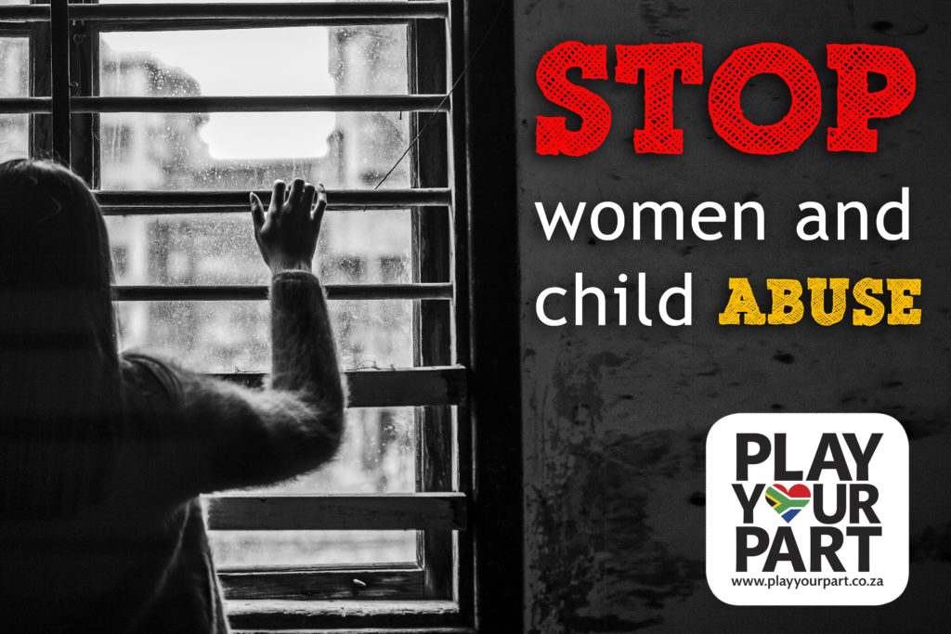
Conclusion
As we recalibrate our resolve to fight the GBVF, let us religiously work together to observe the preventative measures because we can only win this as we join hands in the spirit of the DDM Approach

