Slide 1
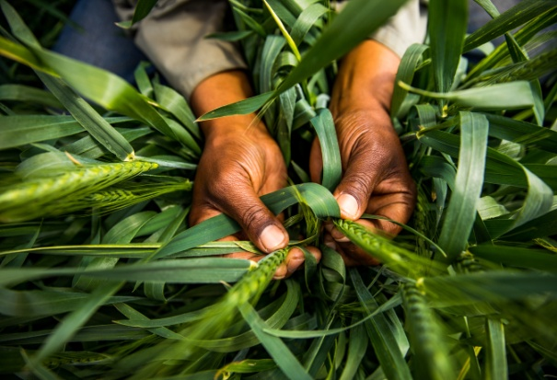
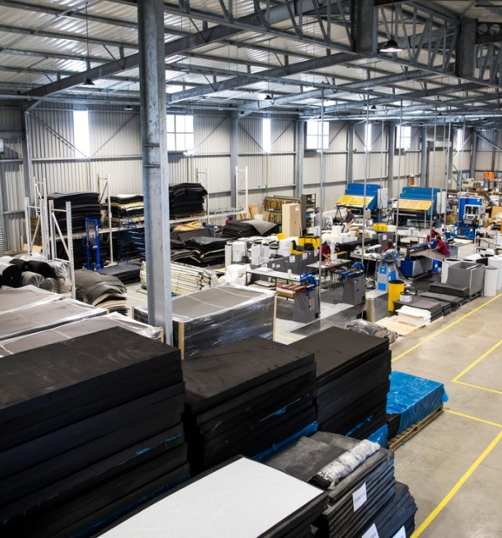
BUSINESS RECOVERY PROGRAMME
INFORMAL TRADERS SUPPORT PROGRAMME
PREPARED BY: DSBD PORTFOLIO
PREPARED FOR: PORTFOLIO COMMITTEE
DATE: 25 AUGUST 2021

Slide 2
Presentation Outline
1. | Purpose
2. | Background
3. | Business Recovery Programme focus areas
4. | Informal Traders Support Programme
5. | Interim Relief Measures
6. | Sefa Funded Clients
7. | Update on the Business Recovery Package

Slide 3
PURPOSE
To inform the Portfolio Committee on:
The impact of the recent looting and unrest
The initiatives put in place to support formal and informal businesses through the Department of Small Business Development and its agency's the Small Enterprise Development Agency (Seda) and the Small Enterprise Finance Agency (sefa) to ensure stabilization of the economy

Slide 4
BACKGROUND
SMMEs in both the informal and formal sector who operate in the affected provinces and cities have been affected by the recent riots and looting.
SMMEs across all sectors who have retail, production or office space in the city streets and malls have had their goods and equipment looted and or damaged.
The Impact is not only on the informal and formal SMME retail sector, but even in all other sectors including the services sectors whereby either equipment has been looted and or damage as well as the damage to property.
In addition, taverns and shebeens which were closed due to the level 4 restrictions, have suffered with their alcohol stock being looted
Destruction of the business infrastructure has been severe. We need to mobilize resources to restore law and order in order to protect property and safeguard economic infrastructure.
Disruptions in the supply chains more especially in cases where stock is not able to reach shelves, Informal businesses not able to ply their trade resulting in loss of income to SMMEs, this will lead to increased poverty, unemployment and decrease in the growth of the GDP.

Slide 5
BACKGROUND
ECONOMIC CONSIDERATIONS: THE COMPOUNDING ECONOMIC PROBLEM
A fragile pre-COVID-19 base
low economic growth rates
Unemployment,
Poverty,
Inequality
formal employment
Implications
An increasing need for social security amid the existing fiscal pressures.
Compounded health problems in the coming few weeks (the stalled vaccine rollout and new infections)
Delayed economic recovery - Borrowing from the recent (March 2021) IMF study;
GDP will likely remain about a %point below year-on-year, until 1.5 years after protests.
An average social unrest episode causes a 1.4 %point drop in returns over a two-week event window.
Emerging protest-induced considerations
Ransacked malls and shopping centers (investor sentiment)
Destruction of infrastructure
Restricted Mobility & burned trucks ( impact on supplies)
Looting (Further decimation of businesses, especially those that do not have business insurance)
More job losses
A likely surge in informal employment
Hard Lockdown: The economy is still reeling from the 2020 hard lockdown
Lockdown level 4 when unrest erupted
Trade: Restricted businesses operations - 20h00
Prohibition of sit-down meals
Prohibition of liquor sales
Tourism: Prohibition of leisure travel in and out of Gauteng
The cross-cutting limit to 50% occupancy of floor space, including employees.

Slide 6
BACKGROUND
According to the South African Property Owners Association (SAPOA) and Business Leadership South Africa (BLSA), the estimated cost of the recent violent protests on the economy of KwaZulu Natal & Gauteng is as follows:
R1.5 billion in stock has been lost.
Damage to the tune of R15 billion recorded on property and equipment.
More than 800 retail stores were looted and 100 were completely burnt.
This has impacted negatively on about 50 000 informal traders and 40 000 businesses. To date 150 000 jobs are reported to be at risk.
This necessitates the introduction of formal and informal sectors business recovery support packages to accelerate business and economic recovery with a view to curb job loses as well as business closure.

Slide 7
BUSINESS RECOVERY PROGRAMME
The Business Recovery Support Programme will focus on the following:
Uninsured small enterprises impacted negatively by the unrest predominantly in KwaZulu Natal and Gauteng provinces.
Small enterprises which require funding for working capital (including stock), equipment (including delivery vehicles) and furniture as well as fittings.
Small enterprises with existing funding from other lenders will still be considered.

Slide 8
FINANCIAL SUPPORT
The programme offers the following financial support:
Blended Finance which is a combination of a grant (60%) and a loan (40%).
Interest rate on the loan component is limited to 5%.
Initial payment moratorium of up to maximum of 12 months for small enterprises in KwaZulu Natal and Gauteng and six (6) months for other Provinces.
Repayment period of a maximum of 60 months.
Maximum funding accessible per entity is R2 million.

Slide 9
NON-FINANCIAL SUPPORT (BDS)
Pre investment
Small enterprises will be assisted by Small Enterprise Development Agency to package their funding applications.
Post investment
The programme through the Small Enterprise Development Agency will offer customised Business Development Support based on the needs of the small enterprises.

Slide 10
CRITERIA
The small enterprise must be negatively affected by the unrest that took place in July 2021 (SAPS case number to be submitted).
Be a registered legal entity in South Africa (CIPC).
Be a 100% owned by South African citizens.
Have been in operation as at 30 June 2021 (Bank statements to prove operations)
Be registered and compliant with the South African Revenue Service.
Be registered on the National SMME Database – https://smmesa.gov.za
Preference will be given to businesses in KwaZulu Natal and Gauteng.
Affidavit confirming that the business is not insured (the conditional grant provided in the scheme will be converted into a loan should the business benefit from insurance post approval).
Informal businesses are excluded since there is a dedicated support package for them (Informal Traders Support Package).

Slide 11
FUNDING REQUIREMENTS
FICA documents (e.g Municipal accounts, etc);
Certified ID copies of Directors/Members;
3 months bank Statements;
Latest Annual Financial Statements;
Three (3) years Cash Flow Projections (with clear assumptions);
Copy of Lease Agreement or Proof of Ownership;
Facility Statements of Other Funders - where applicable;
Quotations for applied funding; and
Detailed break down on application of funds including salaries, rent etc.

Slide 12
IMPLEMENTATION PROCESS
Applications are submitted to BRP@sefa.org.za.
Funding queries can be directed to BRP Hotline on 0860 663 7867 or email: info@dsbd.gov.za.
Upon receipt of the applications, they are reviewed and completed applications are subjected to due diligence exercises and subsequently submitted to sefa for approval.
Follow ups are made with SMMEs whose funding applications are incomplete to submit the outstanding information.
SMMEs that require non-financial support are referred to Seda for further handling.

Slide 13
BUDGET IMPLICATIONS
Total budget available is R300 million secured through the reprioritization process.
Targeting 150 small businesses predominantly in KwaZulu-Natal and Gauteng.

Slide 14
INFORMAL TRADERS SUPPORT PROGRAMME

Slide 15
INFORMAL TRADERS SUPPORT PROGRAMME
The Programme is aimed at supporting informal and micro businesses in the informal sector following the unrest.
Provision of business focused support (financial and non-financial) through the Township and Rural Entrepreneurship Programme specifically the Fruit & Vegetable Vendors Scheme.
The Programme will support 17 667 entrepreneurs @ R3 000 each (as a once-off grant) amounting to a cumulative amount of R53 000 000 via the banking partners.
Business Development Support linked to the Programme will be coordinated through Seda.

Slide 16
CRITERIA
Must be a South African and must produce a valid South African ID document.
Should have a bank account in SA and those who do not have should be willing to be assisted to open and use an SA bank account.
No minimum turnover required for vendors.
Willing to participate in the DSBD/ Seda facilitated business development processes.
Preference will be given to businesses owned by women, youth and people with disabilities.
NB: Applying entities in this category need not be registered with CIPC and SARS due to their size and status of operations.

Slide 17
IMPLEMENTATION PROCESS
sefa and the nominated bank to enter an arrangement in terms of implementation of the Programme (such as the existing Nedbank agreement on the Fruit & Vegetable Vendors Scheme)
Applications to be done via the participating bank -Nedbank.
Nedbank will utilise the various Informal Traders Associations to package applications and verify the operations of the Informal Traders.
Disburse grant funding via Nedbank and Nedbank to provide periodic reporting to sefa on all disbused funds. Associations can submit their members applications on sefainformaltraders@nedbank.co.za
Seda to provide post funding support where necessary.

Slide 18
INTERIM RELIEF MEASURES
Implementation of moratorium on permits and business licences requirements.
The requirements for business permits and licences to be lifted until 31 December 2022.
This has the potential of reducing the cost of doing business for the period covered by the moratorium.
It is expected that the SMMEs including Co-operatives will plough back the money into their respective businesses (Acquire equipment or Stock).
However, SMMEs and Co-operatives will be encouraged to strive to comply with the Business Act.
Reduction of the cost of finance or borrowing for SMMEs and Co-operatives.
Considering the increase in the grant component and reduction in the debt component of the Blended Finance model to make funding more accessible to SMMEs and Co-operatives more especially those in the informal sector.

Slide 19
sefa FUNDED CLIENTS
sefa funded clients
 | Number of Companies Impacted | Economic Sectors | Business Insurance Cover | Total sefa Exposure
Gauteng | 6 | Food Retail (4), Fuel Retail (2) | All 6 are covered | R12 816 687.24
Kwa-Zulu Natal | 5 | Services (Eye care) (1) Food Restaurants (4) | All 5 are covered | R2 096 572.08
Total | 11 |  |  | R14 913 259.32

Slide 20
UPDATE ON THE BUSINESS RECOVERY SUPPORT
Information as at 20 August 2021
REGIONAL OFFICE | KwaZulu Natal | Gauteng South | Gauteng North | TOTAL
Total Number of applications received | 30 | 10 | 19 | 59
Total Value of applications received | R30 000 000 | R9 700 000 | R8 100 000 | R47 800 000
Total Number of applications being processed | 13 | 5 | 3 | 21
Total Value of applications being processed | R15 500 000 | R2 593 000 | R1 500 000 | R19 593 000
Projected approvals dates | 25-08-2021 | 25-08-2021 | 25-08-2021 | 25-08-2021

Slide 21
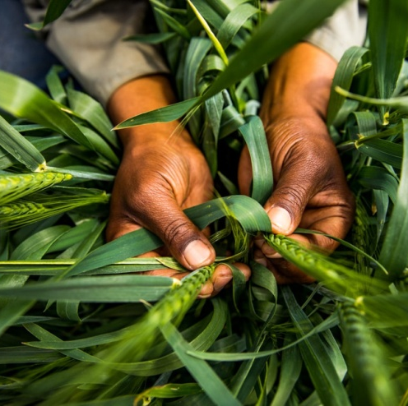
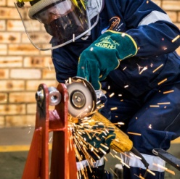
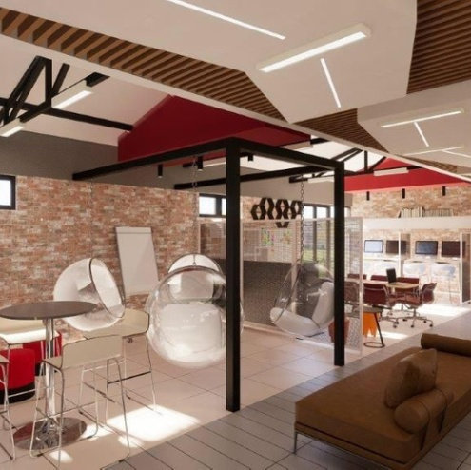
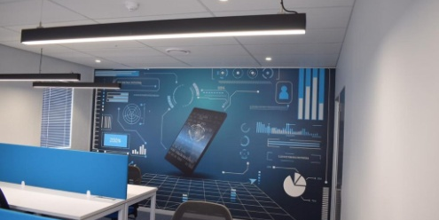
Thank You!

Slide 22
REACH OUT
Department of Small Business Development
77 Meintjies Street
Sunnyside
Pretoria
0001
+27 861 843 384
info@dsbd.gov.za
www.dsbd.gov.za
Small Enterprise Development Agency
The Fields, Office Block A
1066 Burnett Street
Hatfield
Pretoria
0833
+27 12 441 1000
info@seda.gov.za
www.seda.org.za
Small Enterprise Finance Agency
Byls Bridge Office Park, Cnr Olievenhoutbosch Street & Jean Avenue, Building 14 , Block D 11 Byls Bridge Boulevard Highveld Extension 73 Centurion
0157
+27 12 748 9600
helpline@sefa.org.za
www.sefa.org.za

