Slide 1
Update on Implementation of Online Learning Presentation to the Portfolio Committee on Basic Education 2021

Slide 2
PURPOSE
To provide an update on implementation of online learning in basic education.
2

Slide 3
PRESENTATION OUTLINE
Background
Remote Learning Interventions
Broadcasting (TV & Radio)
Woza Matric (Grade 12)
Tswelopele (Grade R – 11)
Zero-Rating of Educational Sites
Virtual Classroom Project
Online Content Resources Sources
Recommendation
3

Slide 4
BACKGROUND
The COVID-19 pandemic has adversely affected the basic education sector through inadvertent temporary school closures aimed at reducing the spread of the virus.
This is has been evident in the 1st , 2nd and 3rd COVID-19 wave.
Various remote learning interventions have been implemented by DBE, NECT, PEDs & partners to mitigate the impact of the pandemic on learning.
4

Slide 5
REMOTE LEARNING INTERVENTIONS
Remote learning interventions include:
Broadcasting (TV & Radio);
Zero-rating of educational sites;
Virtual Classrooms; and
Online Content & Support Resources – National & Provincial Educational portals, School websites, Educational Organisation portals.
5

Slide 6
BROADCASTING (TV & RADIO)
The DBE, in collaboration with NECT, are implementing the Remote Learning Programme.
Two (2) work-streams were set up:
Woza Matric Work-stream (Grade 12); and
Tswelopele Work-stream (Grade R – 11)
Woza Matrics and Tswelopele aim to support learning, exam preparations and catch up targeting 1.2 million learners, 50 000 teachers & parents.
Programme delivers lessons remotely via broadcasting (TV & Radio) & online platforms.
6

Slide 7
BROADCASTING (TV & RADIO)
7

Slide 8
WOZA MATRIC (GRADE 12) FLYER

Slide 9
WOZA MATRIC TV SCHEDULE (AUGUST/SEPTEMBER 2021 SABC 1, Openview Channel 122 & DStv Catch Up
9

Slide 10
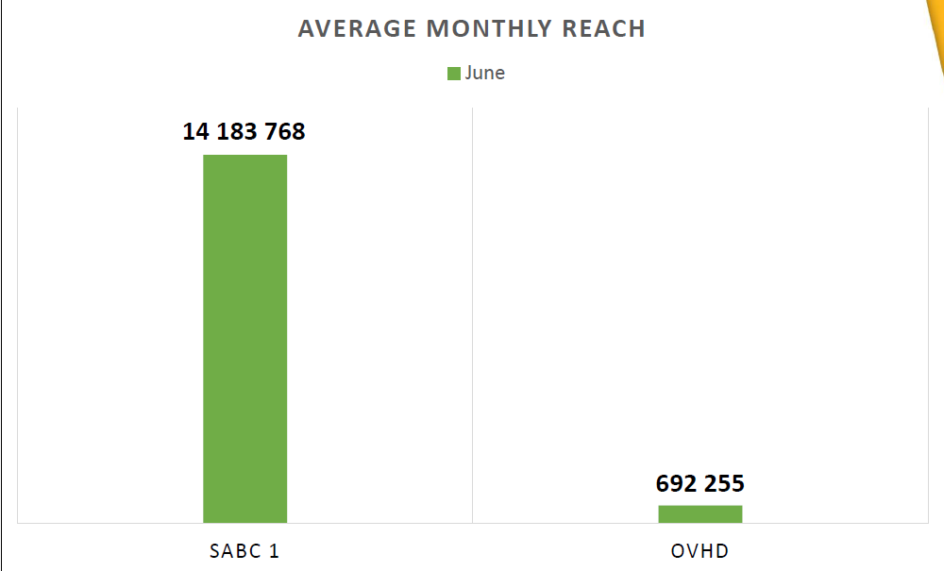
WOZA MATRIC AVERAGE MONTHLY REACH
10

Slide 11
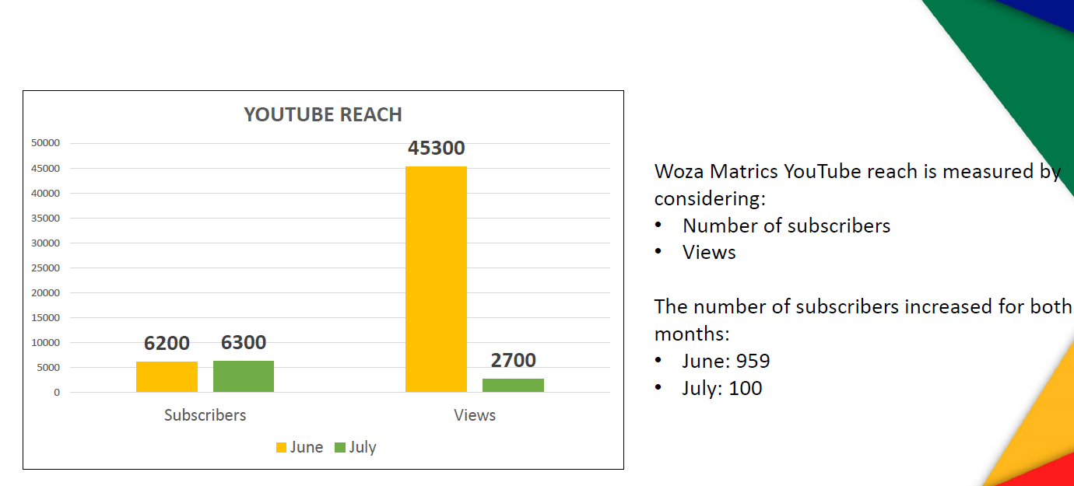
WOZA MATRICS YOUTUBE: SUBSRIBERS & VIEWS
11

Slide 12
TSWELOPELE (GRADE R – 11) FLYER

Slide 13
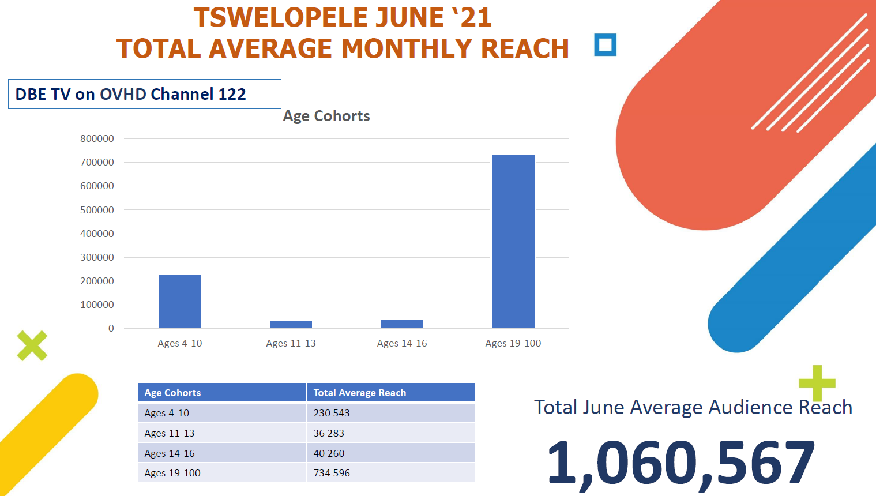
TSWELOPELE (GRADE R – 11) TOTAL AVERAGE MONTHLY REACH
13

Slide 14
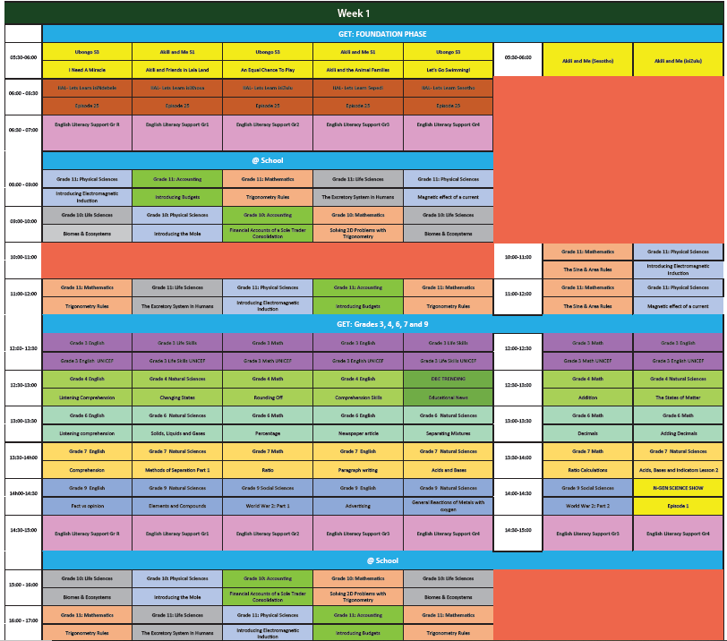
TSWELOPELE AUGUST DBETV SCHEDULE
14

Slide 15
RADIO LESSONS BROADCAST
Programme has targeted SABC and private community radio stations to broadcast lessons.
Limpopo Province: Munghana Lo Nene FM; Thobela FM and Phalapala FM Radio Stations;
Mpumalanga Province: Ikwekwezi FM; Pulpit FM; Ligwalagwala FM, Radio Laeveld; Radio Kragbron; Community Radio Stations; and Rise FM Radio Stations;
Eastern Cape Province: Umhlobo Wenene FM Radio Station; and
Other Provinces: Unspecified Radio Stations.
15

Slide 16
ZERO-RATING OF EDUCATIONAL WEBSITES
The Minister of Communication & Digital Technologies (DCDT) issued directions under regulation 10 (8) of the Regulations made under the Disaster Management Act, 2002 (Act No. 57 of 2002) as Government Notice No. 318 published in Government Gazette No. 43107 of 18 March 2020.
The directions require Electronic Communications Service Licensees such as MTN, Cell C, ISPA, Liquid Telecom, Rain, Telkom and Vodacom to “zero-rate” access to local education content websites.
16

Slide 17
ZERO-RATING OF EDUCATIONAL WEBSITES
Currently 487 educational websites including provincial & national education department portals, school website and free private sector portals have been recommended for zero-rating.
This enables learners, teacher and parents to accessing available free online educational resources, services and e-learning platforms for learning without incurring data costs.
The Updated Status Report of Zero-rated Educational Websites is published monthly on the DBE Website at https://www.education.gov.za/LinkClick.aspx?fileticket=8IJy9YJjbZE%3d&tabid=2587&portalid=0&mid=9122
17

Slide 18
VIRTUAL CLASSROOM (VC)
The Minister of Communications and Digital Technologies (DCDT) directed that school sites already connected with 10Mbps bandwidth be used to establish the virtual classrooms.
The virtual classroom lessons and teaching platforms should be broadcast live through various digital platforms such as TV, Smart Devices, Laptops, Mobile phones.
Commencement of Phase 1: Testing and piloting is delayed due to COVID-19 protocols.
168

Slide 19
VIRTUAL CLASSROOM (VC)
The Virtual Classroom Solution will:
Provide an interactive online education platform for educators and learners;
Enable users to create self-grading and interactive learning content that will lead to effective and efficient teaching and learning;
Be accessible to teachers and learners anywhere and anytime using different web-enable devices;
Equip learners with the 21st Century skills for the workplace; and
Support the emergence of a new type of school.
19

Slide 20
VIRTUAL CLASSROOM (VC)
On 17 April 2020, ICASA assigned the temporary radio frequency spectrum in the various bands, to the following Mobile Network Operators, namely:
Liquid Telecommunications Operations SA (Pty) Ltd;
Mobile Telecommunications Network SA (Pty) Ltd;
Rain Networks (Pty) Ltd;
Vodacom (Pty) Ltd; and
Telkom SA SOC Ltd.
The obligation will be implemented for a period of seventeen (17) months from the date of the installation of the complete solution.
20

Slide 21
VIRTUAL CLASSROOM SOLUTION
DBE, DCDT and ICASA identified 17 schools in the 8 NHI District to implement Phase 1 of the Virtual Classroom solution;
The number of schools allocated to each Mobile Network Operator (MNOs) are as follows:
Mobile Network Operators | Number of Schools | Number of school(s) per province
Vodacom | 6 | Three Schools Northern Cape Two Schools Limpopo One school in KwaZulu-Natal
MTN | 5 | Four Schools in Eastern Cape One school in North West
Telkom | 4 | Two schools in Free State Two schools in Mpumalanga
Liquid Telecom | 1 | One school in KwaZulu-Natal
Rain Networks | 1 | One school in North West
TOTAL | 17

Slide 22
LIST OF THE SELECTED SCHOOLS
# | SELECTED SCHOOLS | PROVINCE | Mobile Network Operator
1 | Alexandra High | KwaZulu Natal | Liquid Telkom
2 | St Paul John II | KwaZulu Natal | Vodacom
3 | Bukazi Secondary School | Eastern Cape | MTN
4 | Toli Senior Secondary School | Eastern Cape | MTN
5 | Dalibaso Senior Secondary School | Eastern Cape | MTN
6 | Qumbu Secondary School | Eastern Cape | MTN
7 | BA Seobi Secondary | North West | MTN
8 | Tshedimosetso Secondary | North West | Rain
9 | Tiisetsang Secondary School | Free State | Telkom
10 | Kgola-Thuto Secondary School | Free State | Telkom
11 | Methula Seconary School | Mpumalanga | Telkom
12 | Qhubulwazi Combined School | Mpumalanga | Telkom
13 | Hluvuka Secondary | Limpopo | Vodacom
14 | E.P.P. Mhinga Secondary | Limpopo | Vodacom
15 | Stenville Secondary School | Northern Cape | Vodacom
16 | Umso High School | Northern Cape | Vodacom
17 | Veritas High School | Northern Cape | Vodacom

Slide 23
COMPONENTS OF THE SOLUTION
The key components of the Virtual Classroom solution are as follows:
Virtual Classroom Platform as a software use;
Internet connectivity with requisite Bandwidth for teaching and learning;
Digital Education Content that will be shared through the Platform;
Available Hardware within the Virtual Classroom;
Teachers and learners devices; and
Data packages for learners and teachers use.
23

Slide 24
IMPLEMENTATION PLANS
The MNOs have submitted their implementation plans to the Department of Basic Education which include timeframes and targeted dates based on the following activities:
Assessment of the selected school(s);
Installation of the connectivity;
Rollout of ICT equipment to each school;
Demonstration of the LMS to DBE, PEDS, and schools;
Teacher training on how to use the solution;
Testing of the solution – dry run;
Launch of the project;
Monitoring and evaluation; and
Maintenance and support for 17 months.
24

Slide 25
PROGRESS WITH THE IMPLEMENTATION PLANS
ICASA, DCDT and DBE held a meeting with MTN, Vodacom, Telkom, Liquid Telkom and Rain officials on 01 July 2021 to discuss implementation of the Virtual Classroom solution;
MTN and Vodacom have submitted their implementation plans; and
Rain, Liquid Telkom and Telkom will be submitted their implementation plans on or before the 31 August 2021 to the DBE.
25

Slide 26
ONLINE CONTENT RESOURCE SUPPORT
The following portals provide access to free online content resources:
DBE website (zero-rated) at https://www.education.gov.za provides links to Learner Support Packages.
DBE and Bhelela partnership online portal (zero-rated) at http://dbecontent.bhelela.com provides access to state-owned e-textbooks, teacher guides, study guides, e-workbooks in PDF, ePub and HTML formats as well as other Open Education Resources (OER) such as PhET simulations, Apps, storybooks, encyclopaedia, Khan Academy videos.
Provincial e-Learning portals (zero-rated) provide access to free educational resources such as videos, apps, eBooks, courses etc.
26

Slide 27
DBE WEBSITE ONLINE CONTENT RESOURCES https://www.education.gov.za/covid19supportpackage.aspx
27

Slide 28
DBE/BHELELA ONLINE CONTENT RESOURCES http://dbecontent.bhelela.com
28

Slide 29
PED ONLINE CONTENT RESOURCES
PED e-Learning Portals & Platforms provide learners with free access to educational content resources such as video lessons, Apps, eBooks, interactive revision material, Assessment, ATPs. These included:
WCED ePortal at https://wcedeportal.co.za/;
GDE eContent platform at https://gdecontent.co.za/;
KZN DoE Funda e-learning solution at http://kznfunda.kzndoe.gov.za/; and
ECDOE Curriculum portal at https://www.eccurriculum.co.za/
29

Slide 30
PARTNER CONTENT RESOURCE SUPPORT
MTN Foundation and Siyavula Foundation Online High School Maths and Science Practice Platform (Zero-rated) at www.siyavula.com or Siyavula App provided learners with free access to Siyavula’s zero-rated online high school maths and science practice.
Vodacom Digital Classroom at htttp://www.digitalclassroom.co.za/digitalclassroom/ provides a comprehensive range of online educational resources in all subjects.
Telkom e-Education at https://www.bcxlearn.com/ provides multiple content packages for Grade 1 - 12 via “BCX Learn”.
30

Slide 31
RECOMMENDATION
It is recommended that the committee notes the progress on the implementation of online learning in basic education.
31

Slide 32
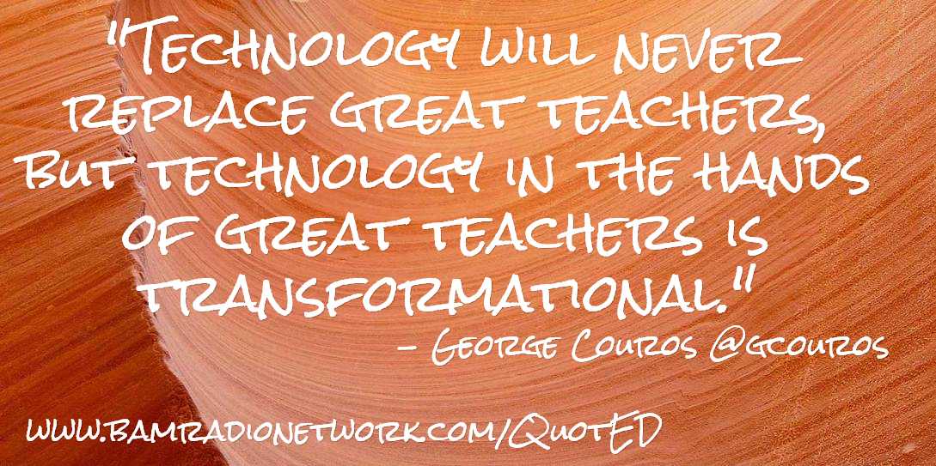
THANK YOU !!

